Slide 1
NORTHWIND ANALYTICS
Sales Analysis Project
Multi-Dimensional Business Intelligence · 1994 – 1997
Power BI Dashboard Suite · SQL EDA Analysis · 5 Business Domains
830
$1M
91
9
29
5
Total Orders
Total Revenue
Customers
Employees
Suppliers
Dashboards

Slide 2
Project Objective
What this analysis set out to answer
Analyse Northwind trading company (1994–1997) across 5 business domains using SQL + Power BI
Answer 15 structured EDA questions — Insight → Impact → Action format throughout
Build 5 interactive dashboards with cross-page navigation and year filtering
Produce 10 prioritised, data-driven business recommendations for leadership
91
830
9
77
29
Customers
Orders
Employees
Products
Suppliers
Business question approach: Insight → Impact → Action
Northwind Analytics · Sales Analysis Project · 1994–1997

Slide 3
Dataset Overview
Northwind Relational Database — 8 tables | Star / Snowflake Hybrid Schema
Table | Rows | Role | Key Fields
order_details | 2,155+ | FACT TABLE | OrderID, ProductID, Quantity, UnitPrice, Discount, Revenue
orders | 830 | Dimension | OrderID, CustomerID, EmployeeID, OrderDate, ShipDate
customers | 91 | Dimension | CustomerID, CompanyName, ContactTitle, Country
products | 77 | Dimension | ProductID, ProductName, CategoryID, SupplierID, UnitPrice
employees | 9 | Dimension | EmployeeID, Title, HireDate, Country
categories | 8 | Dimension | CategoryID, CategoryName
suppliers | 29 | Dimension | SupplierID, CompanyName, Country
shippers | 3 | Dimension | ShipperID, CompanyName
Northwind Analytics · Sales Analysis Project · 1994–1997

Slide 4
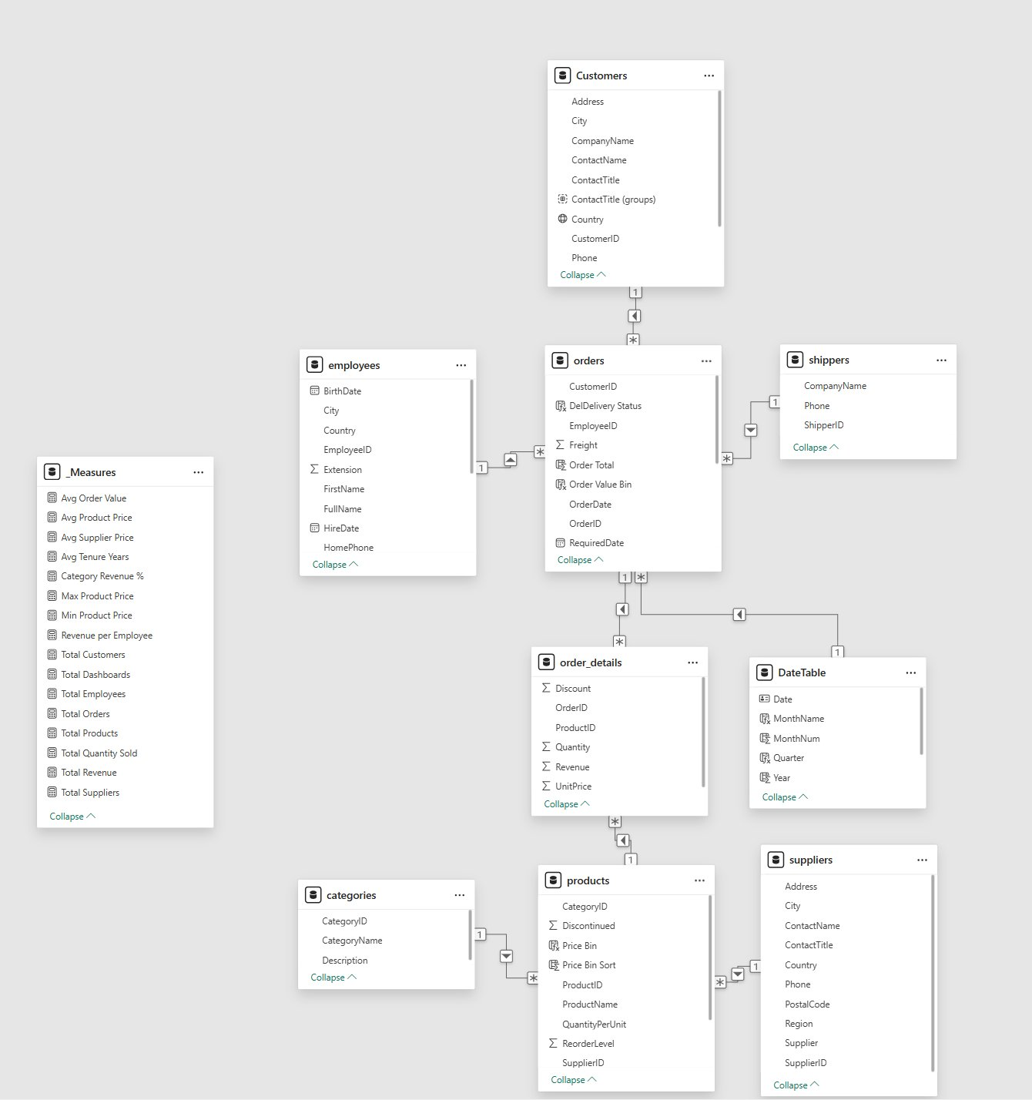
Data Model — Star Schema
Power BI Relationship Diagram | 1 Fact Table · 7 Dimensions · 14 DAX Measures
Schema Type
Star / Snowflake Hybrid
order_details → Central Fact Table
7 surrounding Dimension Tables
DAX Measures (_Measures Table)
Total Revenue, Avg Order Value, Avg Product Price
Revenue per Employee, Avg Tenure Years
Total Orders, Customers, Products, Suppliers
Category Revenue %, Max / Min Product Price
Total Dashboards, Total Quantity Sold
Key Computed Columns
Revenue = UnitPrice × Qty × (1 − Discount)
Order Value Bin & Price Bin (segmentation)
DateTable: Date, Month, Quarter, Year
DeliveryStatus, FullName, ContactTitle Groups
Northwind Analytics · Sales Analysis Project · 1994–1997

Slide 5
Data Preparation
SQL EDA + Power BI model readiness — key steps only
Removed Clutter
Null Handling
Power BI Enhancements
Binary BLOBs dropped (Photo, Picture columns)
Sparse Region column excluded from grouping
Redundant image fields removed from Customers
ShippedDate NULLs excluded from delivery duration
ReportsTo NULL = root node (Andrew Fuller, VP)
Discount = 0 treated as full-price, not missing
DateTable: Date, Month, Quarter, Year
Revenue = UnitPrice × Qty × (1−Discount)
Order Value Bin & Price Bin for segmentation
ContactTitle Groups, FullName, DeliveryStatus
14 DAX measures in _Measures table
Northwind Analytics · Sales Analysis Project · 1994–1997

Slide 6
Customer Analysis — Key Insights
91 Customers | 22 Countries | 830 Orders
91
22
45%
9.1
Customers
Countries
Sales Rep Contacts
Avg Orders/Customer
Geographic Distribution
Customer Segmentation
Germany & USA lead at 122 orders each — joint top markets by volume
France & Germany each have 11 customers — dense European presence
Brazil dominates South America with 83 orders
High-Value: ≥10 orders AND ≥$5K — drive disproportionate revenue
Big Spenders: <10 orders, ≥$5K — high margin, low frequency
Low-Value: Majority of customers — conversion opportunity
Northwind Analytics · Sales Analysis Project · 1994–1997

Slide 7
Order Performance — Key Insights
830 Orders | $1M Revenue | 51K Units Sold
830
$1M
$1,530
51K
Orders
Revenue
Avg Order Value
Units Sold
Revenue Breakdown
Order Trends & Distribution
Beverages: $270K (27%) + Dairy: $230K (23%) = ~50% of total revenue
Top 2 categories alone drive half the business
Germany & USA tied at 122 orders each — equal market dominance
Volume grew from ~20/month (Aug 1994) to ~75/month (May 1996) — 3.7× growth
Most orders cluster in $1K–$2.5K bin (273 orders) — the volume sweet spot
Only 10 orders exceeded $10K — premium segment is small but significant
Northwind Analytics · Sales Analysis Project · 1994–1997

Slide 8
Employee Analysis — Key Insights
9 Employees | 2 Countries | Avg Tenure 3.0 yrs
9
$233K
3.0 yrs
$111K
Employees
Top Performer
Avg Tenure
Rev / Employee
Revenue Performance
Team Structure
Peacock: $233K — Top performer, 3.4× more than Buchanan ($69K) at bottom
Top 3 (Peacock, Leverling, Davolio) = $628K — 63% of total employee revenue
Revenue gap signals territory/incentive imbalance, not capability alone
All hiring occurred 1992–1994 only — no workforce growth since
1 VP manages 8 staff directly — high span of control, unsustainable at scale
6 in Seattle, 3 in London — two-location workforce
Northwind Analytics · Sales Analysis Project · 1994–1997

Slide 9
Product Analysis — Key Insights
77 Products | 8 Categories | Avg Price $28.87
77
$28.87
8
35
Products
Avg Price
Categories
Items $26–$50
Top Products & Pricing
Anomalies & Demand
Côte de Blaye: ~$150K revenue — #1 product, high-price/low-volume outlier
Beverages leads both revenue ($270K) and quantity (~9.5K units)
35 products priced $26–$50 — most common pricing tier across catalogue
Most products cluster in low-revenue zone — long-tail concentration risk
Demand peaked mid-1996; Q4 consistently outperforms Q1 each year
Near-zero sales products identified — candidates for discontinuation
Northwind Analytics · Sales Analysis Project · 1994–1997

Slide 10
Supplier Analysis — Key Insights
29 Suppliers | 13 Countries | $1M Combined Revenue
29
13
$200K+
~$140
Suppliers
Countries
Top Supplier Rev
Highest Avg Price
Revenue & Product Distribution
Pricing & Risk
Aux joyeux ecclésiastiques: Highest revenue — dominant single supplier
Pavlova Ltd. & Plutzer Lebensmittel: Most products (5+) — critical partners
European suppliers (UK, Germany, France) dominate the portfolio
Grains/Cereals: Concentrated supplier base — single-source supply chain risk
Norway holds highest avg product price by country
Beverages & Condiments have the most diverse supplier competition
Northwind Analytics · Sales Analysis Project · 1994–1997

Slide 11
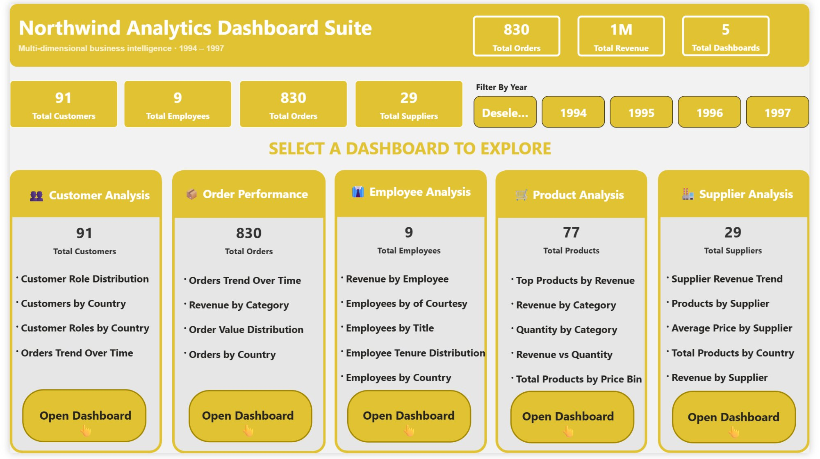
Dashboard — Index / Navigation Hub
Entry point for the entire BI suite with year slicer and KPI overview
KEY INSIGHTS
830 orders, $1M revenue, 91 customers visible at-a-glance in the header
Year slicer (1994–1997) drives all 5 dashboards simultaneously
5 domain cards provide one-click navigation — no searching required
Consistent gold/white design theme maintained across all dashboards
Northwind Analytics · Sales Analysis Project · 1994–1997

Slide 12
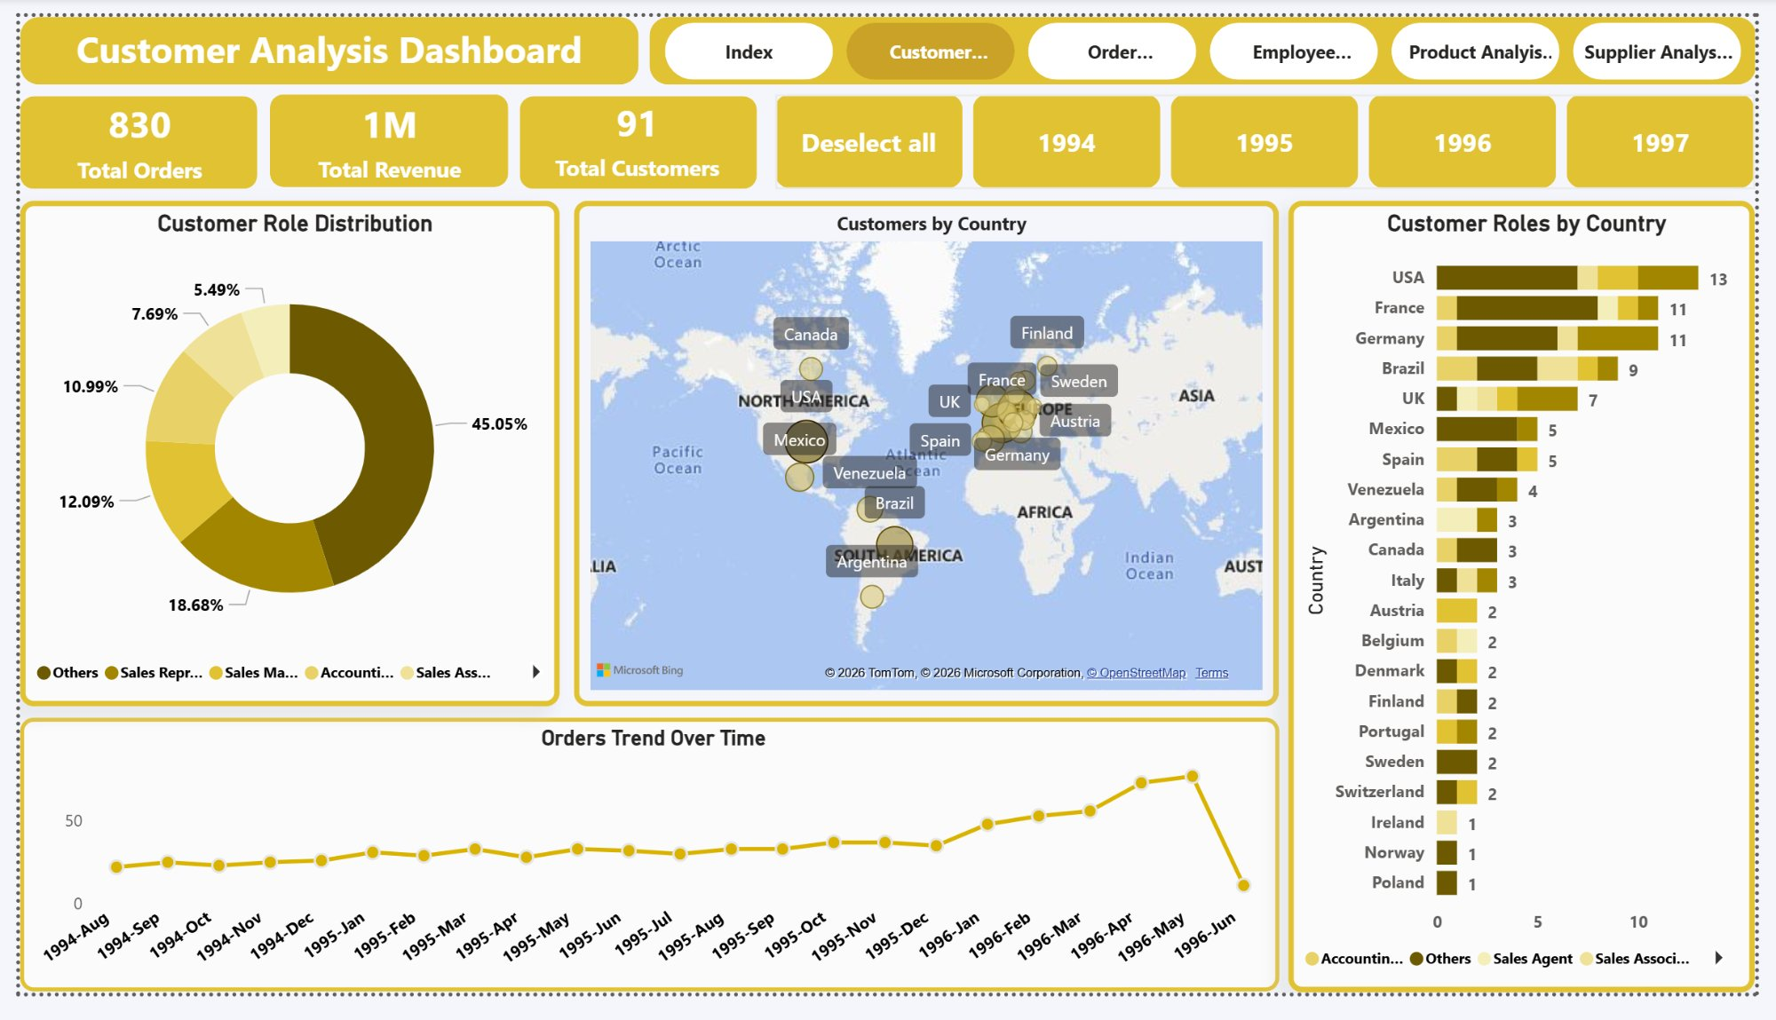
Dashboard — Customer Analysis
Geographic spread, role distribution, and order trends across 91 customers
KEY INSIGHTS
USA leads with 13 customers; France & Germany follow with 11 each
45% of contacts are Sales Representatives — single role dominates
Orders trend rising YoY — clear upward trajectory 1994 → 1996
Brazil and France emerge as high-potential secondary expansion markets
Northwind Analytics · Sales Analysis Project · 1994–1997

Slide 13
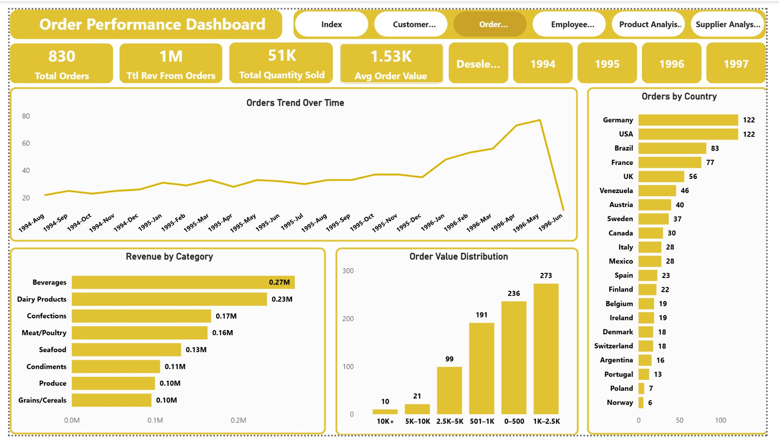
Dashboard — Order Performance
Revenue trends, category breakdown, and value distribution across 830 orders
KEY INSIGHTS
Beverages ($270K) + Dairy ($230K) = 50% of revenue — two categories carry the business
Orders scaled from ~20/month (1994) to ~75/month (May 1996) — 3.7× growth
273 orders in $1K–$2.5K bin — the volume sweet spot for order sizing
Germany & USA tied at 122 orders — equally balanced top markets
Northwind Analytics · Sales Analysis Project · 1994–1997

Slide 14
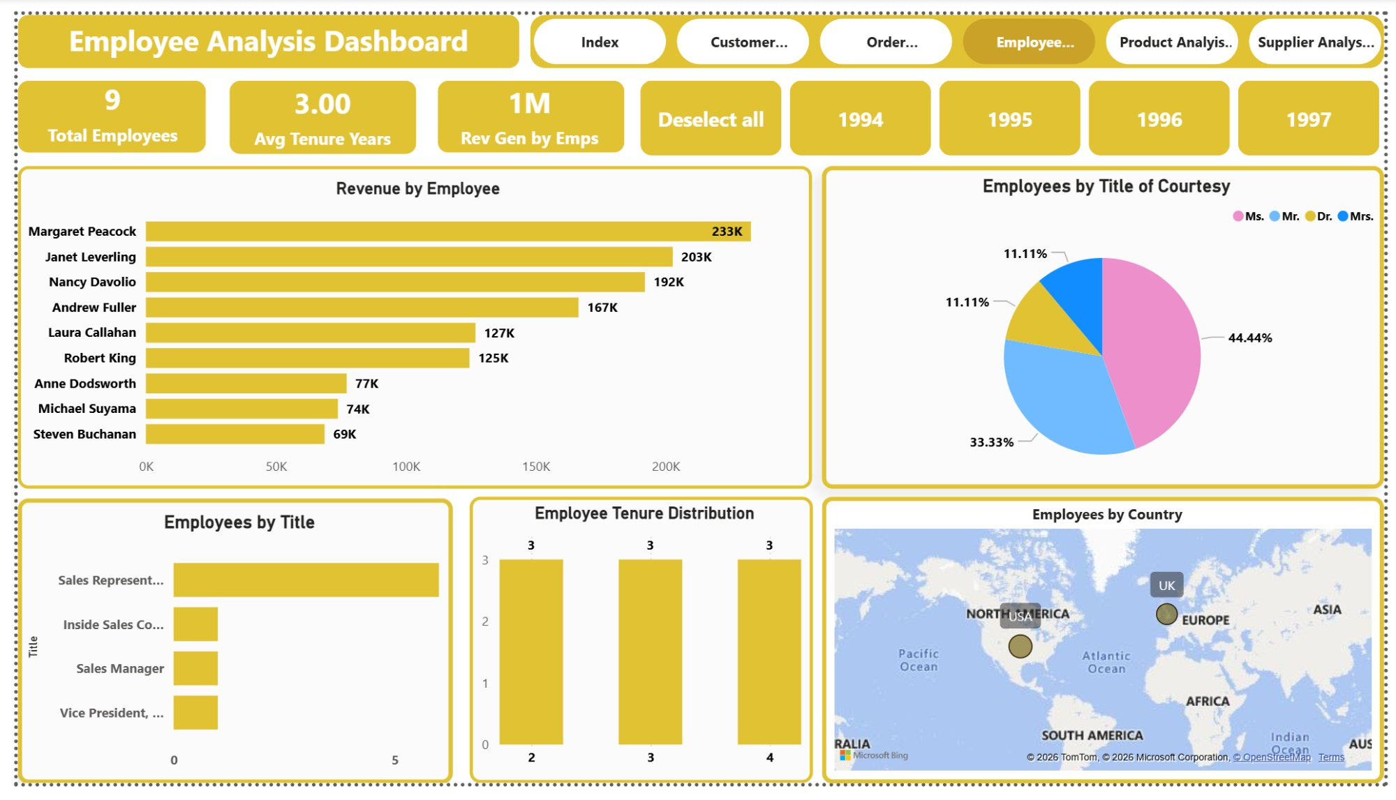
Dashboard — Employee Analysis
Revenue by employee, tenure distribution, and geographic coverage
KEY INSIGHTS
Peacock ($233K) outperforms Buchanan ($69K) by 3.4× — large internal gap
Top 3 employees account for over 60% of employee-attributed revenue
Even tenure split (3 employees per band) — experienced but aging workforce
Only 2 countries covered (USA, UK) — geographic concentration risk
Northwind Analytics · Sales Analysis Project · 1994–1997

Slide 15
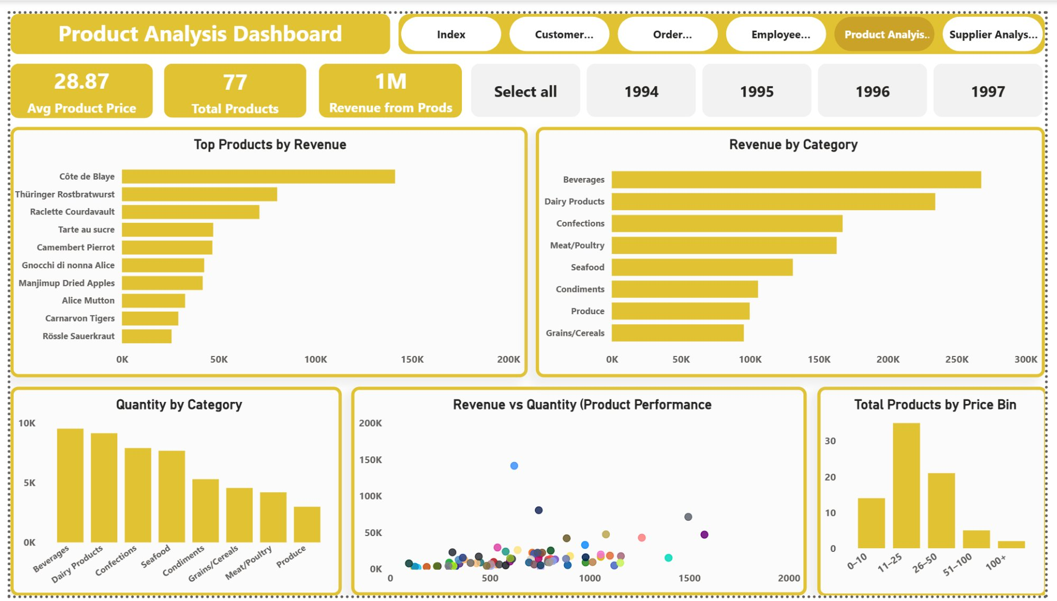
Dashboard — Product Analysis
Top products, category revenue, pricing tiers, and demand patterns
KEY INSIGHTS
Côte de Blaye is a revenue outlier — high-price, low-volume, single-product risk
Beverages leads all categories in both revenue and quantity sold
Most products cluster in a low-revenue zone — long-tail concentration risk
$26–$50 price tier has 35 products — mid-market is most crowded
Northwind Analytics · Sales Analysis Project · 1994–1997

Slide 16
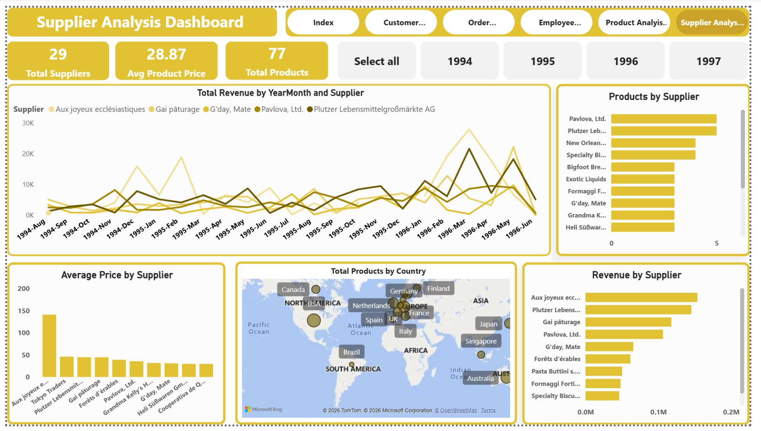
Dashboard — Supplier Analysis
Supplier revenue trends, product counts, and global geographic reach
KEY INSIGHTS
Aux joyeux ecclésiastiques leads revenue — single supplier over-dependence risk
Pavlova & Plutzer carry the highest product counts — critical partners to retain
Grains/Cereals has concentrated supply — supply chain vulnerability
13 countries represented — but European suppliers dominate revenue share
Northwind Analytics · Sales Analysis Project · 1994–1997

Slide 17
Business Recommendations
10 data-driven actions — TOP 3 flagged as immediate priorities
01
Protect High-Value Customers
06
Convert Low-Value Customers
● PRIORITY
≥10 orders & ≥$5K spend — assign dedicated account managers + loyalty incentives immediately
Most customers, least revenue — run minimum-order promotions or targeted campaigns
02
Double Down on Beverages & Dairy
07
Prepare for Q4 Demand Spikes
● PRIORITY
50% of $1M revenue — deepen stock, negotiate better supplier terms before next Q4
Q4 consistently outperforms Q1 — increase pre-Q4 procurement and inventory levels
03
Secure Côte de Blaye Supply Chain
08
Diversify Grains/Cereals Supplier Base
● PRIORITY
~$150K single-product risk — build safety stock or qualify backup sourcing now
Concentrated supply chain — qualify at least one alternate supplier per high-risk category
04
Expand in Germany & USA
09
Review $10K+ Orders for Premium Accounts
122 orders each — deploy regional managers or local partners to capture latent demand
Only 10 such orders — verify accuracy and identify for VIP account escalation
05
Address Lagging Employee Performance
10
Add Mid-Level Management Layer
Buchanan ($69K) vs Peacock ($233K) — review territory allocation and incentive structure
1 VP managing 8 staff — high span of control, unsustainable as business scales
Northwind Analytics · Sales Analysis Project · 1994–1997

Slide 18
Conclusion
Northwind Sales Analysis · 1994–1997 · SQL + Power BI
1
$1M revenue across 830 orders from 91 customers — analysed across 5 business domains
Beverages & Dairy drive 50% alone; Germany & USA lead at 122 orders each
2
Margaret Peacock leads employees ($233K); Côte de Blaye leads products (~$150K)
Both represent concentration risks requiring supply chain and retention action now
3
5 interactive Power BI dashboards with year-filtering and cross-page navigation
Backed by 14 DAX measures + star/snowflake data model — reusable for future periods
4
15 SQL EDA questions answered with MECE structure across all 5 domains
CTEs, window functions, segmentation logic, and anomaly detection applied throughout
5
10 actionable recommendations — 3 immediate priorities identified
Focus: High-value customer retention · Beverages/Dairy supply · Côte de Blaye single-product risk

