Slide 1



DEPARTMENT OF CHEMISTRY
Presented by
  Mr. A.R..SIVAKUMAR, AP/CHEMISTRY
  KAMARAJ COLLEGE OF ENGINEERING AND TECHNOLOGY (AUTONOMOUS)
  VIRUDHUNAGAR
SUB.CODE:CY1171
SUB .NAME:ENGINEERING CHEMISTRY
UNIT-IV-POLYMERS

Slide 2
POLYMERS 9
Introduction: Functionality - degree of polymerization- Classification of polymers- natural and synthetic, thermoplastic and thermosetting. Types and mechanism of polymerization: addition (free radical, cationic, anionic and coordination); condensation and copolymerization. Properties of polymers: Tg, tacticity, molecular weight-weight average, number average and polydispersity index. Techniques of polymerization: Bulk, emulsion, solution and suspension. Synthesis, Properties and uses of: PE, PVC, Nylon 66, Bakelite, Epoxy resins.

Slide 3
POLYMER CHEMISTRY
  Introduction of Polymer
  Classification of Polymer
  Types of Polymer
  Polymerisation
  Types of Polymerisation
      Addition Polymerisation
      Condensation Polymerisation
      Co-polymerisation

Slide 4
POLYMER CHEMISTRY
  Mechanism of Polymerisation
      Free radical mechanism
      Cationic mechanism
      Anionic maechanism
  Properties of Polymer
  Methods of preparation of polymer

Slide 5
INTRODUCTION OF POLYMER
Greek word
Poly - many
Mer - units or part
Macromolecules or giant molecules
Its formed by combination of small
(micro) molecules to form a large
(macro) molecules
Micro - small (low molecular weight)
Macro -large (high molecular weight)
* 2 M
POLYMER
Examples

Slide 6
Monomer
        Having low molecular weight
        Smaller molecule
        Micromolecules
        Two or more monomers combine to form Polymer

Slide 7
Monomer | Polymer
Ethylene | Polyethylene
Styrene | Polystyrene
Vinylchloride | Polyvinyl chloride
Acrylonitrile | Polyacrylonitrile
Tetrafluroethylene | Polytetrafluroethylene (Teflon)
Other example
    Nylon 6, 6 Hexamethylene diamine and adipic acid
    SBR (Styrene Butadiene Rubber) or Buna – S rubber
    Styrene and Butadiene

Slide 8
Polymerisation
The process of conversion of monomer into polymer in the presence of heat, pressure and catalyst is known as polymerisation
* 2 M
n
Example
n
n

Slide 9
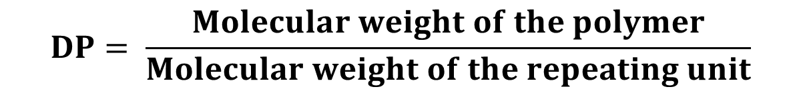
Degree of Polymerisation
Definition
The number of repeating units in a chain like polymer is known as Degree of polymerisation (DP)
  It is denoted by “n”
  It is represented by
* 2 M
$$DP= \frac{Molecular weight of the polymer}{Molecular weight of the repeating unit}$$
DP = 5

Slide 10
TYPES OF DEGREE OF POLYMERISATION
Based on the molecular weight the DP is classified
Oligo polymer (or) LDP
Low degree polymerisation
High polymer (or) HDP
High degree polymerisation

Slide 11
Oligo Polymer (or) LDP
    In this polymer having low molecular weight
    The molecular weight ranges from 500 - 5000
High Polymer (or) HDP
    In this polymer having high molecular weight
    The molecular weight ranges from 10,000 - 2,00,000

Slide 12
FUNCTIONALITY
* 2 M
Definition
The number of bonding sites (or) reactive sites (or) functional group present in the monomer is known as Functionality
Examples
Name | Functional
Ethylene glycol | Bifunctional monomer
Hexamethylenediamine | Bifunctional monomer
Acetylene | Tetrafunctional monomer
Ethylene | Bifunctional monomer
Glycerol | Trifunctional monomer
HO-CH₂-CH₂-OH

Slide 13
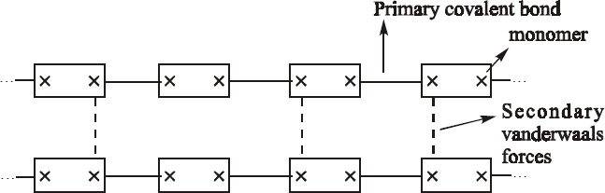
Significance of Functionality
Bifuncitonal monomers
They are soft, flexible and soluble in organic solvent. (why?)
Reason
Because in the bifunctionl monomer, the straight chain carbons are connected with another carbon by strong covalent bond
But the adjacent layer held together by weak vanderwalls force of attraction

Slide 14
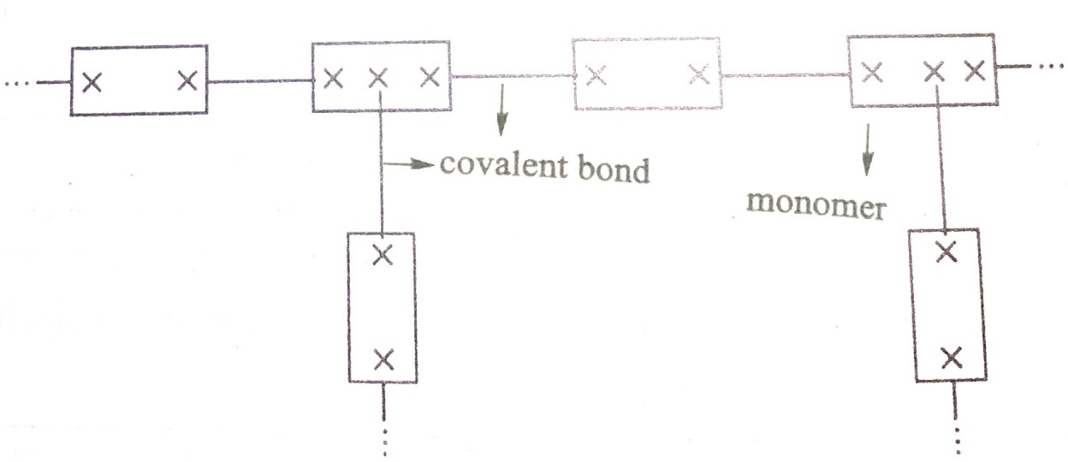
Trifuncitonal and Polyfunctional monomers
They are hard, brittle and insoluble in organic solvents. (why?)
Reason
Because in the trifunctionl monomer, the straight chain carbons are connected with another carbon by strong covalent bond

Slide 15
* 8 M
Types of Polymerisation
Addition Polymerisation
Chain growth Polymerisation
Condensation Polymerisation
Stepwise Polymerisation
Co-Polymerisation
Joint Polymerisation

Slide 16
Addition Polymerisation
In this type of polymerisation, the monomer is converted into polymer
at particular condition
Here the monomer containining one or more multiple bond
No elimination takes place
No by products are formed
Mainly involved homochain polymer
Soft on heating and hard on cooling
Thermoplastics
Example
    Formation of Polyethylene (PE)
    Formation of Polyvinlychloride (PVC)
    Formation of Polyacrylonitrile (PAN)

Slide 17
Formation of PE
Formation of PVC
Formation of PAN

Slide 18
Condenstion Polymerisation
In this type of polymerisation, the two different types of monomer
condens together to form polymer
Elimination takes place
By products are formed
Mainly involved heterochain polymer
Once harden, it cannot be soften
Thermosetplastics
Example
    Formation of Nylon 6,6 &Nylon 6
    Formation of Terylene (or) polyester (or) Dacron

Slide 19
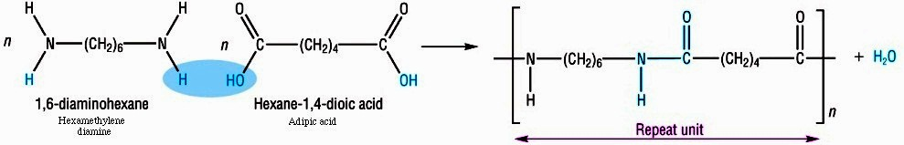


Formation of Nylon 6,6
Hexamethylene diamine
Adipicacid
Nylon 6,6 (Polyamide)
Formation of Nylon 6
Nylon 6
ε caprolactam
Formation of Polyester
Terephthalicacid
Polyethylene terephalate (or) Terylene
Dacron
Ethylene glycol

Slide 20
Co – Polymerisation
In this type of polymerisation, the two different types of monomer
combines together to form polymer
No elimination takes place
Mainly produce high molecular weight compound
Example
    Formation of SBR rubber (or) BUNA – S rubber
    Formation of Polyvinylchloridecovinylacetate (PVCCVA)

Slide 21

    Formation of SBR rubber (or) BUNA – S rubber
Polymerisation
Butadiene
Styrene
Styrene butadiene rubber
Formation
Formation of Polyvinylchloridecovinylacetate (PVCCVA)

Slide 22
Differentiate between Addition and Condensation Polymerisation
* 8 M
S.No | Addition | Condensation
1 | Monomers must have at least one multiple bond | Monomers must have at least two functional groups
2 | Monomers add to give polymer | Monomers condense to give polymer
3 | No by products are formed | By products are formed
4 | No elimination takes place | Elimination take place
5 | Mainly involved homochain polymer | Mainly involved hetero chain polymer

Slide 23
S.No | Addition | Condensation
6 | Mainly produce thermoplastic Eg 1. Polyethylene 2. Polystyrene 3. Polyvinylchloride | Mainly produce thermoset plastic Eg 1. Bakelite 2. Ureaformaldehyde
7 | Monomers decreases steadily throught out the reaction | Monomer disappear early stage of the reaction
8 | Molecular weight of the polymer is an integral multiple of molecular weight of the monomer | Molecular weight of the polymer need not be an integral multiple of molecular weight of the monomer
9 | Mainly involved for free radical, anionic and cationic mechanism | Does not involved for free radical, anionic and cationic mechanism

Slide 24
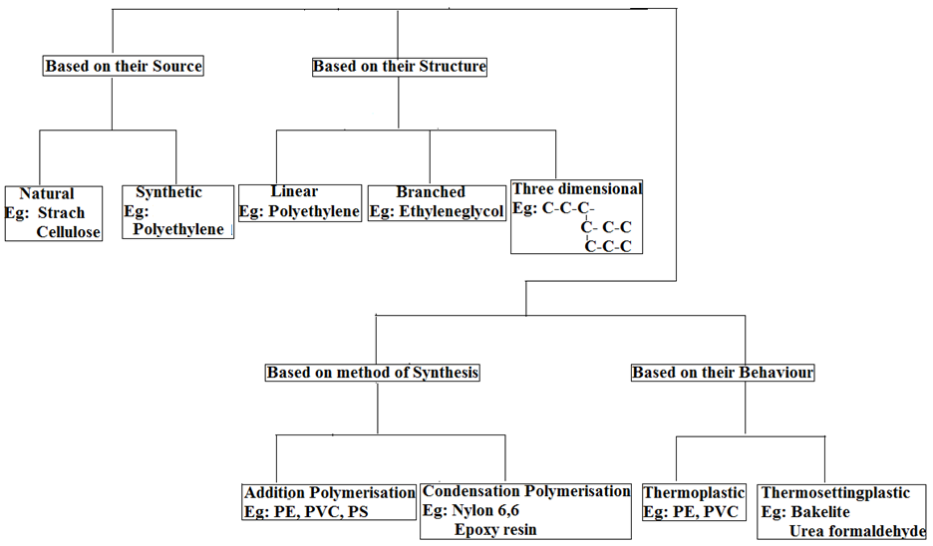
Classification of Polymer

Slide 25
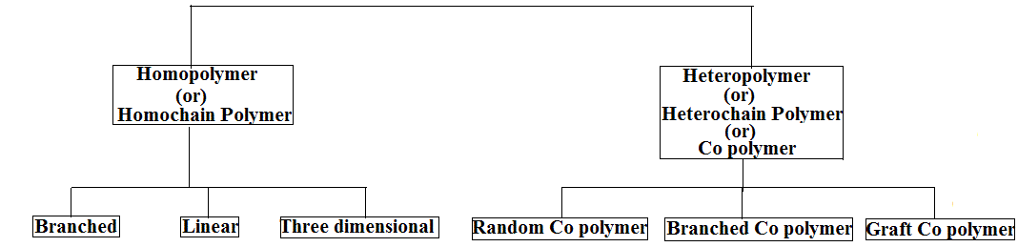
Nomenclature of Polymer
* 2 M
Polymer

Slide 26
Homopolymer
In this type of polymer the main chain is made up of same species of atom
Example : C-C-C-C-C-C-C-
Polyethylene
Heteropolymer
In this type of polymer the main chain is made up of different species of atom
Example: -C-C-O-O-C-C-
Nylon – 6,6

Slide 27
Heteropolymer
Random copolymer
  In this type of polymer no definite sequence in the main chain
  Example: M₁—M₁—M₂—M₂—M₁—M₁
Branched copolymer
In this type of polymer the linear straight chain monomer is connected with the another monomer in a branched manner
Example : M₁—M₁—M₁—M₁
M₂—M₂—M₂—M₂
Graft copolymer
In tis type of polymer the linear straight chain monomer is connected with the another monomer in a straight chain manner
Example : M₁—M₁—M₁—M₁— M₂—M₂—M₂—M₂

Slide 28
* 16 M
Mechanism of Polymerisation
Addition Polymerisation
It mainly involves three types of mechanism
    Free radical mechanism
    Cationic mechanism (or) Carbonium ion mechanism
    Anionic mechanism (or) Carbanion mechanism

Slide 29
FREE RADICAL MECHANISM
* 8 M
Free radical mechanism occurs in a three steps
  Initiation
  Propagation
  Termination
I Initiation
It involves two steps
Step I Formation of free radical
Step II Free radical combines with monomer
Free radical
  It is highly charged species
  Having unpaired electrons
  It is denoted by

Slide 30
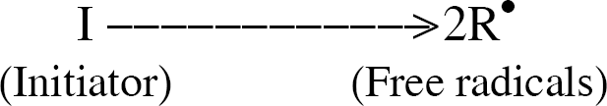
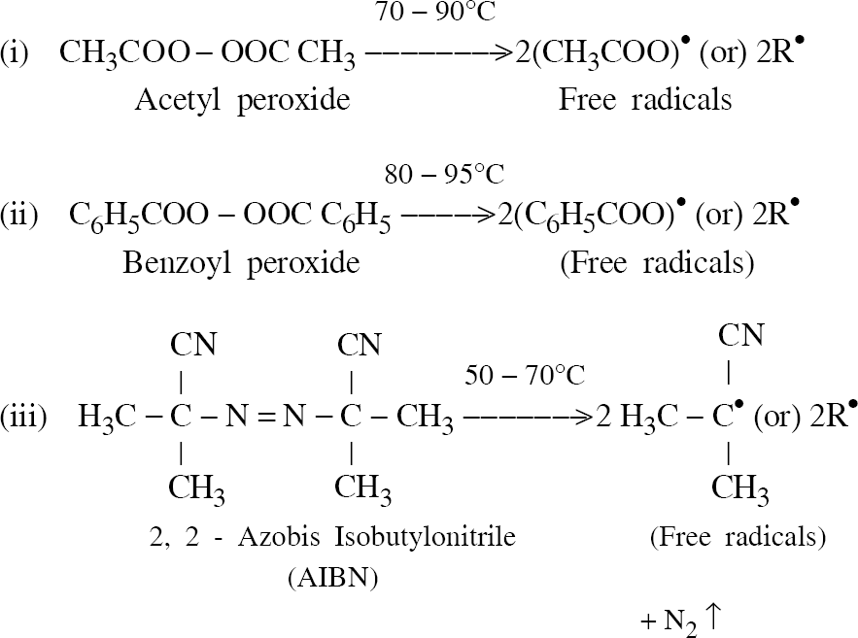
Step I
Formation of free radical
  Free radicals are formed by homolytic dissociation of Initiator
  Example

Slide 31
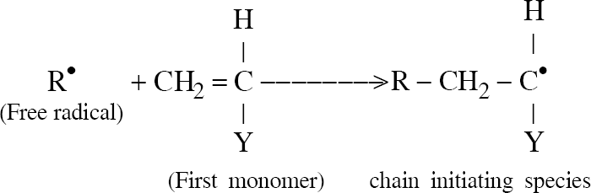
Step II
Free radical combines with monomer
  In this step the free radical combines with monomer to form initiating species
  Example

Slide 32
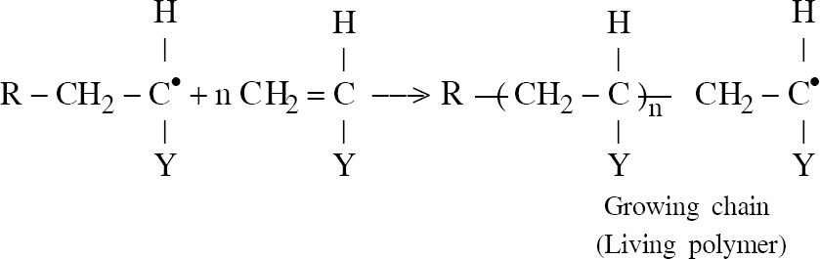
II Propagation
  In this step the initiating species combines with the new monomer.
  The free radical transferred in to end of the carbon atom, to form living polymer
  Example

Slide 33
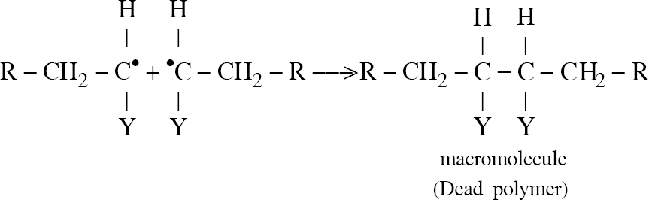
III Termination
It involves two steps
Step I Coupling (or) Combination
Step II Disproportionation
Combination
  In this step the two initiating species (or) two living polymer combines together to form a dead polymer.
  Example

Slide 34
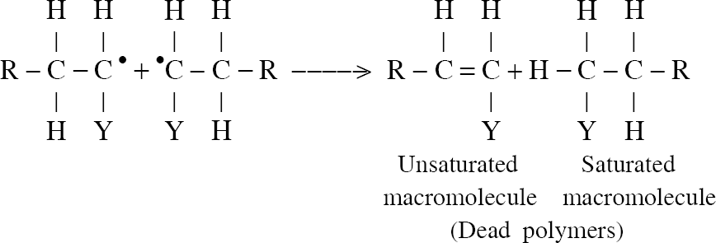
Disproportionation
  In this step the hydrogen from one initiating species transferred in to another species.
  It forms two type of polymer
  1. Unsaturated Polymer
  2. Saturated Polymer
  Example

Slide 35
CATIONIC MECHANISM
It is faster than free radical mechanism
In this mechanism monomer contains electron donating groups
Example:
Styrene, Isobutylene, Isoprene.
It involves three step
    Intiation
    Propagation
    Termination

Slide 36
Initiation
It involves two steps
Step I: Formation of Carbocation
Step II: Carbocation combines with monomer
Step I: Formation of Carbocation
    It is formed from the initiatar (or) catalyst
    Here the acids like AlCl₃, BF₃, CCl₄ are act as a Initiator
    These acids do not have proton and react with Co catalyst

Slide 37
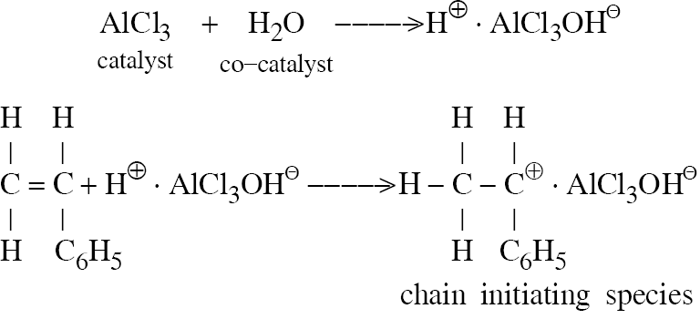

Slide 38
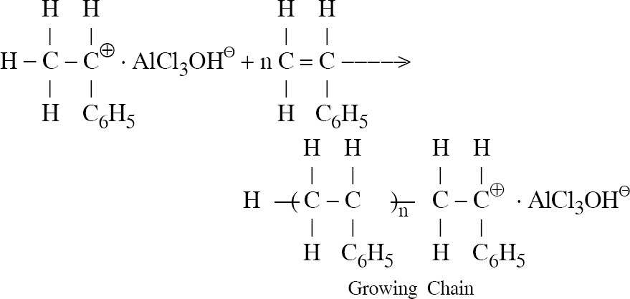
Propagation
  In this step the initiating species combines with new monomer to form living polymer

Slide 39
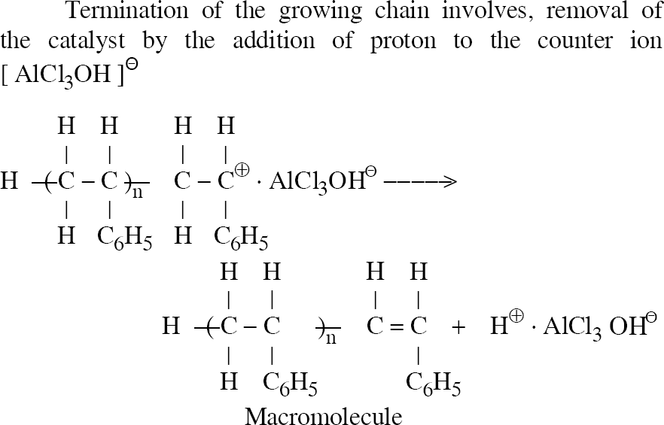
Termination
  In this step the proton (H⁺) removed from the initiating species to form dead polymer and carbonium ion can be separated

Slide 40
ANIONIC MECHANISM
In this mechanism the monomer contains electron withdrawing groups like Cl⁻ & CN⁻.
Example:
Vinyl chloride, Styrene, Acrylonitrile.
It involves three step
    Intiation
    Propagation
    Termination

Slide 41
Initiation
It involves two steps
Step I: Formation of Carbanion
Step II: Carbanion combines with monomer
Step I: Formation of Carbanion
    It is formed from the initiatar (or) catalyst
    Here the Lewis base like KNH₂ & NaNH₂ are act as a Initiator

Slide 42
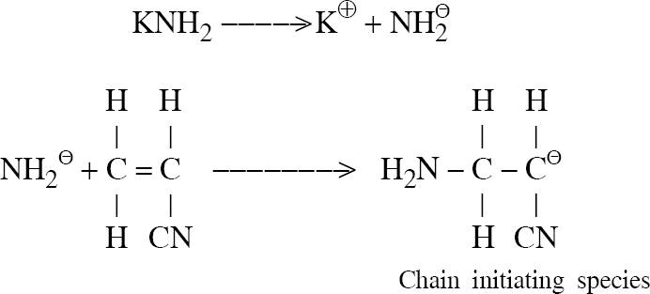

Slide 43
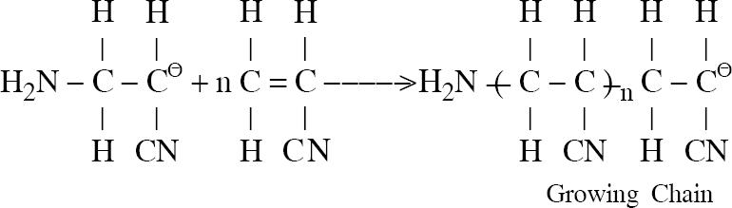
Propagation
  In this step the initiating species combines with new monomer to form living polymer

Slide 44
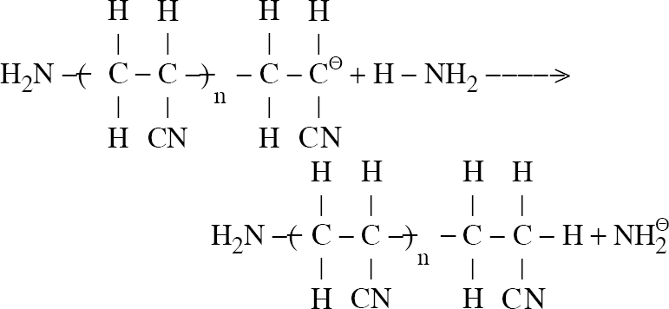
Termination
  In this step the living polymer combines with base (NH₃) to form dead polymer

Slide 45
PLASTICS
Are high molecular weight organic material
It is easily involved for fabrication (or) moulding process
Fabrication
    The plastic material converted into desired articles by the application of heat, pressure (or) catalyst is known as fabrication
* 2 M

Slide 46
Advantage
    Light weight
    Low melting point
    Highly corrosion resistance
Disadvantage
    Non biodegradable
    Deformation under load
Classifications
    Based on their structure
    Based on their types of resin

Slide 47
Differentiate between Thermoplastics and Thermosetplastics
S.No | Thermoplastics | Thermosetplastic
1 | It is formed by addition polymerisation | It is formed by condensation polymerisation
2 | It is softened on heating and harden on cooling | It is harden on heating Once harden it cannot be softened
3 | It consists of linear (or) slightly branched Eg: Polyethylene, Polyvinylchloride | They are three dimensional network Eg: Bakelite Epoxy resin
4 | The adjacent layer is held together by weak Vanderwaal’s force of attraction. | The adjacent layer is held together by strong covalent bond

Slide 48
S.No | Thermoplastics | Thermosetplastic
5 | It can be remoulded | It cannot be remoulded
6 | Thermoplastics are low molecular weight | Thermoplastics are high molecular weight
7 | They are weak, soft and flexible in nature | They are hard, strong and brittle in nature
8 | They are soluble in organic solvent | They are in soluble in organic solvent
9 | Eg: PE, PS, PP, PVC and PAN | Eg: Nylon 66, Epoxy resin, Bakelite, Urea formaldehyde.

Slide 49
IMPORTANT SYNTHETIC POLYMER
Nylon 6,6
Nylon 6
Epoxy resin

Slide 50
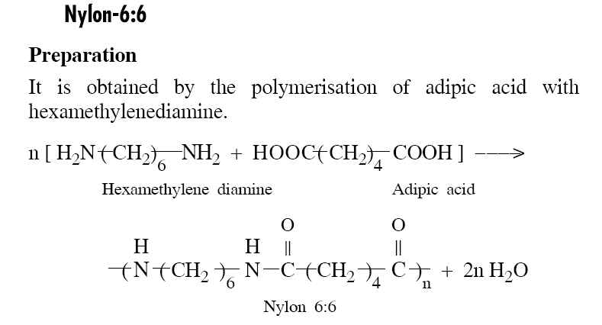
Nylon 6,6
Preparation
  It is one of the synthetic aliphatic polyamide
  It contains the common amide linkage
  It is prepared by mixing Hexamethylenediamine and adipicacid

Slide 51
Properties
  They are not soluble in organic solvents but soluble in phenol and formic acid
  It is less stiff soft material compared to Nylon 6
  It’s melting point is 264ºC

Slide 52
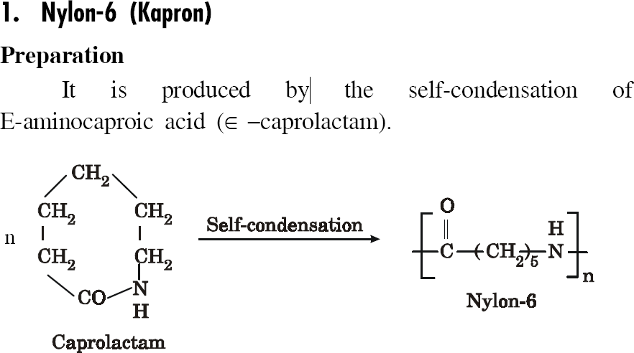
Nylon 6
Preparation
  It is prepared by ring opening polymerisation of ε caprolactam
Properties
  It is tough and highly heat resistant
  It is in soluble in organic solvent
  It is light weight, soft, less stiff
  It’s melting point is 225ºC

Slide 53
Uses of Polyamides
It is used for making socks, ladies shoe material and carpets.
It is used for making Nylon rope, and bristles for toothbrush.
It is used for making electrical apparatus.

Slide 54
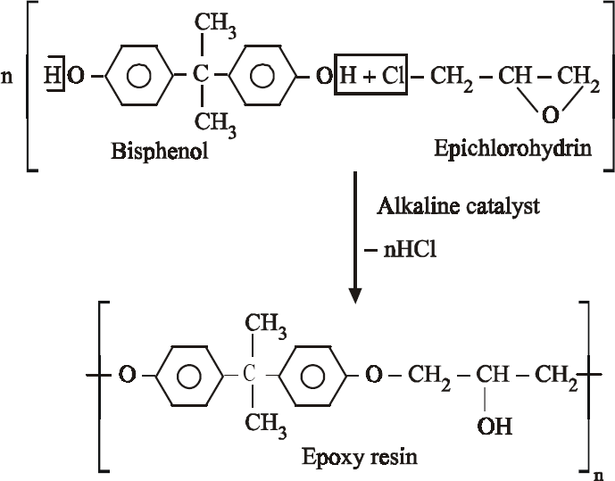
Epoxy Resin
* 4 M
Preparation
  It is prepared by heating a mixture of Bis-phenol and epichlorohydrin under alkaline catalyst (NaOH) at 60 ºC
  It is one of the important cross linked synthetic polymer.
  It contains ether linkage R – O – R

Slide 55
Properties
During the ether linkage it is highly resistance to acids and alkalies.
It is highly heat resistance
Because of the polar group / polar nature it is highly adhesive in property
It is not soluble in organic solvents.
Uses
It is used for making surface coating material like araldite.
It is used for protective shield in air craft components.
It is used for blending agent ( to avoid shrinkage and crease resistance) in wool.

Slide 56
PROPERTIES OF POLYMER
Tacticity (or) Stereospecific polymer
Tg (Glass transition temperature)
Molecular mass
Chain length and strength
Physical state

Slide 57
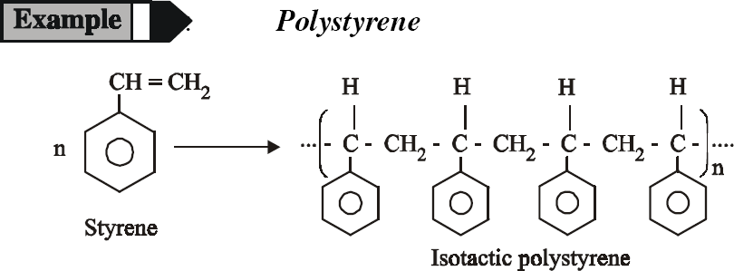
TACTICITY
* 2 M
Definition
The functional group arranged in the polymer takes place in an orderly or disorderly arrangement to the main chain is known as Tacticity.
Examples :

Slide 58
Classification
a. Isotactic Polymer
b. Syndiotactic Polymer
c. Atactic Polymer

Slide 59
a. Isotactic Polymer
The arrangement of functional group in the same side of the polymer is known as Isoatactic
Examples :

Slide 60
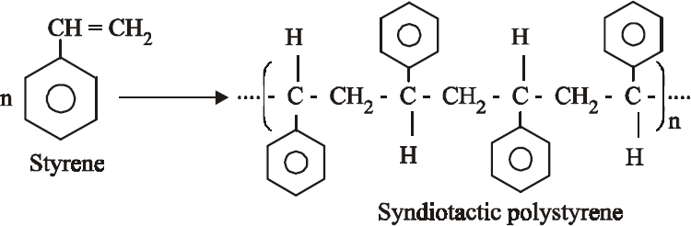
b. Syndiotactic Polymer
The arrangement of functional group in the opposite side of the polymer is known as Syndiotactic
Examples :

Slide 61
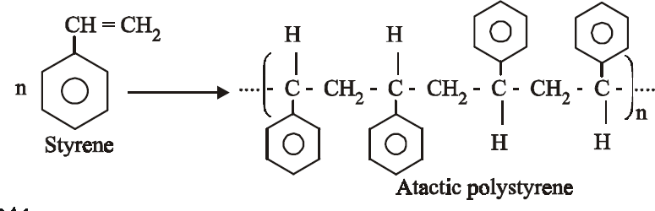
c. Atactic Polymer
The arrangement of functional group in the random side of the polymer is known as Atactic
Examples :

Slide 62
Tg (Glass Transition Temperature)
* 4 M
Definition
It is defined as the temperature at which the amorphous solid transformed into liquid is known as glass transition temperature
Examples : Tg of Polystyrene = 100 ºC
Polycarbonate = 150 ºC

Slide 63
Based on their Tg
Polymer is classified in to two state
Rubbery state
(Soft)
(Above Tg)
Glassious state
(Hard)
(Below Tg)

Slide 64
Factors influencing Tg
  Increase in chain length – Tg increases
  High strength – Tg increases
  Rate of heating (or) cooling
Significance (or) Uses
  It is one of the important property of polymer
  It is used to decide whether the polymer is soft (or) hard
  It is used to identify the processing temperature of polymer

Slide 65
Molecular Mass
Definition
Molecular mass depends on the number of monomer present in the polymer
Examples :
116
146
262

Slide 66
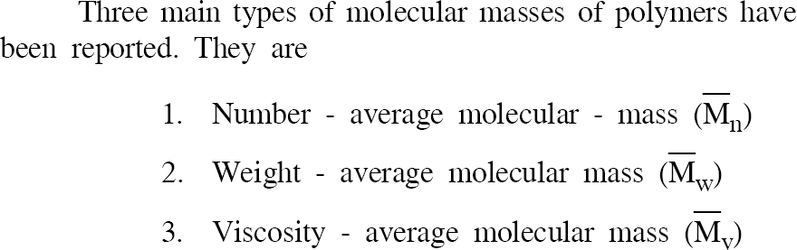
Based on their molecular mass, it is classified into 2 types
* 6 M

Slide 67
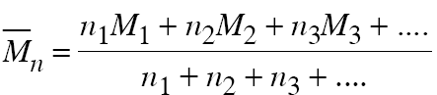
Definition
is mass obtained by dividing total molecular mass of polymer with number of monomer present in it

Slide 68
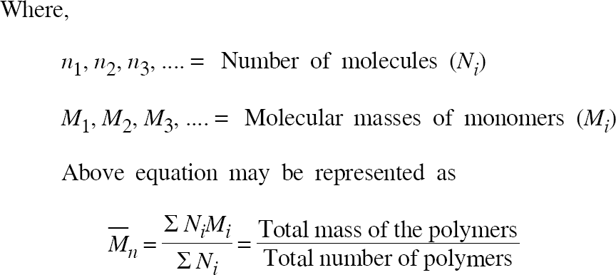
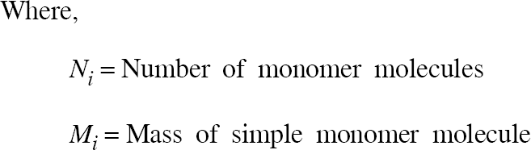

Slide 69
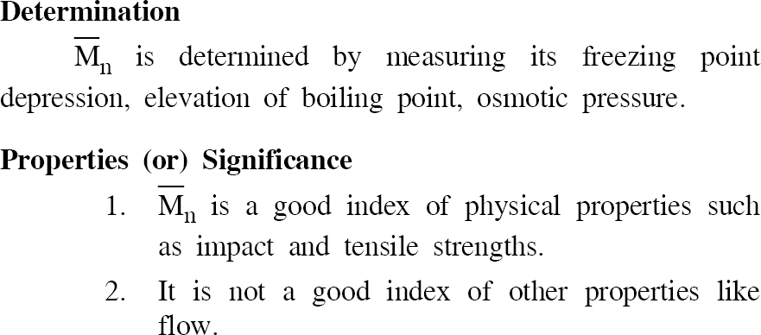

Slide 70

It is not only depends on number of monomer but also depends on mass of the monomer
Hence it is averaging process the molecular weight of each individual species is divided by mass not by number.

Slide 71
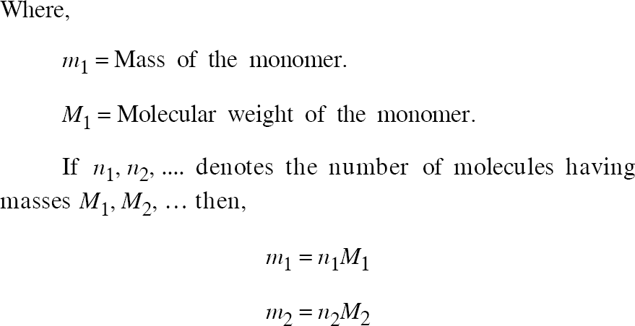

Slide 72
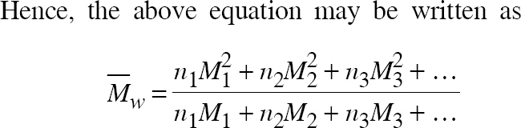


Slide 73
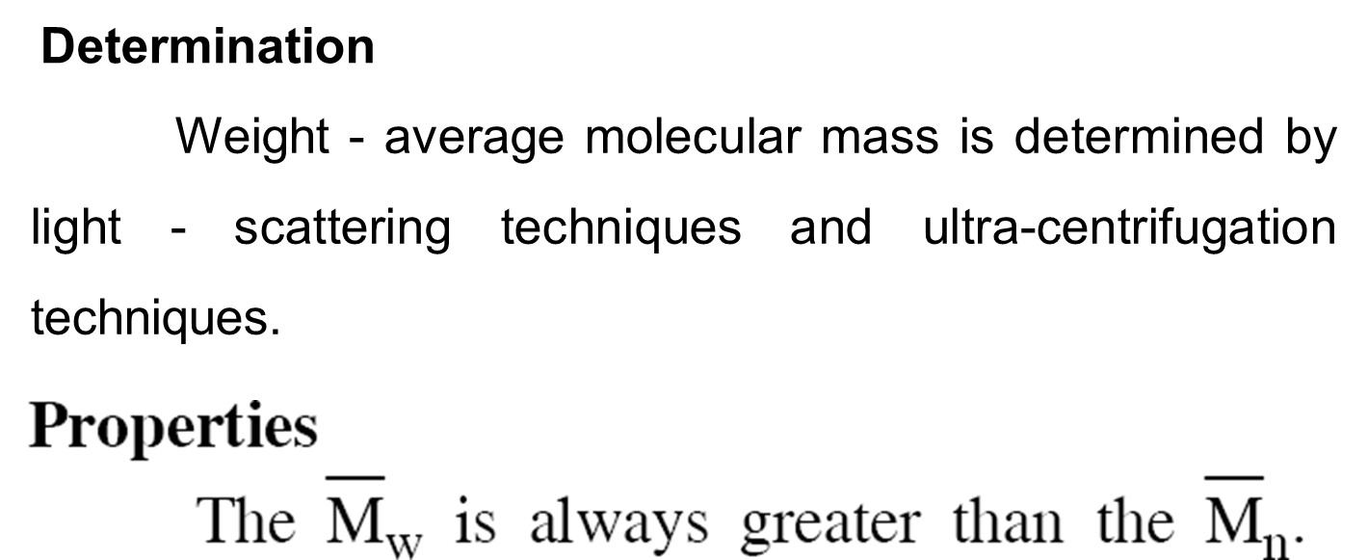

Slide 74
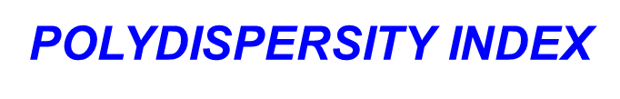
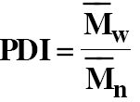
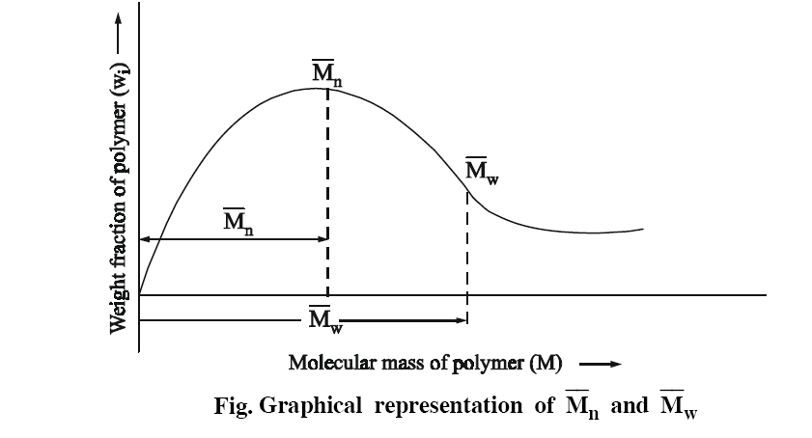
* 2 M
Definition
The ratio of weight average molecular mass to that of number average molecular mass is known as Polydispersity index (PDI)
≥1

Slide 75
If the above graph plotted between molecular weight vs. weight fraction
The graph shows that the weight average molecular mass is always greater than that of number average molecular mass

Slide 76
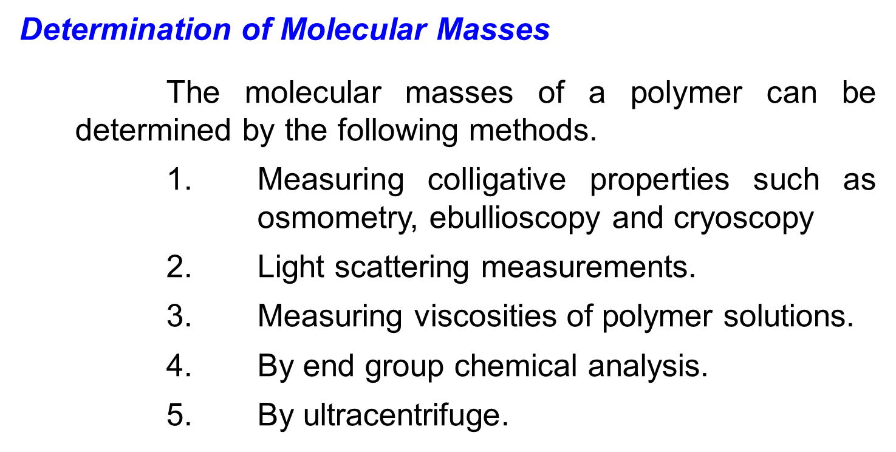

Slide 77
Chain length:
  The physical properties of the polymer depends on chain length
  Increase in chain length
  Tg increases
  Strength increase
  Boiling point & melting point increases
Strength:
Strength depends on molecular forces between the polymer
Examples:
    Bifunctional molecules
      Low strength
      Low Tg
    Polyfunctional molecules
      High strength
      High Tg

Slide 78
TECHNIQUES OF POLYMERIZATON
(or)
* 16 M
Methods of preparation of Polymer

Slide 79
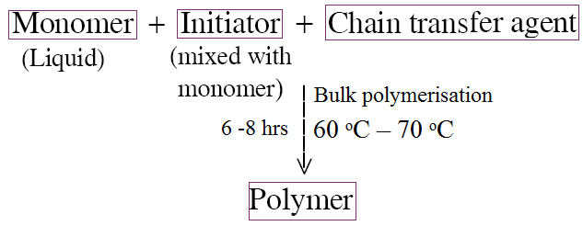
BULK POLYMERISATION
Aim:
To prepare PVC, PVA, PS by bulk polymerisation method
Apparatus required:
Thermoflask, Thermostat, condenser and required reagent
Reaction:

Slide 80
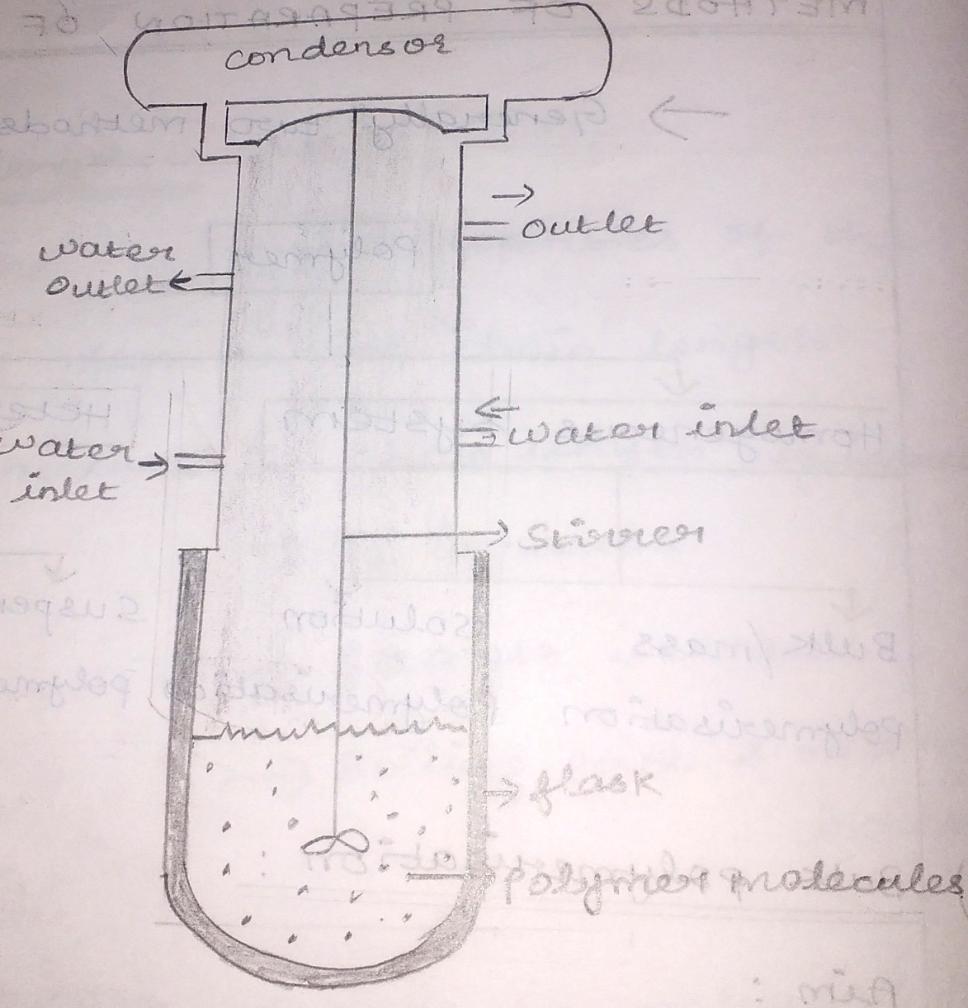
Diagram:
Procedure:
  It is also called as mass polymerisation
  In this polymerisation, the monomer is taken in the flask as a liquid form and initiator, chain transfer agent dissolve in it

Slide 81
Procedure:
  The flask is placed in a thermostat under constant agitation and heat
  The reaction is slow but becomes fast as the temperature increases.
  After a known period of time, the polymers are formed and separated out
Advandage:
  Using simple equipment.
  Highly pure polymers are formed.

Slide 82
Disadvandage:
  The reaction is highly exothermic and sometime it is not possible to control the explosion.
  It is not possible to produce large amount of polymer
Application:
  Mainly produces low molecular weight polymer used as adhesive and additives in lubricants.

Slide 83
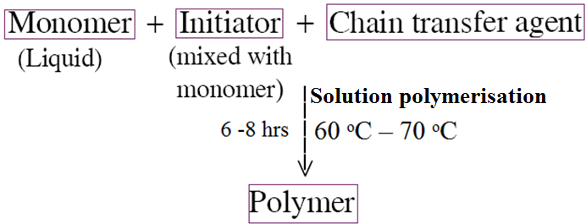
SOLUTION POLYMERISATION
Aim:
To prepare polyisobutylene, PAN by solution method
Apparatus required:
Thermoflask, Thermostat, condenser and required reagent
Reaction:

Slide 84
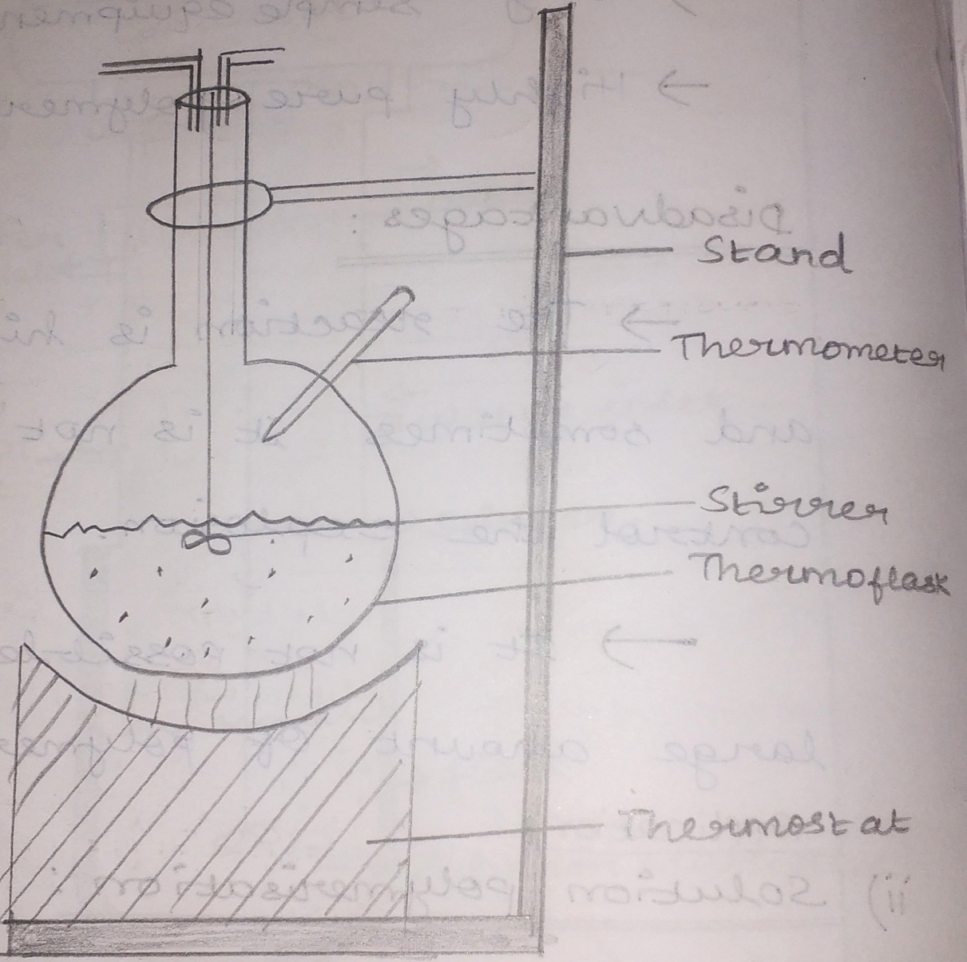
Diagram:
Procedure:
  In this method the monomer, initiator and chain transfer agent taken into the flask and dissolved in inert solvent (Eg: Alcohol)

Slide 85
Procedure:
  The above mixture is kept under constant agitation
  After some time, the above content is transfer into the suitable solvent.
  The polymers are separated out
Advandage:
  Heat control is easy
  The mixture can be agitated easily

Slide 86
Disadvandage:
  The removal of solvent is difficult.
  It is difficult to get high molecular weight polymer.
Application:
  It is also used as adhesives.

Slide 87
SUSPENSION POLYMERISATION
(or)
Beads Polymerisation
(or)
Pearls Polymerisation
Aim:
To prepare PS and polystyrenedivinylbenzene by suspension polymerisation method
Apparatus required:
500 mL beaker, stirrer, heating bath and required reagent.

Slide 88
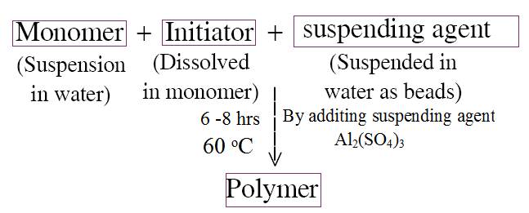
Reaction:

Slide 89
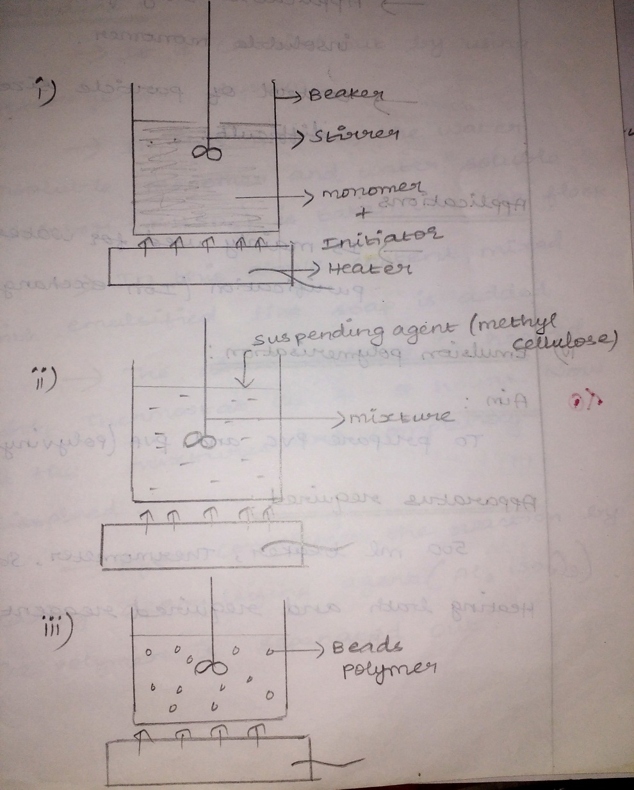
Diagram:
Procedure:
  This method is used only for water insoluble monomer.
  This polymerisation reaction is carried out in heterogeneous system.

Slide 90
Procedure:
  At the end of the step, the polymer is separated out as beads or pearls so it is called s beads or pearls polymerisation.
  The water insoluble monomer is suspended in water, and the initiator is dissolve by agitation.
  By adding suspending agent Al₂(SO₄)₃ and methyl cellulose, PVA (polyvinylacetate).
  The whole content taken in a flask and heated.
  At the end the beads polymers are formed.

Slide 91
Advantage:
  Products obtained is highly pure.
  Efficient heat control.
  More economical (because water is used as solvent)
Disadvantage:
  Applicable only for water insoluble monomer.
  Control of particle size is difficult
Application:
  It is mainly used for water purification (Ion exchange method).

Slide 92
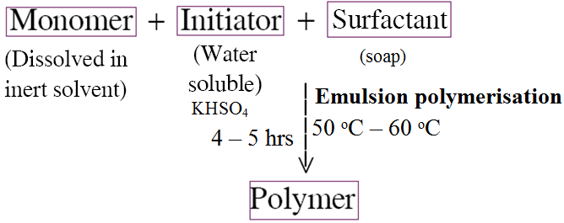
EMULSION POLYMERISATION
Aim:
To prepare PVC and PVA.
Apparatus required:
500 mL beaker, thermometer, stirrer, heating bath and required reagent.
Reaction:

Slide 93
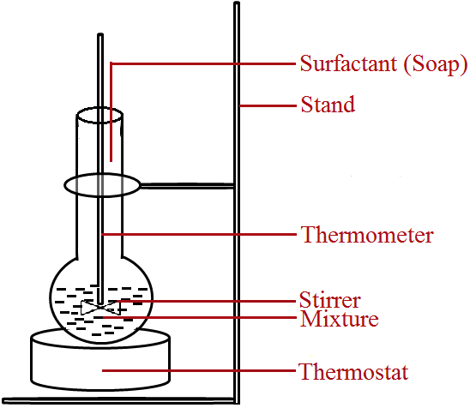
Diagram:
Procedure:
  It is carried out by using heterogeneous system.
  In this method, the water insoluble monomer and water soluble initiator potassium persulphate (KHSO₄) is taken into the flask.

Slide 94
Procedure:
  In this above content, mixed with emulsified like soap is added.
  The above content is heated with thermostat at 4 – 5 hours.
  Now all the mixtures are completely dissolved.
  After completion the reaction by adding demulsifying agent (Al₂(SO₄)₃, The polymer is separated out.

Slide 95
Advantage:
  High molecular weight polymers are produced
  The rate of polymerisation is high
Disadvantage:
  The polymers need purification
  It requires rapid agitation
Application:
  It is used in paint industry and plastic industry.

Slide 96
2 marks

Slide 97
What are Oligopolymers and high polymers
How are polymers classified on the basis of their tacticity
Name some natural and synthetic polymers.
What is Tacticity
What are thermoplastics.
What are thermosets plastics?
What is ionic polymerisation?
What are the types of ionic polymerisation?
What is the condition for a monomer for cationic polymerisation to be carried out
What is the catalyst used in cationic polymerisation?
What is the c0ondition for a monomer for nionic polymerisation to be carried out
Define Tg
What is glassy state and viscoelastic state?
What is the structural arrangement in crystalline and amorphous polymers.
What are the factors affecting Tg

Slide 98
16. What is poly disperse?
17. What is number – average molecular mass?
18. What is poly dispersity index?
19. Name the various polymerisation techniques.
20. What are the advantages of solution polymerisation?
21. What are the disadvantages of suspension polymerisation.
22. Name some important applications of emulsion polymerisation.
23. What are the properties of epoxy resins?

Slide 99
Differentiate between thermoplastics and thermosetting polymers.
Define degree of polymerization.
How are polymers classified? (Any one method)
Write the preparation of nylon 6,6 with the relevant reaction.
What is the functionality of (a) propylene (b) phenol towards polymerisation?
Define polydispersity index.
What are copolymers?
What are thermoplastics?
What is meant by degree of polymerisation?
Mention any two uses of epoxy resin.
Mention any two uses of nylon 6,6.
Write the preparation of epoxy resin with the relevant reaction.
What is copolymerization? Give an example.
Explain functionality of a monomer with a suitable example
Explain condensation polymerization with a suitable example.

Slide 100
16. Explain addition polymerization with a suitable example.
How is polymerization classified? Give one example for
each class.
18. What are homochain and heterochain polymers
19. Why thermosetting plastics can not be remoulded?
20. Define the term monomer and polymer
21. How are number average and weight average molecular
weight of polymer determined?
22. How are polymers classified based on their tacticity? Give
examples.

Slide 101
1. (a) (i) Write the preparation and properties of (8)
(1) Nylon 6,6
(2) Epoxy resins
(ii) Distinguish between addition and condensation
polymerization (8)
Or
(b) (i) Discuss the mechanism of addition polymerization.(8)
(ii) Explain the number average and weight average
molecular weight.
2. (a) (i) Bring out the differences between thermoplastic and
thermosetting resins. (8)
(ii) Describe the mechanism of free radical
polymerization. (8)
Or
(b) (i) What is co-polymerization ? Describe the
different types of copolymerization. (8)
(ii) Explain the term glass transition temperature. What are
the factors influencing T_{g} ? (8)

Slide 102
  (a) (i) Explain the mechanism of polymerization through free
radicals. (8)
(ii) What are the different types of molecular mass of
polymers? Explain each type with significance. (8)
Or
(b) (i) What are the differences between thermoplastic
polymers and thermosetting polymers? (8)
(ii) Explain the following :
(1) Emulsion polymerisation. (4)
(2) Solution polymerisation. (4)
  (a) (i) Discuss the mechanism of condensation polymerisation
in detail. (8)
(ii) Explain any four important properties of
polymers. (8)
Or
(b) (i) Describe the emulsion polymerisation technique. Give
two examples. (8)
(ii) Write down the preparation, properties and uses of
Nylon 6:6. (8)

Slide 103
  (a) (i) Discuss cationic polymerization mechanism in
detail (8)
(ii) Distinguish thermoplastics and thermosetting
plastics (8)
Or
(b) (i) Explain any four properties of polymers in
detail. (8)
(ii) Discuss the preparation, properties and uses of
Nylon 6:6. (8)
Write the mechanism of free radical polymerization. What are the
monomers which can be polymerized by free radical polymerization?
7. Explain the free radical mechanism involved in the formation of
polyethylene.
Explain the different types of classification of plastics with suitable
examples
Explain the free radical mechanism of polymerization taking vinyl
chloride as a monomer.

Slide 104
