Slide 1
Covid-19 Cases With Python

Slide 2
Table of Contents
Introduction
Team Members
Objectives
Project Requirements
Algorithm
Importing Libraries and Load Dataset
Data Analysis
Data Visualization
Model Development & Evaluation
Limitations and Challenges
Conclusion

Slide 3
Introduction
The COVID-19 pandemic has had a significant impact on global health and economies. Analyzing COVID-19 cases can provide valuable insights into the spread of the disease and help inform public health strategies. This project aims to analyze COVID-19 cases using Python, leveraging various data analysis and machine learning techniques.
The goal of this project is to analyze COVID-19 cases using Python. The project involves importing relevant libraries, loading the dataset, performing data analysis, visualizing the data, and developing a model to make predictions.

Slide 4
Team Members
Deepak M
Priyadharshini R
Venkatesh N
HarishKumar V
Yukesh M

Slide 5
Objectives
The objectives of this project are as follows:
Importing Libraries: Import the necessary Python libraries for data manipulation, analysis, visualization, and machine learning.
Load Dataset: Load the COVID-19 cases dataset, obtained from reliable sources, into a pandas DataFrame for further analysis.
Data Analysis: Perform exploratory data analysis (EDA) to understand the structure, patterns, and trends in the COVID-19 cases data. Handle missing values appropriately and extract relevant features for analysis.

Slide 6
Objectives
Data Visualization: Create visualizations to effectively communicate the findings of the data analysis. Use line plots, bar plots, heatmaps, and pie charts to visualize the COVID-19 cases data from different perspectives.
Model Development: Develop a machine learning model to predict COVID-19 cases based on the available data. Evaluate the model's performance using appropriate metrics and make predictions on the testing data.

Slide 7
Project Requirements
Programming Language: Python
Version: 3.x
Libraries: Pandas, Numpy, Matplotlib, Seaborn, Scikit-Learn.
System Requirements:
Operating System: Windows 10
RAM: at least 4GB(8 GB or more recommended)
Storage: at least 10GB of free disk space

Slide 8
Algorithm
Algorithm used: Gradient Boosting Regressor
In this project, we utilize the GradientBoostingRegressor algorithm to analyze and predict COVID-19 cases using Python. The Gradient Boosting Regressor is a powerful machine learning algorithm, To apply the GradientBoostingRegressor algorithm to the COVID-19 dataset, we preprocess the data, considering factors such as cases, deaths, and various demographic variables. After splitting the dataset into training and testing sets, we train the GradientBoostingRegressor model using the training data. The algorithm learns the underlying patterns and relationships within the data, enabling it to make predictions based on unseen data.

Slide 9
Importing Libraries and Load Dataset
Importing Libraries:
In this section, we import the necessary libraries for our project. The libraries include:
pandas for data manipulation and analysis.
numpy for numerical computations.
matplotlib and seaborn for data visualization.
scikit-learn for machine learning models.
Load Dataset:
In this section, we load the dataset that contains COVID-19 cases data. The dataset obtained from kaggle. We use the pandas library to read the dataset and create a DataFrame for further analysis.
Dataset: https://www.kaggle.com/datasets/chakradharmattapalli/covid-19-cases

Slide 10
Data Analysis
In this section, we analyze the loaded dataset to gain insights into COVID-19 cases. Data analysis tasks include:
Count the total number of cases and deaths in the dataset.
Calculate the percentage of cases and deaths by country.
Find the country with the highest number of cases and deaths.

Slide 11
Data Visualization
Data visualization is an essential part of understanding and communicating the findings of the data analysis. In this section, we use libraries such as matplotlib and seaborn to create various visualizations, including:
Find top five countries in terms of cases, store them in a new dataframe and Visualize them.
Find top five countries in terms of deaths, store them in a new dataframe and Visualize them.

Slide 12
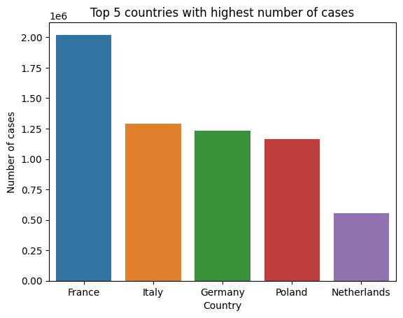
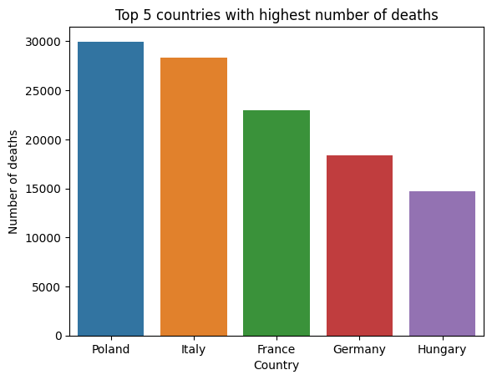
Data Visualization

Slide 13
Model Development & Evaluation
In this section, we use the scikit-learn library to develop a Gradient Boosting Regression model. The purpose of this model is to make predictions related to COVID-19 cases based on the available data. The steps involved in this section include:
Resample the COVID-19 cases data by date
Split the data into training and testing sets
Scale the training and testing data
Fit a GradientBoostingRegressor model
Make predictions using the trained model on the testing data.
Evaluate the model's performance using the route_mean_squared_error and r2_score

Slide 14
Model Development & Evaluation
After training our GradientBoostingRegressor model on the COVID-19 dataset, we proceed to evaluate its performance using two widely used evaluation metrics: Root Mean Squared Error (RMSE) and R-squared (R2) score.
The RMSE metric is a measure of the average difference between the predicted values and the actual values in the testing set. It provides a quantifiable estimate of the model's prediction error. A lower RMSE value indicates that the model's predictions are closer to the true values, reflecting higher accuracy. To calculate the RMSE, we take the square root of the average of the squared differences between the predicted and actual values.

Slide 15
Model Development & Evaluation
The R2 score, also known as the coefficient of determination, assesses the proportion of the variance in the target variable that is explained by the model. It ranges from 0 to 1, where a score of 1 indicates a perfect fit, and a score of 0 suggests that the model does not explain the variance in the data.
During the evaluation process, we compare the obtained RMSE and R2 score values, the RMSE is low and the R2 score is close to 1, it indicates that ‘our model is performing well’.
This evaluation process enables us to make informed decisions about the model's reliability and potential applications, providing valuable insights for public health officials, policymakers, and researchers in managing and mitigating the impact of the COVID-19 pandemic.

Slide 16
Limitations and Challenges
Data Quality: The first challenge in analyzing Covid-19 cases is the quality of the data. The data may be incomplete, inaccurate, or not up to date, which can affect the analysis results.
Data Preprocessing: Another challenge is the preprocessing of the data. The data may be in different formats or have missing values, which need to be handled before performing any analysis.
Data Visualization: Visualizing the data is an important step in understanding the trends and patterns. However, with the large amount of data available, creating meaningful visualizations can be challenging.
Model Validation: Evaluating the performance of the model and validating its predictions can be complex in the context of COVID-19. The dynamic nature of the pandemic and evolving interventions make it challenging to validate the model accurately.

Slide 17
Conclusion
In this project, we analyzed COVID-19 cases using Python. We imported the necessary libraries, loaded the dataset, performed data analysis, visualized the data, and developed a Gradient Boosting Regression model for making predictions. The project provides insights into the COVID-19 situation and demonstrates the potential of using machine learning models to analyze and predict cases.

Slide 18
THANK YOU

