Slide 1

Project1: Rice Image Classification Project2: Identification and Classification of Corrosion Types A Comprehensive Analysis
Team Members:
Venkatesh Swarna
Sai Krishna Gudipati Rajesh Yatham

Slide 2
Project1: Rice Image Classification

Slide 3
Dataset
Provide details
Task: Classifying five rice varieties using image and feature datasets while Convolutional Neural Networks (CNN) were employed for the image dataset to perform the classification tasks.
Link to the dataset: https://www.kaggle.com/datasets/muratkokludataset/rice-image-dataset
Number of samples: 75000
Image size: 224x224 pixels
Number of classes: 5('Arborio', 'Basmati', 'Ipsala', 'Jasmine', 'Karacadag’)
Length of training dataset: 2000, Length of validation dataset: 500, Length of testing dataset: 600
Data Normalization : Mean=[0.485, 0.456, 0.406], Std=[0.229, 0.224, 0.225]

Slide 4
Data augmentation techniques for training and prediction
Training:
Random Resized Crop (224x224)
Random Horizontal Flip
Random Rotation (Eg:-15° to 15°)
Colour Jitter (brightness, contrast, saturation, hue)
Normalization (mean, std)
Prediction:
Resize (256x256)
Centre Crop (224x224)
Normalization (mean, std)

Slide 5
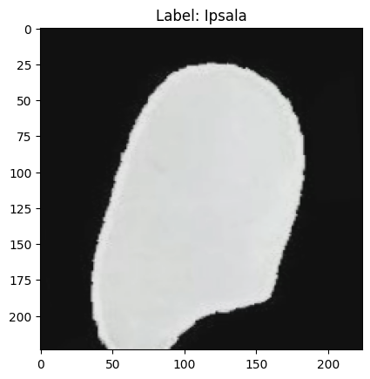
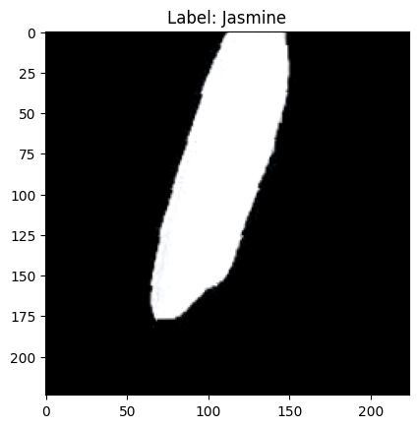
Add samples images from two classes

Slide 6
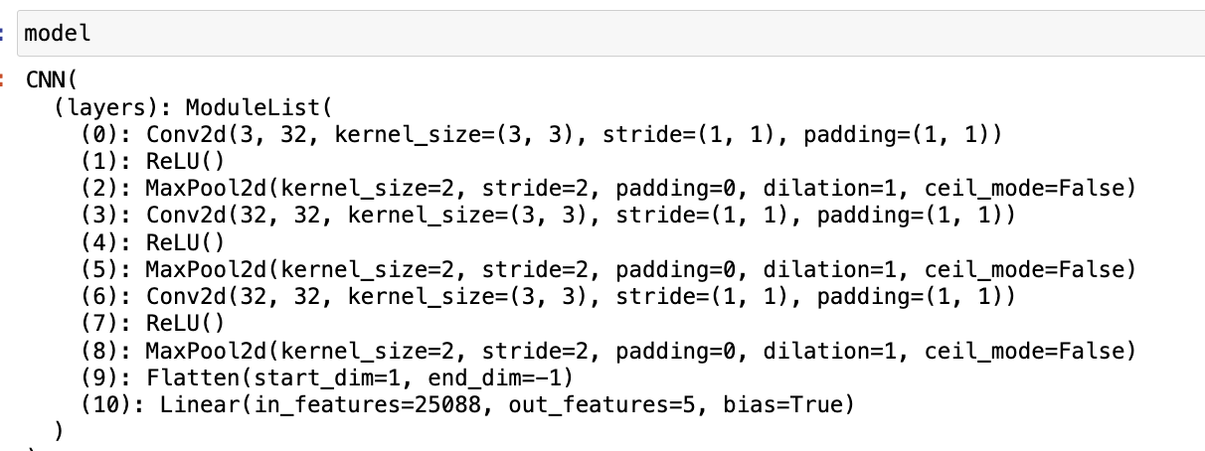
NN
Architecture of the base NN and the loss function

Slide 7
NN
Loss Function:
Cross Entropy Loss:
Cross Entropy Loss is a commonly used loss function for classification tasks. It measures the difference between the predicted probability distribution and the true class labels. Here’s a brief explanation
Purpose: To compute the loss between predicted class probabilities and true class labels.

Slide 8
Optimization and Hyperparameter tunings
Mini-batch size - 64
Optimization algorithms and its hyperparameters
Algorithm: Stochastic Gradient Descent (SGD)
Hyper Parameters: Learning Rate (lr),Momentum and Weight Decay
List other hyperparameters that were tuned
Number of Filters, Number of Layers and Learning Rate

Slide 9
Optimization and Hyperparameter tunings
Hyperparameter tuning strategies/algorithms
Grid Search: Explored combinations of learning rates, filters, and layers.
ClearML: Used for tracking, logging, and visualizing tuning results.
Range or values of the hyperparameter:
Learning Rate (lr)- 0.001 to 0.1
Momentum: 0.9 (fixed for SGD)
Weight Decay: 0.001
Number of Filters: 32, 64
Number of Layers: 2,3
Mini-batch Size: 64

Slide 10
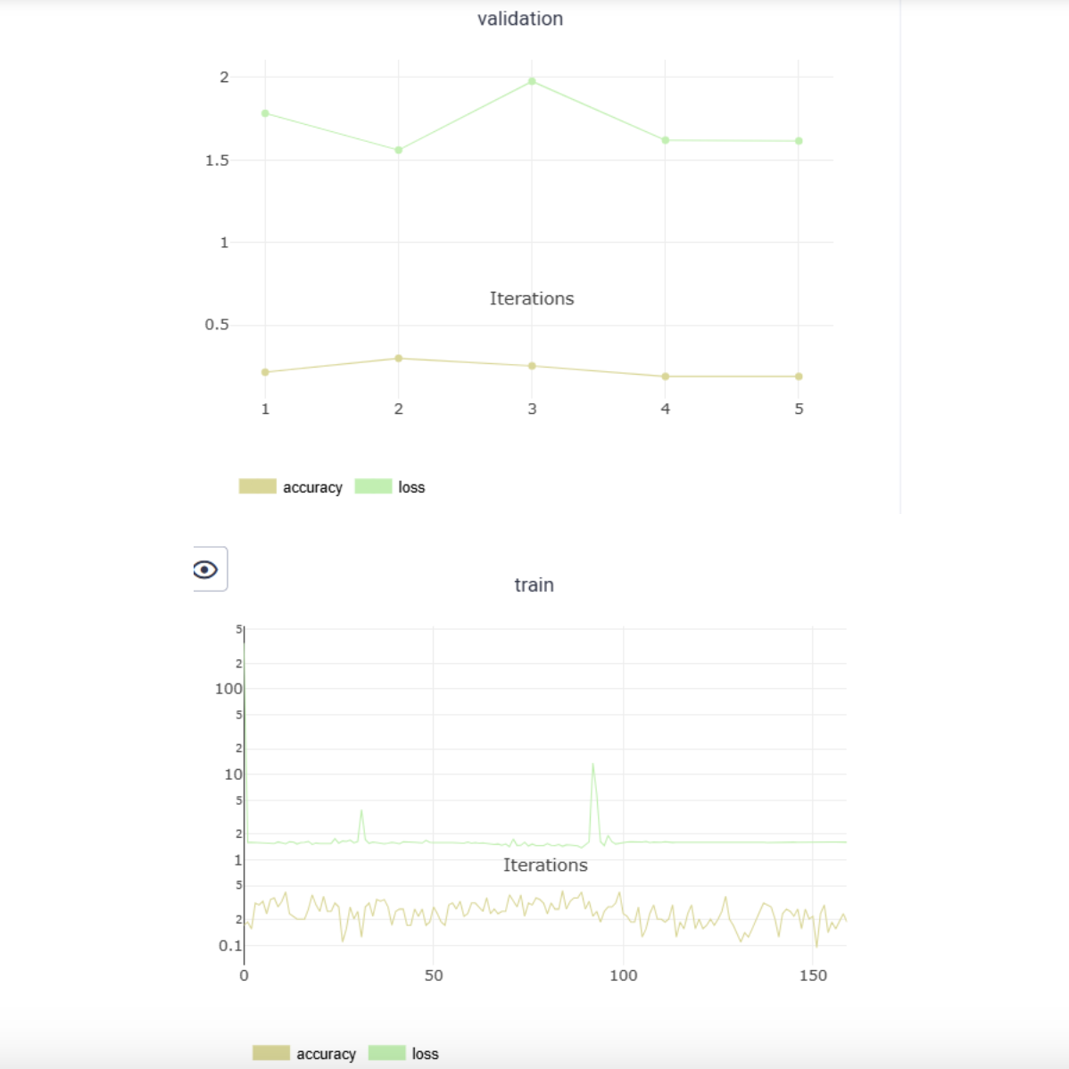
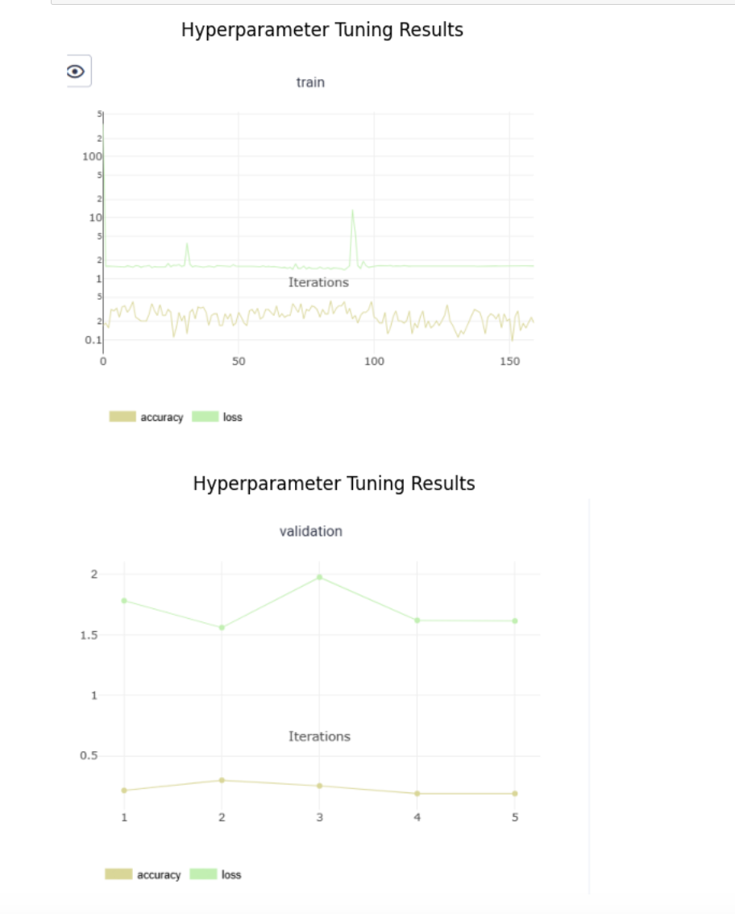
Hyperparameter tuning results

Slide 11
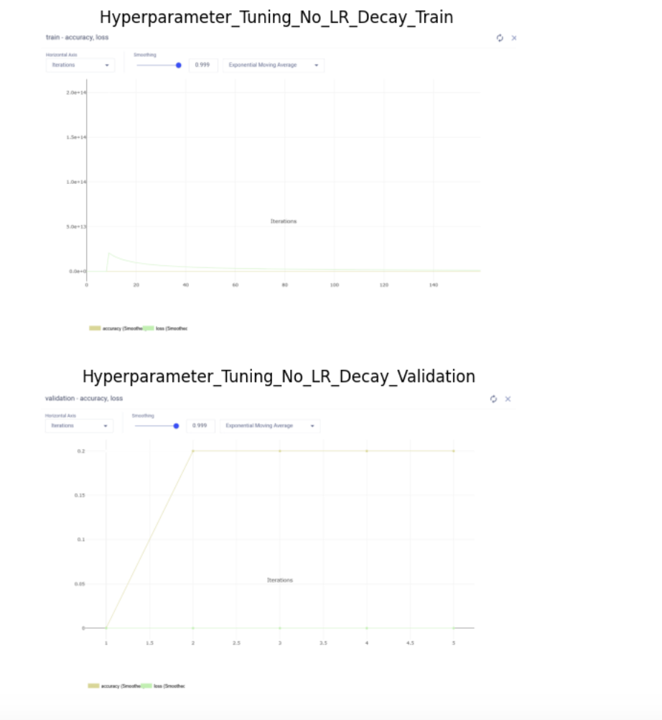
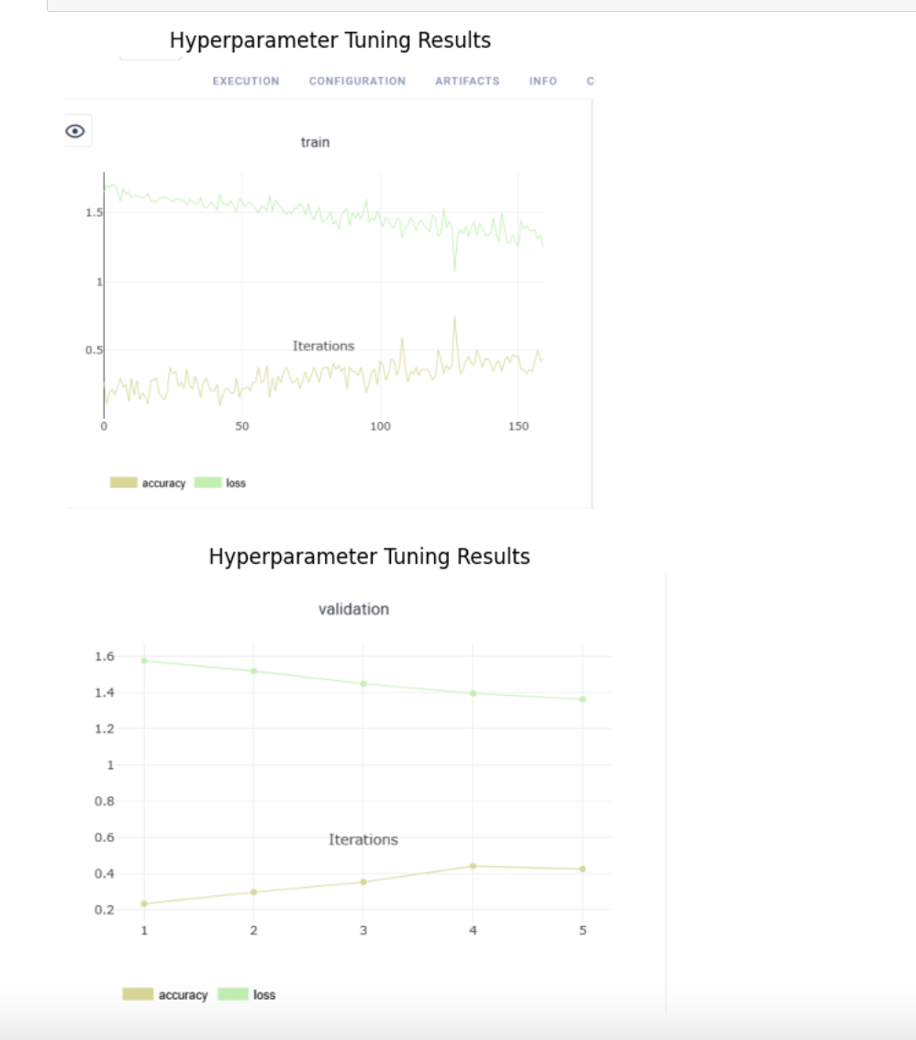
Hyperparameter tuning results

Slide 12
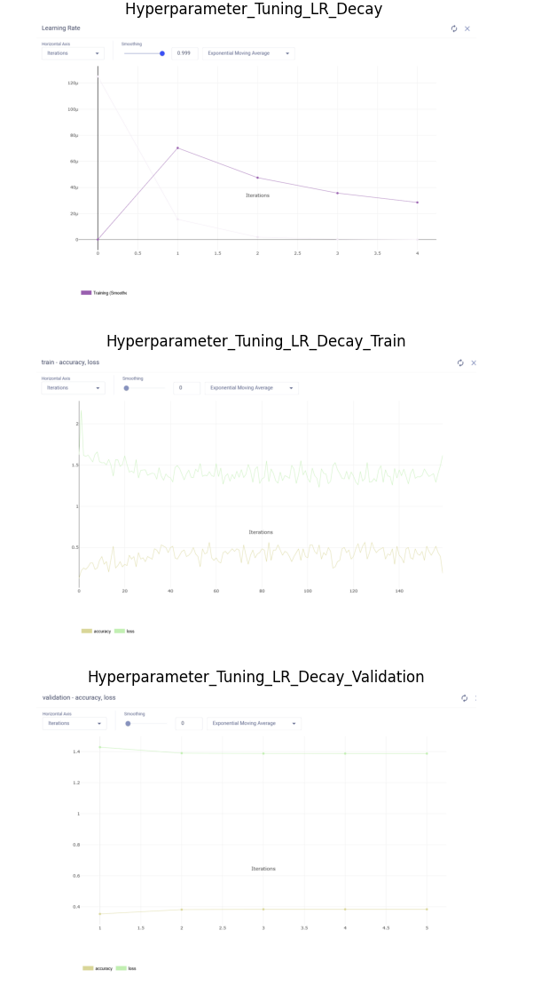
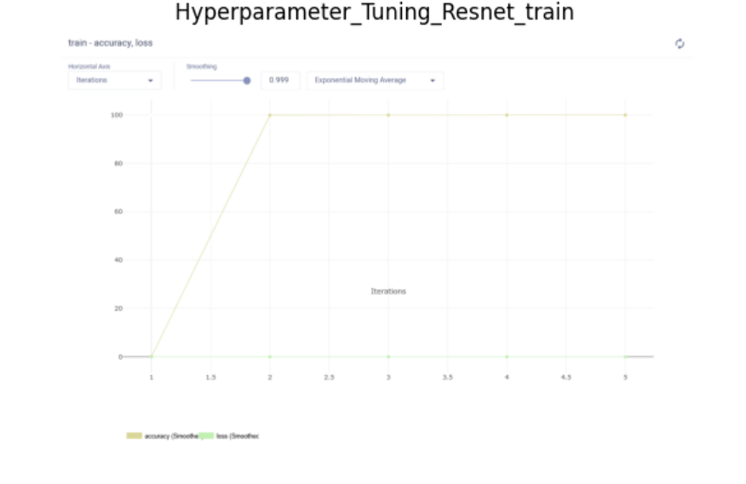
Hyperparameter tuning results

Slide 13
Transfer Learning
Experiment Setup
Model:
Pre-trained ResNet-18 from ImageNet.
Modifications:
Replaced the fully connected layer to match the number of classes (5).
Training Configuration:
Learning Rate: 0.001
Optimizer: Adam
Mini-batch Size: 32
Used transfer learning by freezing earlier layers and fine-tuning the fully connected layers.
Dataset:
Images resized to 224x224 pixels.
Train-Test split as defined earlier.

Slide 14
Results
Accuracy: Achieved 99% accuracy on the validation set.
Metrics: High precision, recall, and F1-score observed (Validation Loss: 0.0092, Accuracy: 99.83%, Precision: 1.0000, Recall: 0.9984, F1: 0.9992).
Comparison: Transfer learning outperformed models trained from scratch due to the pre-trained weights on ImageNet.

Slide 15
Transfer Learning vs Fully trained NN
Compare the performances
Transfer Learning:
Accuracy: Achieved ~99% validation accuracy.
Training Time: Faster due to pre-trained weights.
Generalization: Superior performance on unseen data.
Advantages:
Pre-trained ResNet-18 effectively extracts features.
Minimal training required for fine-tuning.
Fully Trained NN:
Accuracy: Lower (~95%-96%).
Training Time: Significantly longer due to learning from scratch.
Generalization: Struggled with overfitting.
Challenges:
Requires larger dataset to match the performance of transfer learning.
Sensitive to hyperparameter tuning.
Transfer Learning outperformed Fully Trained NN in terms of accuracy, efficiency, and robustness.

Slide 16

Project 2: Identification and Classification of Corrosion Types A Comprehensive Analysis

Slide 17
Data Collection and processing
Data preprocessing is a critical step in machine learning workflows, ensuring that the input data is in an optimal state for model ingestion and training. This section delves into the normalization and transformation techniques employed to enhance the model's performance.

Slide 18
Data Collection and processing
Provide details
Task : This data set contains 200 images We collected a dataset by photographing samples directly at the university, ensuring a diverse and comprehensive representation of the corrosion types under study.
Link to the dataset: https://unhnewhaven-my.sharepoint.com/personal/vswar1_unh_newhaven_edu/_layouts/15/onedrive.aspx?id=%2Fpersonal%2Fvswar1%5Funh%5Fnewhaven%5Fedu%2FDocuments%2FDL%20Project2&ga=1
Number of samples – 200
Image size - 640
Number of classes – 3(Crevice Corrosion, Filiform Corrosion, Uniform Corrosion)
Train– 80% test– 10% and validation- 10%
Data Normalization (mean and standard deviation)
Mean: [0.485, 0.456, 0.406] and Standard Deviation: [0.229, 0.224, 0.225]

Slide 19
Data augmentation techniques
Training Augmentation Techniques:
Random Horizontal Flip (50%)
Random Brightness and Contrast Adjustment (±20%)
Conversion to Tensor for PyTorch
Normalization (Mean: [0.485, 0.456, 0.406], Std: [0.229, 0.224, 0.225])
Prediction Augmentation Techniques:
Resize images to standard resolution (e.g., 256x256)
Normalize using the same mean and std as training

Slide 20
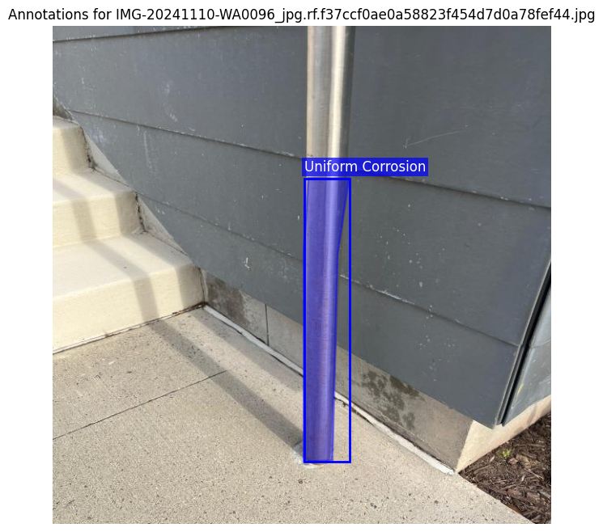
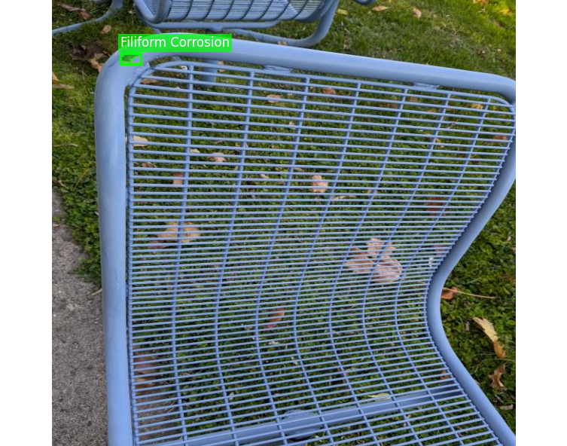
Sample images
Visualize two samples from different classes and their annotations
Data structure of labels for one sample Class ID: 0 (Uniform Corrosion)
Bounding Box:
x_center = 0.5234
y_center = 0.6789
width = 0.1562
height = 0.3407

Slide 21
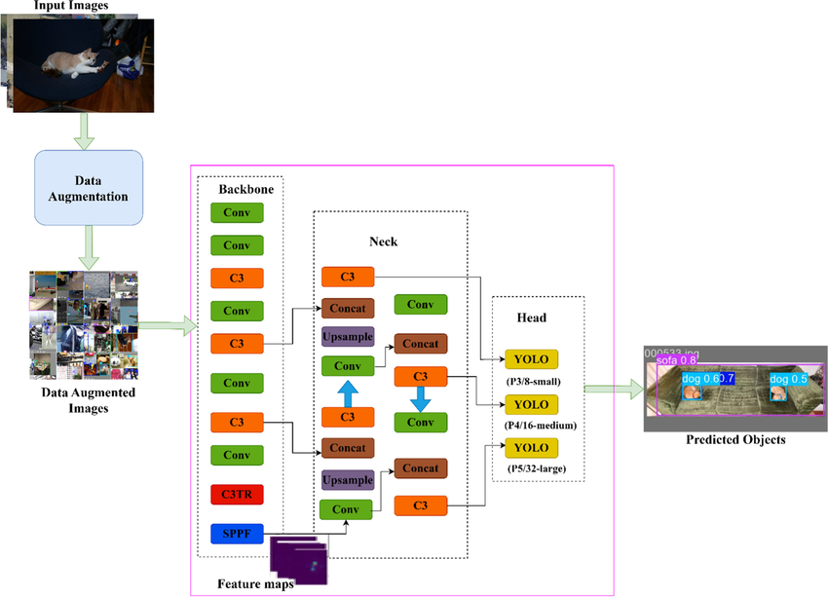
NN
Architecture of the NN using block diagrams

Slide 22
NN
Loss function
Components of Loss Function:
Classification Loss: Penalizes incorrect class predictions using Binary Cross-Entropy Loss.
Bounding Box Regression Loss: Measures localization error with CIoU Loss, considering overlap, distance, and aspect ratio.
Object Loss: Evaluates confidence in bounding box predictions using Binary Cross-Entropy Loss.
Total Loss: Sum of all components to optimize classification and localization tasks.
Computation Process:
Forward Pass: Generates predictions for class labels, bounding boxes, and objectness scores.
Loss Calculation: Compares predictions with ground truth.
Backward Pass: Computes gradients and updates model parameters to minimize total loss.

Slide 23
NN model from pytorch
YOLOv5x Architecture
Backbone:
Architecture: CSPNet (Cross Stage Partial Network)
Function: Extracts hierarchical feature representations.
Advantage: Efficient feature extraction with reduced complexity.
Neck:
Architecture: PANet + FPN (Path Aggregation and Feature Pyramid Networks)
Function: Aggregates multi-scale features for object detection.
Advantage: Improves detection of small and large objects.
Head:
Architecture: YOLO Head
Function: Performs object classification and bounding box regression.
Advantage: Real-time inference capabilities.
Detection Layers:
SPP (Spatial Pyramid Pooling):
Function: Pools features at multiple scales for better context.
Advantage: Detects objects of varying sizes effectively.

Slide 24
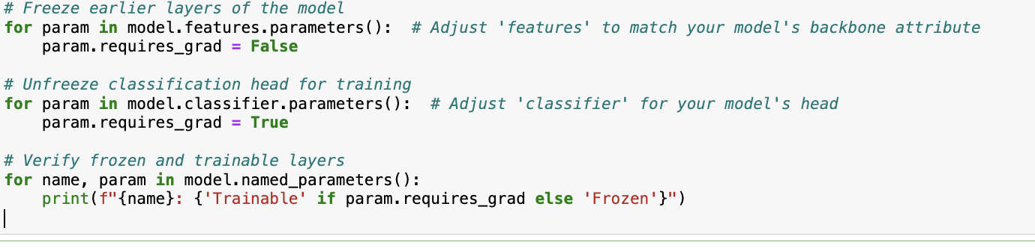
Transfer Learning

Slide 25
Training
Mini-batch size -32
Optimization algorithm and its hyperparameter settings (e.g., learning rate, weight decay)
Adam Optimizer:
Utilized for training the corrosion classification model.
Combines the benefits of:
Momentum for accelerating convergence.
Adaptive learning rate for different parameters.
Learning Rate:
Initial learning rate: 0.005.
Learning Rate Scheduling: Step scheduler reduces the learning rate by a factor of 0.1 every 3 epochs for fine-tuning the learning process.
Weight Decay:
Set to 0.001, preventing overfitting by penalizing large weights.
Momentum:
Momentum value of 0.95 for stabilizing updates during training.

Slide 26
Training
Hyperparameter search Goal: Optimize model performance by tuning key hyperparameters.
Search Method: Grid Search.
Hyperparameters Tuned:
Learning Rate: Range from 0.001 to 0.01.
Batch Size: Values of 16, 32, 64.
Number of Layers: Choices between 2 and 3.
Dropout Rate: 0.1, 0.2, and 0.3.
Results:
Optimal Learning Rate: 0.005.
Best Batch Size: 32.
Model achieved higher accuracy and generalization with fine-tuned hyperparameters.

Slide 27
Pre and post training comparison
Compare losses and performance metric for training, validation, and test (e.g., mAP)
Performance Metrics: Validation mAP (Mean Average Precision): 0.79 Validation Loss: 0.2
Training and Validation Performances:
1. Loss: Both training and validation loss showed a consistent decline over epochs, indicating effective learning. The validation loss stabilized at 0.2, demonstrating minimal overfitting.
2. mAP: The validation mAP improved steadily throughout training, starting from 0.65 and reaching a peak value of 0.79 at the end of 50 epochs.
Compare predictions for two samples before and after training
Pre-Training Results: The model initialized with pretrained YOLOv5x weights (yolov5x.pt) had a baseline validation mAP of 0.68. This baseline performance was suboptimal for corrosion-specific tasks, showing limited detection capability.
Post-Training Results: After training with optimized hyperparameters, the validation mAP improved to 0.79, a relative increase of over 16%. Validation loss reduced significantly from 0.85 at initialization to 0.2, indicating better bounding box localization and classification accuracy.

