Slide 1
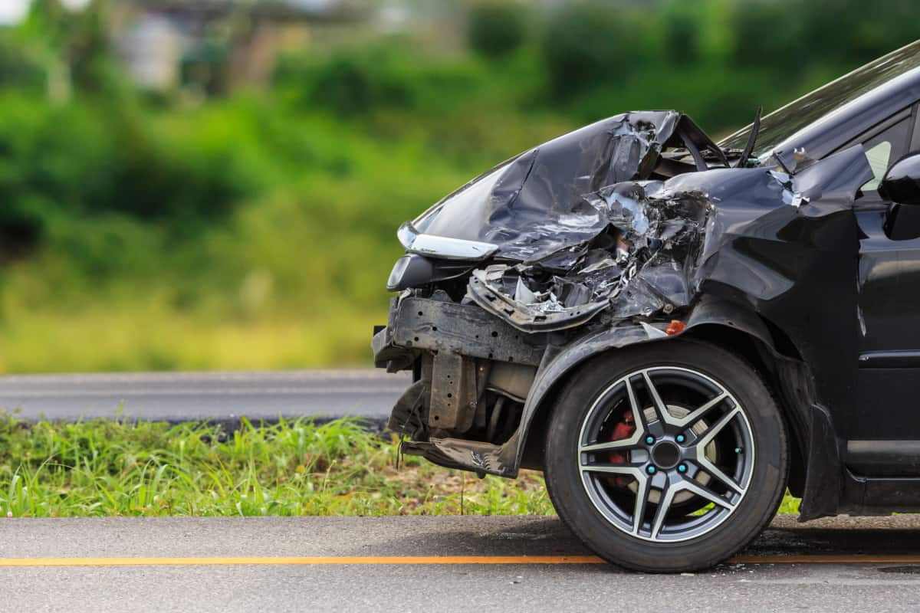

US Accidents Analysis And Severity Prediction

Slide 2





TEAM-2
AMARNATH REDDY
BHAVANA
VENKATESH
MANASA

Slide 3

Table of contents
Objective
About Data
Technologies
Data Pre-processing
Machine Learning Model
Winning Model
Streamlit App Demo
Challenges
Conclusion

Slide 4
Objective
To predict the severity of accidents categorized as '1,' '2,' '3,' or '4' utilizing key features, including distance, wind speed, weather conditions, and more, through the development of a robust and accurate machine learning model

Slide 5
Data
Data is taken from Kaggle US- Accident Analysis
It has 500000 rows × 46 columns

Slide 6
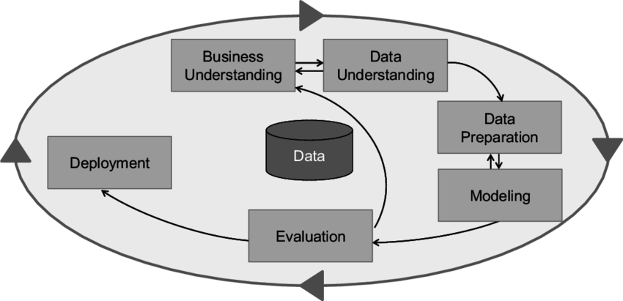
CRISP DM METHODOLOGY

Slide 7
Business Understanding
What would be the accident severity if distance is 35m,temperature 78F is 5F wind chill is 67F wind speed is 78m/hr pressure is 67in humidity is 67 bump is true ,crossing is true ,amenity is True junction is true railway is true ,stop is true , traffic signal True, and if it is night?

Slide 8
DATA UNDERSTANDING
Severity- Shows the severity of the accident, a number between 1 and 4, where 1 indicates the least impact on traffic
.Pressure(inches)
Distance(mi)-The length of the road extent affected by the accident in miles.
Humidity - Represents the amount of moisture or water vapor present in the air.
Wind chill - Refers to the "feels-like" temperature, which takes into account wind speed and temperature
Temperature - Indicates the air temperature at the location.
Wind speed - Represents the speed of the wind at the time of the incident.
Amenity - Indicates the presence (1) or absence (0) of amenities near the location of the traffic incident.
Bump - Indicates the presence (1) or absence (0) of road bumps or speed bumps.
Crossing - Indicates the presence (1) or absence (0) of a road crossing, such as a pedestrian crosswalk.
Junction - Indicates the presence (1) or absence (0) of a road junction.
Railway - Indicates the presence (1) or absence (0) of a railway crossing.
Stop - Indicates the presence (1) or absence (0) of a stop sign or stop signal.
Traffic signal - Indicates the presence (1) or absence (0) of a traffic signal or traffic light.
Sunrise sunset - Indicates whether the incident occurred during daylight or nighttime.

Slide 9
DATA PRE - PROCESSING
Loading Dataset.
Conversion to Datetime
Checking Null Values.
Dropping Null Values.
Exploratory Data analysis and visualization
Train-Test Split(75-25).

Slide 10
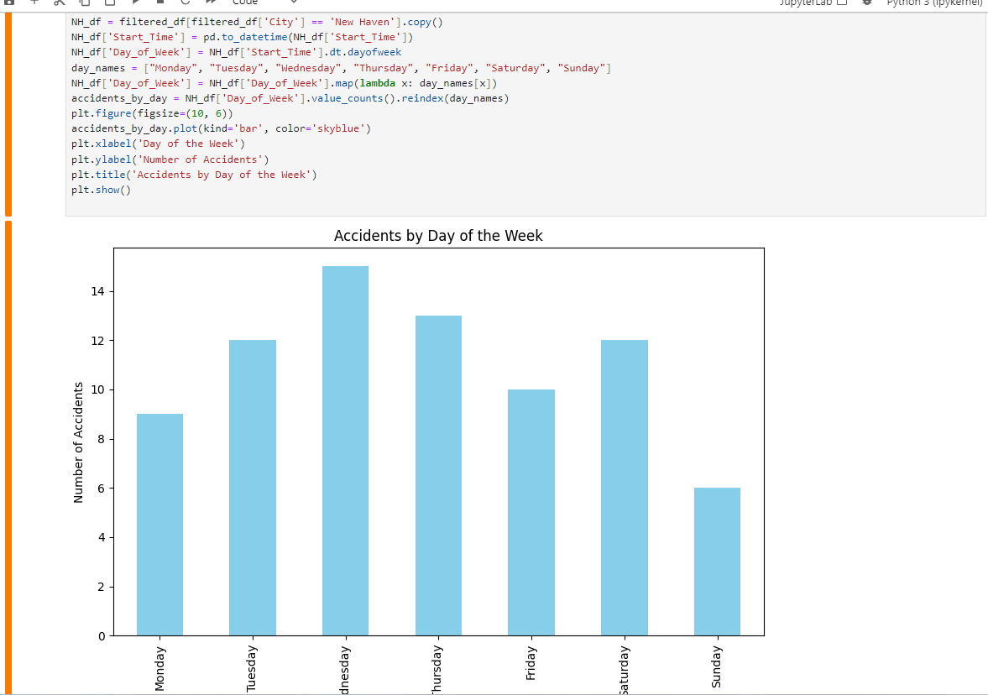
VISUALIZATION

Slide 11
MODELS PERFORMANCE
Random Forest – ROC – AUC Score - 0.7582067197672271
Linear regression – ROC-AUC Score - 0.6723784907287994
SVM – ROC-AUC Score - 0.5794237915422512

Slide 12
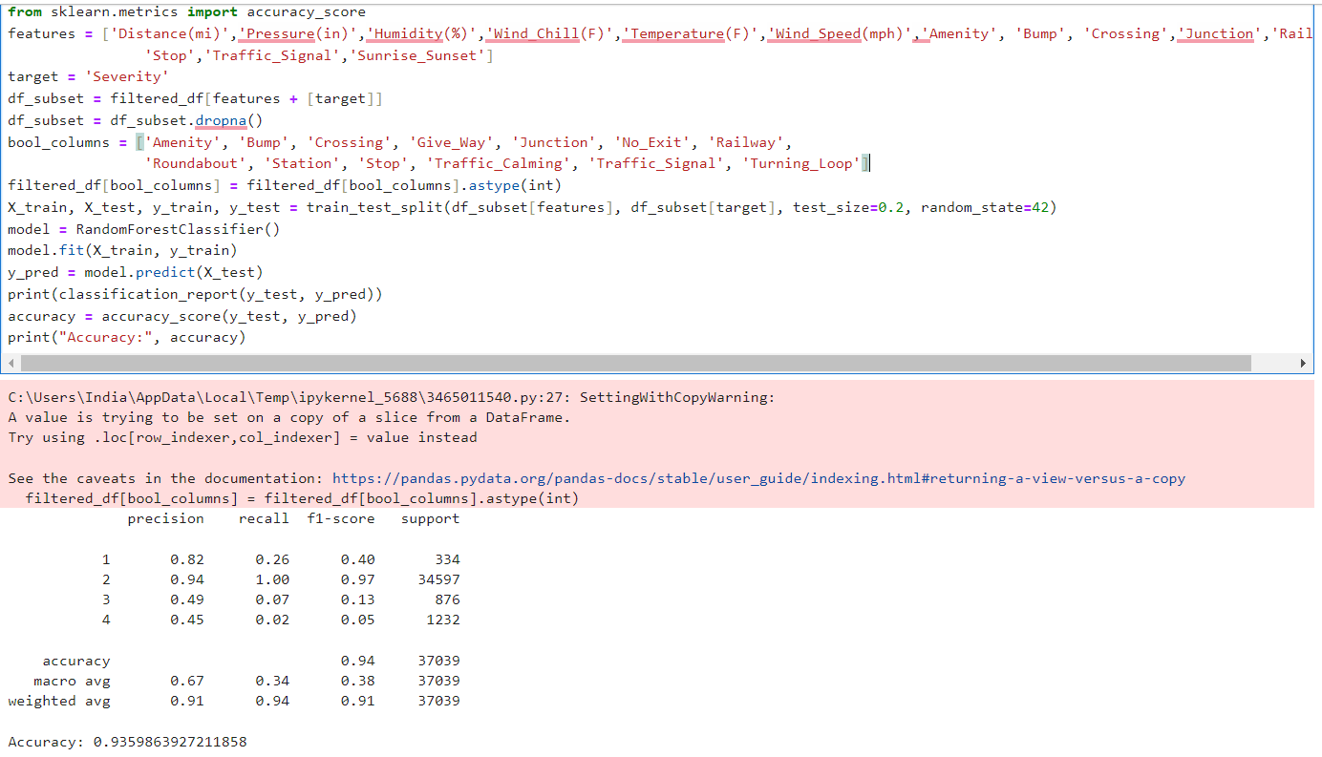
RANDOM FOREST

Slide 13
Winning Model
Clearly winning model is Random forest. So we have implemented this model on our data.

Slide 14
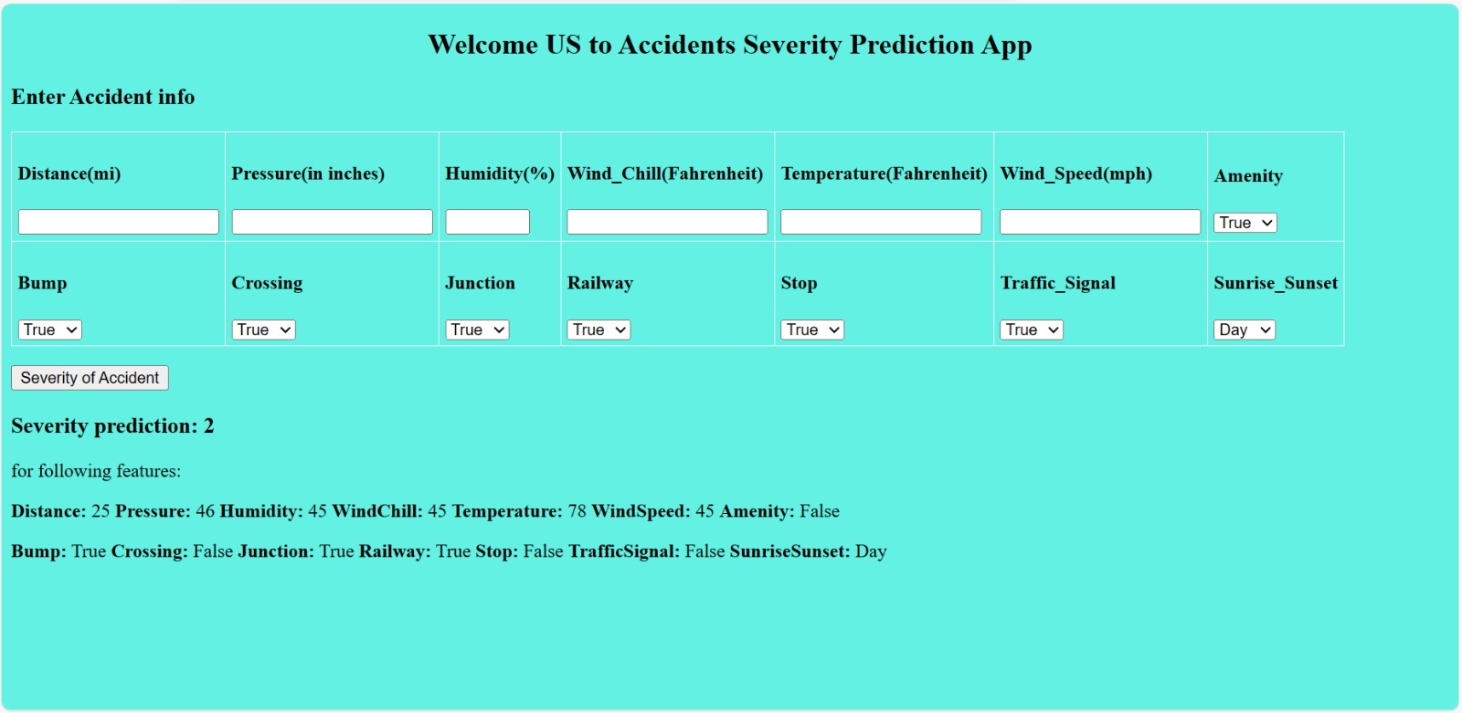
OUTPUT

Slide 15
DEPLOYMENT
https://github.com/VenkateshSwarna/USAccidentsProject

Slide 16
CHALLENGES
Analyzing and predicting accidents in the United States is hindered by challenges such as inconsistent and incomplete data, the need for sophisticated data integration, the dynamic nature of human behavior, and the impact of emerging technologies. Balancing accuracy with privacy concerns adds an additional layer of complexity to this multifaceted problem.

Slide 17
CONCLUSION
In summary, our analysis underscores the urgency of prioritizing road safety in the US. Predictive models for accident severity offer a proactive approach, enabling targeted interventions and enhancing overall transportation safety

Slide 18
REFERENCES
https://www.kaggle.com/datasets/sobhanmoosavi/us-accidents/data
https://www.kaggle.com/code/leandrocassius/analyzing-and-predicting-car-accident-severity

Slide 19


