Slide 1
Maximum Bipartite Matching
via Augmenting Paths
Workforce allocation with role capacities, Hopcroft–Karp, and a proof of optimality
Delta Code 2026 · Problem Statement 1: Linear Algebra & Graph Optimization
Venkatesh Dharavath · M.Sc. Mathematics & Scientific Computing, NIT Warangal
Notes:
Introduce the problem: place as many candidates as possible into capacity-limited roles. Show that greedy loses hires and how augmenting paths recover them.

Slide 2
Greedy hiring leaves people unplaced
2,400
320
6,142
2,039
candidates |U|
roles |V| (3–10 seats)
eligibility edges |E|
total seats Σ c_v
The smallest trap
The fix
Roles X and Y have 1 seat each
Ann fits X or Y; Ben fits only X
Greedy gives Ann X, so Ben is stranded: 1 hire
Ann on Y and Ben on X: 2 hires
First-fit decisions are irreversible
An augmenting path shifts a chain of placed people one step each
Each chain adds exactly one hire; repeat until no chain exists
Notes:
Data is synthetic (seeded) because no dataset came with the statement; the program also accepts real CSVs.

Slide 3
Optimal placement beats greedy by 192 hires
1,709
greedy first-fit hires
1,901
optimal hires (Hopcroft–Karp)
+192
Greedy Capacity Gap (+11.2%)
Notes:
499 candidates stay unplaced in the optimum; 138 seats stay empty because no route connects them to an unplaced candidate (the min-cut certificate).

Slide 4
Two equivalent formulations
Flow network G′
Integer linear program
Source s, sink t
s → u, capacity 1, for each candidate
u → v, capacity 1, if u is eligible for v
v → t, capacity c_v (seats)
Max flow = max hires; an integral flow is a legal assignment
max Σ x_e
s.t. Σ x_e ≤ 1 (candidate u)
Σ x_e ≤ c_v (role v)
x_e ∈ {0,1}
Each column of A has two 1s (its candidate row, its role row): A is totally unimodular, so the LP relaxation is already integral.

Slide 5
Berge’s Lemma: the optimality test
M is a maximum matching if and only if there is no M-augmenting path (alternating, from a free candidate to a free seat).
(⇒) A path gives a bigger matching
(⇐) A bigger matching gives a path
Flip the path: matched edges out, unmatched edges in
Both endpoints were free, interior vertices keep one partner
|M′| = |M| + 1, so M was not maximum
Take M′ with |M′| > |M|; look at M △ M′
Degree ≤ 2, so it splits into paths and even cycles
Some odd path has more M′ edges; its endpoints are M-free: an augmenting path

Slide 6
Hopcroft–Karp in Dinic form, warm-started
1
2
3
4
Greedy start
BFS levels
DFS blocking flow
Repeat
Pre-load the greedy assignment as flow, so every fix found repairs a specific greedy mistake
Label vertices by distance from s over pipes with spare capacity; if t is unreached, stop: optimal
Walk only level k → k+1, push one unit per path, prune dead ends with current-arc pointers
Shortest path length strictly grows each phase: 5, 7, 9, 11 edges on our data
Only 4 phases were needed from the greedy start (5 from scratch).

Slide 7
Complexity: O(|E|√|V|)
One phase costs O(|E|)
About √N phases
BFS touches each edge once
Every edge except (v,t) has capacity 1, so it carries at most one path per phase
Current-arc pointers: each edge is a dead end at most once
Total path work ≤ |E| + #paths
After √N phases the shortest fix has ≥ √N edges
Candidates have unit throughput, so leftover fixes are disjoint, each using ≥ √N/2 candidates
At most 2|U|/√N ≤ 2√N remain; each phase fixes ≥ 1
Observed: 4 phases, far below √N ≈ 52

Slide 8
Code structure and design choices
generate / load_csv
greedy
Seeded synthetic data or validated real CSVs; original ids preserved
First-fit baseline that defines the gap
Network
bfs / blocking_flow
Hand-written flow graph; edge e and its reverse e^1 stored together
Iterative level graph + DFS, no recursion limit
verify + min-cut
ilp_solve / draw
Feasibility check; residual BFS gives the optimality certificate
scipy milp & linprog benchmark; networkx used only for drawing and flow validation

Slide 9
Optimality is certified three independent ways
Berge
Min-cut
Solvers
1,901
1,901
1,901
No augmenting path remains: residual BFS cannot reach t
Capacity of the cut around vertices reachable from s equals the flow
networkx max-flow, scipy milp (ILP) and linprog (LP) all agree
The program asserts all three on every run and aborts on any disagreement.

Slide 10
How one greedy mistake is undone
C1173 takes R219
C0540 vacates R219
C0540 takes R300
C0768 vacates R300
C0768 takes R060
C0700 vacates R060
C0700 takes R277
C2215 vacates R277
C2215 takes R017
Green: a new placement. Red: a candidate gives up the seat greedy had given them (a backward residual edge)
C1173 had no open role because greedy filled R219 early; four earlier hires each shift one step and the chain ends at R017, which still had a free seat
5 placements and 4 removals: net +1 hire, nobody loses a job
Notes:
This is chain 1 of 192 augmenting paths found from the greedy start. All 192 were multi-step chains; the longest had 11 edges.

Slide 11
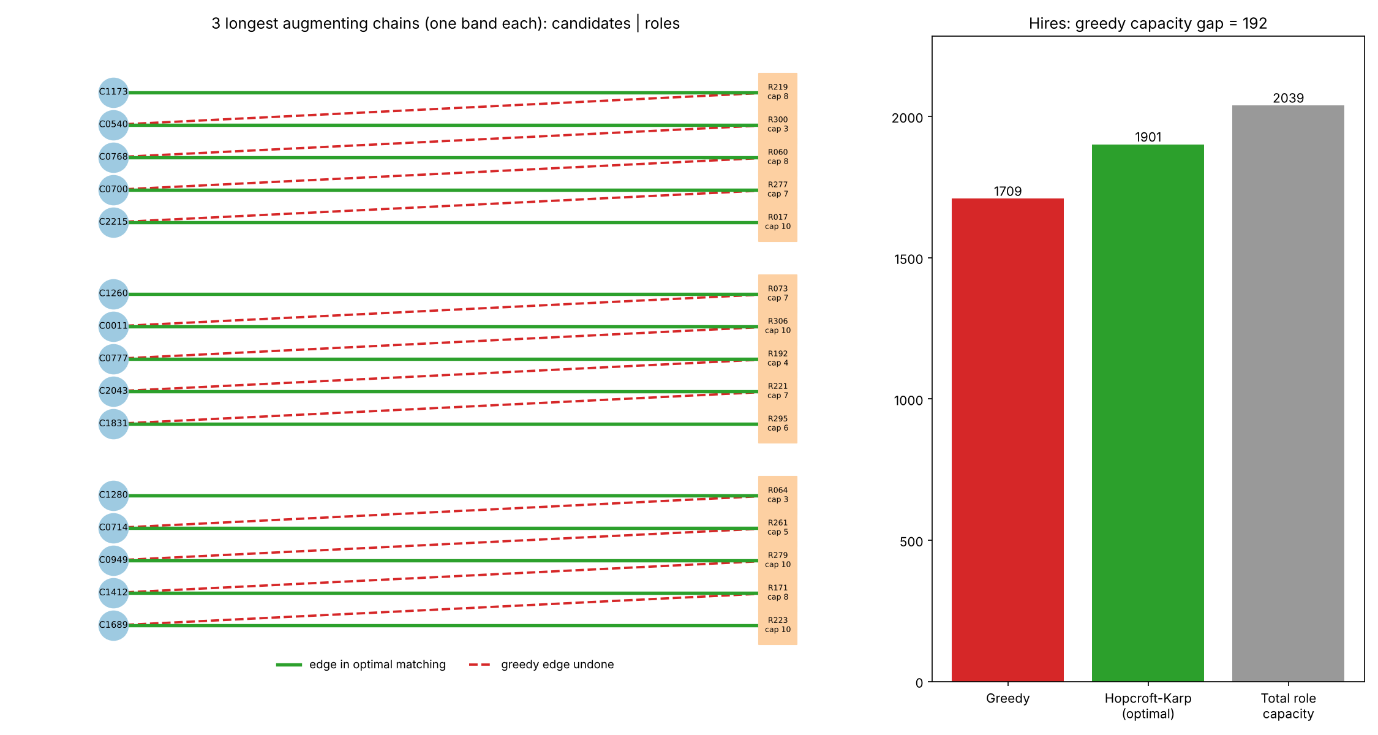
Visualization: chains and the gap
Green: edge in the optimal matching
Red dashed: greedy edge that was undone
Each band is one chain; the staircase is the “everyone shifts one seat” move
Right panel: the 192-hire gap

Slide 12
Hopcroft–Karp scales gently and beats the ILP
|U| | |E| | HK ms | ILP ms | ILP / HK
1,200 | 3,053 | 19 | 73 | 3.8x
2,400 | 6,101 | 31 | 102 | 3.3x
4,800 | 12,236 | 75 | 295 | 3.9x
9,600 | 24,732 | 230 | 842 | 3.7x
Size ×8.1 (|E|) → HK time ×12, about |E|^1.19, inside the |E|√|V| bound (×23). Main instance: HK 25 ms, LP 35 ms, ILP 123 ms.

Slide 13
Trade-offs between methods
Method | Optimal? | Speed (main instance) | Best used when
Greedy first-fit | No: 1,709 | 0.4 ms | Instant estimate; never reconsiders
Hopcroft–Karp (ours) | Yes: 1,901 | 25 ms | Pure matching; provable O(|E|√|V|)
LP relaxation | Yes (integral) | 35 ms | Extra linear constraints, weights
ILP (milp) | Yes: 1,901 | 123 ms | Side constraints that break the flow model
Key trade-off: the flow engine is 3–4x faster and carries a proof; the ILP is more general but offers no better answer here.

Slide 14
Constraint adherence and edge cases
Guaranteed on every run
8 automated tests
Only eligible roles assigned
No role exceeds its capacity
Warm and cold runs agree
Min-cut = max-flow = networkx = ILP = LP
300 random small instances vs networkx
Real string ids kept; duplicate edges collapsed
Zero-capacity roles; more candidates than seats
Candidates with no edges; empty input
Clear errors: unknown role, negative or non-integer capacity, duplicate role, missing column
A 40-step forced augmenting chain

Slide 15
Takeaways
Greedy leaves 192 hires (11%) on the table because its choices are irreversible
Augmenting-path repair recovers all of them in 4 phases, with nobody losing a job
Berge’s Lemma, a matching min-cut and three solvers certify 1,901 as optimal
O(|E|√|V|) engine, 3–4x faster than an ILP, tested on edge cases
Caveat: data is synthetic; run allocate.py with --edges and --roles on real data
Repository: allocate.py · assignment.csv · matching_vis.png · report.md · README.md

