Slide 1
RAShR
Repeated Angular Shorth Regression
angles on the
projective circle
Fit a line by asking which direction pairwise chords agree on, not which line has small residuals.
Based on “Robust Linear Regression via the Repeated Angular Shorth” — V. Dharavath & V. Srivastava, NIT Warangal
Notes:
Title. The whole deck follows one story: coherent contamination fools residual-based fits; pairwise chord directions, concentrated twice with the shorth, do not get fooled — within limits.

Slide 2
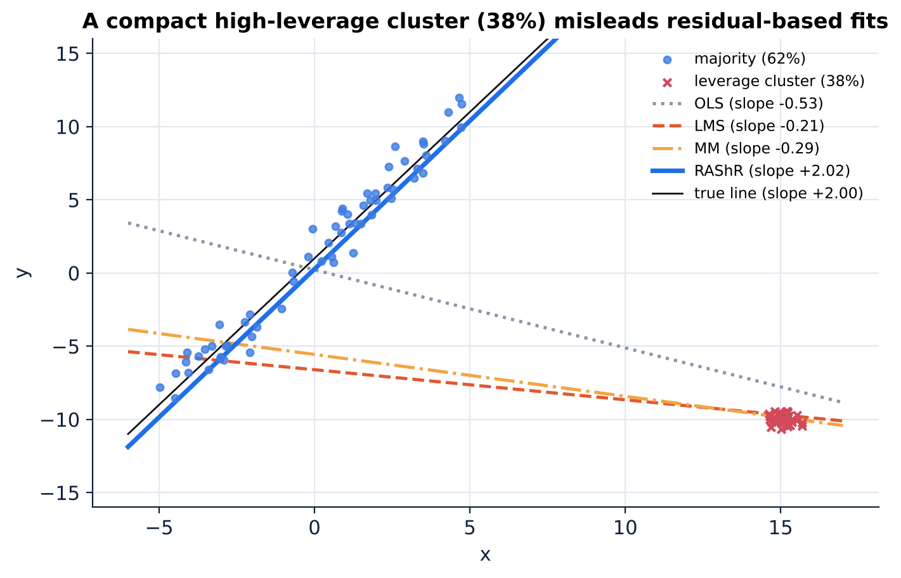
A robust fit can still follow the wrong line
+2.02
−0.20
RAShR slope (paper)
LMS slope (paper)
−0.26
−0.53
MM slope (paper)
OLS slope (paper)
Why surprising?
High breakdown means the estimate stays bounded — not that it follows the dominant structure.
Our re-creation; paper's exact sample not available.
Notes:
Figure re-created from the paper's setting (seed 3). Paper values: OLS -0.53, LMS -0.20, MM -0.26, RAShR +2.02, truth +2.00.

Slide 3
Vocabulary, built up step by step
Outlier vs contamination
Coherent contamination
High leverage
Outlier: one unusual point. Contamination: observations not following the main pattern — possibly many.
Contaminated points related to each other: a compact cluster or a competing line.
x far from the bulk of the x-values → strong pull on the slope.
Breakdown point
Residual-based method
Chord
Fraction that can be replaced before the estimate can be driven arbitrarily far: a boundedness guarantee.
Judges candidate lines by residuals y_{i} − ŷ_{i}: LMS, LTS, MM…
The segment joining two points. It has a direction; it is not a regression line.

Slide 4
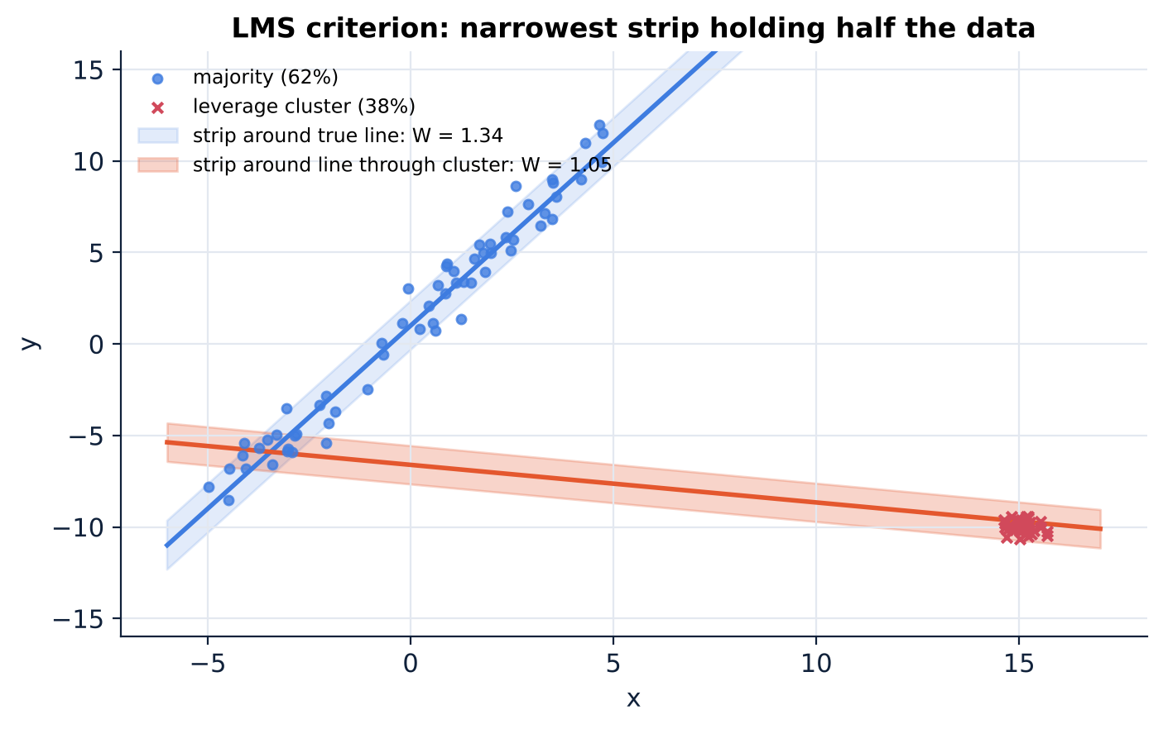
Why residuals mislead: a narrow strip through the cluster
Reading the picture
• The true line needs positive width because of noise.
• A line through a point-mass cluster only needs a little extra mass from the majority.
• As contamination → ½, that width → 0.
• Proved for population LMS only; LTS/MM are studied empirically.
Notes:
W(l) is the smallest half-width of a vertical strip around l containing half of the mass. Proposition 3 formalises this for population LMS.

Slide 5
The central shift
Instead of asking “Which line produces small residuals?”
RAShR asks “Which direction receives the strongest agreement from pairwise chords?”

Slide 6
Related work as one story: pairwise slopes → pairwise directions
Theil–Sen
Repeated median
LMS / LTS
MM
median of all pairwise slopes
breakdown ≈ 29%
median of per-anchor medians
50% breakdown; rank effect
narrow strip / trimmed residuals
coherent cluster can win
robust start + M-step
efficient, inherits start
RANSAC
Hough transform
Shorth
Directional regression
2-point models, count inliers
strong on some geometries
votes in parameter space
mode seeking
shortest half-interval
→ RAShR building block
orientation as geometry
→ same spirit
Each method: geometric object → what it measures → limitation → link to RAShR

Slide 7
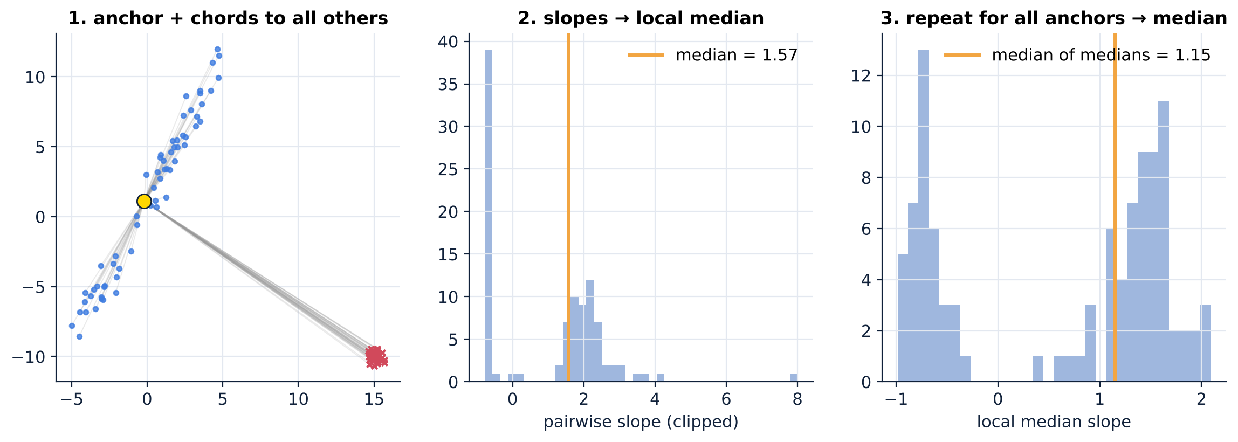
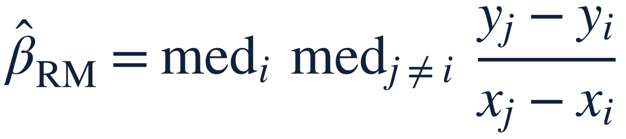
Siegel's repeated median: median of local medians
1 anchor
›
2 chords
›
3 slopes
›
4 local median
›
5 all anchors
›
6 median of medians
Bridge to RAShR
Keep the pairwise-geometric idea; replace slope/median aggregation by angular concentration through the shorth.

Slide 8
RAShR
02
points → chords → directions → projective angles → angular shorth → local directions → repeated shorth → slope → intercept → line

Slide 9
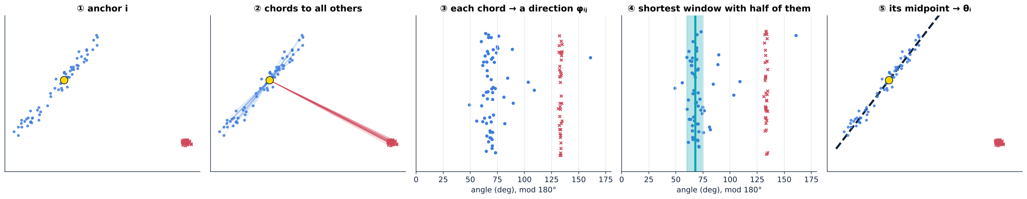
The whole path, in one picture
points
›
standardize
›
chords
›
directions φ
›
projective angles
angular shorth
›
local θ_{i}, w_{i}
›
repeated shorth θ-hat
›
slope β-hat
›
intercept α-hat

Slide 10
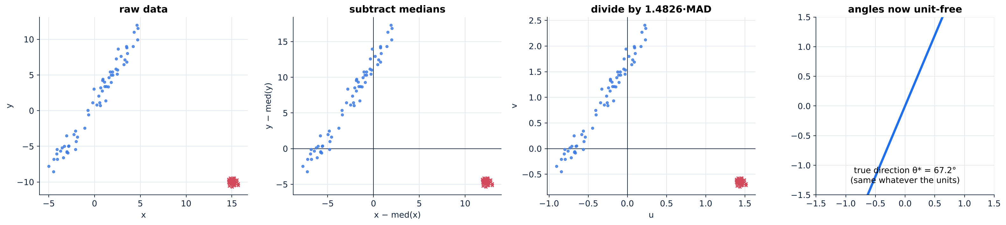
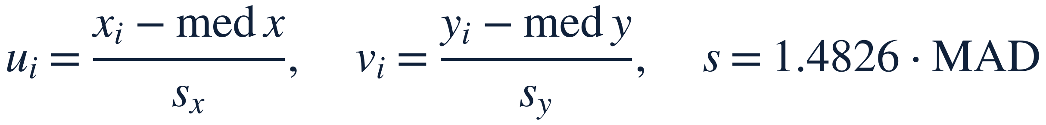
Step 1 — Angles depend on units, so standardize robustly
Details from the paper
1.4826·MAD = normal-consistent scale. If MAD = 0, use the standard deviation of that coordinate.
original data → robust centre → robust scale → standardized data

Slide 11
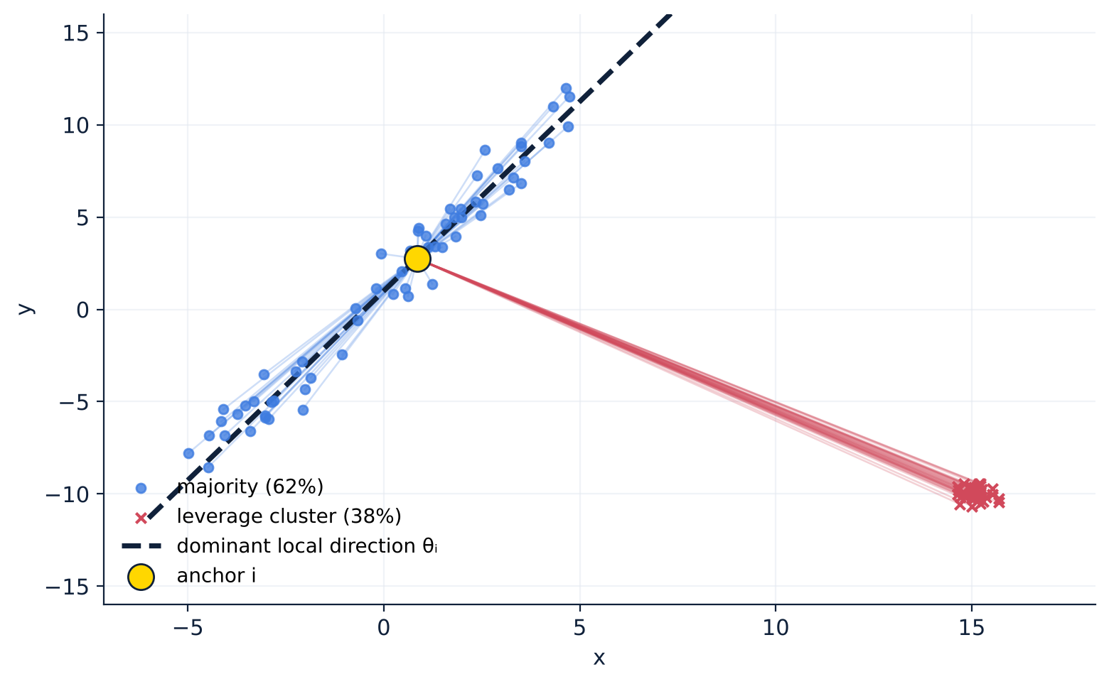
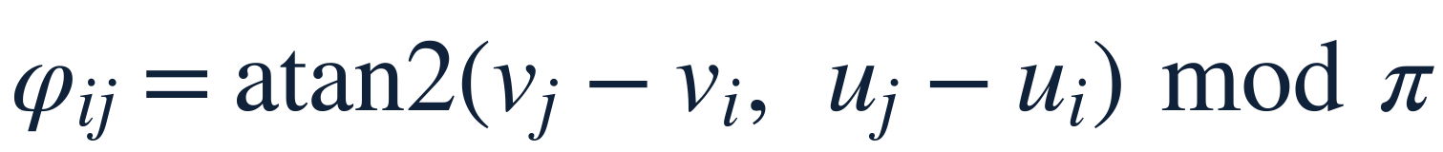
Step 2 — A chord is a vector; its direction is atan2
Why atan2?
• It uses the vector (Δu, Δv), not the ratio Δv/Δu.
• A nearly vertical chord (Δu ≈ 0) is harmless.
• Majority–majority chords (blue) fan out near the true direction; chords to the cluster (red) all share one very different direction as seen from this anchor.

Slide 12
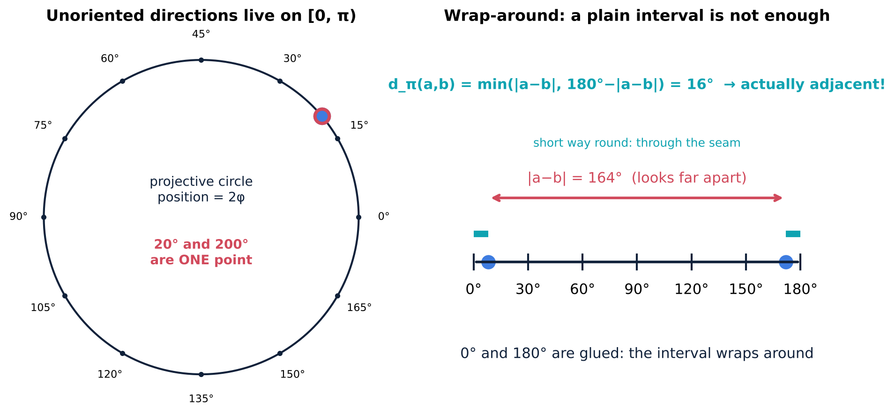
Step 3 — The projective circle: a line has no orientation
20° ≡ 200°
Opposite directions are the same unoriented line, so directions live on [0, π) with 0 and π glued.
Wrap-around
5° and 175° are only 10° apart. An ordinary real interval cannot represent an arc crossing the seam.

Slide 13
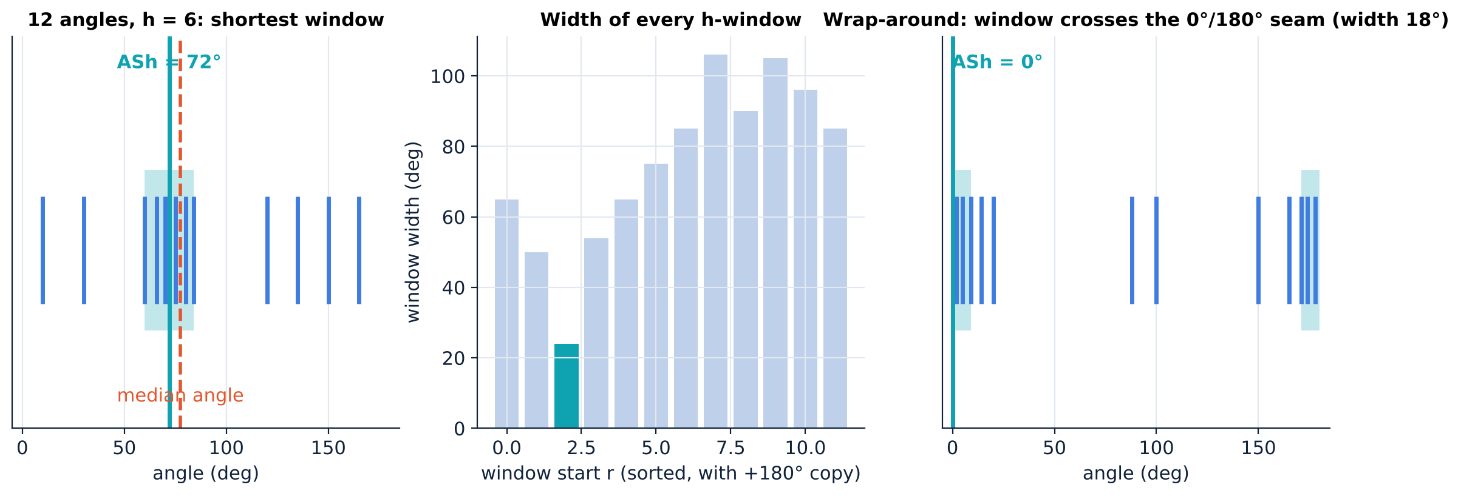
Step 4 — Angular shorth: the shortest arc holding half the angles
on circle
›
sort
›
copy + π
›
slide h-windows
›
measure widths
›
shortest wins
›
midpoint
Shorth ≠ median
Median angle = middle-ranked. Shorth = centre of the strongest concentrated half. Ties → smallest left endpoint.

Slide 14
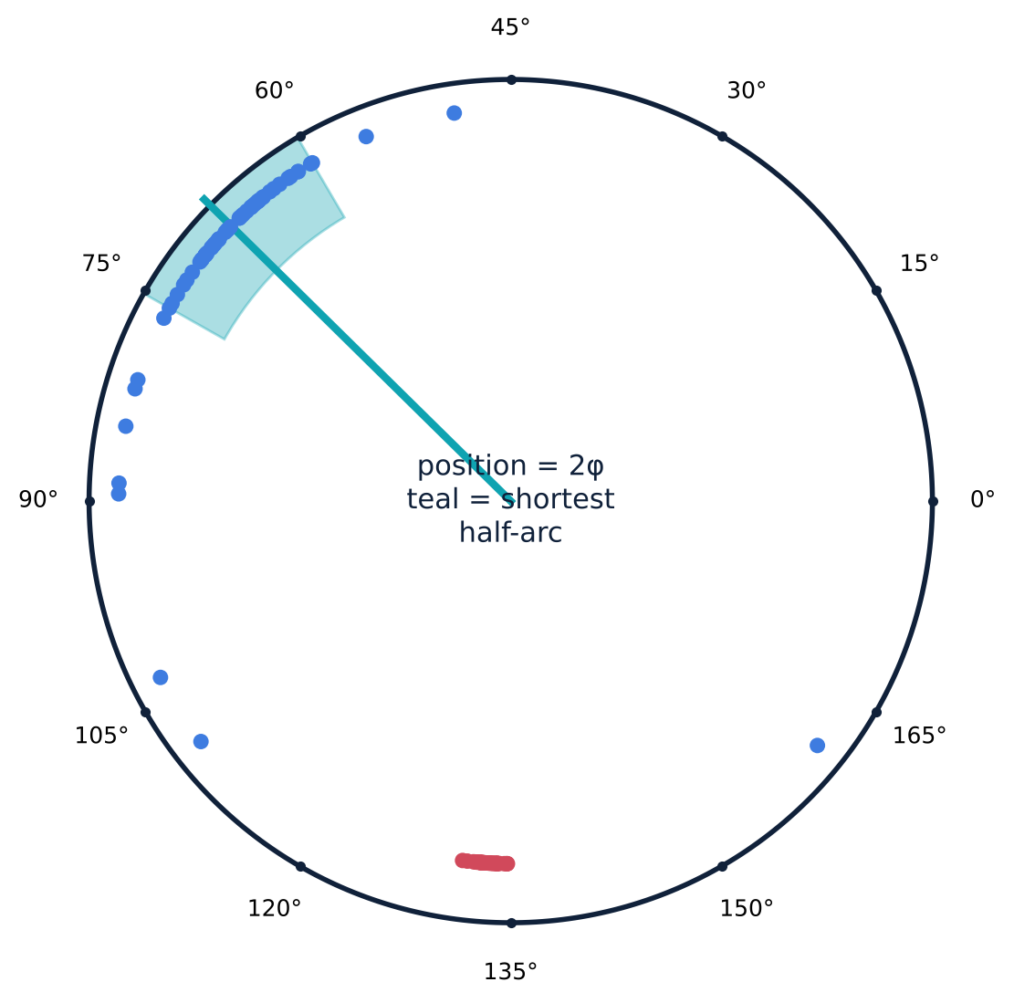
Step 5 — Local direction: what one anchor sees
Small w_{i}
Large w_{i}
Strong directional agreement from anchor i.
Weak agreement; no clear direction from this anchor.
On the circle
Blue dots: chords to majority points. Red dots: chords to the cluster. The teal arc is the shortest half-window; its midpoint is θ_{i}.

Slide 15
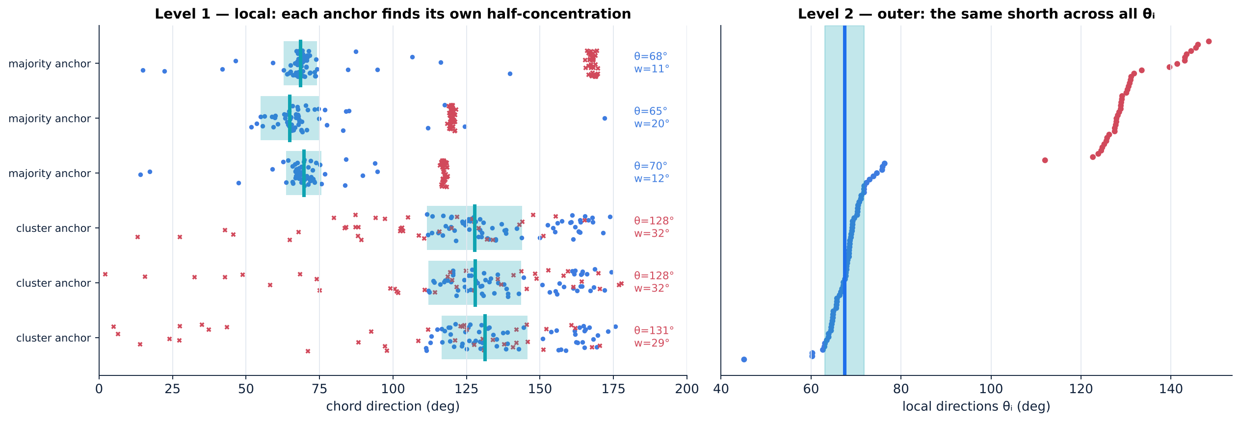
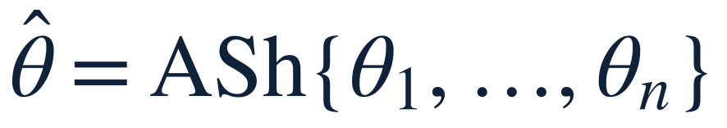
Step 6 — Repeated: the same shorth, twice
Local aggregation
Outer aggregation
inside each anchor's n − 1 chords (h_{L} = ⌈(n−1)/2⌉)
across the n local directions (h_{O} = ⌈n/2⌉)

Slide 16


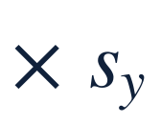
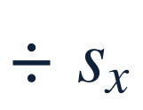

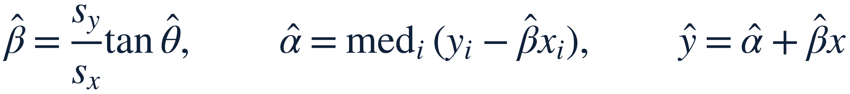
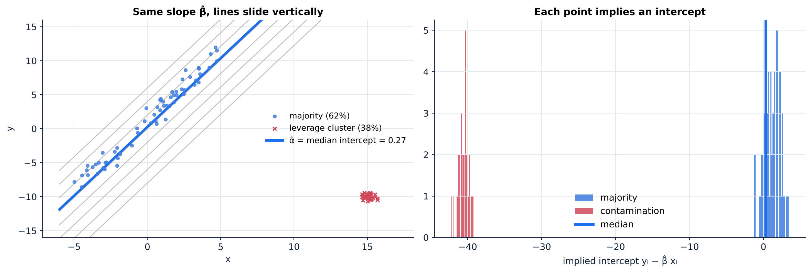
Step 7 — Back to the original scale
›
›
›
›
Honest caveat
α-hat is a median over all observations. With 38% contamination at (15, −10) it can be pulled even when β-hat is right; the paper evaluates the slope.

Slide 17
Algorithm and cost
raw observations
O(n² log n)
O(n)
robust standardization
pairwise chord directions
time: n anchors × sort n−1 angles
extra memory, one anchor at a time
local shortest half-window
vs exhaustive subset search
local directions θ_{i}
Direct LMS/LTS subset search is O(n³) in the paper's implementations. Same order as a direct repeated median.
second angular shorth
original-scale slope β-hat
Deterministic
median intercept α-hat
No random sampling. Ties go to the smallest left endpoint, so the same data always give the same line.
final line

Slide 18
Theory through geometry
03
statement → meaning → geometry → experiment → significance

Slide 19
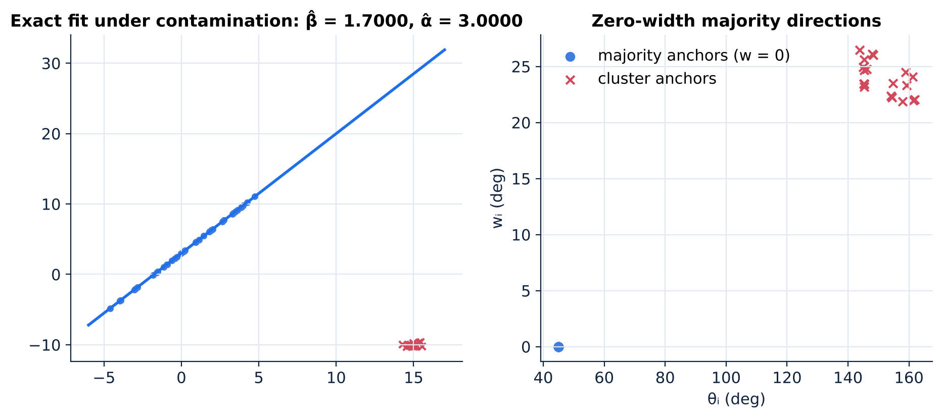
Proposition 1 — Exact fit (and Corollary 1)
Statement
If y_{i} = α* + β*x_{i} with distinct x_{i}, then (α-hat, β-hat) = (α*, β*).
All chords share one direction → all shorth widths are 0.
Corollary 1 — exact fit under contamination
If the majority lies exactly on a line, no contaminated point is on it, and |B| < ⌈(n−1)/2⌉, the line is recovered wherever the contamination is: a group smaller than the half-sample cannot form a competing zero-width window. (Shared with LMS and the repeated median.)

Slide 20
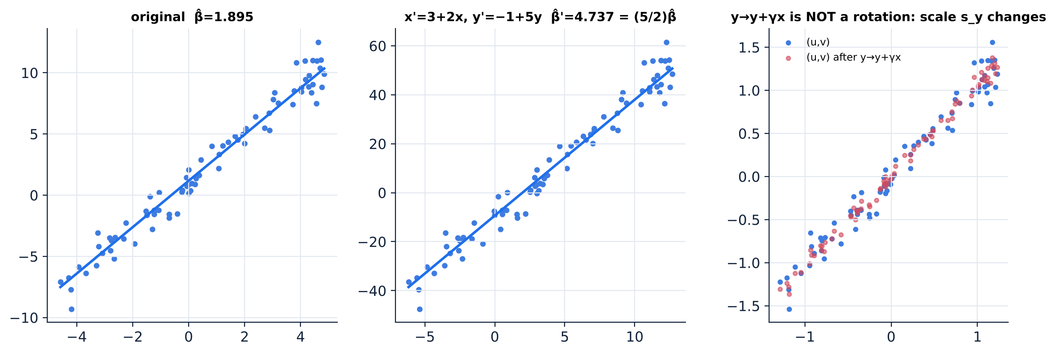
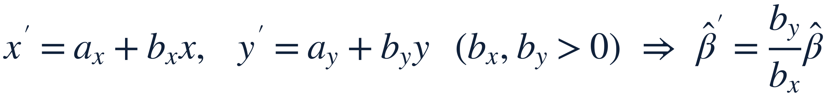
Proposition 2 — Translation and positive-scale equivariance
Limitation
Not fully affine equivariant: y → y + γx changes s_{y}, so it is not a simple rotation of the standardized data.
Standardization removes translation and positive rescaling, so the same chords and shorths are selected.

Slide 21
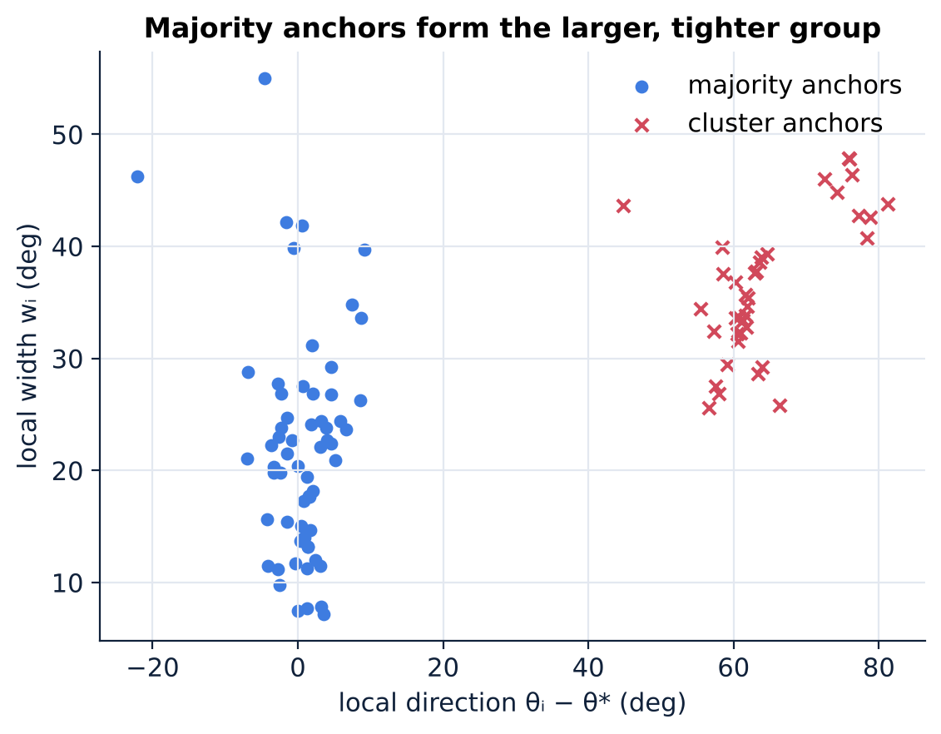
Separation: lemma, local condition, outer condition
Lemma 1
(L) Local
If every arc with ≥ h elements that touches B is strictly wider than A's shortest arc, then ASh(A ∪ B) = ASh(A).
At each majority anchor, majority–majority chords form a narrower half-window than any involving contamination.
(O) Outer
Size
Majority-anchor directions form a narrower half-sample window than any involving contaminated anchors.
|G| > n/2 ⇒ |G|−1 ≥ h_{L} and |G| ≥ h_{O}: both stages can be built from majority points alone.

Slide 22
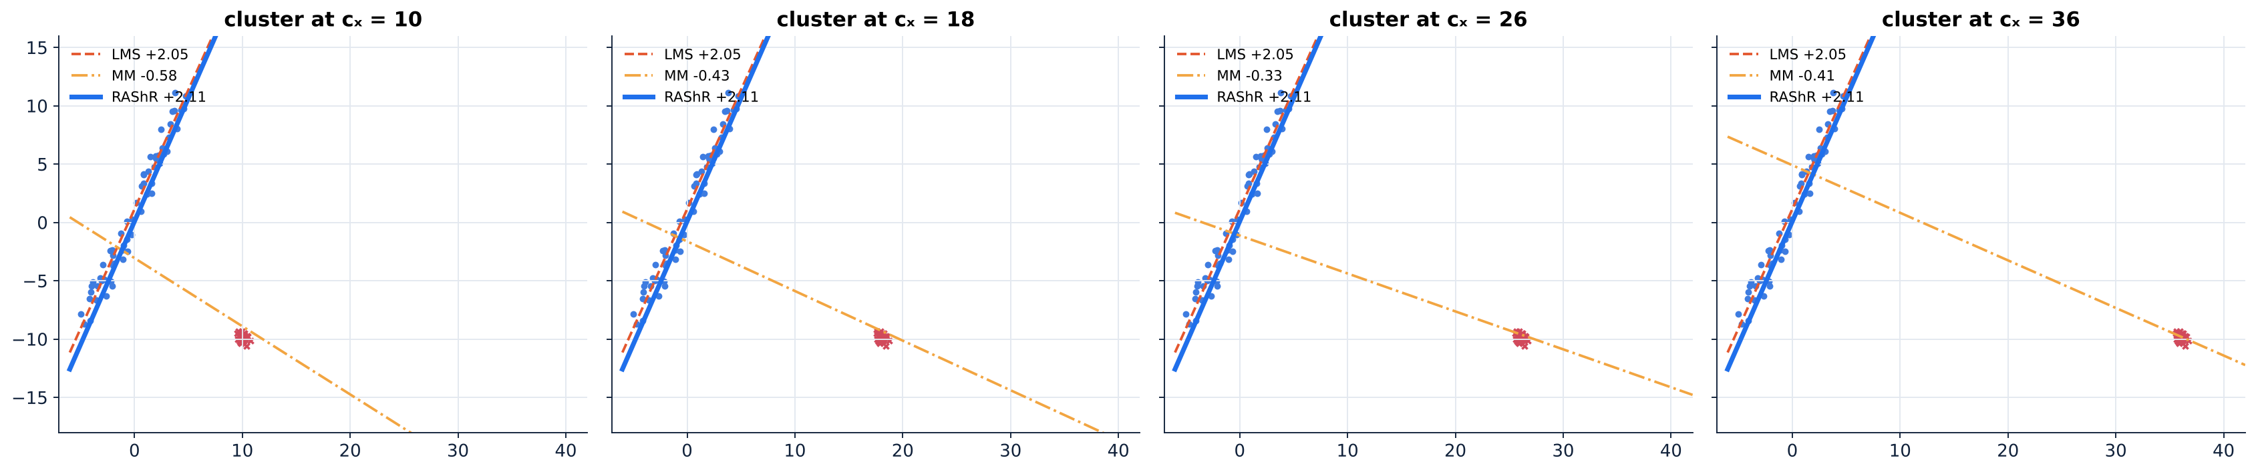
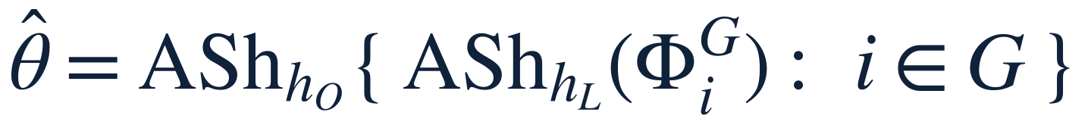
Theorem 1 — Zero influence of separated contamination
What it says
Once (L), (O) and |G| > n/2 hold, moving, adding or removing contaminated points does not change β-hat.
Caveat: the standardization medians/MADs must stay unchanged — contamination can still affect Eq. (2).
Paper: slope exactly 2.058 once the cluster is far enough (its sample). Ours differs (different sample); the constancy is the point.
Notes:
Cluster at cx=10,18,26,36 with majority fixed. In our run RAShR stays at the same slope; paper reports 2.058 on its sample.

Slide 23
Proposition 3 — Why coherent contamination can attract LMS
Model
(X, Y) ~ (1−ε)P_{G} + ε δ_{c}, with P_{G}: Y = α* + β*X + e, e ~ N(0, σ²). The point mass c is at vertical distance Δ > 0 from the majority line.
Statement
There is ε₀ < ½ such that for ε ∈ (ε₀, ½) every population LMS solution ℓ has |c_{y} − ℓ(c_{x})| ≤ W(ℓ) with W(ℓ) → 0 as ε ↑ ½. The majority line is not an LMS solution.
Scope
Proved for population LMS, asymptotically in ε ↑ ½. For LTS and MM only empirical evidence (Section 5), no theorem.

Slide 24
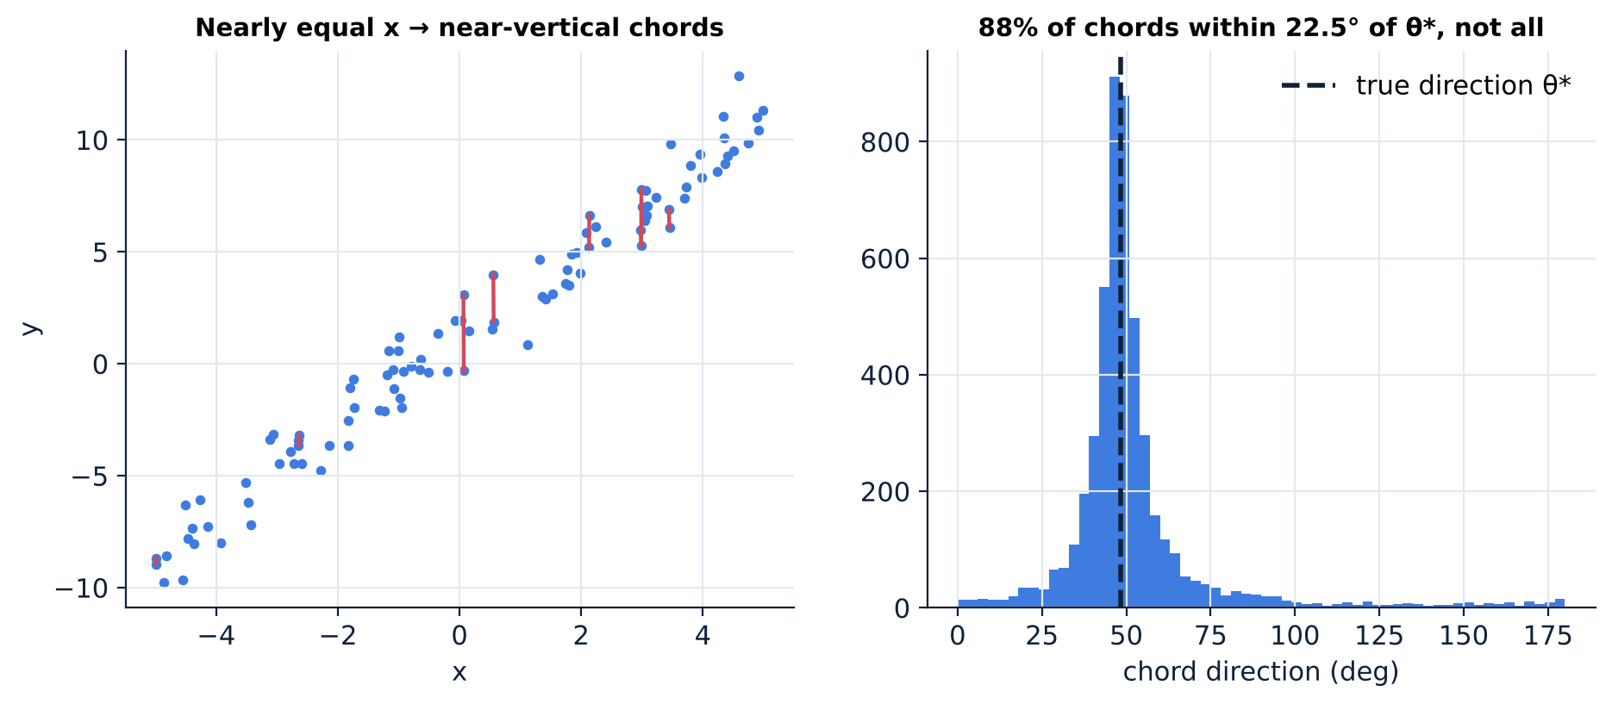
Remark — why “all chords near θ*” is too strong
The problem
Two points with almost equal x and a little vertical noise give a chord with an almost arbitrary direction. Requiring every majority chord within δ < π/8 of θ* is far too restrictive for noisy data.
What RAShR needs instead
Concentration of a half-sample of chords — exactly what the shorth detects — not concentration of all of them.

Slide 25
Simulation evidence
04
where RAShR helps — and where it does not

Slide 26
Simulation design (paper, Section 5)
Data
Competitors
n = 100, x ~ U[−5, 5], y = 1 + 2x + e, e ~ N(0, 1)
A fraction f is replaced by:
① compact leverage cluster at (15, −10), spread 0.3
② competing line y = 5 − 1.25x + e_{c}, e_{c} ~ N(0, 0.5²)
③ funnel: majority sd 0.2 + 0.6|x| plus a line with sd 0.3
Metric |β-hat − 2|; failure = |β-hat − 2| > 0.5; 60 replications.
LMS · LTS (10 best elemental fits + 20 C-steps) · MM (LTS start, MAD scale, Tukey bisquare) · RANSAC (2-point samples, MAD-based threshold, 1000 trials)
Reproducibility note
All curves in this deck come from our re-implementation with fixed seeds. Some constants (e.g. RANSAC's threshold) are not fully specified, so we compare patterns; the paper's own numbers are shown separately.

Slide 27
Limitation first: RAShR is not universally better
Paper — median |β̂ − 2|
Take-away
setting | RAShR | MM | RANSAC
Clean data | 0.033 | 0.024 | 0.022
20% vertical contamination | 0.040 | 0.027 | 0.037
10% bad leverage | 0.041 | 0.020 | 0.021
At low contamination or in standard settings MM is generally the more efficient choice. RAShR's advantage needs a contaminating group that is both large and geometrically coherent.
This project's re-implementation (100 reps)
setting | RAShR | LMS | LTS | MM | RANSAC
Clean | 0.043 | 0.054 | 0.051 | 0.022 | 0.022
20% vertical | 0.034 | 0.052 | 0.056 | 0.023 | 0.056
10% bad leverage | 0.042 | 0.054 | 0.067 | 0.022 | 0.022
20% competing line | 0.045 | 0.070 | 0.060 | 0.032 | 0.061

Slide 28
Failure rate vs contamination (our re-implementation)
Failure = |β̂ − 2| > 0.5. Below ≈30% the high-breakdown methods behave alike; between ≈35% and 46% they separate. Compact cluster at 46%: every method fails.
Notes:
Native charts built from results/simulation_results.json (60 replications). Paper's own values are on the next slide.

Slide 29
What the paper reports (Figure 2 text)
(a) Compact leverage
(b) Competing line
(c) Funnel + line
36%: RAShR 0 · LMS 2 · LTS/MM 23 · RANSAC 50
40%: RAShR 0 · LMS 58 · LTS/MM 100 · RANSAC 77
44%: RAShR succeeds in 40% of samples; every competitor fails in ≥ 97%
46%: all methods fail
RAShR: no failures through 46%
At 46%: LMS 60 · LTS/MM 93 · RANSAC 12 · RAShR 0
RANSAC remains a strong competitor on this geometry
40%: RAShR 0 · LMS 25 · LTS 62 · MM 60 · RANSAC 5
44%: RAShR 3 · LMS 83 · LTS 100 · MM 98 · RANSAC 40
46%: RAShR 8
Not a general “near-50%” guarantee
A finite regime (≈ 35–46%) in which RAShR can stay near the majority line after several established methods have begun to follow the competing structure. All numbers: failure rate in %.

Slide 30
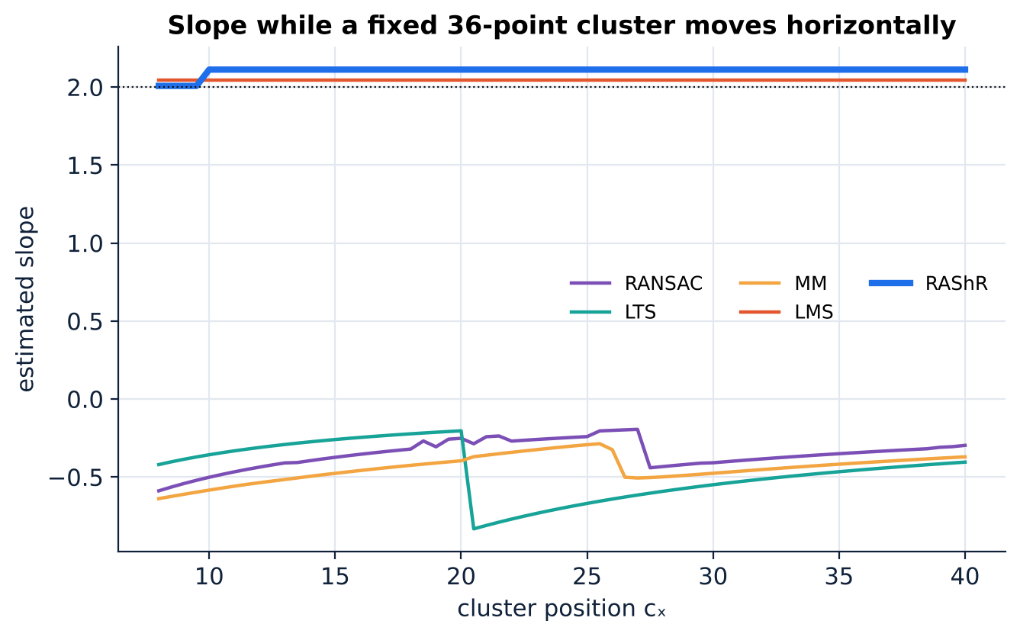
Figure 3 geometry: a moving cluster, and the 2.058 plateau
2.058
RAShR slope once the cluster is far enough (paper's sample)
Reading it
RAShR's slope becomes exactly constant — consistent with Theorem 1. Residual-based fits (LTS, MM, RANSAC) jump to the cluster when it is closer; each has a different switching point.
Our sample's plateau value differs from 2.058 (different majority sample); constancy is the point.

Slide 31
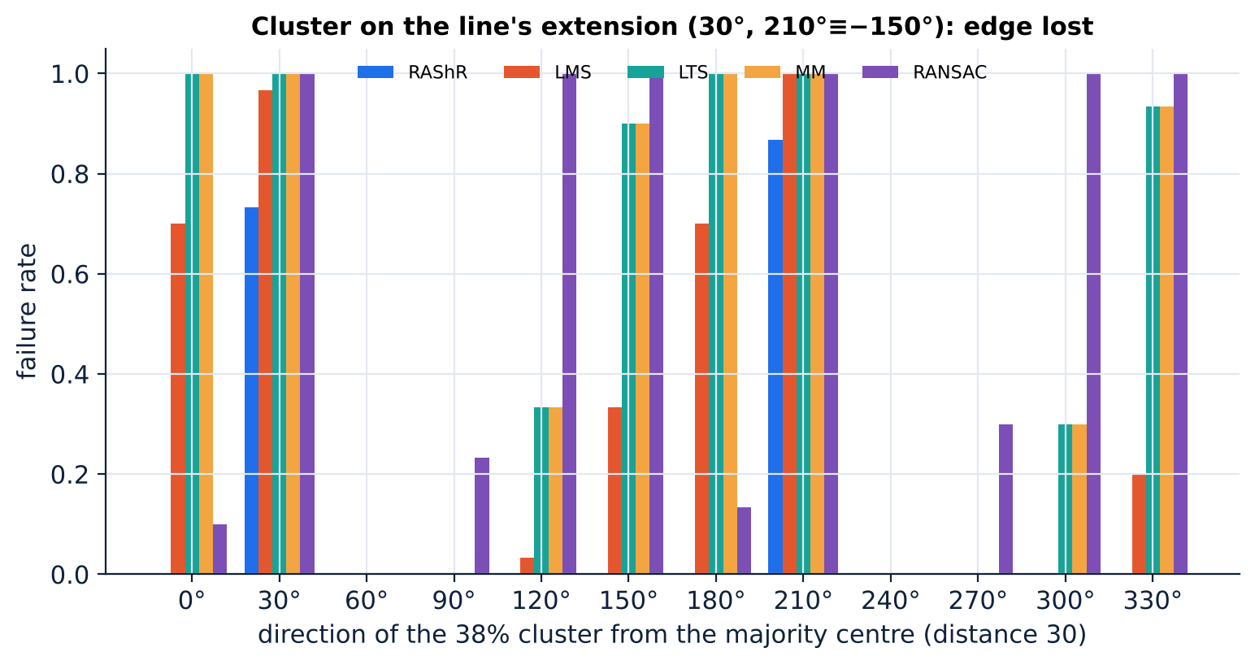
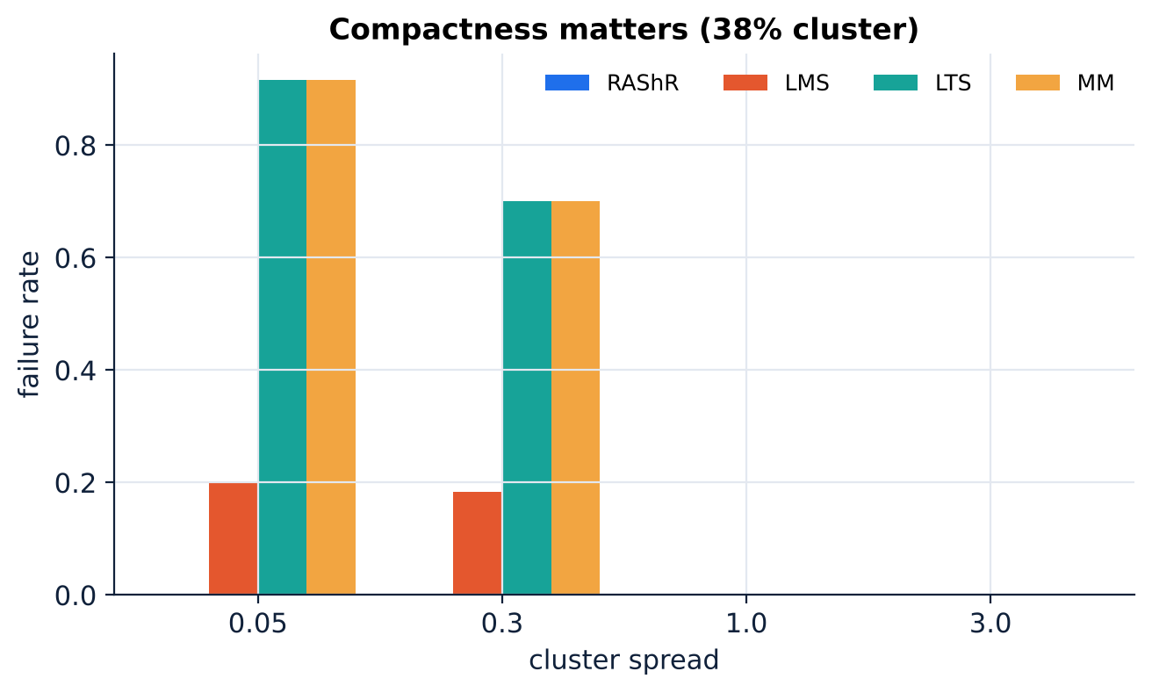
When the advantage disappears
Direction ≈ 30° / −150°
Compactness
Cluster on the extension of the majority line. −150° ≡ 30° on the projective circle, so chord directions overlap and separation is lost (paper: 78% and 75% failure at distance 30).
Spread 0.05: RAShR 0 failures, LMS 25%, LTS/MM ≈ 98% (paper). Spread 1 or 3: all fail ≤ 2% — the cluster is no longer a compact coherent group.

Slide 32
When is RAShR useful?
Use it when
Prefer MM / RANSAC when
Known limits
≈ 35–46% of the data form a compact, coherent structure that is angularly separated from the majority line, and a deterministic estimator is wanted.
Data are clean or lightly contaminated, contamination is diffuse or arbitrary, or efficiency matters most.
Cluster on the line's extension (≈ 30°, −150°); compact cluster at 46%: all fail; not fully affine equivariant; scales and intercept use all data.
direction, not residual → concentrate twice → robust slope
Companions: Manim video · HTML deck · Beamer · notebooks · Streamlit lab

