Slide 1
Alarm Clock System
Web frontend for the C-based OS project
Team No. 3
2520030071 G. Hemanth Venkatesh
2520030314 B. Rishik
Guide: Dr. Hema

Slide 2
Overview
The C program is a terminal menu app that runs one child process per alarm.
The frontend gives it a visual dashboard in a single HTML file.
It mirrors the same features, PIDs and process life cycle.
Built with plain HTML, CSS and JavaScript, no libraries.
2

Slide 3
C program to frontend mapping
C code | Frontend
display_dashboard() | Live clock, stats and tables
create_delay_alarm() | Delay tab (seconds)
create_datetime_alarm() | Date/time tab with daily repeat
start_alarm() / fork() | Child PID assigned per alarm
snooze / cancel (SIGTERM) | Snooze and Cancel buttons
alarm_history() | History table
save_alarms() | Browser storage
3

Slide 4
Key features
Dashboard
Two alarm types
Live clock plus total, active and completed counts
Delay in seconds, or exact date/time with daily repeat
Priority levels
Process view
Low, Medium and High on every alarm
Child PID, parent PID and state per alarm
4

Slide 5
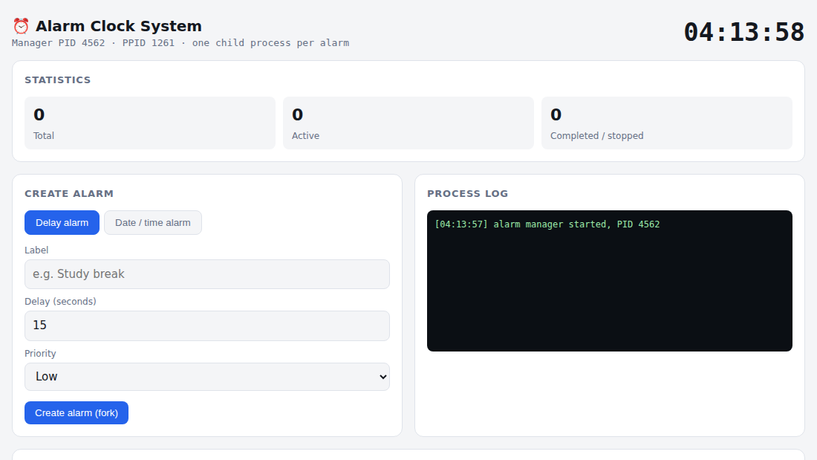
Screenshot: dashboard
5

Slide 6
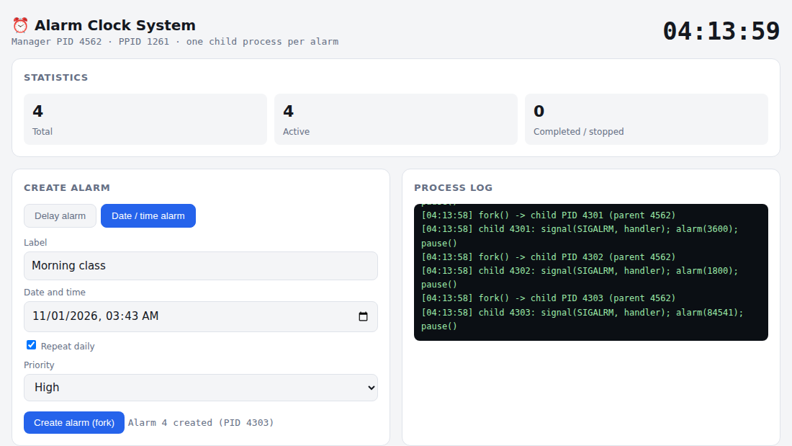
Screenshot: creating alarms and process log
6

Slide 7
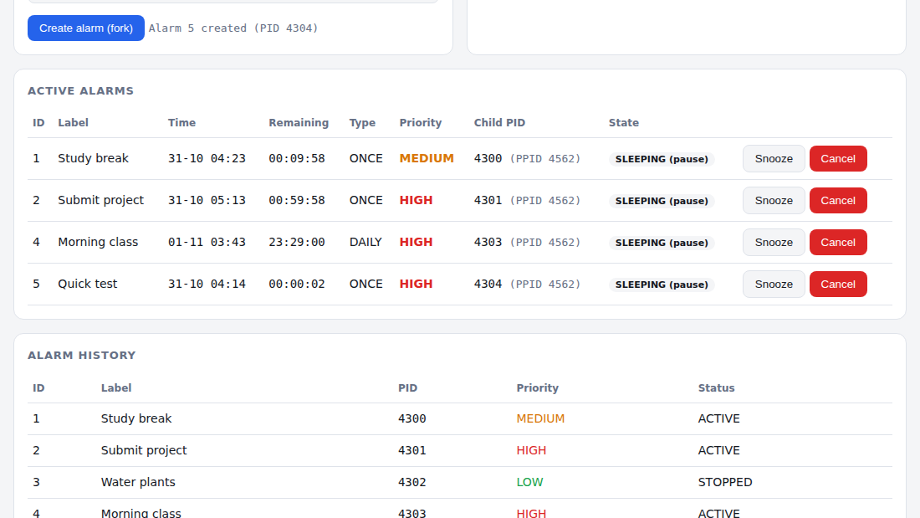
Screenshot: active alarms and history
7

Slide 8
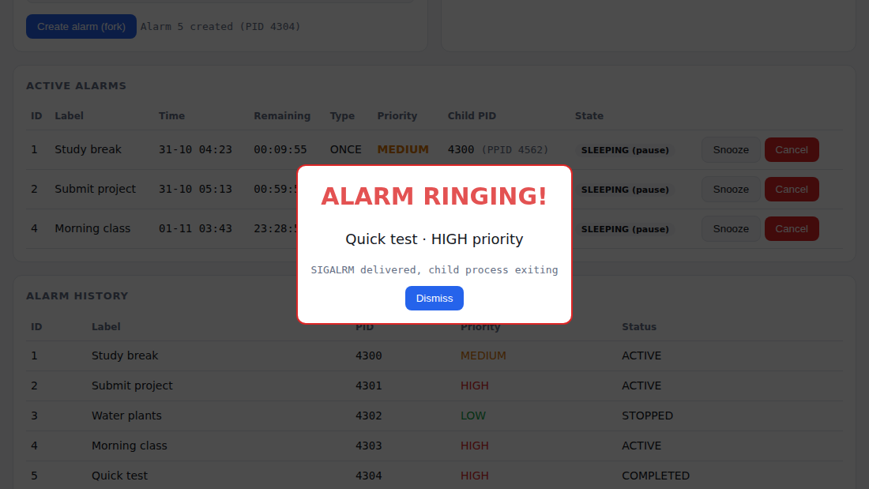
Screenshot: alarm ringing
8

Slide 9
Code: creating an alarm
function fork(a, target){
a.pid = nextPid++; // simulated child PID
a.target = target;
a.active = 1;
log("fork() -> child PID " + a.pid);
log("child: signal(SIGALRM); alarm(n); pause()");
}
function create(){
...
A.push(a);
fork(a, tg); // like start_alarm()
save(); // like save_alarms()
render();
}
9

Slide 10
Code: when an alarm rings
function tick(){ // runs every 500 ms
A.forEach(function(a){
if (a.active && a.target <= Date.now())
ring(a); // SIGALRM delivered
});
}
function ring(a){
...
if (a.recurring) { // like update_alarms()
a.target += 86400000; // +24 hours
fork(a, a.target); // new child process
} else {
a.active = 0; a.status = "COMPLETED";
}
}
10

Slide 11
OS concepts demonstrated
Process creation
fork() creates one child per alarm
Signals
alarm() schedules SIGALRM and the handler rings
Blocking
pause() keeps the child sleeping until the signal
Termination
SIGTERM and waitpid() on cancel and snooze
11

Slide 12
Future work
Connect the page to the real C binary through a small backend (Node or Python).
Show real process states from /proc.
Add sound choices and custom snooze presets.
12

Slide 13
Thank you
Alarm Clock System · Web frontend for the OS project

