Slide 1

PROJECT ON
"WORLD WIDE ENERGY CONSUMPTION
USING SQL"
By – Venkatesh V. Karnure

Slide 2
INTRODUCTION
In this project, we used Structured Query Language (SQL) to analyze a comprehensive dataset containing information on:
Energy production and consumption
Gross Domestic Product (GDP)
Carbon emissions and population statistics
By writing and executing SQL queries, we extracted meaningful insights related to:
Country wise energy trends
Emission patterns over time
Economic and environmental performance comparisons.

Slide 3

OBJECTIVE
Ensure data consistency and integrity by implementing primary and foreign keys.
Retrieve, manage, and manipulate datasets efficiently using SQL.
Analyze the relationship between GDP growth and energy/emission trends.
Utilize SQL queries to extract, compute, and visualize meaningful insights from structured datasets

Slide 4
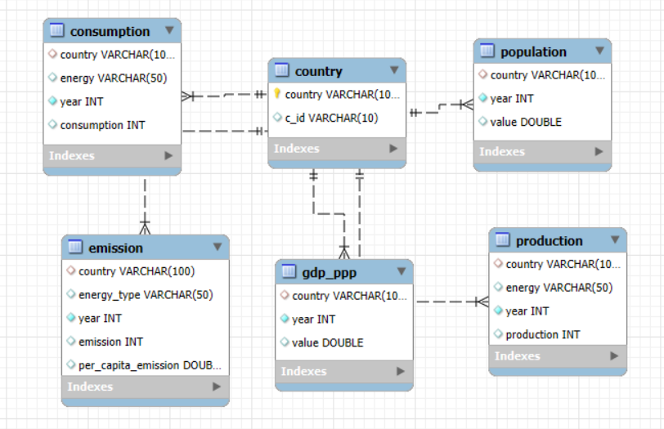
ER - DIAGRAM
Table | Primary Key | Foreign Key(s)
country | c_id | None
consumption | (country, energy, year) | country → country.c_id
population | (country, year) | country → country.c_id
production | (country, energy, year) | country → country.c_id
emission | (country, energy_type, year) | country → country.c_id
gdp_ppp | (country, year) | country → country.c_id

Slide 5

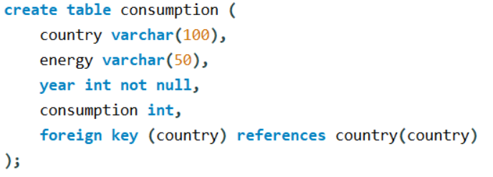

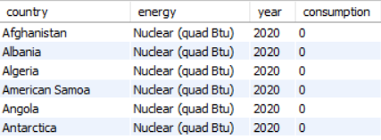
TABLE CREATION
1. COUNTRY TABLE
2. CONSUMPTION TABLE

Slide 6
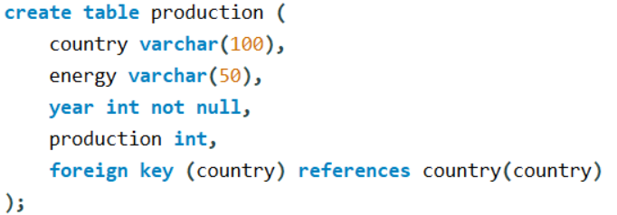
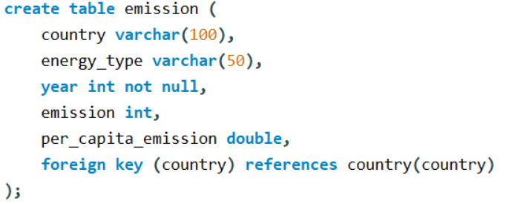
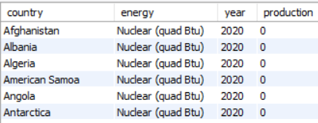
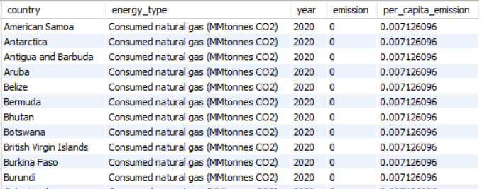
3. PRODUCTION TABLE
4. EMISSION TABLE

Slide 7


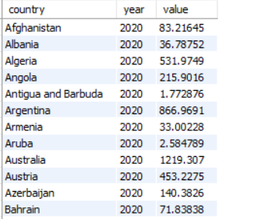
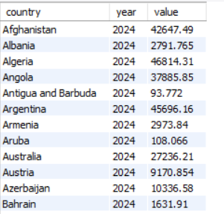
5. GDP_PPP TABLE
6. POPULATION TABLE

Slide 8
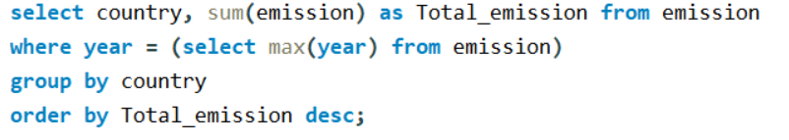
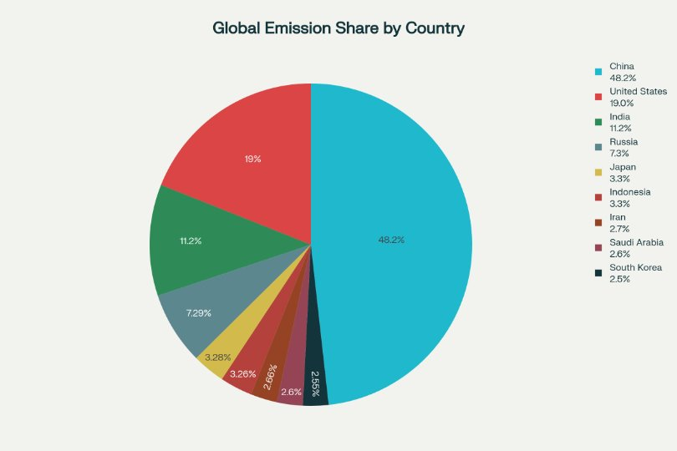
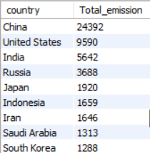
1. What Is The Total Emission Per Country For The Most Recent Year Available?
China Has The Highest Total Emissions , Followed By The United States And India.
Other Major Contributors Include Russia, Japan, And Indonesia.
Middle Eastern Countries Like Iran And Saudi Arabia Also Contribute Significantly.
South Korea Is Also Among The Top Emitters.
Overall, Emissions Are Heavily Dominated By A Few Large Countries, Especially China, Which Is Far Ahead Of Others.

Slide 9
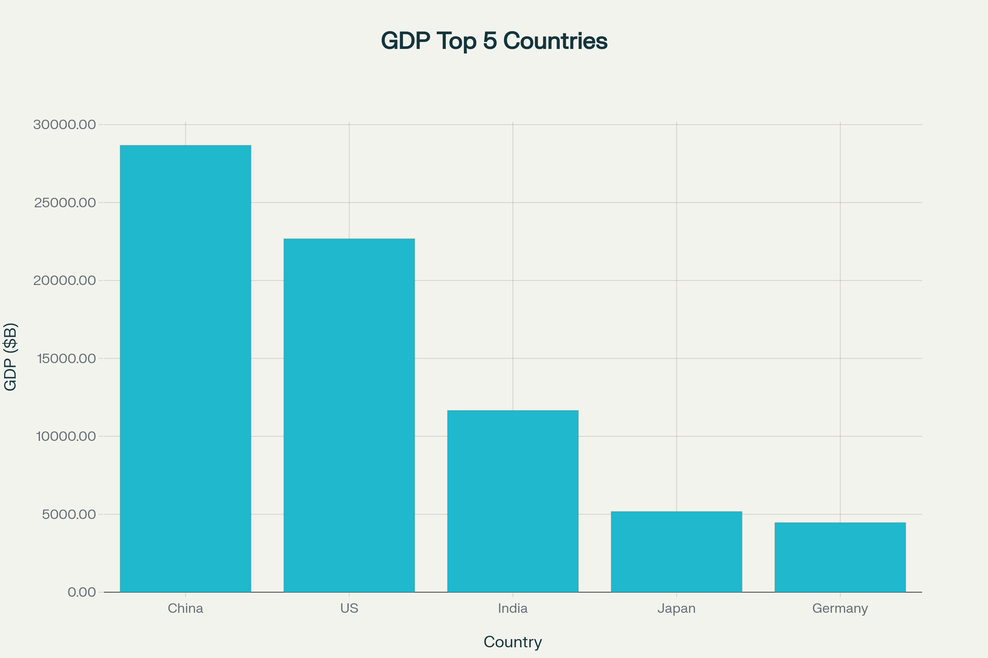
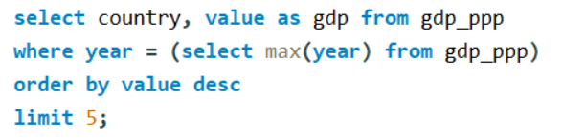
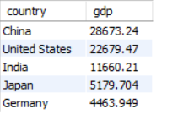
2. What Are The Top 5 Countries By GDP In The Most Recent Year?
The SQL Query Extracts The Top 5 Countries By GDP (PPP) For The Most Recent Year In The Dataset.
China Has The Highest GDP, Followed By The United States.
India Ranks Third With, Showing Its Rapid Economic Growth.
Japan And Germany Complete The Top Five.
The Data Highlights That China And The Us Dominate Global Gdp, While India Is Emerging As A Major Economic Power.

Slide 10

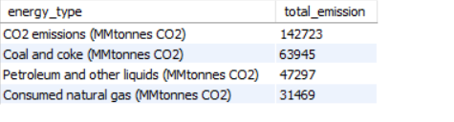
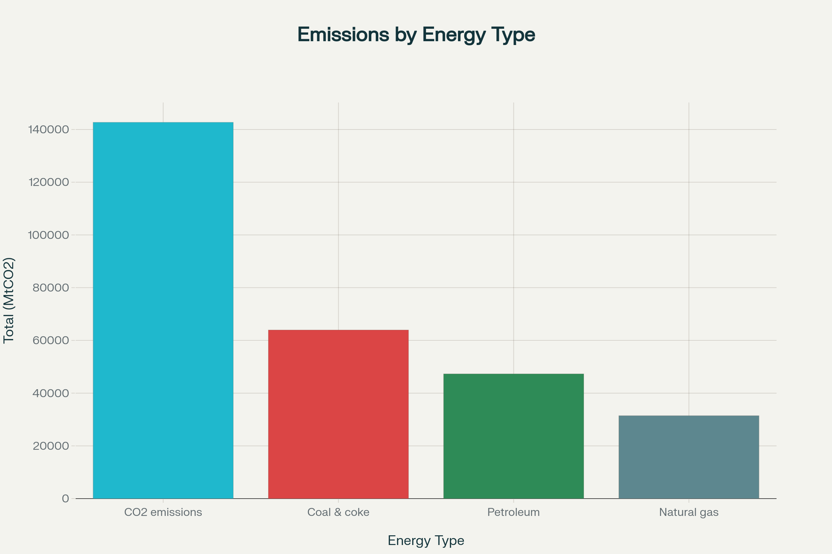
3. Which Energy Types Contribute Most To Emissions Across All Countries?
The energy types that contribute the most to emissions across all countries are primarily fossil fuels.
CO2 emissions are the highest overall with 142,723 MtCO2.
Among specific energy sources, Coal and coke contribute the most with 63a,945 MtCO2, followed by Petroleum and other liquids at 47,297 MtCO2, and Consumed natural gas at 31,469 MtCO2.
This indicates that coal is the largest single contributor among fuels, while petroleum and natural gas also play significant roles.

Slide 11
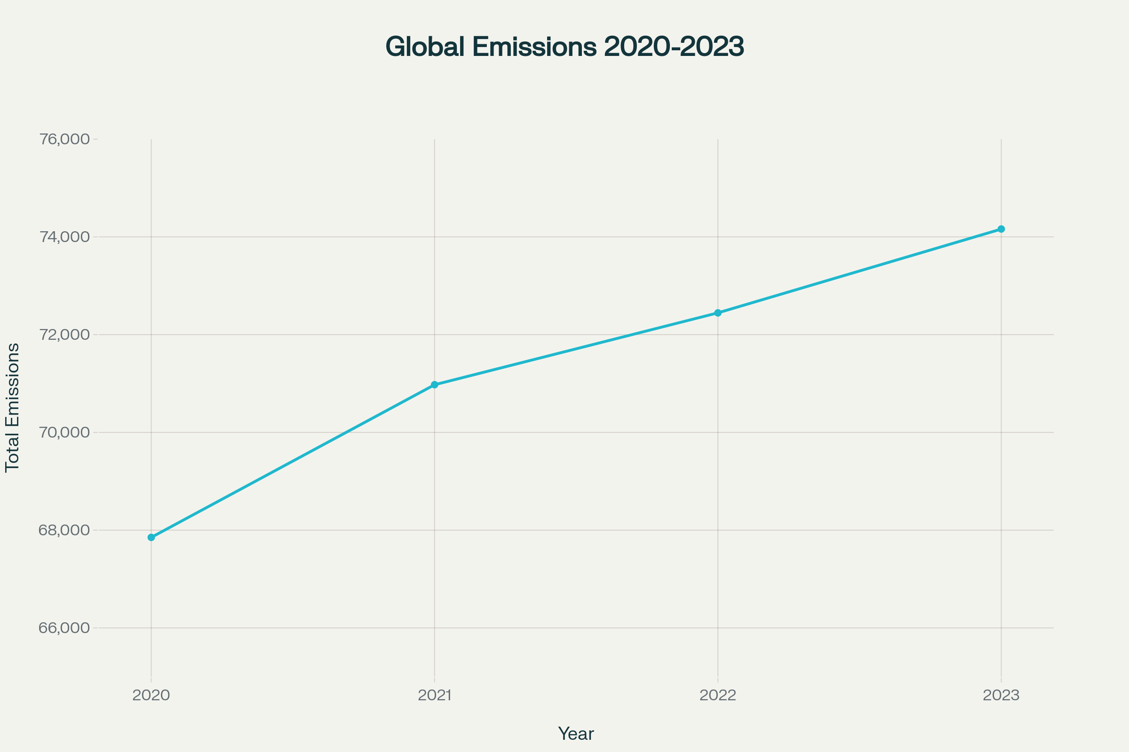

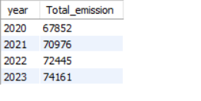
4. How Have Global Emissions Changed Year Over Year?
Consistent Increase in Total Emissions: The most prominent observation is that the "Total_emission" has consistently increased year over year from 2020 to 2023.
Emission Values:
  In 2020, the total emission was 67852.
  In 2021, it increased to 70976.
  In 2022, the emissions further rose to 72445.
  By 2023, the total emission reached 74161.
Growth Trend: The data clearly shows an upward trend in global emissions within this four-year period, indicating a continuous rise in emissions post-2020

Slide 12
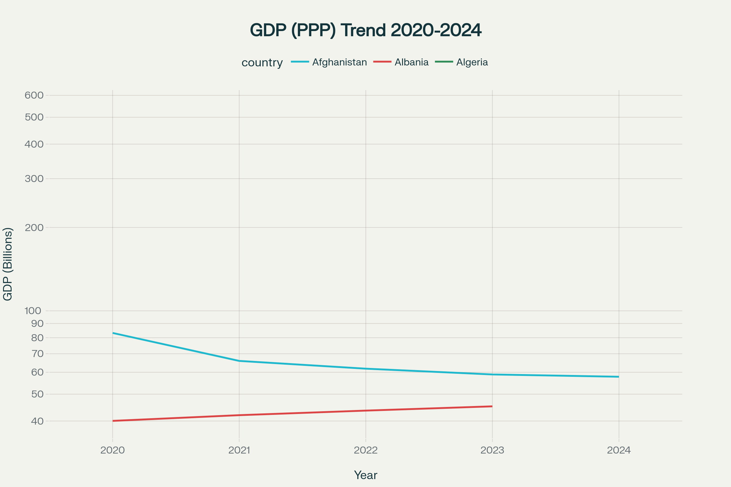

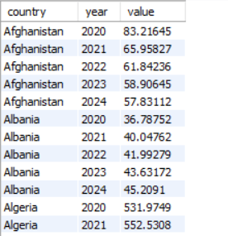
5. What Is The Trend In GDP For Each Country Over The Given Years?
Afghanistan's GDP exhibits a downward trend from 2020 to 2024, declining from 83.21 to 57.83.
Albania shows steady upward growth in GDP, increasing from 40.05 in 2020 to 45.20 in 2023.
Algeria's GDP values (for two reported years) are substantially higher than those of Afghanistan and Albania, indicating a much larger economy, with both values exceeding 500.

Slide 13
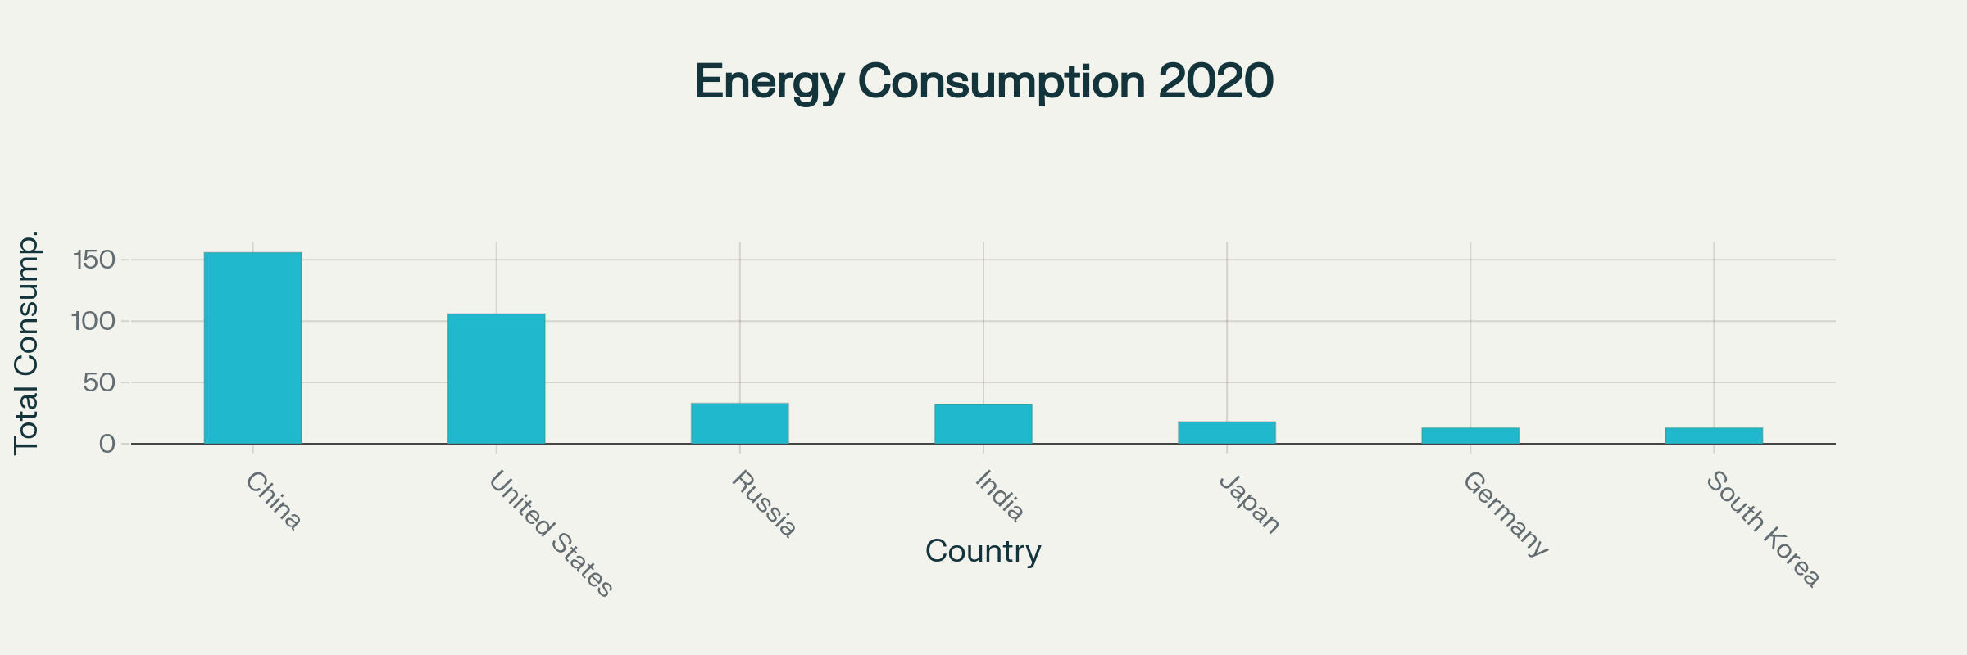

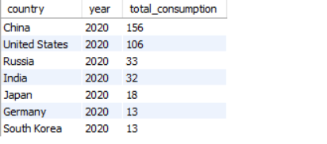
6. Has Energy Consumption Increased Or Decreased Over The Years For Major Economies?
China had the highest recorded energy consumption among the listed major economies in 2020, with a total of 156 units.
The United States followed as the second-largest consumer, with 106 units in the same year .
Russia and India showed comparable consumption levels, with 33 and 32 units, respectively.
Japan consumed 18 units, while Germany and South Korea had the lowest consumption among this group, both at 13 units.
All data points presented are for the year 2020

Slide 14
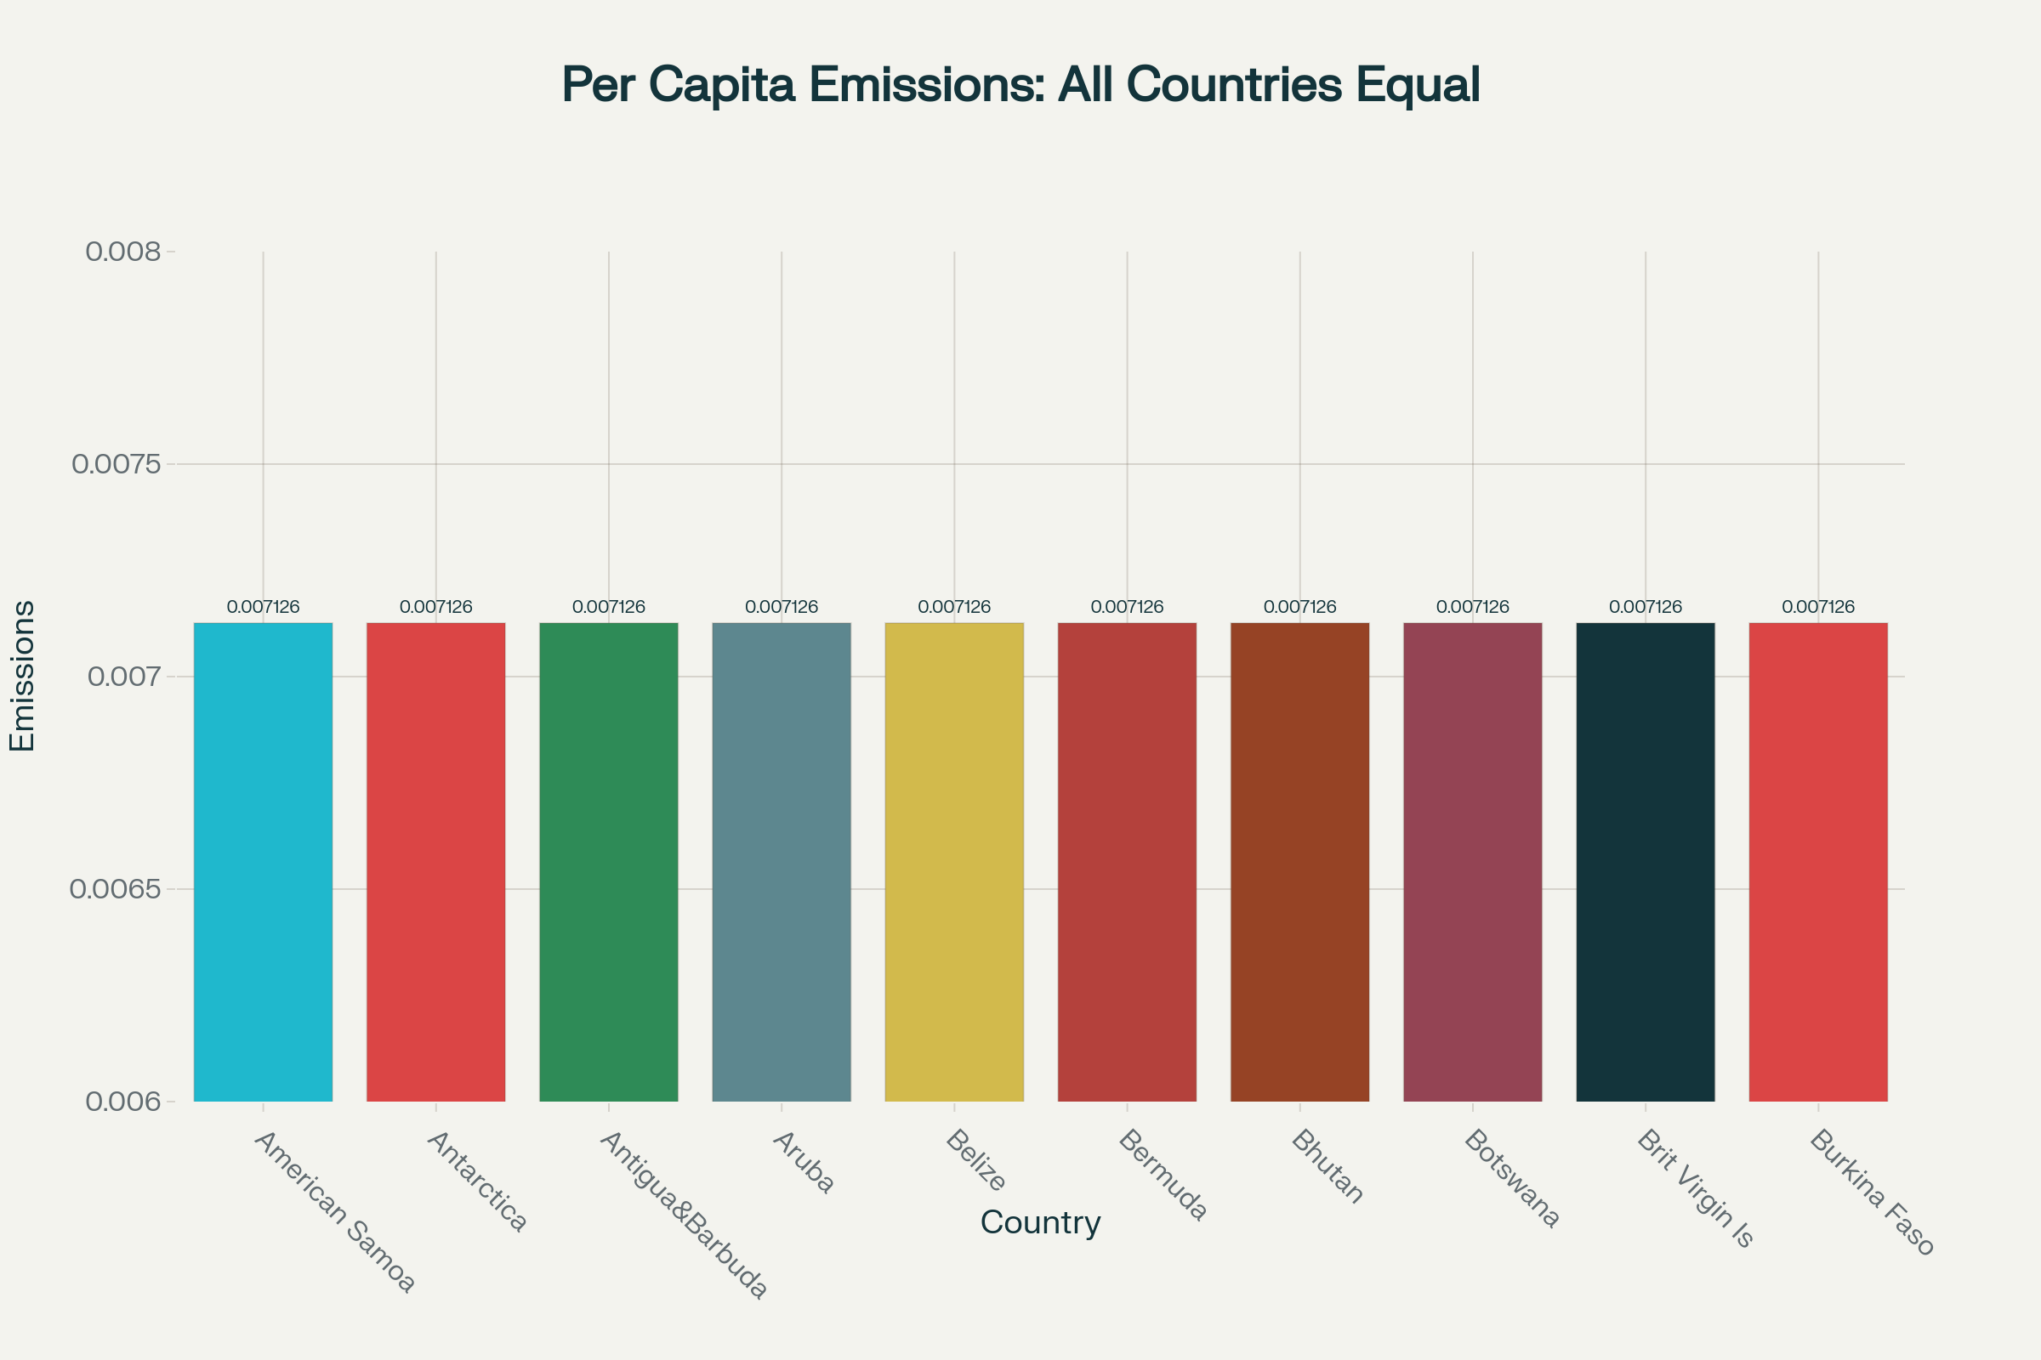

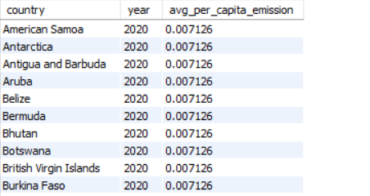
7. What Is The Average Yearly Change In Emissions Per Capita For Each Country?
The SQL query calculates the average yearly per capita emission for each country and year using the AVG(per_capita_emission) function.
The result table shows data for multiple countries (e.g., American Samoa, Antarctica, Bhutan, Botswana, etc.) for the year 2020.
Interestingly, the average per capita emission value (0.007126) is the same for all listed countries in the sample output.
Overall Observation: The average yearly change in per capita emissions is shown as nearly identical (0.007126) across multiple countries in 2020, indicating possible aggregation or uniform trends in the dataset.

Slide 15
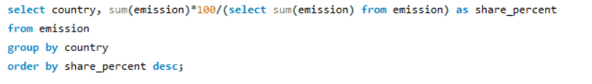
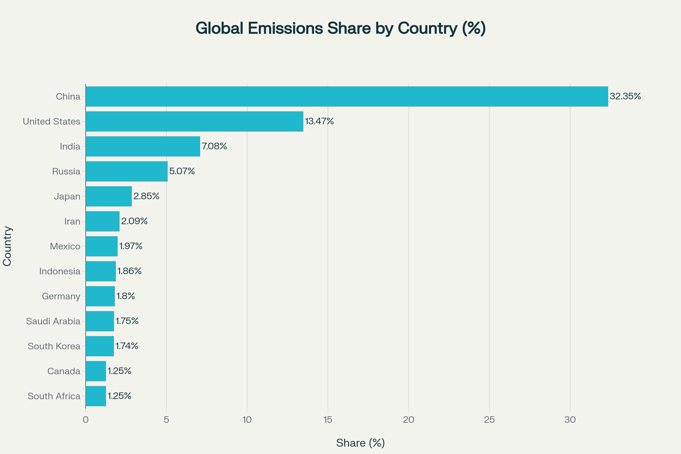
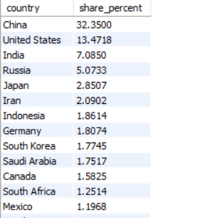
8. What Is The Global Share (%) Of Emissions By Country?
The results show that China (32.35%) is the largest contributor, followed by the United States (13.47%) and India (7.08%).
Together, these top three countries account for over 50% of global emissions.
Other significant contributors include Russia (5.07%), Japan (2.85%), and Iran (2.09%).
Overall observation: Global emissions are highly skewed, with a few countries (China, US, India) responsible for the majority of emissions, while the rest contribute relatively small shares

Slide 16
CONCLUSION
Through This Project, We Successfully Used SQL To Explore Large Datasets And Uncover Valuable Insights About Global Energy Production, GDP, Emissions, And Population Trends.
We Identified Countries With High Energy Use And Emissions, And Those Making Sustainable Progress.
The Analysis Showed Clear Links Between Economic Growth And Energy Demand, As Well As The Environmental Trade-offs.
Some Nations Demonstrated Strong Energy Efficiency, Producing Higher GDP With Lower Emissions.
This Project Highlights The Importance Of Data-driven Decision-making In Balancing Economic Development And Environmental Responsibility For A More Sustainable Future.

Slide 17

Thank You...

