Slide 1
DEVELOPMENT OF SMART TOILET

Slide 2
ABSTRACT
In today's modern world, access to hygienic public restrooms, especially for women, remains a pervasive challenge. This project addresses this problem by proposing the development of an innovative automatic self-cleaning toilet system. Unlike traditional systems, this toilet emphasizes ultraviolet (UV) disinfection, hot air drying, and intelligent water conservation.
The system maintains a pleasant restroom environment through the integration of an air freshener.our project presents an innovative urine protein detection sensor integrated into this smart toilet system, augmented by machine learning techniques.
This sensor leverages biosensor technology, specifically enzyme-based and antibody-based approaches, to accurately and selectively detect urine protein levels.The concept of a smart toilet, incorporating the monitoring of urine samples for kidney failure detection through IoT (Internet of Things) technology adds a critical health-related dimension to the system.
Designed to address the persistent challenge of locating clean and accessible public restrooms, especially in urban areas and during travel. Through seamless integration with an Android application, our system empowers users to effortlessly pinpoint the nearest available smart toilets in real-time, also user can register their compliant about toilet condition throught android app. The GPS technology, this feature offers unparalleled convenience by offering turn-by-turn directions to the nearest restroom, ensuring users can quickly and easily find a clean and well-maintained facility when they need it most and also monitor the user selected particular restroom availability.

Slide 3
OBJECTIVE
The public restroom facilities by developing an innovative smart toilet system that addresses both hygiene and health monitoring.
We aim to create a public restroom experience that surpasses traditional standards, emphasizing cleanliness, convenience, and accessibility. Through the integration of ultraviolet (UV) disinfection, hot air drying, and intelligent water conservation, we seek to enhance restroom hygiene while minimizing resource wastage.
By seamlessly integrating with an Android application and leveraging GPS technology, our objective is to empower users to effortlessly locate the nearest clean and well-maintained smart toilets in real-time, ensuring they can easily access a restroom facility whenever the need arises and monitor the user selected particular restroom availability.
To improve public sanitation, health awareness, and overall restroom quality, aligning with our commitment to innovation, sustainability, and user well-being.

Slide 4
INTRODUCTION
In today's rapidly advancing world, despite the numerous technological breakthroughs, one persistent challenge remains largely unaddressed – the availability of clean and accessible public restrooms, particularly for women.
The inconvenience and discomfort caused by inadequate restroom facilities, especially in urban areas and during travel, continue to plague individuals worldwide. Recognizing this pervasive issue, our project endeavors to tackle this problem head-on by introducing an innovative and transformative solution “The Automatic Self-Cleaning Smart Toilet System”.
The heart of our system lies in its emphasis on hygiene and convenience, achieved through a combination of advanced features including ultraviolet (UV) disinfection, hot air drying, intelligent water conservation, and even an integrated air freshener. This comprehensive approach ensures that each visit to our smart toilet is not just a necessity but also a pleasant experience.

Slide 5
EXISTING METHOD
In this existing method public restroom systems have long relied on manual cleaning and maintenance practices, resulting in various challenges related to hygiene, accessibility, and user satisfaction.
These conventional restrooms typically incorporate basic flushing mechanisms and limited sanitation features, often leading to issues such as unpleasant odors, insufficient cleanliness, and water wastage.
The users cannot track the locations of the restrooms.

Slide 6
BLOCK DIAGRAM
IOT cloud storage
PIR sensor
ultrasonic sensor
bio enzyme sensor
sensor data collected
API Key
ATMEL 328 Microcontroller & wi-fi device Esp8266.
Driver board
IR sensor
power supply
Lid open and close
Relay device channel 7
Exhaust fan
UV sensor
Flushing pump motor
Hot air drying pump
Air freshener
Light
Door open and close.

Slide 7
ANDROID APPLICATION
welcome page
users
Track current location using gps coordinates
Search nearest toilet location and pin point the location
Restroom availability
Health status monitor
Feed back and compliant register about toilet
admin
login for IOT cloud
prediction of users kidney failure details view.

Slide 8
PROPOSED METHOD
In this proposed method we developed smart toilet system when the user cames into infront of restroom ,the IR sensor will detect the person and automatically open the door.
The PIR sensor detect the human thermal radiation and it will turn on the light , if the person exit form the restroom automatically turn off light.
The Ultrasonic sensor detect the person distance ,if the person near by the toilet basin it will automatically open the lid ,if the person exit form the restroom automatically close the lid.
As well as they will activate the flushing the water and applying the UV disinfection ,hot air drying .If the person far the toilet basin automatically clean the restroom using flushing of water ,activate the UV disinfection ,hot air drying process and also activate the Exhaust fan and air fresheners.
our smart toilet system with integrated health monitoring ,the process continues with the selection and prototyping of urine protein detection sensors, where we explore enzyme-based and antibody-based options and rigorously test sensor prototypes for accuracy, sensitivity, and specificity. Machine learning algorithms are designed and implemented to analyze sensor data in real-time, aiding in the early detection of kidney dysfunction.

Slide 9
CONT.,
Create a user-friendly Android application with features such as real-time restroom location tracking using GPS, restroom availabilty status updates , and navigation tracking.
IoT integration facilitates data transmission between the smart toilet system and the Android application.
Here the users can also register complaint about toilet and share there feedbacks through android application.

Slide 10
PROBLEM STATEMENT
The problem at hand revolves around the pervasive challenge of providing clean and accessible public restrooms, with a specific focus on addressing the needs of women.
The hygiene maintenance remains a critical concern. Many public restrooms suffer from inadequate cleaning routines and sanitation practices, leading to unsanitary conditions that can pose health risks and discomfort for users.
The information gap regarding the availability and condition of nearby public restrooms exacerbates the problem, leading to inconvenience and discomfort during urgent restroom needs.

Slide 11
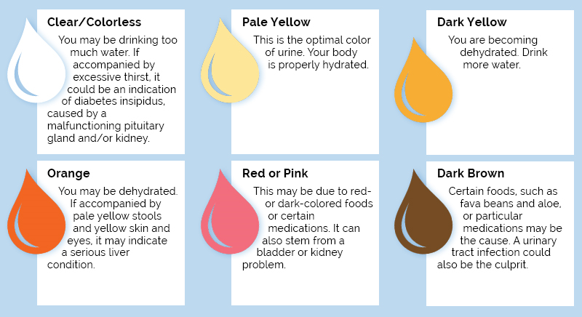
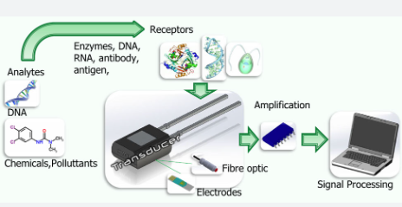
URINE COLOUR SAMPLES

Slide 12
ADVANTAGES
Enhanced Hygiene: UV disinfection and hot air drying ensure a clean and bacteria-free restroom environment.
Water Conservation: Intelligent water usage reduces waste and promotes environmental sustainability.
Early Health Detection: Integrated urine protein sensor and machine learning enable early kidney disease detection.
Convenience: Users can easily locate and navigate to nearby clean restrooms via a mobile app.
Real-time Information: Users receive up-to-date details on restroom availability and cleanliness.
Environmental Responsibility: Water and energy-efficient features align with eco-consciousness.
User Comfort: Air fresheners and home-like amenities enhance the restroom experience.

Slide 13
FUTURE SCOPE
The future scope of the Automatic Self-Cleaning Smart Toilet System with integrated health monitoring and developments and transformative possibilities.
As sustainability gains increasing importance, future iterations of smart toilets will likely focus on minimizing their environmental footprint, through advanced waste disposal methods and eco-friendly energy sources.
The utilization of data analytics and artificial intelligence could enable smart toilets to offer health recommendations and early interventions, thereby contributing to preventive healthcare.
Moreover, integration with healthcare systems and the establishment of a wider network of smart toilets in public spaces could create a seamless of care and improve healthcare outcomes.
Privacy and security will be paramount concerns, necessitating the continuous evolution of robust cybersecurity measures to safeguard user data.

Slide 14
SYSTEM SPECIFICATION
Hardware specification
Atmel328 Microcontroller.
Esp8266 wi fi device.
bio enzyme sensor
PIR sensor
Ultrasonic sensor
Driver controller
Relay
Light
Exhaust fan
water pump
Hot air dryer
Air freshener
Software specification
Keil software
Android studio
Thingspeak IOT cloud.
Programming language
For android application
Front end: XML
back end: java.
For hardware.
C++.

Slide 15
Thank you

