Slide 1
Sales Dashboard Insights
Superstore Dataset - Task 8

Slide 2
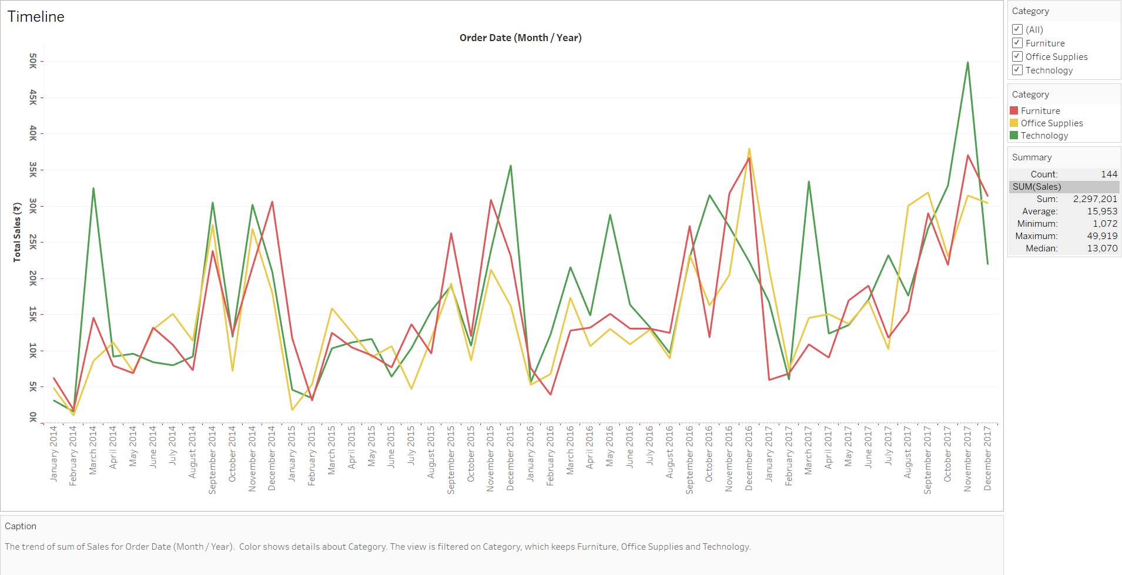
1. Timeline: Sales Over Time
Insight:
Sales exhibit a seasonal pattern with peaks during November and December each year. The West region consistently outperforms other regions, while the South region records the lowest sales across the timeline.
Recommendation:
- Capitalize on year-end sales by launching targeted promotions.
- Investigate performance in the South to identify growth opportunities.

Slide 3
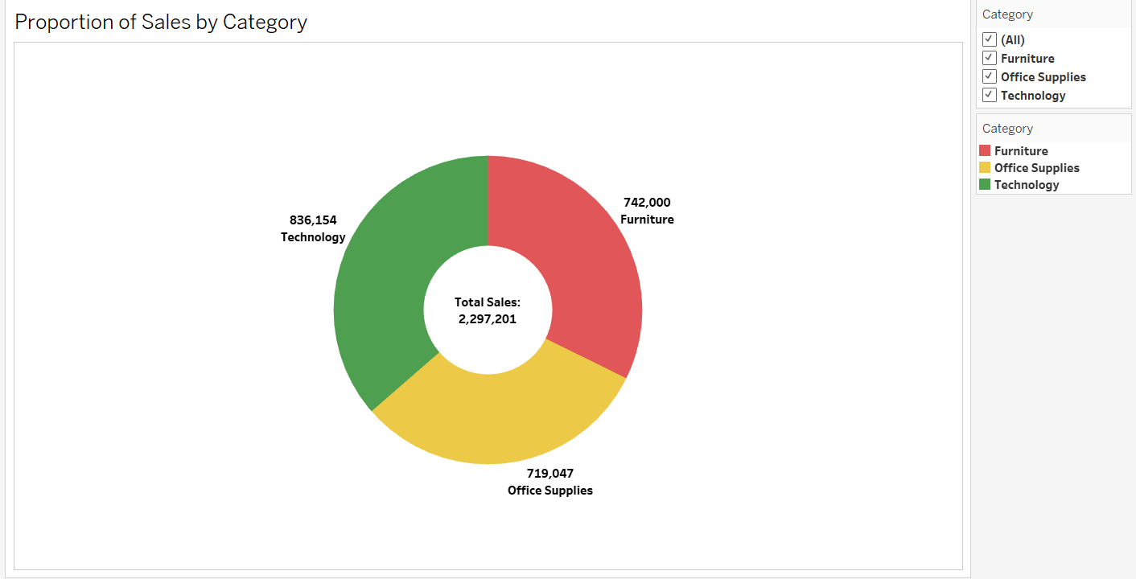
2. Proportion of Sales by Category
Insight:
Technology is the highest revenue-generating category (₹836,154), followed by Furniture (₹742,000) and Office Supplies (₹719,047). Technology contributes approximately 36% to total sales.
Recommendation:
- Expand technology offerings and promotional focus.
- Bundle technology products with low-performing categories to boost their sales.

Slide 4
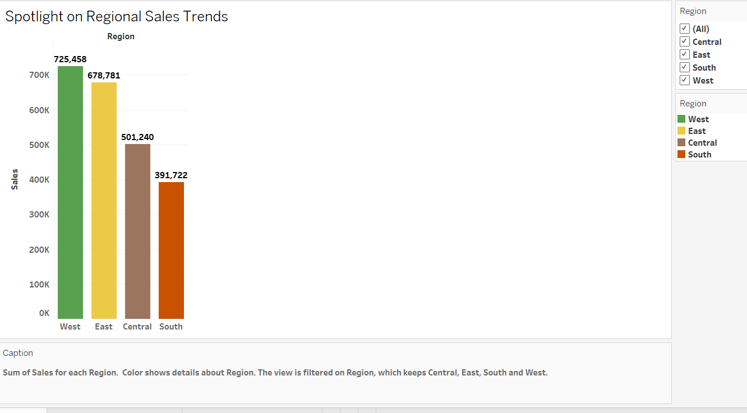
3. Regional Sales Trends (Bar Chart)
Insight:
The West region tops in sales (₹725,458), followed by East (₹678,781). Central (₹501,240) and South (₹391,722) trail behind.
Recommendation:
- Maintain momentum in West and East through loyalty programs.
- Conduct detailed analysis in the South to enhance engagement and optimize sales strategies.

