Slide 1
Doubly Linked List
MSIT

Slide 2
Agenda
What is a Doubly linked list.
Why do we need a Doubly Linked list.
Creating a doubly linked list.
Adding node to a doubly linked list
  Add at the beginning.
  Add at the end.
Delete a node from the doubly linked list.
  Delete from the beginning.
  Delete from the end.

Slide 3
Doubly linked list
A linked list which allows traversal in two directions.
  Forward and backward from a given node.
The node of a doubly linked list has three parts
  The data part
  The address to the previous node
  The address to the next node

Slide 4
Structure
struct node
{
int data;
struct node prev;
struct node next;
}
prev
data
next

Slide 5
When to use a Doubly LL?
To over come the limitation of Singly linked list.
  When there is a requirement to traverse the linked list in two directions, forward and backwards.

Slide 6
Example
1
2
3
4
Head
p
With the same pointer , we can’t move backwards
1
2
3
4
Head
p
With the same pointer , we can move backwards and forwards

Slide 7
Building a DLL
Create the first node
  Create and allocate memory to node.
  Point the head pointer to the first node.
  Make the prev of the node as Null.
  Make the next of the node as Null.

Slide 8
Contd..
Create the other nodes
  Create and allocate memory.
  Make the prev of the node point to the previous node(most recently created node).
  Make the next part of the previous node point to the current node.
  Make the next of the node as Null.

Slide 9
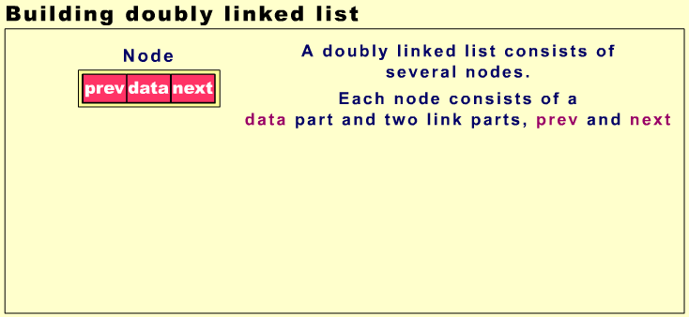

Slide 10
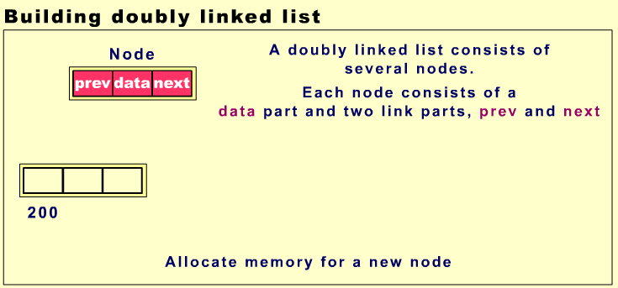

Slide 11
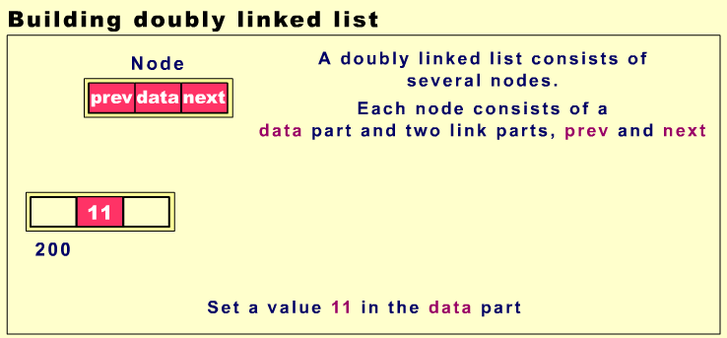

Slide 12
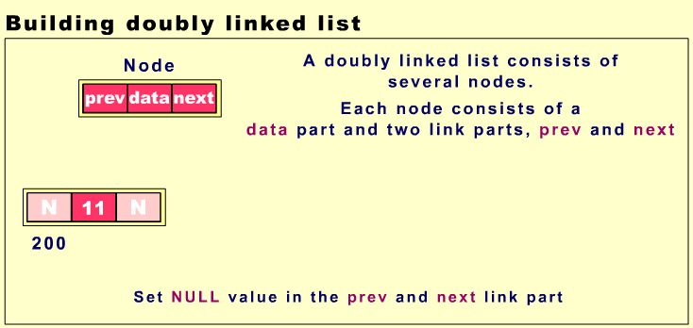

Slide 13
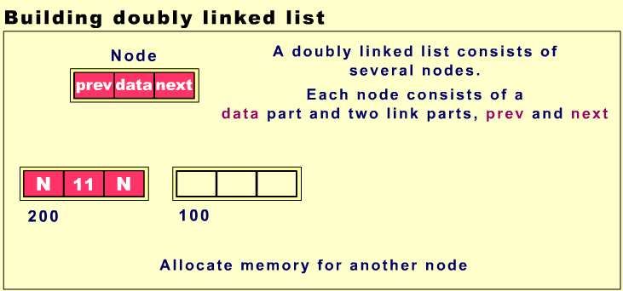

Slide 14
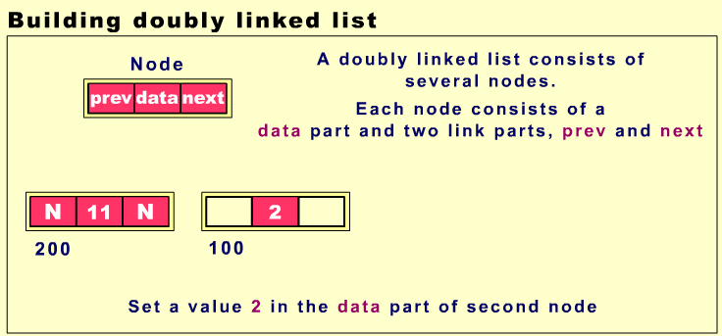

Slide 15
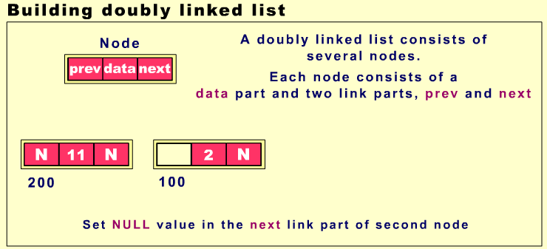

Slide 16
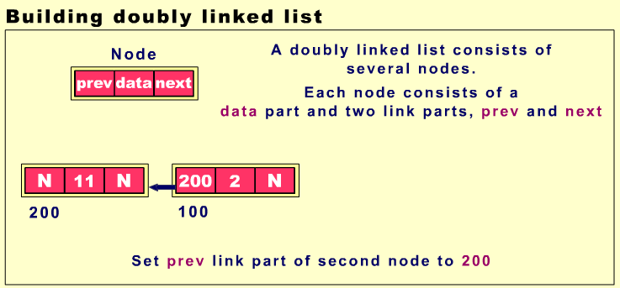

Slide 17


Slide 18
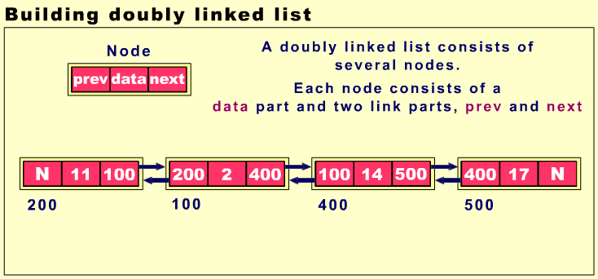

Slide 19
Adding a node at the beginning
Let p be the pointer pointing to the first node in a doubly linked list.
Create a new node and allocate memory
Let temp be the pointer pointing to the new node.
Set the prev of the new node to null.

Slide 20
Contd..
Set the next part of the new node to the first node
Set the prev part of first node as to the new node Point ‘p’ to the new node

Slide 21
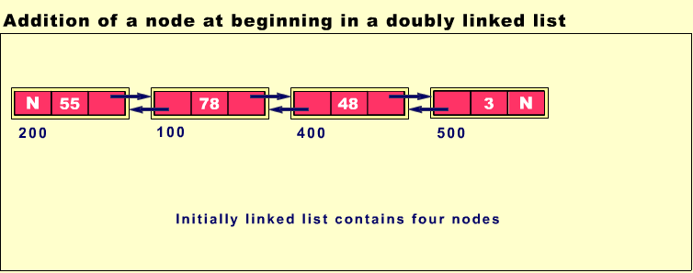

Slide 22
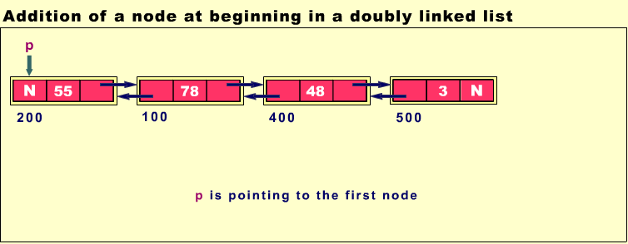

Slide 23
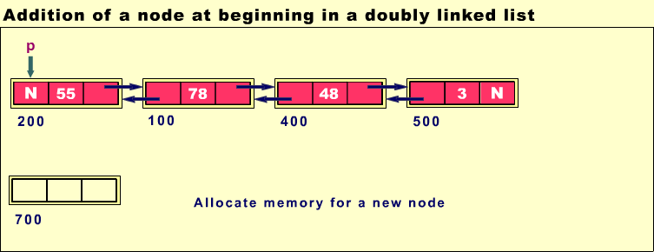

Slide 24
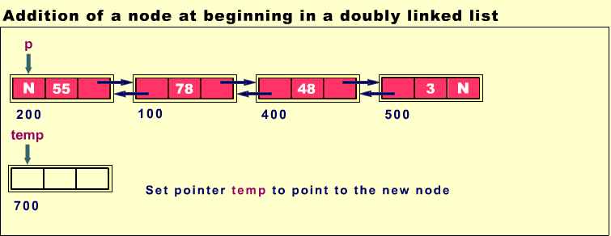

Slide 25
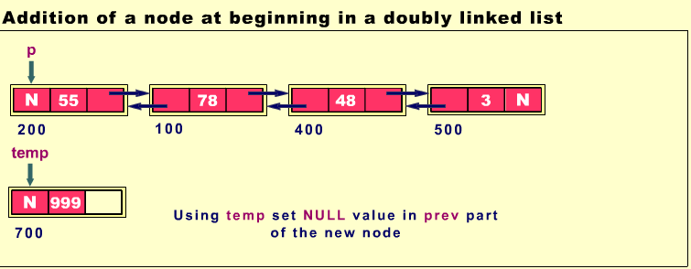

Slide 26
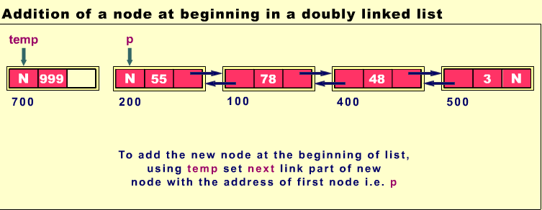

Slide 27
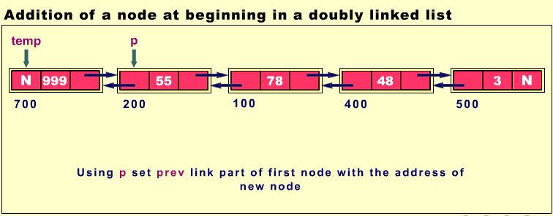

Slide 28
Code
class Link {
public double dData; // data item
public Link next; // next link in list
public Link previous; // previous link in list
public Link(double d) // constructor
{ dData = d; }
public void displayLink() // display this link
{ System.out.print(dData + " "); }
} // end class Link

Slide 29
Contd..
private Link first; // ref to first item
private Link last; // ref to last item
public DoublyLinkedList() // constructor
{
first = null; // no items on list yet
last = null;
}

Slide 30
insertFirst()
public void insertFirst(double dd) // insert at front of list
{
Link newLink = new Link(dd); // make new link
if( isEmpty() ) // if empty list,
last = newLink; // newLink <-- last
else
first.previous = newLink; // newLink <-- old first
newLink.next = first; // newLink --> old first
first = newLink; // first --> newLink
}

Slide 31
Adding a node at the end of DLL
Traverse till the end of the linked list
Point ‘temp’ to the last node
Create a new node and allocate memory
Set the next of the new node to null.
Point temp to the new node
Set next of the last node to the new node
Set the prev of the new node to the last node

Slide 32
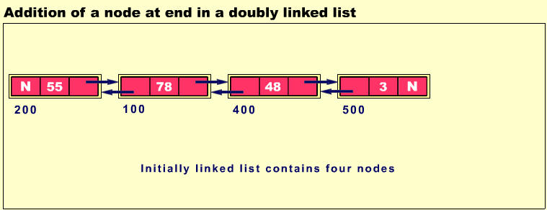

Slide 33
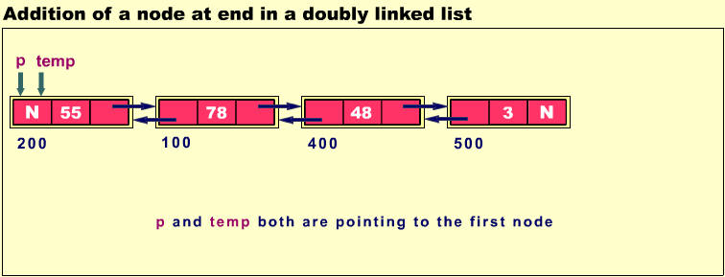

Slide 34
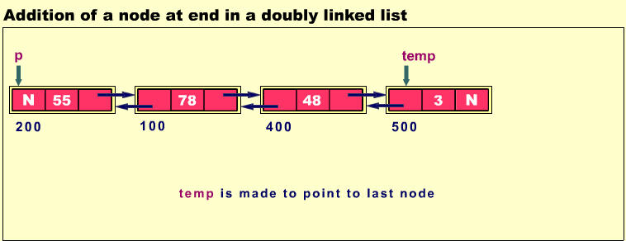

Slide 35
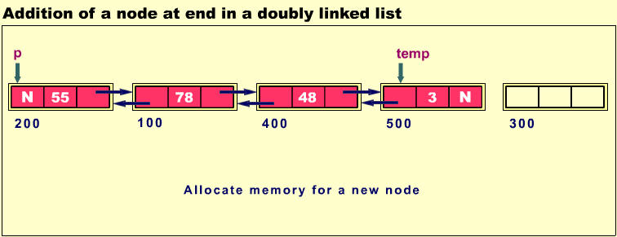

Slide 36
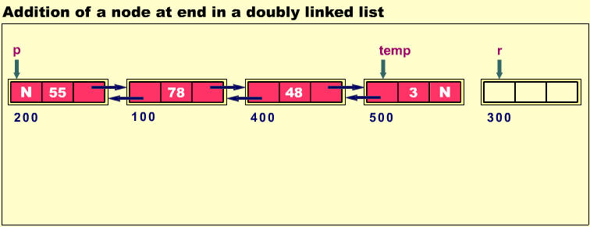

Slide 37
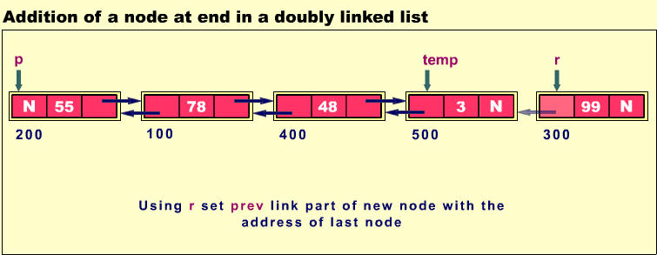

Slide 38
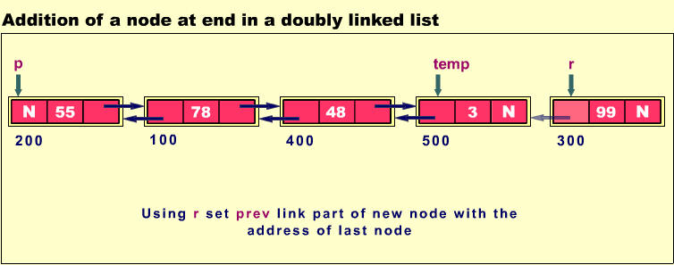

Slide 39
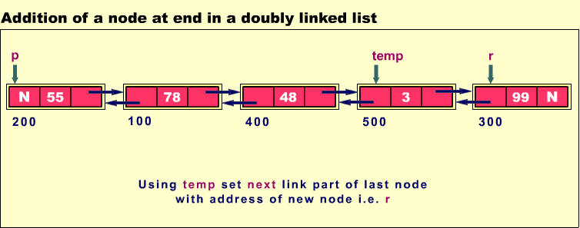

Slide 40
insertLast()
public void insertLast(double dd) // insert at end of list
{
Link newLink = new Link(dd); // make new link
if( isEmpty() ) // if empty list,
first = newLink; // first --> newLink
else
{
last.next = newLink; // old last --> newLink
newLink.previous = last; // old last <-- newLink
}
last = newLink; // newLink <-- last
}

Slide 41
Deletion of node at beginning
Let p,q point to the first node.
Make p point to the second node.
Free the memory allocated to the first node.
Set the prev of the second node to null.

Slide 42
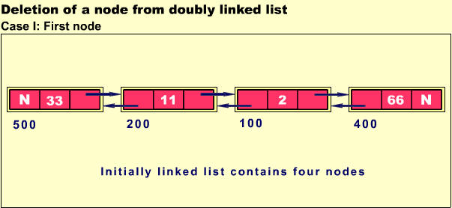

Slide 43
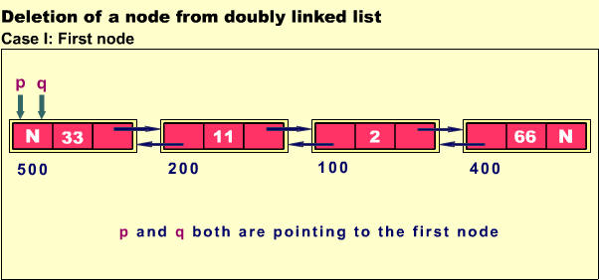

Slide 44
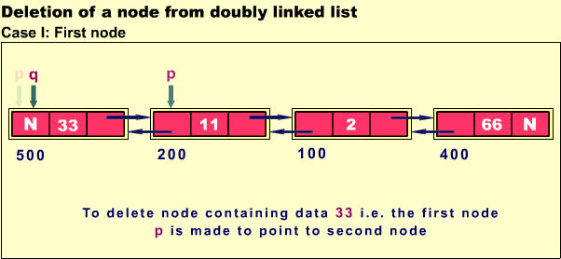

Slide 45
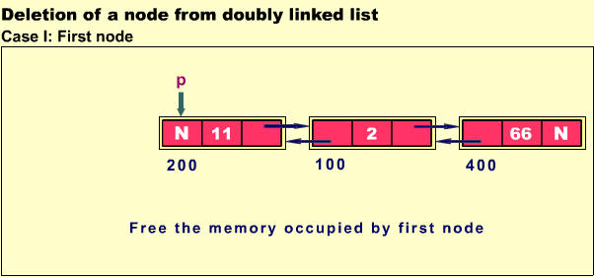

Slide 46
deleteFirst()
public Link deleteFirst() // delete first link
{ // (assumes non-empty list)
Link temp = first;
if(first.next == null) // if only one item
last = null; // null <-- last
else
first.next.previous = null; // null <-- old next
first = first.next; // first --> old next
return temp;
}

Slide 47
Deletion of node at the end
Let p point to the last node
Set the prev part of the last node as null.
Free the last node

Slide 48
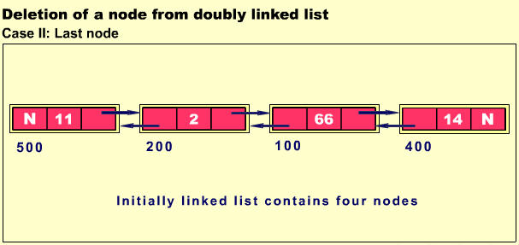

Slide 49
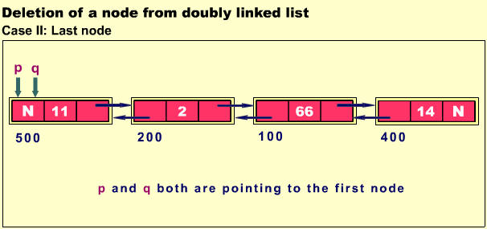

Slide 50
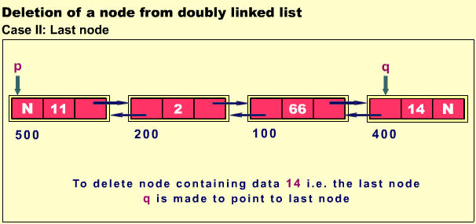

Slide 51
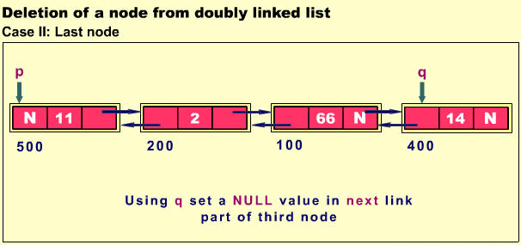

Slide 52
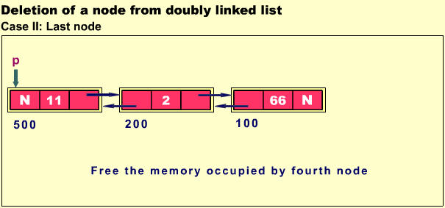

Slide 53
deleteLast()
public Link deleteLast() // delete last link
{ // (assumes non-empty list)
Link temp = last;
if(first.next == null) // if only one item
first = null; // first --> null
else
last.previous.next = null; // old previous --> null
last = last.previous; // old previous <-- last
return temp;
}

Slide 54
Applications of Doubly LL.
Trees are implemented using Doubly linked list
prev
data
next
Reference to the left child
Reference to the right child

Slide 55
Disadvantage
We cant traverse from the last node to first node with out having to traverse backwards.

Slide 56
Program

Slide 57
THANK YOU

