Slide 1
Impact Analysis(Cost) on TRAIs New Regulation
Using Python Jupiter Notebook to perform EDA

Slide 2
New Cable Fees Structure under TRAI’s New regulations
The Telecom Regulatory Authority of India (TRAI) recently drafted new regulations and directed various DTH service providers and operators to implement them. These regulations were set up to ensure all operators in the DTH and cable ecosystem get a fair share of earnings.
The new regulations also bought in new changes in the cost structure of the cable fees. The cost of cable fees now have 2 components,
The first one is like a rental charge & is called the Network Capacity Fee (NCF). This is 153.40 (inclusive of 18% GST). This rental includes the carriage of 100 FTA TV channels and is inclusive of 25 mandatory channels.
The second part is the cost that you will have to pay for each paid channels that you chose to watch. This cost is also inclusive of 18% GST and is charged on a monthly basis.
The immediate benefit to consumers is that there is a transparency as you get to know what you are paying for and you also have the freedom of choosing what you want to watch.
The new plan is already in place since February 1, 2019.

Slide 3
Concerns on Cable Fee of under TRAI’s New regulations
Though TRAI’s intent was to provide benefits to the Consumer, Service Providers and Broadcasters, but there has been a growing concern from the consumers around the increased cost of cable fees which they have to pay under the new cost structure.
Key concern : Why do we have to pay more now?
It is estimated that the average cable fees was around 250 Rs where an consumer was able to watch all the channels. But now, consumers are complaining that now they have to more 2 to 4 times more for the same choice.
Is this a fair deal?

Slide 4
Concerns on Cable Fee of under TRAI’s New regulations
TRAIs has responded stating that the issue highlighted around the cost is “incorrect“ as the comparison being done was between apple to oranges.
Consumers need to be aware that since the Cable fees are itemized now and the more they add to the cart the higher their cable cost will be.
TRAI’s recommendation to chose wisely. Their research suggests that around 90% of an average viewer does not watch more than 50 channels. So, if you pick the channels correctly you will not have to “pay more”.
Testing the Hypothesis “If we pick our channels smartly as recommended by TRAI (around 50)”. Can we keep the cost <= 250 Rs(Consumer’s Benchmark)?
Used TatasSky’s Master list which contains all the FTA and paid channels. (Source: TRAI’s website https://main.trai.gov.in/sites/default/files/DPO_TataSky.pdf)
The preliminary data had only Channel Name, Channel Type, Genre, Channel Cost. We added new fields PayType to distinguish if its Free or Paid ,Pay Category and Region (North/South /Other – to see cost distribution between north and south).
We also collected 8 samples from south region to study the patterns around selection of channels across Genre, Language and Pay type. And, finally use rule of averages (channel count and Genre cost) to compute the Average cable fee and see if it lies within the consumers benchmark of 250 Rs.

Slide 5
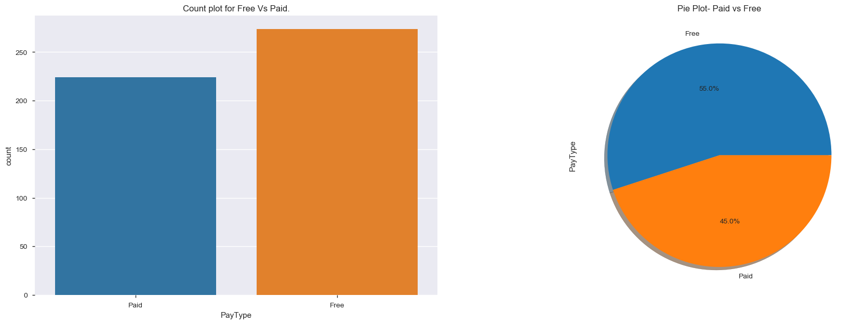
EDA –Analysis on the Master List
Using the Master channels List
Total channels available 589 – 498 are SD and 91 HD channels.
For the analysis purposes only SD data is chosen as those are the majority.
Distribution of Channel count (SD only) under Pay type(Free Vs Paid).
Free 274(55%) vs Paid 224(45%) – In SD Gives an indication there is lot available to chose from Free.

Slide 6
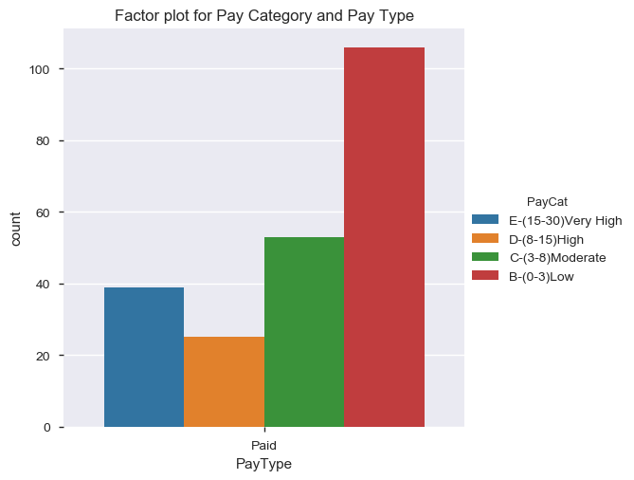
EDA –Analysis on the Master List
Distribution of cost under Paid which are segmented in 4 buckets
Key observations
Majority of them are in 0-3(Low) and 3-8(Moderate) Range(106+53=159).
A good chunk is available in the High (>8-15) range(25) and Very High(>15-30) range (39).

Slide 7
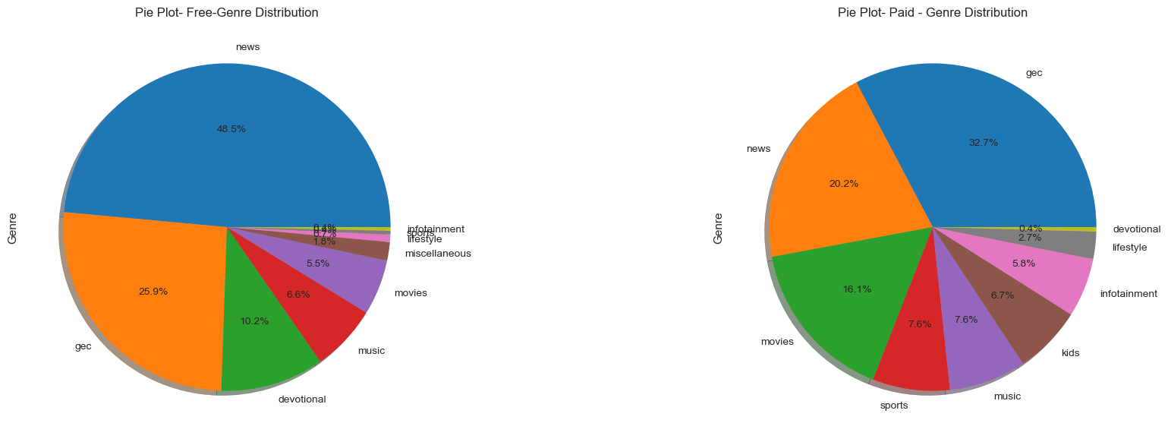
EDA –Analysis on the Master List
Distribution of Genre under Pay type(Free Vs Paid)
Key observations
Top 3 Contributors under Free – News(49%), GEC(26%) & Devotional(10%)
Top 3 Contributors under Paid– GEC(33%), News(20%) & Movies(16%),
Paid had no Devotional and Free had no Kids

Slide 8
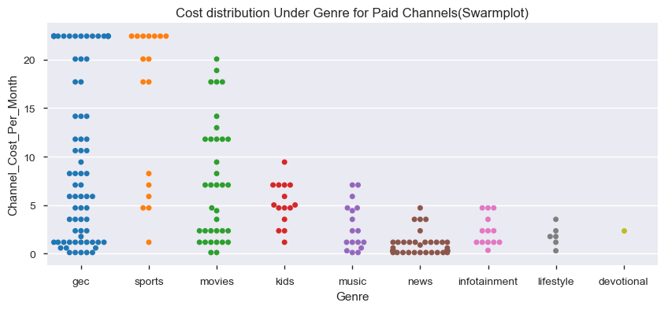
EDA –Analysis on the Master List
Drill down on the Cost distribution under Genre for Pay channel
Key observations
GEC, Sports and Movies are the ones which will be adding to cost burden as they have a major chuck in High(15-18) & Very High bucket (18 – 25).
News, Infotainment, Lifestyle, Devotional, Kids and Music all offer under low(0-3) and moderate(3-8) cost buckets

Slide 9
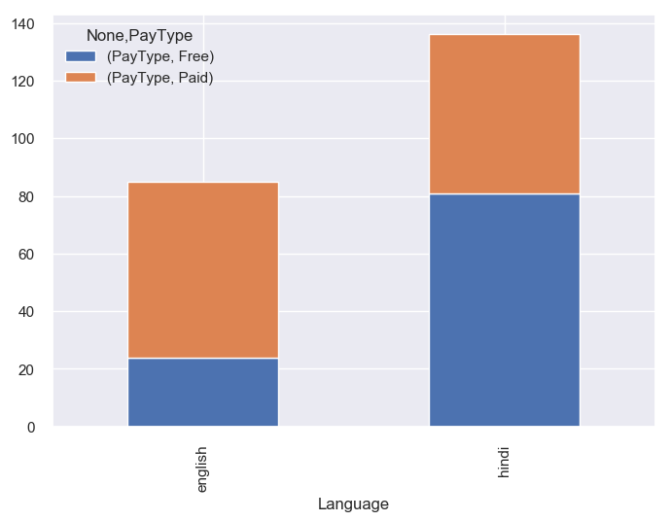
EDA –Analysis on the Master List
Distribution under common language(English and Hindi) under Pay type(Free Vs Paid).
Key observations
Hindi has more Free channels and English more Paid.

Slide 10
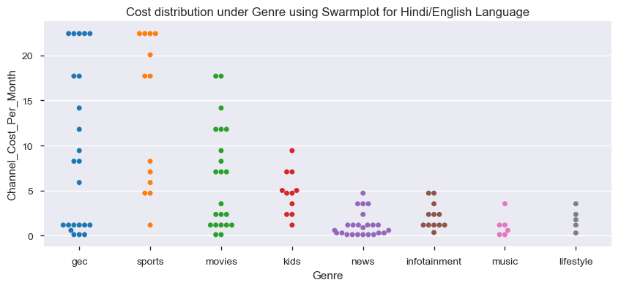
EDA –Analysis on the Master List
Drill down on the Cost distribution under Genre for Hindi and English (Pay Channel)
Key observations
GEC, Sports and Movies will be adding the burden as .
News, Infotainment, Lifestyle, Devotional, Kids and Music all offer under low(0-3) and moderate(3-8) cost buckets

Slide 11
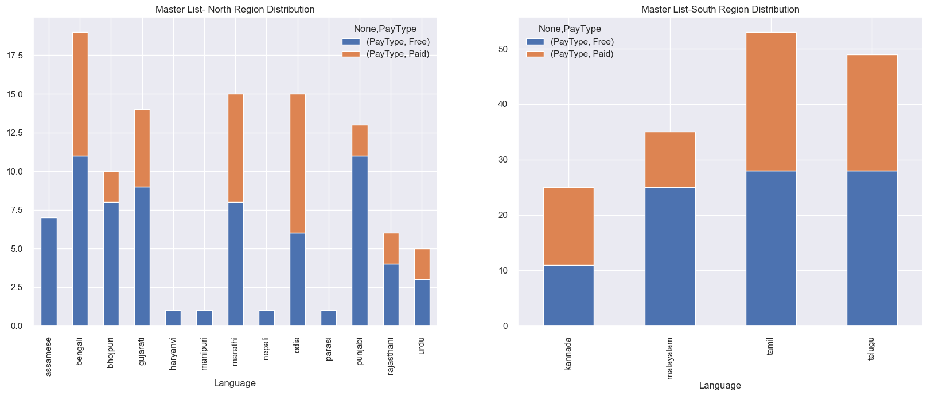
EDA –Analysis on the Master List
Distribution of languages under north and south region.
Key observations
South region - Malayalam offers more free over paid. And in North it is Punjabi, Bhojpuri, Rajasthani and Gujrati.
It is worth noting to see no paid channels under Nepali, Parasi, Manipuri and Harayanvi(and this is due to the fact that all except Nepal 1 are doordarshan channels which are mandatory to air)

Slide 12
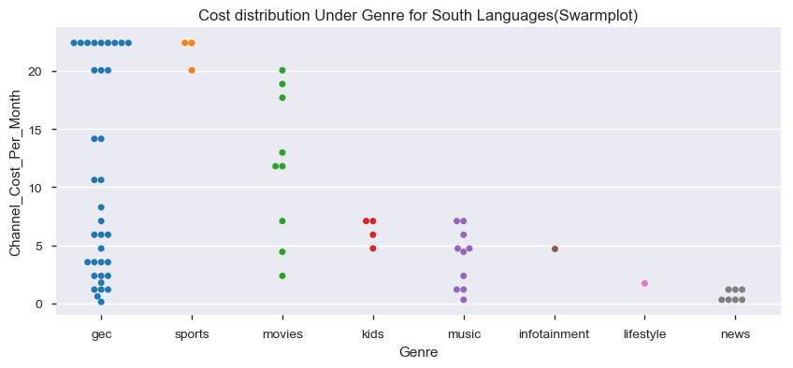
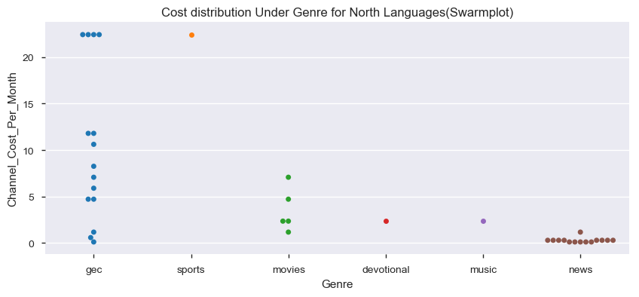
EDA –Analysis on the Master List
Drill down on the Cost distribution under Genre for South/North(Pay Channel)
Key observations
Same trend seen for North and South languages for GEC and Sports. However there are fewer options in North
Watching Sports and movies will be costlier in south language as a majority are in High and Very High cost buckets.
Kids, Music, Infotainment, Lifestyle and News will be a relief as they all fall under Low and Moderate.

Slide 13
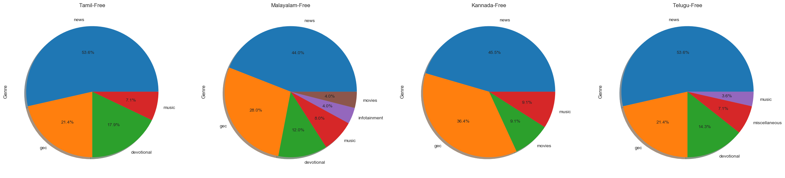
EDA –Analysis on the Master List
Distribution of Genre Under Pay type Free for different languages (South)
Key observations
There are no channels for Kids
It is interesting to note that Malayalam language has most to offer(all except Kids, Sports and Lifestyle) followed by Telugu (all except Kids, Movies, Infotainment, sports and lifestyle).
News, GEC and Devotional were the top 3 categories for Tamil, Malayalam and Telugu language.

Slide 14
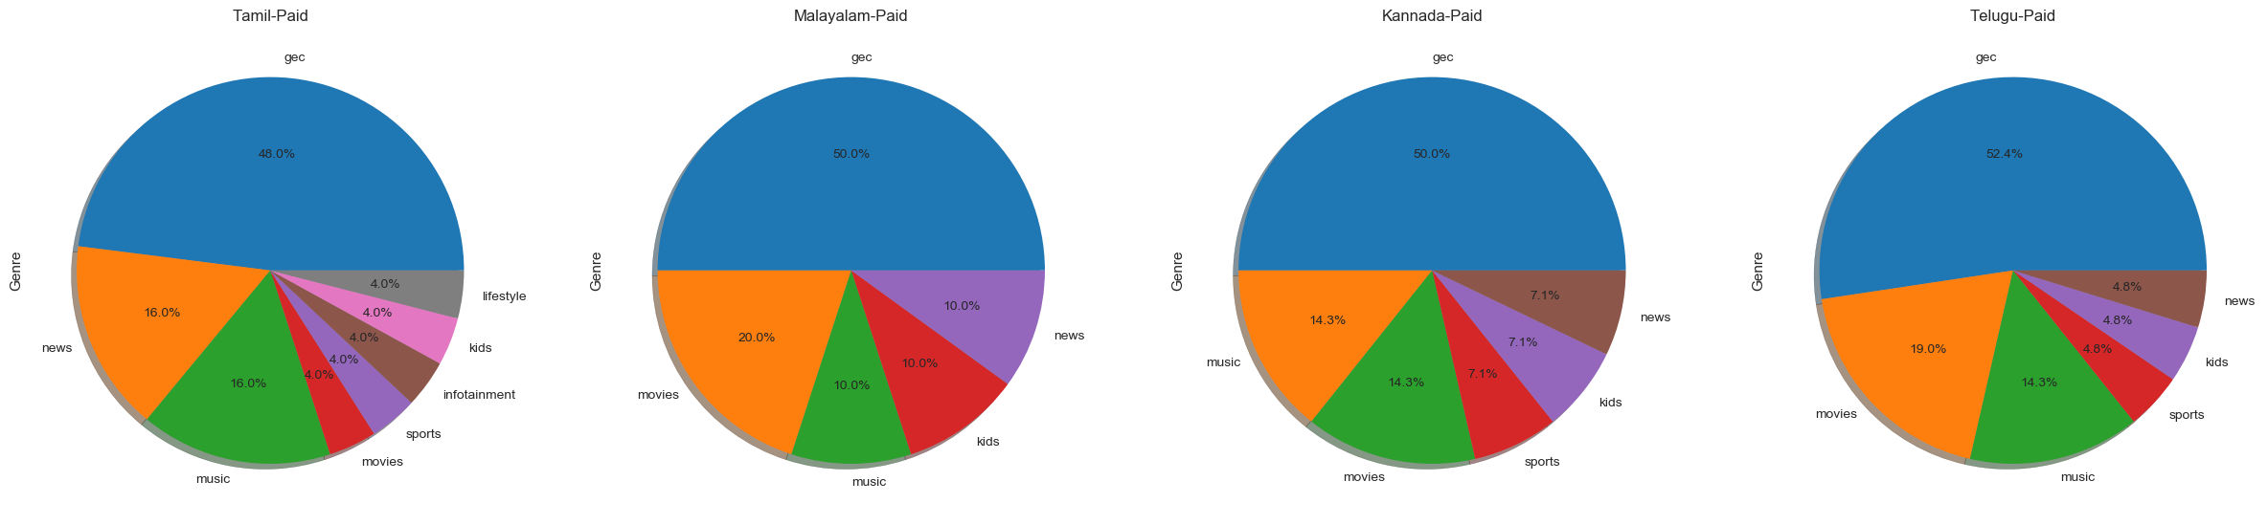
EDA –Analysis on the Master List
Distribution of Genre Under Pay type Paid for different languages (South)
Key observations
There are no channels for Devotional
Tamil language has the most offerings under genre(all except devotional), Next was Telugu and Kannada language(all except infotainment and lifestyle) followed by Malayalam(all except infotainment, sports and lifestyle).
GEC, Music and Movies were the top 3 categories for Malayalam, Kannada and Telugu language.

Slide 15
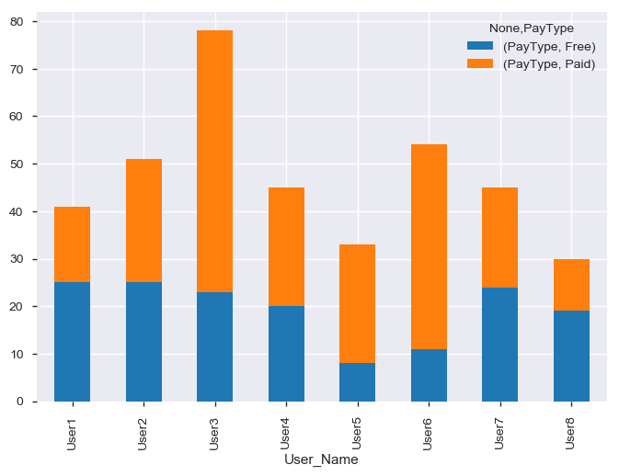
EDA –Analysis on the Sample Users
Distribution of Pay type (Free vs Paid)
5 users have tried to have equal mix of Paid and Free(User1, 2,4,7,8).
However there were outliers(3 users) as well where paid was more(User 3,5,6)

Slide 16
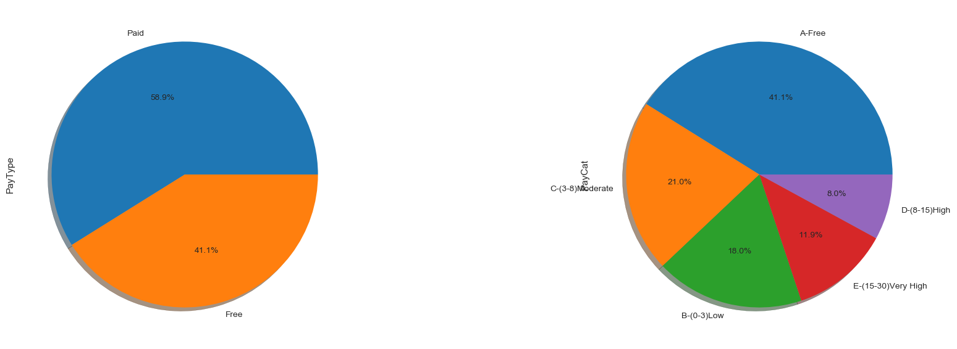
EDA – Analysis on the Sample Users
Overall distribution of Sample under Pay type and Pay category
The distribution under Pay type is 59% Paid Vs 41% Free
The distribution under Pay category –21% (Moderate), 18% (Low), 12% (very High) and 9% in (High).

Slide 17
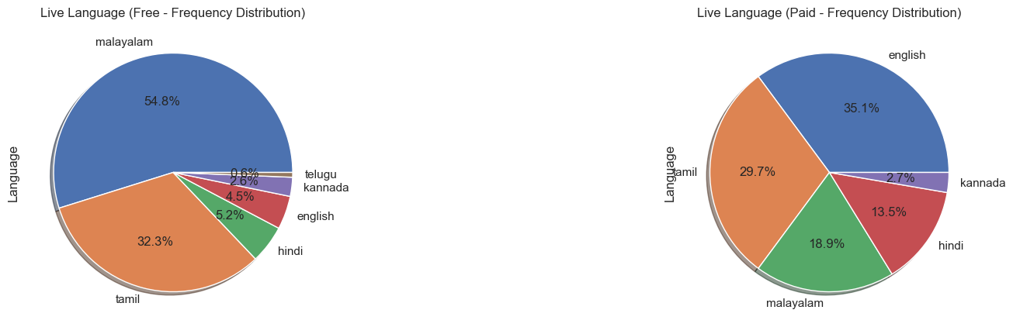
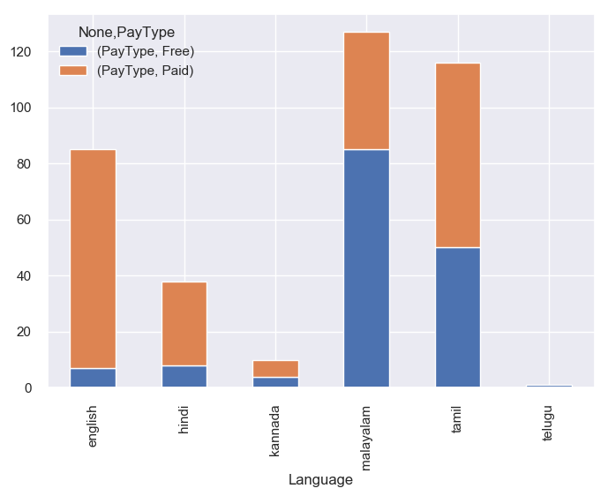
EDA – Analysis on the Sample Users
Overall distribution of Language under Pay type (Free Vs Paid).
The spread is high for English, Tamil and Malayalam in Paid category and in Free category its Malayalam and Tamil.
The distribution low for Hindi, Kannada and English in Free category and this could be due to less choices available in Free.

Slide 18
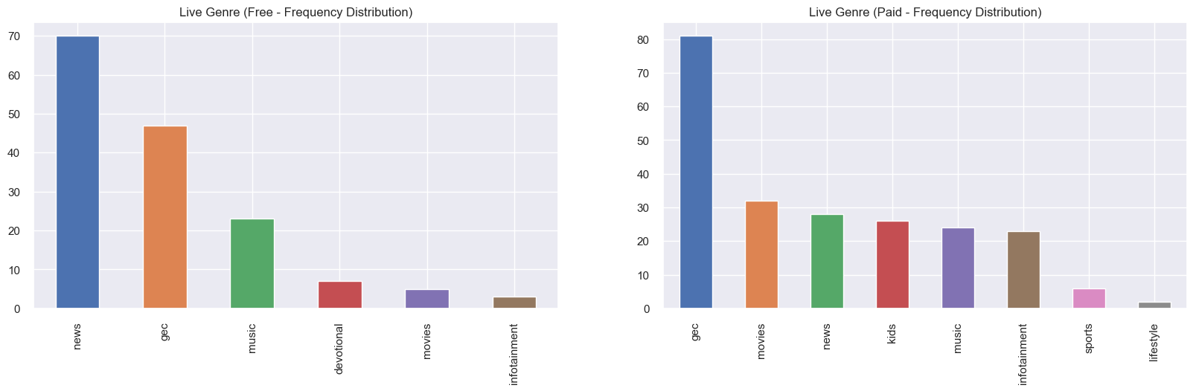
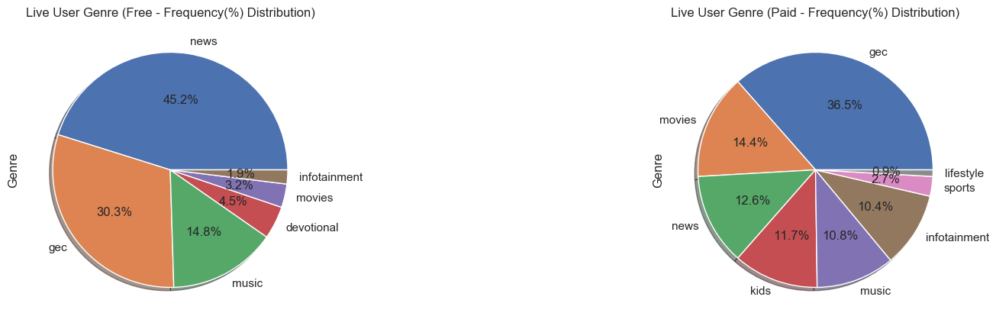
EDA – Analysis on the Sample Users
Overall Distribution of Genre under Pay type(Free Vs Paid)
The top 3 Free – News, GEC and Music.
The top 3 Paid – GEC, Movies and News.
From the pie we see that below is the distribution for Genre under the Paid
GEC (36%) ,Movies (14%) ,News (13%) ,Music (11%) ,Kids (12%) ,Infotainment (10%) ,Sports (3%) ,Lifestyle (1%).

Slide 19
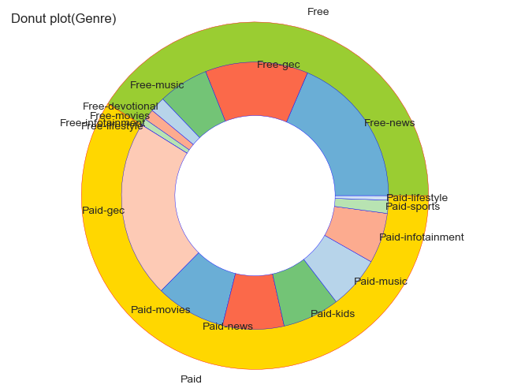
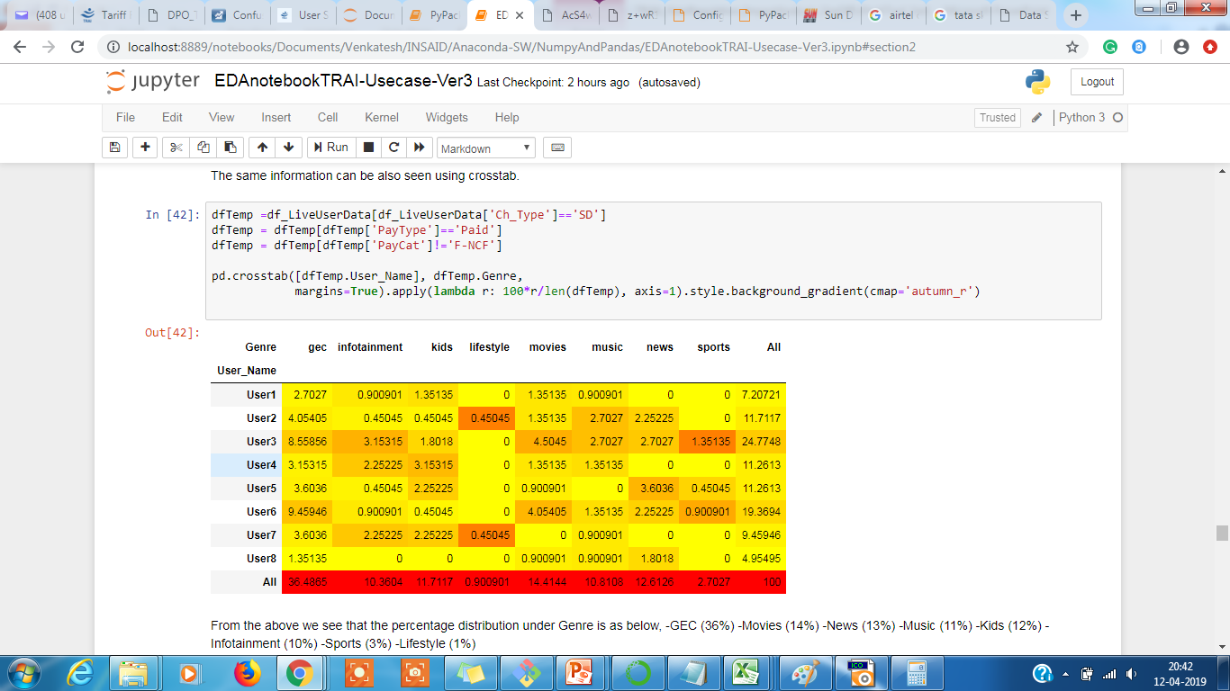
EDA – Analysis on the Sample Users
Overall Distribution of Genre under Pay type(Free Vs Paid)
The same distribution for Genre under the Paid category GEC (36%) ,Movies (14%) , News (13%) ,Music (11%) ,Kids (12%) ,Infotainment (10%) ,Sports (3%) ,Lifestyle (1%) is also seen in donut and crosstab report as well.

Slide 20
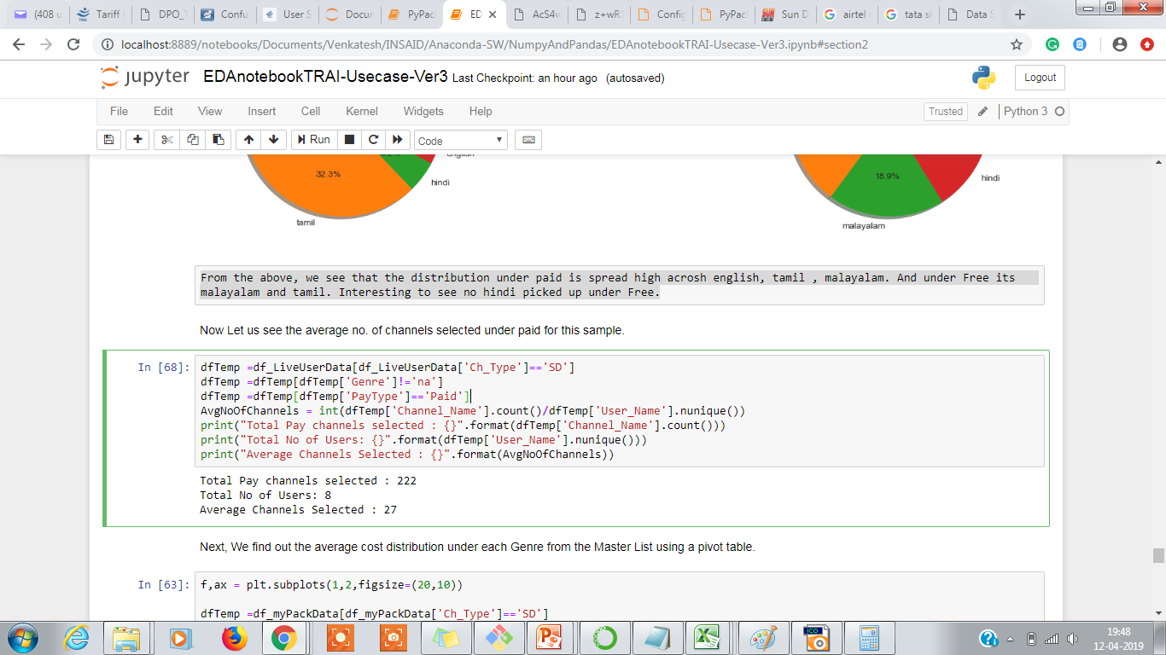
EDA – Analysis on the Sample Users
Now , let us see what is the average no. of channels selected under paid for these sample users.
Average channel selected under paid = 27.

Slide 21
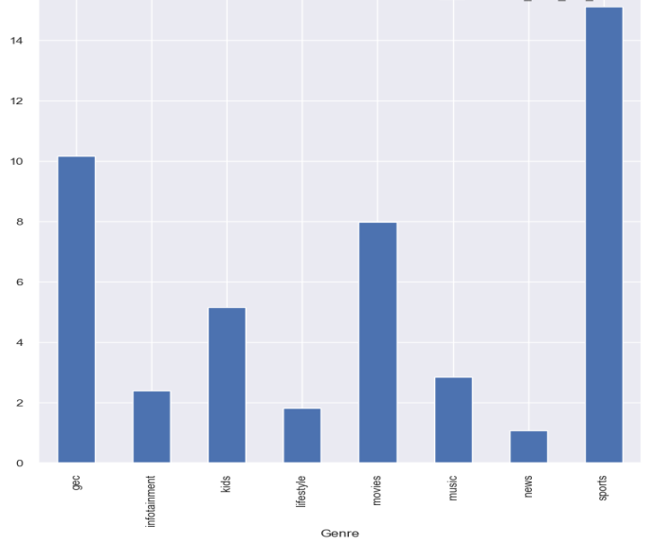
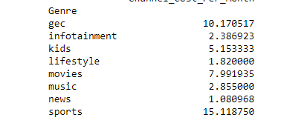
EDA – Computing Avg Cost(Master List)
Next, compute the average cost for each Genre from the Master List using pivot table.
The highest cost is for Sports(15) and GEC(10) and lowest for News(1) and Lifestyle(1.8)

Slide 22
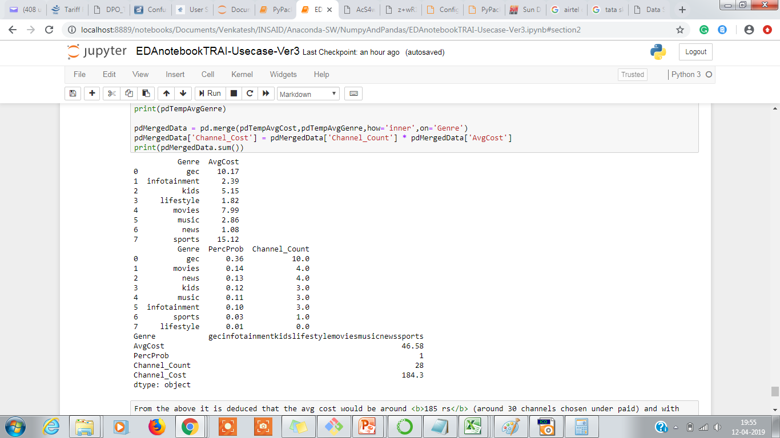
EDA – Computing Avg Cost of Cable Fee
Now, Assuming an average selection of 27 channels under paid we try to compute the average cost by assuming the distribution of Genre as per below,
GEC (36%) ,Movies (14%) ,News (13%) ,Music (11%) ,Kids (12%) ,Infotainment (10%) ,Sports (3%) and Lifestyle (1%)
The average cost computed is 184.3 ~ 185 rs.
We now add the NCF which is 153.40 rs to arrive at the
Average Cable Fee = 185 + 153 ~ 340 Rs

Slide 23
EDA – Conclusion
From the analysis done so far it is deduced that the average cost would be around 340 Rs ( for an average of 28 paid channels selected with a Genre distribution of GEC (36%) ,Movies (14%) ,News (13%) ,Music (11%) ,Kids (12%) ,Infotainment (10%) ,Sports (3%) and Lifestyle (1%))
Adding a +/- 20% variance to get the range as 301.40 Rs to 370.40 Rs
This indicates that the users will be seeing an increase in the cost of cable fees in the range of 50 Rs to 120 Rs when he is comparing it with his benchmark of 250 Rs.

Slide 24
EDA –Suggestions
Below 2 options are suggested to help reduce their costs.
Option 1 : As prescribed by TRAI – try to keep the channel list around 50. Filter out the list channels which are only absolutely needed and discard the ones which we seldom or rarely watch. This if done wisely can reduce the cost by 5-10 %. which means the 185 can be further reduced in the range of 165 (10%) to 175(5%).
Option 2 : Use the pyPackRecommendation tool to achieve the benefits of using packs which offer lesser cost and try to reduce the cost by 10 to 20%.
140 (assuming a 20% reduction) to 158(assuming a 10% reduction)
The above 2 recommendations if implemented correctly would bring down the cost in the range of 295 Rs to 312 Rs. But, this is still an increase of 45 Rs to 60 Rs when compared with consumers benchmark of 250 Rs.
Hence, the final conclusion is that even after following TRAI's recommendation of keeping the channel count under 50 and using optimization tools such as pyPackRecommendation the user will still see an increase cost of cable fees when he compares it with his benchmark of 250 Rs. However, the costs will not increase 2-3 times more.

Slide 25
Future Considerations
Final thoughts and some future Considerations :
Below are some thoughts to reduce the cost further by looking at the first component of the fees Network Capacity Fees,
Reduce the NCF (which is currently a whopping 153.40 rs and is the major cost contribution if it can be reduced by half(75 Rs) or even 50 rs it will help consumers a lot as this will help users to pick channels of their choice from the Paid category. however, this has to be reviewed by TRAI and other regulatory bodies and is in control with consumer.
The broadcasters can reduce the cost of channels in order to increase the TRP and increase their revenues from advertisements. Again, the decision is with the broadcasters and is not in control with consumer.
Though the study was conducted using the sample of south , the average cost computed should not vary too much as the variance was considered +/- 20% and this should be able to absorb any variations due to language. But, we would like to get more data from North and see if the results vary too much from South.
Also, will like to use ML techniques to further refine the average cost.

Slide 26
Using PyPack Recommendation Tool
User is not sure which pack offer the best savings
Provide the tool your wish list (the channels that your prefer to view). This is captured in MyPack worksheet. The Base Cost is sum of cost of all the paid channels in your wish list.
The tool uses this information and then starts comparing the set of channels against each of the packs offered by the service provider and picks up only those packs which offer the best saving.
Those which could not fit in any pack would be recommended to be added as ALACARTE.
The new cost is computed based on the recommended packs cost + ALACARTE. Also, it will add the Network Capacity Fee (153 Rs).
The savings will be Base Cost – Recommended Cost.
Notes:
Tool offered by TRAI : https://channel.trai.gov.in/channelbouquet.php

Slide 27
Using PyPack Recommendation Tool – Usecase 2
User already has pack but is not sure if that is the best which offers cost savings
Make a list of all the channels that the current pack offers and captured it in MyPack worksheet.
Refine your selection to see if any of these can be replaced by FTA channels or with ones which offer less cost. Remove the channels that you don’t watch. Make sure the new count is around 50 which is the recommended number.
Feed your new wish list to the pyPackRecommendation Tool to see what new packs it offers as savings and compare the cost from what you had in your current pack. If you see any benefits both in terms of cost or channels offered then move to this new plan by discarding the current and adding the new recommended packs.
Notes:
Tool offered by TRAI : https://channel.trai.gov.in/channelbouquet.php

Slide 28
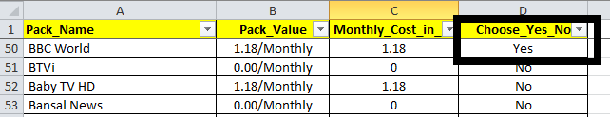

Steps to Follow to Run Recommendation Report
Step 1 : Open the below worksheet
Step 2 : Add all the channels to your wish list by marking the Choose_Yes_No as Yes in the “MyPack” sheet
Step 3 : Add the email id in the “MyEmail” sheet (ID to which you wish to receive the recommendation report). Leave it blank if you don’t want to receive the report.
Step 4: Keep the Recommender Script(PyPackage_Recommender_SR_Ver6.ipynb) , the configuration file(Configurator.py) and the WishList(xlsx file) in the same path and then Run the Python script from Jupiter Notebook to receive the report in your email id.

Slide 29
Thank You

