Slide 1
Wine Quality Prediction
Using Python Jupiter Notebook to perform EDA

Slide 2
Wine Quality Prediction
The dataset consists of the information about physicochemical tests on the different varieties of wines. Various variables present in the dataset includes data of fixed acidity, volatile acidity, citric acid, ph, alcohol etc.
The dataset comprises of (red wine - 1599 observations; white wine - 4898 observations) with 12 columns. Below is a table showing names of all the columns and their description.
Column Name | Description
fixed acidity | Fixed acidity content
volatile acidity | Volatile acidity content
citric acid | citric acid content in ml
residual sugar | Residual sugar content
chlorides | Chlorides content
free sulfur dioxide | Free sulphur dioxide content
total sulfur dioxide | Total Sulphur dioxide content
density | Density
pH | pH value
sulphates | sulphate content
alcohol | alcohol content in ml
quality | Output Variable - score between 0 and 10
The goal is to predict the quality of the wine using the chemical compositions that each wine contains.

Slide 3
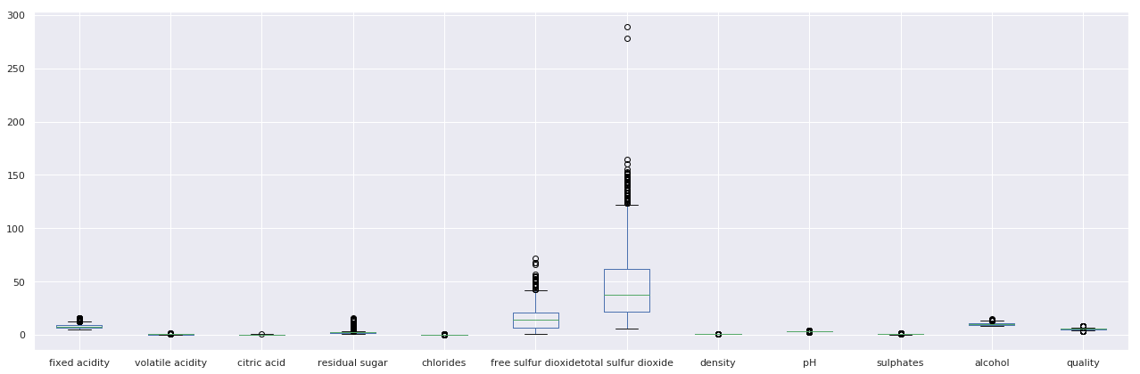
EDA – Wine Dataset
On plotting the box plot data for Red wine .
Outliers found in free suphur , total sulfur dioxide , residual sugar, chlorides, sulphates, citric acid and fixed acidity data.

Slide 4
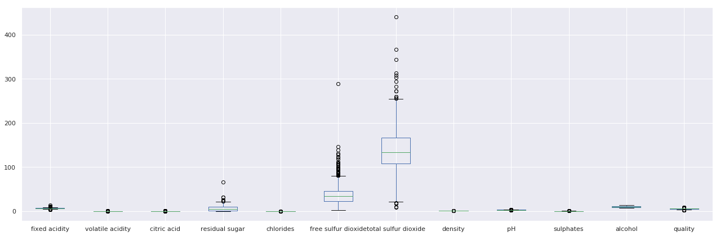
EDA – Wine Dataset
The same was observed on plotting the box plot data for White wine
Outliers found in free suphur , total sulfur dioxide , residual sugar, chlorides, sulphates, citric acid and fixed acidity data.

Slide 5
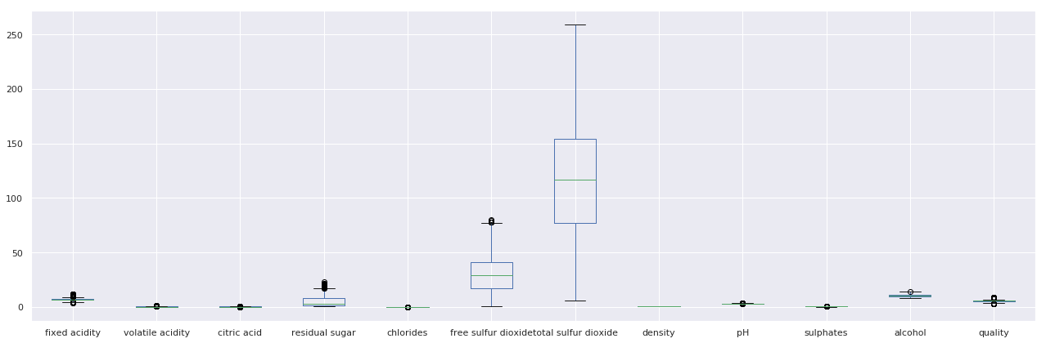
EDA – Wine Dataset
Outliers were removed from free suphur , total sulfur dioxide , residual sugar, chlorides, sulphates, citric acid and fixed acidity data.
The distribution of data looked better after removing the outliers

Slide 6
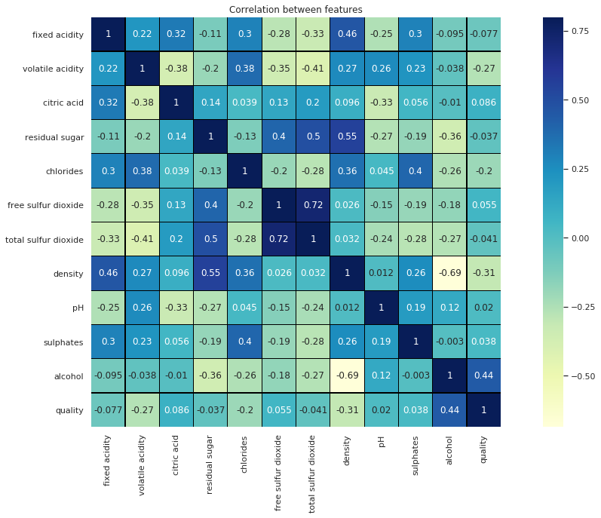
EDA – Wine Dataset
Establishing correlation between all the features using heatmap.
density, residual sugar,total sulphur dioxide and chlorides are negatively corelated with alcohol..
total sulphur dioxide is positively coorelated with free sulphur dioxide.
With high corelation we face redundancy issues.

Slide 7
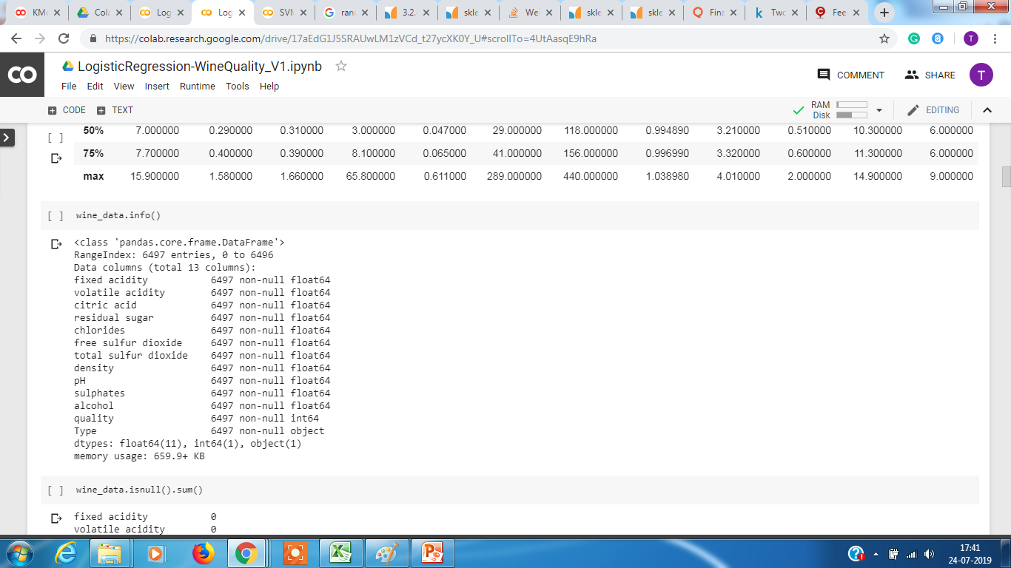
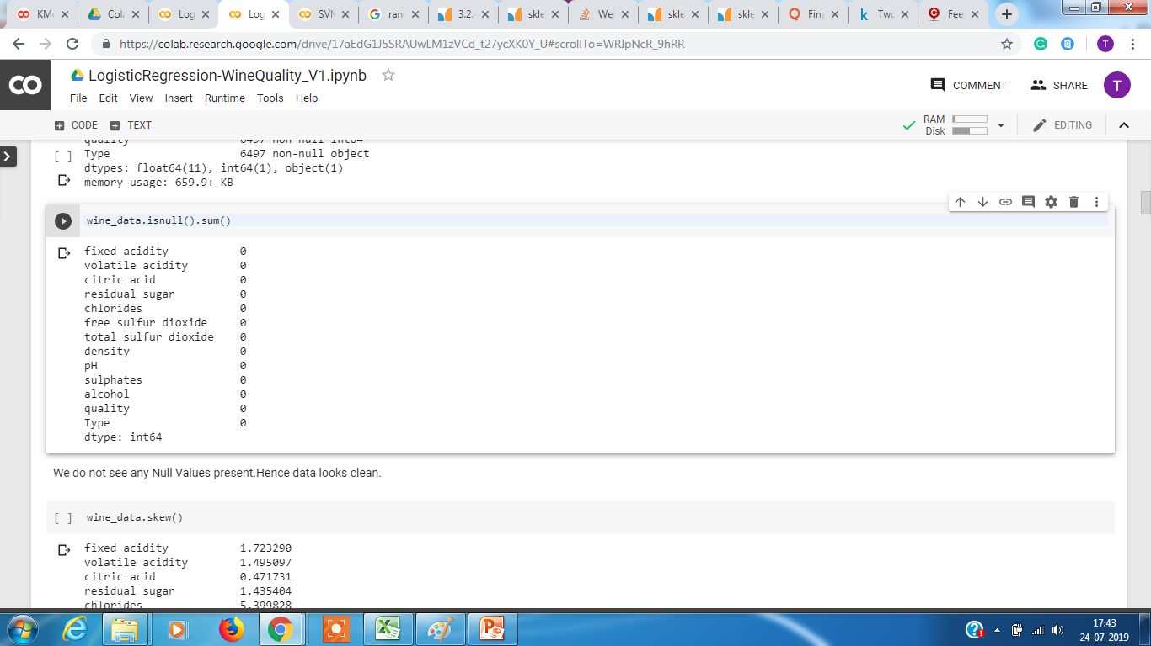
EDA – Wine Dataset
Checking for Null Values
We do not see any Null Values present. Hence data looks clean.

Slide 8
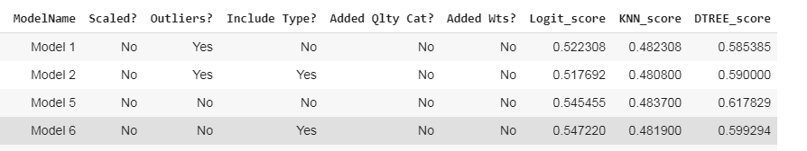
EDA – Model Evaluation
Based on the data available we tried the following approach to see if the models built on these gives a good accuracy.
Approach 1 : Check a Model which doesn't include type information, keep the outliers, doesn't scale data nor add any weights and see if the KNN, Logistic Regression or Decision Tree provide good accuracy.
Observation : The accuracy was found to be not good for any models the highest we were able to achieve was 61% and that was for Decision Tree.
Hence, we tried next to see if by adding weights (due to imbalance data) could help in improving the accuracy

Slide 9
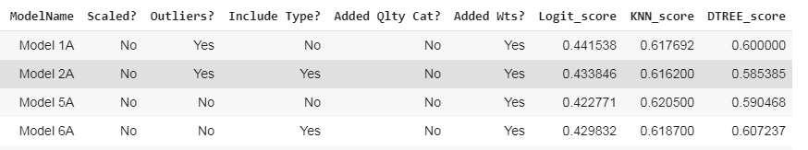
EDA – Model Evaluation
Approach 2 : Check a Model which doesn't include type information, keep the outliers, doesn't scale data but add weights and see if the KNN, Logistic Regression or Decision Tree provide good improve the accuracy.
Observation : The accuracy still did not improve for any models the highest we were able to achieve was 62% and that was for KNN.
Next, we tried to add a new category for quality and see if we could predict the new class by without adding first to improve the accuracy

Slide 10
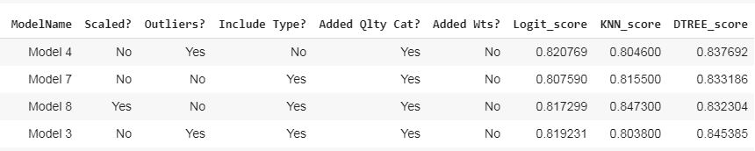
EDA – Model Evaluation
Approach 3 : Check a Model by adding a new category for quality(1 – poor, 2 – good and 3 – Excellent) and see if we could predict the new class by without adding weights for KNN, Logistic Regression or Decision Tree.
Observation : The accuracy shot up to around 80% now and the highest we got was 84% for KNN n=6.
Next, we tried to add weights(due to imbalance data) to see if it improved the accuracy

Slide 11

EDA – Model Evaluation
Approach 4 : Check a Model by adding a new category for quality(1 – poor, 2 – good and 3 – Excellent) and see if we could predict the new class by adding weights for KNN, Logistic Regression or Decision Tree.
Observation : The accuracy improved by 3% and the highest we got was 88% for KNN n=16.
Hence we see that by adding a new category and using weights and including type for prediction of the new class resulted in good accuracy and we select KNN which provided 88% for n = 16. And, The best score for Logistic regression and Decision Tree was model 4 with 82% and Model 8A with 84% respectively.

Slide 12
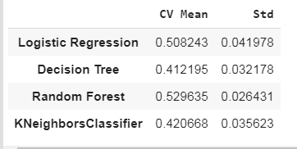
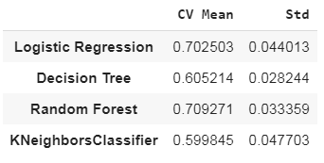
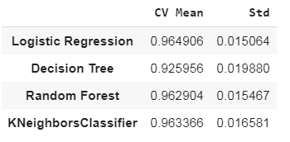
EDA – Model Evaluation
Approach 5 : Check for best model Logistic Regression ,Decision Tree, Random Forrest or KNN using cross validation because data is imbalanced.
First try without new quality class data and then qualityclass with 4 category(Poor,Moderate,Good and Excellent) and finally with 3(Poor, Good and Excellent) categories.
Observation : Without the new category we see the accuracy is very poor , highest being 52% with Decision Tree. However, when the quality was categorized into 4 new we see the accuracy increased and the highest was Random Forrest with 70%. And, when the category was divided into 3 new segments the accuracy increased to 96% with KNN , Random Forrest and Logistic Regression.
Without New quality category
With 4 new quality category
With 3 New quality category

Slide 13
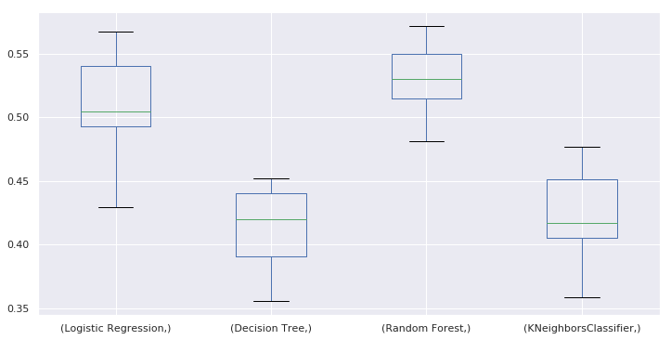
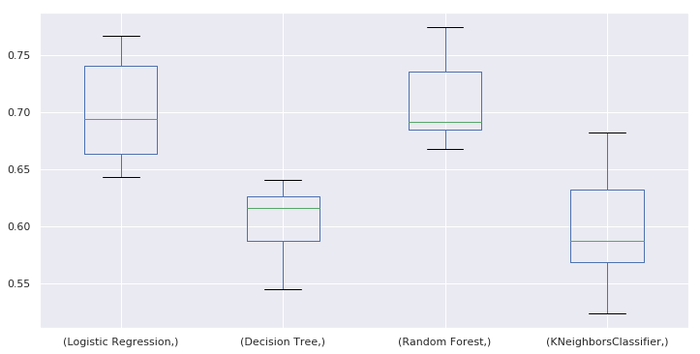
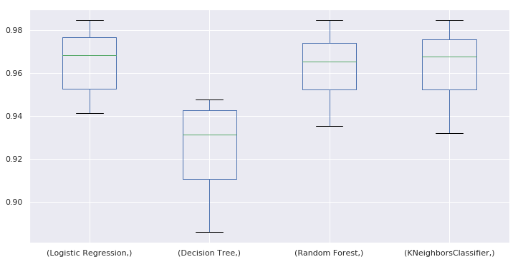
EDA – Model Evaluation
Approach 5 : Draw the boxplot to check the mean and standard deviation,
Observation : Without the new category we see the accuracy is very poor and when we added 4 new category to quality class it improved and with 3 new category it improved to 96%.
Without New quality category
With 4 new quality category
With 3 New quality category

Slide 14
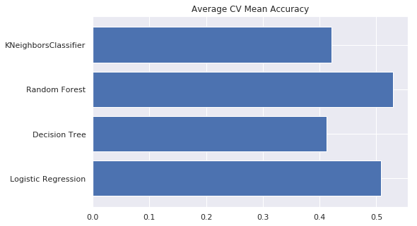
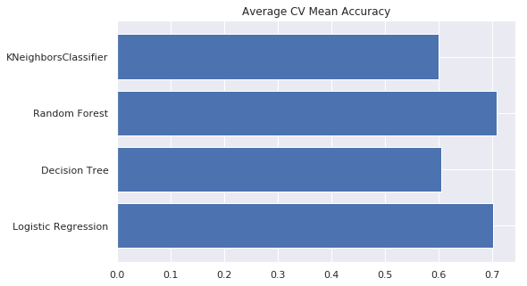
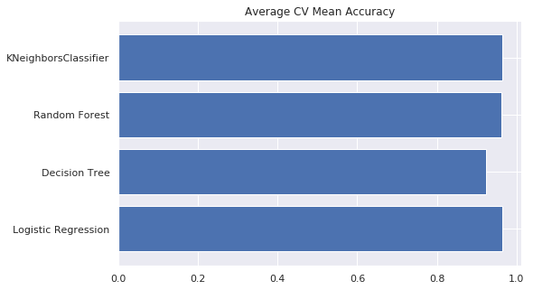
EDA – Model Evaluation
Approach 5 : Checking the Average CV mean accuracy,
Observation : We were able to achieve 96% accuracy for KNN and Logistic Regression after new categories were added.
Without New quality category
With 4 new quality category
With 3 New quality category

Slide 15
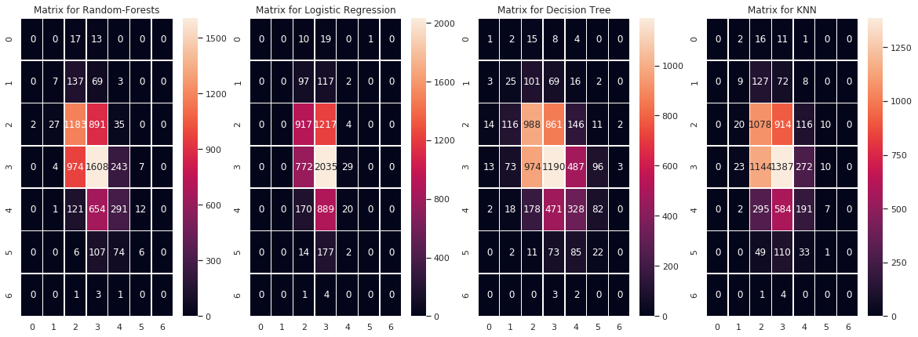
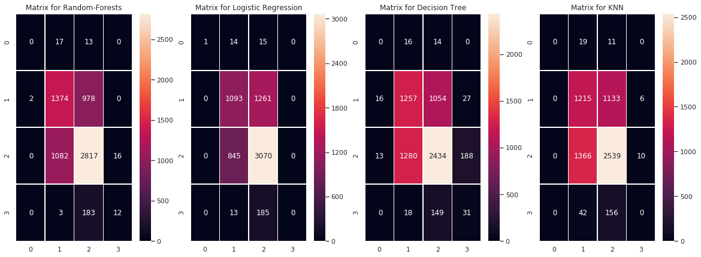
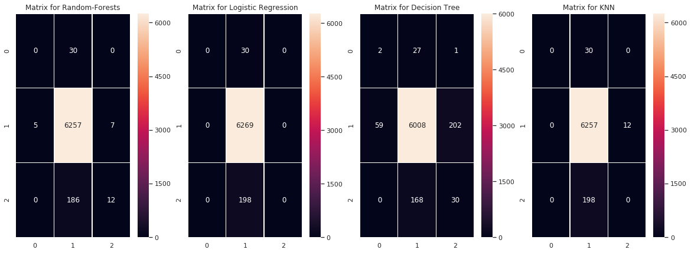
EDA – Model Evaluation
Approach 5 : Checking the confusion matrix first without new category for quality and then with 4 new category for quality(1-Poor, 2-Average, 3 – Good and 4 Excellent) and finally with 3 new category
Without New quality category
With 4 new quality category
With 3 New quality category
Observation : The accuracy increased when the quality was categorised into 3 new categories as Poor, Good and Excellent.
By looking at all the matrices, we can say that KNN and Logistic Regression has a higher chance in **correctly predicting all the new quality class correctly**

Slide 16
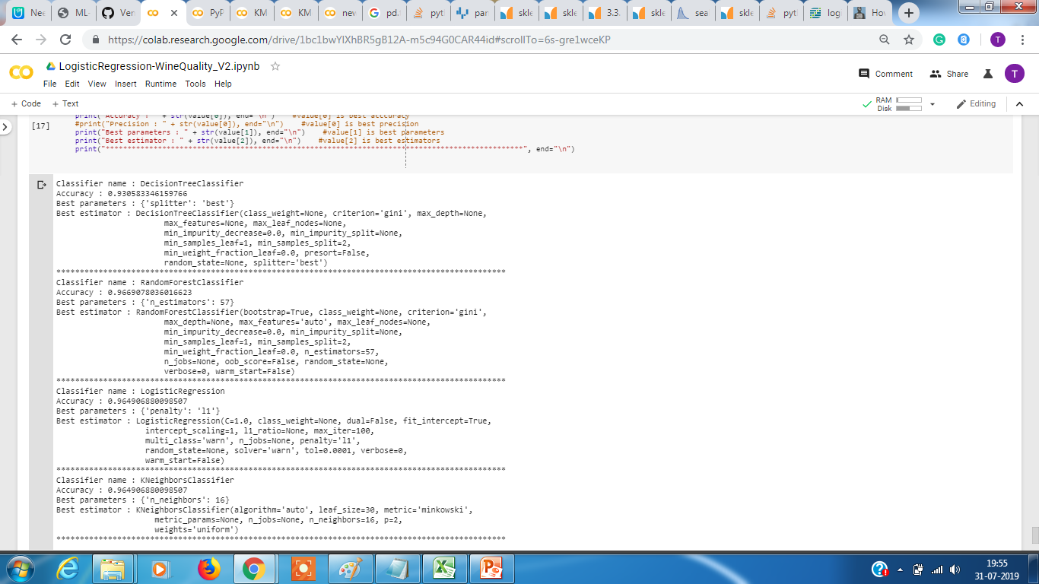
EDA – Model Evaluation
Approach 5 : Using the Grid Search we find that the Logistic and Random Forrest provide a 96% accuracy and below are the best parameters .
Observation : Though the accuracy is 96% for Random Forrest , KNN and Logistic Regression we choose KNN over Random Forrest and Logistic Regression because of its simplicity.

Slide 17
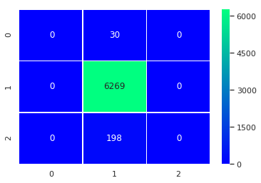


EDA – Model Evaluation
Approach 5 : Using the Grid Search we find that the KNN provide a 96% accuracy and below is the confusion matrix results.
KNN
Random Forrest
Logistic Regression
Observation : Though the accuracy is 96% for both Random Forrest and Logistic Regression we choose Logistic Regression over Random Forrest because of its simplicity.

Slide 18
EDA – Summary
Based on the data available we try the following approaches to see if the model built on these gives a good accuracy.
Check a Model which doesn't includes type information, keep the outliers, doesn't scale data nor add any weights (due to imbalance data) and see if the KNN, Logistic Regression or Decision Tree provide good accuracy.
Check if we add weights but ignore type, keep outliers and use unscaled data.
Check if accuracy improves if we add type, remove outliers, scale data and add weights for predicting the quality
After trying all the above it was observed that accuracy could not go beyond 61% even after adding type, removing outliers, standardised data to scale and adding weights.
The new approach was to see if we can bin the class "quality" from 0-10 to 3 major categories 0-2 [poor] ,3-6 [good] and 7-10 [excellent]. and see if the same Model is able to predict the class "quality" now more accurately.
For the new class (with 3 category) we found that by adding weights , standardised scale data ,including type the accuracy increased and the best was for KNN 88% for n = 16. And, The best score for Logistic regression and Decision Tree was model 4 with 82% and Model 8A with 84% respectively.

Slide 19
EDA – Summary
Using cross validation with the new class (with 3 category) we found that accuracy increased to 96% for KNN , Random Forrest and Logistic Regression.
Without New quality category
With 4 new quality category
With 3 New quality category
And, Using Grid Search we found that to get the accuracy of 96% for KNN and Logistic Regression, we use KNN with parameters as n_estimator :1 6, p=2, algorithm=auto, metric=minkowski and weights=uniform.

Slide 20
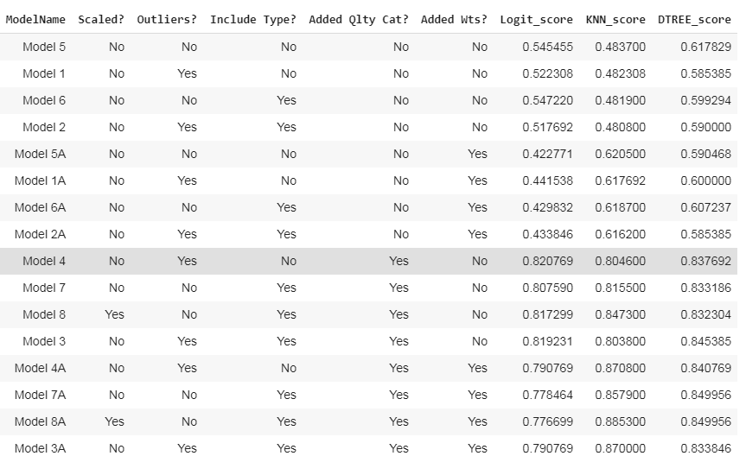
EDA – Conclusion
The Different Models used and their accuracy score.

Slide 21
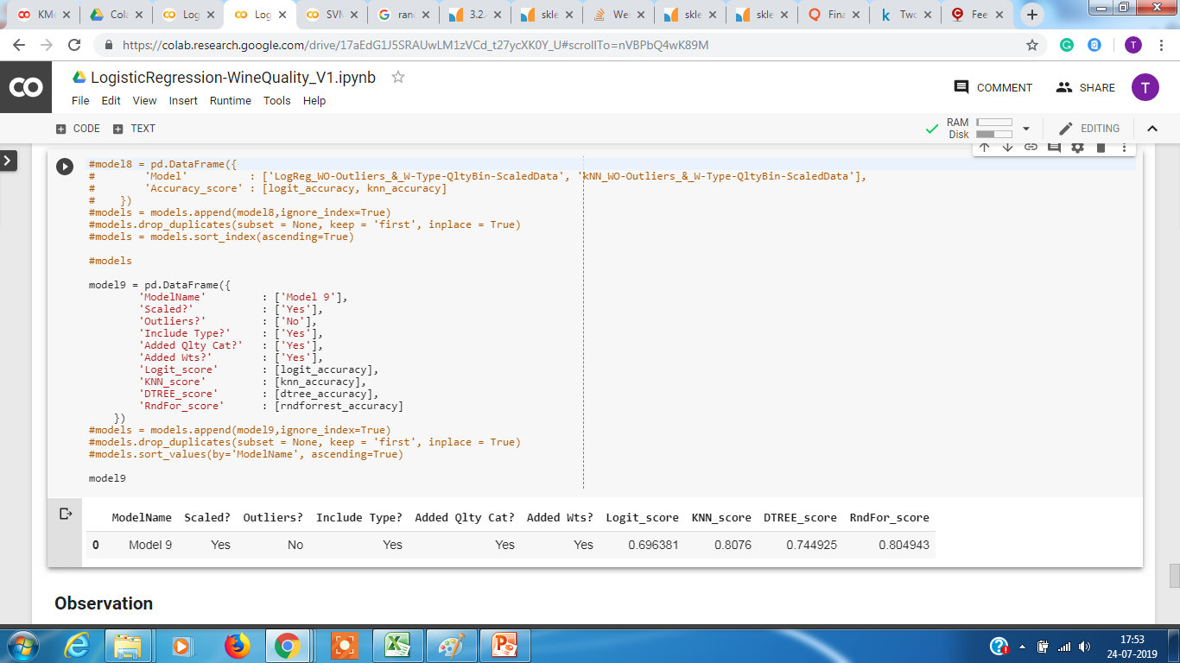
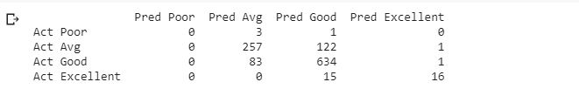
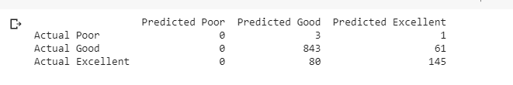
EDA – Conclusion
When the class "quality" was binned into 3 categorised into sub category of poor, good and excellent the accuracy improved from 61% to 87%.
When the class "quality" was binned into 4 categorised into sub category of poor, average, good and excellent the accuracy dropped from 87% to 80%.
Model8A with KNN provides the highest accuracy of 87% with n=7 and hence that is selected.

Slide 22
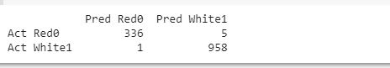
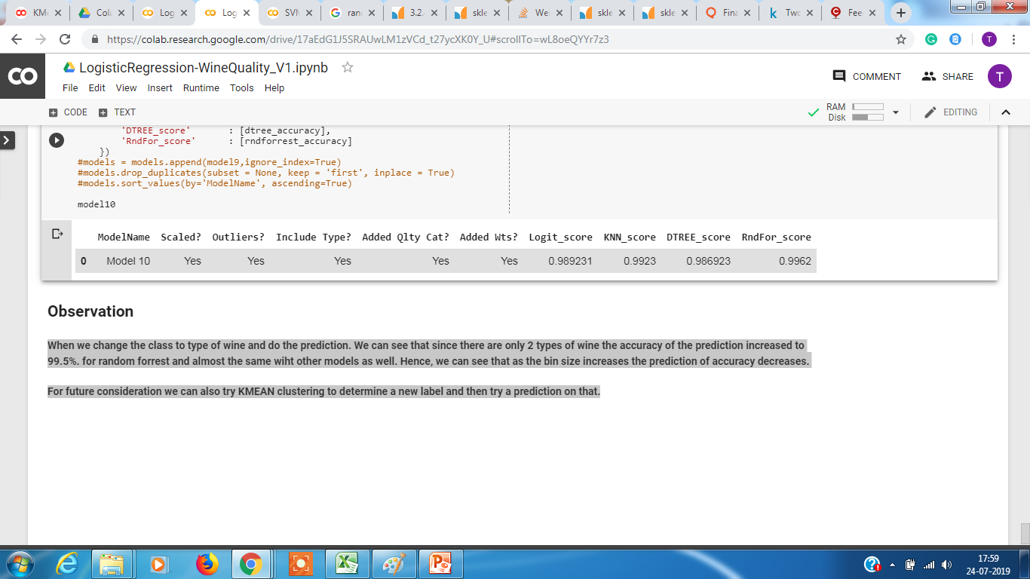
Future Considerations
Final thoughts
When we change the class to type of wine and do the prediction. We can see that since there are only 2 types of wine the accuracy of the prediction increased to 99.5% for Random Forrest and almost the same accuracy with other models as well. Hence, we can see that as the bin size increases the prediction of accuracy decreases.
For future consideration we can also try KMEAN clustering to determine a new label and then try a prediction on that.

Slide 23
Thank You

