Slide 1



PSYLIQ – EMPLOYEE DATA ANALYSIS ASSESMENT
BY
VENKATESH POLISETTI
(DATA ANALYST INTERN)

Slide 2
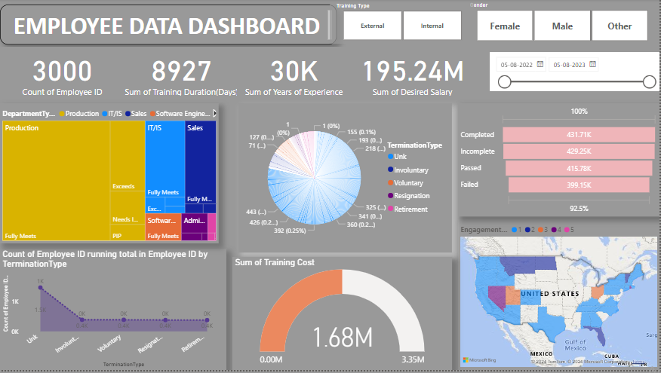

Slide 3
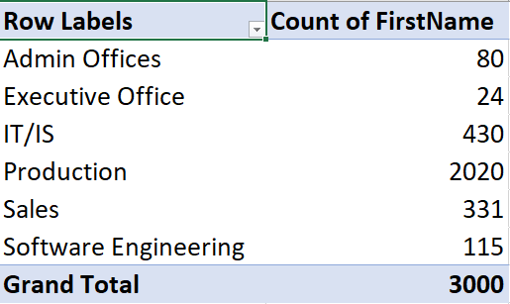
A Pivot table to summarize the total number of employees in each department.

Slide 4
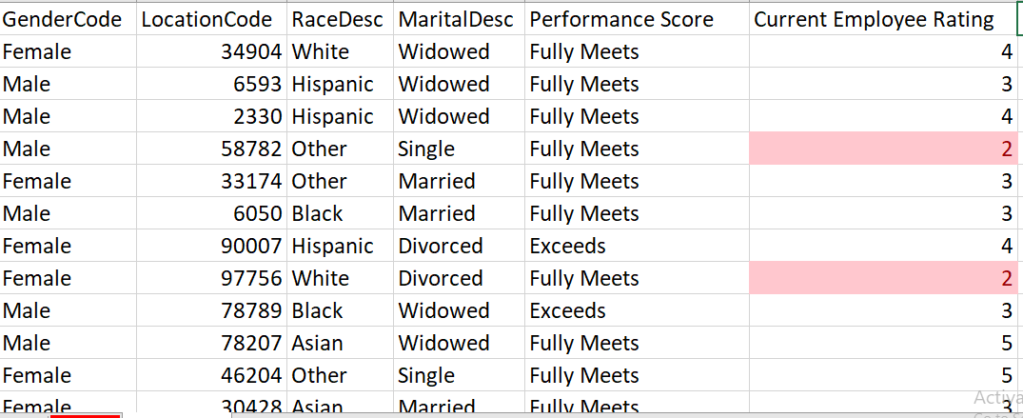
Apply conditional formatting to highlight employees with a "Performance Score" below 3 in red.

Slide 5
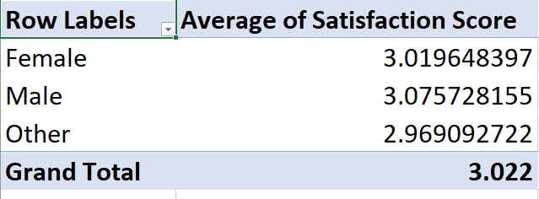
Calculate the average "Satisfaction Score" for male and female employees separately using a pivot table.

Slide 6
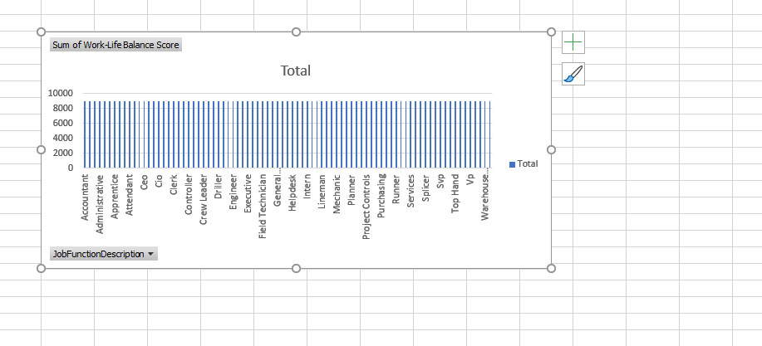
Create a chart to visualize the distribution of "Work-Life Balance Score" for different job functions.

Slide 7
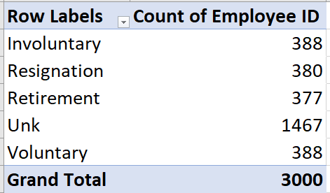
Filter the data to display only terminated employees and find out the most common "Termination Type."

Slide 8
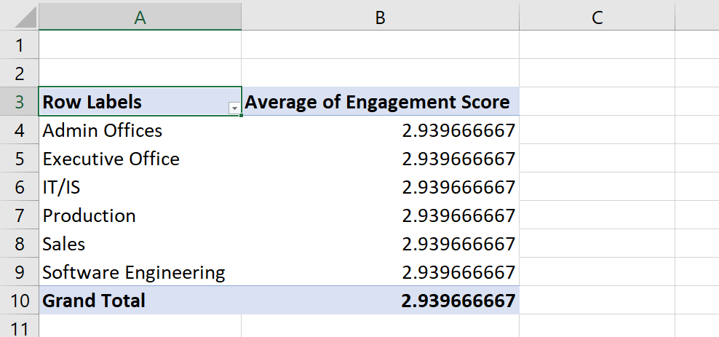
Calculate the average "Engagement Score" for each department using a pivot table.

Slide 9
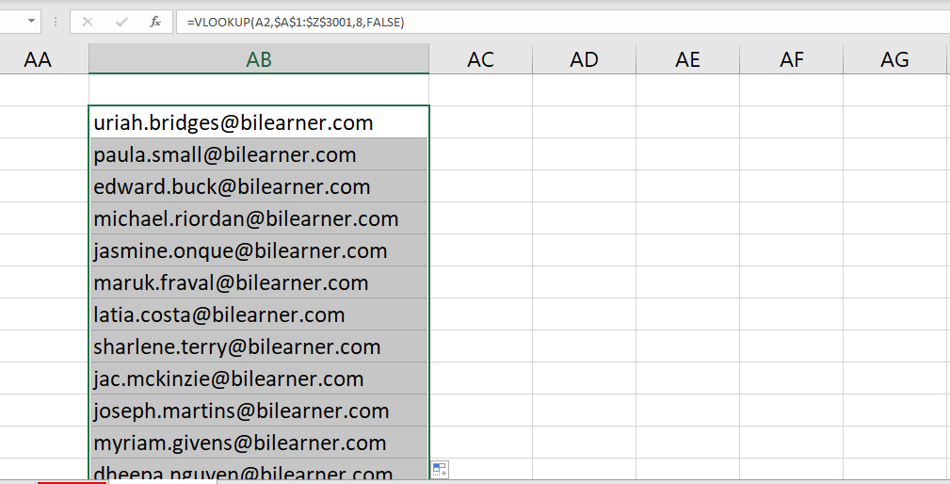
Use VLOOKUP to find the supervisor's email address for a specific employee.

Slide 10
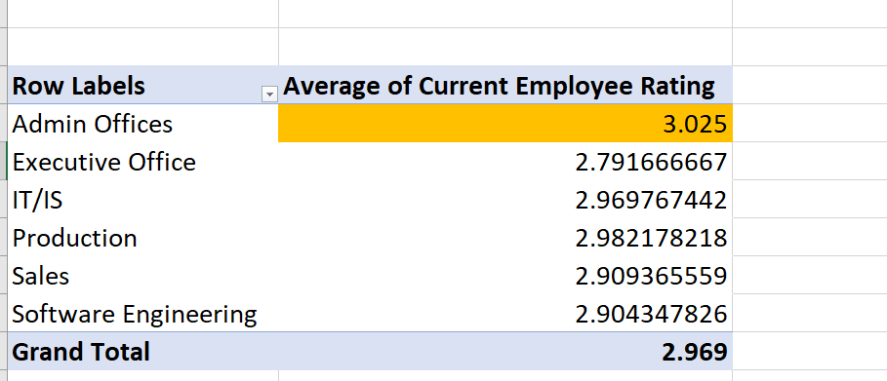
Can you identify the department with the highest average "Employee Rating?"

Slide 11
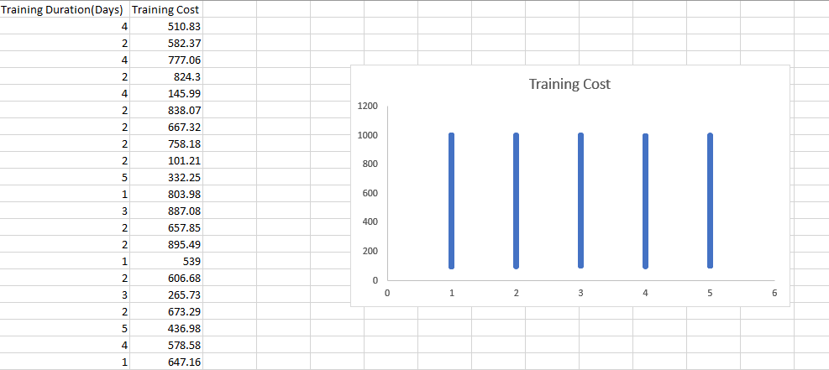
Create a scatter plot to explore the relationship between "Training Duration (Days)" and "Training Cost."

Slide 12
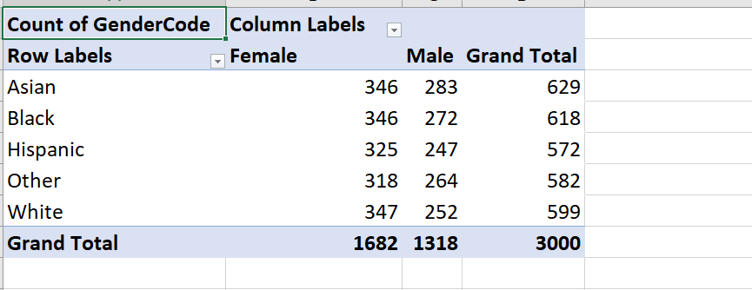
Build a pivot table that shows the count of employees by "RaceDesc" and "GenderCode."

Slide 13
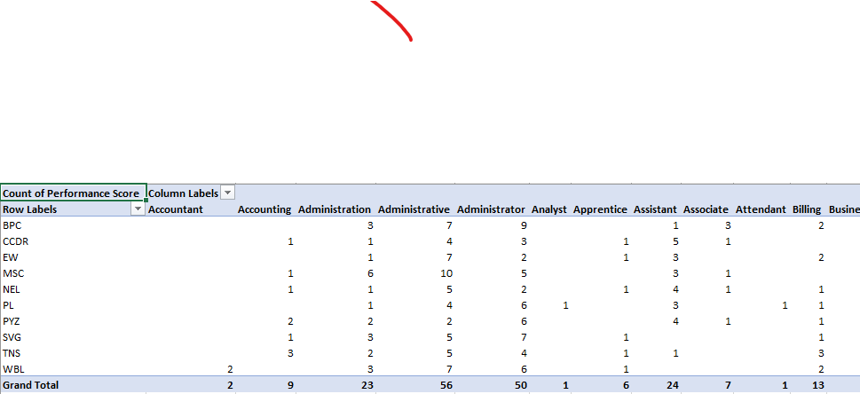
Create a multi-level pivot table to analyse the "Performance Score" by "BusinessUnit" and "JobFunctionDescription."

Slide 14
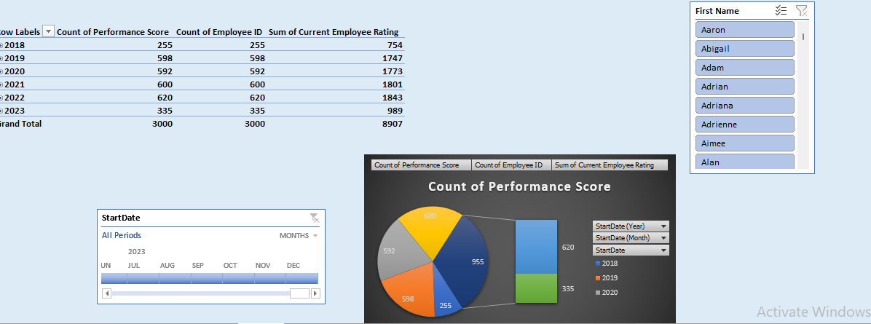
Design a dynamic chart that allows users to select and visualize the performance of any employee over time.

Slide 15
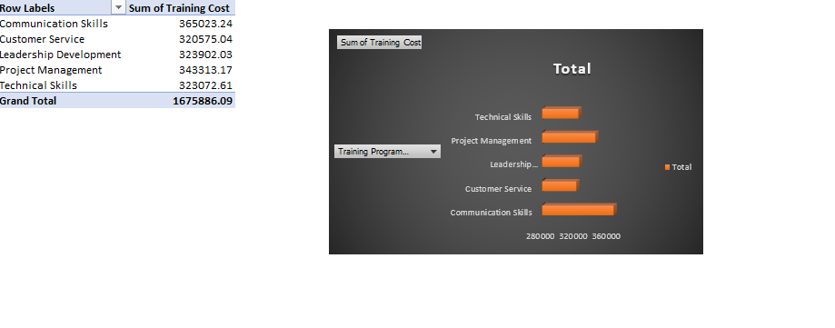
Calculate the total training cost for each "Training Program Name" and display it in a bar chart.

Slide 16
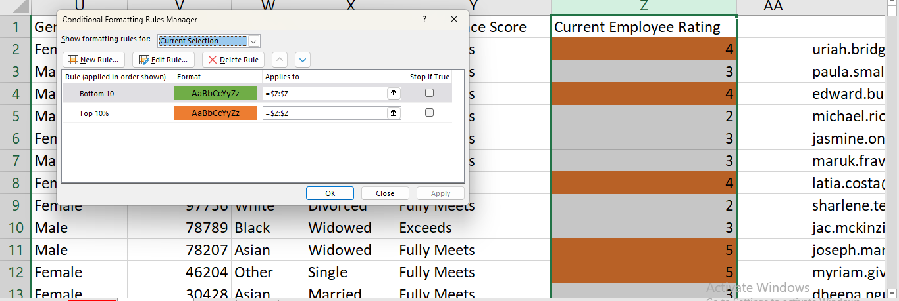
Apply advanced conditional formatting to highlight the top 10% and bottom 10% of employees based on "Current Employee Rating."

Slide 17
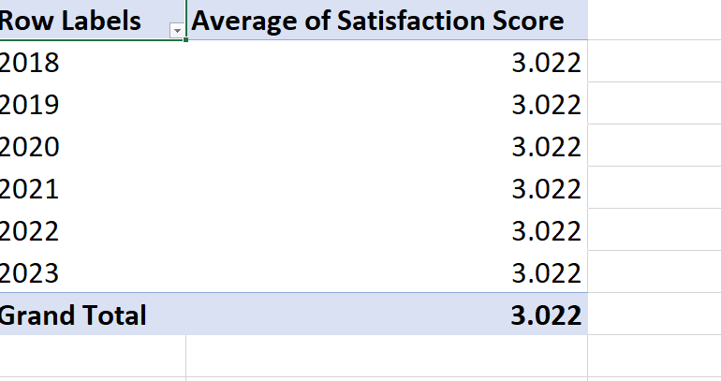
Use a calculated field in a pivot table to determine the average “Satisfaction score" per year.

Slide 18
Can you build a macro that automates the process of updating and refreshing all pivot tables in the workbook?
Press Alt+F11 to open the Visual Basic for Application (VBA)editor
GO to Insert >Module to insert a new module .
Write the code into the module window .
Close the VBA editor
Press Alt +F8 , select “Refresh All Pivot Tables” and click “run”.

Slide 19
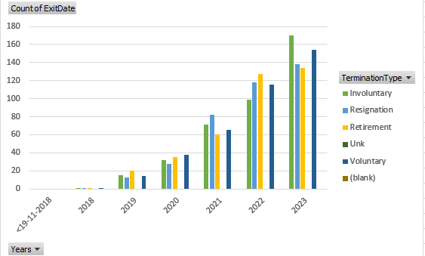
Create a histogram to understand the distribution of "ExitDate" for terminated employees.

Slide 20
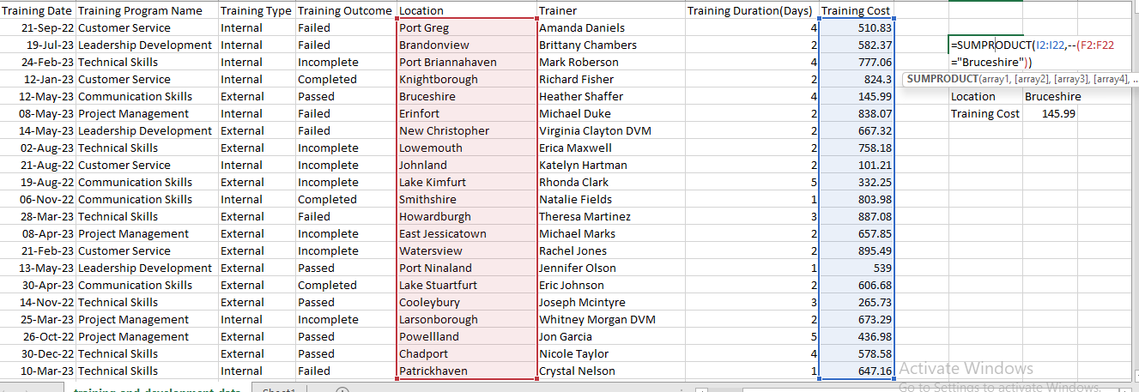
Utilize the SUMPRODUCT function to calculate the total training cost for employees in a specific location.

Slide 21
Dashboard that provides an overview of key HR metrics, including headcount, performance, and training costs, using charts and pivot tables.

Slide 22


