Slide 1
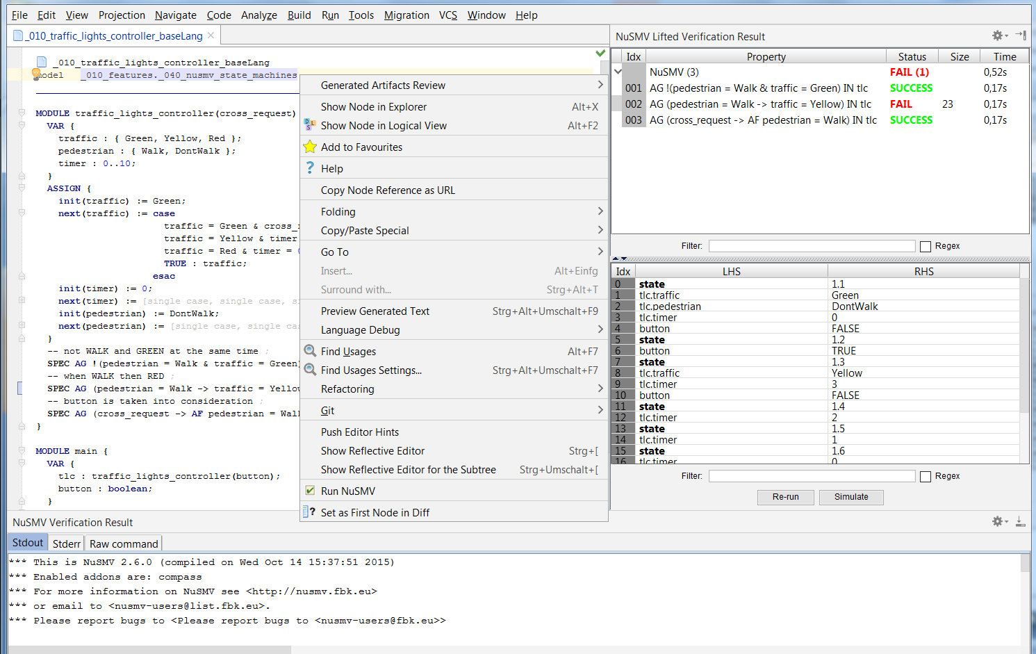
Right-click on a root node
containing a ‘main’ module
Verification results lifted at the DSL level
Counterexample for the selected result
Run NuSMV
Raw output (STDOUT and STDERR) of NuSMV and the command used to run it.

Slide 2
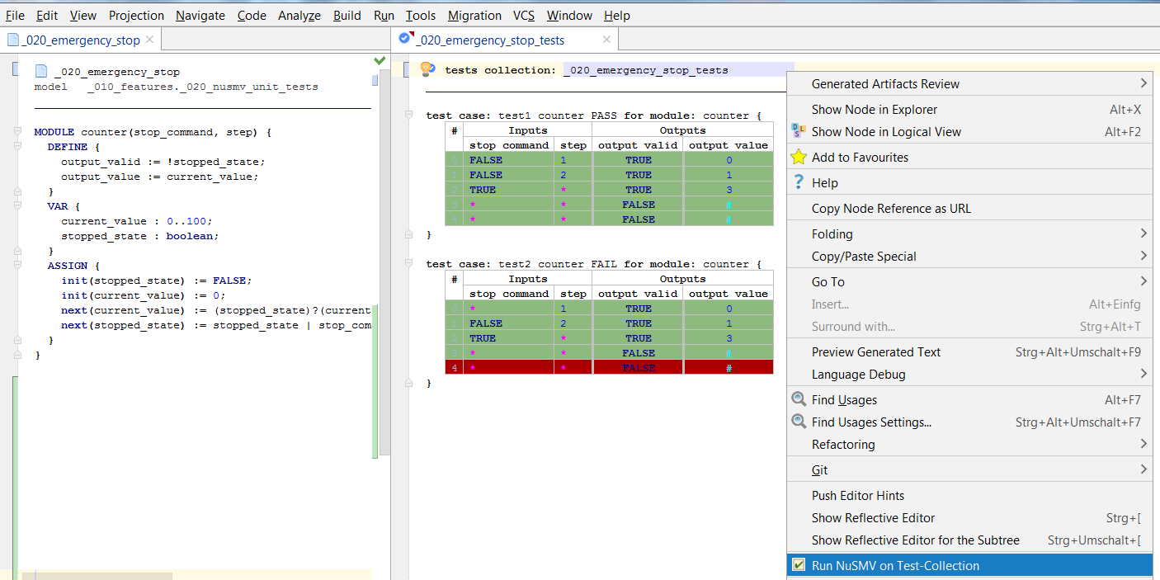
Right-click on a test collection opens a pop-up menu
Two test cases,
each with five steps
System under test
Test results are marked
with green/red background
Run the tests

Slide 3
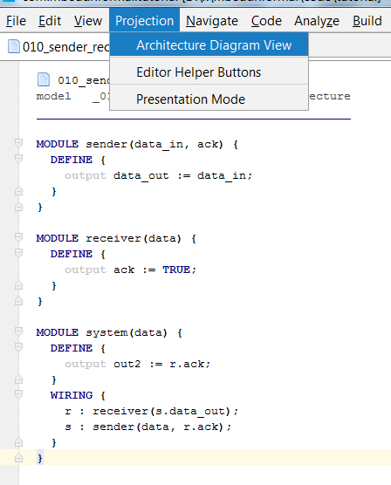
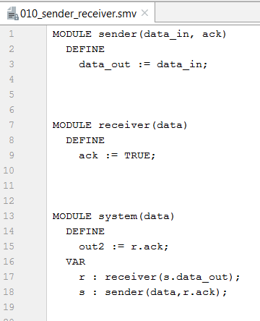
‘output’ declarations are generated into defines
Switch between textual and diagrammatic notations for the architecture
Special defines are used to define output ports
WIRING sections are generated into VAR sections
Architecture definition inside of
a WIRING section of a module
Textual notation
Generated NuSMV code

Slide 4
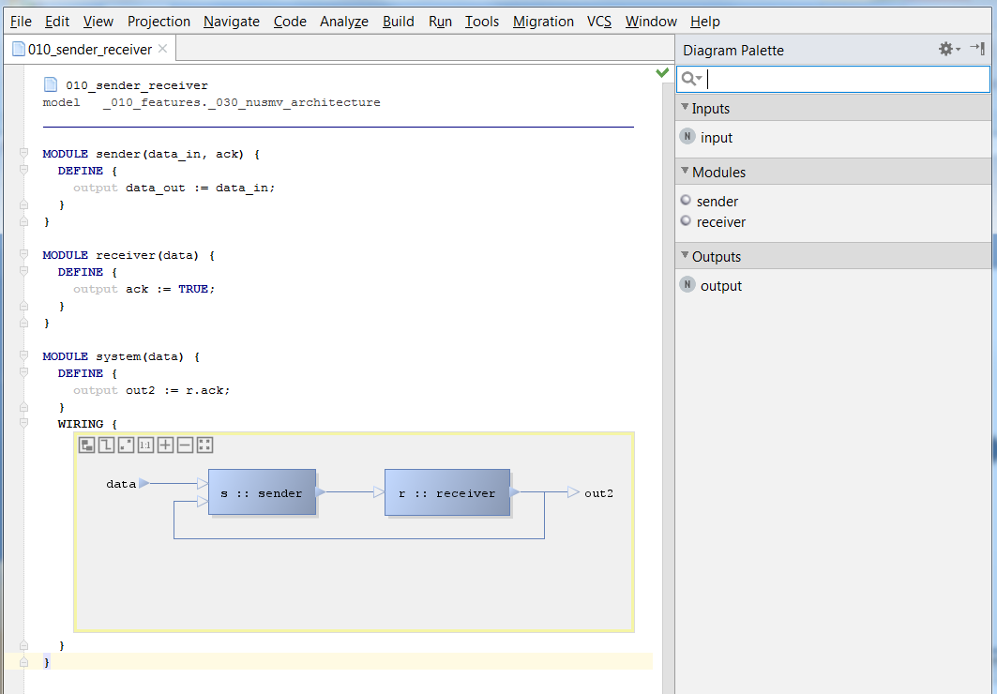
Diagram palette can be used
to create architectures via
drag-and-drop
Diagrammatic notation

