Slide 1
Einstein Vision
Kaushik Kavuri Subrahmanya
Butchi Venkatesh Adari

Slide 2
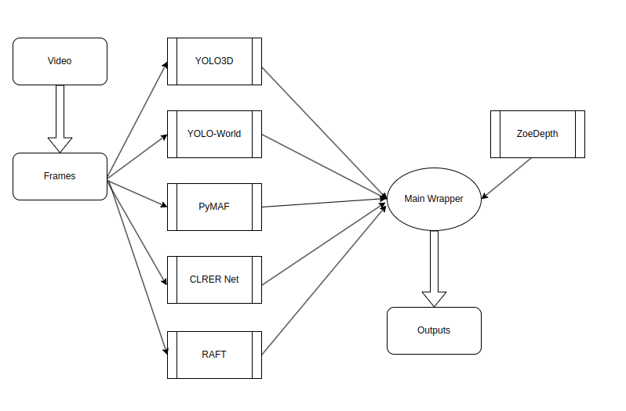
Overview
An important aspect of any computer vision project is the visualization of the output. In this project, we aim to create a visualization of the onboard camera views of a Tesla car. We achieved this by extracting various objects from the video and rendering them through Blender.

Slide 3
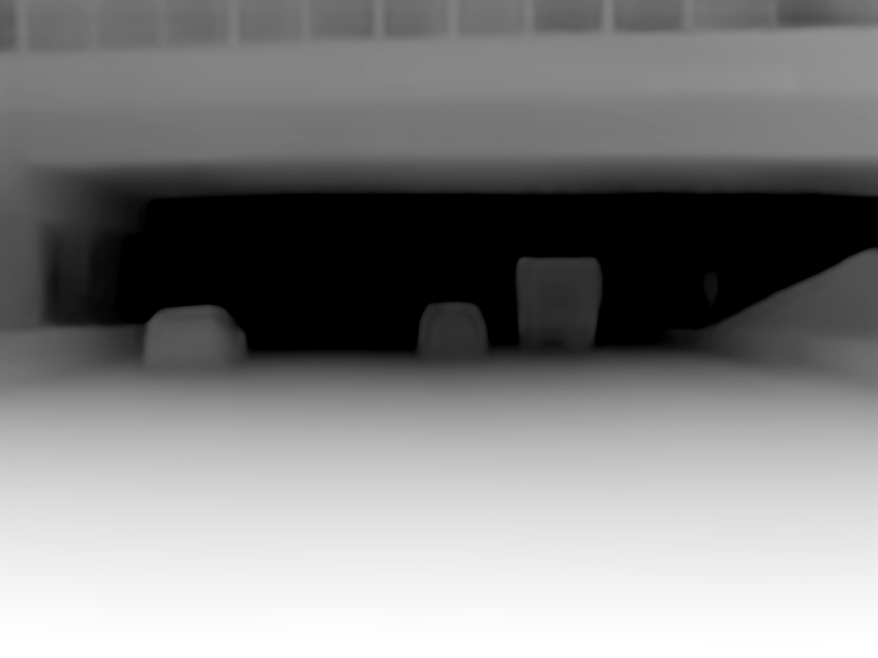
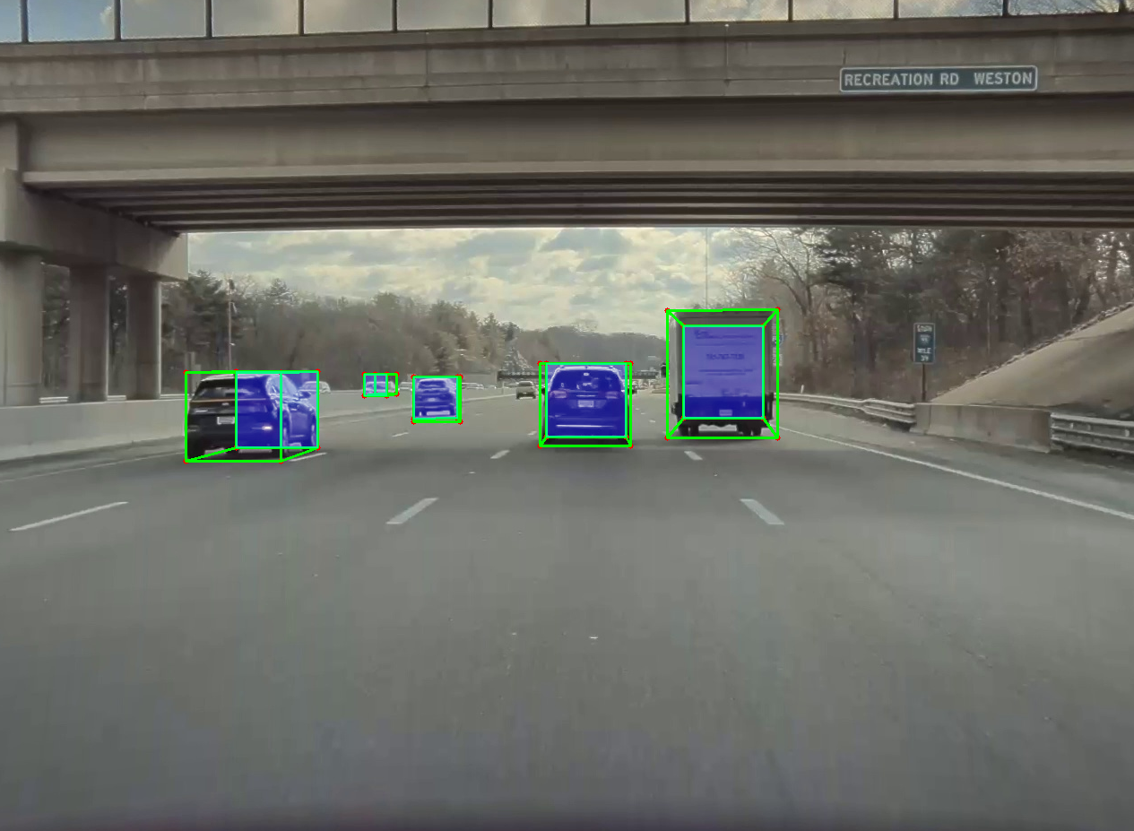
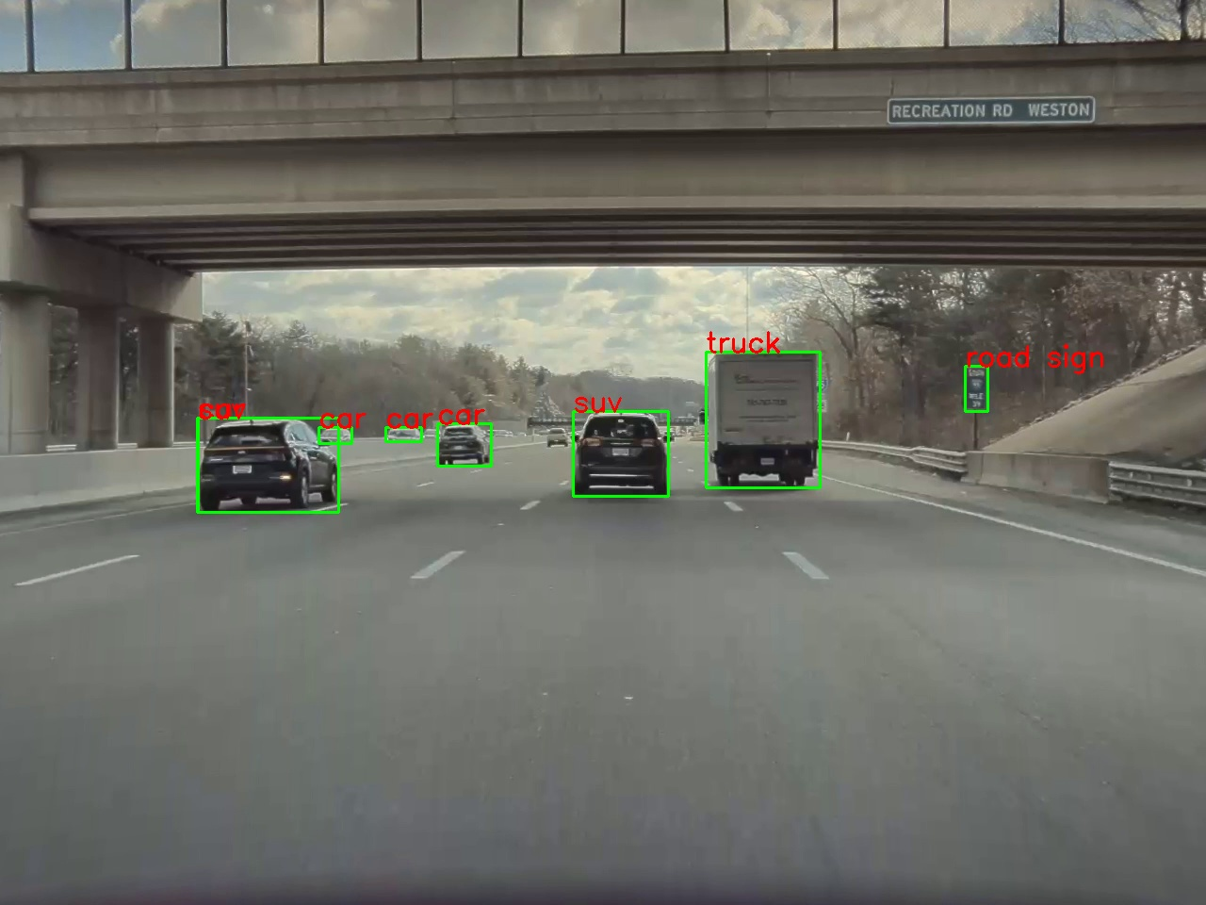
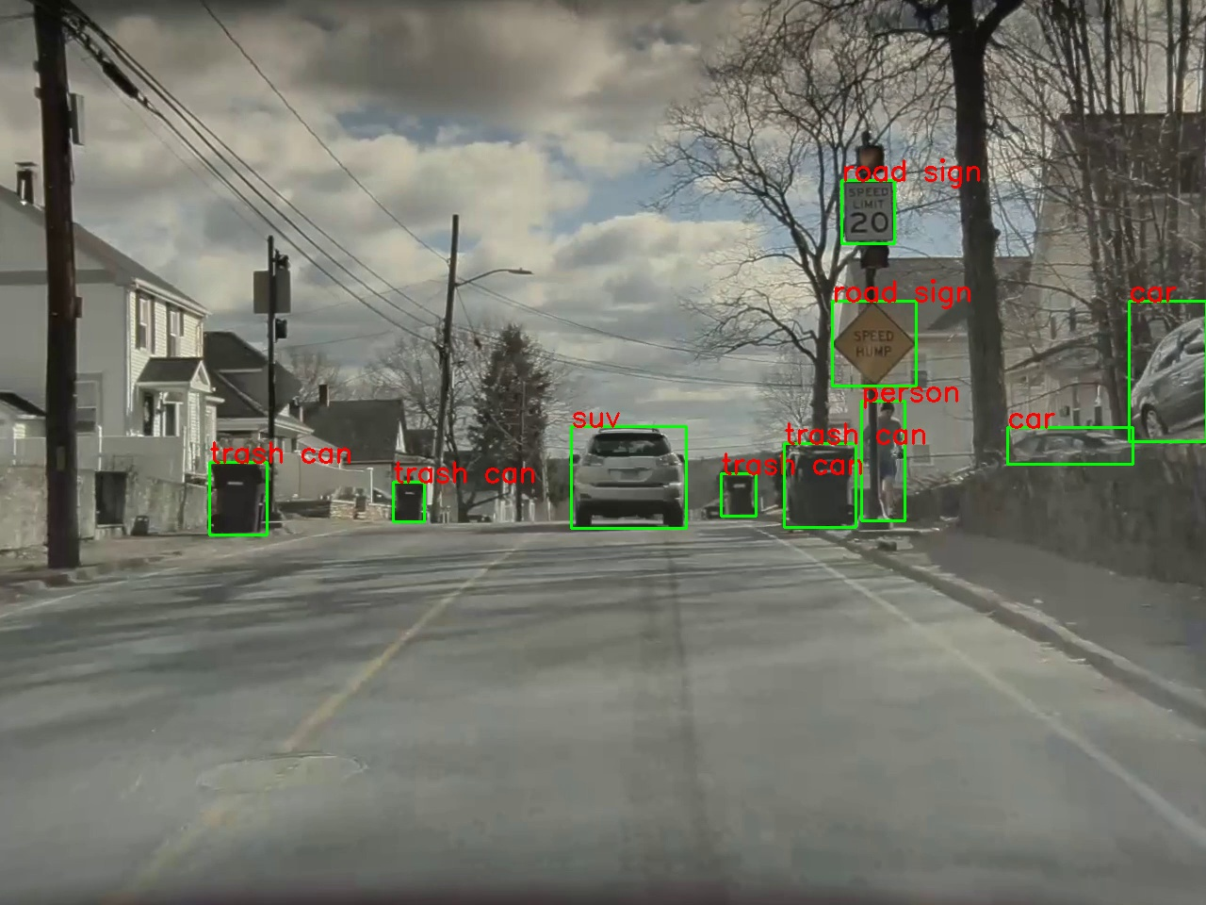
Approach
Object Detection
Implemented detection of lanes, vehicles, pedestrians, traffic lights, and road signs using various models such as CLRerNet, YOLO-World, and PyMAF. Depth of objects was calculated using Zoe Depth, and all detected elements were rendered in Blender.

Slide 4
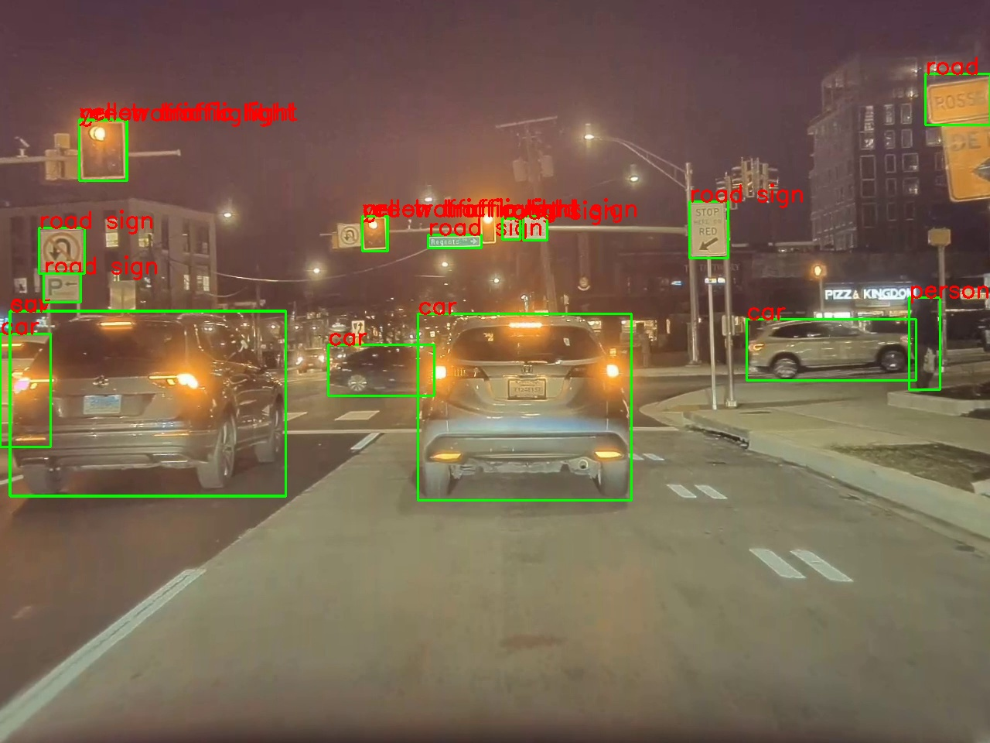
Approach
We used Yolo World to detect most of the road objects, Yolo 3D for vehicle orientation.

Slide 5
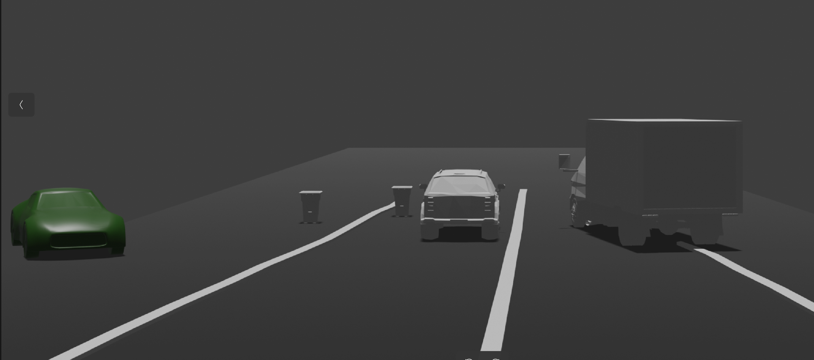
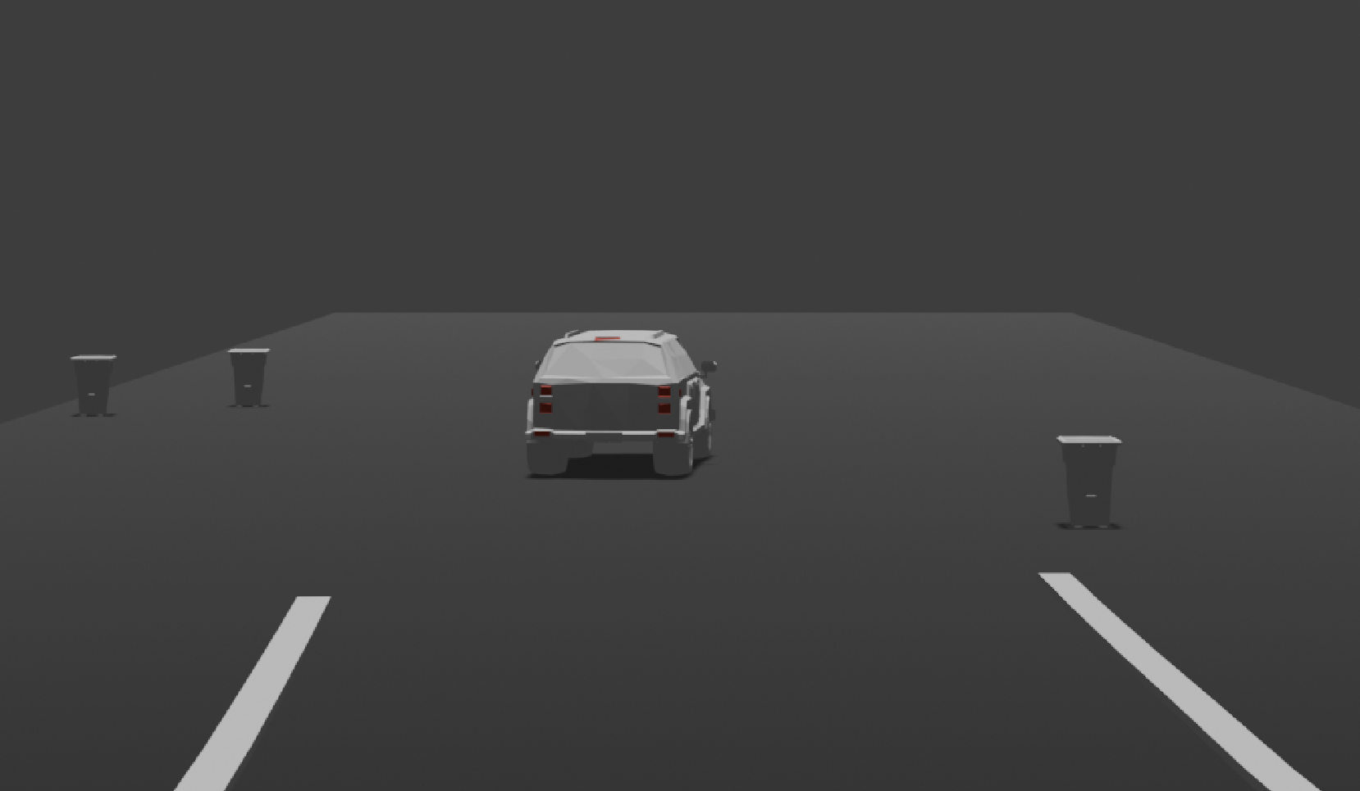
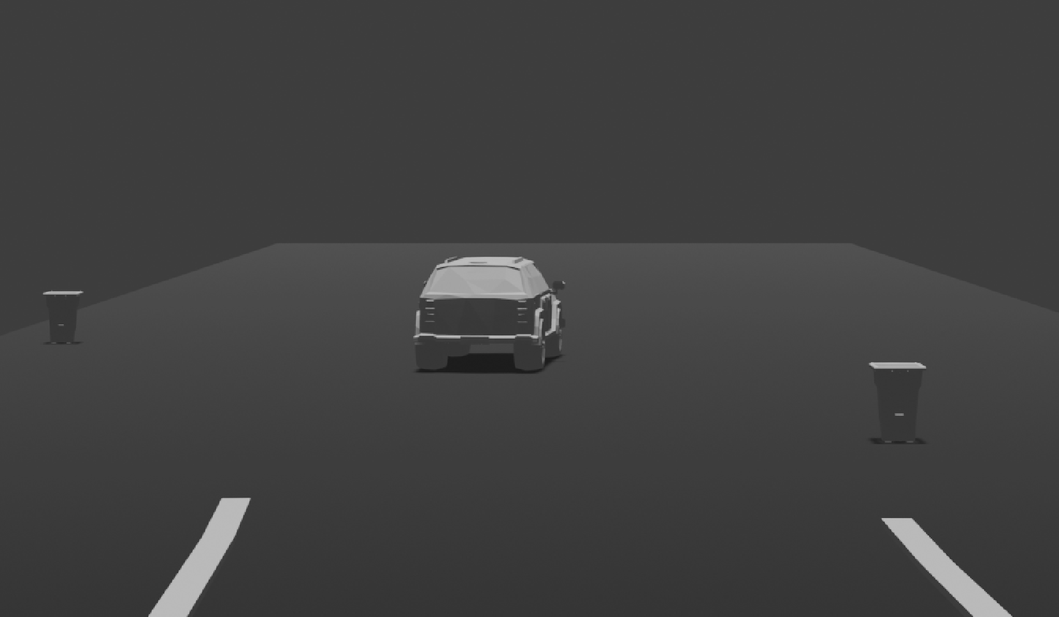
Objectives and Object States
Brake Light Indication: To detect the brake lights, we used tail-light-detection model which was trained based on YOLOv8. The model detects the status of the brake light and returns a label on whether the brake light was engaged or not.
If the light was engaged, the model used for a vehicle was replaced with the corresponding alternative asset we created.
Stationary/Moving Vehicles: We used RAFT for optical
flow and Sampson distance from OpenCV2 to distinguish
between stationary and moving vehicles. Stationary cars are
rendered as green cars in our Blender renders.

Slide 6
Challenges and Resolutions
Scaling: Objects were not scaled correctly in render
Vehicle Detection: Difference of vehicle centers in Yoloworld vs YOLO3D
Stationary/Moving vehicles: Same speed vehicles detected as stationary

