Slide 1
Vehicle insurance promotion data analytics
Venkatesh Satagopan

Slide 2
Agenda
Motivation
Data used
EDA
Clustering
Results
Conclusion

Slide 3
Motivation
18% of worlds population uses vehicles
Vehicle insurance critical for safety of vehicles
New vehicle registered data, working professional area can be used for data analytics by insurance companies, OEM manufacturers for promotion, supply-chain demand etc.
In this project data analysis performed to segregate regions in Munich city for promoting customized offers, policies by a vehicle insurance company.

Slide 4
Agenda
Motivation
Data used
EDA
Clustering
Results
Conclusion

Slide 5
Data Used
Working professionals present in each borough (region) of Munich
Number of new vehicles registered in each borough of Munich
Number of venues tie-up with insurance company for promoting their offers
Venues tie up with the company
Motorcycle shop
Automotive shop
Gas station
Auto Dealership
Hotel & Motel
Rental car shop
Auto repairshop

Slide 6
Agenda
Motivation
Data used
EDA
Clustering
Results
Conclusion

Slide 7
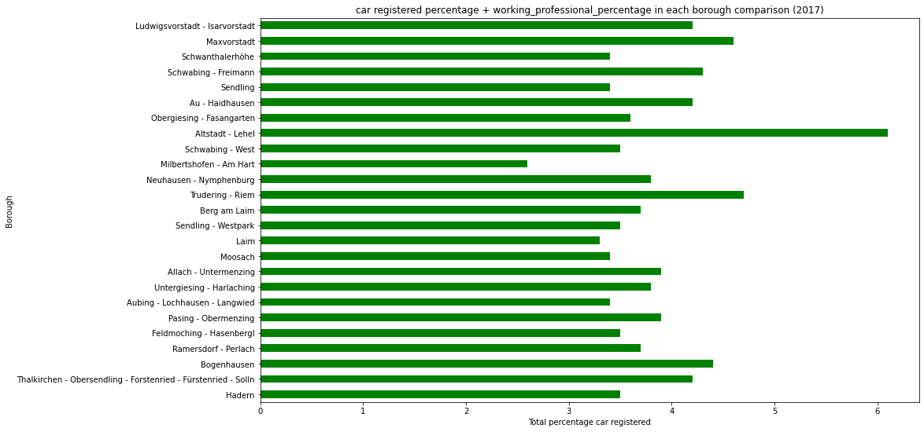
EDA
Hadern and Thaikirchen have less vehicles registered & working professionals
Isarvorstadt and Maxvorstadt have more number of vehicles registered & working professionals

Slide 8
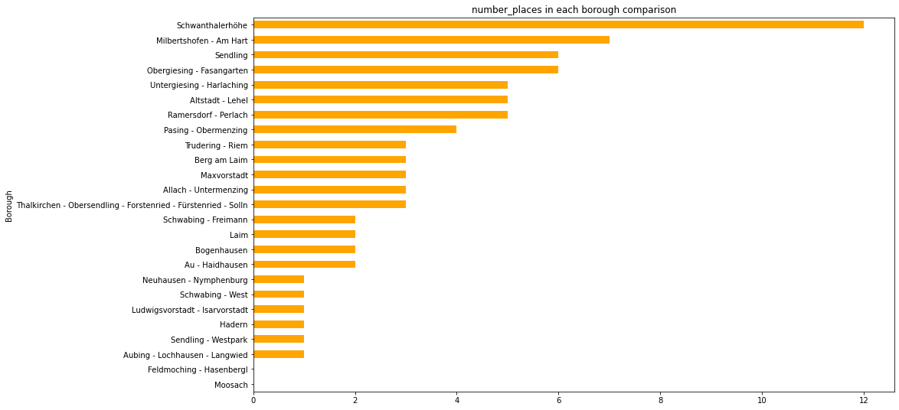
EDA
Moosach and Feldmoching does not have any tie-up venue partners
Schwanthalerhohe and Milbertshofen have more number of tie-up venue partners

Slide 9
Agenda
Motivation
Data used
EDA
Clustering
Results
Conclusion

Slide 10
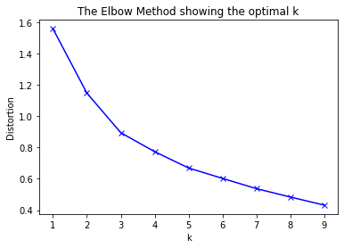
Clustering
Optimal clusters choosen: 3

Slide 11
Agenda
Motivation
Data used
EDA
Clustering
Results
Conclusion

Slide 12
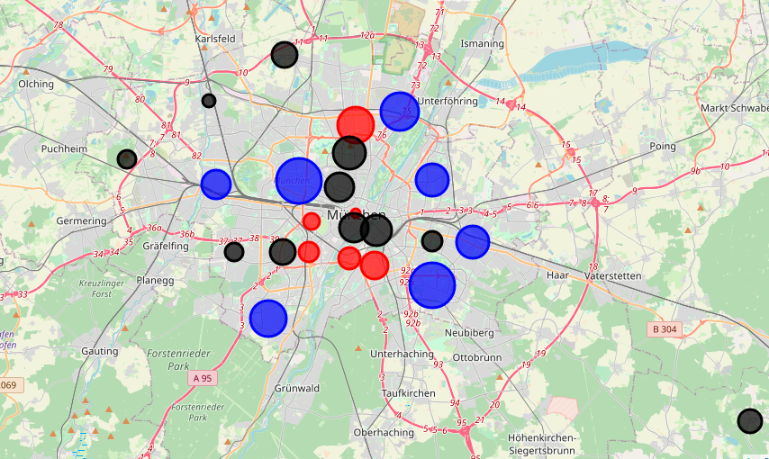
Results
Clusters of Munich main places based on the number of venues partner

Slide 13
Results
Clusters of Munich main places based on the new vehicles registered

Slide 14
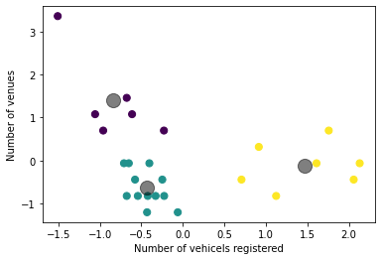
Results
Clusters based on the new vehicles registered and number of venue partners in each region inside Munich city

Slide 15
Results
Cluster 2 (Medium popular region)
Allach untermenzing
Au-Haidhausen
Aubing
Berg am laim
Feldmoching
Hadern
Laim
Moosach
Isarvorstadt
Maxvorstadt
Westpark
Schwabing west
Cluster-0 (High popular region for promoting vehicle insurance)
Altstadt-lehel
Milbertshofen
Fasangarten
Sendling
Schwanthalerhohe
Untergiesing
Cluster-1 (Low popular region for promoting vehicle insurance)
Bigenhausen
Nymphenburg
Pasing
Perlach
Schwabing
Thalkirchen
Trudering

Slide 16
Agenda
Motivation
Data used
EDA
Clustering
Results
Conclusion

Slide 17
Conclusion
Munich city is segmented into three clusters based on data analytics using number of vehicles registered , number of working professionals and number of venue partners with insurance company present in each region.
The clusters can be used by insurance company for creating and promoting customized promotions and offers for their insurance policies.
More features like number of accidents happening in each region, average income of a person in each region helps to get more accurate clusters in future.

Slide 18
References:
https://developer.foursquare.com/
https://www.opengov-muenchen.de/it/dataset
https://www.carsguide.com.au/

Slide 19
Thank You

