Slide 1

DDD-Solution

Slide 2

Domain – The problem to solve
Item catalogue – list of books and audio eBooks and audio books
Payment gateway integration
User registration
Authentication using user id and password
App notification
Web notification
Log Analytics
Pustaka Mobile application reader
Shopping cart

Slide 3

Domain – The problem to solve
Captured from event storming
Resume reading from where last left termed as “Auto bookmark.”
Resume hearing for audio books
Ability to store “user markings” like “comments and highlights” in the application
Need for handling burst load cost effectively
Author biography to be added
User rating displayed and allowed user to rate book
Email Reminder on pending shopping cart items
Interest expressed tracker
Multi factor authentication

Slide 4

ubiquitious Language – Glosarry for all communications

Slide 5
Ubiquitous Terms | Explanation
Catalogue of Items | These refers to audio book sand eBooks that can be purchased by the app
Pustaka App | The mobile app
Shopping kart | The shopping car to which the user adds his purchases before check out
Payments | The payments made by user using payment gateway
User profile | The profile of registered user like email, gender, date of birth, preferences, navigation preferences
Web app | The browser-based app that has similar functionality as that of Pustaka app
Authentication | The process of validating the user
Web notification | Those email that are sent out of any business process
App Notification | Mobile app notification
Auto book mar | To store the last read book or audio book and resume from there when launched next time
User markings | The highlights or comments that are added by user to his copy of book in Pustaka reader
Reader | The Pustaka reader interface both web and mobile
Author Bio | The Biography of the author that needs to be entered manually or screen scrapped from external site.
User rating | The comments the user write about the book accompanied by star rating
Loyalty points | Price discounts given on purchase of user associated with business for long time or have purchased lots of items or Beta copy of book
Analytics | Insights from logs
Favorites aka Interest Expressed | These are books that the user wanted to buy but have not bought for quite some time
Books | Refers to both Audio and eBooks
Multi factor authentication | Typical multi factor app with additional sign on steps to avoid false impersonation

Slide 6

Sub domains – sub Probelm to solve

Slide 7

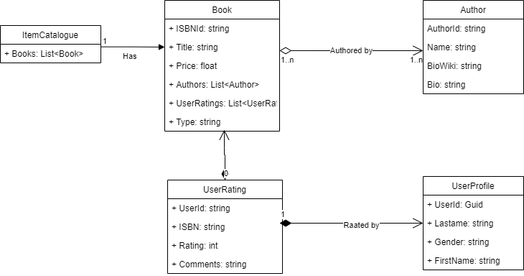
Item catalogue
Item catalogue refers to the list of items that the user can purchase
It is an aggregate type
The various bounded contexts in that and their relationships are shown below

Slide 8

Books Bounded Context
Books Microservice end points
Book is bounded context
It refers to both audio and video books
It also has an aggregate of Authors
End point | functionality
AddBooks | Adds a book
EditBook | The title and price of the book alone can be edited
Removebook | Removes the book
Get | Gets all books
GetBookById | Get book by ID

Slide 9

Authors bounded context
Authors Microservice end points
The next bounded context that we are considering is Authors
It is composed in books bounded context
That is an Author must be associated with a book to get its meaning and books cannot exist without Authors
End point | functionality
AddAuthors | Adds a Author
UpdateBio | Updates the Bio or biowiki of the author
DeleteAuthor | Removes the Author
GetAllAuthors | Gets all authors
GetById | Get Author by ID

Slide 10

User rating bound context
User rating as 0 to many compositions’ relationship with books
In case the user rates the book more than once, the latest rating will be considered
To provide the layout of end point and parameters the swagger.json is attached to here with
End point | functionality
GetAllRatings | Get All Ratings
GetById | Get the rating by user and ISBN id
RateBook | Rate a book by ISBN ID

Slide 11

Payment gateway integration
The payment gateway integration is an important part of the problem domain
It helps to process the payment and returns whether the payment was successful or not
Though it has important functionality, it is a supporting domain and can be integrated with SaaS platforms

Slide 12

User registration
It has an association relationship with the authentication service
The claim provides the user first name, last name, mobile, email address
Additional information captured is used to drive user specific targeted campaigns or user group targeted campaigns like discounts and suggestions based on age group

Slide 13
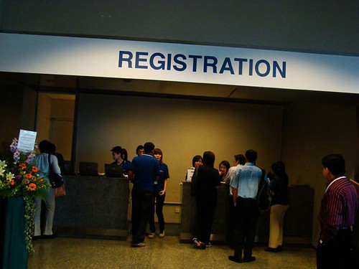
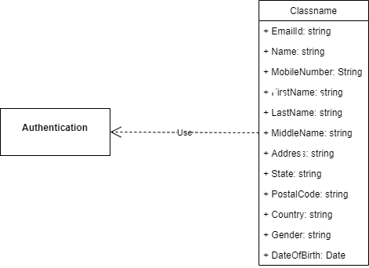
user Registration bounded context
This is a single bounded context and has a simple uses association relationship with authentication
This Photo by Unknown Author is licensed under CC BY-ND

Slide 14
MIcroservices User registration
End point | functionality
GetAllUsers | Get All users
GetUserByID | Get all users by id
AddUser | Add User Id
EditUser | Edit user
DeleteUser | Delete the user
This Photo by Unknown Author is licensed under CC BY-ND

Slide 15

Authentication
No need to store/ manage passwords
Support for Multifactor authentication
Sign in using various domains like Google, Facebook, and live id
Single sign on using claim-based authentication in case of Microservice based distributed architecture
Expiration based authentication tickets

Slide 16

App Notification
App notification is one of the desired functionalities in this problem domain
The ideal way to do this feature is to integrate with existing services provided by the hyper scalers like AWS or Azure
The best way to achieve this is to Use the AWS SNS service Available out-of-the-box

Slide 17
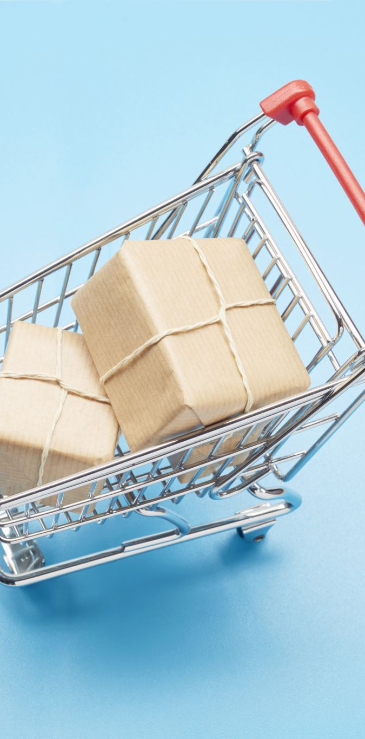
Web notification
Web notifications refers to those notifications that are sent via e-mail
This could be anything like confirming your e-mail or it could be something like a promotion for books or it could be something related to the items pending in the shopping cart
The best way to do this is to integrate with an AWS e-mail service which is provided out-of-the-box in AWS

Slide 18
Log Analytics
Log Analytics is a generic domain
It is used to analyze the logs emitted by the applications of various microservices
Alerts are added to inform the support staff in case of critical events

Slide 19

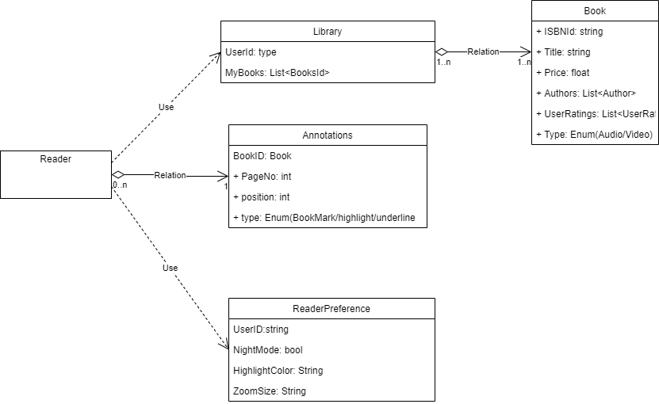
Pushtaka Application
The Pustaka application is a sub domain that is a core domain that needs to be built
The overall bounded context is depicted in the diagram

Slide 20
Reader Bounded context
Metaphor for reading/hearing the book
Adding comment to pages or gearing position
Auto bookmark
Add bookmarks by users
Managing highlights in eBook
Can be implemented using standard Blazor components

Slide 21
Library bounded context
After the user purchases the books, a copy of the book is stored in Blob storage under the user directory
When the users use the Pustaka reader, the list of books bought by the user is shown
This URI is used by the reader to stream the audio or PDF reader
Library Microservice end points
End point | functionality
GetAllPurchasedBooks | Get All purchased books
GetBookURI | Get the book URI based on ISBN id. Used by reader
AddToLibrary | Add books to library. Called by shopping cart

Slide 22
Annotation Bounded Context
Annotation Microservice end points
Users when reading or hearing the book will write comments, perform highlights or book mark a page or audio segment
Apart from that there should be the option for users to resume reading or hearing from where they left
The Reader will be using this service to persist these aspects and load them on page-to-page basis in case of eBook or in case of audio stream load it at start
End point | functionality
GetAnnotationByBookId | Get all the annotation for books. Mostly for use by Audio books.
GetAnnotationByBookPage | Page wise book annotations
UpsertAnnotation | Insert or update annotations
DeleteAnnotation | Remove annotation

Slide 23
Reader preferences Bounded Context
Reader Microservice end points
This is a core domain that needs to be solved
These are certain preferences used by the reader
The preferences include setting like Night mode etc.
End point | functionality
Get | Gets the preferences for reader. In special preferences is found then default preferences is returned
Update | Update the preference by user

Slide 24
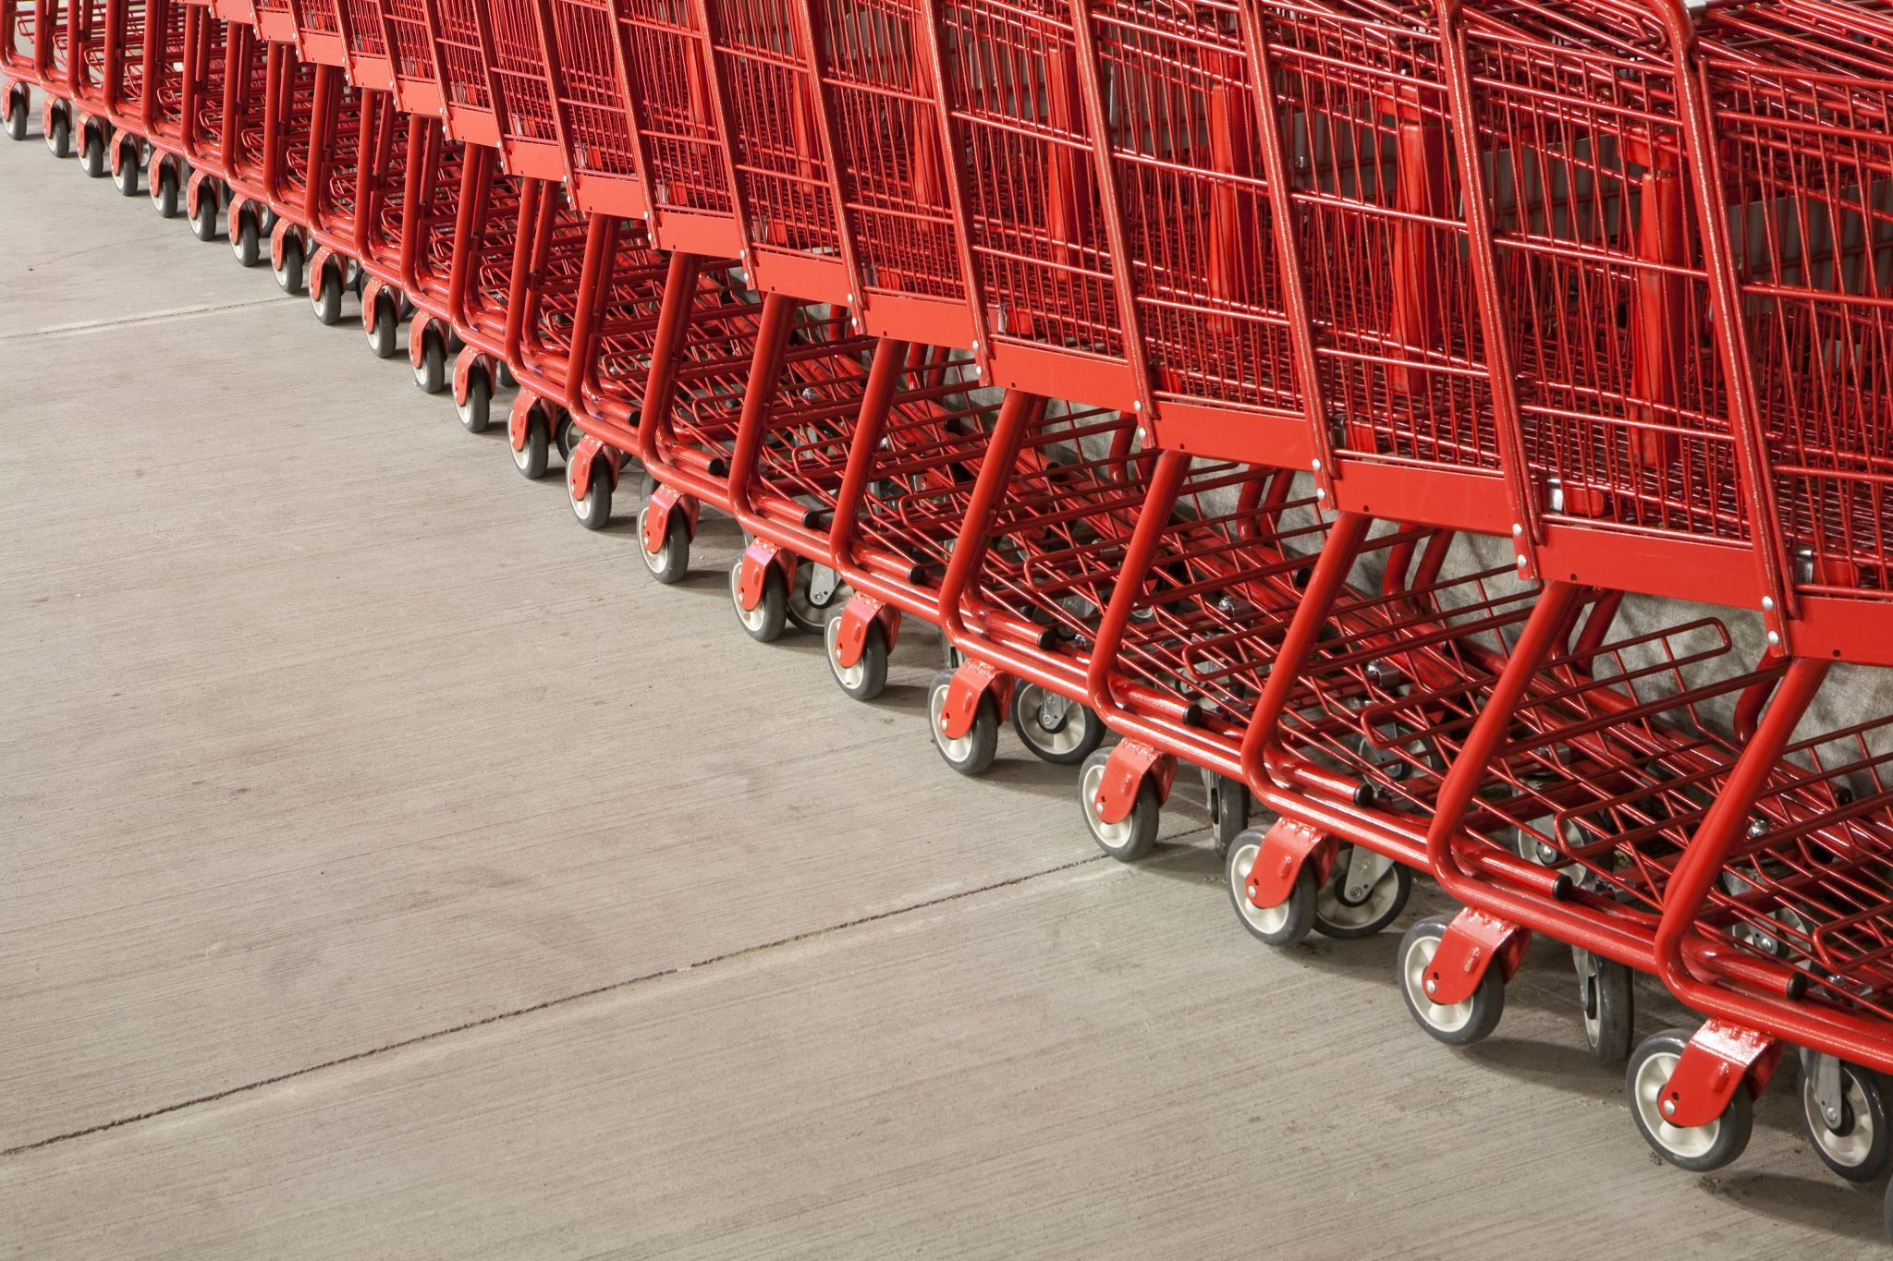
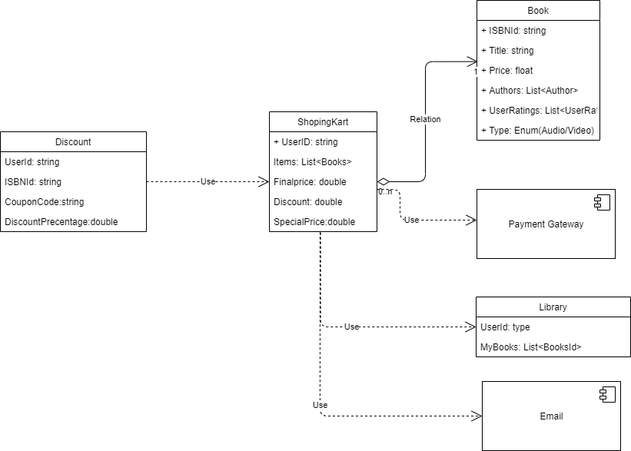
Shopping cart – Sub domain
The users can keep shopping for the books from the item catalogue
After the pricing is arrived on clicking the verify and pay, the shopping Kart domain re-directs to integrated Payment gateway which is an external generic domain
If the payment is successful, shopping kart invokes Library domain, that will get copies of the book that the user wanted and store them in S

Slide 25

Discount Bounded Context
There are multiple discount coupons the user has, and he will provide the code
The second is there could be goodwill discounts or special pricing for items present in the item catalogue
Discount Microservice end points
End point | functionality
GetByBook | Gets specific discount by book
GetByUser | Gets the discount at user level for loyally points or surprise offer
GetByPurchase | Get user by items in the cart
Add | Add a discount coupon
Delete | Deletes the discount code
Edit | Edit discount code

Slide 26
Shopping cart bounded context
End point | functionality
GetByUserId | Gets the shopping cart for a user
AddItems | Add Item to cart
GetByPurchase | Get items in the cart
EditCart | Modify items in cart
RemoveItem | Remove single item from cart
EmptyCart | Remove all items from cart
FinalPrice | Computes the final price
DoPayment | Invokes the payment gateway and receive response
AddToLibrary | Add items to library
Shopping cart is a core bounded context
As when the user browses the item catalogue, they would need to add the item to shopping cart
In this process the final price by updating the discount has arrived at

Slide 27
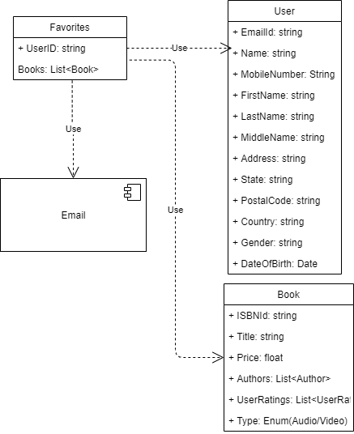
Favorites Sub domain
Favorites is another core domain that needs to be handled
Users sometimes “express interest” over some books without buying it
Whenever there is a new release in that book/upgrade or sale these are communicated to users continuously

Slide 28
Favorites Bound context
Favorites itself is a self-contained bounded context
The input for the preferences comes from the item catalogue
To provide the layout of microservices the swagger json is provided below
End point | functionality
GetByUserId | Gets the favorite for a user
GetByBookId | Get all the favorites for a book
Entice | For a user and for a book send some targeted updates
AddToFavorites | Add a favorite
RemoveItem | Removes from Favorite

Slide 29
NON-FUNCTIONAL sub domain
Cron Jobs: These are some periodic jobs that does altering, archival and emailing of promotions
Anti-corruption Layer: - This is a technical piece for de-composing monoliths to micro services
Event driven components: - In order make the architecture scalable event driven architecture will be implemented

Slide 30
Repository Details
Design documentation link:- DomainDrivenDesign/DDD-Solution.docx at main · VenkateshSrini/DomainDrivenDesign

