Slide 1
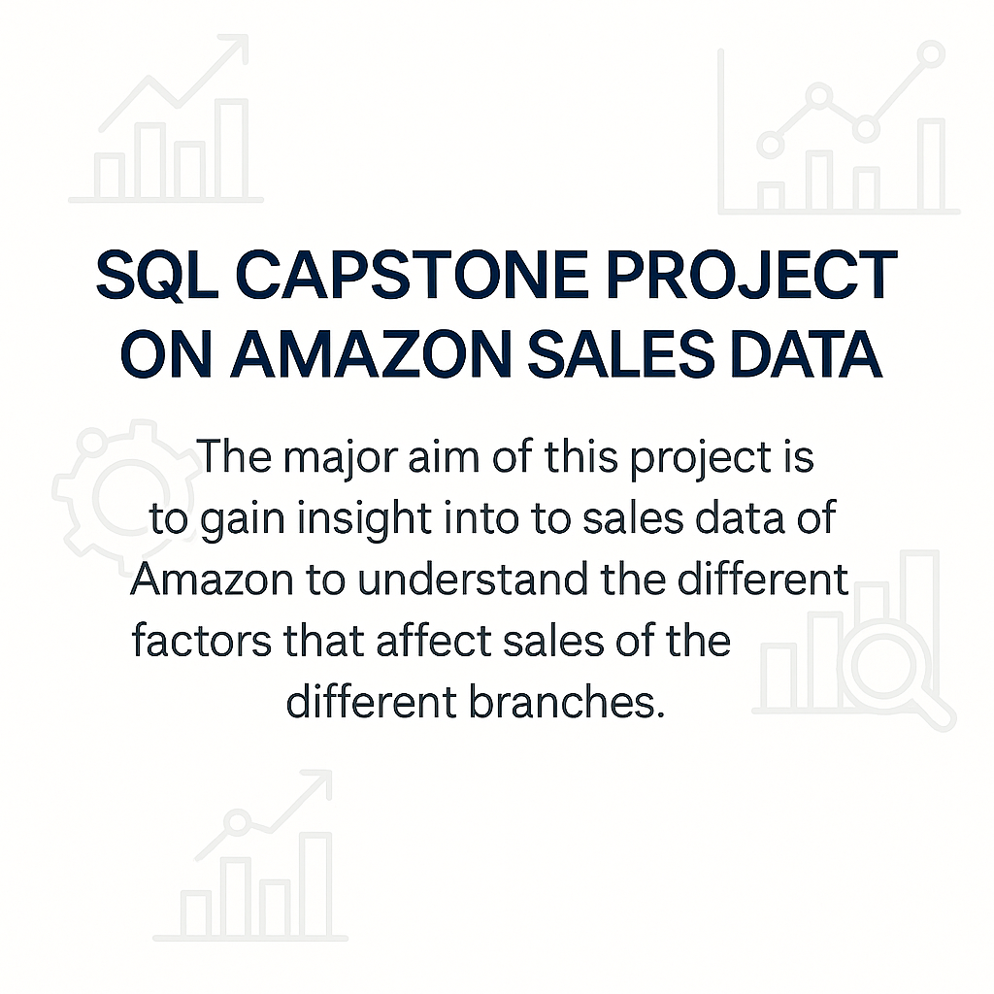

Slide 2
Objective :
Analyze Amazon sales data .
Understand performance of products, branches, and customer behavior.
Draw meaningful insights from transactional data.

Slide 3
Dataset Overview
A csv file with 1000 rows, 17 columns
Sales transactions from 3 Amazon branches: Mandalay, Yangon, Naypyitaw
Key columns: invoice_id, branch, customer_type, product_line, unit_price, total, payment_method, rating

Slide 4
Dataset Preparation & Data Type Modification
Changed column names for SQL compatibility (e.g., `date` to `purchase_date`)
ALTER TABLE table_name
CHANGE old_name new_name datatype NOT NULL;
Modified data types to avoid NULL or out-of-range values
ALTER TABLE table_name
MODIFY column_name new_datatype NOT NULL;
Ensured integrity with NOT NULL constraints, So no null values are included in it .

Slide 5
Feature Engineering (Part 1)
Added `timeofday` column using HOUR(time):
→ Morning, Afternoon, Evening
Added `dayname` using DAYNAME(purchase date)
Added `monthname` using MONTHNAME(Purchase month)

Slide 6
Feature Engineering – SQL Snippets
ALTER TABLE Amazon_sales
ADD COLUMN timeofday VARCHAR(20);
UPDATE amazon_sales
SET timeofday =
CASE
WHEN HOUR(`time`) < 12 THEN 'Morning’
WHEN HOUR(`time`) >= 12 AND HOUR(`time`) < 18 THEN 'Afternoon’
ELSE 'Evening’
END;
UPDATE amazon_sales
SET dayname = DAYNAME(`date`);
gives Name to day:
UPDATE amazon_sales
SET monthname = MONTHNAME(`date`);
Gives month Name:

Slide 7
Highlighted SQL Queries
There are most commonly used Sql functions in our Amazon sales data analyses .
Distinct : DISTINCT keyword is used in a SQL query to retrieve unique values .It eliminates duplicate rows & ensures that each value appears onlyonce.
Count :COUNT() is used to count the number of rows in a result set
Sum , Avg: Adds up values in a column and Average Calculates the average of values
Group by :GroupBy allows you to group rows of data in a tablebased on the values in one or more columns. Once thedata is grouped, you can perform calculations oraggregate functions on each group separately
Order by :ORDER BY clause is used to sort the result setof a query in ascending (ASC) or descending(DESC)
Case : CASE expression is a conditional statement that allows you to evaluate one expression based on a series of conditions.
Subqueries:A subquery is a query that is nested within another query. It allows you to perform complex queries by breaking them down into smaller, more manageable parts.
Limit:e LIMIT clause is typically followed by a numericalvalue that specifies the maximum number of rows to be returned
Having : HAVING clause is used to filter the result set of a queryafter GROUP BY clause with the help of aggregatefunctions.

Slide 8
Count & Distinct:
1. What is the count of distinct cities in the dataset?
SELECT COUNT(DISTINCT city) AS distinct_cities
FROM amazon_sales;
2. For each branch, what is the corresponding city?
SELECT DISTINCT branch, city
FROM amazon_sales;
3. What is the count of distinct product lines in the dataset?
SELECT COUNT(DISTINCT product_line) AS distinct_product_lines
FROM amazon_sales;
19. What is the count of distinct customer types in the dataset?
SELECT COUNT(DISTINCT customer_type) AS customer_type_count
FROM amazon_sales;
20. What is the count of distinct payment methods in the dataset?
SELECT COUNT(DISTINCT payment_method) AS payment_method_count
FROM amazon_sales;

Slide 9
4. Which payment method occurs most frequently?
SELECT payment_method, COUNT(*) AS count
FROM amazon_sales
GROUP BY payment_method
ORDER BY count DESC
;
15. Count the sales occurrences for each time of day on every weekday?
SELECT dayname, timeofday, COUNT(*) AS sale_count
FROM amazon_salesGROUP BY dayname, timeofday
ORDER BY FIELD(dayname, 'Monday','Tueday','Wedday','Thuday','Friday','Satday','Sunday');
21. Which customer type occurs most frequently?
SELECT customer_type, COUNT(*) AS countFROM
amazon_salesGROUP BY customer_type
ORDER BY count DESC
limit 1;

Slide 10
22. Identify the customer type with the highest purchase frequency?
SELECT customer_type, COUNT(*) AS purchase_count
FROM amazon_sales
GROUP BY customer_type
ORDER BY purchase_count DESC
LIMIT 1;
23. Determine the predominant gender among customers?
SELECT gender, COUNT(*) AS countFROM amazon_sales
GROUP BY gender
ORDER BY count DESCLIMIT 2;
24. Examine the distribution of genders within each branch?
SELECT branch, gender, COUNT(*) AS gender_count
FROM amazon_sales
GROUP BY branch, gender
ORDER BY branch;
25. Identify the time of day when customers provide the most ratings.
SELECT timeofday, COUNT(rating) AS rating_count
FROM amazon_sales
GROUP BY timeofday
ORDER BY rating_count DESC
LIMIT 1;

Slide 11
Aggregate functions-SUM & AVG
5. Which product line has the highest sales?
SELECT product_line, SUM(total) AS total_sales
FROM amazon_sales
GROUP BY product_line
ORDER BY total_sales DESC
LIMIT 1;
6. How much revenue is generated each month?
SELECT monthname, SUM(total) AS revenue
FROM amazon_sales
GROUP BY monthname
ORDER BY revenue desc;
7. which month did the cost of goods sold reach its peak?
SELECT monthname, SUM(cogs) AS total_cogs
FROM amazon_sales
GROUP BY monthname
ORDER BY total_cogs DESC;

Slide 12
-- 8. Which product line generated the highest revenue?
SELECT product_line, SUM(total) AS revenue
FROM amazon_sales
GROUP BY product_line
ORDER BY revenue DESCLIMIT 1;
-- 9. In which city was the highest revenue recorded?
SELECT city, SUM(total) AS revenue
FROM amazon_sales
GROUP BY city
ORDER BY revenue DESC;
-- 10. Which product line incurred the highest Value Added Tax?
SELECT product_line, SUM(VAT) AS total_vat
FROM amazon_sales
GROUP BY product_line
ORDER BY total_vat DESC
LIMIT 1;

Slide 13
14. Calculate the average rating for each product line.
SELECT product_line, ROUND(AVG(rating), 2) AS avg_rating
FROM amazon_sales
GROUP BY product_line;
16. Identify the customer type contributing the highest revenue.
SELECT customer_type, SUM(total) AS revenue
FROM amazon_sales
GROUP BY customer_type
ORDER BY revenue DESCLIMIT 1;
17. Determine the city with the highest VAT percentage.
SELECT city, AVG(VAT / total * 100) AS avg_vat_percent
FROM amazon_sales
GROUP BY city
ORDER BY avg_vat_percent DESC
LIMIT 3;

Slide 14
18. Identify the customer type with the highest VAT payments.
SELECT customer_type, SUM(VAT) AS total_vat
FROM amazon_sales
GROUP BY customer_type
ORDER BY total_vat DESC;
26. Determine the time of day with the highest customer ratings for each branch.
SELECT branch, timeofday, avg(rating) AS avg_rating
FROM amazon_sales
GROUP BY branch, timeofday
ORDER BY branch, avg_rating DESC;
27. Identify the day of the week with the highest average ratings.
SELECT dayname, AVG(rating) AS avg_rating
FROM amazon_sales
GROUP BY dayname
ORDER BY avg_rating DESC
LIMIT 1;

Slide 15
CASE :
11. For each product line, add a column indicating "Good" if its sales are above average, otherwise "Bad.“
SELECT product_line, SUM(total) AS total_sales,
CASE
WHEN SUM(total) > (SELECT AVG(total_sales)
FROM( SELECT product_line, SUM(total) AS total_sales FROM amazon_sales
GROUP BY product_line) AS avg_table) THEN 'Good'
ELSE 'Bad'
END AS performance
FROM amazon_sales
GROUP BY product_line;

Slide 16
Subquery
12. Identify the branch that exceeded the average number of products sold.
SELECT branch, SUM(quantity) AS total_quantity
FROM amazon_sales
GROUP BY branch
HAVING total_quantity > ( SELECT AVG(q) FROM (SELECT SUM(quantity) AS q
FROM amazon_sales
GROUP BY branch) AS avg_branch);

Slide 17
13. Which product line is most frequently associated with each gender?
SELECT gender, product_line, COUNT(*)As count
FROM amazon_sales
GROUP BY gender, product_line
HAVING count =
(SELECT MAX(sub.count)
FROM
(SELECT gender AS g, product_line AS p, COUNT(*) AS count
FROM amazon_sales
GROUP BY gender, product_line) AS sub
WHERE sub.g = amazon_sales.gender)
ORDER BY gender;

Slide 18
28. Determine the day of the week with the highest average ratings for each branch?
SELECT branch, dayname, avg_rating
FROM
(SELECT branch, dayname,
ROUND(AVG(rating), 2) AS avg_rating,
RANK() OVER (PARTITION BY branch
ORDER BY AVG(rating) DESC) AS rating_rank
FROM amazon_sales
GROUP BY branch, dayname) AS ranked_days
WHERE rating_rank = 1;

Slide 19
Insights :
We have open 3new branches called A , B and C in following cities called Yangon, Naypyitaw and Mandalay .
Highest Sales generated by cities:
Only Branch A that exceeded the average number of products sold
(Quantities sold by A-1859)
we have 6 products lines .Among 6 products lines Food&Beverages generates highest revenue and Sales by food&Beverages -56144.96
Highest VAT tax collected by food&Beverages is 2673.5640
Health&beauty is the only product line which can’t generate the average of totalsales.
City | Sales
Naypyitaw | 1,10,568
yangon | 1,06,200
Mandalay | 1,06,198
Gender | ProductLine | sold
Female | Fashion Accessories | 96
Male | Health & beauty | 88

Slide 20
Among type of customers Member type customer section contribute more revenue.
VAT paid by each city:
VAT contributed by each customer type :
Customer_Type | Revenue
Member | 164223
City | Average VAT %
Nypyitaw | 4.761894 %
Yangon | 4.761888 %
Mandalay | 4.761877 %
Customer type | Total vat
Member | 7821
Normal | 7560

Slide 21
Time of day when customers provide the most ratings all among the 3 branches:
Time of day with the highest customer ratings for each branch:
Time of Day | Rating count
AfterNoon | 528
Branch | Time of Day | Average rating
A | Afternoon | 7.05676
A | Morning | 7.00548
A | Evening | 6.97927
B | Morning | 6.89153
B | Afternoon | 6.80679
B | Evening | 6.79550
C | Afternoon | 7.09558
C | Evening | 7.09205
C | Morning | 6.97458

Slide 22
The day of the week with the highest average ratings.
The day of the week with the highest average ratings for each branch
DayName | Average Rating
Monday | 7.15360
Branch | Day Name | Rating
A | Friday | 7.31
B | Monday | 7.34
C | Friday | 7.28

Slide 23
Conclusion
SQL was used to clean, enhance, and analyze the Amazon sales dataset
Key transformations: date handling, type enforcement, feature columns
Answered critical business questions using efficient SQL queries
Enabled data-driven decisions from structured amazon sales data

Slide 24
Thank You
Suddhala Venkatesh
Amazon Sales SQL Capstone Project
Feel free to reach out for questions!

