Slide 1
Risk Management

Slide 2
Risk
Definition
An uncertain event or condition that, if it occurs, has a positive or negative effect on a project’s objectives.
The chance of exposure to the adverse consequences of future events.
The key elements of a risk
It relates to the future
It involves cause and effect

Slide 3
Example
Match the following causes to effects
Causes
Staff inexperience
Lack of top management commitment
New technology
Users uncertain of their requirements
Effects
Testing takes longer than planned
Planned effort and time for activities exceeded
Project scope increases
Time delays in getting changes to plans agreed

Slide 4
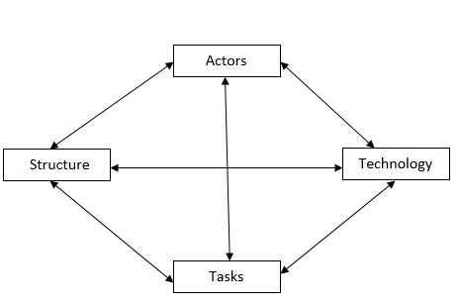
Risk Framework

Slide 5
Risk Framework (contd..)
Actors
Refers to people involved in the development.
High staff turnover leads to the loss of expertise of value to the project being lost.
Technology
Encompasses both the technology used to implement the application and that embedded in the delivered products.
Risks could relate to the appropriateness of the technologies and to possible faults within them, especially if they are novel.
Structure
Describes the management structures and systems, include those affecting planning and control.
Implementation may need user participation in some tasks, but for managing the users contribution might not clearly defined.

Slide 6
Risk Framework (contd..)
Structure
Describes the management structures and systems, include those affecting planning and control.
Implementation may need user participation in some tasks, but for managing the user’s contribution might not be clearly defined.
Tasks
Tasks related to the work planned
The complexity of the work might delay because of the additional time required to integrate the large number of components.

Slide 7
Risk Identification
Two approaches for the identification of risks are
Use of checklists
Brainstorming

Slide 8
Risk Identification
Two approaches for the identification of risks are
Use of checklists
Brainstorming
Risk and Risk reduction techniques
Personnel Shortfalls
Staffing with top talent, job matching, team building, training and career development
2. Unrealistic time and cost estimates.
Multiple estimation techniques, design to cost, incremental development, recording and analysis of past projects, standardization of methods.

Slide 9
Risk Identification
3. Developing the wrong software functions
Improved software evaluation, formal specification methods, user surveys, prototyping, early user manuals.
4. Developing the wrong user interface
Prototyping, task analysis, user involvement.
5. Late changes to requirements
Incremental development
6. Shortfalls in externally supplied components
Benchmarking, inspections, formal specifications, contractual agreements, quality assurance procedures and certification

Slide 10
Risk Identification
7. Shortfalls in externally performed tasks
Quality assurance procedures, competitive design or prototyping, and contract incentives.
8. Real-time performance shortfalls
Simulation, benchmarking, prototyping, tuning, and technical analysis.
9. Development is technically too difficult
Technical analysis, cost-benefit analysis, staff training, and development.
10. Gold plating:
Gold plating concerns the development of features that the team members consider nice to have, and therefore, to develop those even though the customer has not expressed any necessity for those

Slide 11
Risk Planning
After identifying the risks and their priorities, the next task involves how to deal with them.
The different options are
Risk Acceptance
Risk Avoidance
Risk reduction and mitigation
Risk transfer
Risk Avoidance
Change the project plan so that the risk no longer applies.
Example: increase task duration estimates or cut unnecessary functionality to avoid the risk of project overruns.

Slide 12
Risk Planning
Risk Reduction
Some risks can’t be prevented entirely, but their chances of happening can be reduced through good planning.
· Example: prototyping can reduce the risk of last-minute changes to requirements.
Risk Transfer
Pass the risk’s impact onto another party.
Example: take insurance, or contract out risky parts of the project.

Slide 13
Risk Management
Contingency Planning
For risks that cannot be avoided or transferred, make backup plans to reduce the damage if they occur.
Example: plan for substitute programmers if key staff become unavailable.
Deciding on the risk actions
The Cost of Action in risk management refers to the resources (time, money, or effort) that are needed to reduce or eliminate a risk.

Slide 14
Risk Management
Even if a risk has a high exposure value, it may not always be worth reducing it if the cost of risk reduction is more than the benefit gained.
Risk Exposure (RE) = the expected impact of a risk on the project. It combines likelihood (how likely the risk is to occur) and impact (the damage/cost if it occurs).
Risk Exposure (RE)=risk likelihood*risk impact

Slide 15
Risk Management
Even if a risk has a high exposure value, it may not always be worth reducing it if the cost of risk reduction is more than the benefit gained.
That’s why we use the Risk Reduction Leverage (RRL) formula:
RRL=(REbefore−REafter)/Risk Reduction cost
Interpretation:
If RRL > 1, the benefit of reducing the risk is greater than the cost, so it’s worth implementing the action.
If RRL < 1, the cost of action is more than the benefit, so it may not be worth it.

Slide 16
Risk Management
Example
A project risk could cost $50,000 if it occurs.
By spending $10,000 on preventive measures, you can reduce the risk exposure to $15,000.
RRL=(50,000−15,000)/10,000=3.5
Since 3.5 > 1, the reduction is worth it.

Slide 17
Risk Management
Creating and maintaining the risk register
Risk Register Page
Risk Record
Risk Id, Risk Title, Owner, Date Raised, Status
Risk Description
Impact Description
Recommended Risk Mitigation
Probability/ Impact Values
Action history
Date, Action, Actor, Outcome

Slide 18
Evaluating risks to the schedule
PERT is a project scheduling and planning technique that helps estimate the project completion time when there is uncertainty in activity durations.
Unlike CPM (Critical Path Method), which assumes fixed activity durations, PERT uses probability by considering three time estimates for each activity:
Optimistic time (a): – The shortest time in which the task can be completed (best-case scenario).
Most likely time (m): – The time we realistically expect under normal conditions (most probable).
Pessimistic time (b): – The longest time the task might take, assuming bad conditions (worst-case scenario).

Slide 19
Evaluating risks to the schedule
For each activity, the expected duration (te) is calculated as:
te=(a+4m+b)/6
This formula gives more weight (×4) to the most likely time because that’s the most realistic.
Optimistic and pessimistic times are considered to balance uncertainty.

Slide 20
Evaluating risks to the schedule

Slide 21
Evaluating risks to the schedule

Slide 22
Using expected durations
Expected durations are used to carry out a forward pass through a network, similar to CPM.
The calculated event dates are not the earliest possible dates the dates by which we expect to achieve those events.

Slide 23
Using expected durations

Slide 24
Activity standard deviations
A quantitative measure of the degree of uncertainty of an activity duration estimate may be obtained by calculating standard deviation s of an activity time
S=(b-a)/6

Slide 25
Likelihood of meeting targets
To calculate the chance of meeting a deadline:
Calculate the standard deviation of each project event.
Calculate the z-value (how far the target is from the expected value in standard deviations).
Convert z-value to probability using statistical tables (normal distribution).

Slide 26
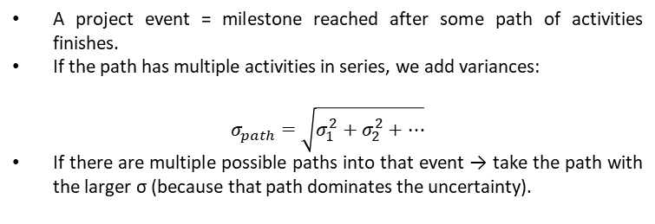
Calculating standard deviation for event
A project event = milestone reached after some path of activities finishes.
If the path has multiple activities in series, we add variances:
$$σ_{path}=\sqrt{σ_{1}^{2}+σ_{2}^{2}+…}$$
If there are multiple possible paths into that event → take the path with the larger σ (because that path dominates the uncertainty).

Slide 27
Calculating standard deviation for event

Slide 28
Calculating z-Values
To calculate the chance of meeting a deadline:
Calculate the standard deviation of each project event.
Calculate the z-value (how far the target is from the expected value in standard deviations).
z=(T−te)/s
where T = target time, te = expected time, s = standard deviation.
Convert z-value to probability using statistical tables (normal distribution).

Slide 29
Calculating z-Values
Z-value of event 6 is 1.23. The probability is approximately 11%.
There is a 11% risk of not meeting target date.

Slide 30
Calculating z-Values

