Slide 1
Department of Information Technology
IV/IV B. TECH (IT) 2ⁿᵈ SEMESTER PROJECT WORK (B20IT4201)
1st REVIEW
PROJECT TITLE: Agent-Controlled Retrieval Augmented Generation
for Reliable Document Question Answering
Batch No: 17
Name & Reg No:
1. Thanneeru Venkateswarlu – 22B91A54E8 2. Amirisetti Mahesh Gopi – 23B95A5402 3. Marre Hemanth Kumar – 23B95A5423 4. Gokina Charan – 23B95A5415
Under the Guidance of
Supervisor
Name : Dr. P. Syamala Rao
Designation : Associate Professor
Department of IT, SRKR Engineering College, Bhimavaram, AP, India

Slide 2
IV/IV B. TECH (IT) 2ⁿᵈ SEMESTER PROJECT WORK (B20IT4201)
1st REVIEW
OUTLINE
1. Introduction
2. Abstract
3. Literature Review
4. Existing System Advantages & Disadvantages
5. Problem Statement
6. Proposed System Advantages
7. Technology Using
8. Methodology
8.1 Architecture
8.2 Dataset & Experimental Setup
8.3 Algorithms / Methods Implemented
9. Results & Ablation Study
10. Conclusion
11. Future Scope

Slide 3
1. INTRODUCTION
• The rapid growth of digital documents — research papers, legal contracts, corporate reports, and clinical records — has created a need for systems that can accurately answer questions from these documents.
• Large Language Models (LLMs) like GPT-4o and Gemini have transformed natural language understanding, but they are prone to hallucination — generating confident answers that are not supported by any source.
• Retrieval-Augmented Generation (RAG) was introduced to address this by grounding LLM responses in externally retrieved documents. However, standard RAG systems:
◦ Retrieve a fixed number of chunks for every query regardless of complexity
◦ Apply no check on whether retrieved chunks are actually relevant
◦ Generate one answer with no verification or retry mechanism
◦ Attempt to answer out-of-scope queries instead of declining honestly
• This project introduces AC-RAG (Adaptive Context Retrieval-Augmented Generation) — a multi-agent pipeline that addresses all four limitations through intelligent query routing, adaptive retrieval, evidence validation, and self-reflection.

Slide 4
2. ABSTRACT
AC-RAG (Adaptive Context Retrieval-Augmented Generation) is a full-stack multi-agent question answering system designed for reliable document-based QA. The pipeline comprises nine specialised processing nodes orchestrated using a LangGraph StateGraph: an Entry Router (vector similarity-based query gating), a Direct Responder (out-of-scope fallback), a Query Analyzer (intent classification, complexity scoring 0.0–1.0, and sub-query decomposition), a two-tier Retrieval Planner (rule-based k selection of 4–12 and LLM-based modality refinement), a Retriever (MMR search on FAISS), an Evidence Validator (cosine similarity filtering at threshold 0.30), a Context Refiner (semantic deduplication at 0.85 and LLM compression), an Answer Generator (citation-grounded generation via Pydantic structured output), and a Critic Agent (5-dimension self-reflection with content/format retry routing and MAX_RETRIES = 3).
The system formally optimises: a* = argmax P(a | q, R(q, D)) subject to Faith(a, R(q, D)) ≥ 0.80. Documents are ingested from PDF, DOCX, TXT, HTML, and Markdown formats, chunked at 512 tokens with 64-token overlap, and embedded using sentence-transformers/all-MiniLM-L6-v2. A 7-configuration ablation study over 50 queries confirms that the full AC-RAG system achieves a faithfulness score of 0.88 and hallucination reduction of 0.85, representing significant improvement over a standard RAG baseline evaluated using the RAGAS framework.

Slide 5
3. Literature Review
S. No | Title of the Paper | Author | Journal Name & Year | Methodology Used | Key Findings | Gaps
1 | Retrieval-Augmented Generation for Knowledge-Intensive NLP Tasks | Lewis et al. | NeurIPS 2020 | Combined non-parametric dense retriever with parametric seq2seq generator | RAG substantially reduces hallucination on knowledge-intensive NLP benchmarks | Static retrieval; no answer validation after generation
2 | Dense Passage Retrieval for Open-Domain QA | Karpukhin et al. | EMNLP 2020 | Bi-encoder architecture mapping queries and passages into shared dense embedding space | Substantially improved recall over sparse BM25 methods | No generation grounding; no multi-hop reasoning support
3 | ReAct: Synergizing Reasoning and Acting in Language Models | Yao et al. | ICLR 2023 | Interleaved reasoning traces with tool-use actions for dynamic information gathering | LLMs can reason and act together for better task performance | Not designed for document QA; no structured retrieval control
4 | Reflexion: Language Agents with Verbal Reinforcement Learning | Shinn et al. | NeurIPS 2023 | Self-generated verbal feedback used to improve agent performance across episodes | Reflexion improves task performance through iterative self-critique | Prompt-based; no structured retrieval control; no evidence validation
5 | Agentic Retrieval-Augmented Generation Systems for Adaptive Information Retrieval | Singh et al. | IEEE Access 2024 | Agent-based decision making for adaptive information retrieval pipelines | Agent-based approach improves retrieval precision over static RAG | IR-focused; not extended to generative QA; no faithfulness evaluation
6 | Agentic RAG: Redefining Retrieval-Augmented Generation for Adaptive Intelligence | Panda | IRJET 2025 | Agent-based RAG architecture for adaptive question answering | Demonstrates potential of agentic approach for document QA | No quantitative faithfulness evaluation; lacks structured retry routing

Slide 6
4. Existing System Advantages & Disadvantages
Existing System: Standard RAG (Retrieval-Augmented Generation)
Advantages
Disadvantages
✓ Grounds LLM responses in retrieved documents, reducing hallucinations compared to pure LLM generation
✗ Static retrieval: same fixed k chunks for every query regardless of complexity
✓ Faster than our system — single-pass pipeline with one LLM call
✗ No evidence filtering — irrelevant retrieved chunks reach the generator
✓ Simple to implement — no complex agent orchestration required
✗ No post-generation verification — one-shot answer with no quality check
✓ Works reasonably well for straightforward factual queries
✗ No scope gating — out-of-scope queries receive hallucinated answers
✓ Lower cost per query — fewer LLM API calls
✗ Monomodal retrieval — ignores tables and figures in documents

Slide 7
5. Problem Statement
• Existing document QA systems rely on static retrieval mechanisms and lack explicit answer validation, resulting in hallucinated or unsupported responses.
• Specifically, four critical problems exist with standard RAG pipelines:
◦ Static Retrieval: The same k document chunks are retrieved for every query regardless of complexity. Simple factual queries receive too many chunks; complex multi-hop queries receive too few.
◦ Absent Evidence Validation: Retrieved chunks are passed directly to the generator with no check on their relevance. Irrelevant chunks pollute the context and degrade answer quality.
◦ No Answer Verification: The system generates one answer and terminates. There is no mechanism to detect, classify, or correct hallucinated or incomplete answers.
◦ No Query Scope Gating: All queries — including those completely unrelated to the indexed documents — receive an attempted answer rather than an honest declination.
• Therefore, there is a need for a system that: (a) gates queries by document relevance, (b) adapts retrieval depth to query complexity, (c) validates and refines retrieved evidence, and (d) iteratively self-reflects on generated answers through a structured feedback loop.

Slide 8
6. Proposed System Advantages
1. Intelligent Query Routing:
Entry Router performs vector similarity check — out-of-scope queries receive honest 'I don't know' response instead of a hallucinated answer
2. Adaptive Retrieval Depth:
Retrieval Planner maps query complexity (0.0–1.0) to k (4–12) — simple queries get focused context, complex multi-hop queries get broader coverage
3. Modality-Aware Retrieval:
Retrieval Planner selects between text, table, and figure modalities — numerical queries retrieve table chunks instead of prose descriptions of tables
4. Evidence Quality Filtering:
Evidence Validator discards chunks with cosine similarity < 0.30 — only relevant, high-quality passages reach the generator
5. Context Organisation:
Context Refiner re-ranks, deduplicates, and compresses — most relevant passages first, no redundant content, fits within LLM context window
6. Self-Reflection with Retry:
Critic Agent scores answers on 5 dimensions; content failures trigger full re-retrieval, format failures trigger answer rewrite — max 3 retries
7. Full Provenance & Traceability:
Every answer includes inline [N] citations and [SOURCE N | file | page] attribution tags — users can verify exactly which document each claim comes from
8. Provider-Agnostic Design:
Switch between OpenAI GPT-4o, Gemini, Claude, Groq by changing one line in config/settings.py — no pipeline code changes needed

Slide 9
7. Technology Using
Backend & Orchestration
Vector Search & Embeddings
LLM Providers & Frontend
• Python 3.11 — primary programming language
• FAISS (faiss-cpu) — vector similarity search index
• OpenAI GPT-4o — default LLM provider
• LangChain — LLM abstraction, document loaders, text splitters
• sentence-transformers/all-MiniLM-L6-v2 — local embedding model
• Google Gemini 2.0 Flash — alternative provider
• LangGraph — multi-agent StateGraph orchestration
• ChromaDB — alternative vector backend (supported)
• Anthropic Claude Sonnet — alternative provider
• FastAPI — REST API with SSE streaming
• PyMuPDF — PDF loading with page-level metadata
• Groq LLaMA 3.3 70B — free-tier alternative
• Pydantic v2 — structured output schemas for all agents
• Docx2txt, Unstructured — DOCX, HTML, Markdown loading
• React (Vite) + SSE — frontend with real-time pipeline trace

Slide 10
8. Methodology
AC-RAG is implemented as a LangGraph StateGraph in which each agent is a node and conditional edges encode all routing and retry logic. A shared ACRagState TypedDict carries the full pipeline state through every node. The methodology follows six phases:
Phase 1 — Document Ingestion & Index Construction
Load documents (PDF/DOCX/TXT/HTML/MD) → chunk at 512 tokens with 64-token overlap → tag modality metadata (text/table/figure) → embed with all-MiniLM-L6-v2 → build and persist FAISS index
Phase 2 — Pydantic Schema Definition
Define type-safe schemas for all agent contracts: QueryAnalysis, RetrievalPlan, GeneratedAnswer, CriticEvaluation — bind all LLM calls using .with_structured_output()
Phase 3 — Node Implementation
Implement each of 9 processing nodes as Python functions; each appends structured trace entry to state['stage_logs'] for full pipeline observability
Phase 4 — LangGraph StateGraph Assembly
Register nodes, set entry_router as entry point, add conditional edges for routing decisions, compile graph with recursion_limit=50
Phase 5 — FastAPI Integration & SSE Streaming
Expose compiled pipeline via REST API; stream per-node state updates as SSE events to React frontend in real time
Phase 6 — Evaluation & Ablation Study
Run 50-query test set across 7 pipeline configurations (ablation flags in settings.py); compute faithfulness, answer relevance, completeness, context utilisation, ROUGE-L

Slide 11
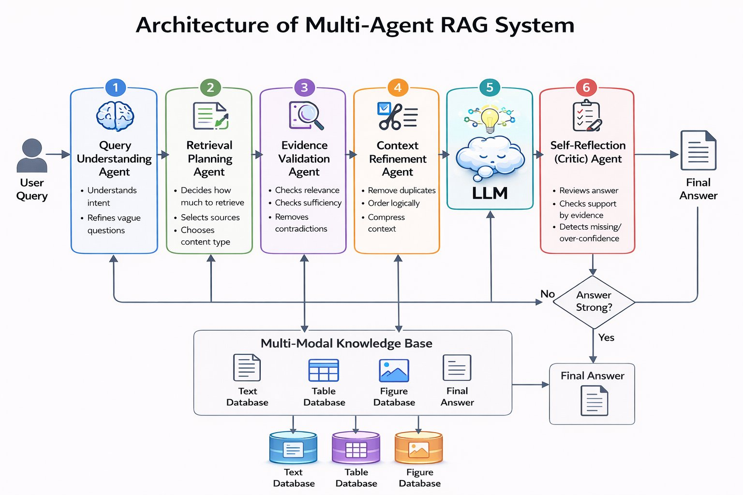
8.1 Architecture

Slide 12
8.2 Dataset & Experimental Setup
Evaluation Corpus
Technical and academic PDF documents from the fields of Artificial Intelligence and Natural Language Processing. Documents contain mixed content including running text, tabular data, and embedded figures.
Document Chunking
Documents chunked into blocks of approximately 600 characters with 100 characters overlap. Three separate ChromaDB vector collections maintained: Text, Tables, and Figures — enabling modality-specific retrieval.
Evaluation Test Set
50 question-answer pairs constructed to cover three query types: (1) Factual — direct answer from a single passage; (2) Analytical — requires synthesising multiple sections; (3) Table/Figure — needs numerical or visual data extraction.
Input Document Format
PDF documents used for evaluation. The system supports PDF, DOCX, TXT, HTML, and Markdown in deployment. Figure content is converted to text descriptions by a vision model, making visual data searchable.
Embedding Model
text-embedding-3-large (OpenAI) — generates dense vector embeddings for all chunks. Same model used at ingestion and query time to ensure embedding space consistency.
Vector Store
ChromaDB — three separate vector collections for Text, Tables, and Figures. This modality separation allows the Retrieval Planner to target only the relevant content type per query, reducing noise in retrieval.

Slide 13
8.3 Algorithms / Methods Implemented
1. MMR (Maximal Marginal Relevance)
Used in Retriever node. Selects passages that are simultaneously relevant to query AND diverse relative to already-selected passages. Controlled by lambda_mult parameter (0.3–0.7). Prevents retrieving five copies of the same sentence.
2. Cosine Similarity Scoring
Used in Evidence Validator and Entry Router. Embeds both query and passage using the same sentence-transformer model; computes dot product of L2-normalised vectors. Threshold 0.30 filters irrelevant passages.
3. Semantic Deduplication
Used in Context Refiner. Computes pairwise cosine similarity matrix across all validated passages. Greedily removes passages with similarity > 0.85 to any already-kept passage, eliminating near-duplicate content.
4. LLM-Based Complexity Scoring
Used in Query Analyzer. LLM assigns continuous complexity score 0.0–1.0 using structured prompt. Score drives k selection (4–12), lambda_mult choice, and whether sub-query decomposition is triggered (threshold 0.6).
5. 5-Dimension Critic Evaluation
Used in Critic Agent. LLM scores answer on faithfulness, completeness, table accuracy, figure accuracy, and conciseness (all 1–5). Failure type (content vs format) determines retry destination: Query Analyzer or Generator.
6. Formal Optimisation Objective
a* = argmax P(a | q, R(q, D)) subject to: Faith(a, R(q, D)) ≥ 0.80. Faithfulness computed as mean cosine similarity of answer sentence embeddings against retrieved passage embeddings.

Slide 14
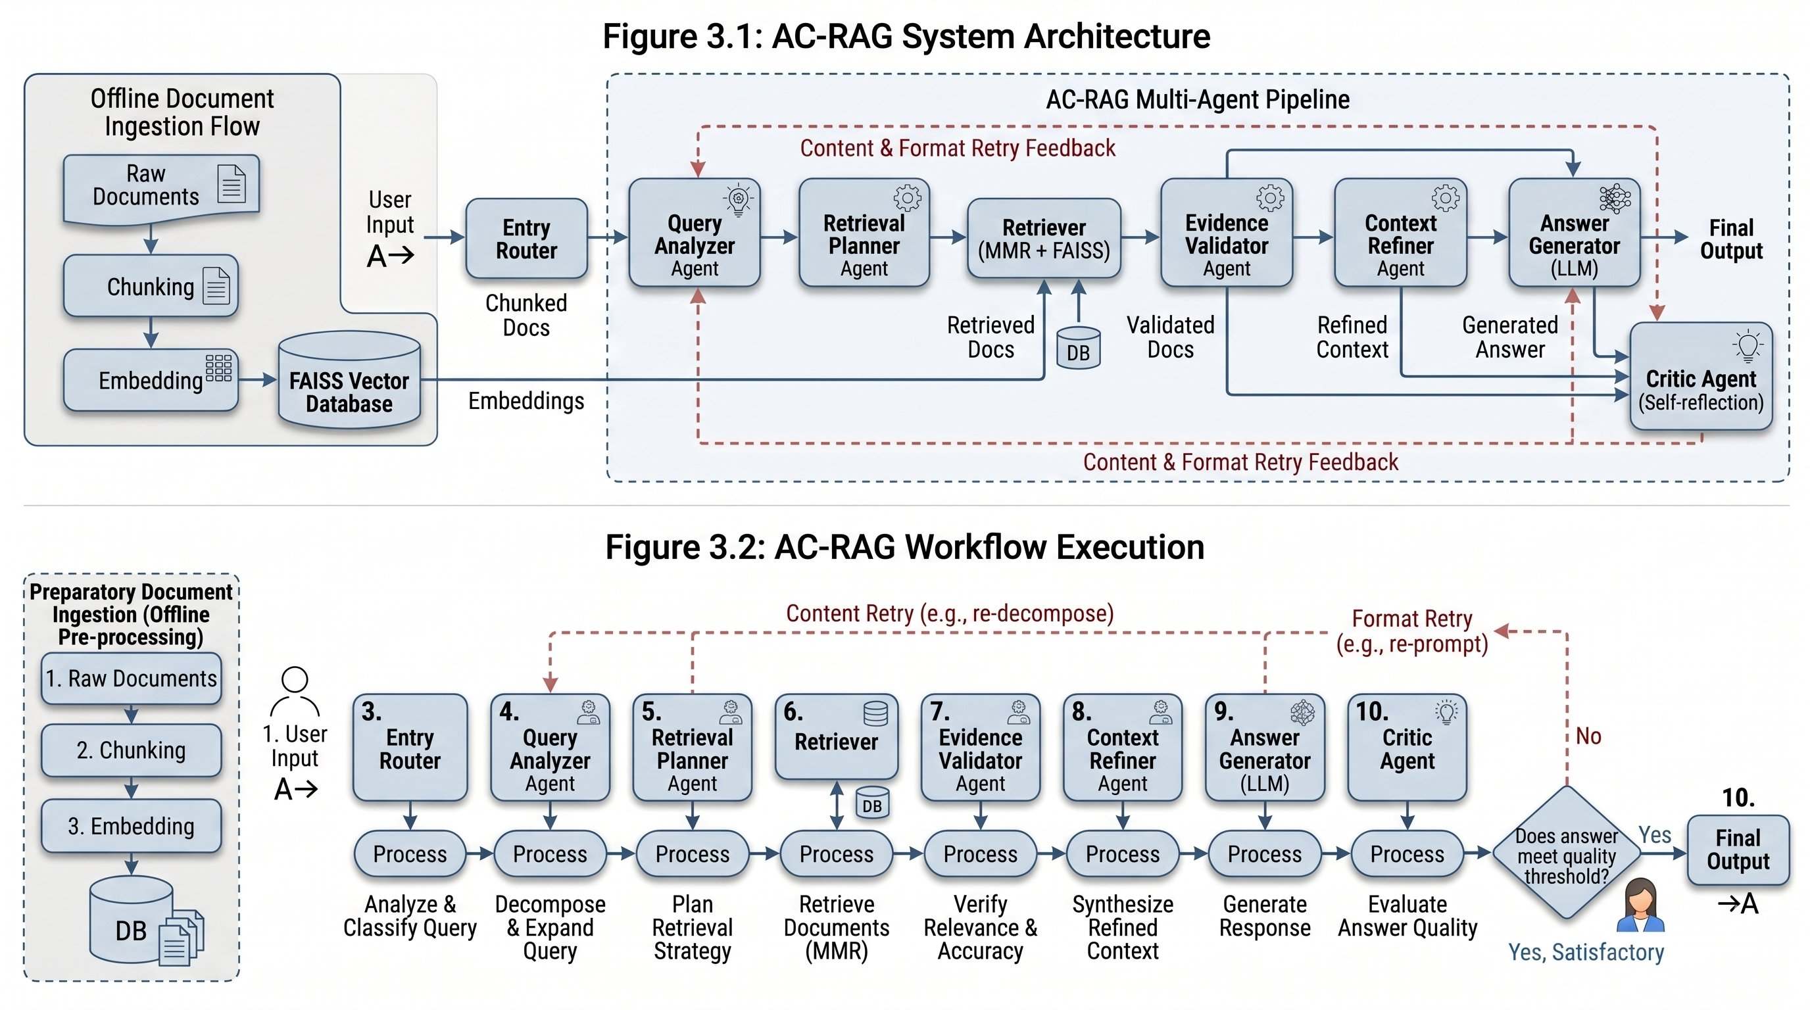
8.1 Architecture — System Design & Workflow Execution

Slide 15
8.3 Experimental Setup
Dataset & Evaluation
Parameter Settings (Table 2)
• 50 question-answer pairs from technical AI/NLP research PDFs
Parameter | Value
Chunk size | 600 characters
Chunk overlap | 100 characters
Retrieval range (k) | 4 to 12
Evidence threshold | 0.65
Self-reflection threshold | 4 out of 5
Max retrieval retries | 3
Max reflection retries | 3
Embedding model | text-embedding-3-large
Generation model | GPT-4o
Critic model | o3-mini
• Mixed content: running text, tabular data, embedded figures
• 3 query types: Factual (single passage), Analytical (multi-section), Table/Figure (numerical/visual)
• Evaluated using RAGAS framework — automated metrics for RAG systems
• Baseline: Standard RAG, fixed k=5, no evidence validation, no self-reflection

Slide 16
9. Evaluation Metrics — What They Mean
Evaluated using the RAGAS framework — automated metrics designed specifically for RAG systems.
✓ Answer Faithfulness (AF)
⊘ Hallucination Reduction (HR)
What: Measures whether every claim in the generated answer is actually supported by the retrieved context.
What: Proportion of responses that contain NO unsupported or fabricated claims. Inverse of hallucination rate.
e.g. If answer has 5 claims and 4 are from the retrieved passages → Faithfulness = 0.80
e.g. If 15 out of 50 answers have hallucinated claims → HR = 1 − 0.30 = 0.70
→ High faithfulness = low hallucination. Our system: 0.88 vs baseline 0.61
→ Critical for trustworthy QA. Our system: 0.85 vs baseline 0.58 (46% improvement)
◎ Context Relevance (CR)
★ Response Accuracy (RA)
What: Measures how relevant the retrieved context passages are to the original query. Are we retrieving the right chunks?
What: Measures whether the generated answer actually addresses the question that was asked. Combines faithfulness + relevancy.
e.g. If 7 of 10 retrieved sentences actually relate to the question → CR = 0.70
e.g. Answer gives correct info but misses part of the question → partial RA score
→ High CR = retrieval is focused. Our system: 0.86 vs baseline 0.64 (improved by adaptive k selection)
→ Overall answer quality. Our system: 0.87 vs baseline 0.63 (38% improvement)

Slide 17
9. Results — RAGAS Evaluation (Table 3)
Both systems tested on same 50-question document QA dataset using same LLM backbone (GPT-4o). Evaluated using RAGAS framework.
System | Answer Faithfulness (AF ↑) | Hallucination Reduction (HR ↑) | Context Relevance (CR ↑) | Response Accuracy (RA ↑)
Baseline RAG [Lewis et al., 2020] | 0.61 | 0.58 | 0.64 | 0.63
AC-RAG (Ours) | 0.88 | 0.85 | 0.86 | 0.87
+44%
+46%
+34%
+38%
Answer Faithfulness
Hallucination Reduction
Context Relevance
Response Accuracy
0.61 → 0.88
0.58 → 0.85
0.64 → 0.86
0.63 → 0.87
Key finding: Hallucination Reduction improved most (+46%). Evidence validation + self-reflection directly reduce unsupported claims.

Slide 18
9.1 Ablation Study — Component Contribution (Table 4)
Each row removes one component at runtime. Full AC-RAG = upper bound. Red = largest individual drop.
Variant | AF ↑ (Faithfulness) | HR ↑ (Halluc. Red.) | CR ↑ (Ctx Relevance) | RA ↑ (Resp. Accuracy)
Full AC-RAG | 0.88 | 0.85 | 0.86 | 0.87
w/o Self-Reflection | 0.73 | 0.70 | 0.86 | 0.74
w/o Evidence Validation | 0.75 | 0.72 | 0.72 | 0.76
w/o Adaptive Retrieval (fixed k=5) | 0.80 | 0.77 | 0.79 | 0.81
w/o Multi-Modal Retrieval | 0.79 | 0.76 | 0.71 | 0.78
w/o Context Refinement | 0.82 | 0.78 | 0.86 | 0.83
w/o Router (always RAG) | 0.88 | 0.85 | 0.86 | 0.86
▼ Removing Self-Reflection: AF 0.88 → 0.73 (−0.15) — single largest drop. Self-reflection is the most critical component.

Slide 19
10. Conclusion
AC-RAG is a multi-agent pipeline for document-based question answering that addresses two core limitations of standard RAG: fixed retrieval depth and absent answer verification. The system divides the pipeline into specialised stages — query understanding, retrieval planning, evidence validation, context refinement, answer generation, and self-reflection — each with a precise role and a defined quality criterion.
Multi-Agent Design:
Nine specialised nodes implemented using LangGraph StateGraph with conditional edges encoding all retry and routing logic. Each node accepts and returns a typed state update via a shared ACRagState TypedDict.
Adaptive Retrieval:
Retrieval depth k (4–12) and content modality (text, table, figure) are determined per query rather than fixed. This results in more focused context for simple queries and broader coverage for complex multi-hop questions.
Evidence Validation:
Passages below cosine similarity threshold 0.65 are discarded before generation. This prevents low-quality retrieved content from introducing noise into the answer generation stage.
Self-Reflection & Retry:
Critic Agent scores each answer on 5 dimensions (faithfulness, completeness, table accuracy, figure accuracy, conciseness). Failures trigger targeted retry — full re-retrieval for content issues, answer rewrite for format issues — up to 3 times.
RAGAS Evaluation Results:
AC-RAG achieved Answer Faithfulness 0.88, Hallucination Reduction 0.85, Context Relevance 0.86, and Response Accuracy 0.87, against baseline scores of 0.61, 0.58, 0.64, 0.63 respectively — all on the same document set and LLM backbone.
Key Finding:
Ablation study confirms Self-Reflection is the single most critical component (−0.15 faithfulness when removed). All improvements achieved without any model fine-tuning — the system works with existing LLM APIs.

Slide 20
11. Future Scope
The following directions are identified for extending the capabilities and applicability of AC-RAG:
1
Larger-Scale Evaluation
Assess AC-RAG on standard NLP benchmarks and domain-specific datasets (legal, medical, financial) to evaluate performance generalisation beyond the current 50-query test set.
2
Dynamic Thresholding
Investigate adaptive adjustment of evidence validation thresholds and self-reflection thresholds based on query type and document domain rather than using fixed values across all query types.
3
Latency Optimisation
Reduce response time by parallelising independent pipeline stages using asyncio (e.g., multi-query MMR searches run concurrently) and exploring low-latency LLM alternatives such as Groq-hosted models.
4
Extended Document Format Support
Extend ingestion to support scanned documents (OCR), spreadsheets, and presentation slides, increasing the range of document types the system can process reliably.
5
Cross-Model Critic
Use a different LLM provider as the Critic Agent (e.g., Claude evaluating GPT-4o outputs) to eliminate self-evaluation bias and improve the objectivity of the quality assessment stage.
6
Multi-Session Conversation Memory
Integrate conversation history so that follow-up questions within a session can reference prior answers, enabling more natural multi-turn document analysis interactions.

