Slide 1
College Admission Agent
CAPSTONE PROJECT
Presented By:
Venkatraman Athimuthu -Kalasalingam academy of research and education -Computer Science and Engineering

Slide 2
OUTLINE
Problem Statement
Proposed System/Solution
System Development Approach
Algorithm & Deployment
Result
Conclusion
Future Scope
References

Slide 3
Problem Statement
Choosing the right college is a stressful and confusing process for many students and parents. With numerous courses, cut-offs and institutions, making an informed decision becomes difficult. Students often miss out on better opportunities due to lack of proper guidance or timely information. An intelligent admission agent can recommend the best-fit colleges based on academic profiles and preferences. The key challenge is to provide accurate, real-time suggestions that simplify and personalize the admission journey.

Slide 4
Proposed Solution
The proposed system aims to assist students and parents in navigating the complex college admission process by providing instant, accurate responses to queries related to fee structures, course availability and eligibility. This is achieved using IBM WatsonX Assistant deployed on IBM Cloud. The solution will consist of the following components:
WatsonX Assistant Design:
Train the WatsonX Assistant using intent-based NLP models to recognize and answer admission-related queries.
Design dialog nodes for specific use cases like “Check Eligibility”, “Fee Structure.”
Integrate conditional logic to guide users based on their inputs (e.g., marks, course preference).
Deployment:
Deploy the assistant on IBM Cloud with an interface that can be embedded into websites.
Ensure the system is scalable to support high query volumes during peak admission periods.
Evaluation:
Monitor assistant interactions to identify unanswered or misinterpreted queries.
Use user feedback and analytics to fine-tune intents, responses and coverage.
Evaluate performance in terms of accuracy and response speed.

Slide 5
System Approach
The System Approach outlines the strategy and components used in building the intelligent College Admission Agent. It includes system requirements, development tools and necessary libraries to ensure a smooth and functional deployment of the solution.
1. System Requirements
Internet: Stable connection for cloud integration and deployment
Software:
Operating System: Windows 10/Linux/macOS
Browser: Chrome, Firefox, or Edge for accessing the IBM Cloud
IBM Cloud
WatsonX Assistant (on IBM Cloud)
2. Libraries and Tools Required
Deployment Tools:
Git
IBM Cloud

Slide 6
Algorithm & Deployment
1. Algorithm
While the WatsonX Assistant doesn't use traditional ML algorithms in the same way as custom models, it does rely on Natural Language Understanding (NLU) and Intent Classification to interpret and respond to user queries.
2. Deployment
The assistant is deployed using IBM Cloud services for scalability, ease of access, and management:
Development Platform:
IBM WatsonX Assistant on IBM Cloud
Dialog nodes and training data configured in WatsonX UI
Deployment Steps:
Create WatsonX Assistant instance from IBM Cloud dashboard.
Design and train the assistant by creating intents, entities, and dialog nodes.
Test the assistant within IBM Cloud to ensure accurate responses.

Slide 7
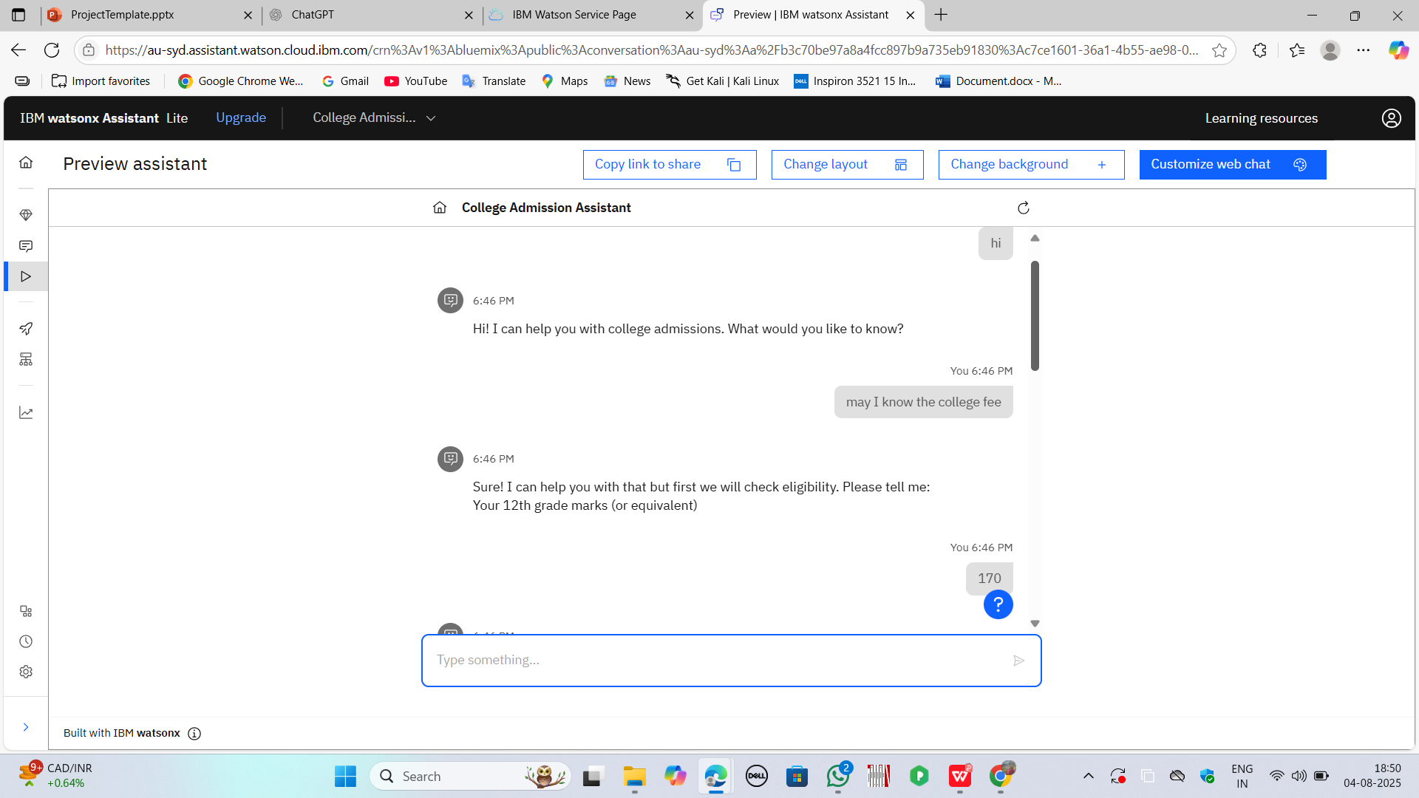
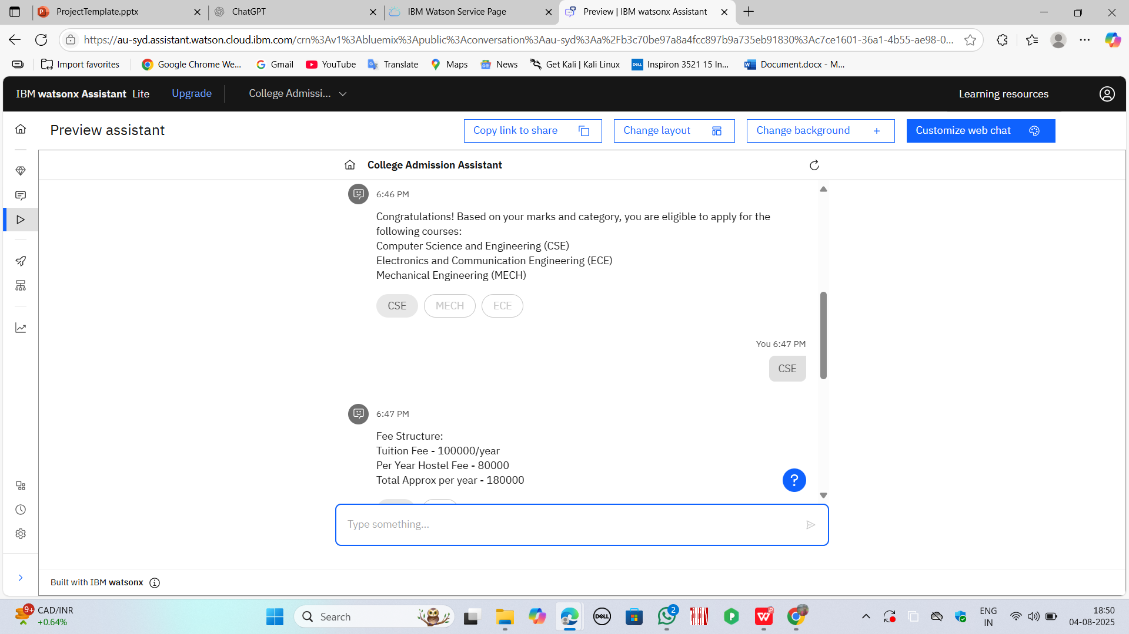
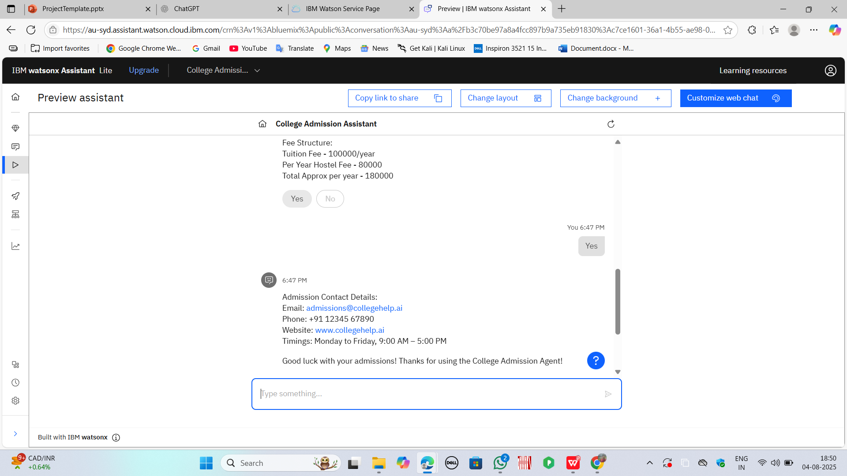
Result
The implemented College Admission Agent successfully responds to user queries regarding eligibility criteria, and fee structures in an accurate and efficient manner. The assistant simplifies the admission process by providing instant, conversational support, reducing the need for manual browsing and institutional visits. Users are able to interact naturally and receive personalized responses based on their academic input.

Slide 8
Conclusion
The College Admission Agent developed using IBM WatsonX Assistant offers a smart, accessible and user-friendly solution to simplify the complex process of college admissions. By providing instant responses to queries related to eligibility, fee structures and available courses, the assistant helps students and parents make informed decisions with confidence. The integration of natural language processing ensures that users can interact in a conversational manner, reducing dependency on manual research or institutional visits.

Slide 9
Future scope
The College Admission Agent has strong potential for growth and enhancement in the coming phases. Some of the future improvements include:
Multilingual Support: Adding support for regional languages to make the assistant more inclusive and accessible across diverse demographics.
Real-Time Data Integration: Connecting the assistant to live databases or APIs from universities to provide up-to-date information on admissions, seat availability, and deadlines.
Document Upload & Verification: Enabling students to upload documents for instant eligibility checks or automated form filling.

Slide 10
References
IBM Cloud Documentation https://cloud.ibm.com/docs
IBM WatsonX Assistant Documentation https://cloud.ibm.com/docs/watsonx-assistant
Watson Assistant – Building Chatbots https://www.ibm.com/cloud/watson-assistant

Slide 11
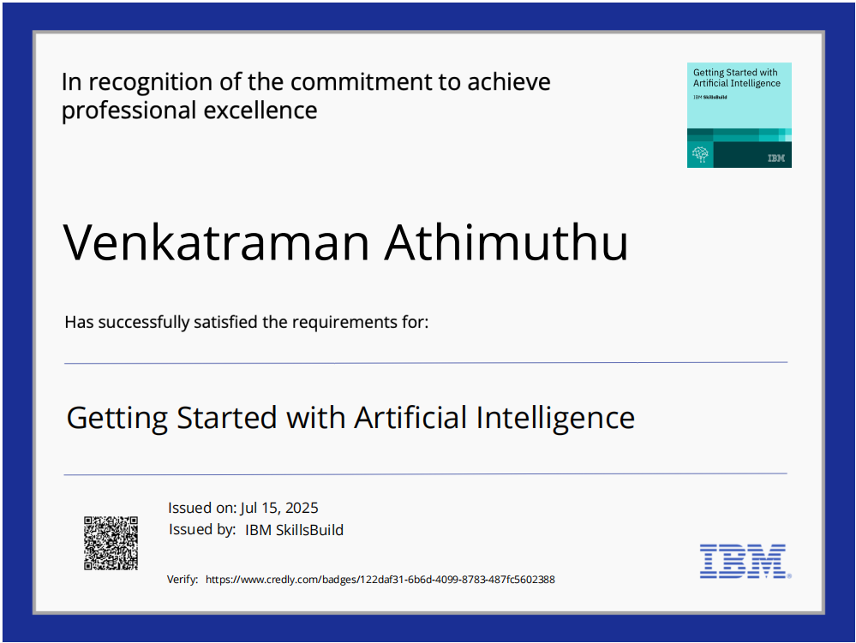
IBM Certifications

Slide 12
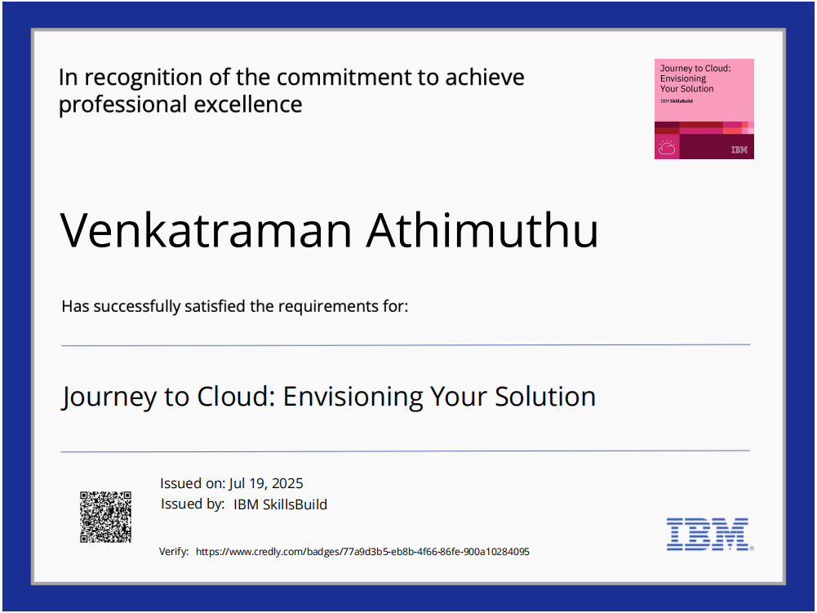
IBM Certifications

Slide 13
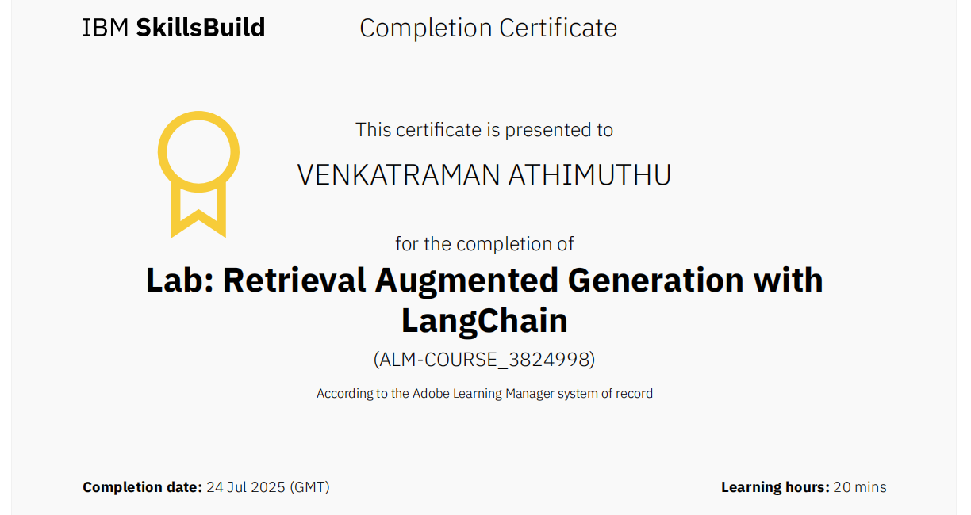
IBM Certifications

Slide 14
THANK YOU

