Slide 1
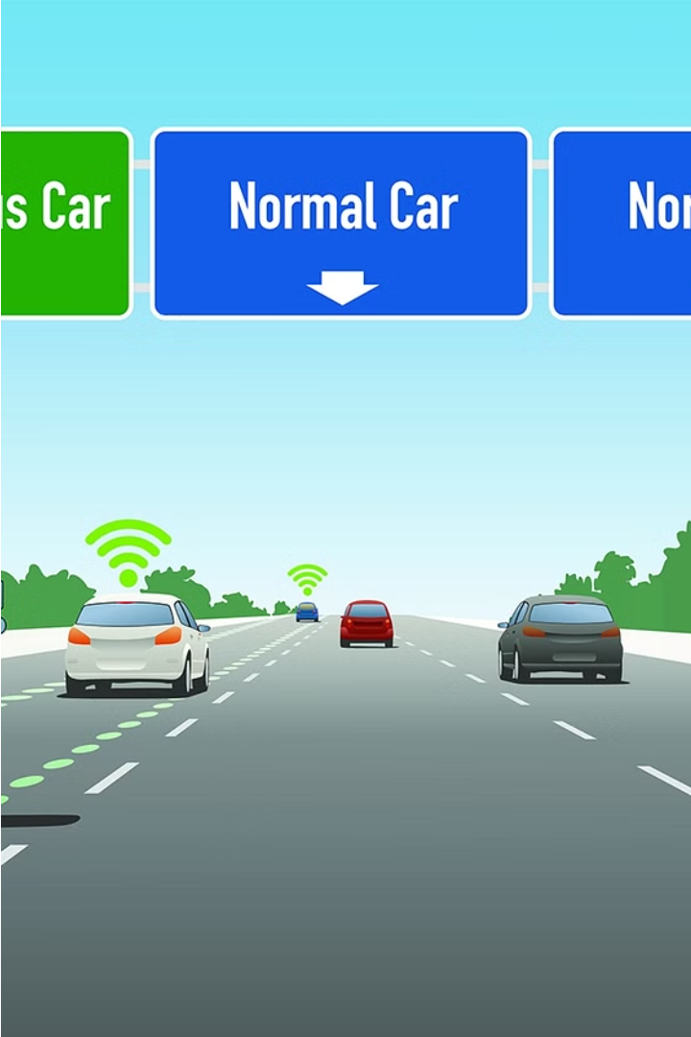

Introduction to Lane Line Detection
Lane line detection is a crucial component of autonomous driving systems. It allows vehicles to precisely identify the boundaries of their lane, enabling safe and accurate navigation on the road.
by Venkat sai Raja

Slide 2
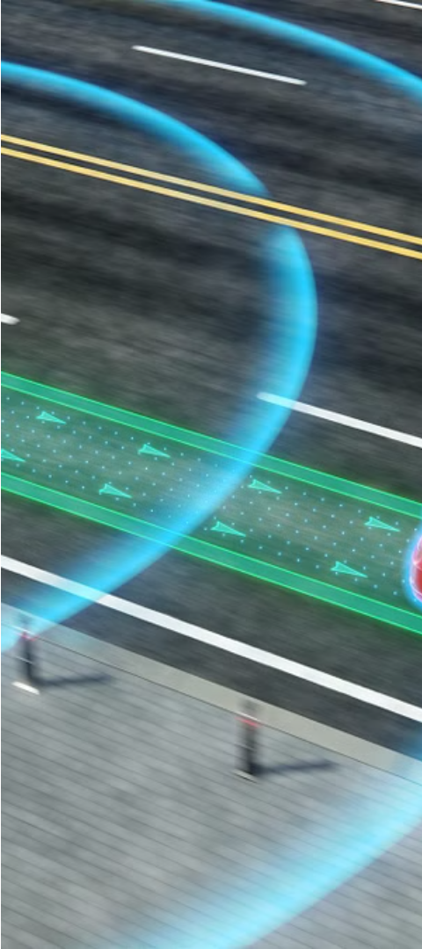
Importance of Lane Line Detection in Autonomous Driving
Precise Navigation
Safety
Lane line detection ensures the vehicle stays centered within its lane, enabling smooth and accurate route guidance.
Detecting lane lines helps autonomous cars avoid unintended lane departures, reducing the risk of collisions.
Adaptability
Advanced lane line detection can adapt to changing road conditions, such as lane merges, exits, and construction zones.

Slide 3
Challenges in Lane Line Detection
1
Varying Lighting Conditions
2
Faded or Obscured Lines
Lane lines can be difficult to detect in low light, glare, or shadows.
Worn, faded, or partially obstructed lane markings can confuse detection algorithms.
3
Complex Road Geometries
4
Environmental Factors
Curved roads, intersections, and lane merges require more advanced detection methods.
Rain, snow, and other weather conditions can impact the visibility and appearance of lane lines.

Slide 4
Computer Vision Techniques for Lane Line Detection
Edge Detection
Hough Transform
Machine Learning
Identifying the sharp contrast between lane markings and the road surface.
Recognizing linear patterns in the image to detect straight lane lines.
Leveraging neural networks to learn and identify complex lane line patterns.

Slide 5

Edge Detection and Hough Transform
Edge Detection
1
Applying filters to the image to highlight the boundaries between lane markings and the road.
2
Hough Transform
Analyzing the edge-detected image to identify straight line segments that represent the lane lines.
Lane Line Extraction
3
Combining the detected line segments to form complete lane line representations.

Slide 6




Real-Time Lane Line Detection Algorithms
Camera Input
Image Processing
Lane Positioning
Feedback to Controls
Capturing live video feed from the vehicle's cameras.
Applying computer vision techniques to detect and track lane lines in each frame.
Determining the vehicle's position within the detected lane boundaries.
Providing the lane information to the vehicle's steering and navigation systems.

Slide 7



Conclusion and Future Developments
Ongoing Research
Sensor Fusion
Smart Infrastructure
Continuous advancements in computer vision and machine learning to improve lane line detection accuracy and reliability.
Integrating multiple sensor modalities, such as cameras, LiDAR, and radar, to enhance lane detection capabilities.
Leveraging connected vehicle and infrastructure technologies to provide additional lane guidance information.

