Slide 1

Excel Final Assessment
Venkatsundhar SP 4403

Slide 2
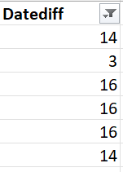
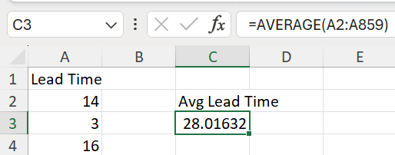
Case Study:
1) To find the average lead time between work date and completion date
To calculate difference between work date & completion date using datedif(). Since some of the work is still pending, term it as “Not completed” using IFERROR function.
=IFERROR(DATEDIF(F2,G2,"d"),"Not Completed")
Filter the not completed values and the average for rest of the values comes up as 28.01632

Slide 3
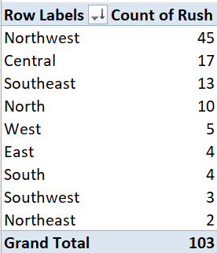
2) District with the highest number of rush jobs
NORTHWEST district has the highest number of rush jobs with a count of 45

Slide 4
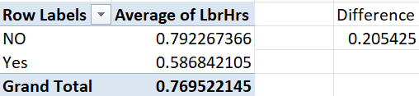
3) How does average labour hrs differ between rush and non-rush jobs?
There is a 0.2 hrs difference between the rush and non-rush jobs which is a bit high considering the count of labourers.

Slide 5
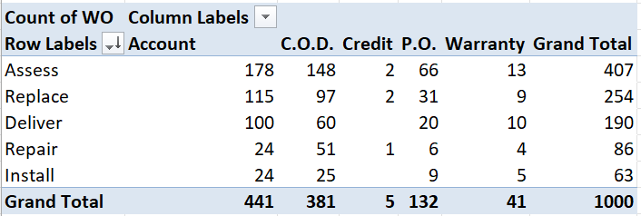
4) Distribution of Payment types across different services
In this distribution we can find the “Assess” services has the highest count of utilising the payment type – 407.
It implies that assess services are frequent in nature.

Slide 6
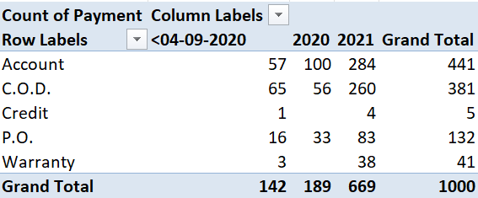
5) Trends in distribution of payment types over the years
If we see the graph, we can notice the upward trend in the distribution of payment types over the years.
Payment over the Account (57 -> 284), C.O.D (65 -> 260) and P.O (16 -> 83) has increased drastically over the years and use of credit and warranty has increased slightly.

Slide 7
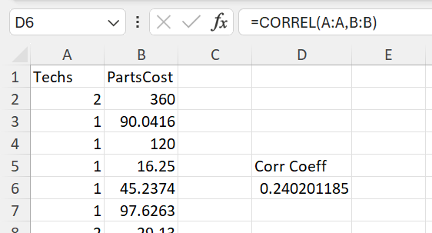
6) Is there a relationship between technicians required and cost of parts
When given formula: =CORREL(A:A,B:B) we are able to determine the strength between the variables technicians required and cost of parts.
With the correlation coefficient = 0.24201185, we can conclude that the relationship between them is relatively weak. Change in one doesn’t influence or imapct the other.

Slide 8









7) To find the most common type of service requested in each district
These are the most common type of services requested in each district. As we saw earlier, assess type of services are the most common type of services requested in majority of the districts.

Slide 9
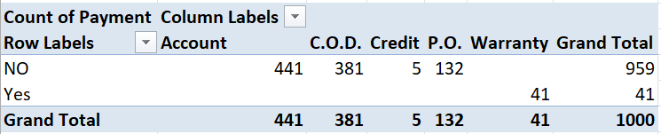
8) To find if there is any difference in distribution of payment type for work order with / without warranty labour.
Yes, there is a major difference in payment types. For those with labour warranty, payment comes under warranty and for others who doesn’t have labour warranty has to pay from their accounts, COD, Credit and etc.
This shows the major advantage of having a labour warranty.

Slide 10
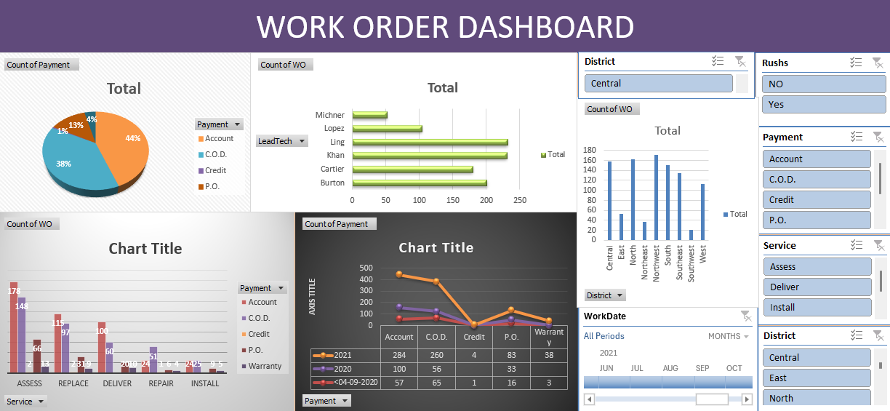
9) DASHBOARD

