Slide 1
Internal Assessment-1
Venkatsundhar SP
4403

Slide 2
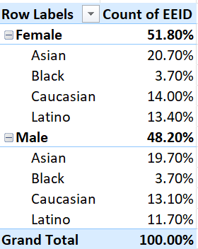
1) Summary of Gender and ethnicity distribution
Summary
This company almost provides equal and fair opportunities to their male and female employees. They hire people from different backgrounds, but comparatively the % of blacks is less.

Slide 3
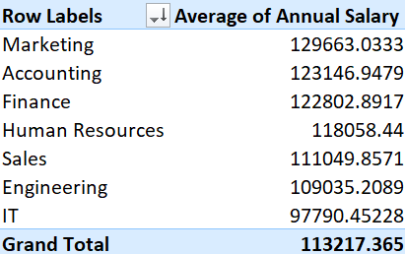
3) Average Salaries by department
Average salary by department
There is a gradual increase in annual salaries between different departments. Only between IT & engineering the jump is pretty significant. Between other departments the increase is gradual.

Slide 4
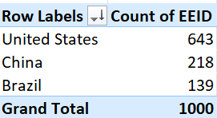
4) Country with highest no of employees
Summary:
UNITED STATES has the most number of employees.

Slide 5
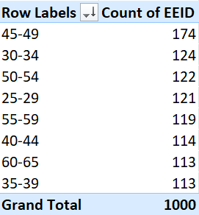
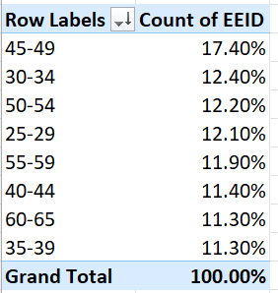
5) Common age range among employes
Count of employee by their age range
The common age range of the employees are 45-49. 174 employees are in the age range of 45-49. They constitute about 17.4%.

Slide 6
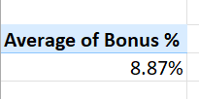
6) Average bonus % given to employees
Average bonus %
The average bonus % given to the employees is 8.87%.

Slide 7
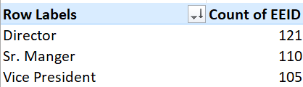
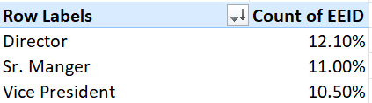
7) Most frequently occurring job title
Director is the most frequently occurring job title. 12.10% of the employees are directors.

Slide 8
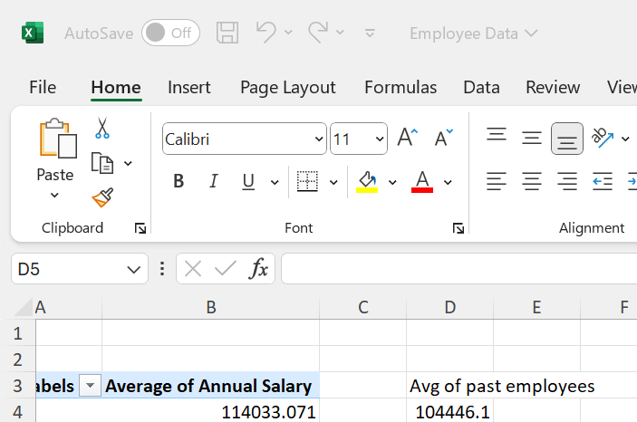
8) Reasons for exit
Here is a comparison between average salaries of exited employees and current employees. There is a significan difference of 10000 in their average salaries. This might be the reason for the exit of employees

Slide 9
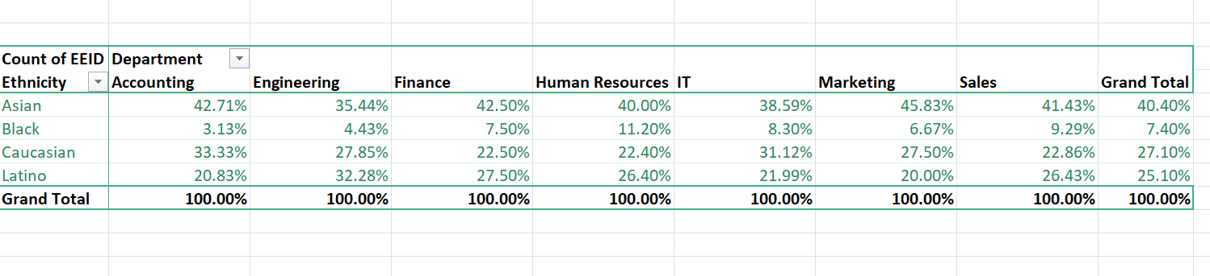
9) Diversity of departments based on ethinicity
Most of the departments are equally diverse in terms of ethnicity. Except for blacks as they are in less numbers.

Slide 10
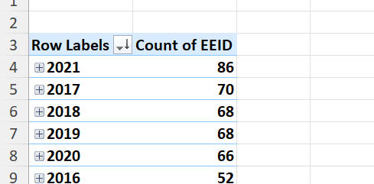
10) Increse In hire
Yes there has been a significant increase in hirein thelast few years.

