Slide 1

Library Management System
Presented by: Team
B. Chaitanya (24B11CS027)
K. Venkatesh (24B11CS191)
K. Rupesh (24B11CS210)
D. Jashuva (24B11CS105)

Slide 2

Objective
The objective of this project is to design and implement a Java-based Library Management System that enables learners for efficient book record management.
The system is developed using Core Java and JDBC, ensuring direct interaction with a relational database.
→ The application performs CRUD operations (Create, Read, Update, Delete) to maintain accurate records, reduce manual errors. Proper validation mechanisms are implemented to prevent issues whether the book is available or not available in library.
→ JDBC is used to establish a secure connection between the Java application and the database, allowing reliable execution of SQL queries.
Overall, this project demonstrates practical knowledge of Java programming, database design, JDBC connectivity, SQL constraints, and data integrity, without using any frontend technologies.

Slide 3
Problem Statement
Manual Tracking:
→Many libraries still use manual registers to maintain book records. This manual process leads to data redundancy, missing records, and frequent human errors. Managing book availability and searching for books becomes time-consuming for both librarians and visitors.
→ To overcome these issues, a system developed using Java and JDBC can be used to search books efficiently by title or author name. This reduces manual effort, saves time for visitors, and minimizes data redundancy and anomalies in library records.
→ Hence, there is a need for a simple, reliable, and database-driven Library Management System that automates book availability using Java and JDBC, ensuring proper validation, structured data storage, and efficient CRUD operations, without relying on any frontend technologies.

Slide 4
System Overview
Console-Based Java Application
This project is implemented as a console-based Java application, where the user interacts with the system through the command line instead of a graphical interface. All inputs such as book details, admin details, and staff details are entered using the keyboard, and outputs are displayed on the console.
Using a console-based approach helps in:
Focus on core Java concepts
Easy understanding of program flow
No dependency on frontend technologies

Slide 5
System Overview
2. JDBC Connectivity
The system uses JDBC (Java Database Connectivity) to connect the Java application with a relational database such as MySQL or Oracle. JDBC acts as a bridge between Java and the database, allowing the program to send SQL commands and receive results.
Using JDBC:
A database connection is established using DriverManager
SQL queries are executed using PreparedStatement
Results are retrieved using ResultSet
Advantages:
Secure execution of SQL queries
Prevention of SQL injection using prepared statements
Smooth communication between Java code and database tables
This demonstrates practical usage of real-time database interaction in Java applications.

Slide 6
System Overview
3. Relational Database Design
The system follows a relational database design, where data is stored in multiple tables:
Book table – stores book details
Admin table – stores admin details
Staff table – stores staff details
Relationships are maintained using:
Primary Keys to uniquely identify records
Foreign Keys to establish relationships between tables
UNIQUE constraints to prevent data inconsistency.
This design ensures:
Data consistency and integrity
Avoidance of redundancy
Easy maintenance and scalability

Slide 7
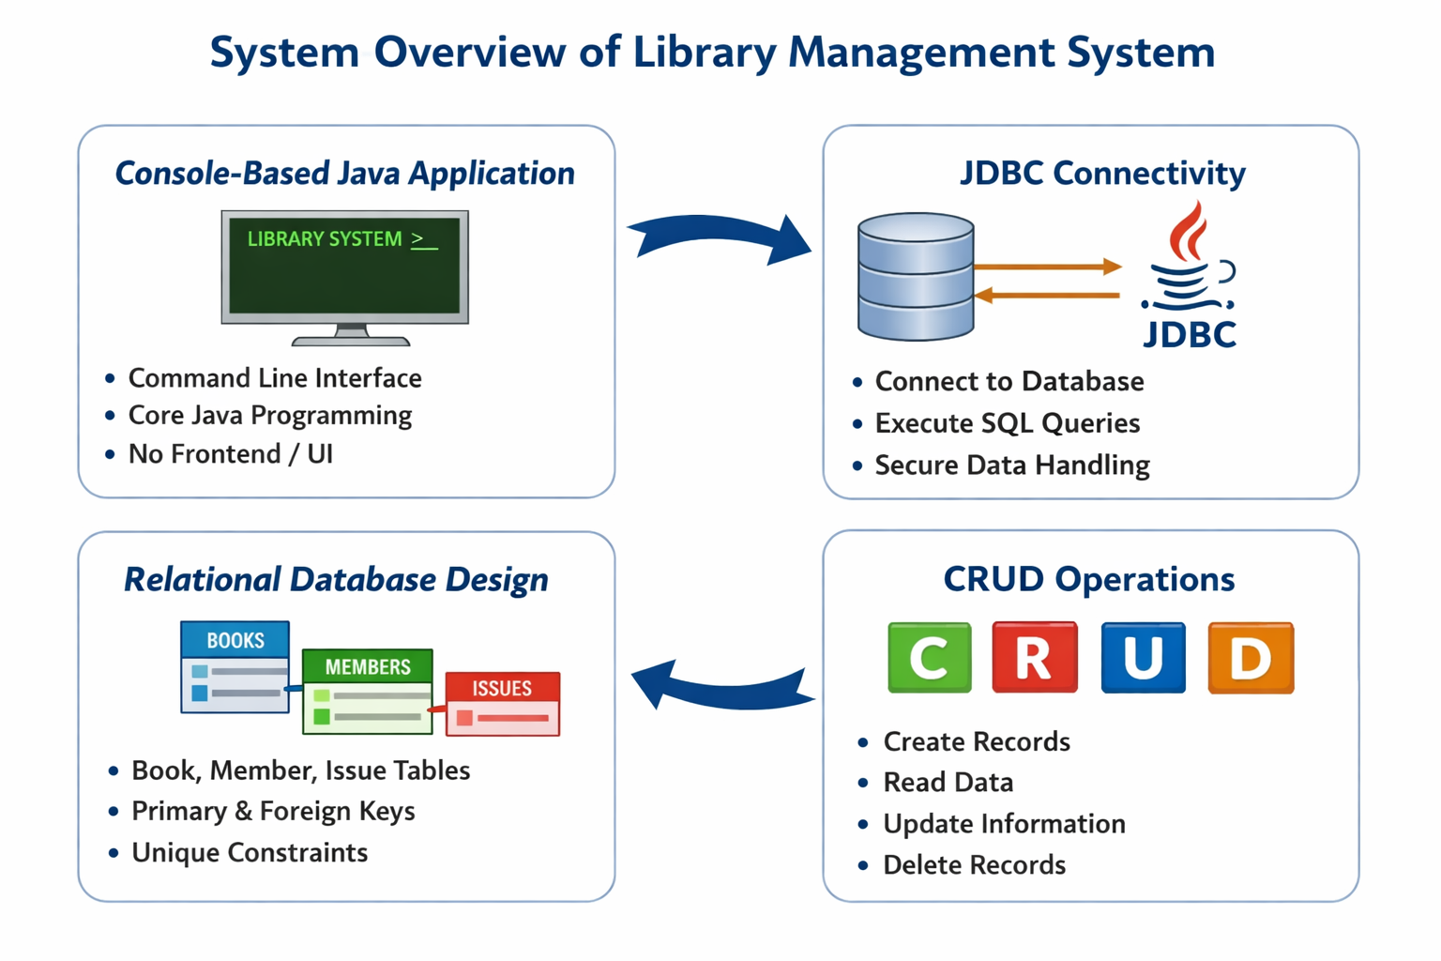
System Overview Diagram
4. No Frontend / UI
This project does not use any frontend technologies such as HTML, CSS, JavaScript, or frameworks. All operations are performed using Java and SQL through the console.

Slide 8
Database Design – Three Main Tables
  To store and manage data efficiently, the Library Management System uses a relational database design. Instead of keeping all information in a single table, the data is divided into three separate tables: Books, Admin, and
  Staff.
1. Book Table
The Book table is used to store all the basic details of books available in library. Each book is uniquely
identified so that the book availability can be tracked accurately.
Key Attributes
Book_id (Primary Key)
  Uniquely identifies each book
  No two books can have the same ID
  Category
  Stores the main content of that book
Name
  Stores the book name for title-based searching.
Author
  Ensures that name of the writer of the book.
Copies
  Stores the number of copies of a book of the each author.

Slide 9
2. Admin Table
The Admin table stores details of admin of that library.
Key Attributes
User_id(Primary Key)
  Uniquely identifies each admin.
Name
  Stores the name of the admin .
  Password
  Stores password of that particular admin.
Contact
  Stores the contact of that admin.
3. Staff Table
The Staff table stores information of the staff in that library.
Key Attributes
Staff_ID
  Uniquely identifies each staff.
Name
  Stores staff member name .
  Contact
  Stores the contact of that staff member.

Slide 10
Workflow
Step 1: Start the Application
The Java application starts execution from the main() method.
A console menu is displayed to the user with options such as:
Add Book
Add Staff
Remove Staff
Search Book by Author
Display All Books
Edit Book Details
Delete Book
Display all staff details
Step 2: Establish Database Connection
The system establishes a connection to the database using JDBC.
DriverManager is used to connect Java with the SQL database.
If the connection is successful, the system proceeds; otherwise, an error message is displayed.
This ensures all operations are performed on a live database.
Step 3: Accept User Input
The user selects an option from the console menu.
For searching by author, the system asks for:
  Author name.
For adding a book, the system asks for:
  BookID, , Category, Name, Author, Copies

Slide 11
Workflow
Step 4: Validate Book
Before performing any operation, the system checks:
  If the entered Author exists in the books table (for search).
  If the entered BookID exists (for update or delete).
Step 5: Check for Duplicate Entry
When adding a book, the system executes a SELECT query to check if a book with the same title and
author already exists.
If it exists, it updates the copies.
Step 6: Perform Database Operation (CRUD)
Based on the selected option:
Add Book (Create)
→ INSERT book into Books table
Search by Author (Read)
→ SELECT records and display all books
Edit Book details (Update)
→ UPDATE book details
Delete Book(Delete)
→ DELETE books if not needed.
S

Slide 12
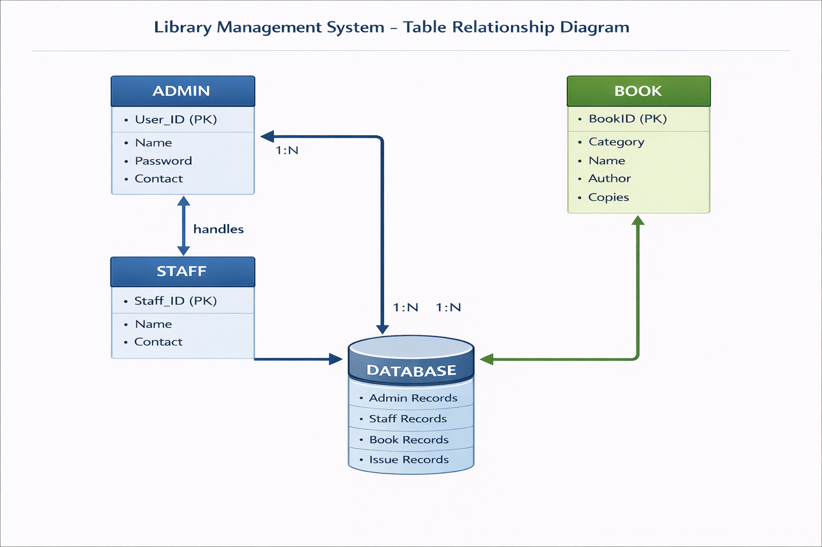
Workflow Diagram

Slide 13
Proposed System
The proposed system is a console-based Library Management System developed using Core Java, JDBC, and a relational database. It is designed to overcome the limitations of manual and unstructured tracking of books by providing a centralized, automated, and validation-driven solution.
In this system, all book, admin, and Staff details are stored in a relational database with well-defined relationships. The Java application interacts with the database using JDBC, enabling secure and efficient execution of SQL queries.

Slide 14
Role Contributions
B. Chaitanya– Java Application Developer
Designed the overall application flow
Implemented core Java logic using control structures and classes
K. Venkatesh– Database Designer
Designed relational database schema
Creating Books, Admin and Staff tables
K. Rupesh – JDBC & Validation Developer
Implemented JDBC connectivity
Wrote SQL queries for CRUD operations
D. Jashuva – Testing & Documentation
Tested application with different input cases
Prepared documentation, PPT, and Review-1 materials

Slide 15
Technologies Used
1. Java (Core Java)
Used for developing the application logic
Implemented classes, objects, methods, loops, and conditionals
Handled user input and output through the console
2. JDBC (Java Database Connectivity)
Used to connect Java application with the database
Executed SQL queries using Prepared Statement
3. Relational Database (MySQL / Oracle)
Stored Books, Admin, Staff data
Implemented table relationships
4. SQL
Used for creating tables and defining constraints
Used SELECT, INSERT, UPDATE, and DELETE queries
5. Development Tools
Java JDK
IDE (Eclipse / IntelliJ / NetBeans)
MySQL Connector
Database client (MySQL Workbench / SQL Developer)

Slide 16
Conclusion
The Library Management System successfully demonstrates the implementation of a pure Java-based backend application using JDBC and a relational database. The project automates the process of tracking books while ensuring accuracy, validation, and data integrity.
By separating data into Books, Admin, and Staff tables, the system follows proper database normalization and avoids redundancy. The use of JDBC enables seamless interaction between the Java application and the database, allowing efficient execution of CRUD operations.
The system effectively prevents time consumption for both librarians and users through both application-level validation and database constraints. Since the project does not involve any frontend technologies, it strongly emphasizes core Java concepts, JDBC connectivity, and SQL fundamentals.
Overall, this project serves as a strong foundation for understanding backend development using Java and can be extended in the future by adding a graphical user interface or web-based frontend.

