Slide 1
Data and Information Retrieval 220CT
Intelligent systems for big data I (Data Mining)

Slide 2
Aims and Objectives
Determine what data mining is
Establish why need data mining
Go through the process involved in data mining
Look an intelligent technique that can be used to process big data

Slide 3
Data mining
It derives its name from the similarities between searching
for valuable business information in a large database,
and mining a mountain for a vein of valuable ore.

Slide 4
Data mining
Data mining involves discovering patterns in large data sets
Using intelligent methods to take data and make it into something understandable.

Slide 5

What is data mining?

Slide 6
Why we need data mining
Only a small portion (typically - 5%-10%) of the collected data is ever analyzed
Data that may never be analyzed continues to be collected, at a great expense
Growth rates of data needs automated data fusion techniques based on data mining

Slide 7
Why we need data mining
Data mining technology can generate new business opportunities by providing:
Automated prediction of trends and behaviors.
Automated discovery of previously unknown or hidden patterns

Slide 8
Why we need data mining
Data mining will become much more important, and companies will throw away nothing about their customers because it will be so valuable. If you’re not doing this, you’re out of business.
Arno Penzias, Chief Scientist @ Bell Labs

Slide 9
Why we need data mining
We are deluged by data – scientific data, medical data, demographic data, financial data, and marketing data. People have no time to look at this data. Human attention has become a precious resource.
Jim Gray, Microsoft Research in preface to Data Mining by Han and Kamber

Slide 10

Tsunami of Data

Slide 11
Data mining v data warehousing
Data mining | Data Warehousing
process of finding patterns in a given data set | process of centralizing or aggregating data from multiple sources into one common repository
patterns can often provide meaningful and insightful data to whoever is interested in that data

Slide 12
Problems faced with data mining
Issue | Description
Individual privacy | Analyze routine behaviour and glean a significant amount of information
Data integrity | integrating conflicting or redundant data from different sources
Cost | Data mining gives us better information lets collect more data

Slide 13
Problems faced with data mining

Slide 14
Problems faced with data mining
Issue | Description
Efficiency and scalability | The data mining algorithms must be able to work with masses of data
Parallelism and distributed systems | There is a need given the process to split the data into sections and work with it

Slide 15


Over to you
Select either a university or a hospital
Identify what data you will collect and what you can use that data for
What data mining social issues need to be considered

Slide 16
Data Mining Process (Life cycle)
Problem
Definition
Data Gathering
& Preparation
Model Building
& Evaluation
Data Assess
Data Sampling
Setting up data
Use
Knowledge
Create Model
Test Model
Evaluate Model
Model apply
Produce Report
Applying findings

Slide 17
Data mining tasks
Classification is a general process related to categorization, the process in which ideas and objects are recognized, differentiated, and understood.

Slide 18
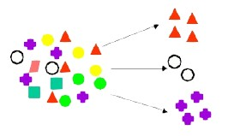
Data mining tasks
Clustering is the task of grouping a set of objects in such a way that those in the same group are more similar.

Slide 19

Data mining tasks
Association. Identifies relationships between events that occur at one time.

Slide 20

Data mining tasks
Sequencing. Identifies relationships that exist over a period of time. Sequence Mining determining a set of patterns shared among objects in a specific order.

Slide 21
Data mining tasks
Forecasting is the process of making predictions of the future based on past and present data and analysis of trends.

Slide 22
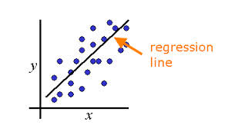
Data mining tasks
Regression. is a statistical process for estimating the relationships among variables

Slide 23

Data mining tasks
Time Series analysis examines a value as it varies over time.

Slide 24
Data mining tasks
Data Mining
Predictive
Descriptive
Predict the value of a specific attribute based on the value of other attributes
To derive patterns that summarizes the underlying relationship between data.
Classification
Regression
Clustering
Association
Sequencing
Time Series Analysis
Forecasting

Slide 25
Data mining applications
Too many to name
fraud detection, aid marketing campaigns, detecting diseases, scientific experiments, weather predictions and study consumers.

Slide 26
Data mining applications

Slide 27

Data mining domains
Text Mining is the application of data mining to non-structured or less-structured text files

Slide 28

Data mining domains
Web Mining is the application of data mining techniques to data related to the World Wide Web.

Slide 29
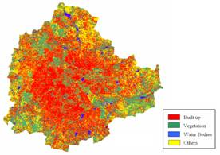
Data mining domains
Spatial Mining is the application of data mining techniques to data that have a location component. (GIS data)

Slide 30
Data mining domains
Temporal Mining is the application of data mining techniques to data that are maintained for multiple points in time

Slide 31
Intelligent techniques for data mining
Technique | Description
Case-based reasoning | uses historical cases to recognize patterns
Neural computing | machine learning approach which examines historical data for patterns
Intelligent agents | retrieving information from the Internet or from intranet-based databases
Genetic algorithms | Computational models inspired by biological evolution

Slide 32
Build Model – Decision Tree
A decision tree can be used as a model for a sequential decision problems under uncertainty

Slide 33
Simple Decision Tree
Body Temperature | Gives Birth | Decision
Warm | Yes | Mammal
Cold | No | Non-mammal

Slide 34
Basic decision tree
Body temp
Warm
Cold
Gives Birth
Non-
Mammals
Yes
No
Mammals
Non-
Mammals

Slide 35
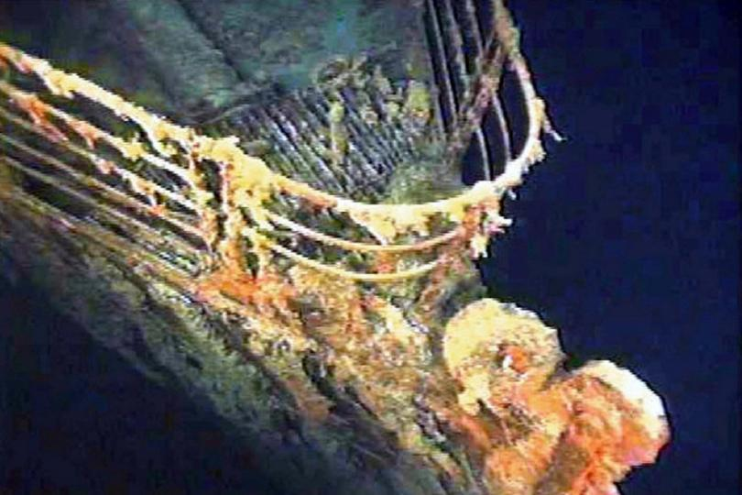
Titanic Data – Decision tree
https://www.youtube.com/user/RapidIVideos

Slide 36



Intelligent Data mining Example 1
Company who wants to create a robot that can recognise the users emotional state from their speech.

Slide 37
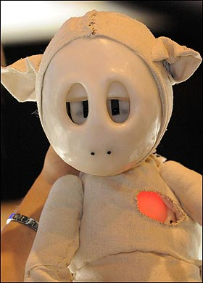
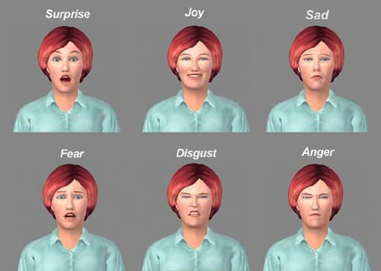
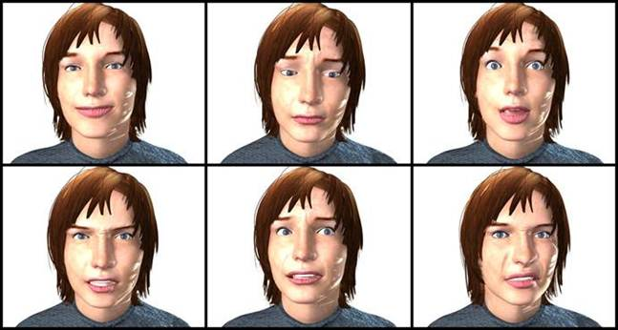

Emotion robots companion

Slide 38
Emotion robots companion

Slide 39
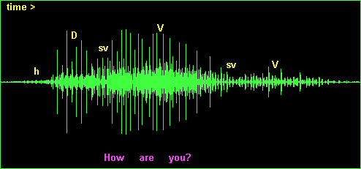

The Big data

Slide 40

Methodology - Database
Berlin Emotional Database
535 files containing German utterances related to six emotions (anger, disgust, fear, sadness, happy, bored, surprise)
Acted by five males and five females
1) 2) 3)
Angry
Happy
Bored

Slide 41
Data Process/Preparation
Generate 8551 features from the speech signal
Signal energy, Loudness, Pitch, Voice quality etc, zero-crossing, max
Use feature reduction to determine critical feature down to 34

Slide 42
Model Build
Self-organising map (SOM) - Clustering
Output layer (o)
Weights (w)
Input layer (i)

Slide 43
Build Model - SOM
Train the map using examples from the data set
Clustering of close examples through self-organising map
Each sample is typically represented by a single winning unit and a surrounding neighbourhood of units

Slide 44
Self-organising map
Advantages | Disadvantages
You do not need to tell it what classes are | Blackbox as it is difficult to understand decision
Can visualise data in a topographical manner | Each time train get a different map
Can identify new relationships in the data

Slide 45







Evaluate Model - SOM
46 | 7 | 15 | 0 | 1 | 1 | 1
2 | 67 | 1 | 3 | 2 | 3 | 1
12 | 1 | 106 | 1 | 5 | 1 | 1
0 | 1 | 0 | 60 | 1 | 0 | 0
3 | 6 | 5 | 3 | 50 | 0 | 2
0 | 4 | 0 | 2 | 2 | 73 | 0
2 | 0 | 0 | 5 | 3 | 1 | 35

Slide 46
Use Knowledge
Can achieve 80% recognition of emotions from speech in our robot
Need better so look at improving this
If this approach works on speech can it work on other time series data

Slide 47
Take Home Message
Data mining is the identification of knowledge from big data
Come about due to the masses of data collected (Big data)
Clear process to follows each time

Slide 48
Next Session
Explore another intelligent technique to perform classification
Explore two data mining tools
Look at WEKA in detail so you can use intelligent tools to analysis big data

