Slide 1
Data and Information Retrieval 220CT
Intelligent systems for big data II

Slide 2
Objectives
Explore an intelligent approach to big data examine
Identify tool for performing data mining
Examine WEKA tool for big data analysis

Slide 3
Define Problem
We are a medical company and we are developing a new screen device to classify breast cancer

Slide 4
Data Gathering
We can go out and collect data related to breast cancer or use existing dataset
University of Wisconsin Hospitals, Madison (available from http://archive.ics.uci.edu/ml).
the data comprise 699 classified as benign or malignant breast cancer

Slide 5
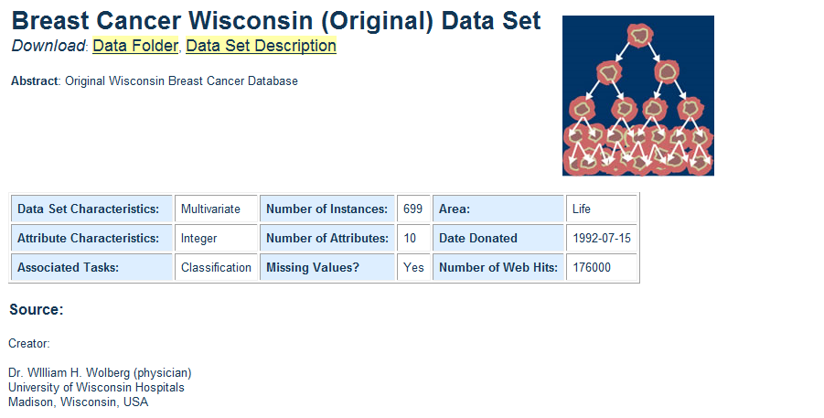

Slide 6
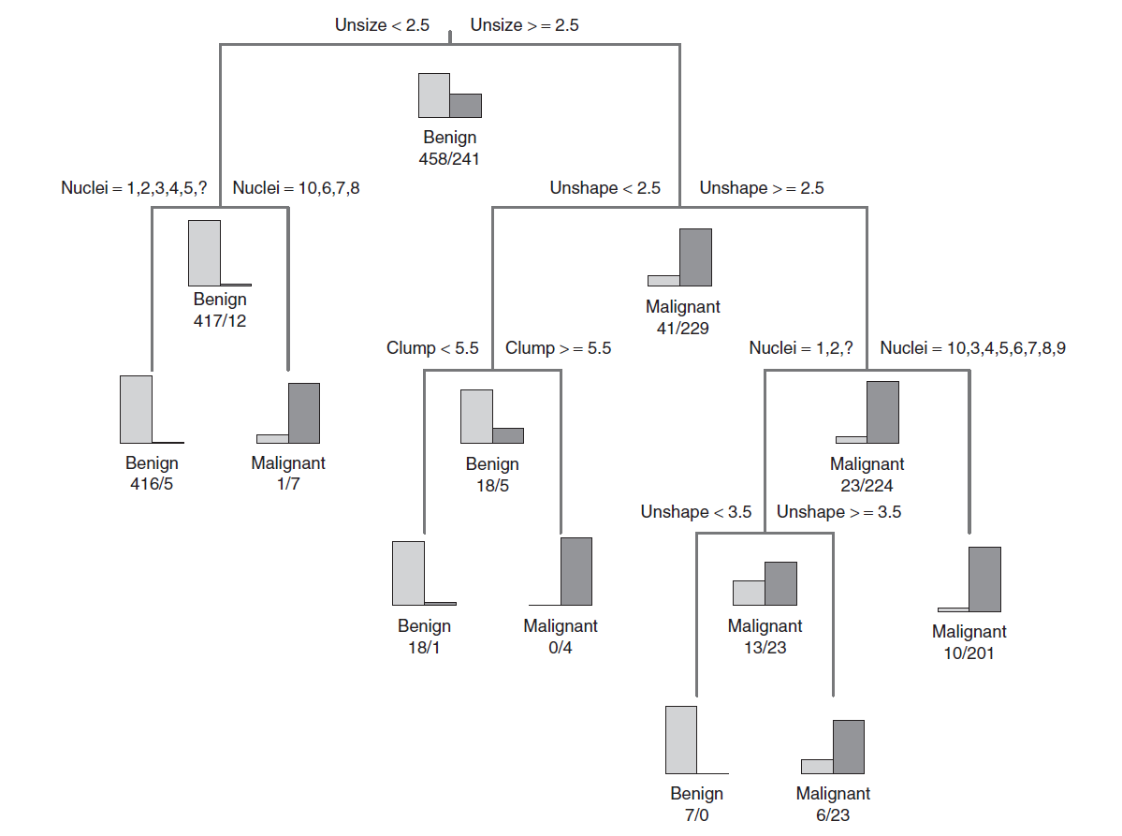
Decision Tree – Diagnostic

Slide 7
Pros and Cons Decision Trees
Pros | Cons
Easy to interpret the decision rules | Can overfit training data which can give poor results when applied to the full data set
Easy to incorporate a range of numeric or categorical data layers | Not possible to predict beyond the minimum and maximum limits of the response variable in the training data
Robust with regard to outliers in training data
Classification is fast once rules are developed

Slide 8
Use Knowledge
Developed approach to classify breast cancer
Can identify factors that influence breast cancer classification
Feed back findings to consider how to improve the system

Slide 9
SAS Enterprise Miner Data mining tools
SAS Enterprise Miner streamlines the data mining process to create highly accurate predictive and descriptive models

Slide 10
SAS Enterprise Miner - Benefits
Support the entire data mining process.
Build more models faster.
Enhance accuracy of predictions and easily surface reliable business information.

Slide 11
SAS Enterprise Miner - Features
Multiple interfaces | Scalable processing
Data preparation, summarization and exploration | Advanced predictive and descriptive modelling
Business-based model comparisons, reporting and management. | Automated scoring process
Open, extensible design

Slide 12
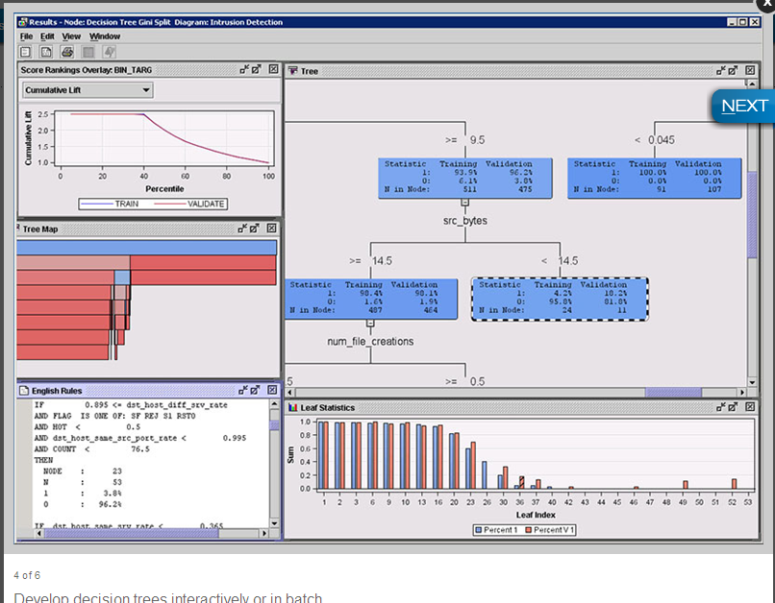
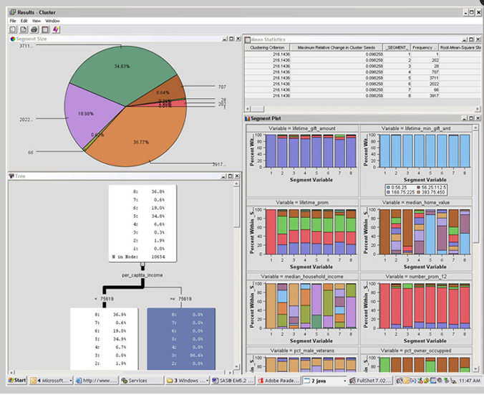
SAS Enterprise Miner - Demo
http://www.sas.com/en_us/software/analytics/enterprise-miner.html#m=patrick-hall-demo

Slide 13

SAS Enterprise Miner - Demo

Slide 14
Rapid miner
A powerful & collaborative analytics platform featuring a rich tool-set for accelerating the creation, delivery, and maintenance of high-value predictive analytics.
The RapidMiner Platform offers more functions than any other visual solution, plus it’s open and extensible to support all your data science needs.
https://www.youtube.com/user/RapidIVideos

Slide 15
WEKA
Created by University of Waikato
Download Weka (the stable version) from http://www.cs.waikato.ac.nz/ml/weka/
Choose a self-extracting executable (including Java VM)

Slide 16
WEKA

Slide 17
WEKA
A collection of open source data mining tools
  pre-processing on data
  Classification:
  clustering
  association rule extraction
49 data preprocessing tools
76 classification/regression algorithms

Slide 18
WEKA - Features
8 clustering algorithms
15 attribute/subset evaluators + 10 search algorithms for feature selection.
3 algorithms for finding association rules
3 graphical user interfaces

Slide 19

WEKA – Getting Started
Going to concentrate on the explorer option here

Slide 20
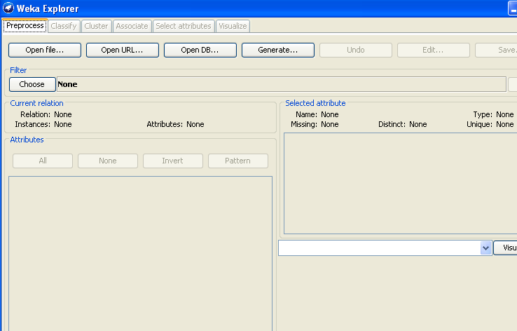


Slide 21
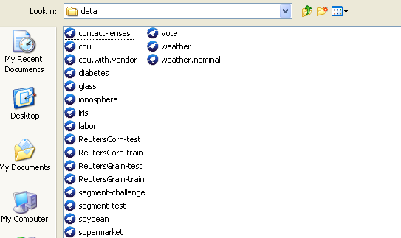
WEKA - Open File

Slide 22
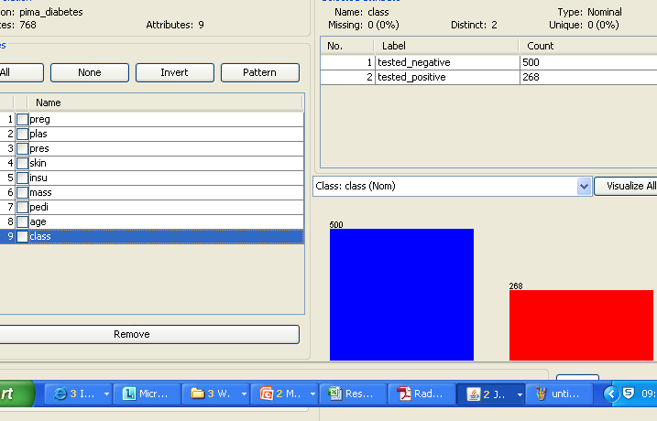
WEKA – Visualisation

Slide 23
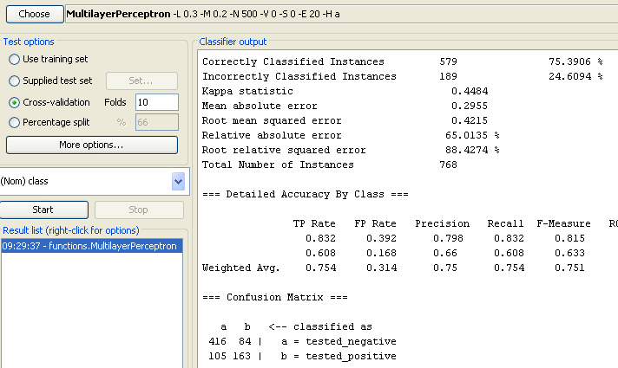
WEKA - Classification

Slide 24
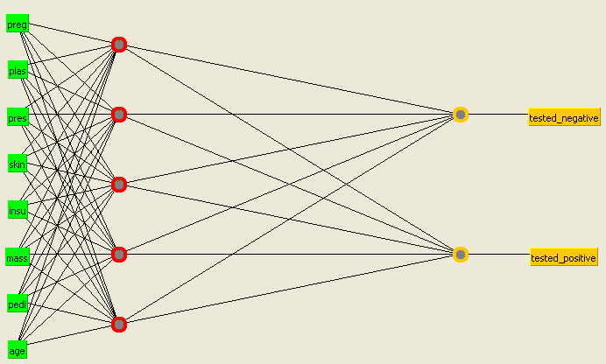
WEKA - Classification

Slide 25
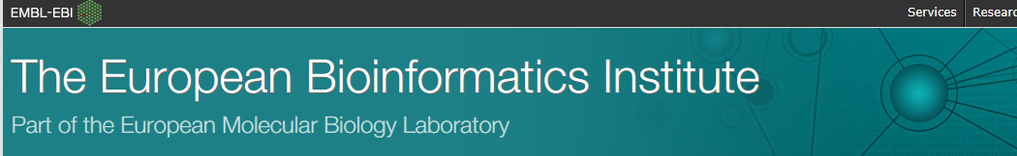
Big data source – Real world

Slide 26
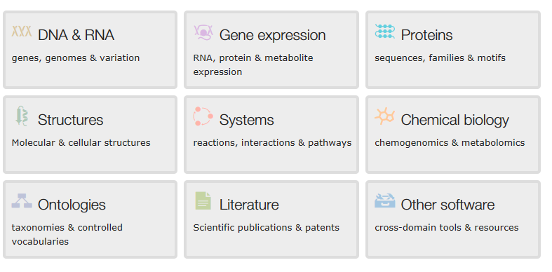
Big data source – Real world
http://www.ebi.ac.uk/services

Slide 27
Summary
Just cover a couple of intelligent techniques here there are many
There are tools out there to help perform analysis of big data to aid enterprises
One studied in detail is WEKA.
We will look at WEKA in the lab

