Slide 1
Operating Systems, Security and Networks 207SE
Introduction – Using Linux Server from University Machines

Slide 2
Linux Server
The activities on the 207SE you do not need to use the Linux server you can install Linux on your PC, laptop or chromebook.
If you do use the Linux server, simply follow the instructions on these slides and the associated video

Slide 3
Linux Server
Carrying out the practical work (including for portfolio we will use linux server)
ITS have set up a server for us called os-207se, which they refer to as “the UNIX server”.
It’s an virtual machine running Linux, we can add cores as we wish so it’s pretty fast in comparison to the typical desktop.

Slide 4
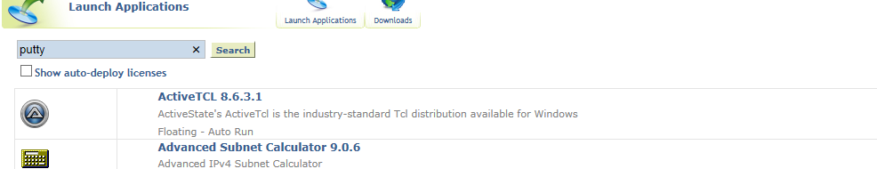
Putty: Connecting to server
You can log in to the server using putty in Windows
To get putty click on the mylaunch shortcut on the desktop and then search for putty. Click on putty and it should open.

Slide 5
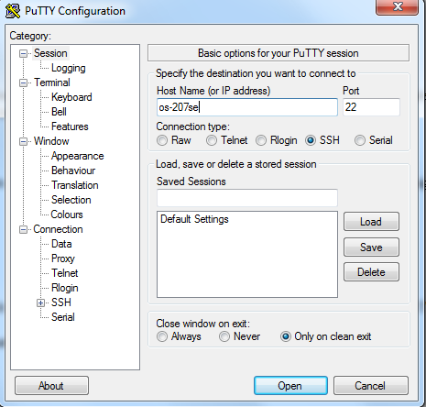
Connecting using Putty

Slide 6

Putty: Editing your code files
Choose your editor
  On the server, you have a choice of text editors: emacs, pico, vi and probably others.
  Pico is very easy to use for beginners, since it displays its shortcuts on-screen.

Slide 7
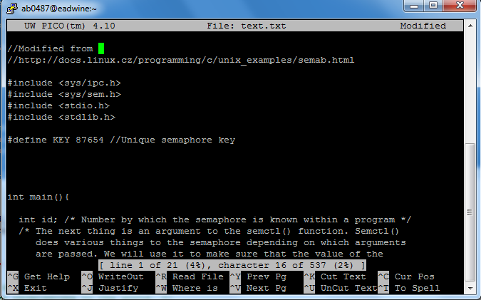
Putty: Editing your code files
Edit and input program
When ready to save Ctrl-x and follow instructions to save

Slide 8
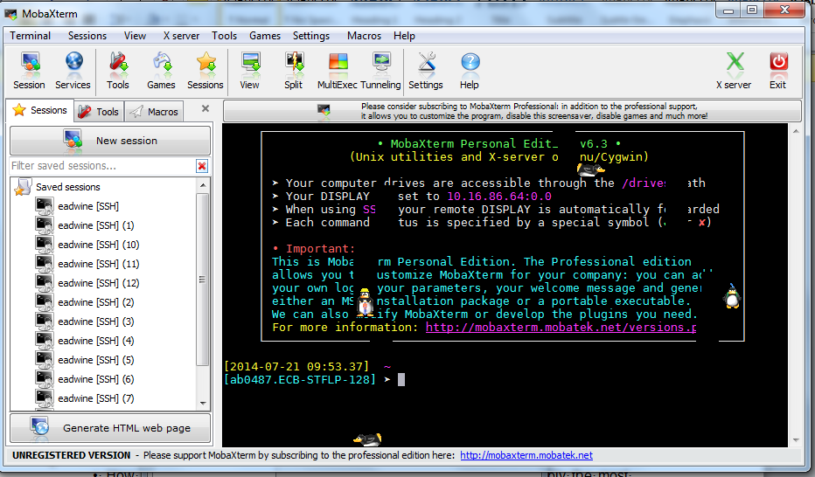
MobaXterm: Connecting to server

Slide 9
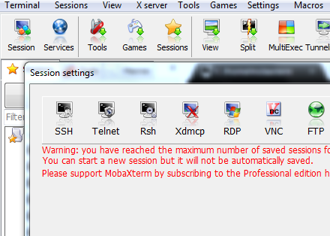
MobaXterm: Connecting to server
Click session > SSH

Slide 10

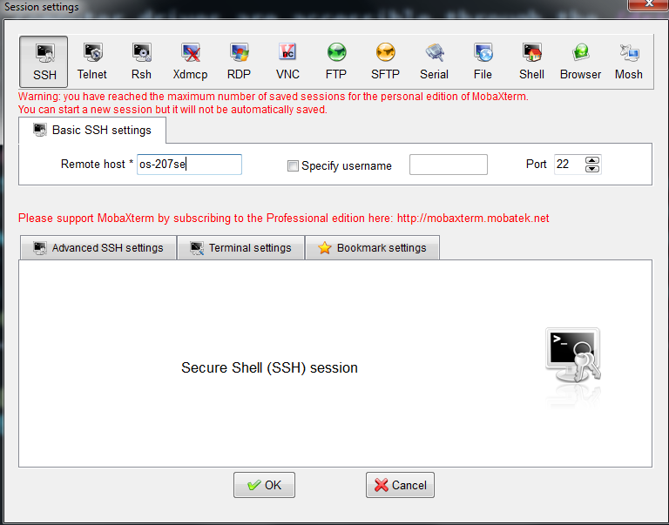
MobaXterm: Connecting to server

Slide 11
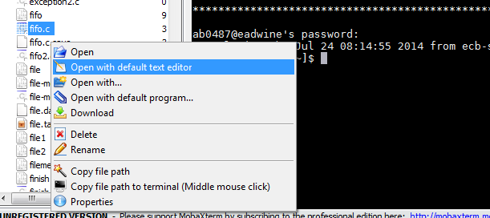
Editing files using MobaXterm

Slide 12
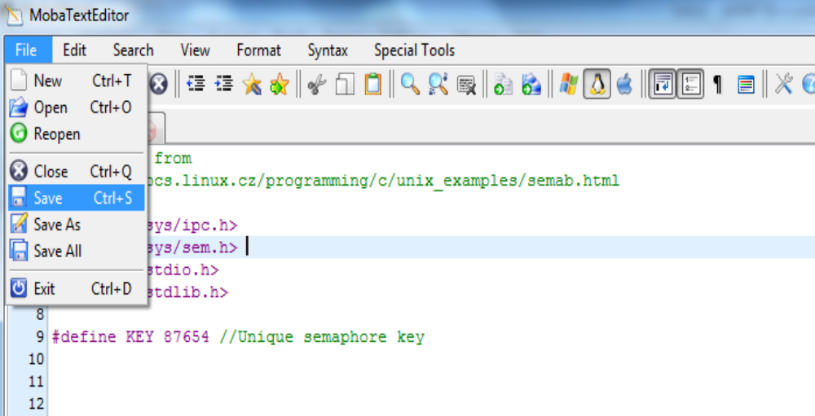
Editing files using MobaXterm

Slide 13
Other software tools
bochs
  An x86 emulator.
nasm
  The netwide assembler.
gcc
  The GNU compiler collection

