Slide 1
HandloomHub: A Digital Marketplace to Expand Market Reach and Empower Rural Handloom Artisans
PIP2001 Capstone Project
Review-3
Batch Number: CAI-G02
Roll Number | Student Name
20211CAI0044 | K. Midhun Kumar
20211CAI0053 | G. Sunil Kumar Reddy
20211CAI0110 | Akash S
20211CAI0127 | D. Narasimha Rao
20211CAI0160 | S. Siva Anjaneyulu
Under the Supervision of,
Dr. Zafar Ali Khan
Associate Professor
School of Computer Science and Engineering
Presidency University
Name of the Program: Computer science and Engineering (AI & ML)
Name of the HoD: Dr. Zafar Ali Khan N
Name of the Program Project Coordinator: Dr. Afroz Pasha
Name of the School Project Coordinators: Dr. Sampath A K / Dr. Abdul Khadar A / Mr. Md Ziaur Rahman
Notes:
HandloomHub is a specialized online platform designed to support rural handloom and textile artisans by offering them a marketplace to showcase and sell their products. The platform enables artisans to manage their inventory, track sales, and participate in community events, while also promoting their crafts to urban consumers. With a focus on transparency, recognition, and economic growth, HandloomHub connects traditional artisans with a wider audience, helping them thrive in the digital economy

Slide 2
Contents
Introduction
Github Link
Literature Review
->Existing Methods and Drawbacks
Proposed Method
Objective
Methodology and Modules
Architecture
Software/Hardware Components
Expected Outcomes
Outcomes
Conclusion
References
SGD Goals

Slide 3
Github Link
The Github link provided should have public access permission.
Github Link
https://github.com/Venky280201/website_for_artisan

Slide 4
Introduction
We aim to empower rural artisans by providing them with an online platform to showcase and sell their handicraft products. The website allows artisans to register, upload their products,such as looms and textile products and access valuable sales statistics. It promotes community engagement through event creation and participation, with transparent communication among artisans. The platform ensures authenticity by initially restricting payments to Cash on Delivery (COD) for new users. Additionally, artisans can gain recognition through features like "Artisan of the Month" and access information on government events and exhibitions to boost their business. The ultimate goal is to bring rural craftsmanship to a urban audience and provide artisans with opportunities to thrive in the digital marketplace.

Slide 5
Literature Review
The concept of empowering artisans through digital platforms is not new, and various projects have been undertaken to support this initiative. However, most previous efforts have been limited in scope, focusing either on basic e-commerce functionalities or lacking features such as community engagement and event management, which are vital for the holistic development of rural artisans. Below is a review of some relevant projects and studies:

Slide 6
Existing methods
ONLINE HANDICRAFTS STORE:
This project was done by CSE batch 2020 Students, Thakur College of Engineering and Technology, Mumbai, India.This is a detailed and Structured website which based on the all art works from various artisans which involves jewelry, many other art items.It has better user interface than many other pages
this page is not contain Event management system that our project involved.
HandCrafted: An Online Shopping Website of Handicrafts:
This project was done by Tannistha Pal CSE depp, NIT Agartala, Agartala, 799046, India in 2021. This is dynamic website which is online retail sales market on e commerce with customer satisfaction and user friendly and less investment website. This is proper website with each and every possible requirement to sellers.
There is no specific partition to the textile and handlooms from this website.
E-Commerce Website For Handloom :
This project was done by CSE batch 2022 students ACE Engineering College, Telangana, India. which involves in creating a website for artisans to exchange there products and get feedbacks from customers.This website also provides basic analysis on product sales.
There is no high user interactive and engaging elements in the website. This support only the exchange of the products.

Slide 7
Existing methods
E-Commerce Website for Artisans:
This project was done by CSE Batch 2023 Students, Jyothy Institute of Technology, Bengaluru, India.Which involves in same process as creating website for rural artisans and they have included AIML for demand and price forecasting, product recommendation, voice search and chat boards.
There is limited access to artisans who uses this website.
E-Commerce Web Application for Local Artisans:
This project was done by CSE Batch 2023 Students, Geetanjali Institute of Technical Studies, Udaipur, India. Which involves in same process as creating website for rural artisans and they have included Best user interface and product management system as wishlist, likes, search options.

Slide 8
Proposed Method
Requirement Analysis
Gather insights from rural artisans about their challenges and needs.
Identify functional (e.g., product uploads, event management) and non-functional (e.g., security, scalability) requirements.
Design
Develop user-friendly UI/UX for artisans and customers.
Create a modular system architecture using Django (backend) and React (frontend).
Design secure databases for artisan profiles, products, and events.
Development
Build core modules:
Artisan Management: Easy registration, product uploads, and dashboards.
Customer Features: Order tracking, wishlist, and personalized recommendations.
Event Management: Tools for artisans to manage workshops and exhibitions.
Integrate secure payment gateways with COD options.
Implement analytics for sales tracking and recommendations.
Testing
Conduct unit, integration, and user acceptance testing.
Ensure security and performance standards.

Slide 9
Objectives
Develop an online platform connecting rural artisans with urban consumers to showcase and sell handicrafts, fostering economic growth and community engagement.
Key Features & Impact:
Simplified Registration & Product Upload: Easy-to-use tools for artisans to upload products with descriptions, images, and fair pricing, enabling independent business management.
Sales Tracking Dashboard: Real-time analytics for sales, inventory, and customer feedback to optimize operations and boost profitability.
Community Building: Forums and event tools for collaboration, skill-building, and group projects, fostering collective growth.
Enhanced Visibility: Artisan stories, featured collections, and urban partnerships to increase recognition and sales.
Sustainability: Secure payments, access to resources, and integration of government schemes to ensure long-term impact and cultural preservation.

Slide 10
Methodology/Modules
The methodology for our project on building a digital platform for rural artisans to sell their handloom and textile products can be divided into several stages, each involving a specific set of tasks and processes.
Individual Accounts:
Users can register as an artisan or customer.
Artisans:
Manage sales, events, and orders through personalized dashboards.
Customers:
Browse and purchase products, follow events, and track orders
User Dashboard:
Artisan Dashboard:
Upload/display products with images and descriptions.
View feedback from buyers.
Create and track events.
Manage orders.
Access sales insights and statistics.
Customer Dashboard:
Explore products listed for sale.
View upcoming events.
Track placed orders.

Slide 11
Methodology/Modules
Sales Board:
Shared marketplace displaying all artisans' products.
Products sorted by:
Location.
Product category.
Popularity.
Customers can explore and buy products.
Artisans can showcase their work to a larger audience.
Event Organization:
Artisans can create and join events.
Events promote:
Skill display.
Friendly competitions.
Creativity and networking.
Leaderboard tracks participants' achievements.
Encourages artisans to improve their craft

Slide 12
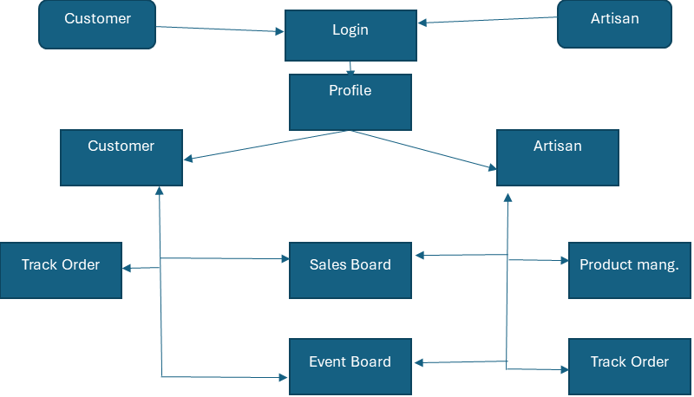
Architecture

Slide 13
Software Components
Frontend Development:
React.js is a popular JavaScript library used for building user interfaces, particularly single-page applications (SPAs).
React utilizes a virtual DOM for better performance and provides features like state management, hooks, and context for building interactive and modern web applications.
Backend Development:
Express.js
It simplifies server-side development by providing robust tools for routing, middleware integration, and handling HTTP requests and responses.
Database:
MongoDB is a NoSQL database, not relational as mentioned in the slide. It stores data in JSON-like documents, making it highly flexible and scalable..

Slide 14
Software components
Version Control and Collaboration:
Git and GitHub – Free tools for source code management and collaboration.
Authentication:
Firebase Authentication – Free tier available for small projects to manage user login and registration.
Payment Gateway:
Razorpay or Stripe – Free to integrate; they charge only transaction fees
Cloud Hosting (for Deployment):
Heroku (Free Tier) – Supports Node.js, Django, and other platforms with free deployment options.
AWS Free Tier – Budget-friendly cloud services for hosting databases or full web apps with minimal costs.

Slide 15
Hardware components
Development Machines:
Budget Laptops or Desktops (₹30,000 - ₹50,000):
Processor: Intel i3/i5
RAM: 8GB (minimum), 16GB
Storage: SSD (256GB or higher)
These laptops are sufficient for web development tasks, running local servers, and testing the platform.
Server for Deployment:
VPS (Virtual Private Server) on platform AWS Lightsail (₹400 - ₹1,000 per month).
Basic configurations with 1GB RAM, 1 vCPU, and 25GB SSD storage would suffice initially for low-traffic environments.
Heroku (Free Tier) or similar free cloud services can also be used in the early stages to save costs.
Testing Devices:
Budget Smartphones (₹10,000 - ₹15,000) – For testing the responsiveness and performance of the website on mobile devices

Slide 16
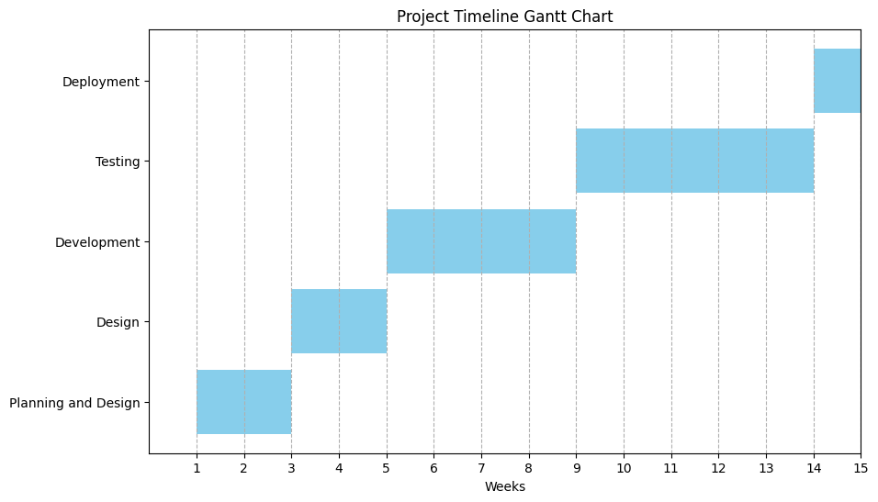
Timeline of Project

Slide 17
Expected Outcomes
1. Increased Visibility for Artisans on wide range customers.
2. Enhanced Sales Opportunities
3. Empowerment and Economic Growth
4. Community Building and Engagement
5. Recognition of artisan over community
6. Data-Driven Insights
7. Increase Participation within artisans through Events

Slide 18
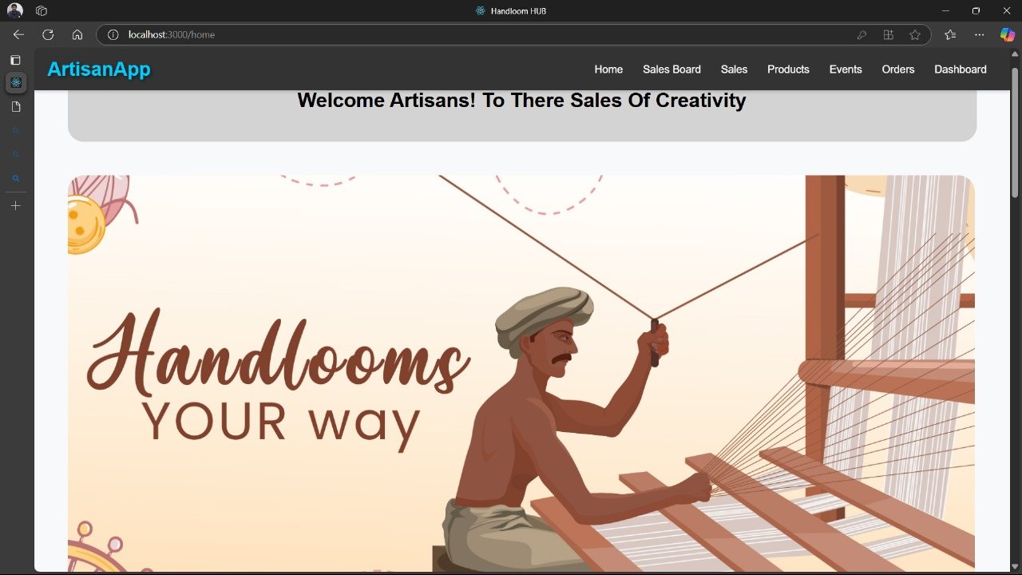
Outcomes
homepage

Slide 19
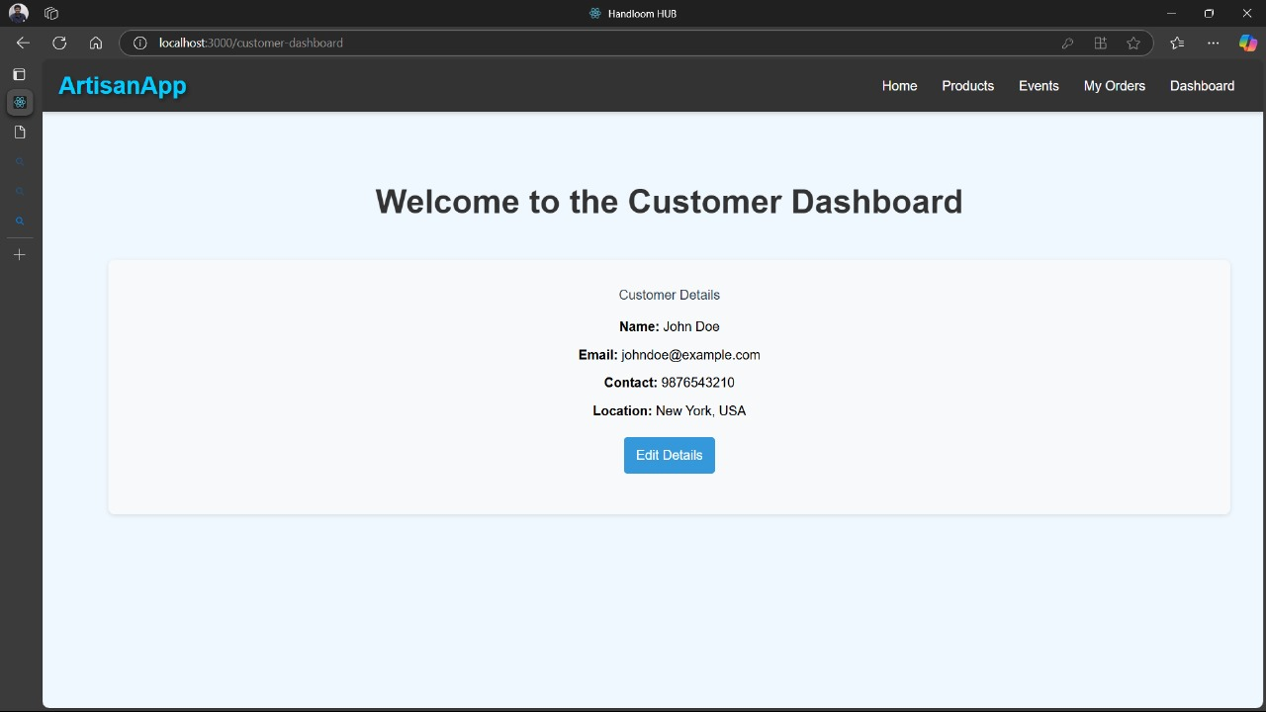
Outcomes
Profilepage

Slide 20
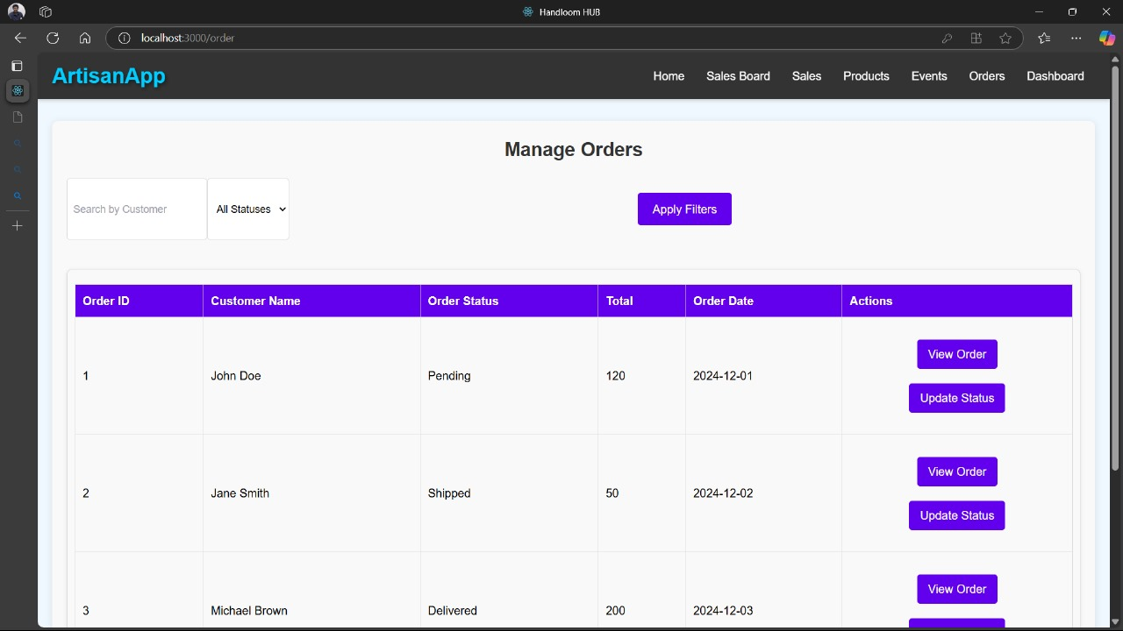
Outcomes
Order page

Slide 21
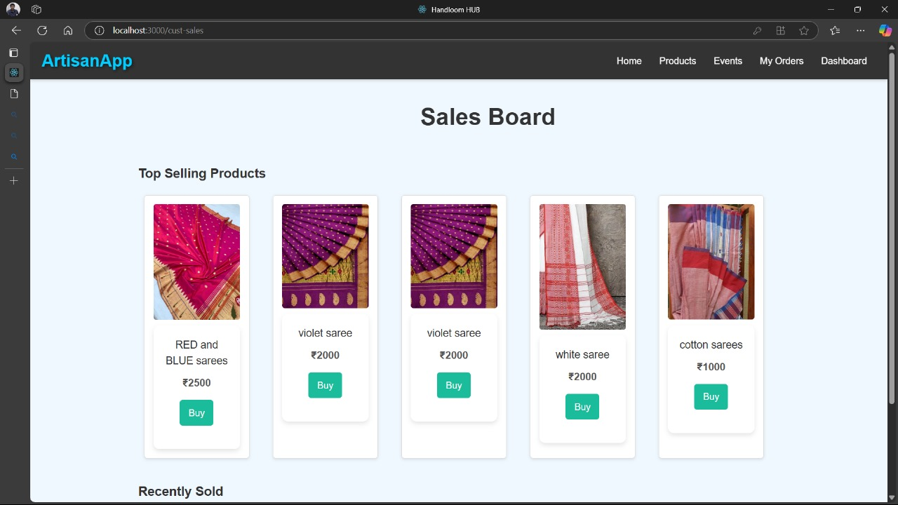
Outcomes
Salesboard

Slide 22
Conclusion
This project focuses on developing an intuitive and accessible digital platform to bridge the gap between rural artisans and a broader market, enabling them to showcase and sell their handloom and textile products. By integrating features like personalized dashboards, artisans can track their sales, earnings, and product performance, while streamlined product management tools allow them to easily upload and categorize their offerings. The platform also fosters community engagement by facilitating event participation and collaboration among artisans, creating opportunities for networking and growth. Secure order tracking and payment systems ensure a seamless customer experience, making it easier for buyers to access unique, handcrafted items while supporting traditional craftsmanship. Ultimately, the project aims to preserve cultural heritage, empower artisans economically, and provide them with the recognition and opportunities needed to thrive in a competitive market.

Slide 23
References
Aabha Patil, Ritu Shailendra Jha, Ritu Raju Jha, Nandini Vijay Gurav, “EPICRAFT – WEBSITE FOR ARTISANS”,IJSRCSEIT November 2022
Amisha Shah, Rajev Patel, “E-COMMERCE AND RURAL HANDICRAFT ARTISANS”, Voice of Research 5(3) December 2016 24-29
.Raghavendra P, Sahana H S, Prasad M D, Srinidhi Kulkarni, G V Bhavana-Commerce Website for Artisans, International Journal of Research Publication and Reviews, Vol 4, no 5, pp 4152-4156 May 2023
Tannistha Pal, HandCrafted: An Online Shopping Website of Handicratfs, February 2021 Journal of Physics Conference Series 1804(1):012079
Nidhi Mantri, Sheetal Sharma, Nitesh Kumawat, Hasnain Abbas Tinwala, KartikeyBharti, Charu Kavadia, E-Commerce Web Application for Local Artisans, International Advanced Research Journal in Science, Engineering and Technology 10(2), May 2023

Slide 24
References
6. Pranav Kumar, Sneha Reddy, Kavya Menon, “Unspoken Craft: E-commerce Site for Handlooms and Handicrafts,” International Journal of Innovative Technology and Exploring Engineering (IJITEE), Vol. 9, Issue 11, March 2024.
Avinash Rao, Meera Shukla, “CraftKart – Promoting Handmade Products through E-Commerce,” Journal of Advanced Research in Computer Science and Applications (JARCSA), Vol. 7, Issue 4, July 2023, pp. 53-60.
Kavita Sharma, Rohit Kumar, “Artisan Connect: A Digital Platform for Artisans,” International Journal of Artificial Intelligence and Applications (IJAIA), Vol. 11, No. 2, April 2024.
Divya Narayanan, Arjun K, “Local Looms: A Platform for Regional Handlooms,” Journal of Textile Engineering and Fashion Technology (JTEFT), Vol. 5, Issue 3, October 2023.
10. Aishwarya Gupta, Sanjay Kumar, “Artify: Empowering Artisans through Digital Platforms,” International Journal of Computer Applications (IJCA), Vol. 180, Issue 4, December 2022.

Slide 25
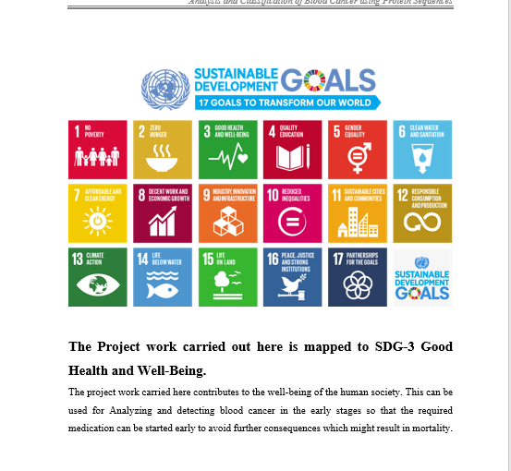
Project work mapping with SDG
SDG 8: Decent Work and Economic Growth
Contribution: The project promotes sustained economic growth by connecting artisans with broader markets, ensuring fair wages, and providing business management tools.
4. SDG 9: Industry, Innovation, and Infrastructure
Contribution: The platform leverages technology to improve access to markets, fostering innovation and supporting small-scale industries like handloom and handicrafts.
SDG 11: Sustainable Cities and Communities
Contribution: Encouraging urban consumers to purchase handmade, locally crafted goods helps preserve cultural heritage and promotes sustainable consumption.
.

Slide 26
Thank You

