Slide 1

BREAST CANCER DETECTION
(Course Name: Introduction to Python Programming Lab) (Course Code: 20CS3352)
A Python Project Report on Breast Cancer Detection
Submitted by
KUNCHAM MEGHANA (22501A0593)
MARIDU NAGA VEERA VENKATA
SAI BABU (22501A05A6)
JUPUDI KRISHNA PRASANTH (22501A0569)
MUTTHA VENKATESH (22501A05B8)
NALLEBOINA RAMYASRI (23505A0509)
II B. Tech I Sem
in
Computer Science and Engineering
Prasad V Potluri Siddhartha Institute of Technology
Accredited with A+ grade by NAAC, NBA Accredited, and Autonomous ISO 9001:2015 Certified Institute
Permanently Affiliated to JNTUK-Kakinada and approved by AICTE
Kanuru, Vijayawada-520 007

Slide 2
TABLE OF CONTENTS
INTRODUCTION
METHODOLOGY
PROJECT DESIGN
IMPLEMENTATION
RESULTS AND ANALYSIS
CONCLUSION

Slide 3

BACKGROUND
Breast cancer is a disease in which cells in the breast grow out of control. There are different kinds of breast cancer. The kind of breast cancer depends on which cells in the breast turn into cancer. Most breast cancers begin in the ducts or lobules.
Breast cancer is considered one of the most common cancers in women caused by various clinical, lifestyle, social, and economic factors. Machine learning has the potential to predict breast cancer based on features hidden in data.

Slide 4
MOTIVATION
Signs and symptoms of breast cancer may include: A breast lump or thickening that feels different from the surrounding tissue. Change in the size, shape or appearance of a breast. Changes to the skin over the breast, such as dimpling.
Early diagnosis of breast cancer increases the chance of recovery and life expectancy. Screening is the primary tool for early diagnosis and timely treatment of breast cancer in early stages.
For successful strategy to increase motivation for mass screening for detection of early breast cancer, three elements are needed:
1) women at risk must be taught the necessity of the examination
2) They must be made aware of the existence of the facility, which must be made easily accessible.

Slide 5
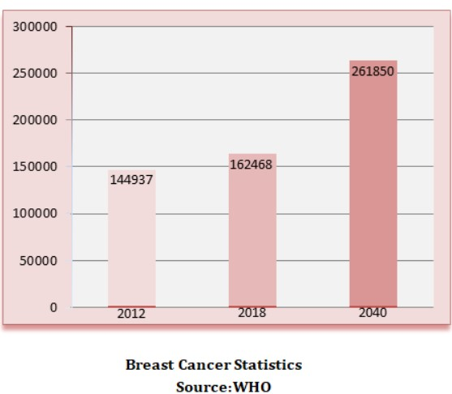

Slide 6
BREAST FUNCTIONALITY USING ML
Machine learning (ML) can be applied to various aspects of breast functionality for both diagnostic and predictive purposes. Here are some ways in which ML is being utilized in the field:
1 Breast Cancer Detection:
Analyzing mammograms for early cancer detection.
Image segmentation to identify and analyze tumor regions.
2 Risk Prediction and Prevention:
Predicting individual breast cancer risk based on factors like genetics and lifestyle.
Analyzing genomic data to understand genetic predispositions.
3 Treatment Planning:
Predicting treatment response and potential side effects.
Personalizing treatment plans based on ML insights.
4 Breast Health Monitoring:
Using wearable devices and electronic health records for continuous monitoring.
Pathology and Histology:
Assisting pathologists in analyzing histological images for tumor characterization.

Slide 7
STEPS IN DESIGNING A MODEL
Gathering Data
Data Processing and EDA
Train Model
Test Model

Slide 8
PROCESS OF DESIGNING A MODEL

Slide 9

GATHERING DATA
A Dataset is a set or collection of data.
Identify various data sources such as Kaggle and collect the required dataset.

Slide 10
DATA PREPROCESSING AND EDA
Checking for the Duplicate Values
Dropping Duplicate Values
Checking for Null Values
Data Visualization

Slide 11
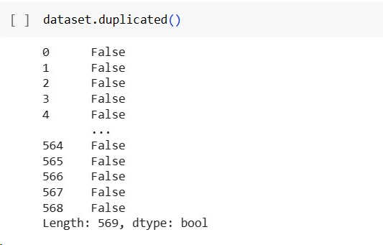
Checking for the Duplicate Values
Checking for duplicates is necessary as they decrease the accuracy.
This is the command to check for duplicates.
The output determines that they are duplicates.

Slide 12
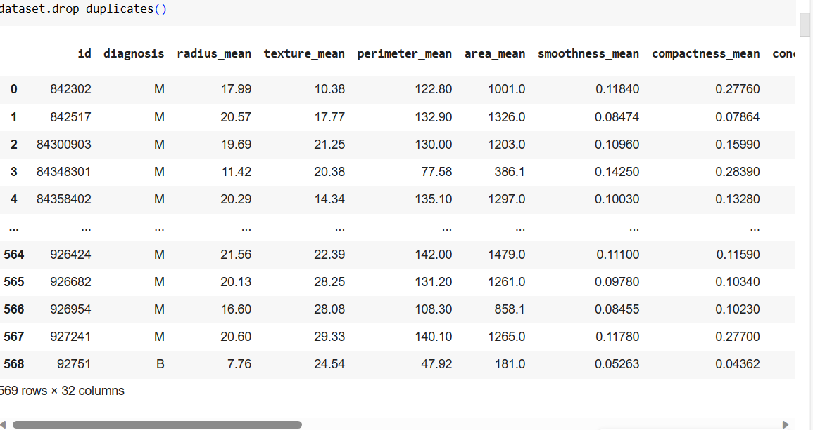
Dropping Duplicate Values
Dropping duplicates can increase the accuracy
The dotted lines in between indicates the dropping of duplicates
This affects the size of data set

Slide 13
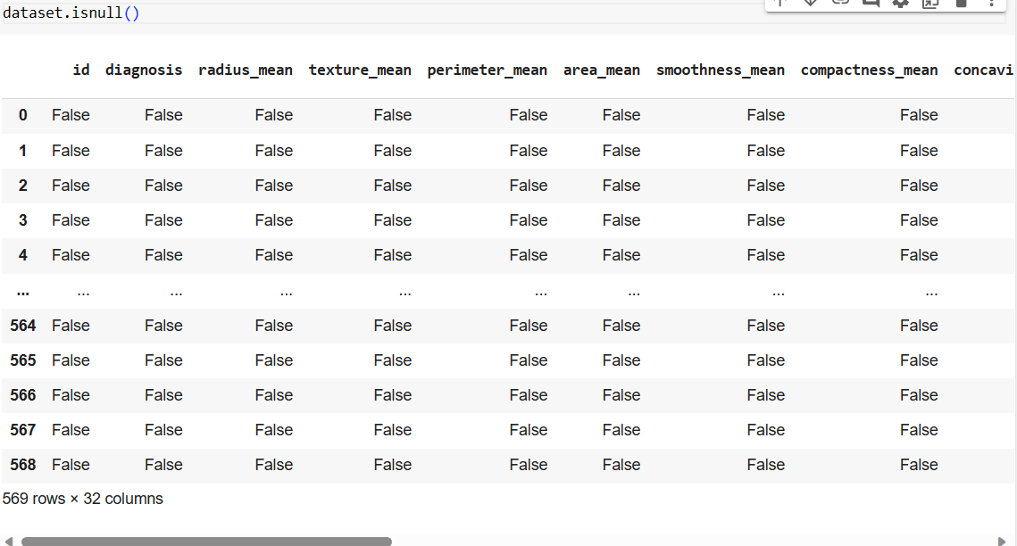
Checking for Null Values

Slide 14
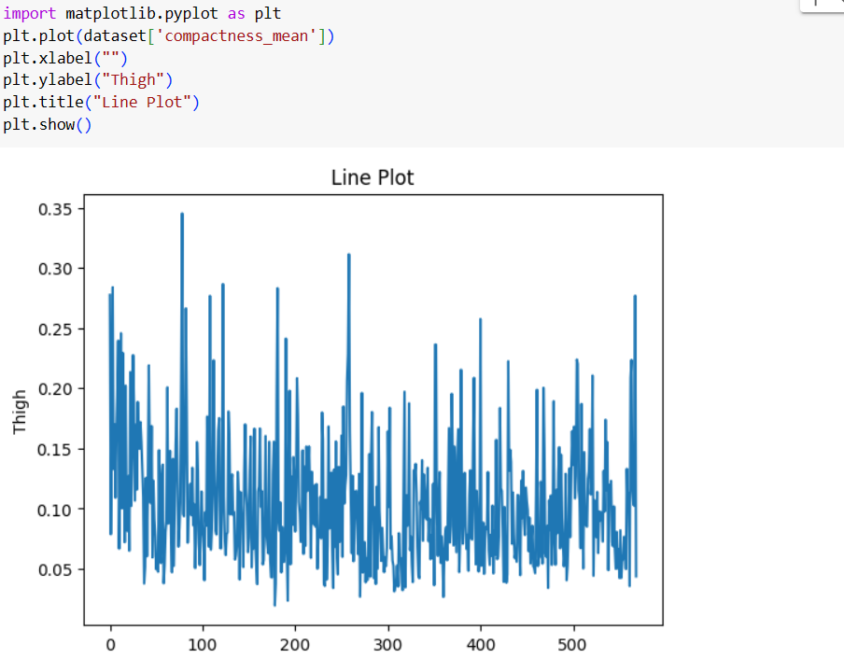
Data Visualization
Data visualization in Python is commonly done using libraries like Matplotlib and Seaborn.

Slide 15
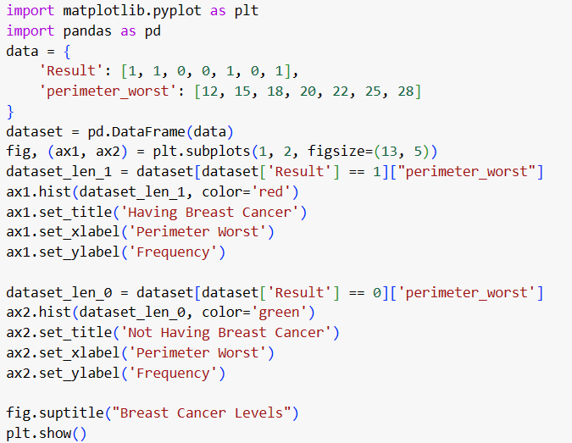
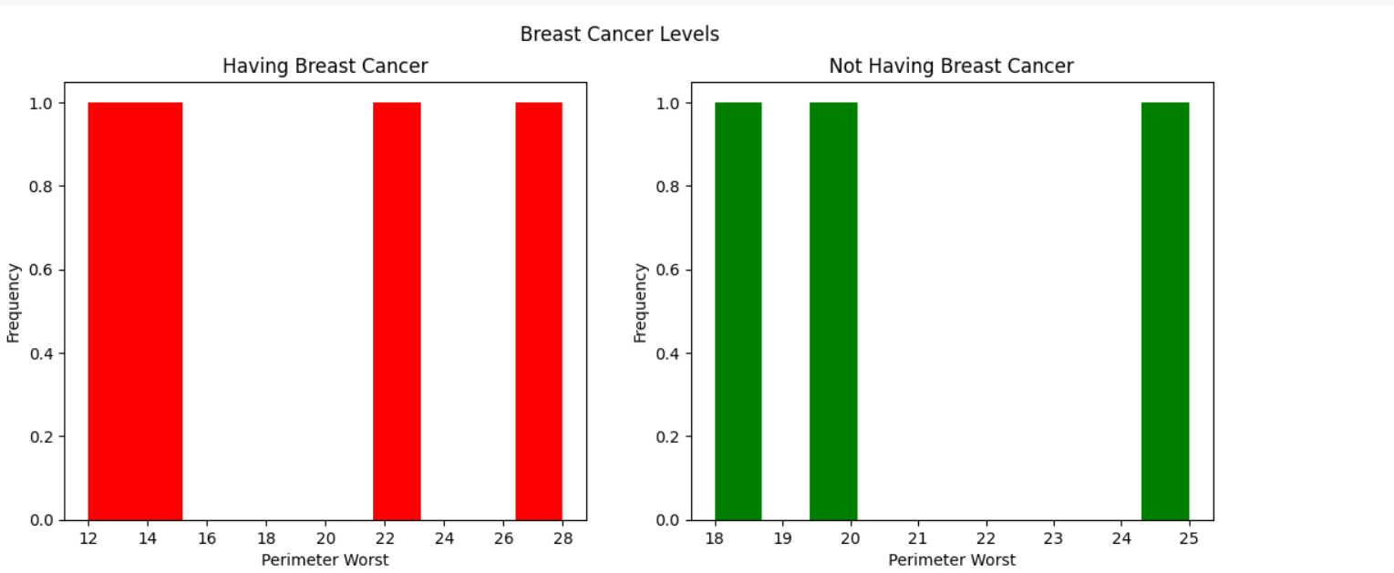
Histogram: A histogram is drawn for the attributes ‘perimeter_worst’ and ‘breast cancer levels’. For the stroke value 0, the histogram is given red colour and named as ‘Having breast cancer’. For the stroke value 1, the histogram is given green colour and named as ‘Not having breast cancer’.

Slide 16
Train Model
Choose a algorithm to fit a model.
Train model and fit the model.

Slide 17
Choosing an Algorithm
Naive Bayes classifier
Decision Trees
Logistic Regression
Linear Regression
Random forest classification

Slide 18
Logic Regression and linear regression
Logistic Regression: Logistic Regression is a statistical method used for binary classification problems, where the outcome variable is categorical and has two classes. Despite its name, logistic regression is a classification algorithm rather than a regression algorithm. It models the probability of an instance belonging to a particular category .
Linear Regression: Linear Regression is a fundamental statistical and machine learning technique used for predicting a continuous outcome variable (dependent variable) based on one or more predictor variables (independent variables). The relationship between the variables is assumed to be linear, following the equation of a straight line.

Slide 19
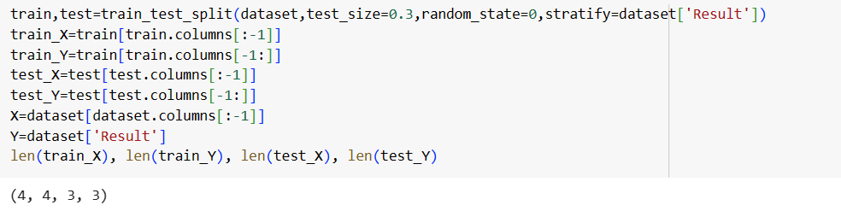
Splitting data for Train and Test

Slide 20
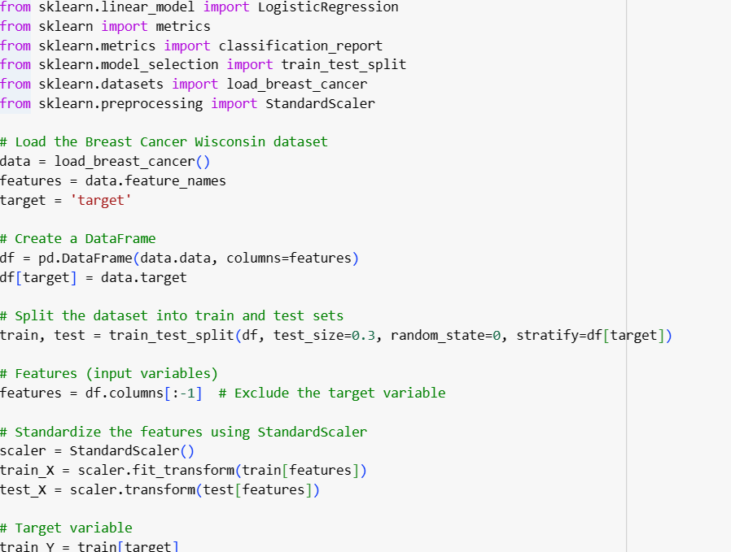
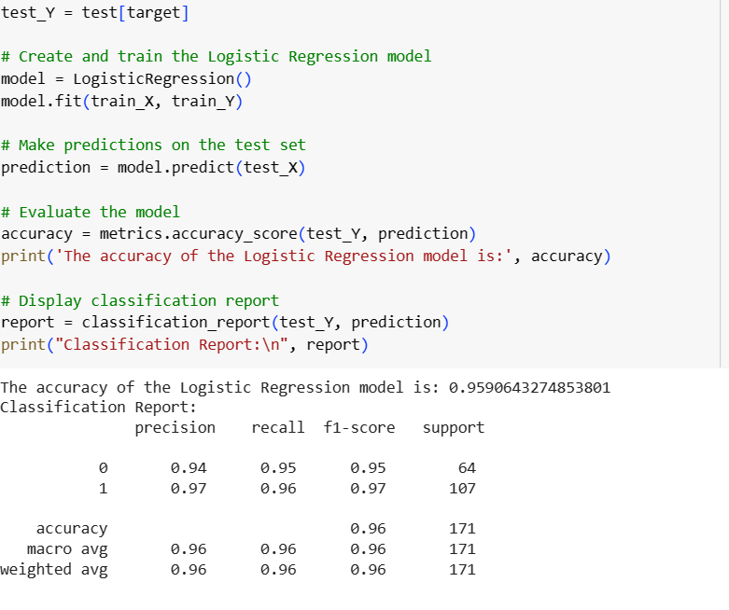
Logistic Regression

Slide 21
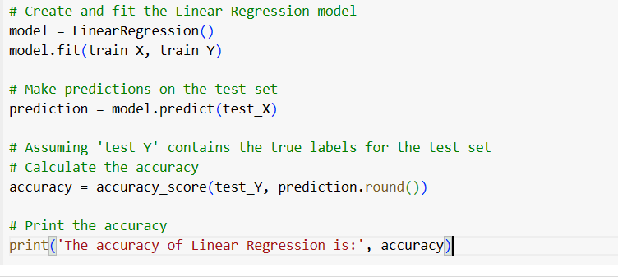
Linear Regression

Slide 22
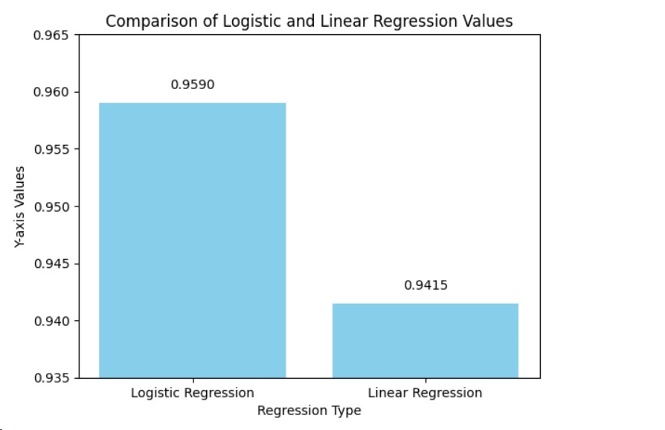
RESULTS
The accuracy of Logistic Regression is | 0.9590643274853801
The accuracy of Linear Regression is | 0.9415204678362573

Slide 23
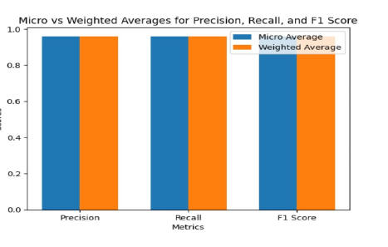
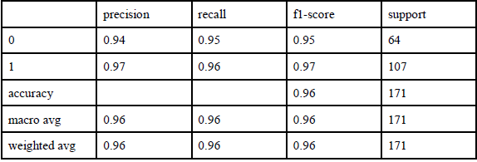
Table 2: Classification report for logistic regression

Slide 24
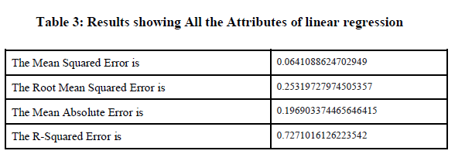
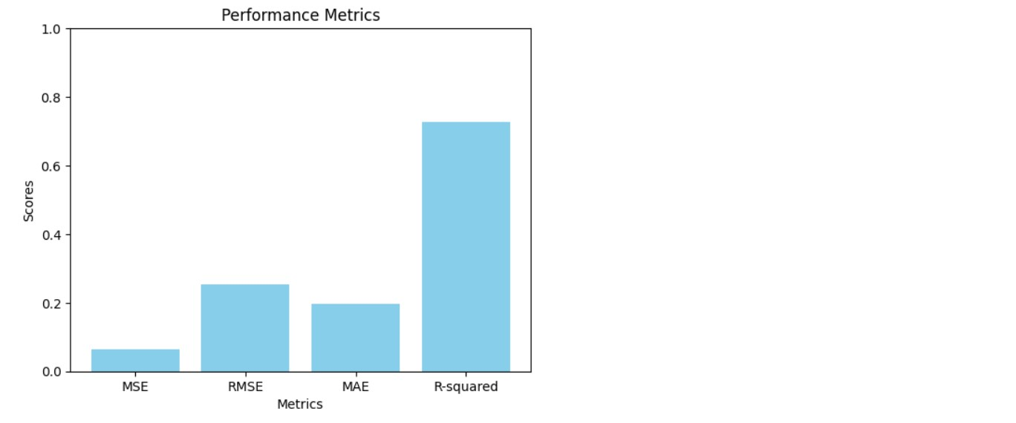

Slide 25
Conclusion
The outcomes of this project indicate that machine learning holds significant potential in developing accurate and sensitive methods for breast cancer detection. The application of machine learning models in this context could lead to earlier diagnosis and intervention, ultimately improving patient outcomes. The code provides a comprehensive data analysis, data processing, data visualization, model training, scaling, and evaluation.

Slide 26
THANK YOU

