Slide 1
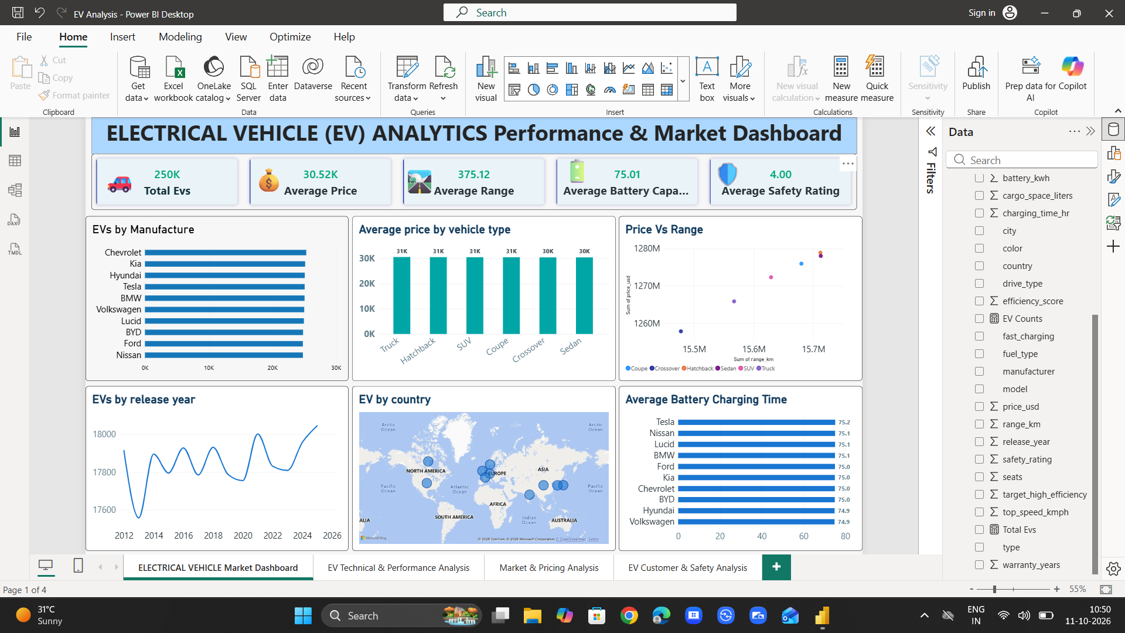
POWER BI • DATA ANALYTICS PROJECT
ELECTRIC VEHICLE
ANALYTICS
Market, technical performance, pricing,
customer and safety insights
Dashboard walkthrough and data-quality review
Built from the provided Power BI dashboard screenshots and EV_dataset.csv

Slide 2
Project overview
A four-page Power BI report for exploring EV market and vehicle characteristics
WHAT THE REPORT COVERS
HOW TO USE IT
Market overview: manufacturer coverage, vehicle types, release-year trend and country distribution.
Technical performance: speed, acceleration, efficiency, safety rating and driving range.
Market and pricing: price comparisons by vehicle type and relationships between price and range.
Customer and safety: seating, cargo space and safety metrics, with slicers for exploration.
Start with KPI cards for a quick summary.
Use charts to compare manufacturers and vehicle categories.
Apply country, manufacturer, type, drive type and release-year slicers.
Validate aggregation and units before drawing business conclusions.
DATASET ROWS
FIELDS / COLUMNS
NUMERIC FIELDS
REPORT PAGES
250,000
22
13
4
EV ANALYSIS • POWER BI PROJECT
02

Slide 3
Dataset and key measures
The provided CSV is the source for the Power BI report
EXAMPLE FIELD GROUPS
KPI INTERPRETATION
Count of EV records: use a distinct vehicle identifier if one exists; otherwise label as record count.
Average price and range: confirm the aggregation is Average, not Sum.
Average safety rating and efficiency: clarify the scale and direction of better performance.
Use consistent units and currency labels on every page.
VEHICLE IDENTITY
manufacturer, model, type, release_year
PERFORMANCE
top_speed_kmph, range_km, efficiency_score, battery_kwh, charging_time_hr
PRICING & OWNERSHIP
price_usd, warranty_years, cargo_space_liters, seats
CONTEXT & FEATURES
country, city, drive_type, fuel_type, fast_charging, safety_rating
Note: The KPI values shown in the screenshots are reproduced as dashboard context, not independently certified business facts.
EV ANALYSIS • POWER BI PROJECT
03

Slide 4
01 Market Dashboard
Portfolio-level view of manufacturers, vehicle types, geography and release-year patterns
EV ANALYSIS • POWER BI PROJECT
04

Slide 5
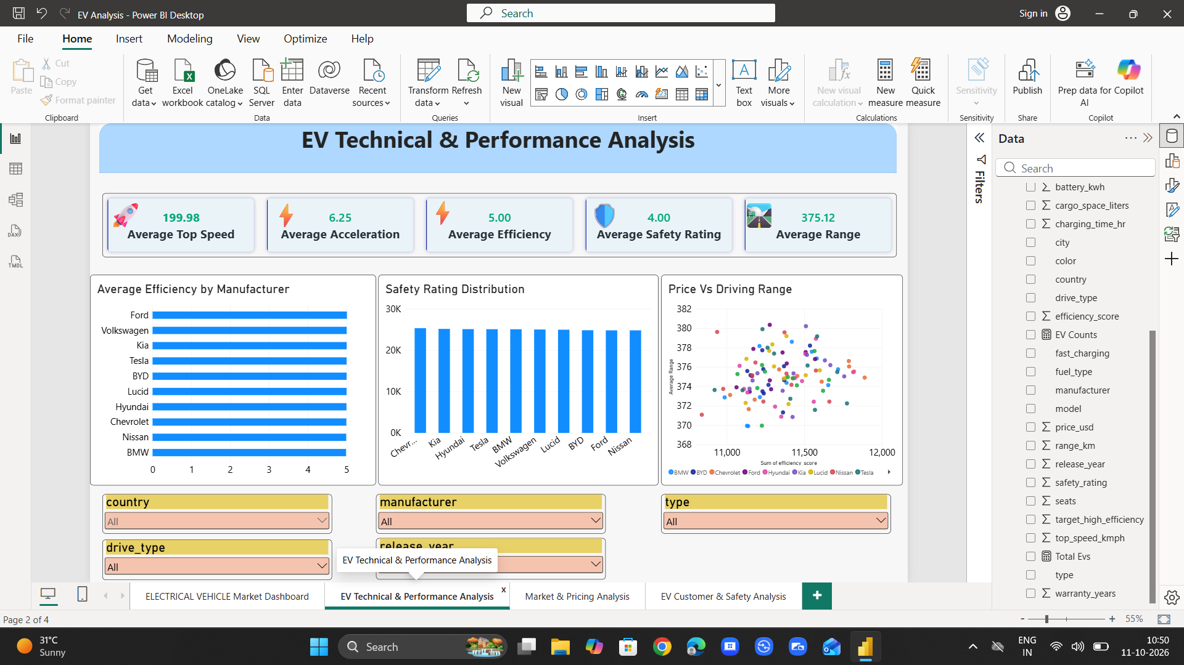
02 Technical & Performance Analysis
Performance KPIs and manufacturer/category comparisons, plus interactive filters
EV ANALYSIS • POWER BI PROJECT
05

Slide 6
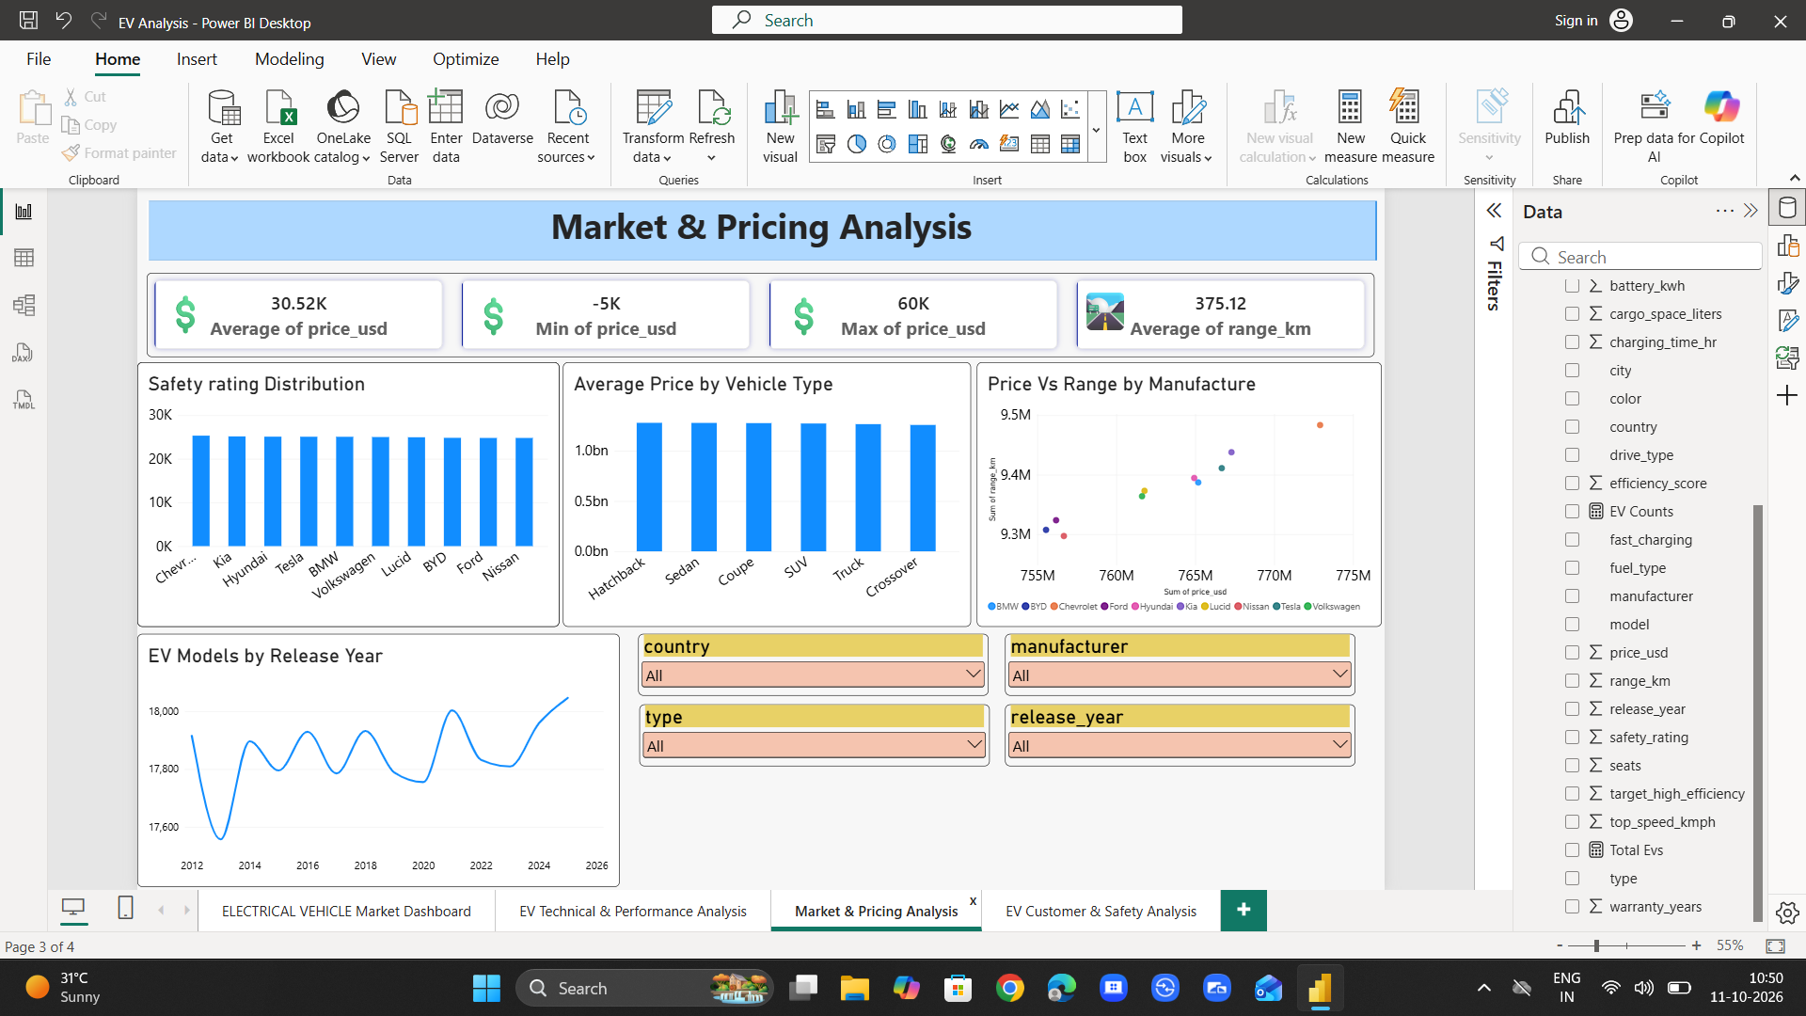
03 Market & Pricing Analysis
Price KPIs, vehicle-type comparisons, price-versus-range relationship and filters
EV ANALYSIS • POWER BI PROJECT
06

Slide 7
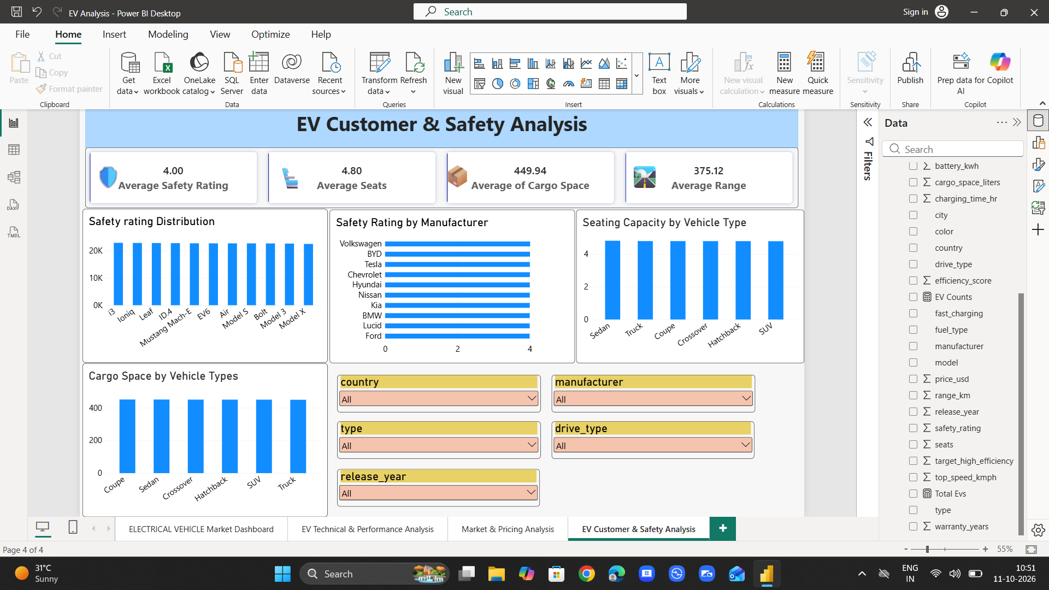
04 Customer & Safety Analysis
Safety, seating capacity and cargo-space comparisons with market filters
EV ANALYSIS • POWER BI PROJECT
07

Slide 8
What the dashboard helps investigate
Use these as analysis questions, not conclusions without validating the underlying measures
MARKET COVERAGE
PERFORMANCE
PRICING
Which makers and vehicle types are represented?
How do range and efficiency vary across makers?
Does price differ by vehicle type or range?
RECOMMENDED ANALYSIS
PRESENTATION IMPROVEMENTS
Compare averages and medians to reduce the effect of outliers.
Use manufacturer and vehicle-type filters to make like-for-like comparisons.
Check whether release-year values represent actual model counts or a different measure.
Use descriptive axis titles and units.
Avoid truncated chart titles and crowded legends.
Use consistent colors for the same metrics across all pages.
EV ANALYSIS • POWER BI PROJECT
08

Slide 9
Data-quality checks before presenting
A few displayed values and aggregations deserve validation
CHECK THESE ITEMS
VALIDATION CHECKLIST
Market & Pricing page shows a minimum price of −5K. Confirm whether negative prices are valid, a placeholder, or a data-quality issue.
Several charts show axes such as “Sum of price_usd” or “Sum of range_km”; sums may be misleading for vehicle-level comparisons.
Some KPI labels use abbreviated or truncated text. Expand titles and state units clearly.
Safety-rating and efficiency charts appear nearly uniform in the screenshots; verify the field placed in Values and the intended aggregation.
Inspect nulls, duplicates and invalid negative values in Power Query.
Confirm whether each row is a vehicle model, trim, or market observation.
Create explicit measures for record count, average price, average range and other KPIs.
Add currency/unit formatting and useful tooltips.
EV ANALYSIS • POWER BI PROJECT
09

Slide 10
CONCLUSION & NEXT STEPS
A strong multi-page foundation for EV market exploration.
Validate data quality and measure definitions before interpreting KPIs.
Replace misleading sums with averages, medians or counts appropriate to each question.
Improve readability with consistent formatting, labels, units and color semantics.
Use slicers to compare comparable segments and document the key findings from each view.
Thank you
10

