Slide 1
Infobasic
Praveen Felix S

Slide 2
Objective
At the end of this session, participants will
Know programming features of Infobasic
Know the various array types
Know how to program using various control structures
Know about file operation in T24 routines
Know about sequential file access in T24 routines
Know build in functions in programming

Slide 3
Why Infobasic?
Programming language used in T24
Has simple English like statement

Slide 4
Understanding Variables
How do we declare variables generally?
int score
Example : 45
Char name
Example : A
boolean result
TRUE or FALSE

Slide 5
Understanding Arrays
How do we store more than 1 character or a number in one variable?
Use arrays
How do we tell the array how many characters or numbers it should store
Char Name[10]
Array ‘name’ can store up to a maximum of 10 characters
Example : Temenos
T E M E N O S
0 1 2 3 4 5 6
Name[0] = T
Name[1] = E
Name[2] = M
Name[3] = E
Name[4] = N
Name[5] = O
Name[6] = S

Slide 6
Understanding Arrays
You don’t want your array to have a fixed length
You don’t want your array to be bound to a data type
Welcome to Dynamic Arrays In jBC

Slide 7
Understanding Arrays
You wish to store the string Temenos in a variable called ARR1
ARR1 = “Temenos”
You wish to store today’s date in a variable called ARR1
ARR1 = “160108”
You wish to store the number 134.67 in a variable called ARR1
ARR1 = 134.67
Can the variable ARR1 store all types of data and data of any length?

Slide 8
Initializing and Declaration – is there Difference
Generally, a variable is declared, initialized and then used
int score → Declaration
score = 0 → Initialization
if score > 100 then …… → Usage of the variable
In jBASE
Variables don’t have to be declared
It is a good practice to initialize the variable before using it
score = 0 →Initialization
If score > 100 then ……. → Usage of the variable

Slide 9
Dynamic Array in T24
How are we able to have variable length records?
Using dynamic arrays
How do we store values of multiple fields in one dynamic array
Using delimiters such as FM, VM and SM
ASCII Decimal Description
254 Field Marker
253 Value Marker
252 Sub-Value Marker
Field1FMField2FM Value1VMValue2VMValue3VMValue4FMField4FMSubValue1SMSubValue2FMField5

Slide 10
Understanding FM,VM and SM
1 Name | Accenture Trg
2.1 Address | India
2.2 Address | UK
2.3 Address | Geneva
3.1 Course Category | Technical
4.1.1 Course Name | jBASE
4.1.2 Course Name | T24
3.2 Course Category | Functional
4.2.1 Course Name | Lending
4.2.2 Course Name | Financials
5 Free Text
6 Inputter | TRAINER.1
Single value field
Multi value field
Sub value field

Slide 11
Dynamic Array – Data Storage
Accenture TrgFMIndiaVMUKVMGenevaFMTechnicalVMFunctionalFM
jBASESMT24VMLendingSMFinancialsFMFMTrainer.1
When a field does not contain any value, there will still be a FM to delimit and say that there is field that does not contain a value now.

Slide 12
Appending Value to an Array
Appending Values using FM
ArrayVar<-1> - Used to append values in an array using FM as delimiter
Example: Y.INFO<-1>=“Test Info”
Appending Values using VM
ArrayVar<FMPos,-1> - Used to append values to a position (Field) in an array using VM as delimiter
Example : R.CUS<EB.CUS.TEXT,-1>="THIS IS FROM TRAINIING“
Appending Values using SM
ArrayVar<FMPos,VMPos,-1> - Used to append values to a certain multi value position (VMPos) of a field in an array using SM as delimiter
Note: FMPos should always contain a valid field number/position.
Example : R.CUS<6,2,-1>=“No 50 Lake View Road, New York“

Slide 13
Dimensional Arrays
A dimensioned array is a group of dynamic arrays
How many dynamic arrays form a dimensioned array?
You can configure that
DIM ARR(5)
Dynamic Array 1
Dynamic Array 2
Dynamic Array 3
Dynamic Array 4
Dynamic Array 5

Slide 14
OPERANDS
EQ- EQUAL
NE- NOT EQUAL
GT- GREATER THAN
GE- GREATER THAN EQUAL
LT- LESSER THAN
LE- LESSER THAN EQUAL
RG- RANGE
NR- NOT IN RANGE
CT- CONTAIN
NC- NOT CONTAIN
BW- BEGINS WITH
EW- ENDS WITH
LK- LIKE
DNBW- DO NOT BEGINS WITH
DNEW- DO NOT ENDS WITH

Slide 15
Control structures
IF..THEN
IF..END ELSE..END
BEGIN CASE
LOOP WHILE

Slide 16
IF..ELSE Structure
IF <condition> THEN
<statements>
END ELSE
<statements>
END

Slide 17
Illustrate
Write a program to print “No. is greater than 7” else to print “No. is smaller than 7

Slide 18
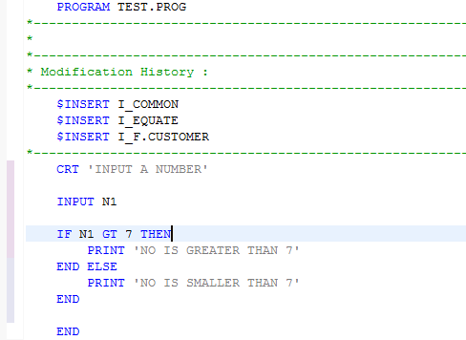
Solution

Slide 19
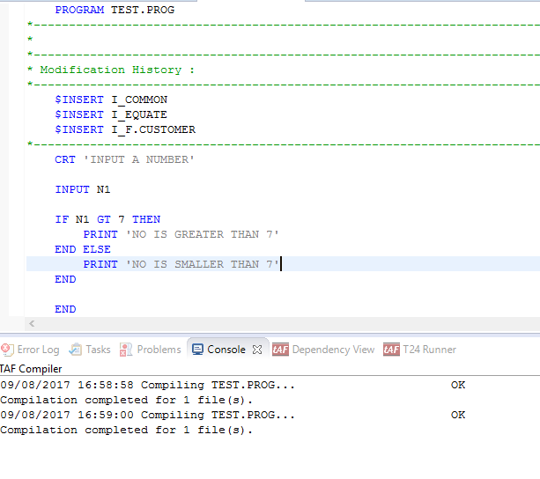
Compilation
Compiling program using CTRL+S

Slide 20
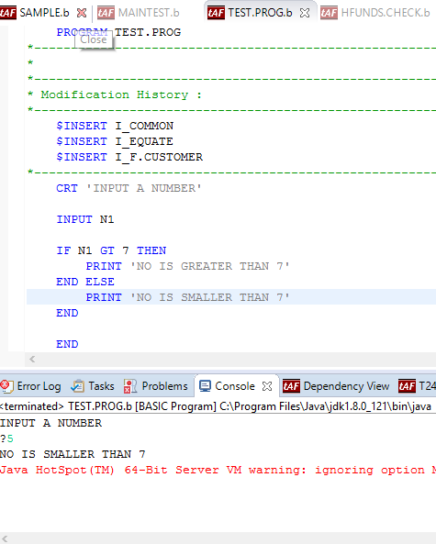
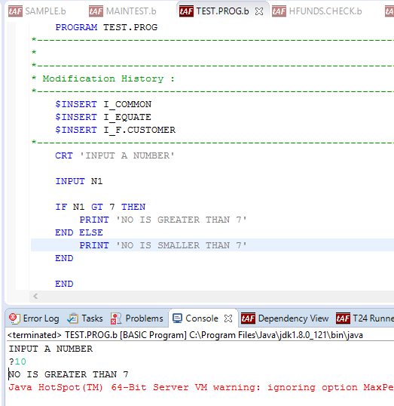
Output

Slide 21
Nested IF Structure
IF expression THEN
statements
END ELSE
IF expression THEN
statements
END ELSE
statements
END
END

Slide 22
Illustrate
Write a program to display
“No. GT 100” – when input number is greater than 100
“No. GT 50 and LT 100” - when input number is greater than 50 and less than 100
“No. LT 50” – when input number is less than 50

Slide 23
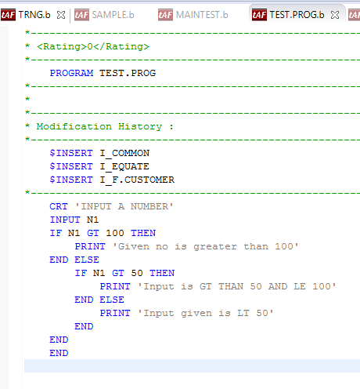
Solution

Slide 24
Compilation
Compilation is same for all programs

Slide 25
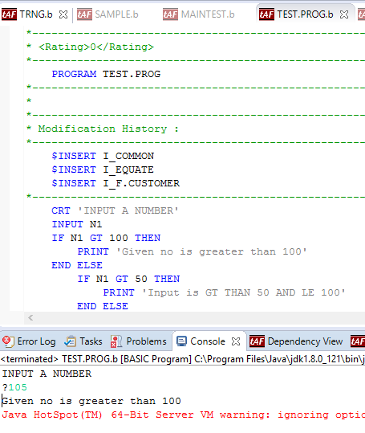
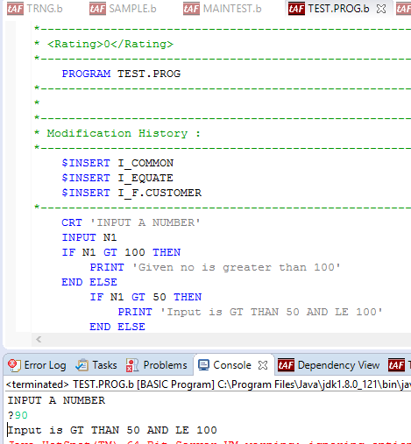
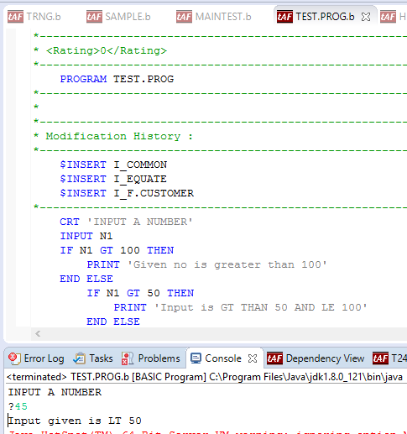
Output

Slide 26
CASE Structure
BEGIN CASE
CASE <variable> = <value>
<statements>
CASE <variable> = <value>
<statements>
CASE <variable> = <value>
<statements>
CASE 1
<statements>
END CASE

Slide 27
Control Flow
Expressions/statements evaluated in sequential order
When a true expression is encountered,
Corresponding statements are executed and control exits from the CASE structure
When no true expression is encountered,
Statements under CASE 1 are executed and control exits from the CASE structure
In the absence of CASE 1 expression, then no statements are executed and control exits from the CASE structure

Slide 28
Illustrate
Write a program to print the name, if the given choice is equal to (or matches) the first two characters of the given name, else print the message “No match”

Slide 29
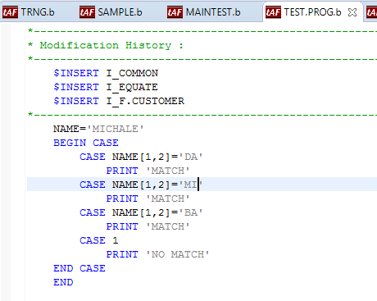
Solution

Slide 30
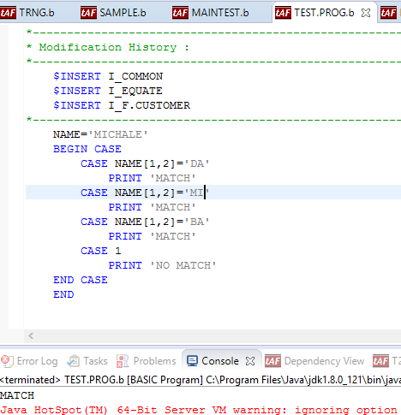
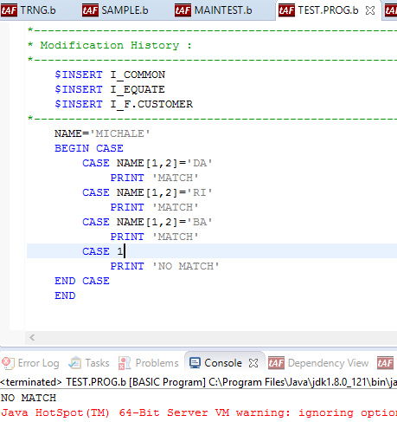
Output
After compiling program is executed and output as below

Slide 31
LOOP-WHILE structure
LOOP <statements>
WHILE/UNTIL <expression>
<statement>
REPEAT

Slide 32
Illustrate
Write a program to print incremental of numbers, using while condition

Slide 33
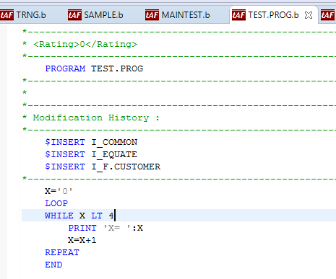
Solution

Slide 34
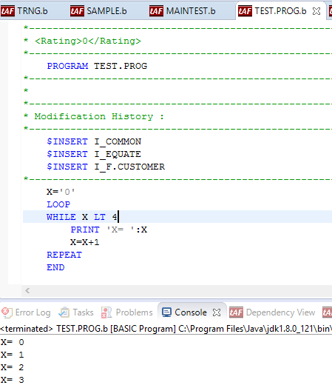
Output
After compiling program is executed and output as below

Slide 35
Programming Execution
Infobasic Programming
Program
Subroutine

Slide 36
Structure of Program
*Comments
PROGRAM <Program name>
Statement 1
Statement 2
Statement 3
END

Slide 37
Structure of Subroutine
*Comments
SUBROUTINE <Subroutine name>
Statement 1
Statement 2
Statement 3
RETURN
END

Slide 38
Sample Program
* <Rating>0</Rating>
*-----------------------------------------------------------------------------
PROGRAM MAINTEST
*-----------------------------------------------------------------------------
*
*-----------------------------------------------------------------------------
* Modification History :
*-----------------------------------------------------------------------------
$INSERT I_COMMON
$INSERT I_EQUATE
*-----------------------------------------------------------------------------
VAR1='10'
VAR2='11‘
IF VAR1 EQ VAR2 THEN
Y.TEMP='FINE'
END ELSE
Y.TEMP='NOT FINE'
END
END

Slide 39
Sample Subroutine
* <Rating>0</Rating>
*-----------------------------------------------------------------------------
SUBROUTINE MAINTEST
*-----------------------------------------------------------------------------
*
*-----------------------------------------------------------------------------
* Modification History :
*-----------------------------------------------------------------------------
$INSERT I_COMMON
$INSERT I_EQUATE
*-----------------------------------------------------------------------------
VAR1='10'
VAR2='11‘
IF VAR1 EQ VAR2 THEN
Y.TEMP='FINE'
END ELSE
Y.TEMP='NOT FINE'
END
RETURN
END

Slide 40
Program Compilation
Compilation of Subroutine are done in Design studio.
After compilation, class file will be generated (Path for class file is already pre-configured in properties file).

Slide 41
Executing Programs
Design Studio
Run as basic program
Out put will shown in console tab

Slide 42
Executing Routines
Design Studio
Make an entry in the PGM.FILE in T24 Runner
Run the routine in debug mode
Out put will shown in T24 Runner

Slide 43
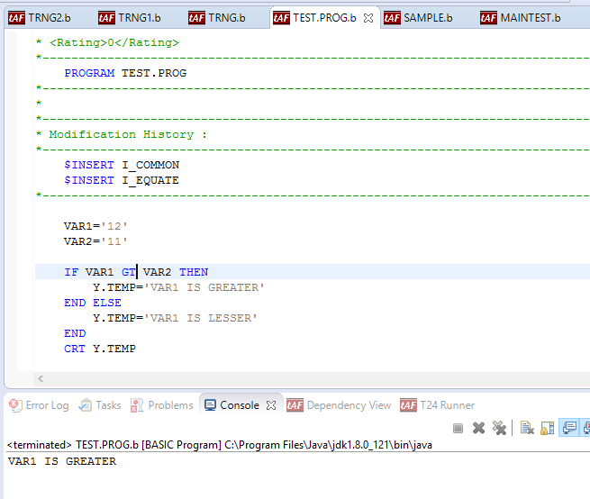
Sample Program

Slide 44
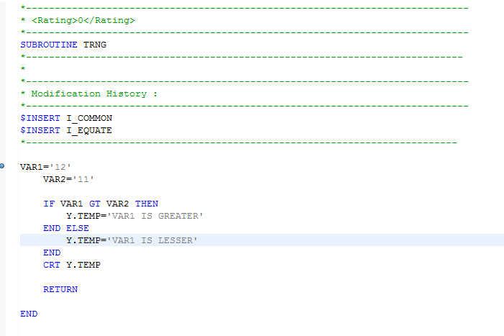
Sample Routine

Slide 45
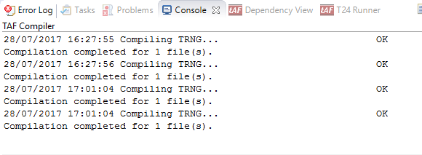
Compilation
Compile the program, using CTRL+ S

Slide 46
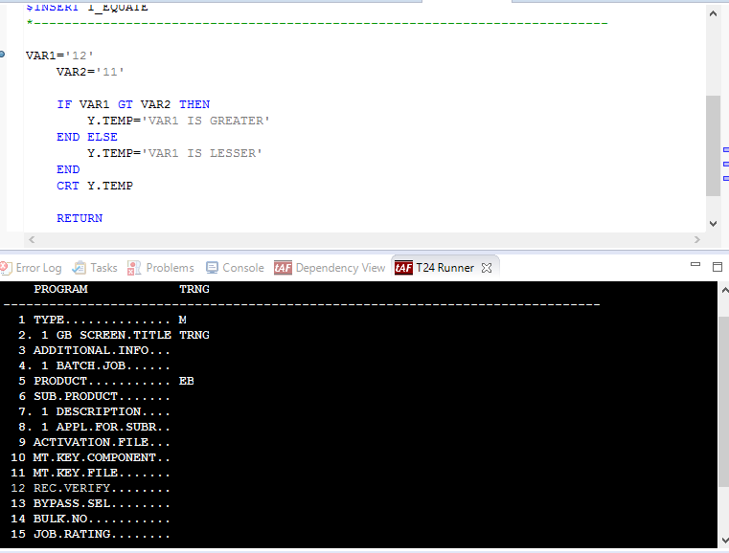
PGM.FILE
Create PGM.FILE for subroutine only(not for program) before execution.
Purpose of PGM.FILE creation is to mention the type of routine M(mainline),S(Subroutine) or B(Batch)

Slide 47
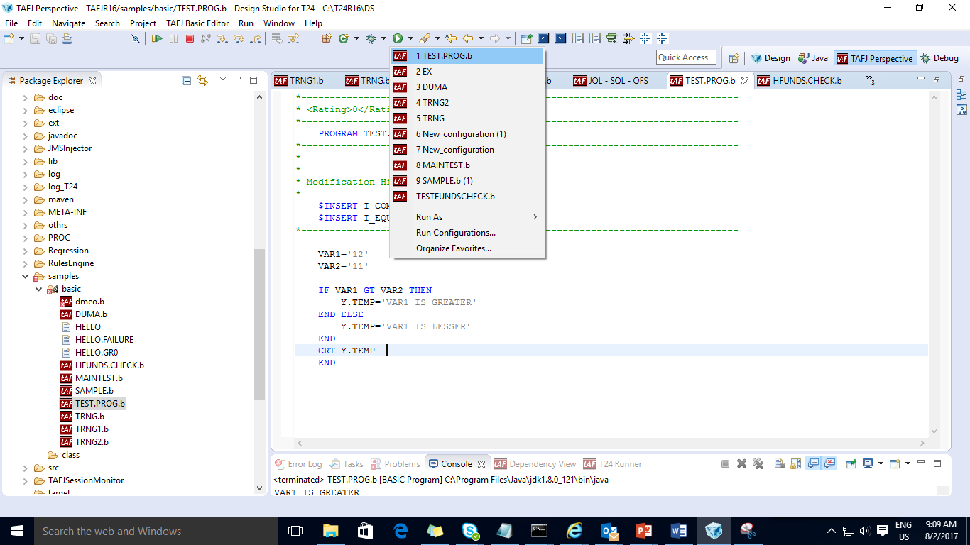
Execution

Slide 48
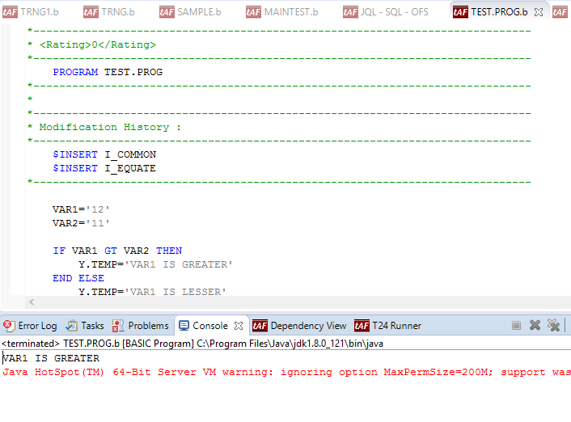
Output

Slide 49
Work Shop
Write a program to print “No. is greater than ‘10” else to print “No. is smaller than 10

Slide 50
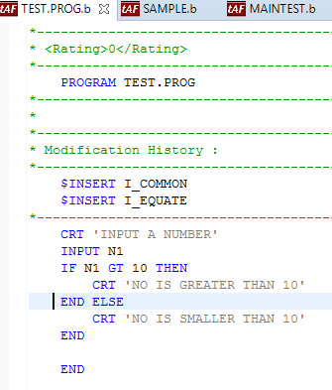
Solution

Slide 51
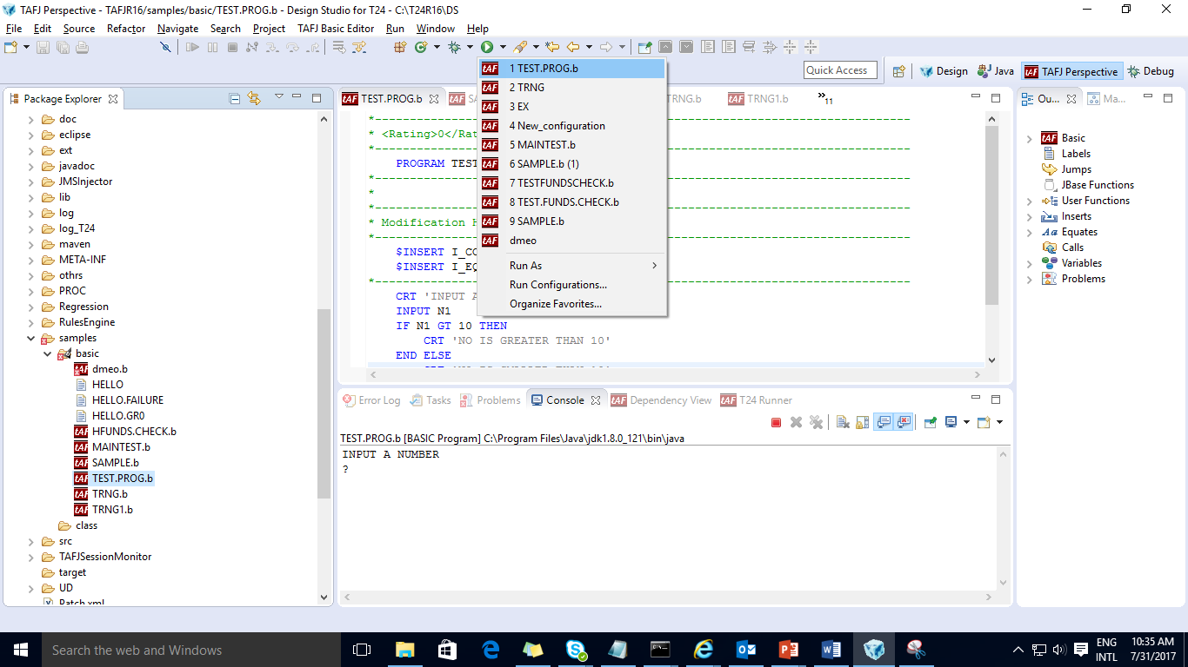
Solution( cont…)

Slide 52
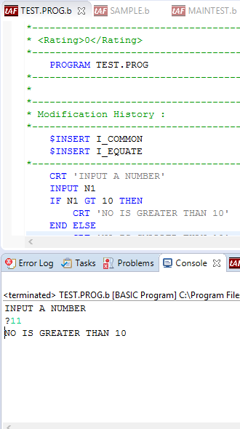
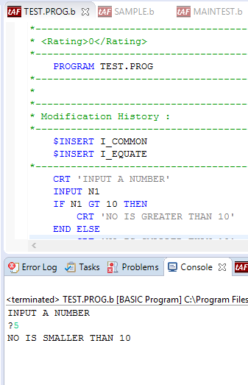
Output

Slide 53
File Operations
Records of T24 application needs to be written/read
Programming made easier

Slide 54
Various File Operation
OPF
F.READ
F.WRITE
EB.READLIST
READ
WRITE

Slide 55
File Operations Usage Procedure
Write the code i.e. program/subroutine in Design Studio
Compile the program/subroutine using function (CTRL + S)
Make a PGM entry with M or S as type, and EB as product
Run the subroutine in T24 Runner from Design Studio

Slide 56
OPF
Used to open a file for reading/writing purpose
Has 2 parameters passed
Syntax:
CALL OPF(Filename,Filepointer)
Where,
Filename : Name of the file E.g. FBNK.CUSTOMER
Filepointer : Pointer/Path to the file

Slide 57
OPF
Programming Flow
<Initialize variables FN.CUSTOMER,F.CUSTOMER,….>
<Open the file using OPF>
i.e. CALL OPF(FN.CUSTOMER,F.CUSTOMER)

Slide 58
F.READ
Syntax:
CALL F.READ(Filename,record.id,dynamic.array,File.var,Error.var)
Where,
Filename : File Name
Record.id : ID of the record to be read
Dynamic.array : Dynamic array that will hold read record
File.var : File Path
Error.var : Error Variable

Slide 59
F.READ
Programming Flow
<Initialize variables FN.CUSTOMER,F.CUSTOMER,….>
<Open the file using OPF>
<Read the record using F.READ>
i.e. CALL F.READ (FN.CUSTOMER,Y.CUSTOMER.ID,R.CUSTOMER,
F.CUSTOMER,Y.CUS.ERR)

Slide 60
F.WRITE
Syntax:
CALL F.WRITE(Filename, Record.id, Dynamic array)
Where,
Filename : File Name
Record.id : Record to be written
Dynamic array : Array holding the values to be written on record

Slide 61
F.WRITE
Programming Flow
<Initialize variables FN.CUSTOMER,F.CUSTOMER,….>
<Open the file using OPF>
<Read the record using F.READ>
<Assign the value to the dynamic array which we are going to write>
i.e. CALL F.WRITE (FN.CUSTOMER,Y.CUSTOMER.ID,R.CUSTOMER

Slide 62
Illustrate
Write a program that will display the details
(Id, Mnemonic and Nationality) of a customer

Slide 63
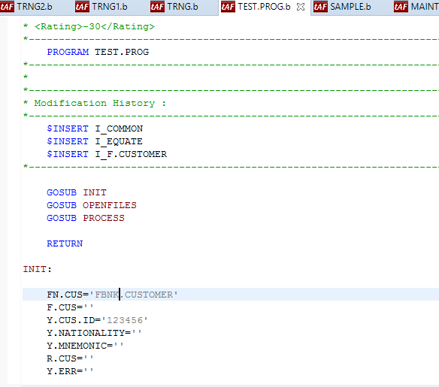
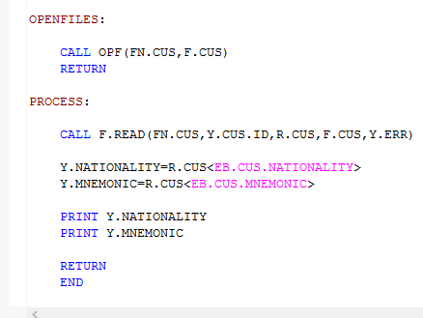
Solution
Write a program as shown:

Slide 64
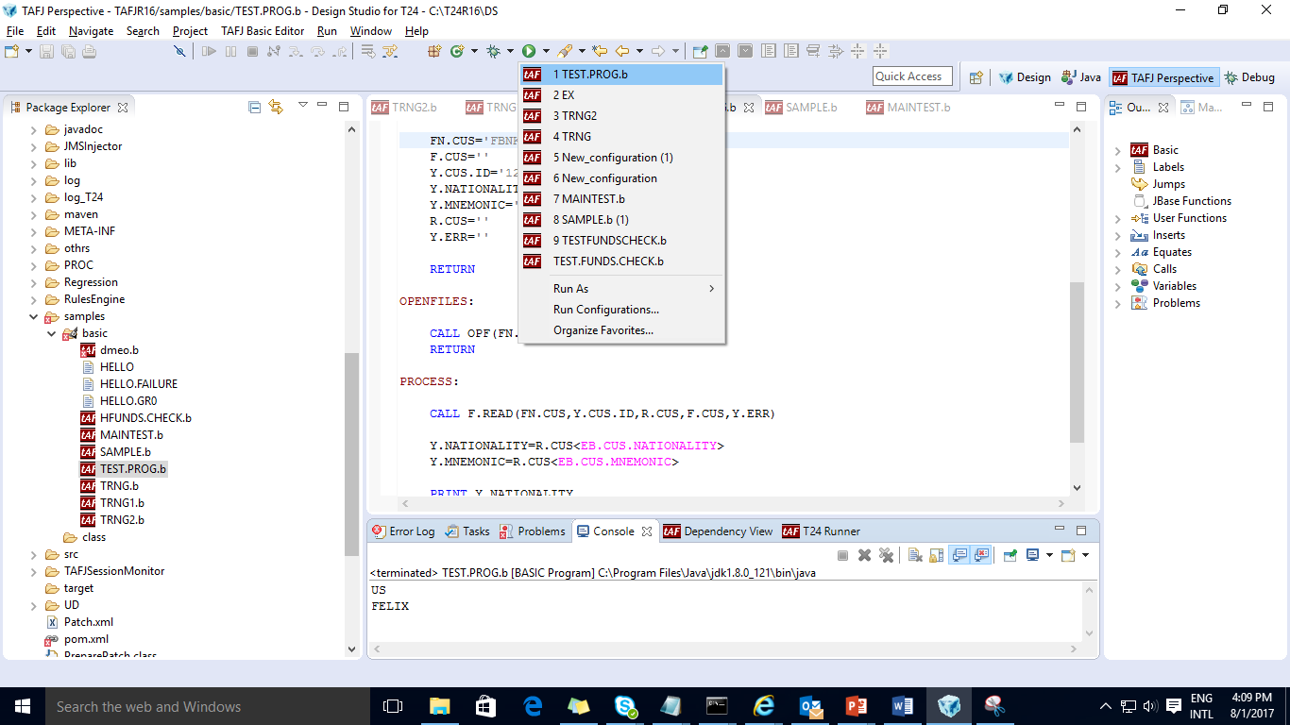
Solution (cont..)
After Compile the program, execute the program.

Slide 65
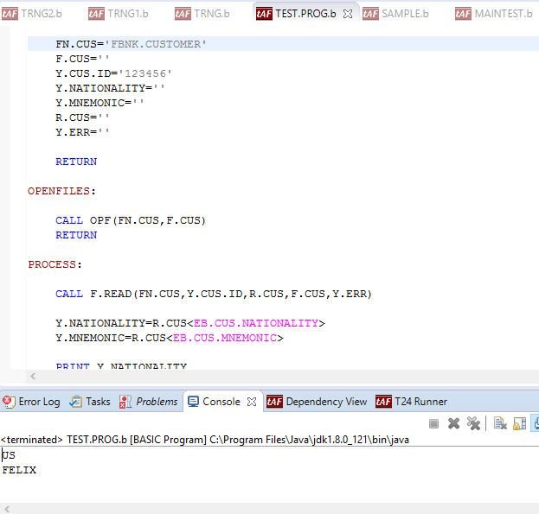
Output
On execution, the Customer record is opened, read and displayed

Slide 66
EB.READLIST
Syntax:
CALL EB.READLIST(1,2,3,4,5 )
Where,
1 : Select Query
2 : List variable that contains only the ID of the selected records
3 : Id of the SAVEDLISTS file (Optional)
4 : No of Records selected (Total Count)
5 : Return code

Slide 67
EB.READLIST
Example
<Initialize File name FN.CUSTOMER>
SEL.CMD = “SELECT “:FN.CUSTOMER
CALL EB.READLIST(SEL.CMD,SEL.LIST,’’,NO.OF.RECORDS,RET.CODE)

Slide 68
REMOVE
SYNTAX:
REMOVE <var> FROM <array> SETTING <set var>
Var : variable which holds the extracted string
Array : Dynamic array from which the string is to be extracted.
Set var : Delimiter by which string is extracted from array.
(2 – FM, 3 – VM, 4 – SM, 0 – End of array)

Slide 69
REMOVE
SYNTAX:
REMOVE <var> FROM <array> SETTING <set var>
Var : variable which holds the extracted string
Array : Dynamic array from which the string is to be extracted.
Set var : Delimiter by which string is extracted from array.
(2 – FM, 3 – VM, 4 – SM, 0 – End of array)

Slide 70
Illustrate
Write a subroutine that will changes the Account officer from 2 to 1 and display the details (Customer, Mnemonic, Old Acct officer and New Acct officer) for all customers

Slide 71
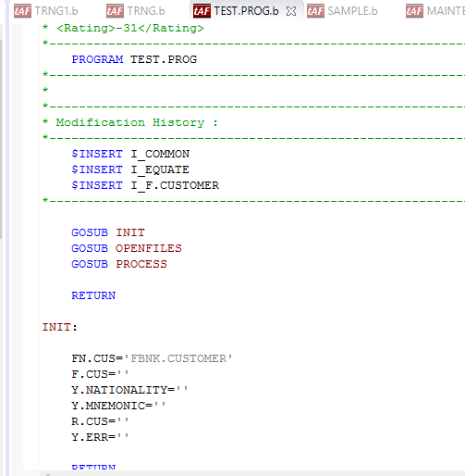
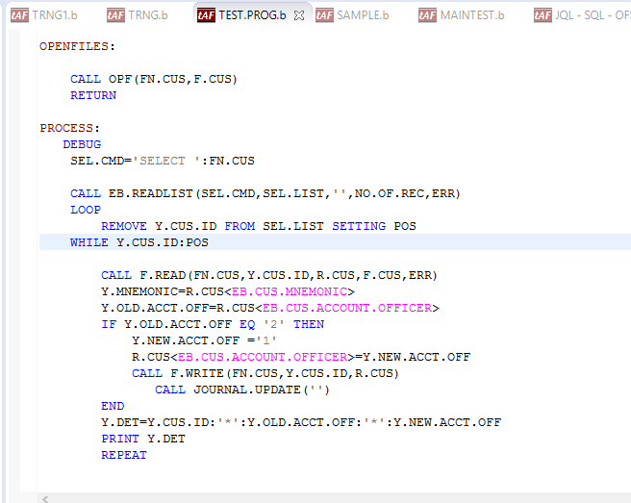
Solution

Slide 72
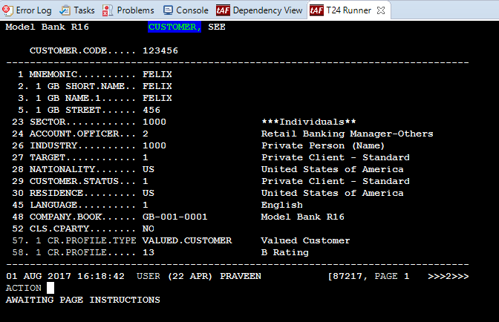
Solution (cont..)
Customer record before execution

Slide 73
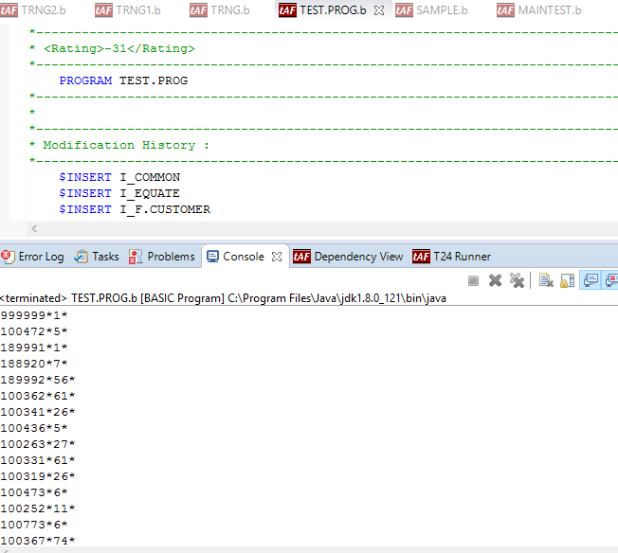
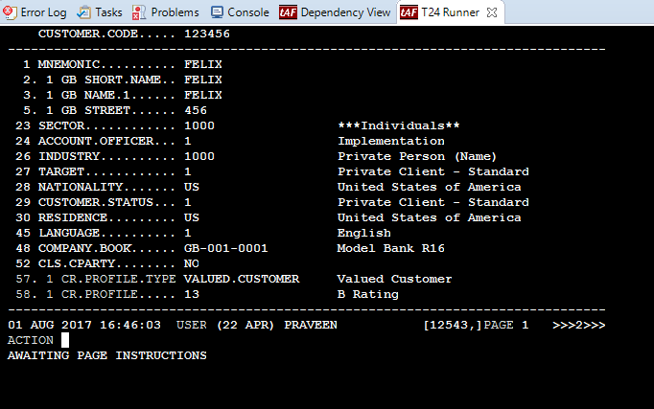
Output
Customer record after execution

Slide 74
READ
Used to read a record from a file
Syntax:
READ variable1 FROM { variable2,} expression {SETTING setvar} {ON
ERROR statements} THEN|ELSE statements
Where,
Variable1 – Identifier into which record will be read
variable2 – jBC variable that is previously opened to a file using OPEN statement

Slide 75
Difference b/w FREAD and READ
FREAD | READ
Reads the buffer first and executes if the required data is in buffer, else checks for the required data in the server and executes | Directly checks for the required data in the server all the time, without checking buffer and executes

Slide 76
Illustrate
Write a program to read a customer record based on input customer ID, and to print message “Record read successfully” or “Record not on file”

Slide 77
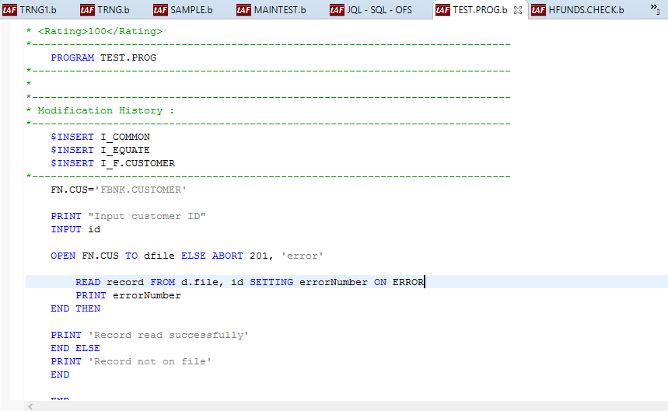
Solution

Slide 78
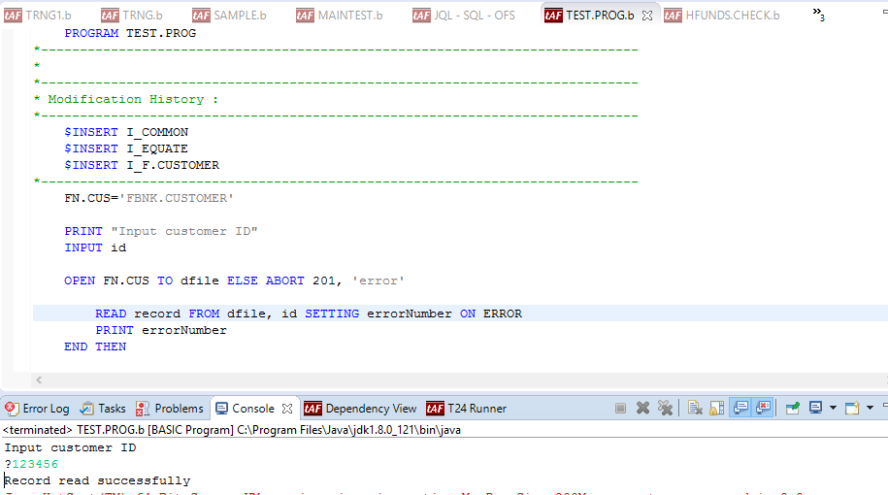
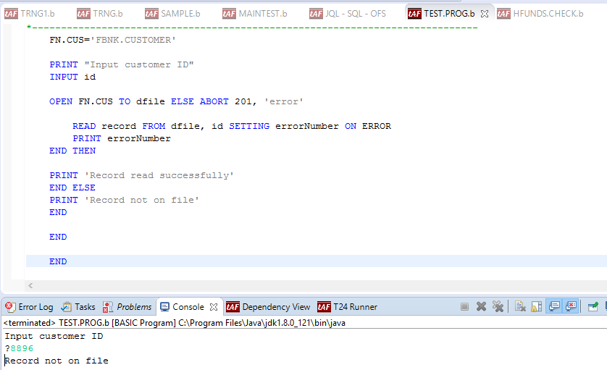
Output
After compiling execute the program

Slide 79
WRITE
Allows a program to write a record into a previously opened file
Syntax:
WRITE variable1 ON|TO { variable2,} expression {SETTING setvar} {ON ERROR statements}
Where,
variable1 – Identifier containing the record to write
variable2 – jBC variable previously opened to a file using the OPEN statement

Slide 80
Difference b/w FWRITE and WRITE
FWRITE | WRITE
Writes date into the buffer first, that's why sometimes we have to use JOURNAL.UPDATE | Writes data directly into the server

Slide 81
Illustrate
Write a program
To check whether field ‘Town Country’ in Customer application has a value
If ‘Town Country’ has no value, then update it with ‘INDIA’

Slide 82
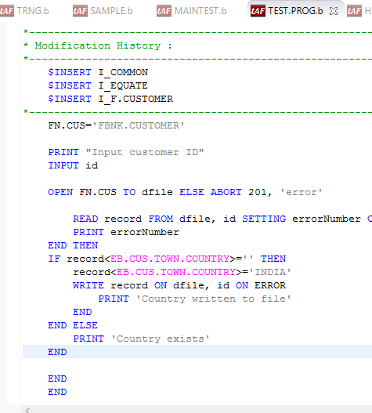
Solution
Write a program as shown

Slide 83
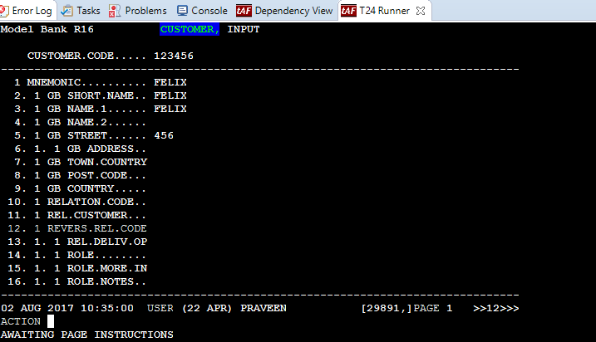
Solution
Before execution, town country field is empty

Slide 84
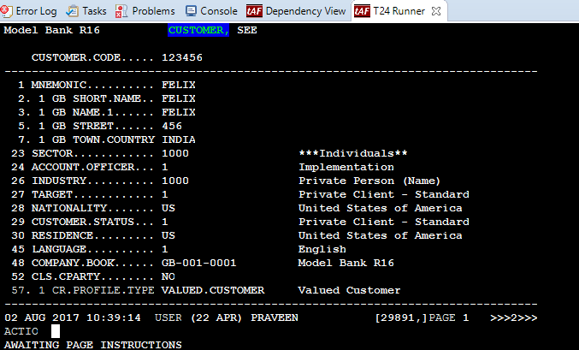
Output
After execution TOWN.COUNTRY field of Customer record is updated automatically, as shown

Slide 85
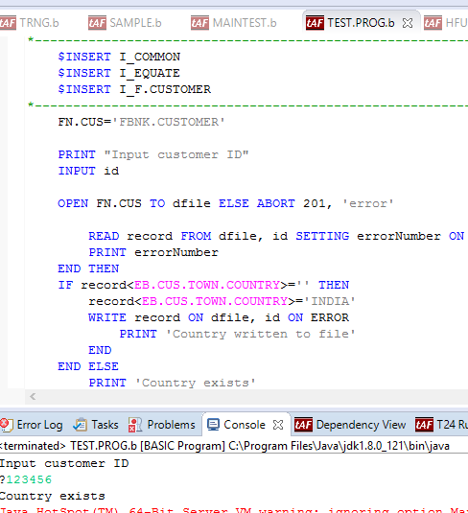
Output
Case if TOWN.COUNTRY is already exists

Slide 86
Sequential File Access Commands
OPENSEQ – Opens a file for sequential writing or reading
READSEQ – Reads from file opened for sequential access
WRITESEQ – Writes data to file opened for sequential access

Slide 87
OPEN SEQ
Syntax:
OPENSEQ Path{,File} {READONLY} TO FileVar { LOCKED statements } THEN | ELSE statements
Where,
Path: Specifies relative or absolute path of target file/directory
File: Specifies additional path information of target file
FileVar: Contains file descriptor of the file opened successfully
Statement: Conditional jBC statements

Slide 88
WRITE SEQ
Syntax:
WRITESEQ Expression {APPEND} TO FileVar THEN | ELSE statements
(Or)
WRITESEQF Expression {APPEND} TO FileVar THEN | ELSE statements
Where,
Expression: Specifies the variable to contain next record from sequential file

Slide 89
Illustrate
Write a sequential processing to create a text file from a jBase non-hashed file

Slide 90
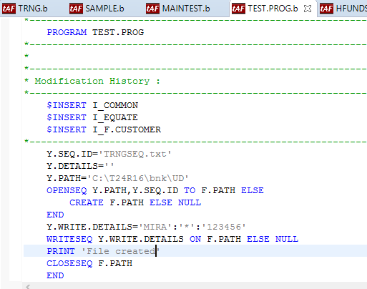
Solution

Slide 91
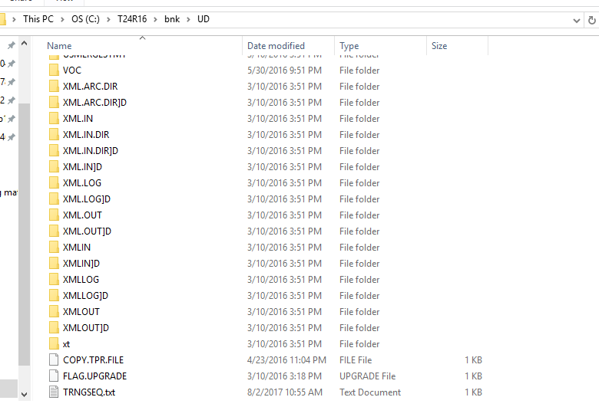
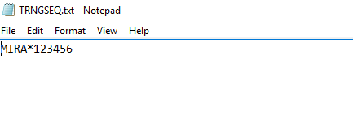
Solution (cont..)
Text file is created using sequential processing

Slide 92
READSEQ
Syntax:
READSEQ Variable FROM FileVar THEN | ELSE statements
Where,
Variable: Specific variable to contain next record from sequential file
FileVar: Specific file descriptor of file opened successfully
Statement: Conditional jBC statement

Slide 93
Illustrate
Write a program that uses sequential processing to a read an ASCII text file and write to a jBase non-hashed file

Slide 94
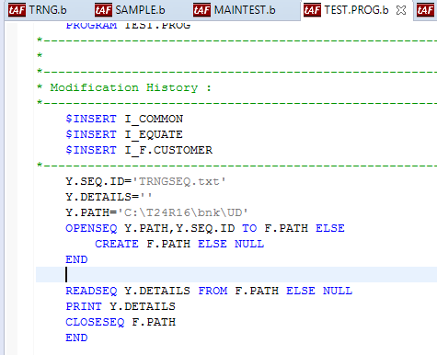
Solution

Slide 95
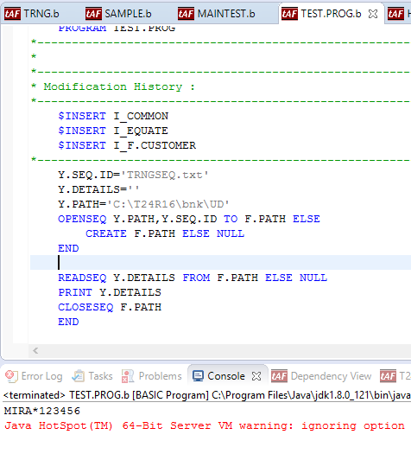
Output

Slide 96
Workshop
Write a program using sequential processing to write a text file containing customer details and to read the text file from jBase non-hashed file

Slide 97
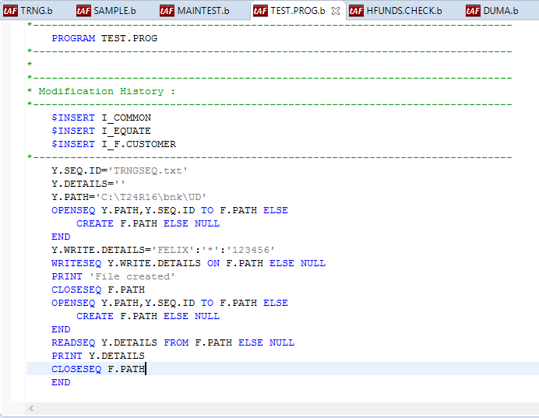
Solution

Slide 98
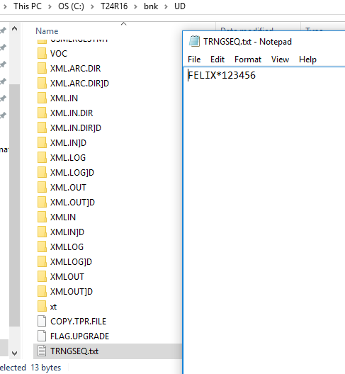
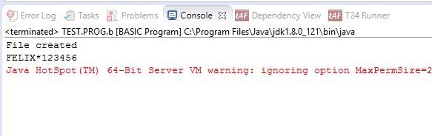
Output

Slide 99
What is Built-in Function?
Functions developed in the Core, for use in programming

Slide 100
Why is Built-in Function?
When programming includes long codes
Confusion is created
Programming is not clear

Slide 101
Built in Functions
LEN
INDEX
COUNT
DCOUNT
UPPERCASE
DOWNCASE
CHANGE
TRIMF
TRIMB
TRIM
FIELD
LOCATE
FIND
FINDSTR

Slide 102
LEN
Calculates the length of the supplied expression
Syntax:
LEN(expression)
Where,
expression can evaluate to any type and the function will convert it to a string automatically

Slide 103
LEN
EXAMPLES
Input:
Lengths = LEN(Values)
PRINT Lengths
Output:
6

Slide 104
INDEX
Returns the starting position of specific occurrence of a substring within a string
Syntax:
INDEX(string,substring,occurrence)

Slide 105
INDEX
Example
Input:
ABet = "abcdefghijklmnopqrstuvwxyzabc"
CRT INDEX(ABet, "a", 1)
CRT INDEX(ABet, "a", 2)
CRT INDEX(ABet, "jkl", 1)
Output:
1
27
10

Slide 106
COUNT
Counts the occurrence of a character in a string/variable/record
Syntax:
COUNT(expression1, expression2)
Where,
Both expression1 and expression2 may evaluate to any data type but logically they will evaluate to character strings

Slide 107
COUNT
Example:
Input:
Calc = "56 * 23 / 45 * 12"
CRT "There are ":COUNT(Calc, "*"):" multiplications“
Output:
There are 2 multiplications

Slide 108
Illustrate
Write a program
To count the occurrence of character ‘E’ in the word ‘TEMENOS’
To find the length of the word ‘TEMENOS’
To find the 2nd occurrence of E in the word ‘TEMENOS’

Slide 109
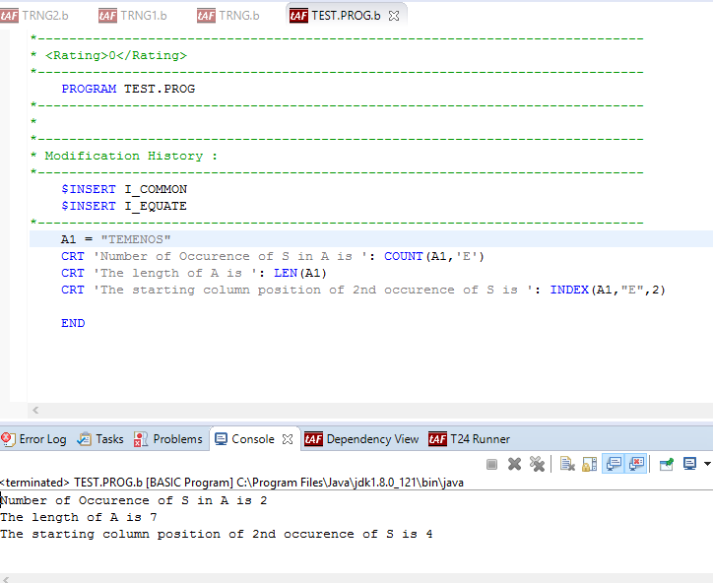
Solution

Slide 110
DCOUNT
Counts the occurrence of delimiters in a string/variable/record
Syntax:
DCOUNT(expression1, expression2)
Where,
expression1 evaluates to a string in which fields are to be counted
expression2 evaluates to the delimiter string that will be used to count the fields

Slide 111
DCOUNT
Example:
Input:
A = "A:B:C:D"
CRT DCOUNT(A, ":")
Output:
4

Slide 112
Illustrate
Write a program
To count the occurrence of value markers in a record
To count the number of occurrence of delimiting of record using value marker

Slide 113
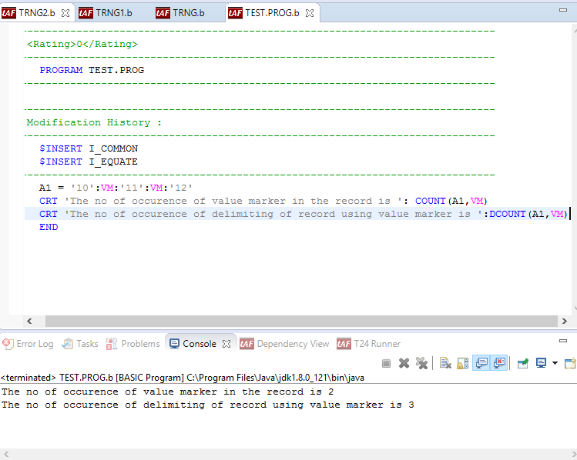
Solution
Initialize data containing value markers to a variable/record
Use COUNT and DCOUNT functions, to count occurrence of value marker and delimiting of record.

Slide 114
UPPERCASE
Converts case of character from lower to upper case
Syntax:
UPCASE(expression)
Where,
expression in a string containing some alphabetic characters

Slide 115
DOWNCASE
Converts case of character from upper to lower case
Syntax:
DOWNCASE(expression)
Where,
expression in a string containing some alphabetic characters

Slide 116
Illustrate
Write a program to convert the string:
TEMENOS to lower case
technologies to upper case

Slide 117
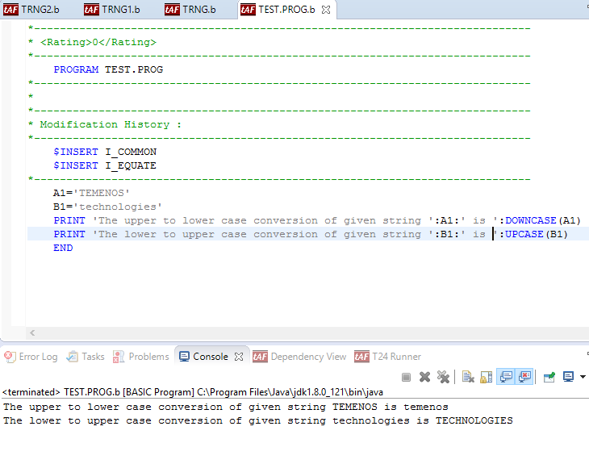
Solution

Slide 118
CHANGE
Changes occurrences of a character to another character in a record/string
Syntax:
CHANGE(e,d,c)
Where c & d – characters
e – string/record
Changes occurrences of d to c in e

Slide 119
Illustrate
Write a routine to change the occurrence of e to i in the string “admenestrateon”

Slide 120

Solution

Slide 121
STRING MANIPULATION
Removes leading and trailing spaces available in a string
Used when storing data in database
During Enquiry selection, avoids cancellation of record from list

Slide 122
STRING MANIPULATION COMMANDS
TRIMF
Removes leading spaces from a string
Syntax: TRIMF(string)
TRIMB
Removes trailing spaces from a string
Syntax: TRIMB(string)
TRIM
Removes both leading &trailing spaces
Syntax: TRIM(string)

Slide 123
Illustrate
Write a program to remove extra space from string ‘TEMENOS TECHNOLOGIES’, using TRIMF, TRIMB & TRIM

Slide 124

Solution

Slide 125
FIELD
Extracts sub-string from a Character string using delimiters
Syntax
FIELD(string,delimiter,occurrence,fields )
Example: FIELD command can be used in scenarios, when value of Nationality & Residence has to be picked from Customer records

Slide 126
Illustrate
Write a program to extract character and number from a string using delimiters

Slide 127

Solution

Slide 128
LOCATE
Search a string in a dynamic array and get its position
Returns the field Position only
Syntax:
LOCATE <string> IN <array> {<field pos,multivalue pos>} SETTING <var> THEN/ELSE <statements>
Used during extraction of string from a large array
E.g. On a condition when Nationality and Residence of Customer is US, so as to do some action

Slide 129
Illustrate
Write a program to locate available and unavailable string in a given array

Slide 130

Solution

Slide 131
FIND
Searches the position of entire string in a dynamic array
Finds the location of a specified string within a Dynamic array
Syntax:
FIND <string> IN <array> SETTING var1,var2,var3 THEN/ELSE <statements>
Example:
On condition, when accounts whose Account Officer corresponds to specific value has to be found

Slide 132
Illustrate
Write a program to find the array position of string ‘2000’ in a given array 'HARRIS':FM:'JONTY':VM:'PETER':FM:'FELIX':VM:'PRAV':VM:'ARUN'

Slide 133

Solution

Slide 134
FINDSTR
Searches a string as a substring in dynamic array
Syntax:
FINDSTR <string> IN <array> SETTING var1,var2,var3 THEN/ELSE <statements>
Example:
On condition, when Accounts whose Account.Title containing specified string has to be found

Slide 135
Illustrate
Write a program to display the array position of a sub-string ‘ONT’ of a string ‘JONTY’ in a given array ‘KALLIS’:@FM:’JONTY’:@VM:’NICKY’

Slide 136

Solution

Slide 137
Solution

Slide 138
Summary
Hence, the topics which are covered in this presentation are valuable to participants to learn technical knowledge in T24 Info basic

Slide 139
THANK YOU

