Slide 1
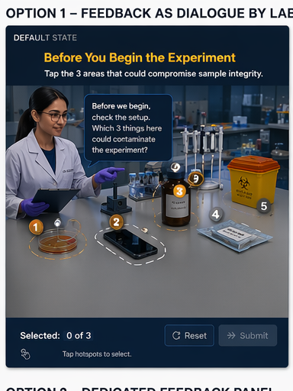
Notes:
[Sources] - Internal concept mockup image asset: 01_option1_default.png

Slide 2
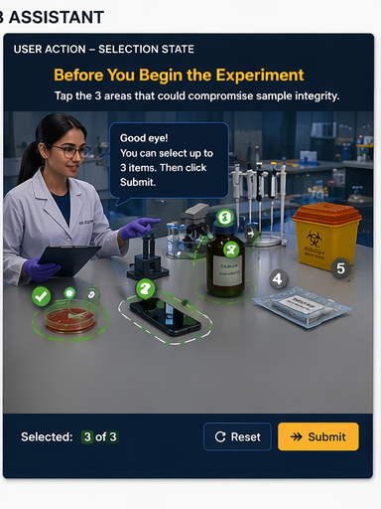
Notes:
[Sources] - Internal concept mockup image asset: 02_option1_selection.png

Slide 3
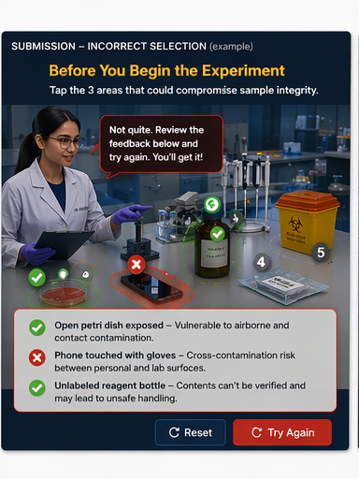
Notes:
[Sources] - Internal concept mockup image asset: 03_option1_incorrect.png

Slide 4
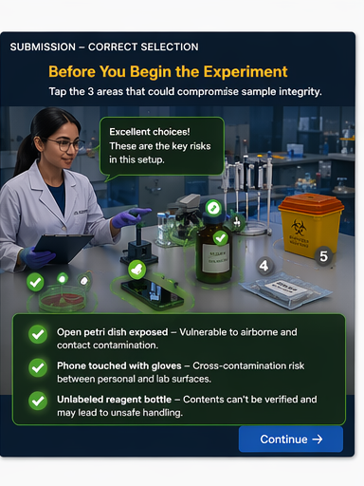
Notes:
[Sources] - Internal concept mockup image asset: 04_option1_correct.png

Slide 5
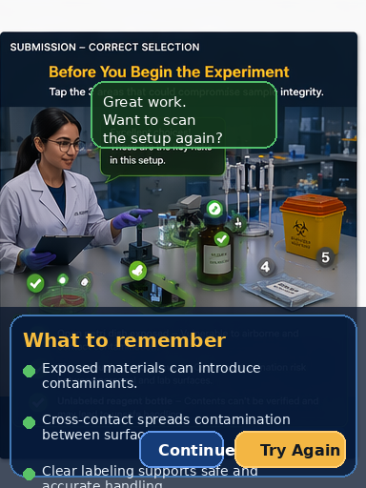
Notes:
[Sources] - Internal concept mockup image asset: 09_option1_closing.png

Slide 6
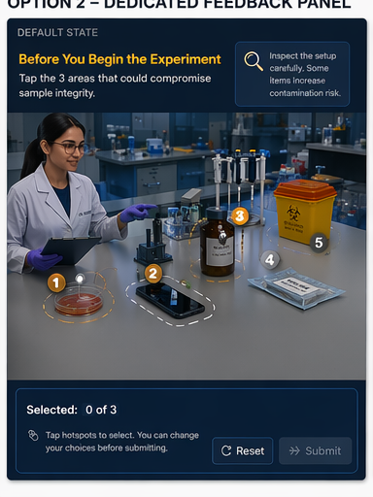
Notes:
[Sources] - Internal concept mockup image asset: 05_option2_default.png

Slide 7
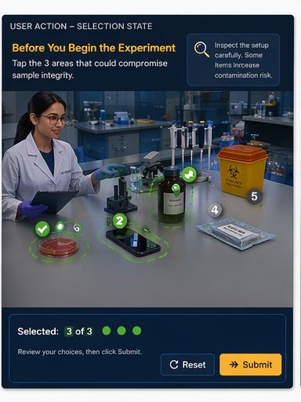
Notes:
[Sources] - Internal concept mockup image asset: 06_option2_selection.png

Slide 8
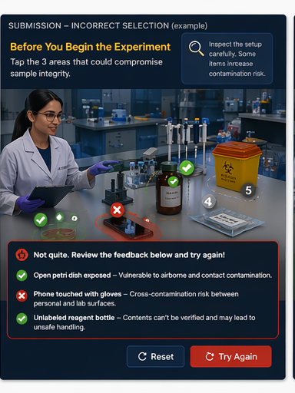
Notes:
[Sources] - Internal concept mockup image asset: 07_option2_incorrect.png

Slide 9
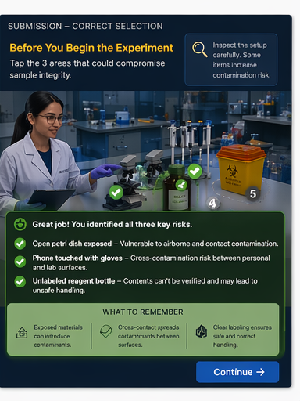
Notes:
[Sources] - Internal concept mockup image asset: 08_option2_correct.png

Slide 10
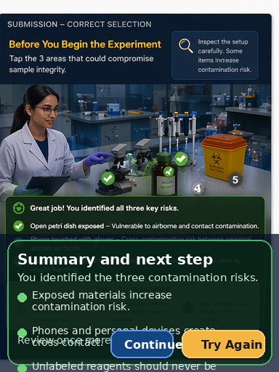
Notes:
[Sources] - Internal concept mockup image asset: 10_option2_closing.png

