Slide 1
Retail Sales Dashboard Summary
Presented by [K K Venkatesh]

Slide 2
Objective of the Dashboard
- To analyze retail sales performance
- Identify trends in sales, profit, and customer behavior
- Provide actionable insights for business decisions

Slide 3
Key Performance Indicators (KPIs)
- Total Sales
- Total Profit
- Quantity Sold
- Customer Count
- Profit Margin

Slide 4
Sales Performance Overview
- Monthly/Quarterly sales trends
- Top-performing products and categories
- Sales by region or location

Slide 5
Profit Analysis
- Profit trends over time
- High and low-profit segments
- Comparison of sales vs. profit

Slide 6
Customer Insights
- Customer acquisition and retention trends
- Segmentation by region or product preferences
- Average revenue per customer

Slide 7
Region-wise Sales & Profit
- Sales distribution by region
- Profit contribution per region
- Regional heatmaps (if used)

Slide 8
Product Analysis
- Best-selling products
- Profit-generating products
- Low-performing items (sales/profit)

Slide 9
Actionable Insights & Recommendations
- Focus on top regions and products
- Optimize low-margin categories
- Strengthen customer engagement in underperforming regions

Slide 10
Conclusion
- Dashboard provides a holistic view of retail sales
- Helps drive strategic and data-driven decisions

Slide 11
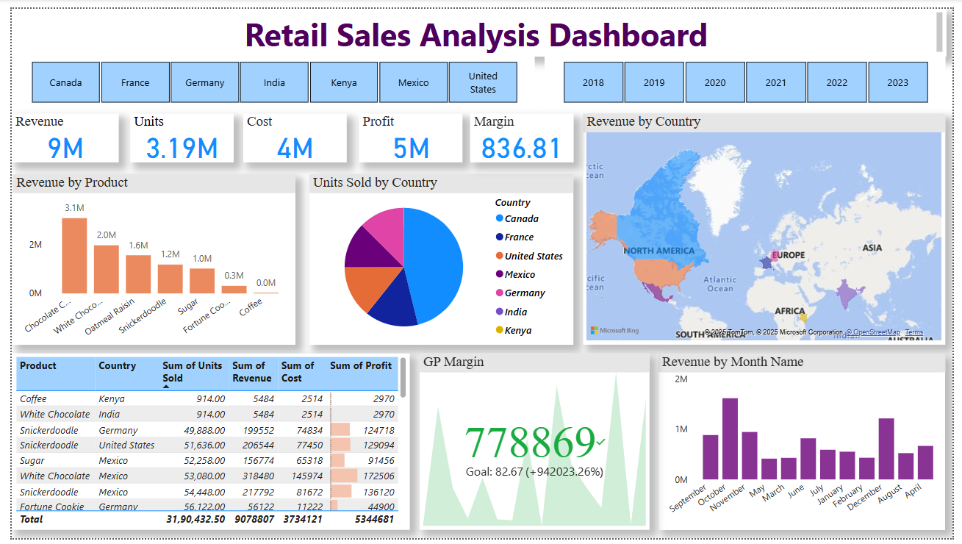
Dashboard

