Slide 1

Introducing Smart Farming Project
NIT CALICUT, 2016

Slide 2


Indian Agriculture and Challenges
We have noticed following problems associated with the Indian agriculture, looking in view of the solutions that are easily possible with current IoT technology:
There is very less knowledge among the farmers about the exact values of the temperature, humidity and soil moisture of the field. This leads to unnecessary watering, wrong crop selection, etc
Most of the farmer’s time is consumed in irrigating the field which can be automated and irrigated automatically according the current moisture level of the soil.
Saving the crop from problems like fire accidents and grazing by cattle

Slide 3
Project Vision
Our vision is to provide each and every farmer with the tool that
guides farmer in the following ways:
Testing farmer’s land conditions(real time) and rate it for exact amount of treatment required for particular crop yield.
Auto irrigation or Manual Irrigation that farmer can control remotely through App
Providing weather monitoring that can help farmers in the number of ways to ensure their crop is not aﬀected by the climatic changes .
Providing suggestion to the farmer how to increase the crop production by notifying him the details of the actual and desired values of soil moisture, humidity and temperature for particular crop that he has sown(here we have included rice, wheat and jowar)

Slide 4


Technical Details.
Sensors, Technology and Implementation

Slide 5
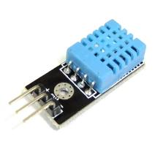
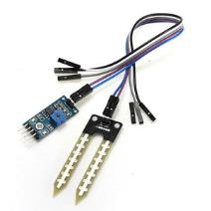
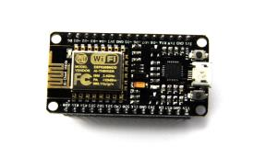
Sensors and Project Setup
To implement the prototype of the project we have used following sensors:
DHT 11 ESP8266 NodeMcu Soil Moisture
Wifi Module Sensor
Humidity and Temperature
Sensor

Slide 6
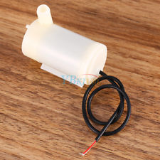
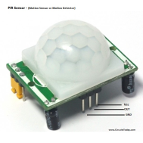
Sensors and Project Setup
Water Pump
PIR Sensor

Slide 7
Sensors and Project Setup
Following tools and platforms are used to provide complete IoT solution to the Smart Farming Application
Arduino IDE
Ubidots :IoT platform
MIT App Inventor 2
Wunderground

Slide 8
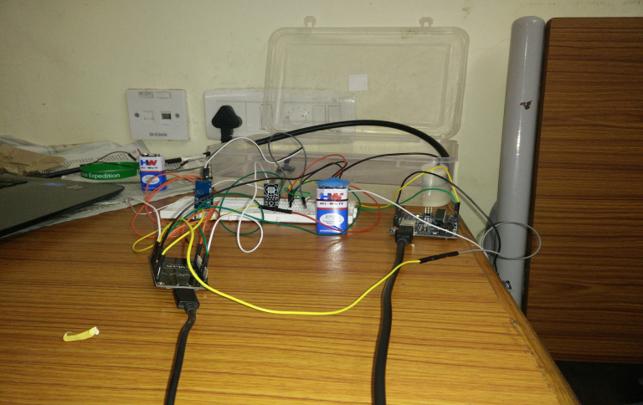
Project Setup

Slide 9
Technical Explanation I
This project involves all the major components that make this project the best ﬁt for IoT.
Technically this project relies on Sensors, Cloud Analytics, Application interface Android app in our case.
We have used Sensors mentioned in the previous slide and their behaviour is programmed in Arduino IDE.
Node MCU has the micro controller in it where we burned the code written for connecting to appropriate Wi-Fi networks through hot spot, for gathering the information from sensors, and sending it to the cloud platform through unique tokens.
To get the data to the web we used UBIDOTS cloud platform’s API features which provided us URLs having unique variable IDs and Tokens. We can see the data streaming in form of Graph and Tabular format so that we can perform analytics over the sensed and give appropriate notification to the farmer accordingly.
Wunderground weather API platform was used to get the forecast conditions of a particular latitude and longitude.

Slide 10

Flow of Operation
1.
Sensors
2.
Node MCU
3.
Cloud
Date is sensed from Sensors
Received by Node MCU connected with Wi-Fi Hotspot
Sensed data is sent to Cloud
Cloud data is fetched on Android App
With App Farmer can control Devices
5.
Water Pump
4.
Android App

Slide 11
Technical Explanation II
Android application has following features
Farmers have to create an account on an App which provides them an unique Login ID
Farmer can see the Sensed data and Suggestion according to the current readings of the sensors for the Crop he has sown ,by clicking on the Crop of interest button.
Each Farmer can perform Irrigation operation upon checking the soil moisture level of the field. When farmer clicks on the irrigate button, App generates unique URL inside the App which is specific to the Farmer Login ID.
The Unique URL has IP address corresponding to the Node MCU present in his field which again controls the pump or Tap connected to its GPIO pins.
Screen Shots are Shared in the Next Slide

Slide 12
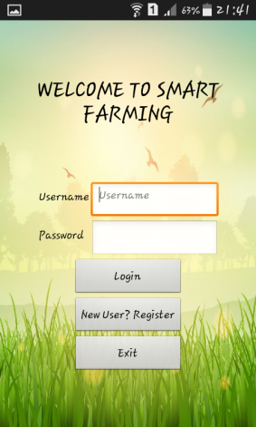
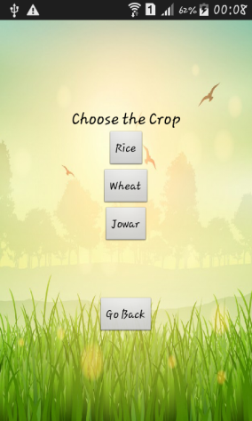
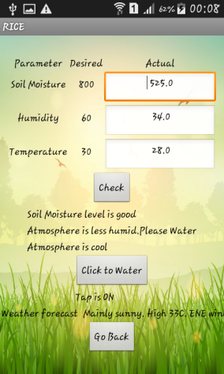
App Screen Shots

Slide 13
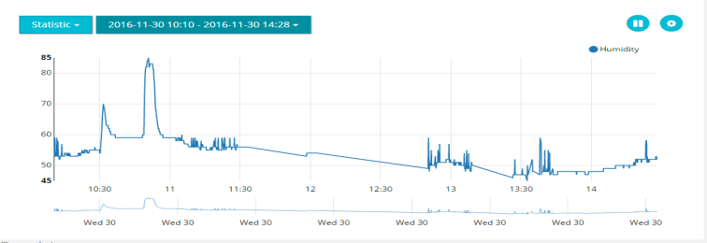
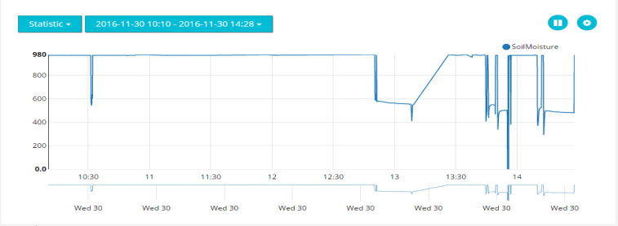
Cloud Data

Slide 14
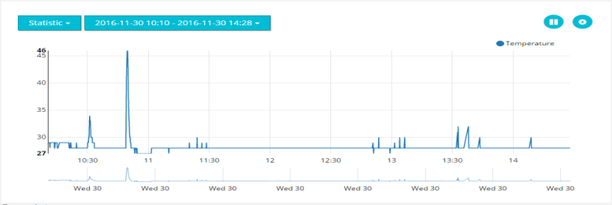
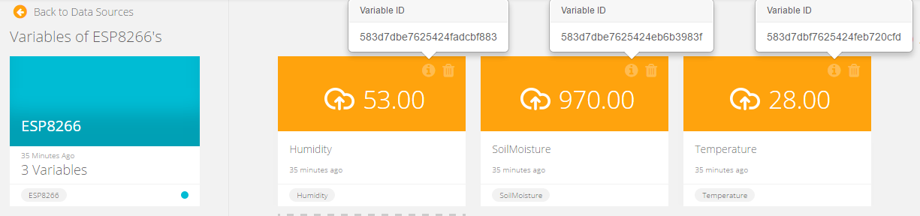
Cloud Data

Slide 15
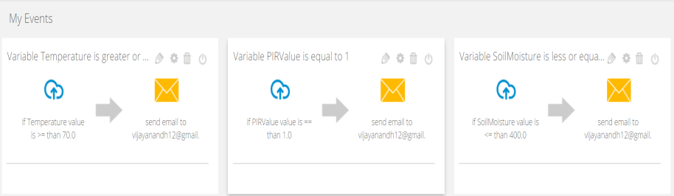
Alert Email Notifications

Slide 16
Technical Explanation III
If the temperature goes beyond 70*C, it might be due to fire in field. In such case, i.e, when temperature>=70, we have created an event in Ubidots platform to send an email.
The PIR sensor is connected to digital pin of Node MCU. This updates logic values to the Ubidots cloud and event(sending mail) occurs for logic 1
This could be modified as sending SMS also by just changing the type of event in Ubidots platform.
Slides are shared in the next slides.

Slide 17
Performance Analysis of Project
The performance of the project is real time with lag or 2-3 seconds.
When multiple sensors are used there is no extra delay in the performance. This ensures that we can perform this project with real time data having multiple sensors working concurrently.
There can be variation in the performance depending upon the network speed . If the network is fast the response is satisfying with almost no delay

Slide 18
Cost Incurred for Project
Item Name | Price(in Rupees)
DHT 11 | 160/-
Soil Moisture Sensor | 180/-
ESP 8266 | 540/-
Bread Board | 70/-
Jumper Wires | 30/-
Water Pump | 200/-
Battery 9V | 20/-
PIR Sensor | 100/-
Total | 1300/-

Slide 19
Benefits of Our Project
PIR sensor helps in reducing the crop losses by detecting grazing animals in the farm.
By sensing soil moisture we can avoid wastage of water.
Fire accidents will be notified through email.
If more than adequate amount of water is flowing in the farm the farmer will get notified through email.
We have included rainfall forecast in the app, which is much easier and accurate when compared to usual TV/Radio weather broadcasts.
We have used ESP8266 node mcu which is a very cost effective Wi-Fi module.

Slide 20
Thankyou

Slide 21


Contact Details
Harshverdhan Soni
harshverdhansoni@gmail.com
9907022706
R M Alagappan
achu.smr21@gmail.com
9037708712
Vijay Anandh K
vijayanandh12@gmail.com
7736848495
Venkatesh U
venkateshummadisingu@gmail.com
9746201329
M Pavan Kumar
pavankumar8896@gmail.com
8129991747
Ch Udaya Raghava Sai
chikkamuday007@gmail.com
7736733052

