Slide 1
Employee Data Analysis using Excel
STUDENT NAME: M.VENMUGAI
REGISTER NO : 2213331042150, asunm13332213331042150
DEPARTMENT : B.COM(GENERAL) COMMERCE
COLLEGE : BHARATHI WOMEN'S COLLEGE

Slide 2

PROJECT TITLE
Employee Salary Analysis Using Excel

Slide 3


AGENDA
Problem Statement
Project Overview
End Users
Our Solution and Proposition
Dataset Description
Modelling Approach
Results and Discussion
Conclusion
3/21/2024 Annual Review

Slide 4

PROBLEM STATEMENT
Employee salary analysis is
conducted in companies for various reasons. The reasons are as follows:
1.Fair compensation
2.Market competitiveness
3.Budgeting and cost control
4.Performace Management
5.Promotion and Development
6.Compliance
7.Employee Satisfaction and Retention
8.Succession Planning
9.Mergers and acquisitions
10.Strategic workforce planning

Slide 5

PROJECT OVERVIEW
Employee salary analysis data set collected from "Kaggle".
Data cleaning and process:
Step 1 - Title (Employee salary analysis) add to the dataset.
Step 2- Remove the blanks columns by using "Filtering".
Step 3 - Align the text to centre.
Step 4 - Add a colour to the header row.
Step 5 - I Insert 2 "Pivot tables"
Step 6 - For that I created 3 different types of charts.

Slide 6

WHO ARE THE END USERS?
The end users of salary analysis
are:
1.HR professionals
2.Compensation and Benefits Managers
3.Recruiters
4.Hiring Managers
5.Finance and Accounting teams
6.Business Leaders and Executives
7.Department Managers
8.External Auditors and Consultants
9.Employees
10.Union Representatives (if applicable)

Slide 7

OUR SOLUTION AND ITS VALUE PROPOSITION
1.Insert Row - To add topic of the project.
2.Filtering - To remove blank cells.
3. Insert - Pivot table.
4. Filtering - To remove blank values in the pivot table.
5. Insert - Charts for the summarised data( Pivot table).

Slide 8
Dataset Description
1.Data set - Collected from Kaggle (Employee salary analysis).
2.Features of Data :
Emp ID
Name
Gender
Department
Salary
Start Date
FTE
Employee Type
Work Location

Slide 9

3.Features Choosed for Pivot table :
Gender - Male, Female
Employment type - Permanent,
Temporary,
Fixed Term.
Salary - Numerical Value
Department - Text
Work location - Text

Slide 10

THE "WOW" IN OUR SOLUTION
I created three different types of charts of employee salary analysis for best understanding. And also I created two pivot tables.
3/21/2024 Annual Review
10

Slide 11
MODELLING
Data collection:
Kaggle
Feature collection:
1.Emp ID
2.Name
3.Gender
4.Department
5.Salary
6.Start Date
7.FTE
8.Employment Type
9.Work location.
Data Cleaning
1.Filtering - To remove the blank values
11

Slide 12

2.Align Text to centre.
3.Insert row for the project title.
4.Change the font style, font size, font colour for the project title.
5.Fill the colour header row.
6.Insert Pivot table ( Summarised Data).
7.Insert - Charts for data visualization.

Slide 13
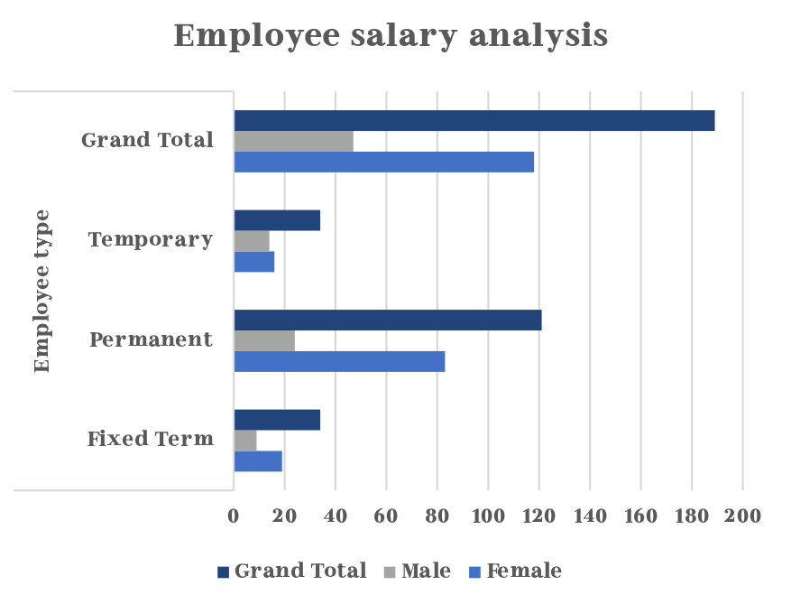
RESULTS
13

Slide 14
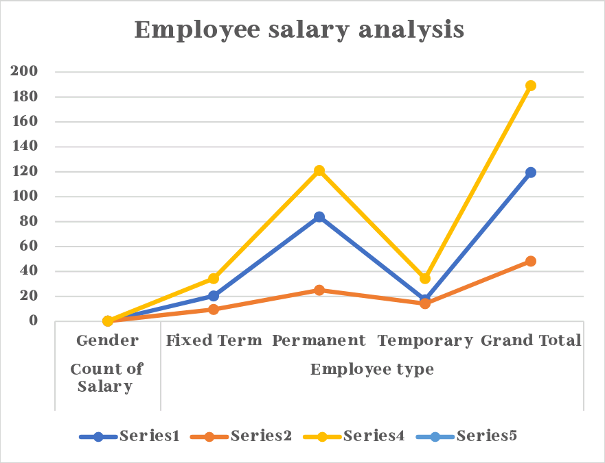

Slide 15
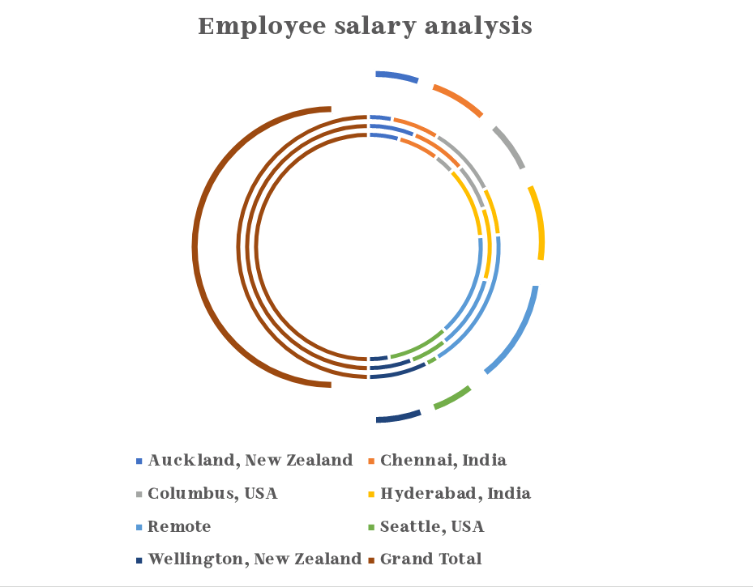

Slide 16
conclusion
Based on these findings, we recommend :
1.Implementing new salary structure with clear grades and ranges.
2.Developing Performance - based bonus systems.
3.Providing training and opportunities to employees.
4.Conduct regular market analysis.

