Slide 1
AWS Fargate & ECS Masterclass
Madhukar Reddy Venna
Vcube

Slide 2
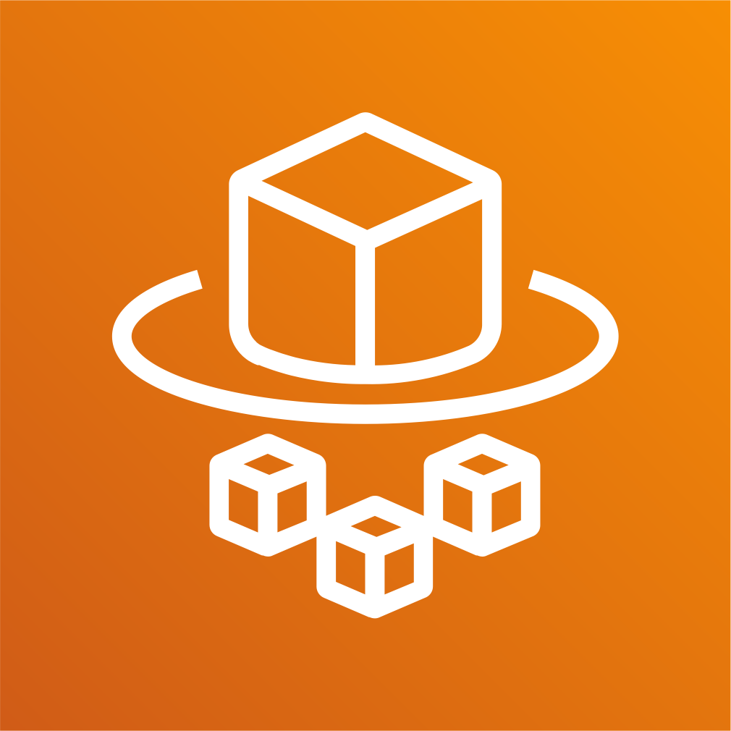

AWS Fargate & ECS
Masterclass Course Contents

Slide 3
Course Outline
Fargate & ECS - First Steps
Docker Fundamentals
Fargate & ECS Fundamentals
ECR – Elastic Container Registry
Load Balancing & Service Autoscaling
Continuous Integration & Continuous Delivery
Microservices Deployment without Service Discovery
Microservices Deployment with Service Discovery
Microservices Deployment with AWS App Mesh and X-Ray
Microservices Canary Deployment with AWS App Mesh
CloudFormation for Fargate Deployments

Slide 4
AWS Fargate & ECS Introduction

Slide 5
ECS & Fargate - Introduction
ECS – Elastic Container Service
Fargate – Serverless Container Service
ECS is a highly scalable, fast, container management service that makes it
easy to run, stop, and manage Docker containers on a cluster.
We can host our cluster on a serverless infrastructure that is managed by
Amazon ECS by launching our services or tasks using the Fargate launch
type.
We can use Amazon ECS to schedule the placement of containers across our
cluster based on our resource needs, isolation policies, and availability
requirements.
Amazon ECS eliminates the need for us to operate our own cluster
management and configuration management systems or worry about
scaling our management infrastructure.

Slide 6
ECS & Fargate - Introduction
Amazon ECS can be used to create a consistent deployment and build experience, manage, and scale batch and Extract-Transform-Load (ETL) workloads, and build sophisticated application architectures on a microservices model.

Slide 7
AWS Fargate & ECS First Steps

Slide 8
Fargate or ECS Objects
Task Definition
Cluster
ECS Objects
Service
Task

Slide 9
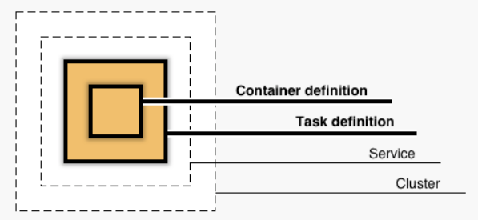
Fargate & ECS – First Steps
Container Definition
Nothing but container image and container level settings (Example: Container Image,
Port, registry, Environment Variables to pass to container etc)
Task Definition
A task definition is a blueprint for our application and describes one or more containers
through attributes.
Very few attributes are configured at the task level, but majority of attributes are
configured per container.
It is a combination of multiple container definitions if we are using more than one
container image in a Task.
Service
A service allows you to run and maintain a specified number (the "desired count") of
simultaneous instances of a task definition in an ECS cluster.
Fargate Cluster
The infrastructure in a Fargate cluster is fully managed by AWS. Our containers run
without we managing and configuring individual Amazon EC2 instances.
Task
A task is the instantiation of a task definition within a cluster.
After we have created a task definition for our application within Amazon ECS, we can
specify the number of tasks that will run on our cluster (run task directly or configure to
run from a service).
Each task that uses the Fargate launch type has its own isolation boundary and does not
share the underlying kernel, CPU resources, memory resources, or elastic network
interface with another task.

Slide 10
AWS Fargate & ECS Clusters

Slide 11
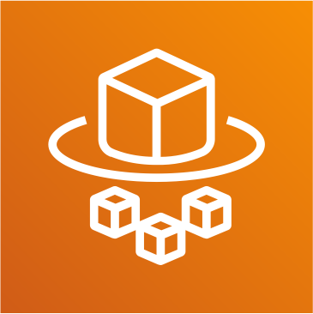


Fargate & ECS Fundamentals – Clusters Introduction
We have 3 types of cluster templates available in ECS.
Fargate - Serverless
EC2 – Linux
EC2 - Windows
An ECS cluster is a logical grouping of tasks or services.
Clusters are Region-specific.
Clusters can contain tasks using both the Fargate and EC2 launch types.
ECS Cluster Types
Fargate (Serverless)
EC2 + Linux
EC2 + Windows

Slide 12
AWS Fargate & ECS Cluster Features

Slide 13
Fargate & ECS Fundamentals – Cluster Features
Services
A service allows you to run and maintain a specified number of simultaneous instances of a task definition in an ECS cluster.
Tasks
A task is the instantiation of a task definition within a cluster
ECS Instances
Will be created when we create the cluster launch type of EC2+Linux or EC2+Windows
Metrics
CloudWatch Container Insights collects, aggregates, and summarizes metrics and logs from your containerized applications and microservices.
Clusters (Fargate or ECS)
Scheduled Tasks
Used primarily for long running stateless services and applications.
Tags
ECS resources can be tagged with values that we define, to help us organize and identify them.
Capacity
Providers
A capacity provider is used in association with a cluster to determine the infrastructure that a task runs on.
Update Cluster
Update the cluster settings primarily leading to Cluster Capacity Providers
Delete Cluster
Used to delete ECS EC2 or Fargate Clusters

Slide 14
AWS Fargate & ECS Task Definition

Slide 15
Fargate & ECS Fundamentals – Task Definition
Task Definition
A task definition is required to run Docker containers in Amazon ECS
A task definition is a blueprint for our application and describes one or more containers through attributes.
Some attributes are configured at the task level, but majority of attributes are configured per container.
Task Definition Parameters - Core
The Docker image to use with each container in your task
How much CPU and memory to use with each task
The launch type to use, which determines the infrastructure on which our tasks are hosted (EC2 or
Fargate)
The Docker networking mode to use for the containers in our task (Fargate defaults to awsvpc, where
as EC2 supports docker networking models like Birdged, Host, None and awsvpc too).
The logging configuration to use for our tasks
Whether the task should continue to run if the container finishes or fails
Any data volumes that should be used with the containers in the task
And many more……..

Slide 16
EC2 Launch Type
Task Definition Name
Task Definitions
Task Definition – Parameters List
Task Role
Network Mode
Healthcheck
Task Execution
IAM Role
Container Name
Environment
Environment Varibales
Fargate Launch Type
Task Size
(Memory, CPU)
Image
Container Timeouts
Container
Definitions
Private Repo
Authentication
Standard
Network Settings
Service Integration
Memory Limits
(Soft, Hard)
Proxy
Configuration
Storage & Logging
Port Mappings
Log Router
Configuration
Resource Limits
Advanced
Volumes
Docker Labels

Slide 17
Fargate & ECS Fundamentals – Task Definition
Step-1: Create Task Definition
Task Role
IAM role that tasks can use to make API requests to authorized AWS services
Network Mode
For Fargate we have only option available is awsvpc in addition we will have Docker Bridge, Docker Host Only and None network modes. We will see them during ECS EC2 Cluster.
Task Execution Role
This role is required by tasks to pull container images and publish container logs to Amazon CloudWatch on our behalf.

Slide 18
Fargate & ECS Fundamentals – Task Definition
Create Task Definition
Task Size
The task size allows us to specify a fixed size for our task.
Task size is required for tasks using the Fargate launch type and is optional for the EC2 launch type.
Container level memory settings are optional when task size is set.
Task size is not supported for Windows containers.
Container Definition
Standard Settings
Container Name
Image: Vcube/dockerintro-springboot-helloworld-rest-api:1.0.0-RELEASE
Private Repo
Memory Limits
Port Mappings
Advanced Container Configurations
Storage & Logging: Log Configuration

Slide 19
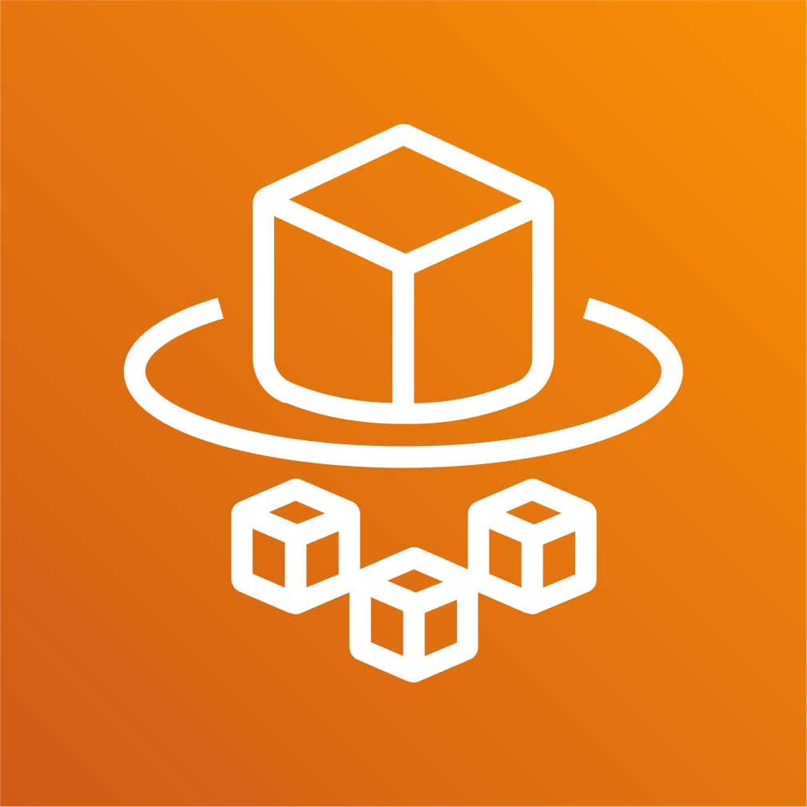


AWS Fargate & ECS Elastic Container Registry - ECR

Slide 20
Elastic Container Registry - ECR
Elastic Container Registry (ECR) is a fully-managed Docker container registry
that makes it easy for developers to store, manage, and deploy Docker
container images.
ECR is integrated with Elastic Container Service (ECS), simplifying our
development to production workflow.
ECR eliminates the need to operate our own container repositories or worry
about scaling the underlying infrastructure.
ECR hosts our images in a highly available and scalable architecture, allowing us to reliably deploy containers for our applications.
Integration with AWS Identity and Access Management (IAM) provides
resource-level control of each repository.
With Amazon ECR, there are no upfront fees or commitments. We pay only
for the amount of data you store in your repositories and data transferred
to the Internet.

Slide 21
Elastic Container Registry - ECR
Benefits
Full managed
Secure
Highly Available
Simplified Workflow

Slide 22








How ECR Works?
Developer
Docker Container
Elastic Container Service - ECS
Push Images
Docker Image
Elastic Container Registry - ECR
Docker Container
Elastic Kubernetes Service - EKS
Pull Images and Run Containers
Pull Images
Docker Container
On-Premise

Slide 23
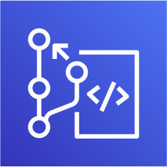
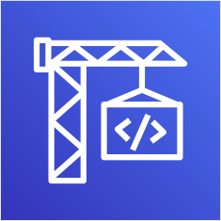
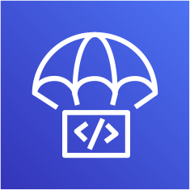



AWS Fargate & ECS
Continuous Integration & Continuous Delivery
CodeCommit
CodeBuild
CodeDeploy
CodePipeline
CloudWatch
Simple Notification Service

Slide 24
Stages in Release Process
Source
Build
Test
Production
Check-in source code
Peer review new code
Pull Request process
Compile Code & build artifacts (war
,jar, container images, Kubernetes manifest files)
Unit Tests
Integration tests with other systems.
Load Testing
UI Tests
Security Tests
Test Environments (Dev, QA and Staging)
Deployment to production environments
Monitor code in production to quickly detect errors

Slide 25


Stages in Release Process
Source
Build
Test
Production

Slide 26
Continuous Integration
Source
Build
Test
Production
Automatically kick off a new release when new code is checked-in
Build and test code in a consistent, repeatable environment
Continually have an artifact ready for deployment

Slide 27
Continuous Delivery
Source
Build
Test
Production
Automatically deploy new changes to staging environments fortesting
Deploy to production safely without affectingcustomers
Deliver to customers faster
Increase deployment frequency, and reduce change lead time and change failure rate

Slide 28
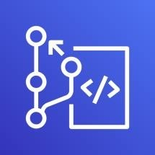
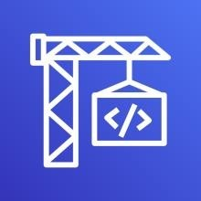

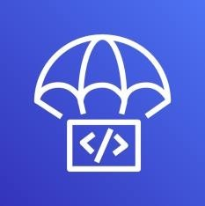
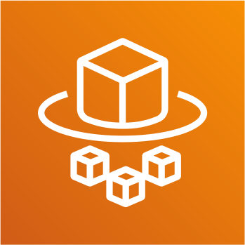

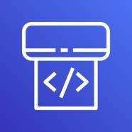
AWS Developer Tools or Code Services
Source
Build
Test
Deploy
Monitor
AWSCodeCommit
AWSCodeBuild
AWSCodeBuild + Third Party
CodeDeploy
Fargate or ECS
Amazon CloudWatch
AWSCodePipeline

Slide 29
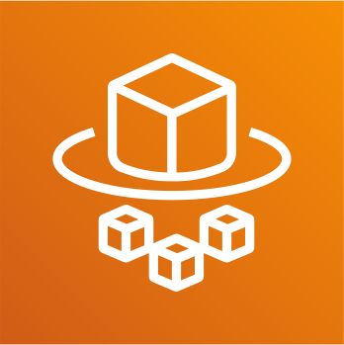
AWS Developer Tools or Code Services
Source
Build
Test
Deploy
Monitor
AWSCodeCommit
AWSCodeBuild
AWSCodeBuild + Third Party
Fargate or ECS
Amazon CloudWatch
AWSCodePipeline

Slide 30
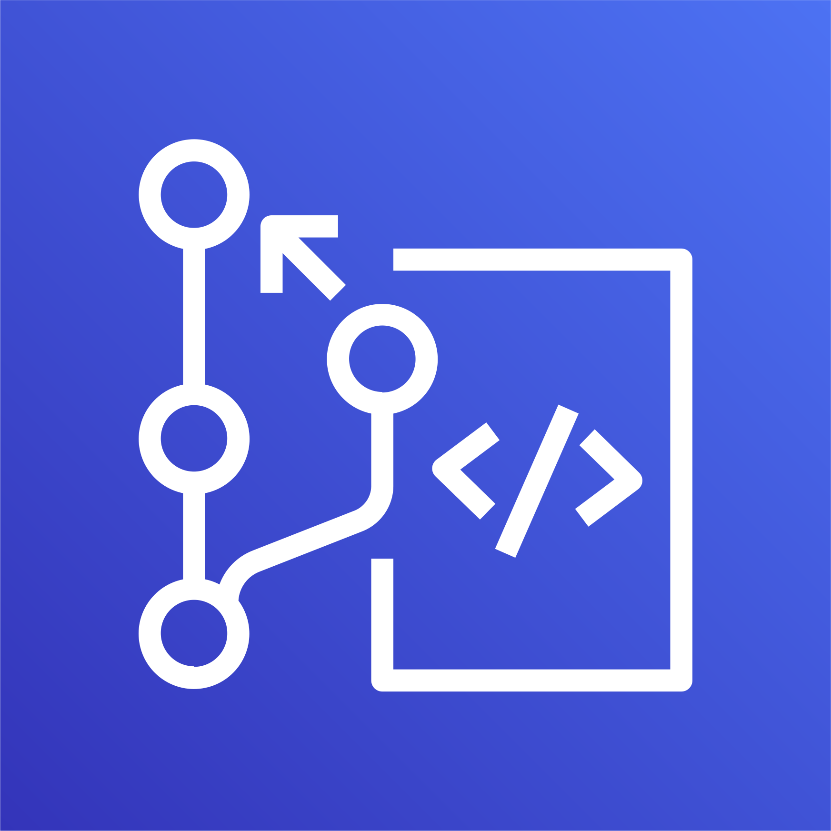
AWS CodeCommit

Slide 31
AWS CodeCommit - Introduction
Version Control Service hosted by AWS
We can privately store and manage documents, source code, and binary files
Secure & highly scalable
Supports standard functionality of Git (CodeCommit supports Git versions 1.7.9 and later.)
Uses a static user name and password in addition to standard SSH..

Slide 32

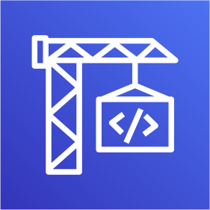




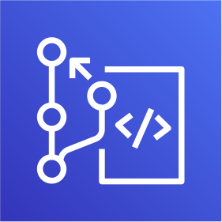



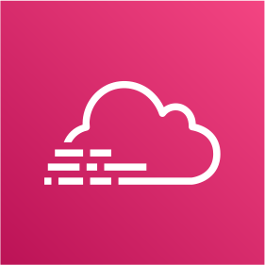

CodeCommit – Integration with AWS Services
AWS CodeStar
AWS CodeBuild
AWS CodePipeline
AWS Cloud9
AWS Amplify
AWS CloudFormation
AWS CodeCommit
Amazon Simple Notification Service
^{AWS Key Management} AWS Elastic Beanstalk Service
AWS CloudTrail
Amazon CloudWatch

Slide 33

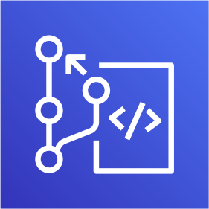
CodeCommit - Steps
Developer
Local Git Repo
push
AWS Cloud
AWS CodeCommit

Slide 34
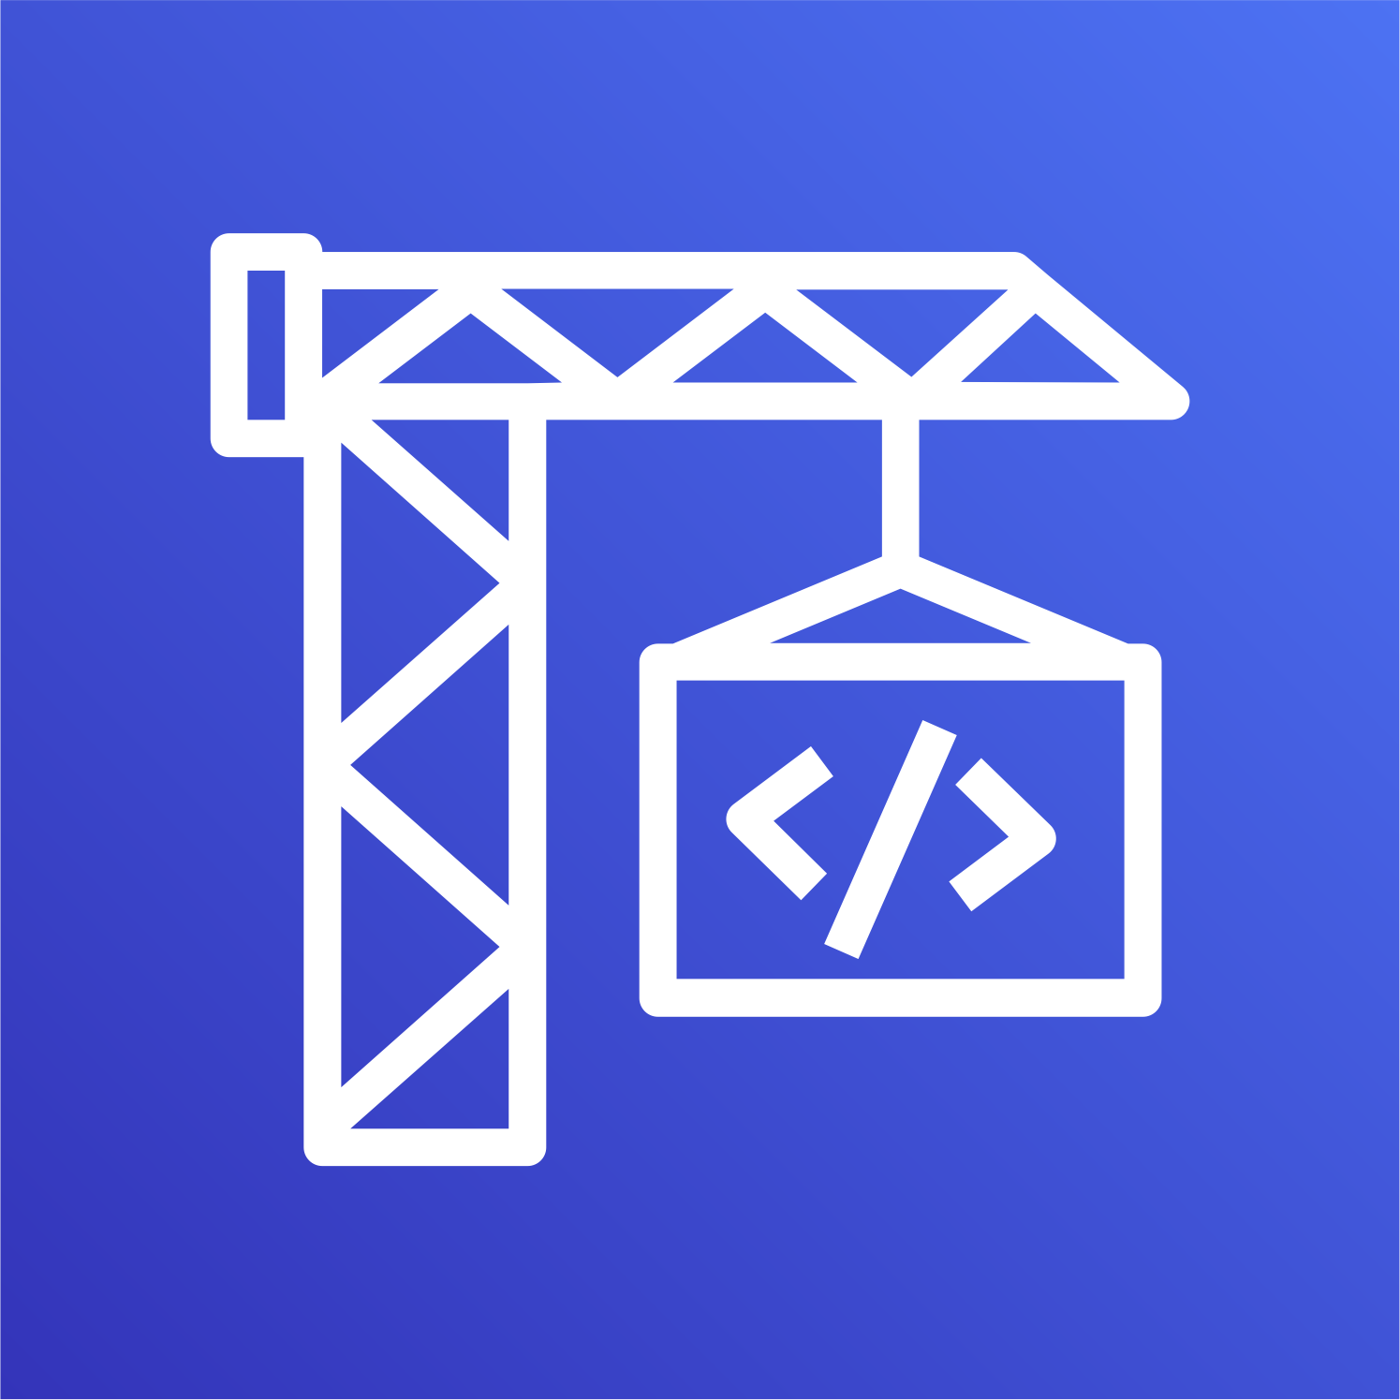
AWS CodeBuild

Slide 35
CodeBuild - Introduction
CodeBuild is a fully managed build service in the cloud.
Compiles our source code, runs unit tests, and produces artifacts that are ready to deploy.
Eliminates the need to provision, manage, and scale our own build servers.
It provides prepackaged build environments for the most popular programming languages and build tools such as Apache Maven, Gradle, and many more.
We can also customize build environments in CodeBuild to use our own build tools.
Scales automatically to meet peak build requests.

Slide 36
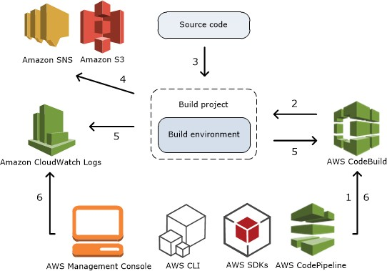
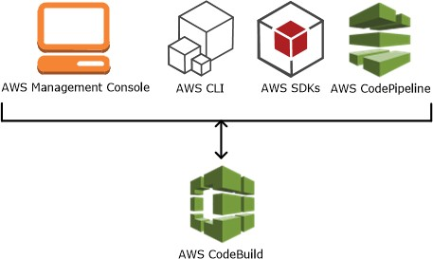
How CodeBuild works?
How to run CodeBuild?

Slide 37
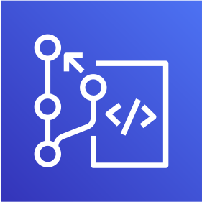




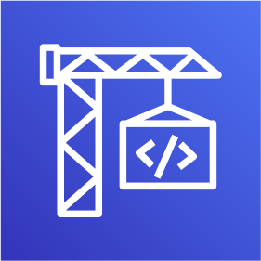





Source
AWS CodeCommit
Amazon Simple Storage Service (S3)
GitHub
GitHub Enterprise
Bitbucket
AWS Managed Image
AWS CodeBuild
Amazon CloudWatch
Build Logs
Amazon EC2 Container Registry
Amazon Simple Notification Service
External Container Registry (Docker Hub)
Build Environment
Amazon Simple Storage Service (S3)
Build Artifacts
Build Notifications
AWS CodeBuild Architecture

Slide 38

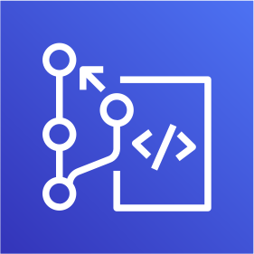
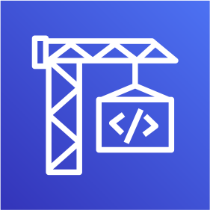

CodeBuild - Steps
Developer
Commit code changes
Local Git Repo
push
AWS Cloud
AWS CodeCommit
AWS CodeBuild
Simple Storage Service (S3)

Slide 39

AWS CodePipeline

Slide 40
CodePipeline - Introduction
AWS CodePipeline is a continuous delivery service to model, visualize, and automate the steps required to release your software.
Benefits
We can automate our release processes.
We can establish a consistent release process.
We can speed up delivery while improving quality.
Supports external tools integration for source, build and deploy.
View progress at a glance
View pipeline history details.

Slide 41




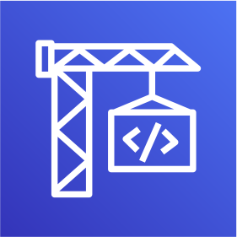


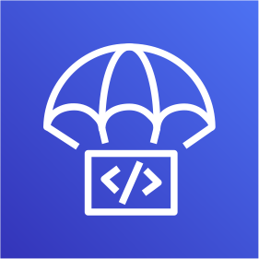





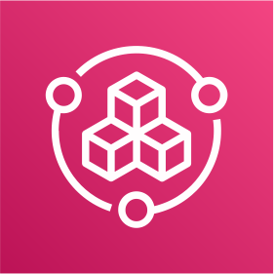
AWS CodePipeline Architecture
AWS CodePipeline
AWS CodeCommit
AWS CloudFormation
Amazon Elastic Container Service
AWS CodeBuild
Amazon CloudWatch
Amazon EC2 Container Registry
AWS CodeDeploy
Amazon Elastic Container Service (Blue/Green)
Simple Storage Service (S3)
AWS Elastic Beanstalk
Jenkins
GitHub Webhooks
Simple Storage Service (S3)
GitHub
Source
AWS Service Catalog
Build
Deploy
Monitor Source Changes

Slide 42
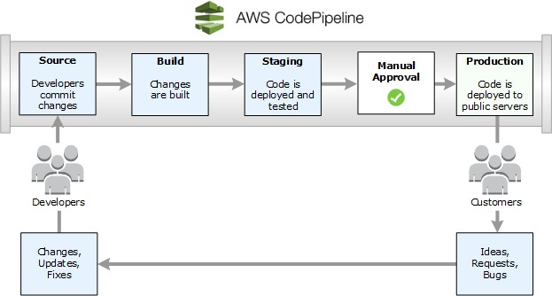
Continuous Delivery
Kalyan Reddy Daida
_{©Amazon} Vcube

Slide 43















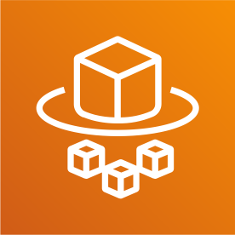





















AWS Cloud
CI CD Process
Developer
CloudWatch
CodePipeline
Commit code changes
Local Git Repo
push
S3
CodeCommit
CodeBuild
Fargate or ECS
Simple Notification Service
ECR
Staging
Production
Authorized Approver
Task Definition
Service
Container
Task
Service
Container
Definition
Elastic Container Service

Slide 44
AWS Fargate & ECS What are Microservices?

Slide 45
What are Microservices?
Microservices - also known as the microservice architecture - is an architectural style that structures an application as a collection of services that are
Highly maintainable and testable
Loosely coupled
Independently deployable
Organized around business capabilities
Owned by a small team

Slide 46
Microservices - Benefits
Developer independence: Small teams work in parallel and can iterate faster than large teams.
Isolation and resilience: If a component dies, you spin up another while and the rest of the application continues to function.
Scalability: Smaller components take up fewer resources and can be scaled to meet increasing demand of that component only.
Lifecycle automation: Individual components are easier to fit into continuous delivery pipelines and complex deployment scenarios not possible with monoliths.
Relationship to the business: Microservice architectures are split along business domain boundaries, increasing independence and understanding across the organization.

Slide 47





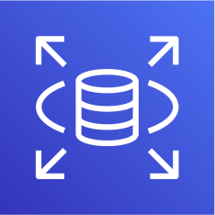




Microservices Deployment on AWS ECS – No Service Discovery
AWS Cloud
User Management Service
/usermgmt*
Task Definition
Service
Container
Amazon RDS
Postman Client
services.Vcube.com
Elastic Load Balancing (ELB)
End User
/notification*
Notification Service
Task Definition
Service
Container
Simple Email Service (SES)
/notification*
Email
API Developer

Slide 48
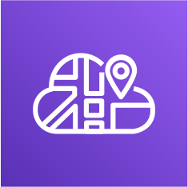

Microservices Deployment on ECS - with Service Discovery
AWS Cloud
User Management Service
/usermgmt*
Task Definition
Service
Container
Amazon RDS
Postman Client
/notification*
services.Vcube.com
Elastic Load Balancing (ELB)
AWS Cloud Map
Amazon Route 53
End User
/notification*
Notification Service
Task Definition
Service
Container
Simple Email Service (SES)
/notification*
Email
API Developer

Slide 49


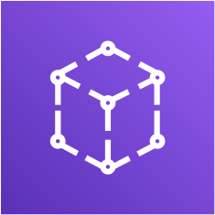


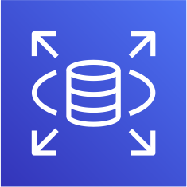


Microservices – with AWS AppMesh on ECS
AWS Cloud
Postman Client
UMS Envoy Proxy |  | NS Envoy Proxy
Elastic Load Balancer
App Mesh
User Management Service
Notification Service
API User
Proxy To Notification Info API
Notification Info AP
Egress 3306
Create User API
User Management Microservice
Send Notification API
End User
Notification Microservice
Egress 587
Amazon RDS
Simple Email Service (SES)
Email

Slide 50

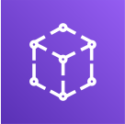




Microservices – Canary Deployments with AppMesh on ECS
AWS Cloud
App Mesh
Virtual Router
50% Traffic to V1
50% Traffic to V2
Postman Client
Elastic Load Balancer
UMS Envoy Proxy |  | NS Envoy Proxy – V1 |  | NS Envoy Proxy – V2
User Management Service
Notification Service
Notification Service
Proxy To Notification Info API
User Management Microservice
Notification Info API
– V1
Notification Microservice
Notification Info API
– V2
Notification Microservice
API User

Slide 51
AWS Fargate & ECS Microservices Deployment

Slide 52
Microservices
User Management Microservice
Notification Microservice

Slide 53

Microservices
Postman Client
Create User API
Send Notification API
List Users API
Email
End User
Health Status API
Delete User API
Health Status API
User Management Microservice
Notification Microservice
API Developer Or
API User
SMTP
Server
Users DB

Slide 54
Microservices Deployment on AWS ECS
AWS Cloud
User Management Service
/usermgmt*
Task Definition
Service
Container
Amazon RDS
Postman Client
services.Vcube.com
Elastic Load Balancing (ELB)
End User
/notification*
Notification Service
Task Definition
Service
Container
Simple Email Service (SES)
/notification*
Email
API Developer

Slide 55
AWS Fargate & ECS
Microservices Service Discovery

Slide 56
Microservices Deployment on ECS with Service Discovery
AWS Cloud
User Management Service
/usermgmt*
Task Definition
Service
Container
Amazon RDS
Postman Client
/notification*
services.Vcube.com
Elastic Load Balancing (ELB)
AWS Cloud Map
Amazon Route 53
End User
/notification*
Notification Service
Task Definition
Service
Container
Simple Email Service (SES)
/notification*
Email
API Developer

Slide 57
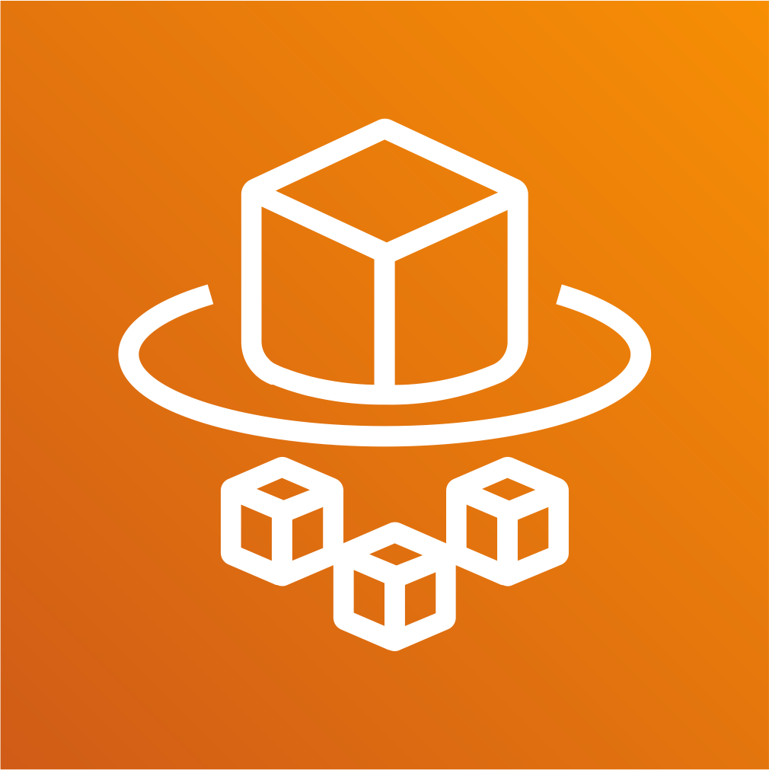
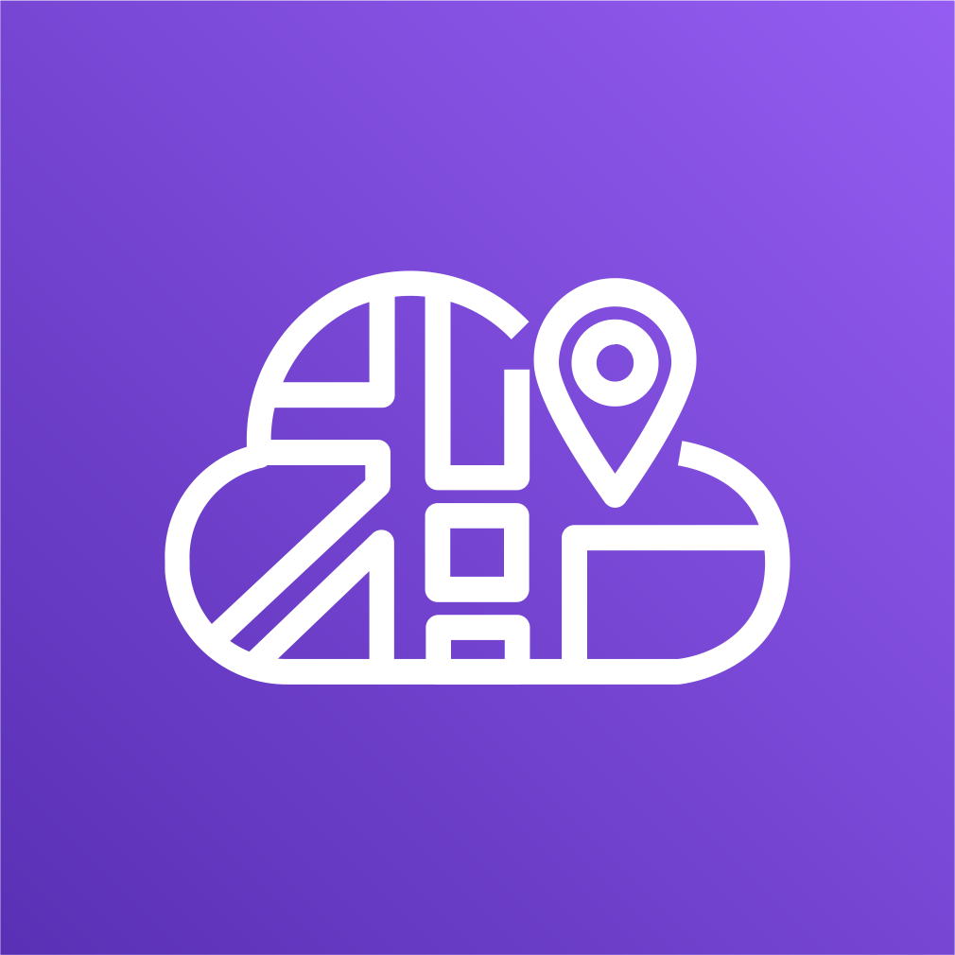

AWS Fargate & ECS Cloud Map

Slide 58
Complexity of modern architectures
Wide variety of resources
Complexity grows exponentially
Multiple versions and stages coexist
Infrastructure scales dynamically
Unhealthy resources are replaced

Slide 59
How to find resources to connect to?
Service Discovery
Finding the location of a service provider myapp: {10.20.30.4:8080, 10.20.30.6:8080}
mylogs: {S3bucket1, S3bucket2}

Slide 60
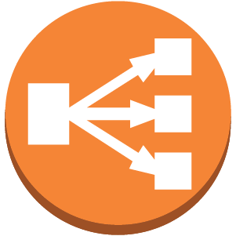
Server-side service discovery pattern
Connections are proxied
Discovery is abstracted away
Availability and capacity impact
Additional latency
Request
Request
Client
Service Provider
LB +
Service Registry
Register
Service Provider
Register
Service Provider

Slide 61
Client-side service discovery pattern
Clients connect directly to providers
Fewer components in the system
Clients must be registry-aware
Client-side load balancing
Request
Client
Register
Service Provider
Query
Service Provider
Register
Service Registry
Register
Service Provider
Kalyan Reddy Daida

Slide 62






Existing solutions require setup andmanagement
Service registry
Service Registries

Slide 63








Build the dynamic map of your cloud
Kalyan Reddy Daida

Slide 64
AWS Cloud Map - Introduction
AWS Cloud Map is a cloud resource discovery service.
With Cloud Map, you can define custom names for your application
resources, and it maintains the updated location of these dynamically
changing resources.
This increases your application availability because your web service always discovers the most up-to-date locations of its resources.
Cloud Map allows you to register any application resources, such as
databases, queues, microservices, and other cloud resources, with custom
names.
Cloud Map then constantly checks the health of resources to make sure the
location is up-to-date.
The application can then query the registry for the location of the resources
needed based on the application version and deployment environment.

Slide 65



AWS Cloud Map registry
microservices.local
Namespace
Service
Service Instance
notification-service
Name = notification-service DNS record = A TTL = 60 sec Health Check = Yes
ECS Task-1 172.10.0.1
ECS Task-2 172.10.0.2
ECS Task-3 172.10.0.3

Slide 66
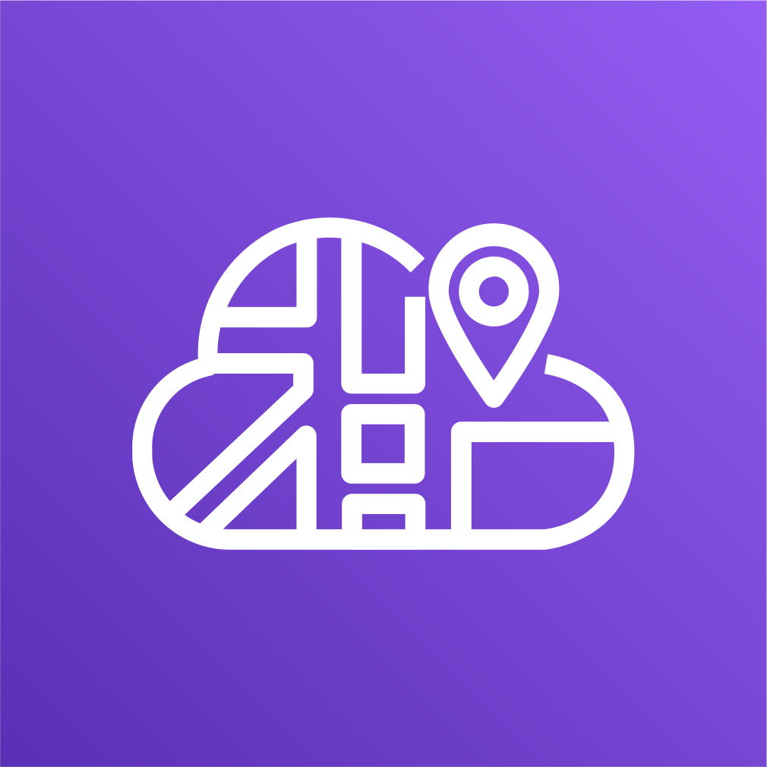
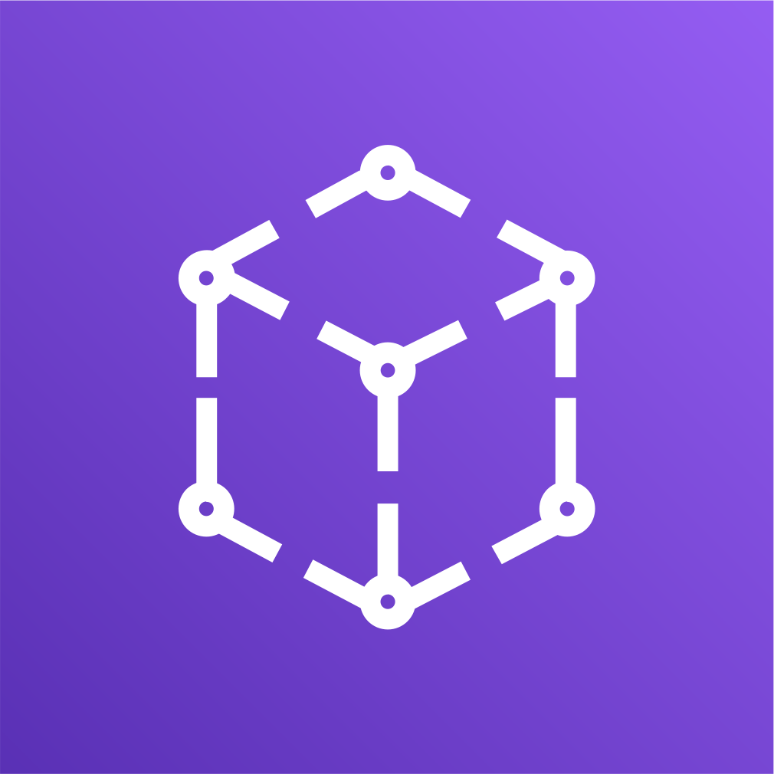
AWS Fargate & ECS Microservices & App Mesh

Slide 67
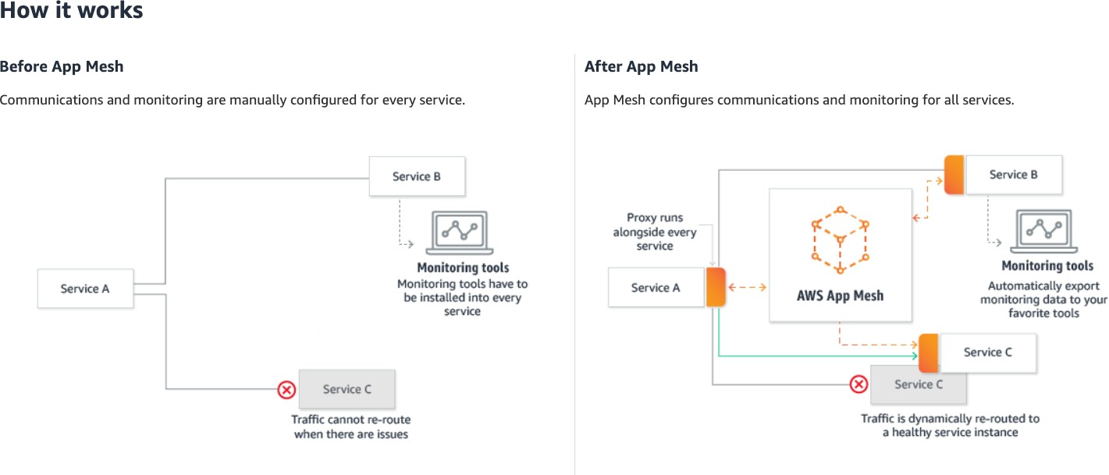
AWS App Mesh
Refernce: https://aws.amazon.com/app-mesh/

Slide 68




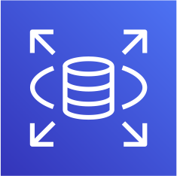


Microservices – without AWS AppMesh on ECS
AWS Cloud
User Management Service
Notification Service
Notification Info AP Send Notification API
Notification Microservice
Proxy To Notification Info API
Postman Client
Create User API
User Management Microservice
End User
Elastic Load Balancer
Amazon RDS
Simple Email Service (SES)
API User
Email

Slide 69
Microservices – with AWS AppMesh on ECS
AWS Cloud
Postman Client
UMS Envoy Proxy |  | NS Envoy Proxy
Elastic Load Balancer
App Mesh
User Management Service
Notification Service
API User
Proxy To Notification Info API
Notification Info AP
Egress 3306
Create User API
User Management Microservice
Send Notification API
End User
Notification Microservice
Egress 587
Amazon RDS
Simple Email Service (SES)
Email

Slide 70
AWS Fargate & ECS Microservices Canary Deployments with App Mesh

Slide 71
Microservices – Canary Deployments with AppMesh on ECS
AWS Cloud
App Mesh
Virtual Router
50% Traffic to V1
50% Traffic to V2
Postman Client
Elastic Load Balancer
UMS Envoy Proxy |  | NS Envoy Proxy – V1 |  | NS Envoy Proxy – V2
User Management Service
Notification Service
Notification Service
Proxy To Notification Info API
User Management Microservice
Notification Info API
– V1
Notification Microservice
Notification Info API
– V2
Notification Microservice
API User

Slide 72

AWS Fargate & ECS CloudFormation

Slide 73









Fargate Tasks – Public Subnet in a VPC
AWS Cloud
VPC 10.0.0.0/16
Public subnet
10.0.1.0/24
Task-1
Task Definition
Internet
Internet Gateway
Elastic Load Balancing
Task-2 Service
Fargate Cluster

Slide 74
Thank You

