Slide 1
STANCE DETECTION FOR TELUGU LANGUAGE
UNDER THE GUIDANCE OF
Dr. Anand Kumar M
BY GROUP-21
G Revanth - 201IT122
E Vennela - 201IT218
SYP Madesh - 201IT254

Slide 2
Introduction
Stance detection is a natural language processing system which automatically identifies the user comment is in favor, against or neutral towards the target entity.
Target entity may be a person, a government new policy, a location, etc.
Mining comments, tweets or posts from social media sites gives us more insights about user reaction towards the target entities.
It has gained significant attention in recent years due to its potential applications in various domains, including politics, social media analysis, and market research.

Slide 3
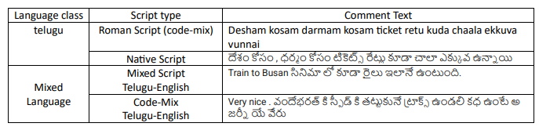
Dataset
Various Different Types Of Scripts

Slide 4
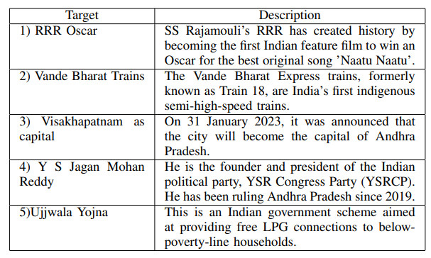
Dataset
DESCRIPTION ABOUT TARGETS

Slide 5
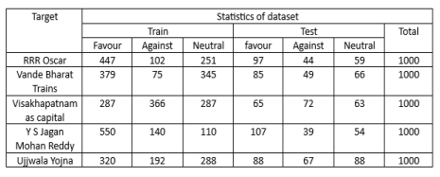
Dataset
STATISTICS OF DATASET

Slide 6
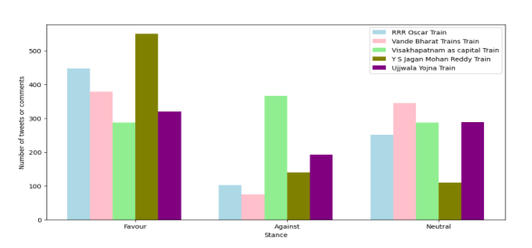
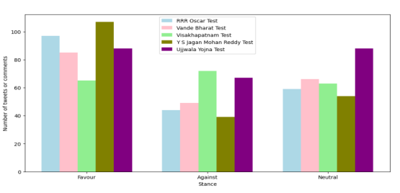
Dataset
Test-Dataset
Train-Dataset

Slide 7
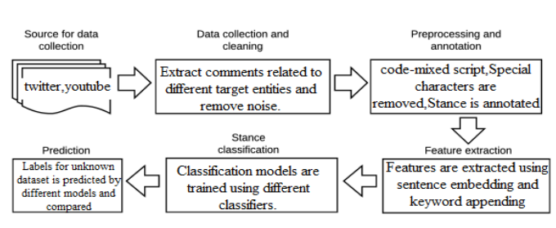
Methodology

Slide 8
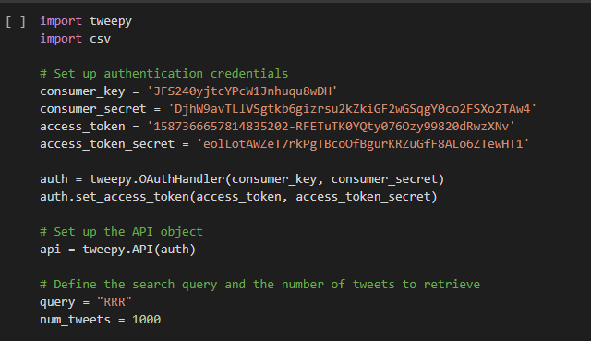
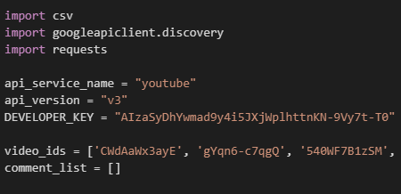
Methodology
Source for Data Collection
Twitter
YouTube

Slide 9
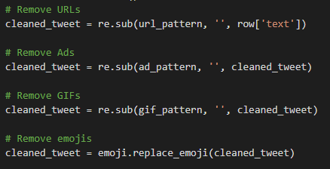
2. Data Cleaning
@pasumahi66: రాజమౌళి ఈ పక్షుల విన్యాసాలు చూసి RRR లో Naatu -- Naatu పాట తీసినట్టున్నాడు🤣🤣😃😎😎 https://tco/05XkZW7MSI
రాజమౌళి ఈ పక్షుల విన్యాసాలు చూసి RRR లో Naatu Naatu పాట తీసినట్టున్నాడు

Slide 10
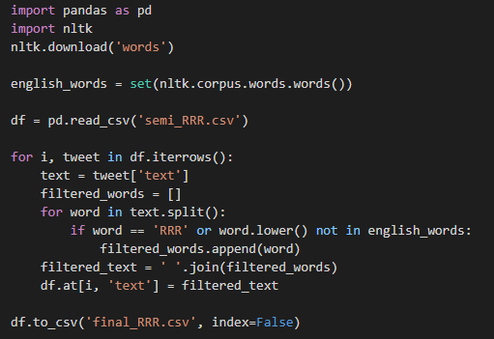
3. Pre-processing and Annotation
English sentences are removed
Stance is annotated Manually

Slide 11
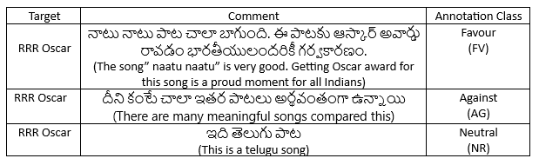
STANCE ANNOTATION PROCEDURE

Slide 12
4. Feature Extraction
Sentence embedding model (Paraphrase-XLM-R) to encode the tweets into dense vector representations.
Extracts keywords from each tweet using a TF-IDF vectorizer.
Finally, the sentence embeddings and keyword features are combined to create the final feature matrix, which will be used as input to a machine learning model.

Slide 13
5. Stance Classification
stance is classified using different Machine Learning Models.Those are
Bagging classifier (’Bg’)
Gradient Boosting Classifier as (’GB’)
Adaboost Classifier as (’AB’)
Multi-layer Perceptron Classifier as (’MLP’)
Gaussian Naive Bayes Classifier (’GNB’)
Random Forest Classifier (’RF’)

Slide 14
6. Prediction
The stance for the test data is predicted using the above mentioned machine learning algorithms.
Accuracy measures such as precision, recall, support and the F1 score is measured to test the accuracy of the implemented system.

Slide 15
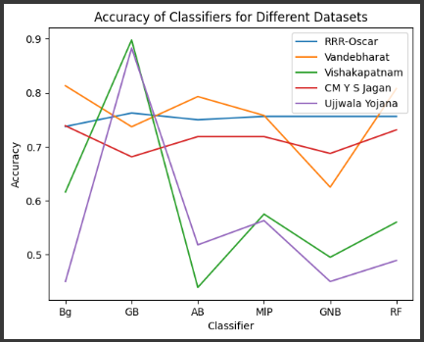
Experiment Results

Slide 16
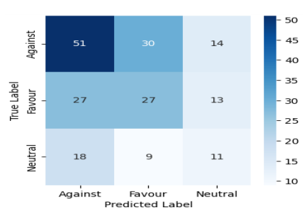
Experiment Results

Slide 17
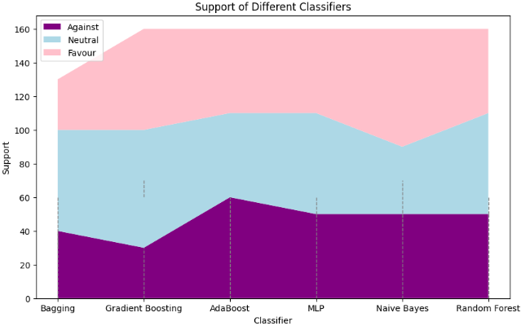
Experiment Results

Slide 18
Conclusion
A manually annotated dataset consisting of 5000 Telugu texts was created to determine stance, with labels including "favour", "against", and "neutral".
Six machine learning methods were employed to analyze the dataset, and it was determined that the Gradient Boosting Algorithm provided the most accurate results.
The results of the analysis showed that people generally held a favourable stance towards all targets, except for the proposal to make Visakhapatnam the capital.
These findings were then visualized to facilitate a clearer understanding of the results.

Slide 19
THANK YOU

