Slide 1
Dopamine and Temporal-Difference Learning
A computational reproduction of classic reward-prediction-error findings
Motivation: understand how the brain learns to predict rewards.
Classic finding: dopamine responses are strong for unexpected rewards, shift toward predictive cues after learning, and dip when an expected reward is omitted.
Research question: can TD(0) reproduce these qualitative patterns?
Reference: Schultz, Dayan & Montague (1997), A Neural Substrate of Prediction and Reward.

Slide 2
Method: simulated cue–reward task
Environment: baseline → cue → delay 1 → delay 2 → reward.
State: current stage in the sequence; tabular value V(s).
Action: no agent-controlled action (Pavlovian conditioning); optional one-action interpretation: wait/advance.
Reward: +1 at reward delivery; 0 otherwise. Omission trial withholds the expected +1.
TD(0): δ = r + γV(next) − V(current); V(current) ← V(current) + αδ.
Parameters: α = 0.15, γ = 0.95, 100 trials.

Slide 3
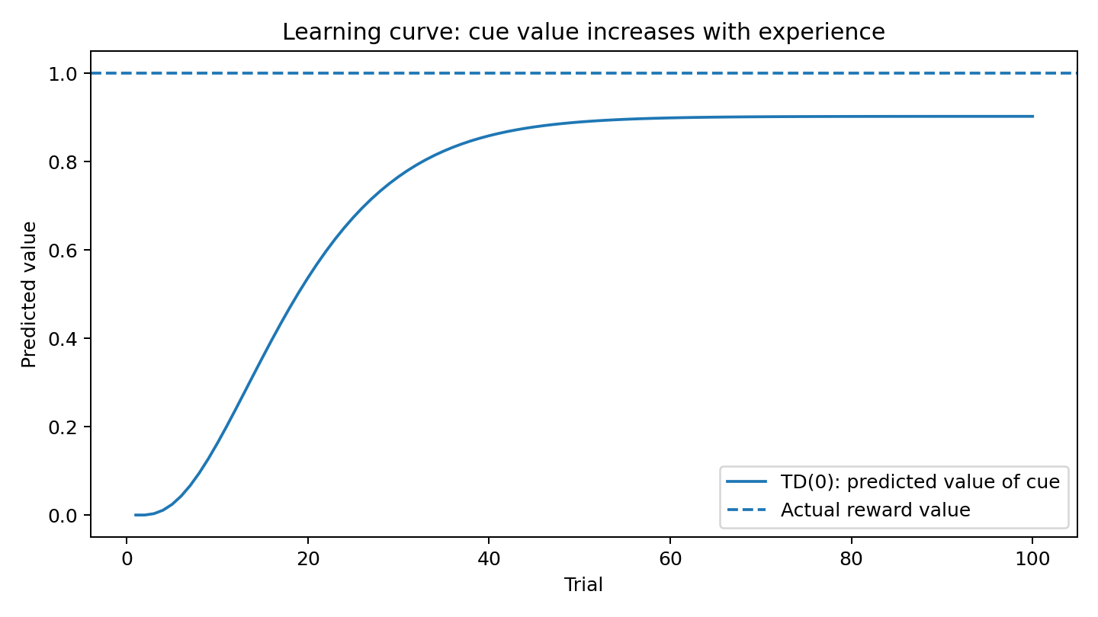
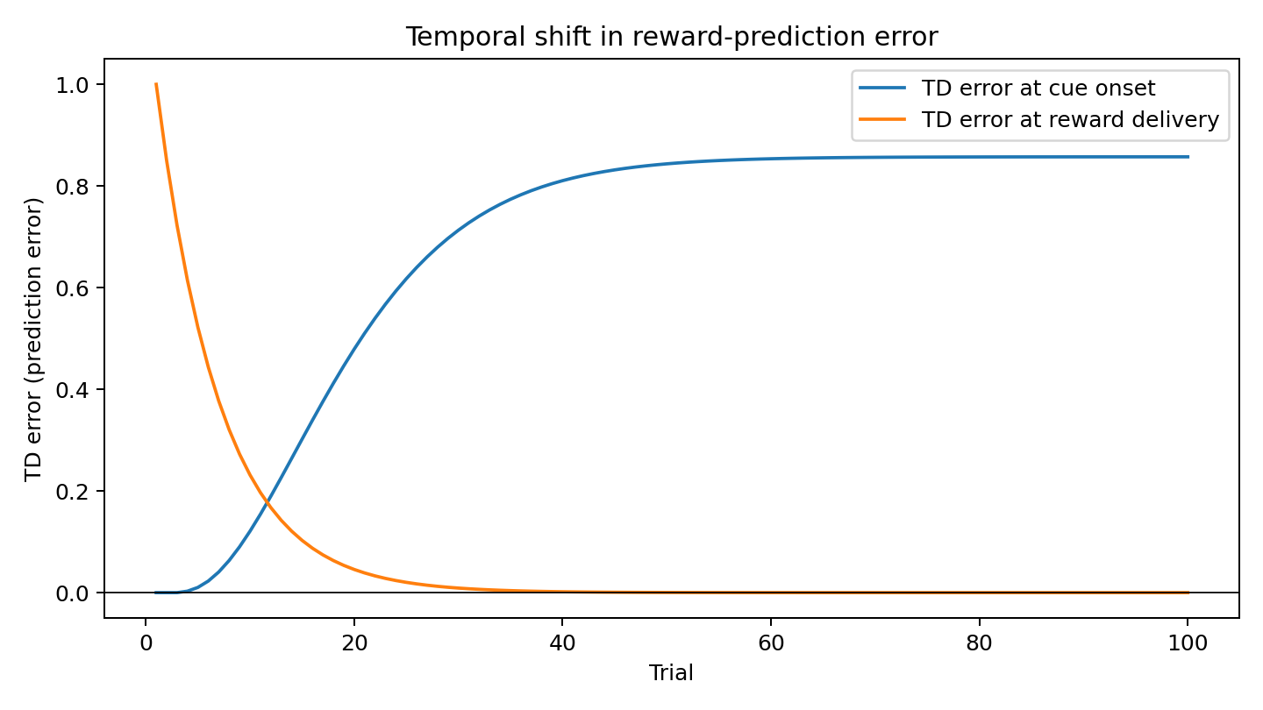
Results: value learning and prediction error

Slide 4
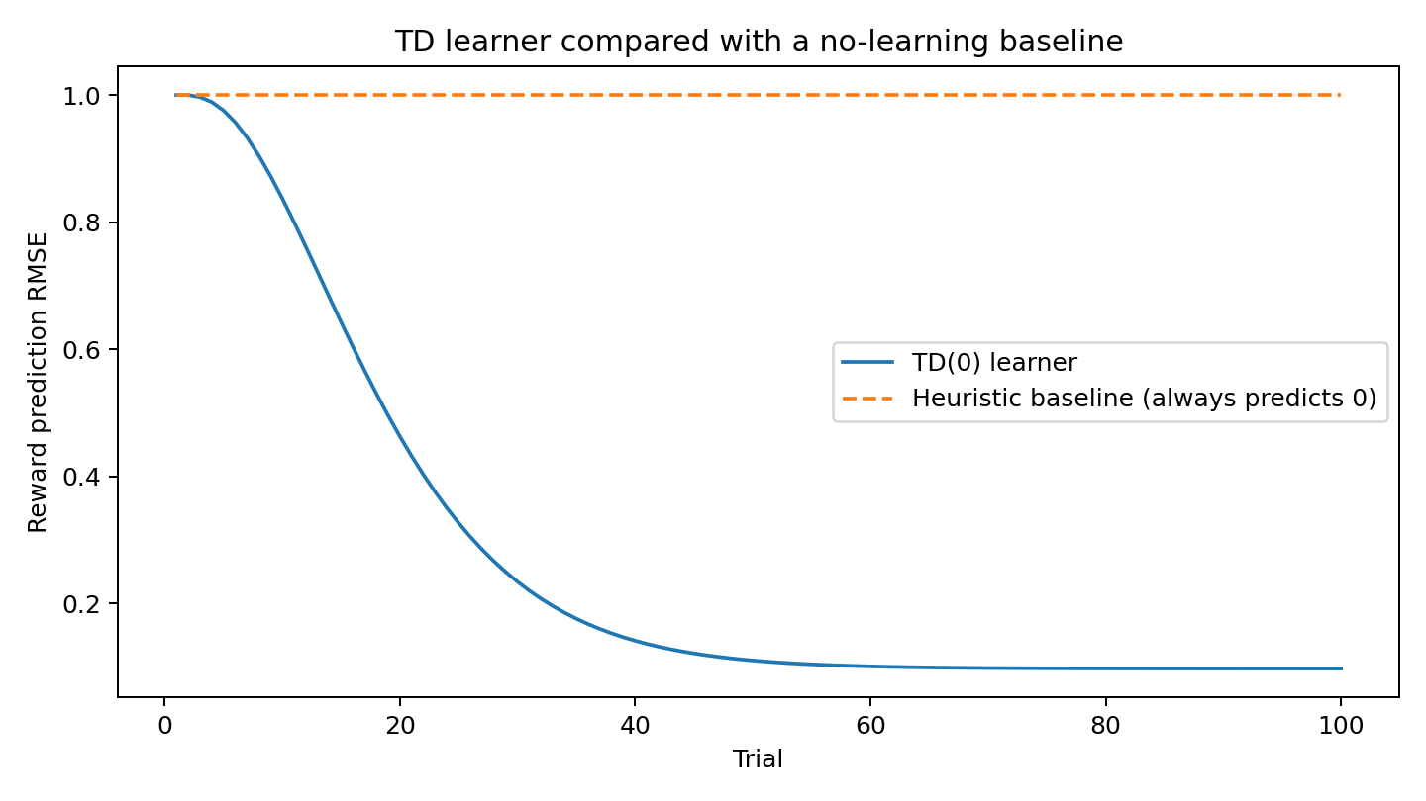
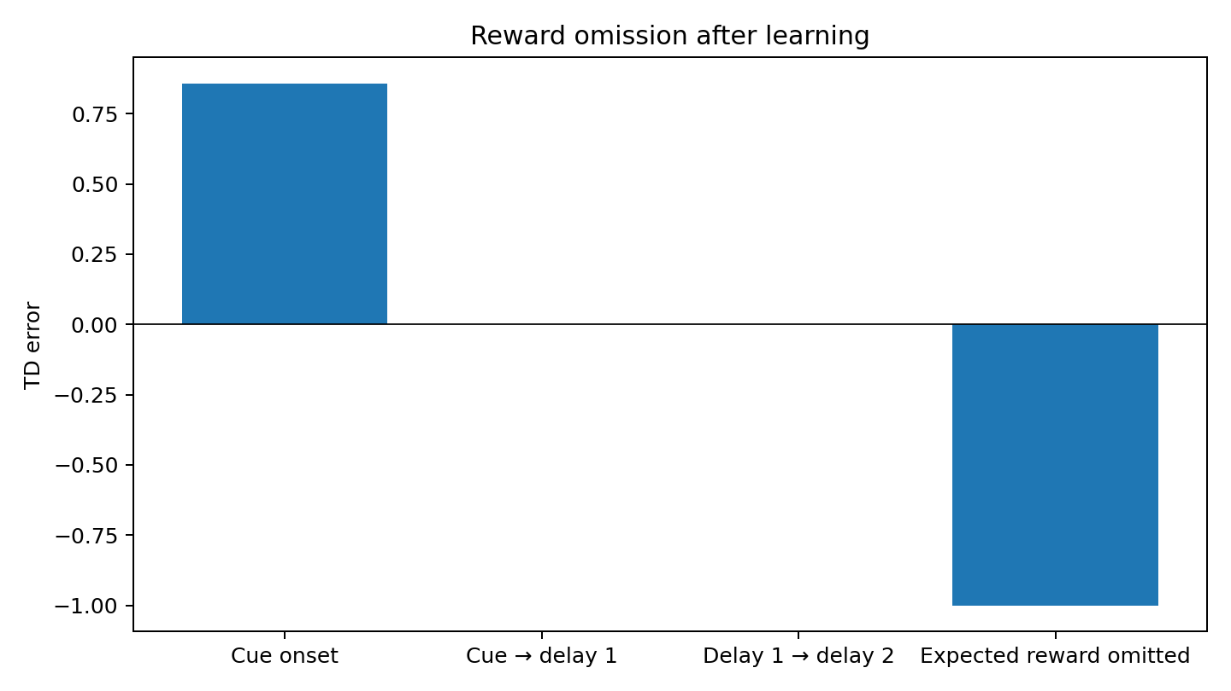
Results: baseline comparison and reward omission

Slide 5
Limitations, ethics and conclusion
Conclusion: TD(0) learns cue value; cue-onset error rises, reward-time error approaches zero, and reward omission creates a negative error.
Baseline: no-learning heuristic always predicts zero; TD(0) achieves lower prediction RMSE.
Limitations: deterministic chain, single reward, fixed learning rate; no neural heterogeneity, noise or physiological dynamics.
Ethics: simulation only—no human/animal subjects or personal data. Do not interpret TD error as a complete biological account of dopamine.
Next steps: stochastic reward timing, multiple cues/rewards, parameter sensitivity and comparison with recorded neural data.

