Slide 1

BLOCKCHAIN BASED CERTIFICATE VALIDATION
Batch-11
P.VENNELA (20S41A0590)
MD.NADIR MUJAHID (20S41A0575)
S.DHANA SRI (20S41A05A4)
T.MAHENDER (20S41A0590)
Under the guidance of
Mrs.A .KALPANA DEVI
Associate Professor

Slide 2

INDEX
EXISTING SYSTEM
ABSTRACT
DISADVANTAGES
PROPOSED SYSTEM
ADVANTAGES
SYSTEM ARCHITECTURE
SYSTEM REQUIREMENTS
MODULES
M0DULES DISCRIPTION
UML DIAGRAMS
SCREENSHOTS
CONCLUSION
REFERENCES

Slide 3
ABSTACT
Block chain technologies have gained interest over the last years. While the most explored use case is financial transactions, it has the capability to agitate other markets. Block chain remove the need for trusted intermediaries, can facilitate faster transactions and add more transparency. This paper explores the possibility to deflate counterfeit using block chain technology. This paper provides an overview of different solutions in the anti-counterfeit area, different block chain technologies and what characteristics make block chain especially interesting for the use case. We have developed three different concepts and the expansion of an existing system concept, is pursued further. It is shown, that reducing counterfeits cannot be achieved by using technological means only. Increasing awareness, fighting counterfeiters on a legal level, a good alert system, and having tamper-proof packaging are all important aspects. These factors combined with block chain technology can lead to an efficient and comprehensive approach to reduce counterfeiting.

Slide 4
EXISTING SYSTEM
In this paper author is using Block chain technology to authenticate supply chain products as this product may be supplied from multiple third party distributors and this distributors can make clone/fake/counterfeits of this product BAR CODE and then manufacture fake products and add this counterfeit label to fake product and this fake products can cause huge loss of financial and lives if fake medicine manufacture.
Not only supply chain any other online transaction require third party to complete transaction and peoples has to trust on third parties to complete their transaction and sometime this third parties can make fraud transaction or misuse user data.

Slide 5
DISADVANTAGES
We now have more fakes than real drugs in the market.
Cloning of product

Slide 6
PROPOSED SYSYEM
To avoid this problem author using Blockchain technology which does not require any third party and verification will be done by software algorithm itself without involvement
of any third party.In this to avoid forge counterfeit we are converting all productsdetails/barcode into digital signatures and this digital signatures will be stored in Blockchain server as this Blockchain server support tamper proof data storage and nobody can hack or alter its data and if by an chance if its data alter then verification get failed at next block storage and user may get intimation about data alter.

Slide 7
ADVANTAGES
In supply chain also all products barcode digital Block chain signatures will be stored and if any third party distributor make clone of barcode then its signature will be mismatch and counterfeit will be detected.

Slide 8
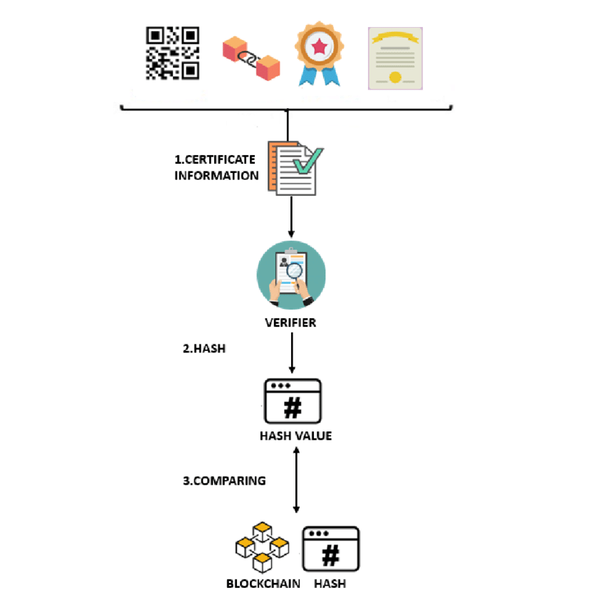
SYSTEM ARCHITECTURE

Slide 9
SYSTEM ARCHITECTURE
SOFTWARE REQUIREMENTS
Operating system:Windows 8
Coding Language: Python 3.7
HARDWARE REQUIREMENTS
System | : MINIMUM i3.
Hard Disk | : 40 GB.
Ram | : 4 GB.

Slide 10
MODULES
This project consists of 1 modules
1. USER MODULE

Slide 11
MODULE DISCRIPTION
1. USER MODULE
In Block chain technology same transaction data stored at multiple servers with hash code verification and if data alter at one server, then it will be detected from other server as for same data hash code will get different. For example, in Block chain technology data will be stored at multiple servers and if malicious users alter data at one of the servers then its hash code will get changed in one server and other servers left unchanged and this changed hash code will be detected at verification time and future malicious user changes can be prevented. In Block chain each data will be stored by verifying old hash codes and if old hash codes remain unchanged then data will be considered as original and unchanged and then new transaction data will be appended to Block chain as new block. For each new data storage all blocks hash code will be verified.

Slide 12
UML DIAGRAMS
UML stands for Unified Modeling Language. UML is a standardized general-purpose modeling language in the field of object-oriented software engineering. The standard is managed, and was created by, the Object Management Group.
The goal is for UML to become a common language for creating models of object oriented computer software. In its current form UML is comprised of two major components: a Meta-model and a notation. In the future, some form of method or process may also be added to; or associated with, UML.
The Unified Modeling Language is a standard language for specifying, Visualization, Constructing and documenting the artifacts of software system, as well as for business modeling and other non-software systems.
The UML represents a collection of best engineering practices that have proven successful in the modeling
of large and complex systems.

Slide 13
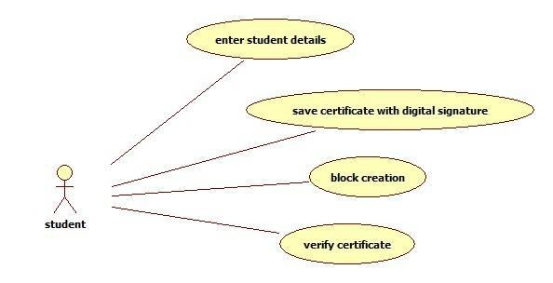
USE CASE DIAGRAM:
A use case diagram in the Unified Modeling Language (UML) is a type of behavioral diagram defined by and created from a Use-case analysis. Its purpose is to present a graphical overview of the functionality provided by a system inter of actors, their goals (represented as use cases), and any dependencies between those use cases. The main purpose of a use case diagram is to show what system functions are performed for which actor. Roles of the actors in the system can be depicted.

Slide 14
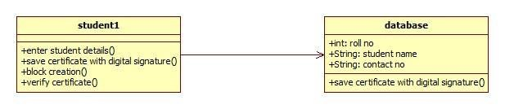
CLASS DIAGRAM :
In software engineering, a class diagram in the Unified Modeling Language (UML) is a type of static structure diagram that describes the structure of a system by showing the system's classes, their attributes, operations (or methods), and the relationships among the classes. It explains which class contains information.

Slide 15
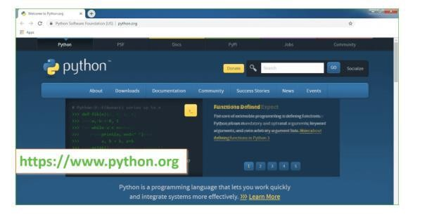
SCREENSHORTS
Test Results: All the test cases mentioned above passed successfully. No defects encountered.
OUTPUT SCREENS

Slide 16
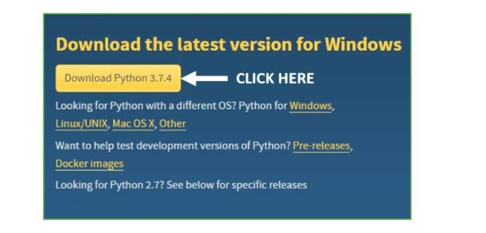
Download the latest version

Slide 17
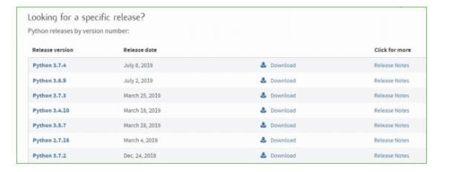
Scroll down the page until you find the downloaded page

Slide 18
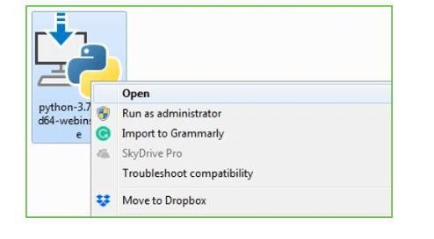

Slide 19
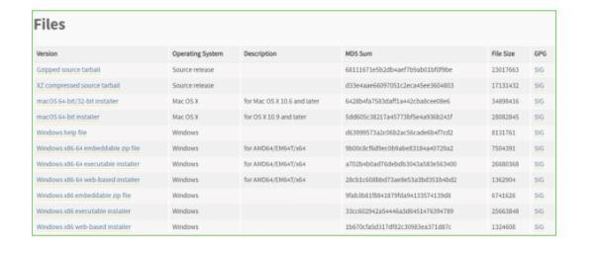

Slide 20
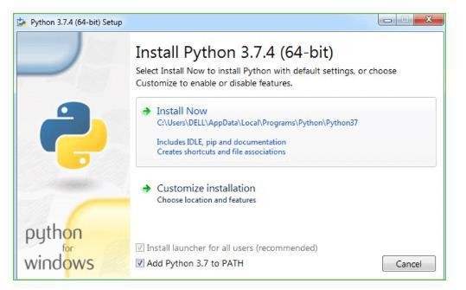

Slide 21
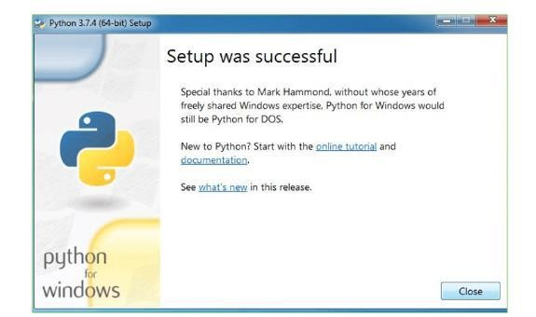

Slide 22
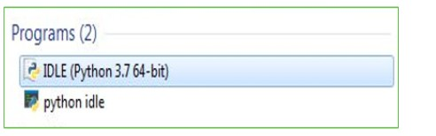

Slide 23
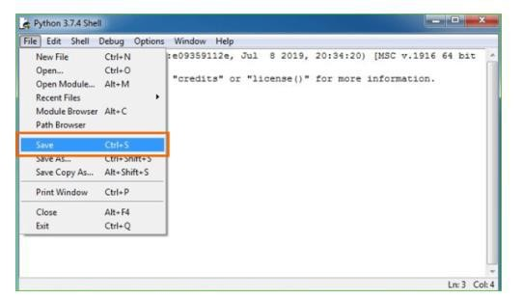

Slide 24
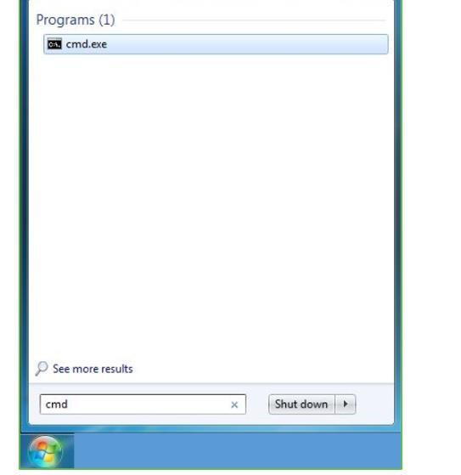

Slide 25
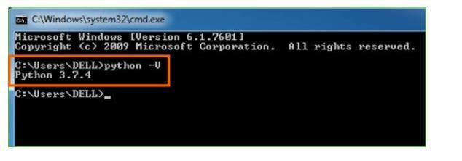

Slide 26
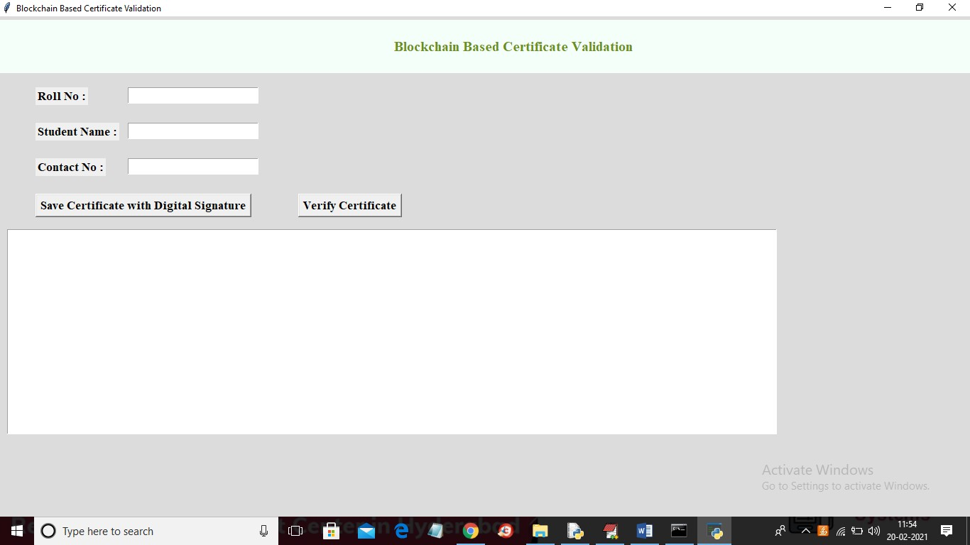

Slide 27
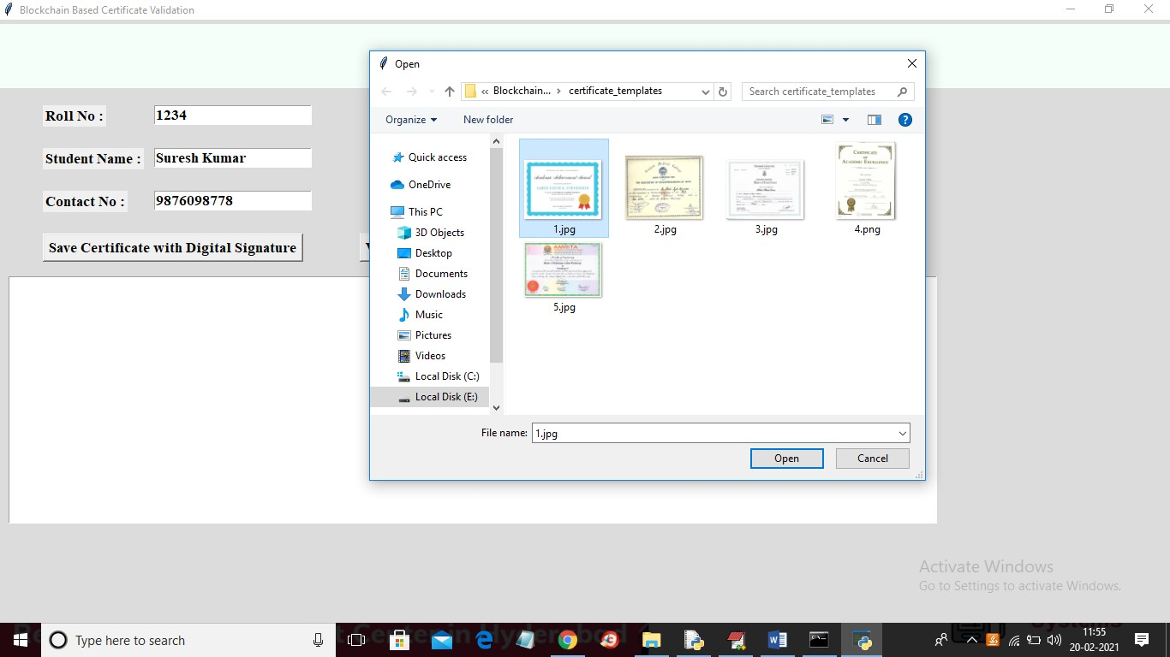
Enter the input

Slide 28
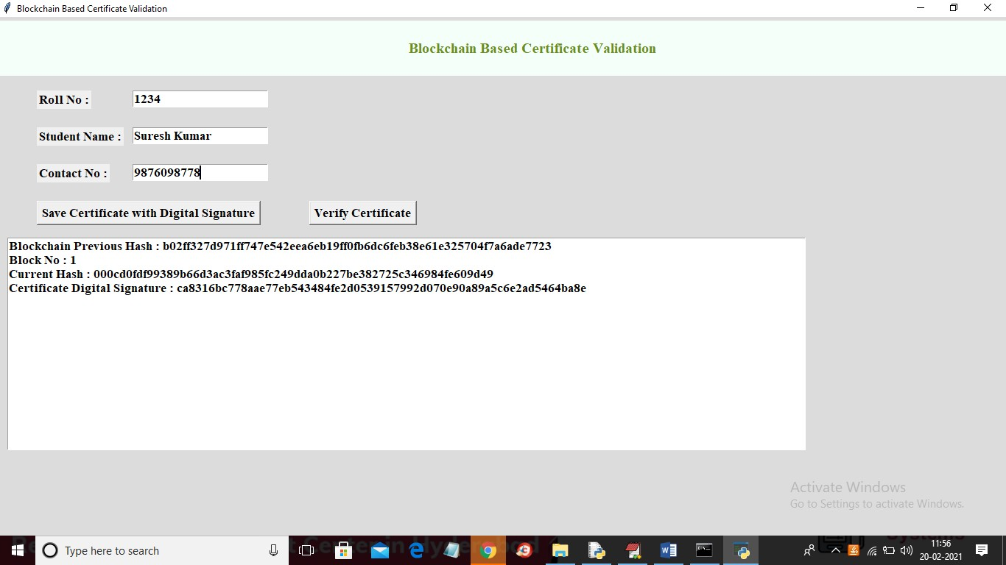

Slide 29
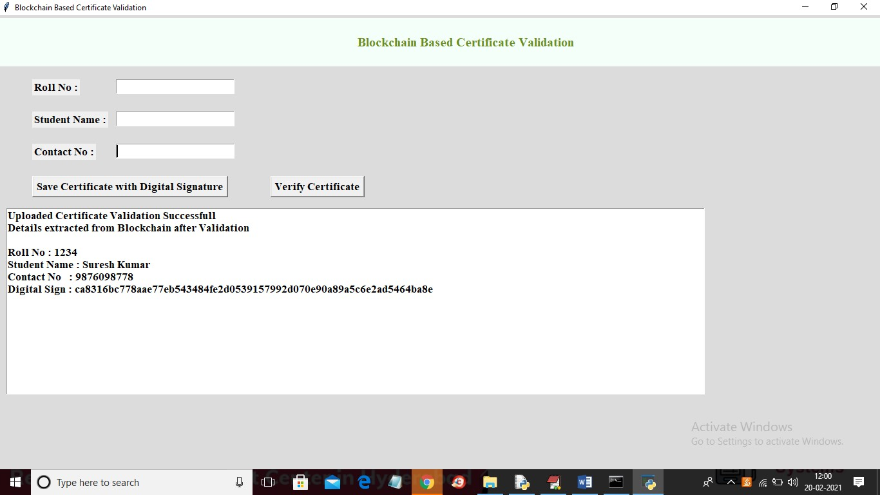

Slide 30
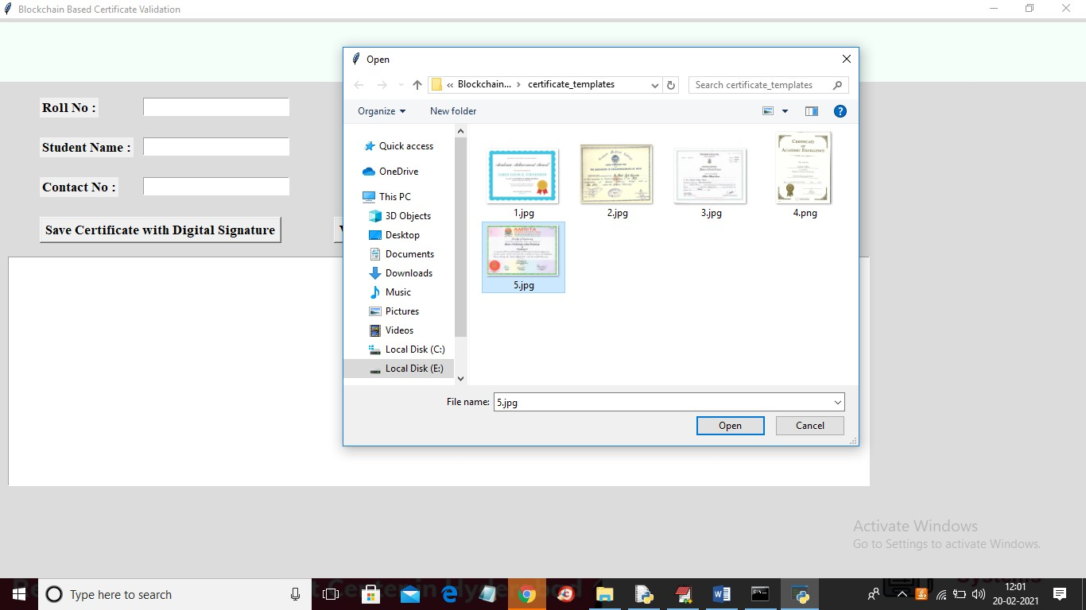

Slide 31
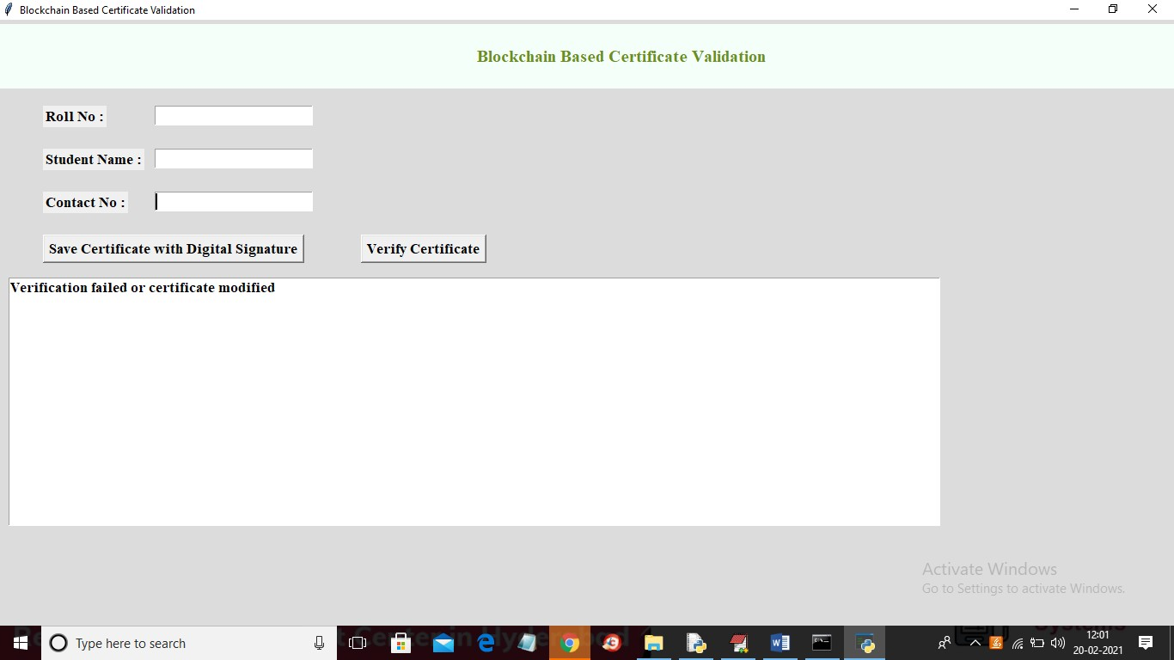

Slide 32
CONCLUSION
In June 2016, the MIT media lab released their block chain-based credential system which is more secure, more reliable and harder to forge, in contrast to existing technologies that based on the third party arbitration. However, there are some serious authentication defects and vulnerable revocation mechanism which limits the prevalence and application of the project. In our project, to solve these problems and make its concept more practical, we proposed and designed a set of innovative cryptographic protocols which includes multi-signature, BTC- address-state-based revocation mechanism and trusted federated identity.
Among these protocols, the multi-signature scheme most notably increases the difficulty of forging owing to the fact that each issuing progress is obliged to be signed by the majority of the academic committee members. Besides, it enhances the safety of the private keys storing for the reasons that the private keys are possessed by separated devices and people. Besides, BTC-address-based revocation mechanism improved the stability of the certificate revocation because BTC address is accessible and stable at any time. Moreover, this approach reduced the failure probability of revocation, because the realms such as digital right protecting and contract proof

Slide 33
REFERENCES
[1] Tengyu Yu, Blockchain operation principle analysis: 5 key technologies, iThome, https://www.ithome.com.tw/news/105374
[2] JingyuanGao, The rise of virtual currencies! Bitcoin takes the lead, and the other 4 kinds can't be missed. Digital Age, https://www.bnext.com.tw/article/47456/bitcoinether-li tecoin-ripple-differences-betweencryptocurrencies
[3] Smart contractswhitepaper, https://github.com/OSELab/learning-blockchain/blob/ master/ethereum/smart- contracts.md
[4] Gong Chen, Development and Application of Smart Contracts, https://www.fisc.com.tw/Upload/b0499306-1905- 4531-
888a-2bc4c1ddb391/TC/900
[5].pdfYong Shi, “Secure storage service of electronic ballot system based on block chain algorithm”, Department

Slide 34

