Slide 1
TBR
Venniz Valente

Slide 2
What is tbr?
TBR is a web application designed to encourage and help readers lessen their physical TBR piles in a light-hearted way by removing the competitiveness of “reading challenges” and encouraging recreational reading space that guides readers in a mindful and positive way.

Slide 3
How does TBR encourage recreational reading?
Eliminate Choice Overloading
Creating a playful way to encourage readers to go to their physical TBR shelf and select a book by…
Closing your eyes and pointing at x random books.
Choosing the first x books that you look at that makes you happy.
Choosing the first x books you see that are the most aesthetically pleasing.
Time is just a Concept
Reading challenges are competitive… I read 104 books in 1 year…
The Time Bubble Frame:
Allows the user to turn it off and on, giving readers a chance to read without a strict deadline.
Allows the user to start and stop, giving readers control of their own time.
Mindful Guidance
Lead by example by providing a guide to suggest a flexible structure to encourage not to dishearten.
Let them know so they can go with the flow… The average reader reads 200-400 words per minute, The average reader reads for 20 minutes a day, that’s about 8-16 pages a day.

Slide 4
Technology Stack
Front end
React - Increasingly popular choice within the software development community due to its intuitive and responsive user interface.
Back end
Node.js & Express.js - Enables seamless JavaScript development across the front and back end, ensuring efficient performance and easier code maintenance.
Google Books API - Provides a comprehensive repository of book data with few limitations, its interoperability makes it flexible and easy to integrate with different applications.
Fast API - Powerful framework that is very compatible with React, in combination making it powerful yet easy to use, and combines speed and efficiency with developer-friendly features.
API
database
MySQL - Popular and widely used in the industry due to its reliability and efficiency, due to its popularity MySQL is well documented and offers plenty of resources.

Slide 5
Implementation goals
3 Functionalities
Reading Allocation
Reading Level Selection
Reading Allocation
Google Books API Calls
Create an intuitive guide to help readers select books from their physical TBR.
From their now lessened electronic TBR shelf help allocate a sequence to help readers start reading.
Reading Level Selection
Google Books API Calls
Novice, Intermediate, and Expert
Select a level and obtain a suggested guide for book amounts and time bubble frames.
Make calls to retrieve book data from the API.

Slide 6
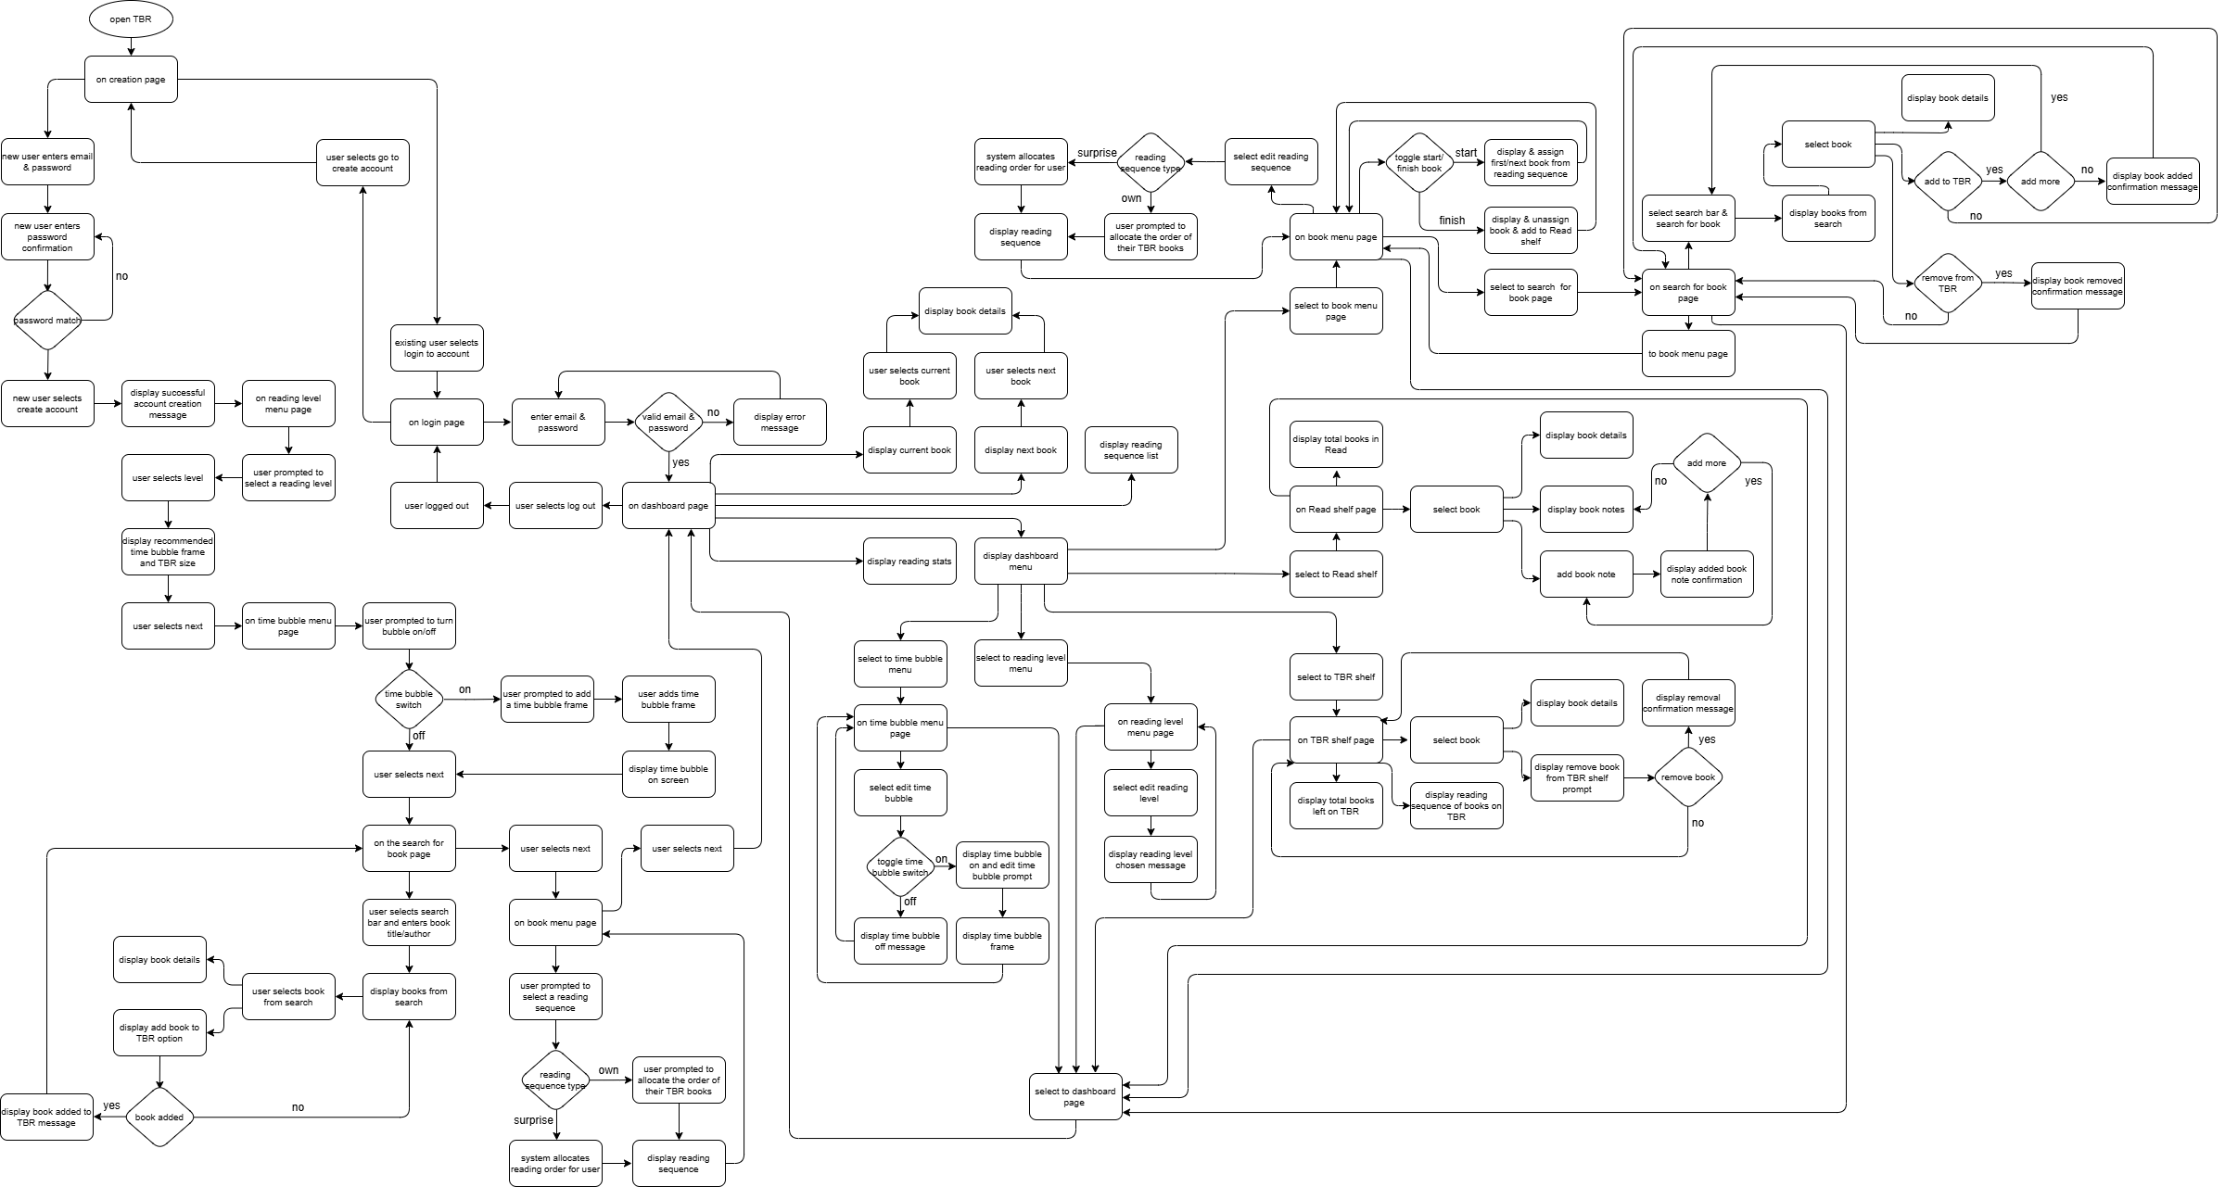
Design Flow

Slide 7
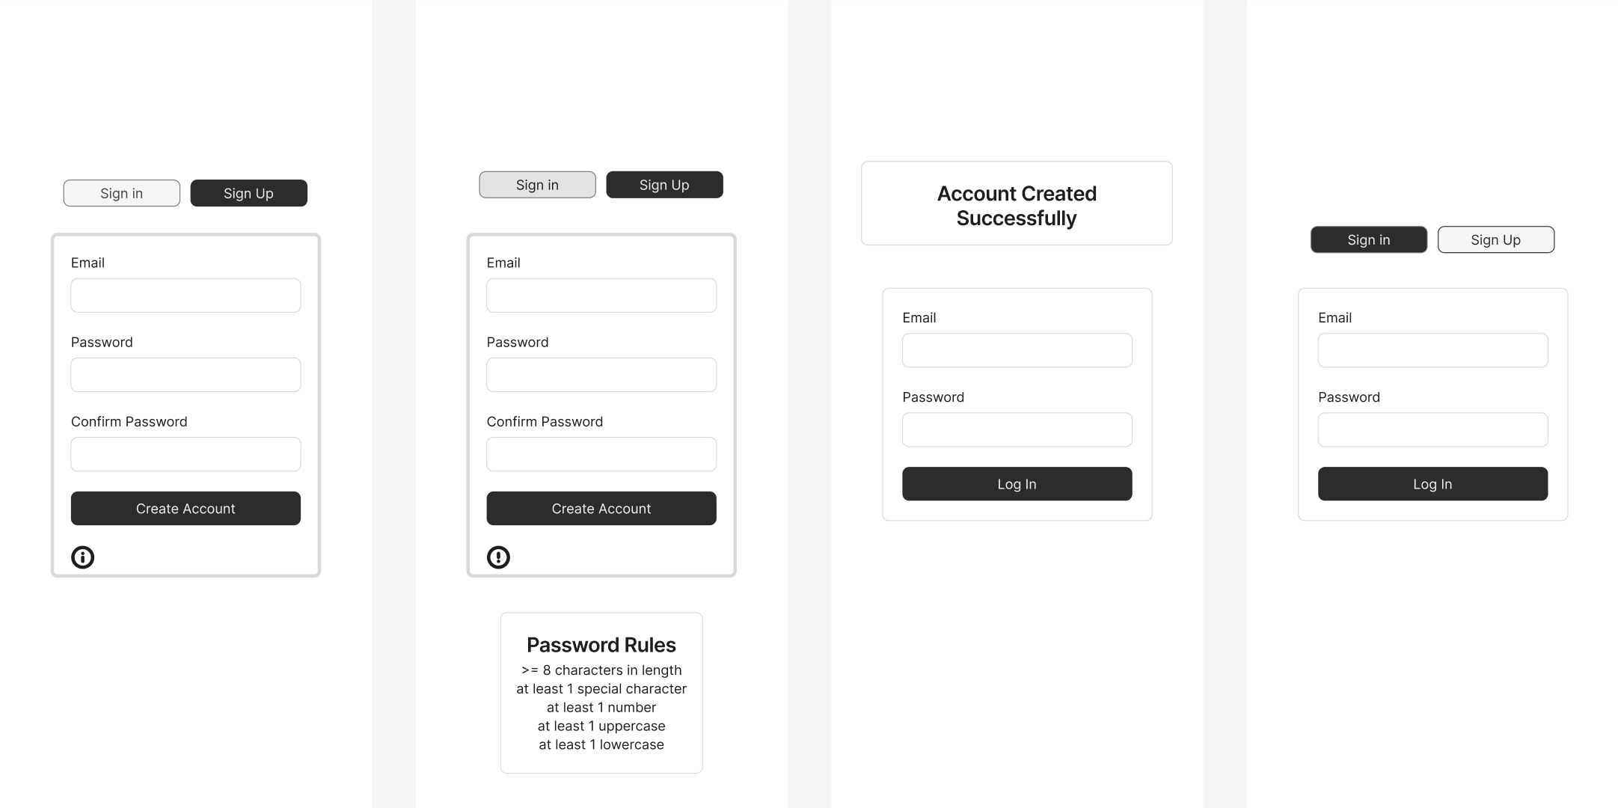
Wire Frames
https://www.figma.com/design/RmDAmCTOwuOK7AhdEfngel/TBR?m=auto&t=r31AZi7afzckxOEX-6

Slide 8
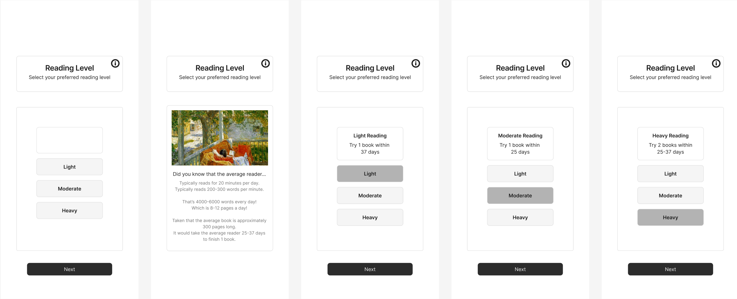
Wire Frames
https://www.figma.com/design/RmDAmCTOwuOK7AhdEfngel/TBR?m=auto&t=r31AZi7afzckxOEX-6

Slide 9
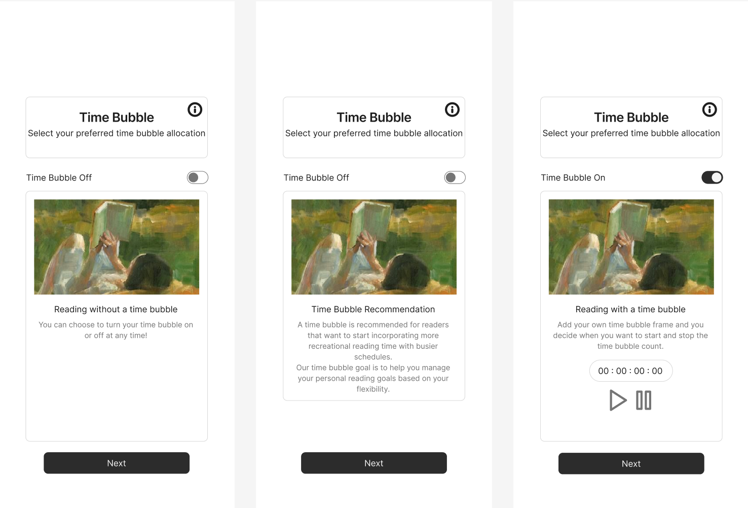
Wire Frames
https://www.figma.com/design/RmDAmCTOwuOK7AhdEfngel/TBR?m=auto&t=r31AZi7afzckxOEX-6

Slide 10
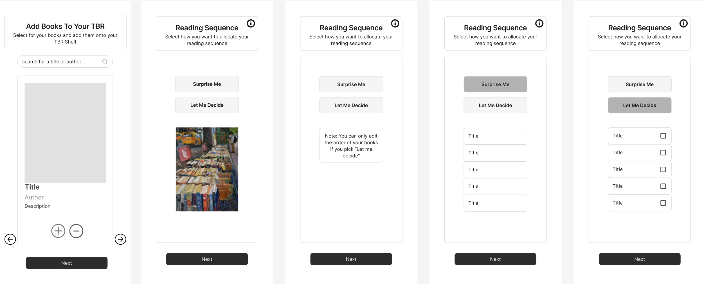
Wire Frames
https://www.figma.com/design/RmDAmCTOwuOK7AhdEfngel/TBR?m=auto&t=r31AZi7afzckxOEX-6

Slide 11
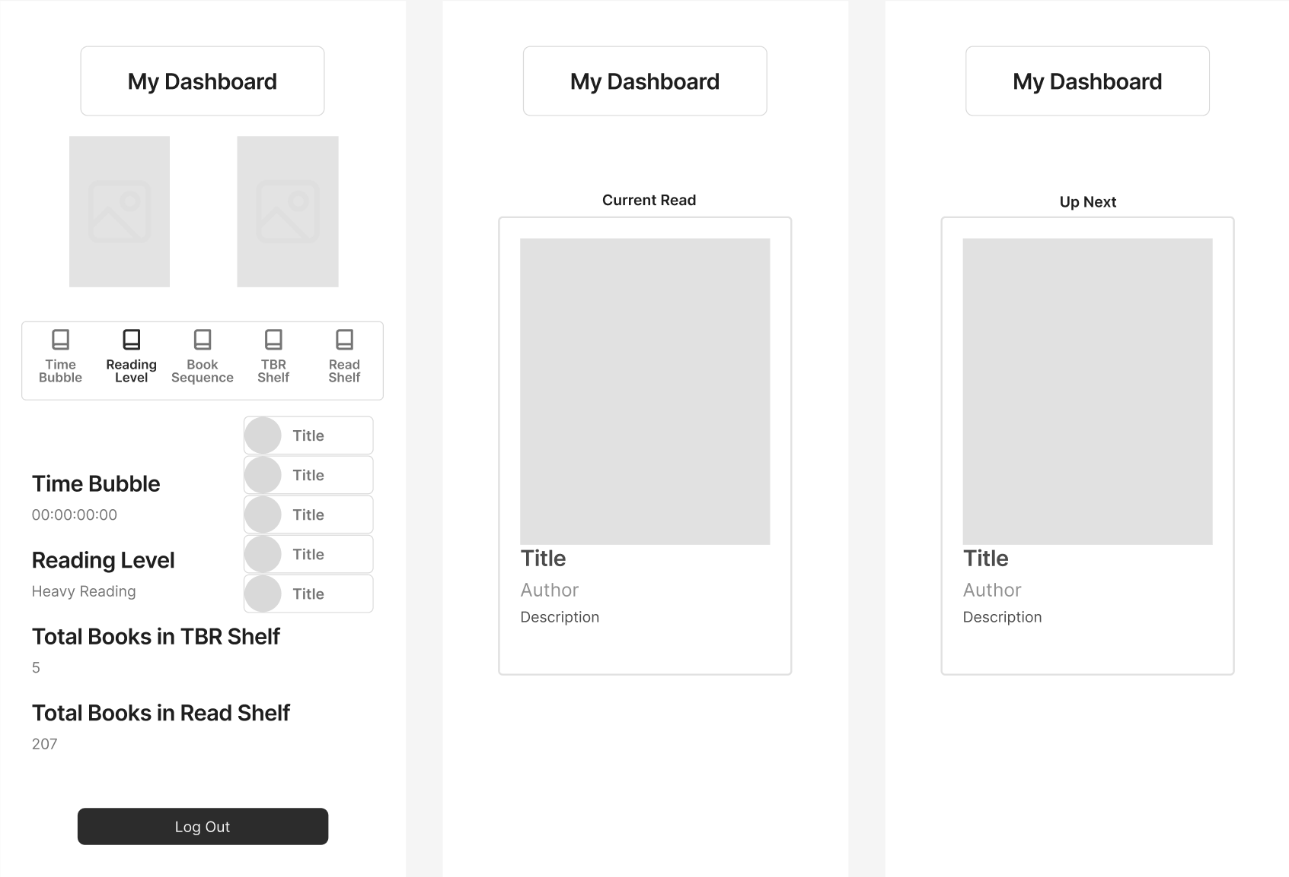
Wire Frames
https://www.figma.com/design/RmDAmCTOwuOK7AhdEfngel/TBR?m=auto&t=r31AZi7afzckxOEX-6

Slide 12
THANK YOU
If you have any suggestions for guiding the user to select books or allocating a reading sequence…
If anything was unclear with regards to the system flow or you think there’s a better path…
Please let me know!

