Slide 1
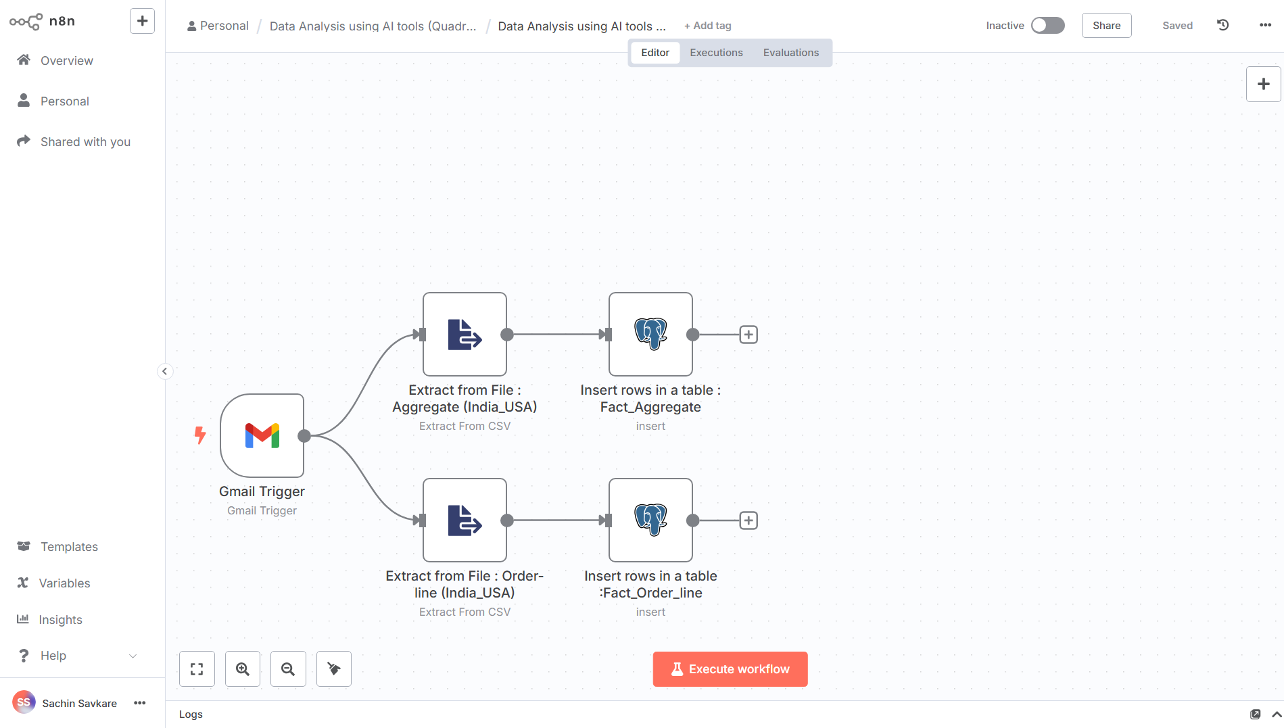


AI-Driven Supply Chain Analysis
Quadratic + N8N + Supabase
AtliQ Mart
Presented by : Sachin Savkare

Slide 2
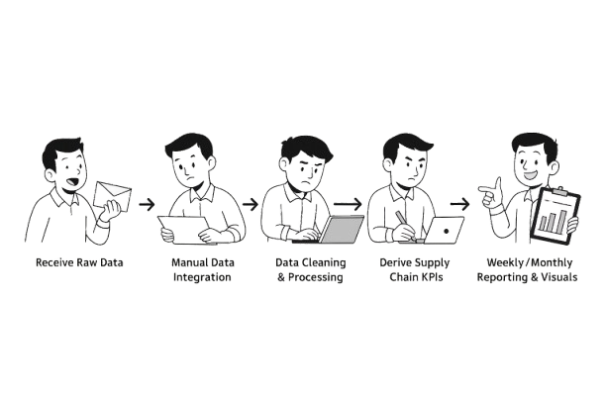
Manual Process
Receive Raw Data from 3PL & Internal Teams
Manual Data Integration
Data Cleaning & Preprocessing
Derive Supply Chain KPIs
Ad Hoc Requests
Weekly/Monthly Reporting & Visuals
Manual Sharing

Slide 3
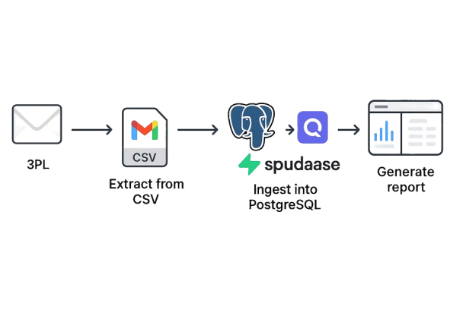
Automation Process : N8N | Quadratic AI Sheet
Supbase

Slide 4
Data : Tables & Columns
Fact_aggregate_India_2025-05-17
Order_id
Customer_id
Order_placement_date
On_time
In-full
otif
Fact_order line_India_2025-05-17
Order_id
Order_placement_date
Customer_id
Product_id
Order_qty
Agreed_delivery_date
Actual_delivery_date
Delivery_qty
In Full
On Time
On Time In Full
Fact_order line_USA_2025-05-17
Order_id
Order_placement_date
Customer_id
Product_id
Order_qty
Agreed_delivery_date
Actual_delivery_date
Delivery_qty
In Full
On Time
On Time In Full
Fact_aggregate
Order_id
Customer_id
Order_placement date
On Time
In Full
OTIF
dim_products
Product_name
Product_id
Category
Price_INR
Price_USD
dim_customers
Customer_id
Customer_name
City
Currency
Fact_order Line
Order_id
Order_placement_date
Customer_id
Product_id
Order_qty
Agreed_delivery date
Actual delivery date
In Full
On Time
On Time In Full
Fact_aggregate_USA_2025-05-17
Order_id
Customer_id
Order_placement_date
On_time
In-full
otif
dim_targets_orders
Customer_id
Online_target %
In_full Target %
OTIF Target %
3PL Incoming Mail Data
Postgres DB : Supabase

Slide 5

Prompt-Driven Data Table Creation in Quadratic AI
Date Table
Prompt
create a date table that has the dates from 03-01-2025 (March 1st, 2025)
to 05-31-2025 (May 31st, 2025)
Exchange Rate Table
Prompt
Create an exchange_rate table for the period from March 1st, 2025, to May 17th, 2025. Use the
following API request sample to fetch historical exchange rates:
response = requests.get(f'https://openexchangerates.org/api/historical/2024-10
21.json?app_id=<Replace your app id here>&symbols=INR')

Slide 6
Data Cleaning and Summarization into Fact Table (fact_summary)
fact_summary
Prompt
Create a Python code that:
Load data from:
- fact_order_line table
- dim_products sheet (skip first row, use second row as headers)
- dim_customers sheet (skip first row, use second row as headers)
- Exchange Rate sheet (skip first row, use second row as headers)
2. Cleans the data:
- Convert product_id and customer_id to numeric
- Strip whitespace from IDs - Remove rows with NULL IDs
- Convert IDs to integers
- Convert dates to datetime
3. Merges the tables:
- Orders with products using product_id
- Result with customers using customer_id
- Result with exchange rates using order_placement_date
4. Calculates total amounts:
- For USD currency: price_USD * USD_INR_Rate * order_qty
- For INR currency: price_INR * order_qty
5. Clean final output:
- Drop intermediate columns: price_USD, price_INR, currency, Date, USD_INR_Rate
- Keep only essential columns: order details, IDs, dates, quantities, delivery information,
and total_amount (in INR)

Slide 7
Supply Chain Domain Knowledge
KPIs
New Column Created in (fact_summary)
backorder_qty
order_cycle_time_days
delivery_delay_days
in_full_percent
on_time_flag
reliability_flag
unit_fill_percent
otif_flag
week_of_year
category_demand_variability
lead_time_variability
converted_value_inr
perfect_order_flag
✅ Order Performance KPIs
Total Orders
Total Order Lines
Total Backorder Quantity
Order Cycle Time (days)
Average Delivery Delay (days)
🚚 Delivery Performance KPIs
On-Time Delivery %
In-Full Delivery %
On-Time In-Full (OTIF) %
Line Fill Rate
Volume Fill Rate
📉 Variability & Risk KPIs
Lead Time Variability
Category Demand Variability

Slide 8
Business Question : Exercise 1
Show me Monthly On time Performnace by Cities
Show me top 5 customers based on order value and their OTIF %, IF %, OT %. Also add the customer name, customer ID and city in the table
Show me top 5 customers in India based on order value and their OTIF %, IF %, OT %. Also add the customer name, customer ID and city in the table
Quantify the revenue loss attributed to undelivered orders. Revenue Loss from Undelivered Orders (in Millions)
Identify customers with the most significant On-Time, In Full (OTIF) discrepancies
Determine product categories that exhibit low 'In Full' delivery rates.
Calculate the average delay time for late deliveries
Identify product categories with the lowest 'In Full' delivery rates. What could this indicate about supply chain bottlenecks?

Slide 9
Business Question : Exercise 2
Which product categories are facing the highest fulfilment and delivery challenges?
Are any customers consistently missing OTIF targets?
Where is lead‑time variability threatening service levels?
Which weeks experienced the worst demand swings and did that impact service?
Do long delivery delays correlate with larger backorders?
Which customers are improving—or worsening—in order cycle time?
Are metro and non‑metro customers served differently?

Slide 10
THANK YOU

