Slide 1
Python – 4

Slide 2
1. NumPy - Introduction
NumPy is the fundamental package for scientific computing with Python.
a powerful N-dimensional array object (multi-d container of data)
enhanced performance: advanced functions and tools for integrating C/C++
useful in linear algebra, transforms..
with a collection of high-level mathematical functions
http://www.numpy.org/

Slide 3
2. NumPy – numpy.array
List
A data structure in core Python
Used to store data
Without specialized properties, methods and tools
NumPy array
A data structure in NumPy
Used to store lists of numerical data for vectors, matrices and etc.
Designed to handle large data sets
With powerful math and manipulation methods for scientific use

Slide 4
3. Create numpy.array
# array() function
a_1 = np.array([1,2,3,4])
# [[1.+0.j 2.+0.j 3.+0.j]
# [4.+0.j 5.+0.j 6.+0.j]]
a_2 = np.array([[1,2,3], [4,5,6]], dtype=complex)
# range and shape
# [0 1 2 3]
a_3 = np.arange(4)
# [[ 0 1 2]
# [ 3 4 5]
# [ 6 7 8]
# [ 9 10 11]]
a_4 = np.arange(12).reshape(4,3)
# zeros() function
# [[0. 0. 0.]
# [0. 0. 0.]]
a_5 = np.zeros((2,3))
# ones() function
# [
# [[1 1 1 1]
# [1 1 1 1]
# [1 1 1 1]]
# [[1 1 1 1]
# [1 1 1 1]
# [1 1 1 1]]
# ]
a_6 = np.ones((2,3,4), dtype=np.int32)

Slide 5
4. Basic Operations
Arithmetic operators on arrays apply elementwise. A new array is created and filled with the result.
a = np.array([1,2,3,4])
print(a*2)
print(a+2)
print(a-np.array([1,1,1,1]))
# [2 4 6 8]
# [3 4 5 6]
# [0 1 2 3]
x = np.array([[1, 2], [0, 3]])
y = np.array([[100, 99], [77, 20]])
print(x*y)
# [ [100 198]
# [0 60] ]
a = np.array([[1,2],[3,4]])
b = np.array([[0,1],[0,1]])
print(a.dot(b))
print(np.dot(a, b))
# [[0 3]
# [0 7]]
# [[0 3]
# [0 7]]

Slide 6
5. Axis
a = np.array( [ [ 0, 1, 2, 3],
[ 4, 5, 6, 7],
[ 8, 9, 10, 11] ] )
print(a.shape) # (3, 4)
print(a.ndim) # 2
print(a.size) # 12
print(a.min(axis=None))
print(a.min(axis=0))
print(a.min(axis=1))
# 0
# [0 1 2 3]
# [0 4 8]

Slide 7
a = np.array( [ [[ 0, 1, 2, 3],
[ 4, 5, 6, 7],
[ 8, 9, 10, 11]],
[[12, 13, 14, 15],
[16, 17, 18, 19],
[20, 21, 22, 23]] ] )
print(a.shape) # (2, 3, 4)
print(a.ndim) # 3
print(a.size) # 24
print(a.sum(axis=None))
# 276
print(a.sum(axis=0))
# [ [12 14 16 18]
[20 22 24 26]
[28 30 32 34] ]
(2, 3, 4)
print(a.sum(axis=1))
# [ [12 15 18 21]
[48 51 54 57] ]
(2, 3, 4)
print(a.sum(axis=2))
# [ [ 6 22 38]
[54 70 86] ]
(2, 3 , 4)

Slide 8
Clutering: k-means

Slide 9
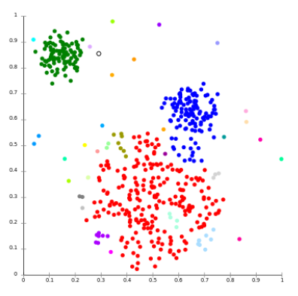
1. Clustering
Clustering is the task of grouping a set of objects in such a way that objects in the same group (cluster) are more similar to each other than to those in other clusters.
Application:
machine learning
pattern recognition
graphics
…

Slide 10
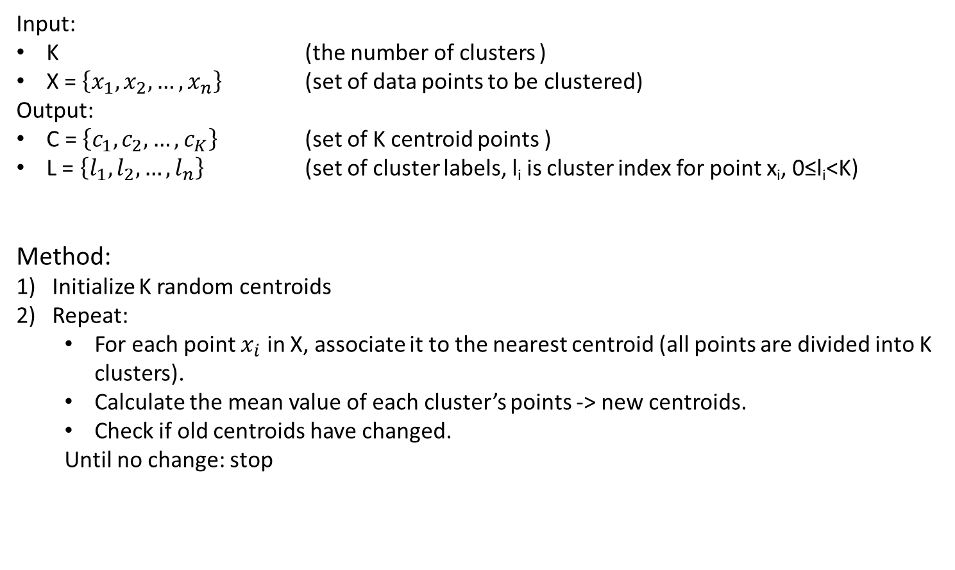
2. k-means clustering
Input:
K (the number of clusters )
X = $\left\{x_{1}, x_{2}, …,x_{n}\right\}$ (set of data points to be clustered)
Output:
C = $\left\{c_{1}, c_{2}, …,c_{K}\right\}$ (set of K centroid points )
L = $\left\{l_{1}, l_{2}, …,l_{n}\right\}$ (set of cluster labels, l_{i} is cluster index for point x_{i}, 0≤l_{i}<K)
Method:
Initialize K random centroids
Repeat:
For each point $x_{i}$ in X, associate it to the nearest centroid (all points are divided into K clusters).
Calculate the mean value of each cluster’s points -> new centroids.
Check if old centroids have changed.
Until no change: stop

Slide 11
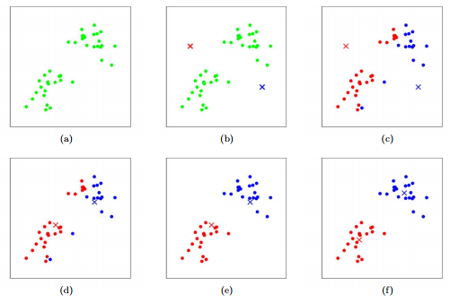

Slide 12
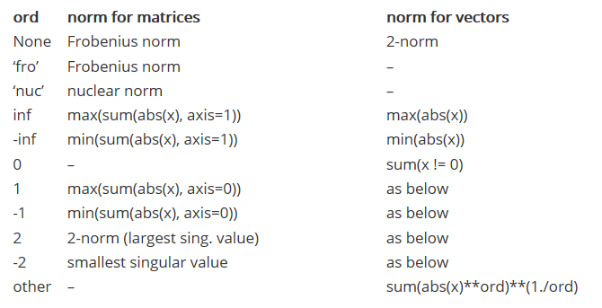

numpy.linalg.norm()
(linalg=linear+algebra)
https://docs.scipy.org/doc/numpy-1.15.1/reference/generated/numpy.linalg.norm.html

Slide 13
Thank you!

