Slide 1
About the Course

Slide 2
Module Objectives
In this module, you will be able to:
Find information regarding the McAfee University curriculum.
Describe the lab environment for this course.

Slide 3

Module Topics
McAfee University Curriculum
Introductions
About the Course
Lab Environment

Slide 4
McAfee University Product Curriculum
Length | Description
4 Days | McAfee VirusScan Enterprise and ePolicy Orchestrator Administration
4 Days | McAfee Network Security Platform Administration (IntruShield)
4 Days | McAfee Host Intrusion Prevention System Administration
4 Days | McAfee Vulnerability Manager Administration (Foundstone Enterprise)
4 Days | McAfee Data Loss Prevention Endpoint Administration
Notes:
McAfee Security University Curriculum
Visit the McAfee Security University website for detailed course information, a current schedule, and online registration:
http://www.mcafee.com/us/services.aspx
EMEA (Europe, Middle East, Africa) Information
Schedule – https://inter.viewcentral.com/events/cust/default.aspx?calledFromAuto=yes&cid=mcafee_emea&pid=1&lid=5
France, Africa, MED, Middle East – Anne-Sophie Corre +33 1476 25813
Germany, Austria, Switzerland, Netherlands – Simone Kenst +49 89 3707 2135
Spain, Portugal – Damaso Ramos +34 9134 78522
Italy – Giovanni D’Amato +39 06 54 831
BeNeLux – Bart Ooms +35 3124672285
UK and all other EMEA Locations – Nicole Lamb + 44 1753 217472
APAC Information
Schedule - http://inter.viewcentral.com/events/cust/default.aspx?cid=snifferu_apac
Asia Pacific: Lena Soo +65 68293925 lena_soo@mcafee.com
Low Kok Leong +65 68293908
Michael Sentonas +61 2 9761 4200
LTAM Information
Schedule - https://mcafee.edu.netexam.com/LTAM.asp
NOTE: McAfee Security University’s curriculum is subject to change without notice.

Slide 5
McAfee University Product Curriculum
Length | Description
4 Days | McAfee Firewall Enterprise System Administration (Sidewinder)
4 Days | McAfee Control Center System Administration
4 Days | McAfee Web Gateway System Administration (Webwasher)
4 Days | McAfee Email Gateway System Administration (Ironmail)
4 Days | McAfee Policy Auditor Administration
Notes:
McAfee University Curriculum
Visit the McAfee University website for detailed course information, a current schedule, and online registration:
https://www.mcafee.com/us/enterprise/services/education/index.html
North America schedule
https://mcafee.edu.netexam.com/catalog.asp

Slide 6
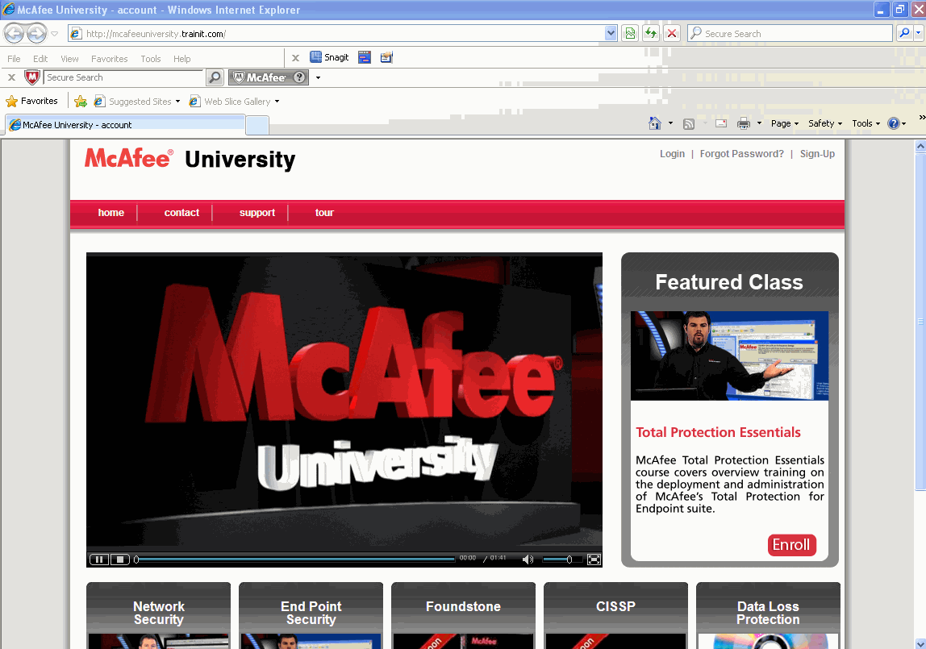
On-line Training
http://mcafeeuniversity.trainit.com/

Slide 7
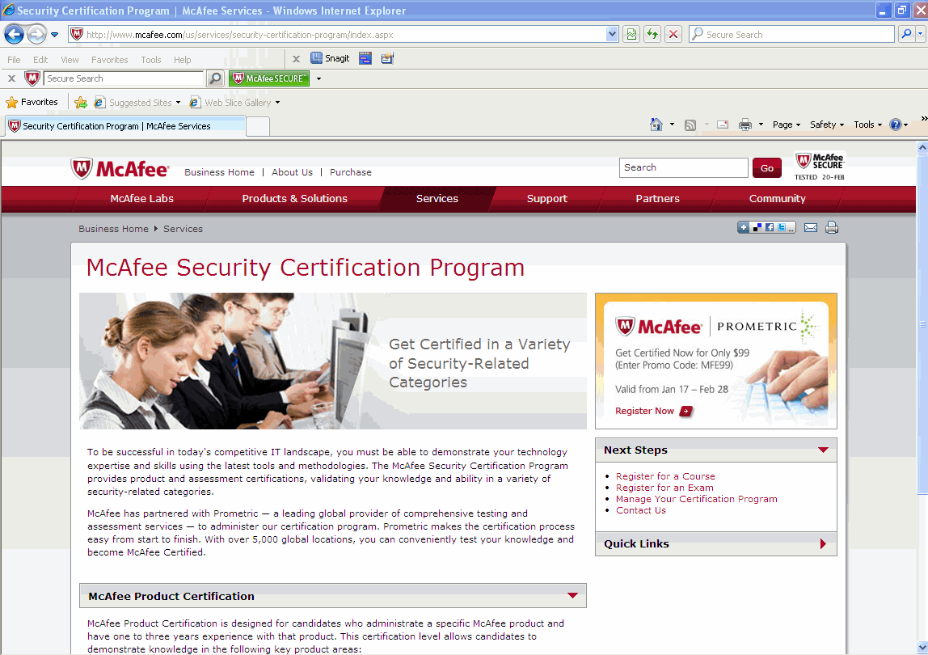
Certification Program
http://www.mcafee.com/us/services/security-certification-program/index.aspx

Slide 8

No Duplication
Duplication of Materials is Not Allowed
Participants are not permitted to audiotape or videotape the course presentation.
Duplication of course materials or labs is strictly prohibited by copyright.
Thank you!
Notes:
Duplication of Materials is Not Allowed
Participants are not permitted to audiotape or videotape the course presentation. Duplication of course materials or labs is strictly prohibited by copyright.

Slide 9
Facilities
Building Hours
Class Hours
Parking
Phones
Rest Rooms
Messages
Meals
Smoking

Slide 10
Introduction
Name
Company Affiliation
Title/Function
Job Responsibility
McAfee Product Experience
What would you like to get from this course?

Slide 11
Prerequisites
Understanding of basic networking concepts
Working knowledge of Windows 2003/2008 System Administration concepts

Slide 12

Course Materials
Student Workbooks
Course Evaluation
On-line
Paper

Slide 13
Acronyms & Terms Used in Course
Throughout the course, the following acronyms & terms will be used:
ePO–McAfee ePolicy Orchestrator
VSE or VirusScan–McAfee VirusScan Enterprise
Administrator–The ePO Global Administrator, or a Network Administrator
Manager–Network Security Manager
Agent-Software used to manage point-products on endpoint computers, i.e., McAfee Agent.
Policy- Settings and configurations applied to point-products on endpoint machines
Repository-A collection of the software used to deploy and update point-products on endpoint machines

Slide 14
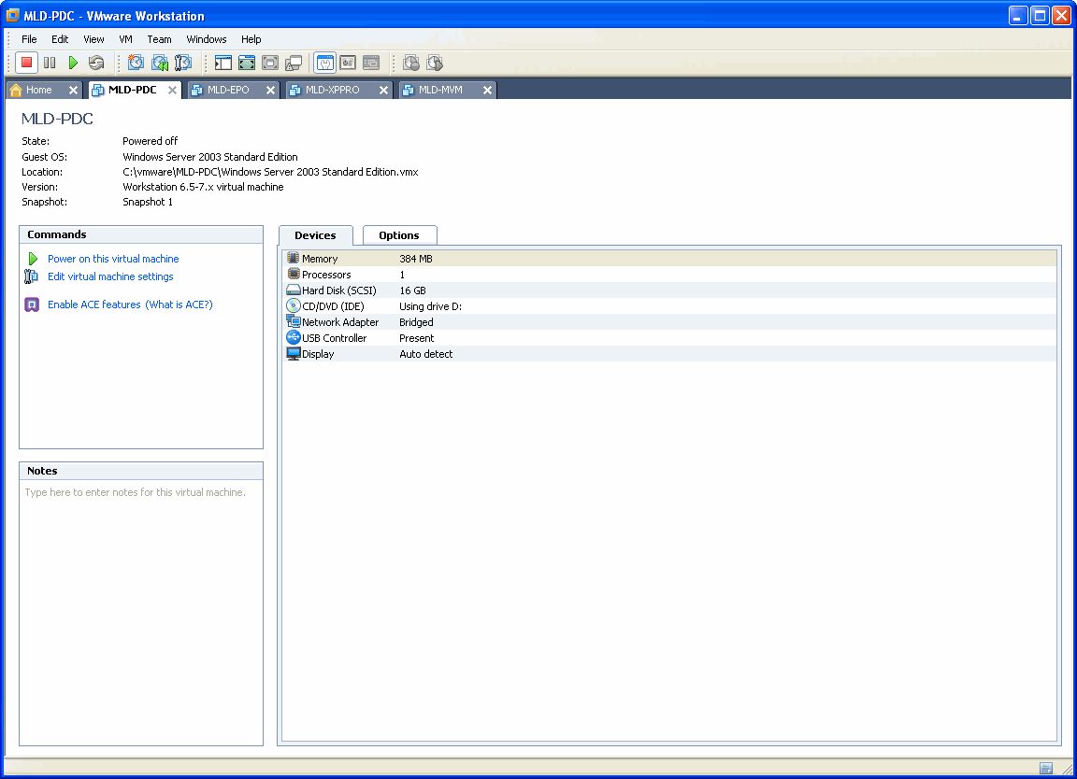
Using VMWare Workstation
http://www.vmware.com/

Slide 15
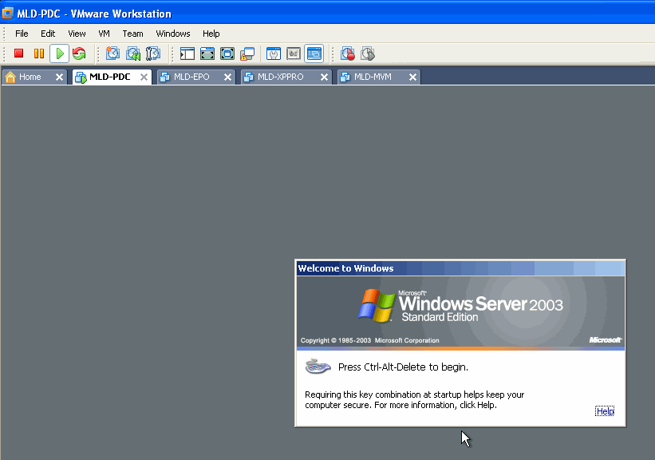
Using VMWare Workstation
Screen
Mode
Virtual Machine
name
Control + Alt + Insert

Slide 16
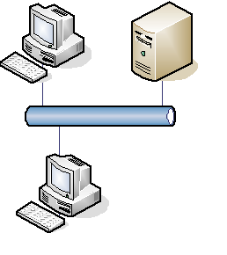
Lab Setup
Physical Host PC will be referred to as Host
VMware Workstation on host providing virtual systems for:
ePO
ePO Remote Agent Handler
Windows XP SP3
All labs run on Virtual Machines
VMs are located in the McAfee Lab Images folder on your host desktop
Do not change any passwords
Virtual network
Virtual systems
Physical Host
Notes:
Lab Setup
There are four virtual machines (VMs) that will be running on one of the host systems. The virtual systems include the following:
MLD-EPO
MLD-PDC
ESMLM
NitroLive
The MLD-PDC virtual machine is also the Domain Controller server.
Labs and lab files
All labs are to be performed on the virtual machines not the physical host systems. The lab files can be found on the desktop of the VM indicated in your lab instructions. The lab instructions will indicate the appropriate subfolder.

Slide 17
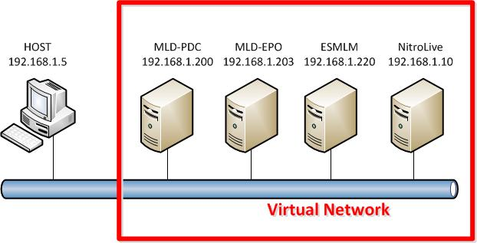
Lab Topology
MLD-PDC (Primary Domain Controller) – 192.168.1.200
MLD-EPO (ePO Server) – 192.168.1.203
ESMLM (ESM/ELM/Receiver Combo Virtual Machine) – 192.168.1.20
NitroLive (Traffic Generator for ESM) – 192.168.1.10
NOTE: Machine prefixes are assigned by region, enter correct machine names used for your specific class in the table below:
Notes:
Lab Topology
As already mentioned in previous slide, you will use four virtual machines on a host system. These virtual machines will comprise your NAC network:
The MLD-PDC VM is a Windows 2003 Server that hosts Active Directory and also contains a DHCP server.
The MLD-EPO VM is a Windows 2003 Server that will become your ePolicy Orchestrator server. It also hosts a MS-SQL 2005 Express used by the EPO.
The ESMLM is a virtual appliance which includes the Enterprise System Manager, Enterprise Log Manager, and the Receiver appliances in one combo-unit.
The NitroLive is a traffic generator virtual machine, used to send syslog traffic to the ESM in order to emulate real-time network traffic. It is necessary for this lab environment only.

Slide 18
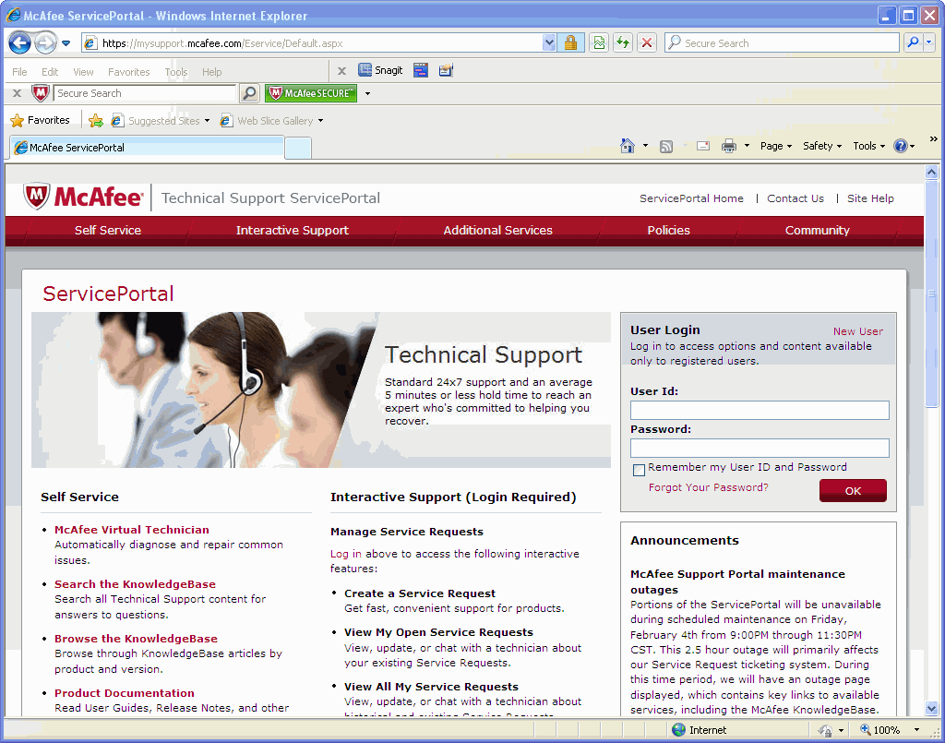
McAfee Technical Support
You can contact Technical Support via Phone (1-800-937-3337) or the Technical Support ServicePortal:
https://mysupport.mcafee.com/Eservice/Default.aspx
Product Documentation
Access to the Knowledge Base
Create Service Requests(requires login and grant number)
Notes:
McAfee Technical Support
ServicePortal (http://mysupport.mcafee.com)
The Technical Support ServicePortal contains access to many support resources. It is the best location to find Product Documentation, search the Knowledge Base for commonly found issues and open and check the status of service requests.
Web Gateway Extranet (https://extranet.webwasher.com)
The Web Gateway Extranet is where you should go if you wish to download the latest Web Gateway version or to get your license.
McAfee Customer Service (http://service.mcafee.com) 1-866-622-3911
If you need a user ID for the Extranet or Service Portal you should contact McAfee Customer Service (service@mcafee.com). Customer Service can also help with:
Product Licensing Issues
grant ID lookups
Problems viewing the ServicePortal or Extranet

Slide 19
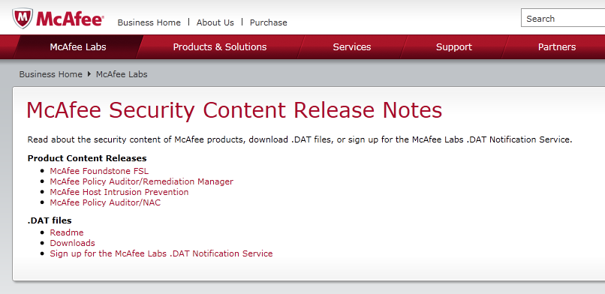
.DAT Releases
http://www.mcafee.com/us/content-release-notes/index.aspx
Notes:
McAfee Product Content Information
Read about a specific McAfee product’s security content, download DATs, or sign up for the Avert DAT Notification Service.
http://www.mcafee.com/us/threat_center/security_content_releases/
http://www.mcafee.com/us/threat_center/security_content_releases/hips_security_content_releases.html

Slide 20
Resources
Resource | URL
Threat Center | http://www.mcafee.com/us/threat_center/default.asp
McAfee Threat Labs | http://www.mcafee.com/us/threat_center/default.asp
MyAvert | www.avertlabs.com
Security Advisories | http://www.mcafee.com/apps/mcafee-labs/signup.aspx
Blog | http://www.avertlabs.com/research/blog/
Podcasts | http://podcasts.mcafee.com/
McAfee Tools | http://www.mcafee.com/us/downloads/free-tools/index.aspx
Threat FAQs | http://www.mcafee.com/us/threat_center/outbreaks/faqs.html
Whitepapers | http://www.mcafee.com/us/threat_center/white_paper.html
Glossary | http://www.mcafee.com/us/threat_center/glossary.html
VGrep | http://www.virusbtn.com/resources/vgrep/index.xml?
Extra.dat request page | https://www.webimmune.net/extra/getextra.aspx
Stinger | http://www.mcafee.com/us/downloads/free-tools/how-to-use-stinger.aspx
Submit a Sample | http://www.mcafee.com/us/mcafee-labs/resources/how-to-submit-sample.aspx
Beta DATs page | http://vil.nai.com/vil/virus-4d.aspx

Slide 21
Lab Exercises
Goal(s)
Open a virtual machine in VMware Workstation.
Estimated Time: 10 minutes

Slide 22
Hidden
Notes:
Set the time on your host machine.
Before you start your virtual machines, set the time on your host machine to the local time.
Steps:
From your desktop double click the time in the lower right hand corner of the system tray.
Select the Time Zone tab and from the drop down select your time zone. Click Apply.
Select the Date & Time tab and verify that the correct Date is selected. If not, then adjust the date. Set the time to the correct time of the day.
Click Apply and click OK.
Virtual Systems: The following exercise is to be performed on your desktop.
Exercise Files: No files are required for this exercise.
Lab 0.1
Objective: Set the time on your host machine.

Slide 23
Notes:
Launch your Windows Server 2003 MLD-PDC virtual machine.
From your desktop double click the VMware Workstation icon to launch the VMware.
Select the MLD-PDC tab from the top of the VMware Workstation console.(or choose File > Open and in the Open Virtual Machine dialog box browse to the C:\vmware\MLD-PDC directory and select the Windows Server 2003 Standard Edition.vmx file and click Open)
Select the Power on this virtual machine blue link under the Commands listing.
On the VMware Workstation dialog box This virtual machine may have been moved or copied select the option of I moved it and click OK.
Once the virtual machine has started make sure that you click your mouse inside the VMware Workstation screen.
Press Ctrl-Alt-Insert to login to the virtual system as JSmith with the password of mcafee.
Launch your Windows Server 2003 MLD-EPO virtual machine.
Select the MLD-EPO tab from the top of the VMware Workstation console.((or choose File > Open and in the Open Virtual Machine dialog box browse to the C:\vmware\MLD-EPO directory and select the Windows Server 2003 Standard Edition.vmx file and click Open).
On the VMware Workstation dialog box This virtual machine may have been moved or copied select the option of I moved it and click OK.
Once the virtual machine has started make sure that you click your mouse inside the VMware Workstation screen.
Press Ctrl-Alt-Insert to login to the virtual system as Administrator with the password of mcafee.
Set the time on your virtual machine (Change both virtual machines)
From your desktop double-click the time in the lower right hand corner of the system tray.
Select the Time Zone tab and from the drop down select your time zone. Click Apply.
Select the Date & Time tab and verify that the correct Date is selected. If not, then adjust the date. Set the time to the correct time of the day.
Click Apply and click OK.

