Slide 1
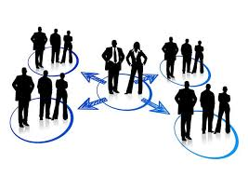
NETWORKING
ART OF BUILDING ALLIANCES

Slide 2
What is networking ?
Networking is a matter of creating useful linkages, both within and among communities, organizations, and societies, in order to mobilize resources and achieve various goals.
▪
Networking is also an important component of community organizing.
This requires that diverse members of the population build relationships, share resources, and work together in an organized way for social change
▪

Slide 3
The Difference Between Networking and Making Friends
Networking is about building rapport , having substantive conversations, and finding commonalities with other professionals in a limited amount of time. Yes, it’s an opportunity to connect with others—but it’s more about advancing your professional goals than it is about getting people to like you or boosting your social scene.

Slide 4
Types Of Networking
Operational Networking
All managers need to build good working relationships with the people who can help them to do their jobs. The number and breadth of people involved can be impressive—such operational networks include not only direct reports and superiors but also peers within an operational unit, other internal players with the power to block or support a project, and key outsiders such as suppliers, distributors, and customers.
The purpose of this type of networking is to ensure coordination and cooperation among people who have to know and trust one another in order to accomplish their immediate tasks.

Slide 5
Personal Networking
Through professional associations, alumni groups, clubs, and personal interest communities, managers gain new perspectives that allow them to advance in their careers.This is what we mean by personal networking.
A personal network can also be a safe space for personal development and as such can provide a foundation for strategic networking.
Strategic Networking
Strategic networking plugs the aspiring leader into a set of relationships and information sources that collectively embody the power to achieve personal and organizational goals.
When managers begin the delicate transition from functional manager to business leader, they must start to concern themselves with broad strategic issues. This is where strategic comes into play.

Slide 6
How To Build A Powerful Professional Network
The Mentor: This is the person who has reached the level of success you aspire to have. You can learn from their success as well as their mistakes. Heed their wisdom and experience. This relationship offers a unique perspective because they have known you through several peaks and valleys in your life and watched you evolve.
The Coach: The coach is someone who comes in at different times in your life. They help with critical decisions and transitions and offer an objective perspective with no strings attached.
The Industry Insider: This is someone in your chosen field who has expert-level information or access to it. This person will keep you informed of what’s happening now and what the next big thing is. Invite them to be a sounding board for your next innovative idea.
The Trendsetter: This is someone outside of your chosen industry who always has the latest buzz. It can be on any topic that you find interesting. The goal in having this person in your network is to look for those connections that spark innovation via the unconventional. It will also help you keep your conversations interesting.
The Connector: This is a person who has access to people, resources and information. As soon as they come across something related to you, they are sending you an e-mail or picking up the phone. Connectors are great at uncovering unique ways to make connections, finding resources and opportunities that most people would overlook.

Slide 7
How To Build A Powerful Professional Network
6.The Idealist: This is the person in your network you can dream with. No matter how “out there” your latest idea is, this is the person who will help you brainstorm ways to make it happen. Without judgment, they are focused on helping you flesh out your dreams in high definition, even if you don’t have a solid plan yet on how to make it happen.
The Realist: On the flip side, you still need the person who will help you keep it real. This is the person who will give you the raised eyebrow when your expectations exceed your effort. These are not people who knock down your dreams, rather they challenge you to actively make your dream happen.
The Visionary: Visionary people inspire you by their journey. They are similar to the Idealist, but the visionary can help you envision an actual plan to reach your goal. One personal encounter with this type of person can powerfully change the direction of your thinking and life.
The Partner: You need to have someone who is in a similar place and on a similar path to share with. In fact, partners do a lot of sharing. This is a person you can share the wins and vows with. Partners will.

Slide 8
TOOLS OF NETWORKING
Social Media-Social media changed the world. Not only has it spawned the most titanic network known to man, but it has changed the way we process information, communicate, interact, and so forth.The vastness of its influence has been both progressive and detrimental. However, it has proven itself to be an incredibly powerful marketing tool for startups.
Some companies are great at social media. Others are hopelessly bad at it. The ones that are hopelessly bad are the ones that will not be around to serve the next generation of consumers. Social media is the new contact point between a corporate entity and end users.
Ford is one of the best examples of how a beleaguered brand successfully used social media to become one of the most beloved and well-respected brands. Ford had gained a lot of respect for its Fiesta line in Europe, and wanted to replicate that in the U.S. To do this, they gave Fiestas to people who were already highly effective at social media. According to the piece: Recipients includes bloggers, filmmakers, and social networkers who were already documenting and sharing their lives.The people in the program claimed that they had complete editorial freedom. They could say anything they wanted about the car, even if they hated it. This helped to give the campaign an authentic voice. The piece goes on to say:For $5 million, Ford achieved with social media what has traditionally cost auto marketers millions. Fiesta had 60 percent name recognition before it hit US lots. Jim Farley, VP of global marketing, said: “I want customers to tell our story. That’s what digital has shown us: how to earn cred among consumers.”

Slide 9
TOOLS OF NETWORKING
Hosting Events
Another way to gain cred among consumers is by hosting public-facing events.
Honda has mastered this tool with the annual Wing Ding convention for Honda Goldwing enthusiasts. Wing Ding 37 will be held in Huntsville, AL in September 2015. In addition to the show floor filled with everything an enthusiast would love, there are tons of events and classes that even non-Goldwing fans will appreciate.
Sci-fi and fantasy conventions such as the Star Trek Convention and Comic-Con are also excellent examples of how hosted events draw fans and outsiders alike to get to know and interact with their brand. The DoubleDutch event app is one example of a mobile device app that make such events more than just a one-off success. Among other things, they promote attendee networking.
DoubleDutch observes:
Speakers may not have enough time to answer questions before the next session begins or attendees may have opinions about what they just learned. Reach event speakers or share your opinions with other attendees through “comments” or “likes” in the activity feed of an event or session.

Slide 10
TOOLS OF NETWORKING
Blogging
Blogging is one of the easiest and most effective networking tool. There are some ways you can use it.
Like, you can use a company blog to communicate your message directly to the public.These messages can be liked and shared on social networks. A more effective way to use a company blog is to make it a resource for information. Don’t just use it to sell products and services. Use it to share your expertise so that it is useful to people who are not necessarily looking to make a purchase with you, but who just want to know more about the topic on which you specialize.

Slide 11
Professional networking isn’t a dying strategy for most modern-day startups, it’s a necessary part of business development
You’ll meet investors. This is essential if you’re strapped for cash and trying to get your business off the ground. While crowdfunding sites make it easier to generate large amounts of capital, meeting an investor could put your cash worries to bed entirely. Plus, your investor can serve as a mentor and adviser, helping to guide your business through its formative years.
You’ll gain influential partners. Partnerships are invaluable, especially for budding startups, and you never know who you’re going to meet. The more connections you have, the more possibilities you’ll have for partnership and expansion.
You’ll expand your team. In the early stages of your business, your team is going to be the force that drives your company forward. Networking and building connections is one of the best ways to find new talent and build a perfect team from the ground up.
You’ll discover new clients and opportunities.Of course, networking is also a great sales tool, and in the first phase of your startup, you’ll need all the revenue you can get.
You’ll gain exposure for your personal brand.

Slide 12
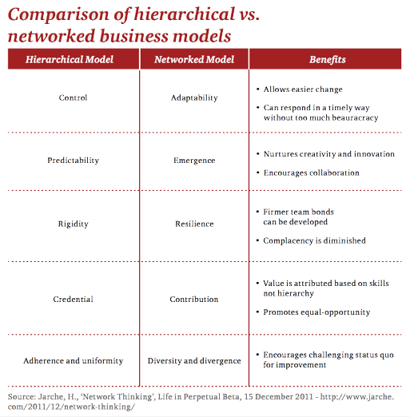

Slide 13
How to start a networking business?
1. Decide what type of products you want to sell in network marketing.
2. Look through small networking business opportunity like magazines .
3. Sign up for the network marketing opportunity with the best pay .
4. Add a separate business phone line for your network marketing .
5.Search for a mailing list supplier via an online search engine.

