Slide 1


Slide 2
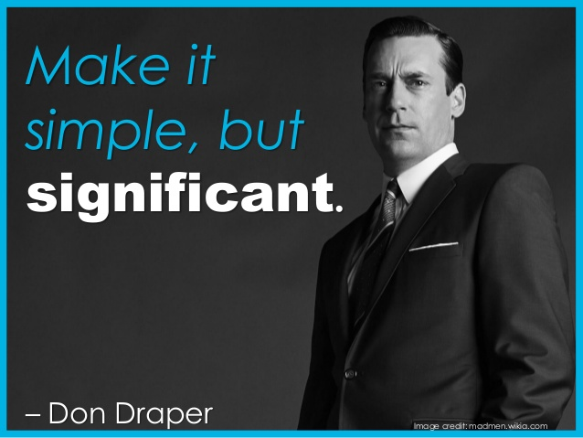
Prepare yourself, not just your idea. Angel investors invest first in the entrepreneur not in the business plan. It's important that the investor and entrepreneur can get along. They will want to see that you are fast, thoughtful and efficient, and can sustain the project through its conception and growth.

Slide 3

What is Pitching ?
An elevator pitch is simply a very short pitch that distils the idea into a short summary that takes only as long as a short elevator ride. A video pitch is a pitch done via a short video rather than in person. Regardless of the means chosen to pitch, the aim is typically the same; describing a business opportunity with the intention of securing funding to develop the idea .

Slide 4

How do you get somebody interested in investing in your startup?
You
pitch
them
the
idea.

Slide 5
Follow this 6-STEP approach
 You will make a compelling pitch
startups by developing your pitch
STEP approach.
 1.Understand yourself
 2.Understand your investor
 3.Create compelling content
 4.Design professional slides
 5.Test your pitch
and stand out from other
through
this
proven
6-
 6.Deliver your pitch with confidence

Slide 6
1. Understand Yourself
You want to get funded. That’s the reason you are meeting the investor. But when you are pitching to him for the first time, ‘getting funded’ is not really the immediate objective.


How will you qualify to Round 2?
You need to excite the investor by telling him a part of
your story . You will present your business case (why he should
give you the money you are asking) in brief. Just enough to get
him hooked and asking for more.
Your first pitch is very similar to a movie trailer . In 2
minutes the movie producer shares parts of the bigger plot and
excites you to go and watch the entire movie of 100 minutes. If
the trailer is bad, it is very likely that you will skip the movie. The
same holds true for your pitch.


Slide 7
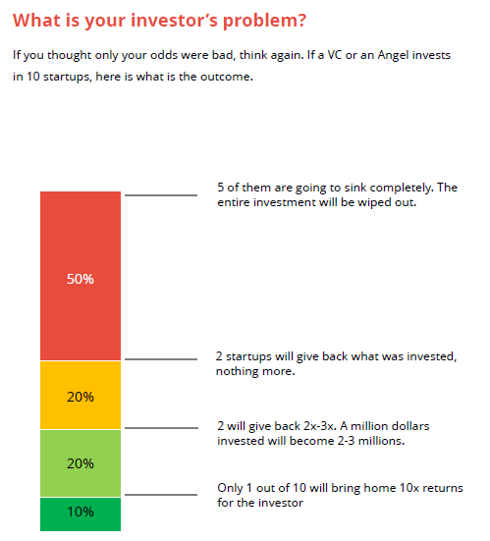

2. Understand your Investors

Slide 8
3. Create compelling comments

Get your key team together and start writing down everything you
want to say about your company on the whiteboard. Refer to the Comprehensive Investor Pitch Template and add more points on your whiteboard. Write down reasons to invest and reasons not to invest. Build supporting arguments for the former and build good defense against the latter. Start editing. Remove things that you cannot say, because of time constraint. Remove things that are not that important. Decide your 10 to 15 main headings. Combine sub-points and supporting arguments under each heading. Now practice the pitch once and arrange these headings in order.
By the end of this step, you will have your key headings along with sub-headings and supporting data ready and arranged in a nice flow


Slide 9
4. Design a professional slide


Put your main message as your slide title.
Make your slide title powerful by communicating a message. Do not make a statement. Be descriptive.
Icons are the easiest way to replace bullet points (which are
completely out of fashion). Avoid bullet points at all costs.
Use full screen images while narrating a story or an anecdote(intresting tale).
Go minimalistic with your charts, tables and graphs. Remove grid
lines and make your charts bigger and bolder. Avoid using too many colors. Highlight the main message using a different color.
Use large and legible fonts.
Stick to simple background colors.Create two versions of your deck; one for in person and one for email.






Slide 10

5.Test Your Pitch
Present your pitch in 20 minutes (or whatever time that has been allotted to
you). Once you are done, ask the friend / stranger to answer
questions:
 What does my company do?
 What is the problem I am solving and what is my solution?
 Who is my customer?
 How large is the market and how will I make money?
 Do you think my team has the capability to make the most
opportunity?
 What did you like about my pitch? Tell me 3 things.
the
following
of this
 What are your concerns around my business? Tell me 3 things.

Slide 11

6. Deliver Your Pitch With Confidence

Slide 12
3-W FORMULA
Use the 3W formula to refine your idea (and craft a message they just can’t ignore)
Here’s the giant, hairy problem we’re all facing when presenting ideas to people:
What will the audience remember when they walk out of the room?
For most people, it’s likely going to be… nothing (dreadful, isn’t it?). The 3W formula is a simple, 3-step process you can use to craft an irresistible message that actually gets remembered.
Who + Why + What

Slide 13
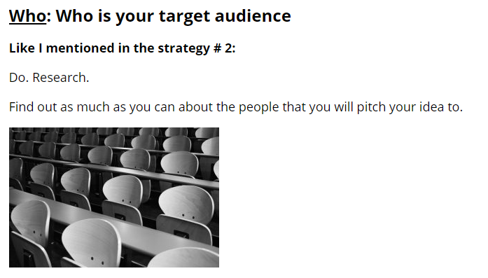
WHO

Slide 14
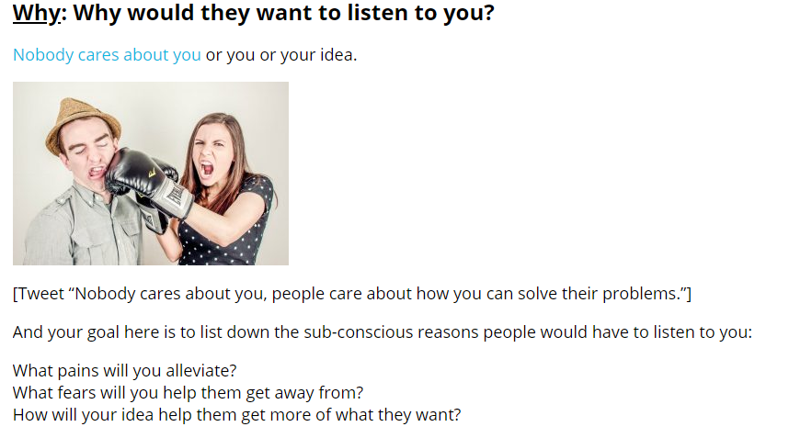
WHY

Slide 15
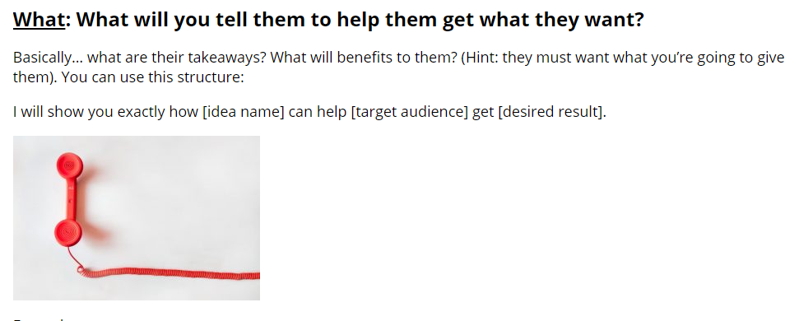
WHAT

Slide 16
Examples of confident delivery
 https://www.youtube.com/watch?v=wzD_JUNwBA0
References and Links
•
•
•
Reid Hoffman’s article- http://reidhoffman.org/linkedin-pitch-to-greylock/
Vinod Khosla’s talk - http://www.khoslaventures.com/pitch-the-way-vcs-think
Aaref Hilaly - https: //www.sequoiacap.com/article/how-to-present-to- investors/
Joel Gascoigne (Buffer) - http://joel.is/raising-funding-as-a-first-time-founder/
•

