Slide 1

Welcome to Reach.
This presentation will change your life!

Slide 2
Let’s answer a few questions…
Are you rich?
Are you scared of month-end?
Do you borrow money often?
Are all your dreams fulfilled?
Is your family getting all that they desire?
Do you want to change your life?

Slide 3

Types of People
Type 1 – Money Time
Type 2 – Money Time
Type 3 – Money Time
Type 4 – Money Time
Which type do you want to be?

Slide 4
Highlights
Well established system
No investment
No infrastructure required
No prior experience required
Pay-outs every week
Zero-risk involved
Are you ready to change your family’s future?

Slide 5

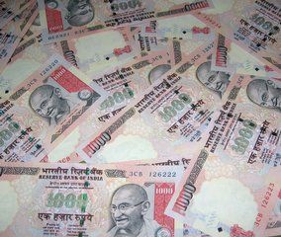



Income Every Week Benefits
Freedom
Happiness
Money
Security
And the ultimate thing in life,
SATISFACTION

Slide 6
About Reach
REACH has been created by a group of positive minded people who can understand your World, and can support you to achieve your dreams.
At REACH we bring together the core strengths of different individuals to deliver solutions that meet your financial goals.
At REACH, we strive to bond people with people and achieve a happy society

Slide 7
About Reach
REACH operates in the following verticals
  Life Insurance
  General Insurance
  IT and Non-IT Training
  Corporate Social Responsibility through Reach Foundation

Slide 8
Our Vision
Reach Life Care originated with a vision to reach out & care for the human spirit and to achieve the economic freedom of the people.

Slide 9
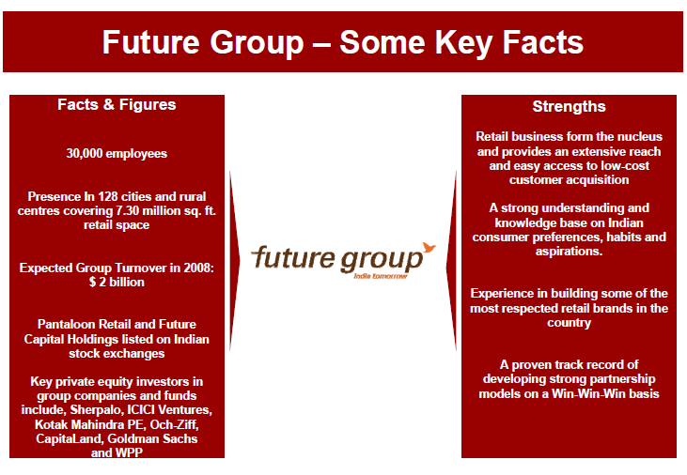
About Future Group

Slide 10

About Future Group

Slide 11
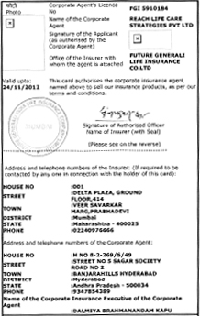
Reach Corporate Agent Certificate

Slide 12
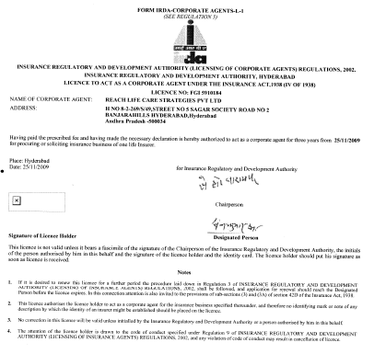
Reach Corporate Agent Certificate

Slide 13
CURRENT STATUS
LESS THAN 5 % PEOPLE IN INDIA
ARE PROTECTED BY
INSURANCE

Slide 14
Products
Future SARAL Anand
A traditional insurance plan with dual benefits of endowment and extended term cover
Hassel Free Insurance cover without any medical underwriting*
Compounded Guaranteed Additions @3.5% of Sum Assured for first 5 policy years
Compounded Reversionary Bonus from the 6th policy year
Risk cover of 150% of the Sum Assured after Premium Payment
Term till age 80 years
Inbuilt Double Accidental Death Benefit
Age at entry Minimum 3 years and Mix 55 last birth day.
Maximum age to receive survival benefit 65 years (Last birth day)
PPT: Minimum – 10 years (subject to age at end of PPT is 18 years last birthday) &
maximum 15 years.
Sum assured : Minimum Rs 75,000/- and Maximum Rs 25,00,000

Slide 15
Products
Loans available during PPT.
Auto Cover: We will convert the policy in to Auto cover for the period of 2 years from
the date of first unpaid premium.
  The policy becomes non participating
  No Guaranteed additions are attached during Auto Cover
  Accidental Death Benefit cover is not available
  In case of death during Auto cover period, the sum assured

Slide 16
Products
Future Guarantee Advantage
This is a non linked, non participating plan.
Provides Assured Loyalty Additions ranging from 60% to 325% of the first year
annual premium payable on maturity or at earlier death if occurs after 8 years from
policy commencement, provided all due premiums are paid.
On death other than accidental, sum assured + Policy Account Value + Assured Loyalty
Additions (if eligible) is payable to the nominee.
On death due to accident provided life assured is above age 18, 3 times sum assured +
Policy Account Value + Assured Loyalty Additions (if eligible) is payable to the nominee.
On maturity, Policy Account Value + Assured Loyalty Additions (if eligible) is payable to
the life assured.
Separate account namely Policy Account will be maintained at policyholder level.
Investment Return will be declared in advance by the company every quarter.
Partial withdrawal can be made after 3rd policy year. No partial withdrawals will be
allowed in the last 5 years of the policy

Slide 17

Business Opportunity
Stage 1: Protect your family by insuring your life
Stage2 : Protect your friends family's life
by insuring there life's

Slide 18
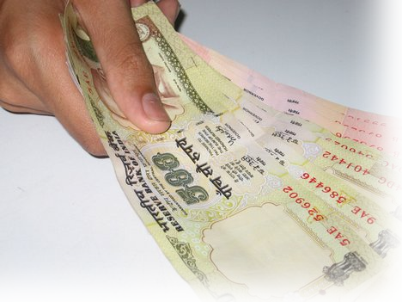
Rewards for your Efforts
1: Satisfaction (selling insurance is a noble act)
2 : Financial Benefits
Income of Rs.1500/-for every Reach Unit

Slide 19
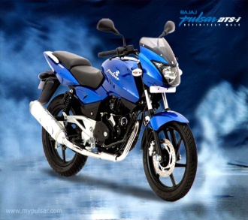
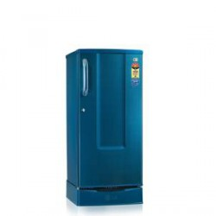
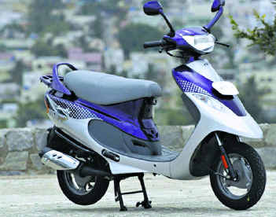

Special Incentives Plan on Earnings
Period From 1st November to 30th Dec -2011
Income during in offer Period
Offer Product
20,000 L.G.Refrigerator
75,000 TVS Scooty Pep+
1,50,000 Bajaj Pulsar 150cc

Slide 20

Choose the path to GLORY.
The FUTURE is YOURS!

