Slide 1

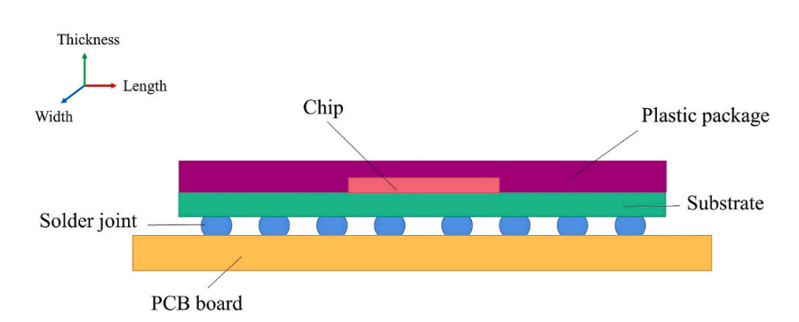
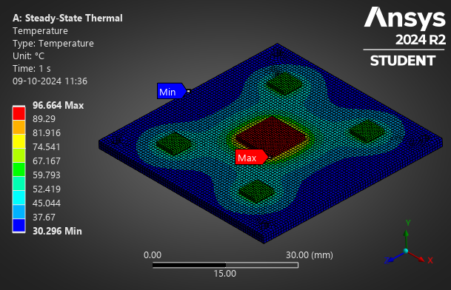
ME 613 (Finite and boundary element methods) Project
Ayush Mishra (22B4511), Venu Arravinth R (22B4524)
under the guidance of
Prof. P. Seshu
Thermal Stress analysis of PCB under cyclic loading
Date: 6/11/2024

Slide 2
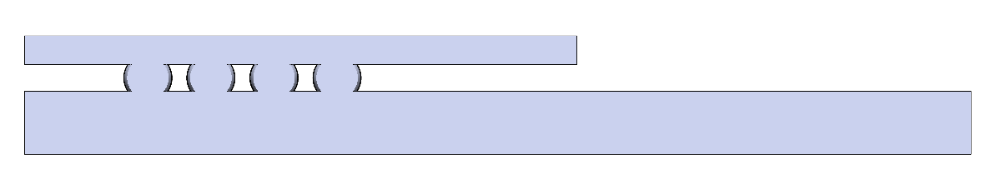
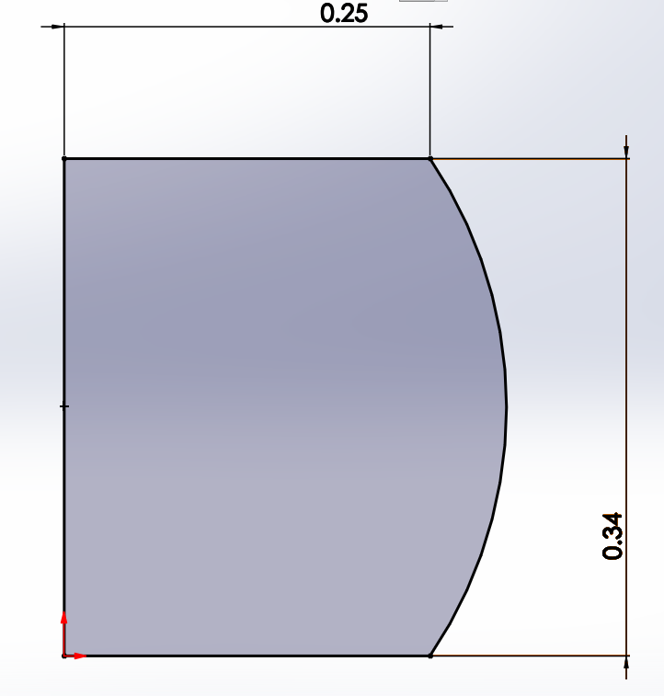
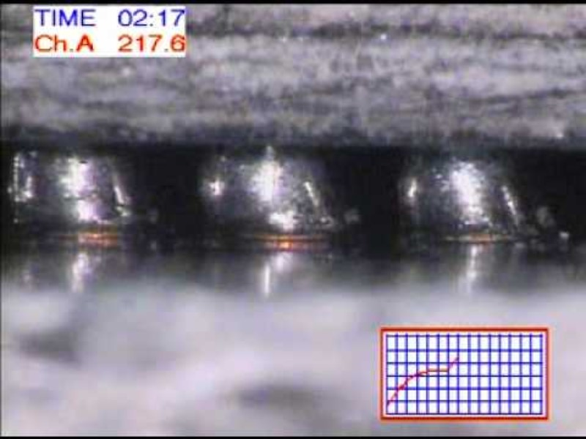
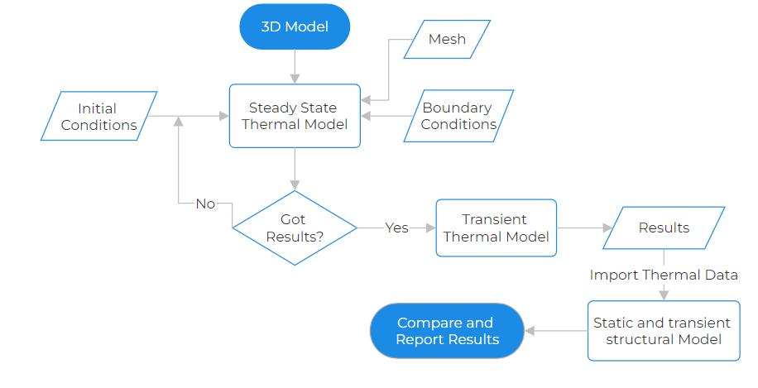
Overview of Last Presentation
Objective
System-level analysis of PCB (Macro-model)
Study and analysis of solder balls with PCB (Micro-model)
Software: Ansys Student version 2024 (R2), SOLIDWORKS 2023

Slide 3
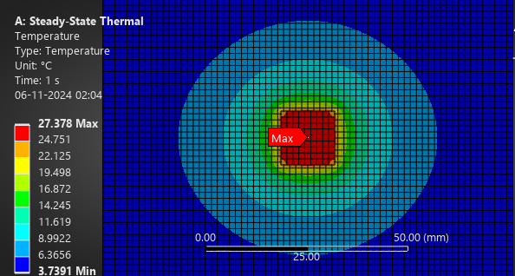
Key Results
Anisotropic PCB Temperature Analysis around one solder ball
Validation
Mesh Convergence
Blue – Analytical
Orange – Numerical
L2 Norm = 4.3209
RMS error = 1.7640
Mesh Size: 1.5 mm (Hexahedral elements)
Nodes: 52617; Elements: 9329

Slide 4
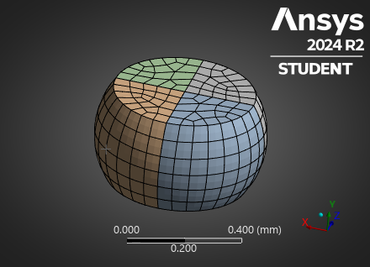
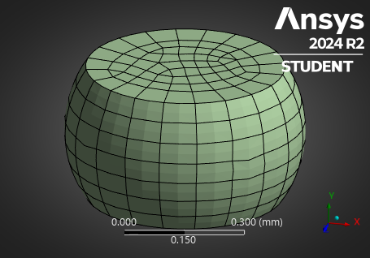
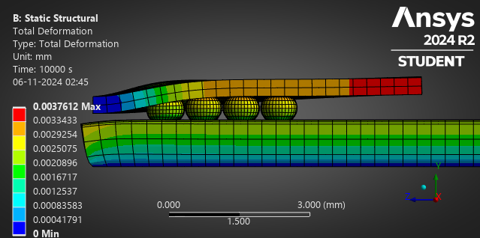
Fatigue in Ball Grid Array Due to thermal Cyclic Loading
Mesh Refinement and computation time trade-off (For 0.5 mm solder ball diameter)
Nodes: 81548
Elements: 14304
Plastic Strain (Max): 0.015
Nodes: 32817
Elements: 6138
Plastic Strain (Max): 0.0139
Total Deformation
Stress Range: 138.9 MPa
Parameter Study (Solder ball Diameter is changed)
0.52 mm – Strain: 0.0139; Stress: 138.92 MPa
0.48 mm – Strain: 0.0177; Stress: 137 MPa
Fatigue Life (Using Coffin-Manson Equation and Anand Viscoplasticity model)
0.48 mm – 101
0.5 mm – 97
0.52 mm – 121.5
Convergence Plot

Slide 5
Conclusion And Future Work
As the solder ball diameter is increased, fatigue life increases, and the plastic strain range decreases.
The Anisotropic PCB model is quite inaccurate in low tolerance applications like PCB design against analytical results (with rms of 1.76 deg C). This could be because of material properties and heat transfer assumptions
Total Deformation was increasing for the whole BGA, upon increasing the solder ball diameter
Crack Initiation Propagation could be performed. We tried initiating an elliptical crack, but the results could not be verified
Modal and vibrational analysis can be performed
Residual Stress effects on fatigue life of BGA

